Slide 1
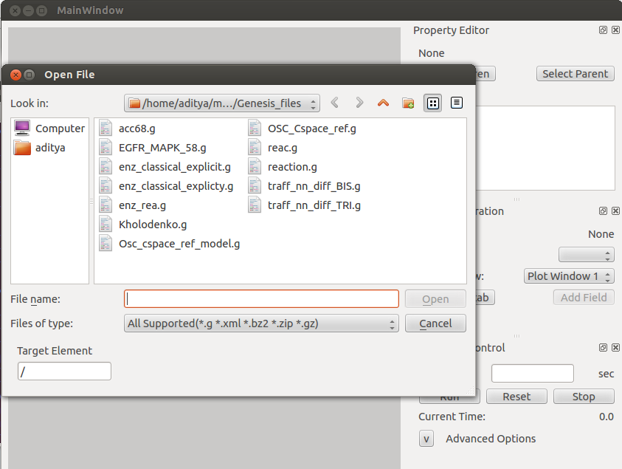
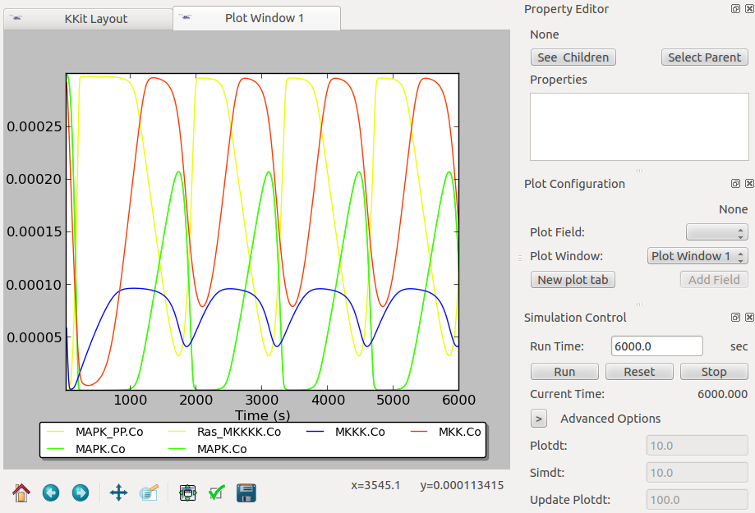
Install MOOSE:
The latest MOOSE is currently packaged as an Ubuntu liveCD/USB. Burn livecd.iso to CD or make bootable USB using Startup Disk Creator (usb-creator-gtk) on Ubuntu 12.04. Boot off it, on your machine, or using virtualbox.org. User:moose, passwd:moose.
Quick start MOOSE:
Double click desktop icon to launch GUI.
‘File’→‘Load Model’ (top menu), navigate to /home/moose/moose_src/Demos/Genesis_files .
Open any .g file there, say Kholodenko.g .
The signalling network schematic appears.
Click the ‘Plot Window 1’ tab to show plots.
Click run, and the plots are updated as the simulation proceeds.
You can ‘stop’ a simulation in-between and ‘run’ again for another ‘Run Time’. ‘Reset’ and ‘run’ to start from t=0.
Buttons below the plots allow you to pan, zoom, and save the plot figure. Home and arrow icons to switch between views.
In ‘advanced options’, you can set the sim time step ‘simdt’ and plot resolution ‘plotdt’. Also the ‘Update Plotdt’ at which the GUI plots are refreshed. Units: seconds.

Slide 2
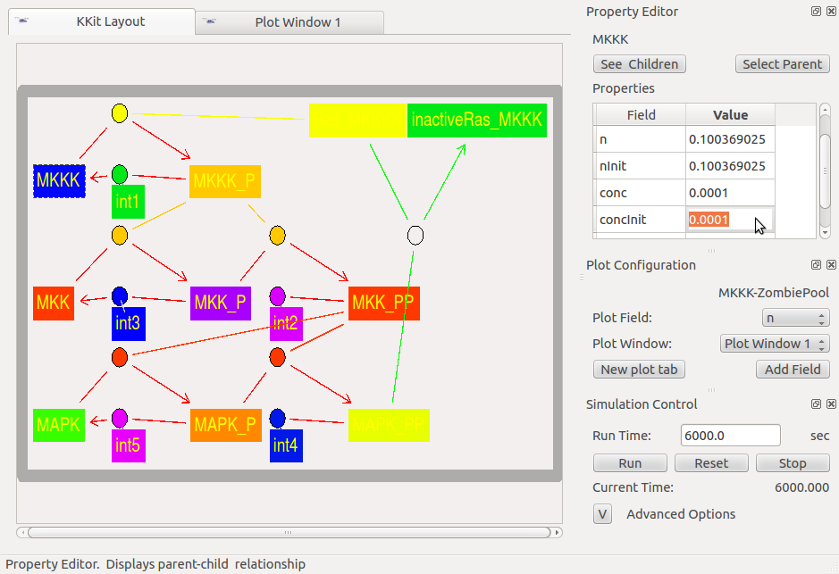
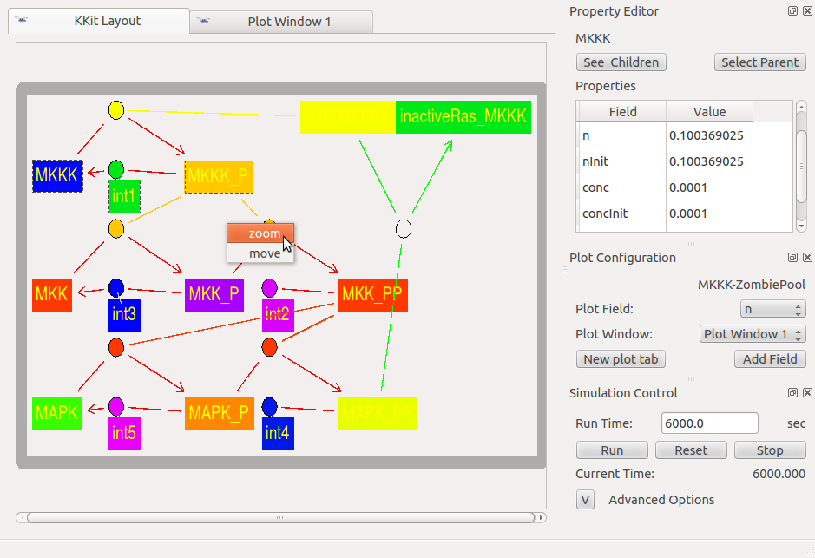
Changing Parameters:
All units are in SI.
Switch to the KKit Layout tab
You can see/edit properties of any object in the right ‘Properties’ panel by double-clicking on a Molecule Pool (rectangle); or a Reaction (ellipse).
Reversible reactions are empty ellipses, with the reaction direction in green.
Enzyme-catalyzed reactions are filled ellipses, with the reaction direction in red, and the enzyme link in the enzyme pool’s colour.
An empty unlinked box near a filled ellipse signifies an explicit enzyme complex for an explicit enzyme reaction.
Layout:
Click and drag any pool/reaction.
Keyboard shortcuts: ‘a’: fit full model; ‘<‘,’>’: incremental zoom out/in; numpad arrow keys: pan.
Rubber-band select (click-and-drag) a rectangular region having a pool, which pops up a context menu to (1) zoom to selected region; or (2) move / click-and-drag the objects in the selected region.

Slide 3
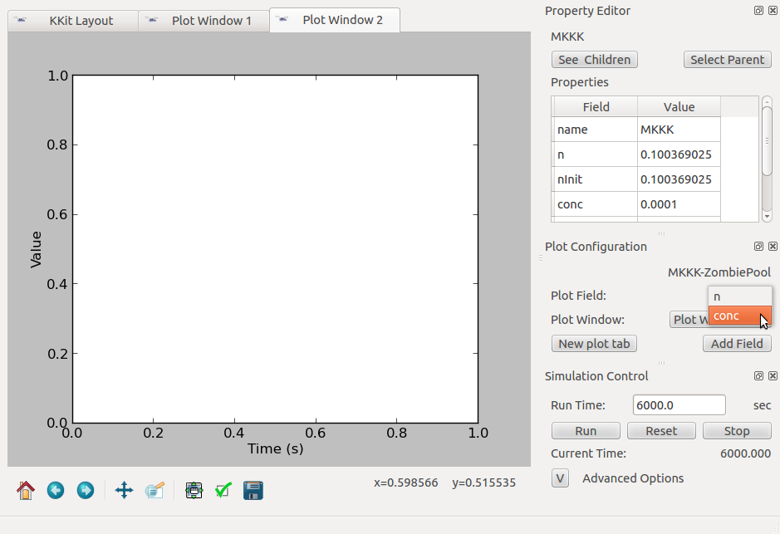
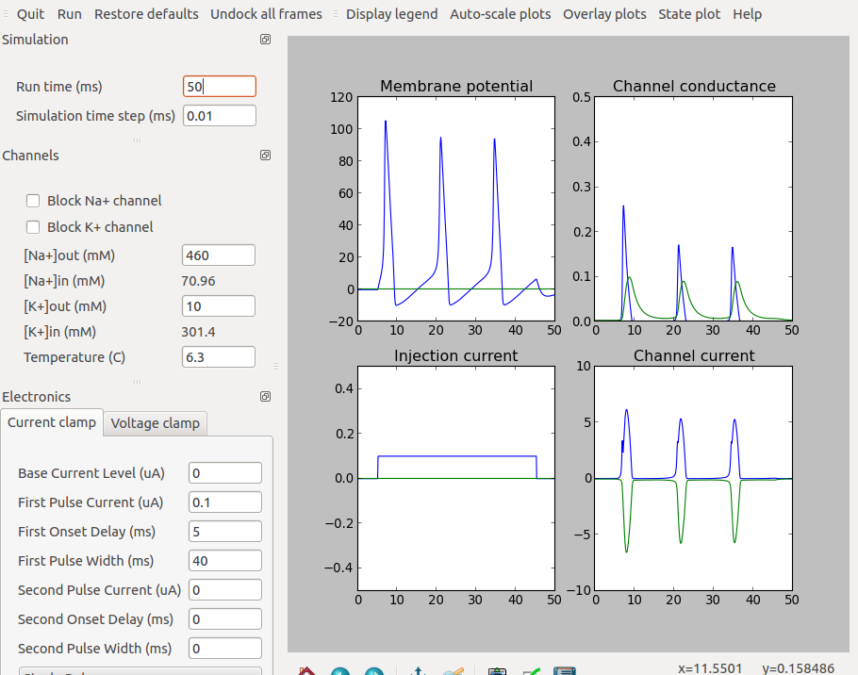
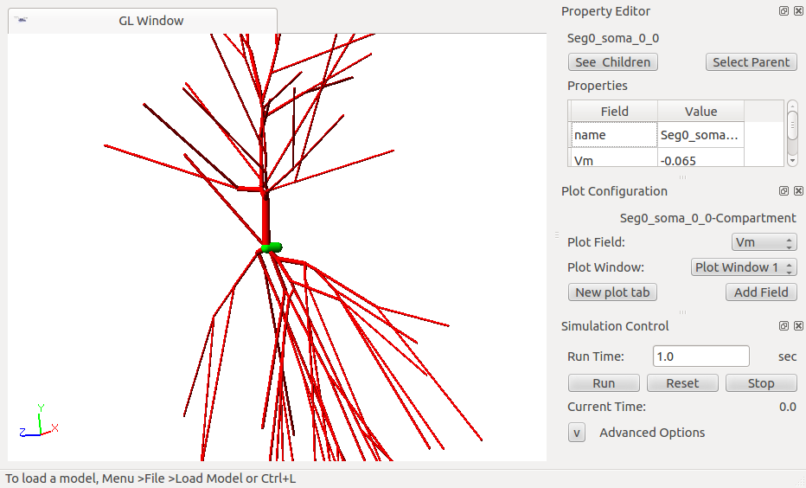
Plotting:
In the ‘Plot Configuration’ panel, click ‘New plot tab’.
In the ‘KKit Layout’ tab, select an object by double-clicking on a Molecule Pool (rectangle); or on a Reaction (ellipse).
All plot-able fields of the object appear in the ‘Plot Field’ dropdown. Select one and click ‘Add Field’ to add it to the newly created plot tab.
Similarly, more object-fields may be plotted in the same tab or in new ones.
Menubar→‘View’ →‘Sub Windows’/‘Tabs’ to tile the plots differently.
Navigate the object tree by ‘See Children’ and ‘Select Parent’ (usually not needed).
Switching Solvers:
Select the ‘Solver’ from the main-menu: RungeKutta (Continuous) / Gillespie (Discrete).
Load the model: File→Load Model.
To switch solvers for the same model, first select solver, then (re-)load the model.
Neuron / Electrical:
Hodgkin-Huxley Squid demo: desktop icon
CA1 / Granule cell in Demos/neuroml.

