Slide 1

Module 0: What you need for these training materials
Paul Macklin, Ph.D.
@MathCancer
last updated: August 16, 2019

Slide 2
Checklist
PhysiCell development environment
nanoHUB account
optional tools

Slide 3
PhysiCell development environment
Local install (64-bit g++ environment with OpenMP support)
64-bit g++ (with OpenMP) and standard command-line tools
Your choice of code editing
Ideal for long-term development
Virtual appliance
Pre-configured environment that runs in VirtualBox as a virtual machine
Use this while debugging your local install, but slow (and not frequently updated)
Cloud-hosted environment (coming soon!)
Cloud-hosted VM on nanoHUB.org
Ideal for use in short courses and classrooms

Slide 4
Local environment
Minimal tools:
64-bit g++ with OpenMP support (other compilers okay)
Make and zip/unzip (at command line)
Some sort of code editor (I just use a text editor.)
Setup tutorials:
Linux: You probably already have it! Use your package manager as needed.
Windows: We wrote detailed instructions here, based on mingw-w64 and msys:
http://www.mathcancer.org/blog/setting-up-a-64-bit-gcc-environment-on-windows/
OSX: We wrote a tutorial using Homebrew:
Note: OSX has "gcc" which is actually llvm/clang without OpenMP support
Note: OSX users must set an environment variable. So please do use the tutorial
http://www.mathcancer.org/blog/setting-up-gcc-openmp-on-osx-homebrew-edition/

Slide 5
Virtual Appliance [not done]
If the local install gives you trouble, you can try a virtual appliance. This is a pre-configured virtual machine
Steps:
64-bit g++ with OpenMP support (other compilers okay)
Make and zip/unzip (at command line)
Some sort of code editor (I just use a text editor.)
Setup tutorials:
Linux: You probably already have it! Use your package manager as needed.
Windows: We wrote detailed instructions here, based on mingw-w64 and msys:
http://www.mathcancer.org/blog/setting-up-a-64-bit-gcc-environment-on-windows/
OSX: We wrote a tutorial using Homebrew:
Note: OSX has "gcc" which is actually llvm/clang without OpenMP support
Note: OSX users must set an environment variable. So please do use the tutorial
http://www.mathcancer.org/blog/setting-up-gcc-openmp-on-osx-homebrew-edition/

Slide 6
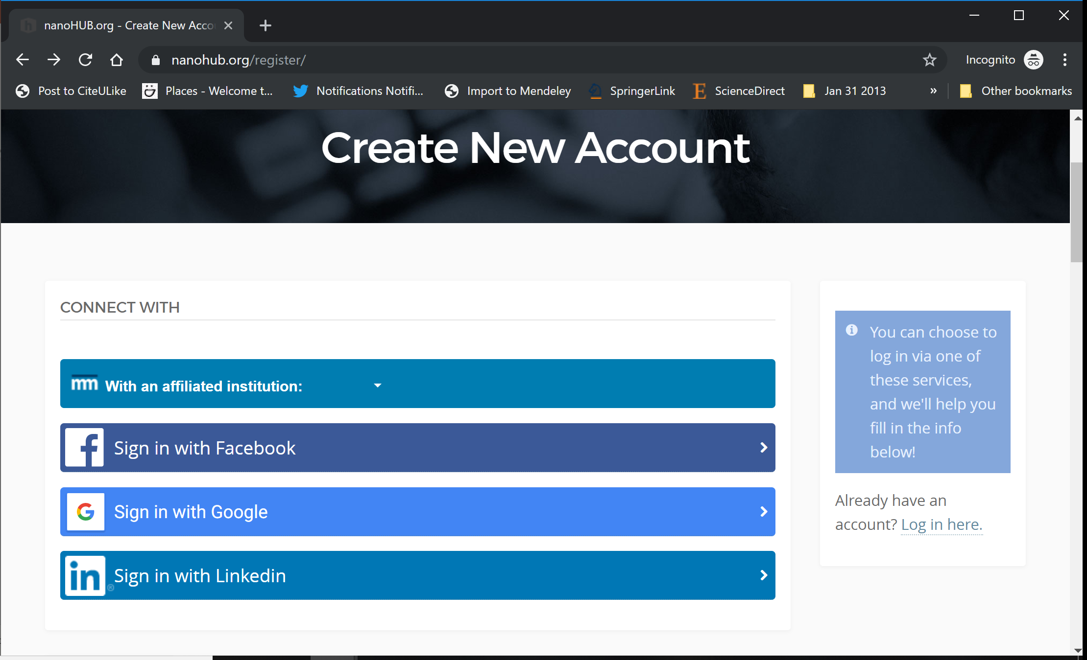
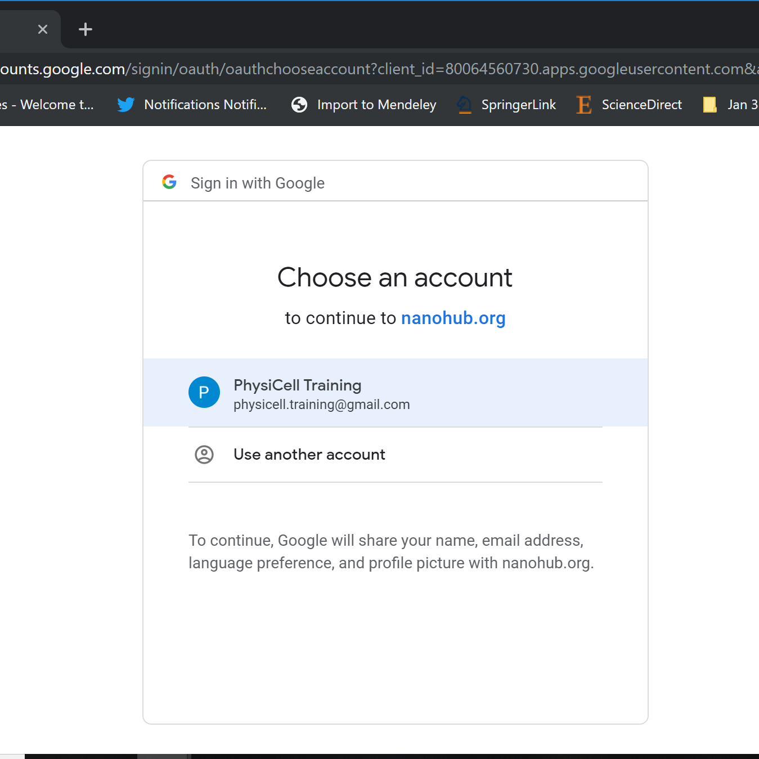
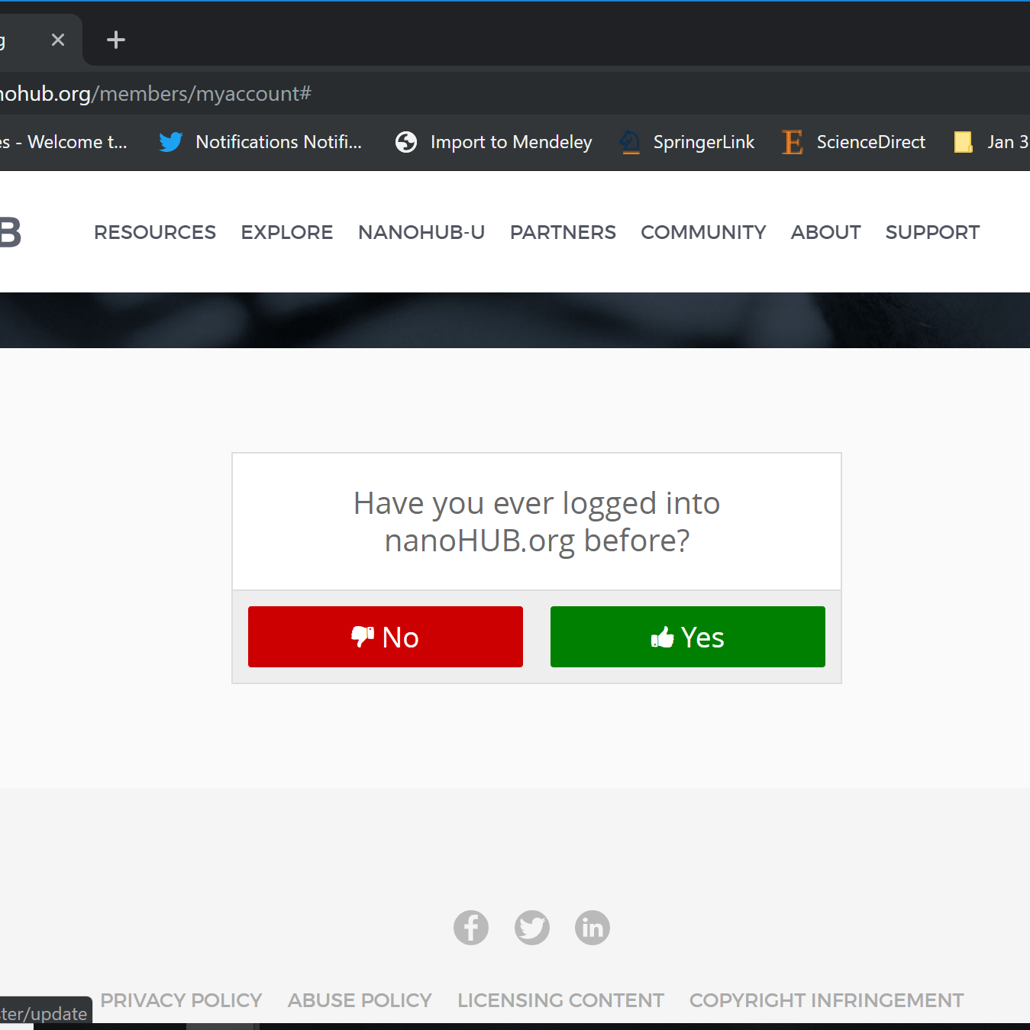
nanoHUB Account
These tutorials use cloud-hosted PhysiCell models on nanoHUB.org.
nanoHUB is free, but it requires a one-time registration.
Steps:
Visit https://nanohub.org/register
Choose "Sign in with Google"
Choose a Google account
Click "No" (so it doesn't try to associate with some other nanoHUB account)
Finish filling in details, and you're done!
Use your google account for future sign-ins.
2
3
4

