Slide 1
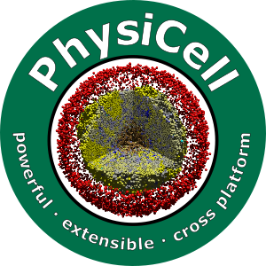

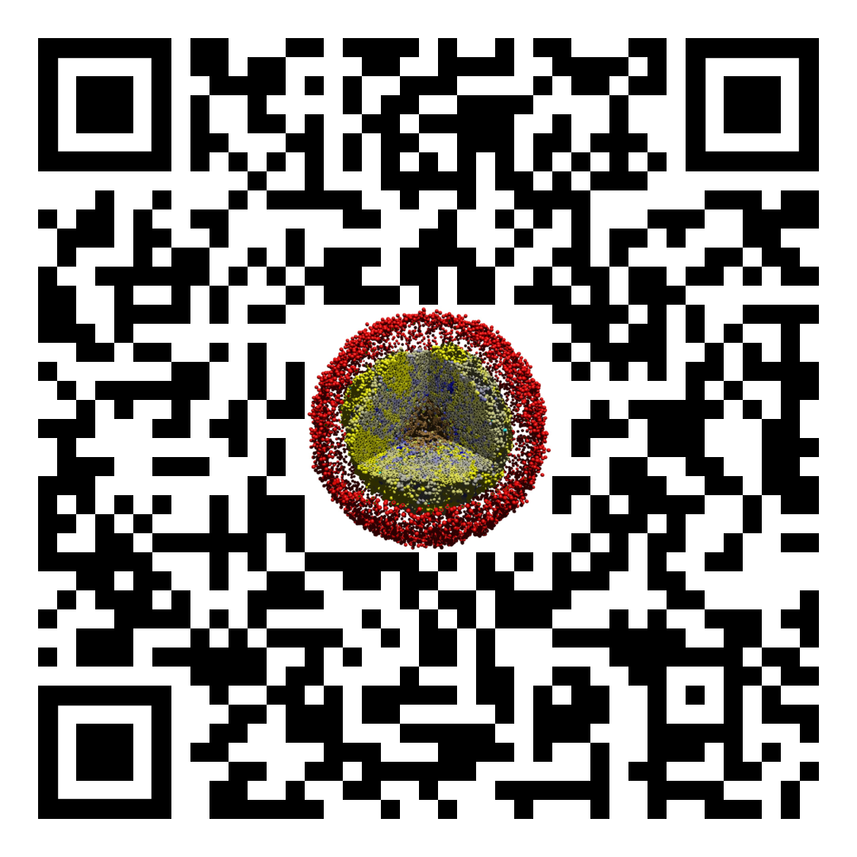
Lesson 1: What you need to code in PhysiCell
Slides, videos, links and more:
https://github.com/physicell-training/01-Welcome-to-training
Paul Macklin, Ph.D.
@MathCancer
last updated: November 13, 2019

Slide 2
PhysiCell is a C++ toolkit
To actively develop PhysiCell models, you will need an appropriate C++ development environment.
For models that aren't shared as cloud-hosted simulators, running PhysiCell-based projects requires compiling and running C++ codes.
This module will help you create your own 64-bit C++ development environment.

Slide 3
PhysiCell development environment
Local install (64-bit g++ environment with OpenMP support)
64-bit g++ (with OpenMP) and standard command-line tools
Your choice of code editing
Ideal for long-term development
Cloud-hosted environment on nanoHUB.org
Cloud-hosted workstation on nanoHUB.org
Ideal for use in short courses and classrooms
Virtual appliance (no longer supported)
Pre-configured environment that runs in VirtualBox as a virtual machine
Use this while debugging your local install, but slow (and not frequently updated)

Slide 4
Local environment
Minimal tools:
64-bit g++ with OpenMP support (other compilers okay)
Make and zip/unzip (at command line)
Some sort of code editor (I just use a text editor.)
Setup tutorials:
Linux: You probably already have it! Use your package manager as needed.
Windows: We wrote detailed instructions here, based on mingw-w64 and msys:
http://www.mathcancer.org/blog/setting-up-a-64-bit-gcc-environment-on-windows/
OSX: We wrote a tutorial using Homebrew:
Note: OSX has "gcc" which is actually llvm/clang without OpenMP support
Note: OSX users must set an environment variable. So please do use the tutorial
http://www.mathcancer.org/blog/setting-up-gcc-openmp-on-osx-homebrew-edition/

Slide 5
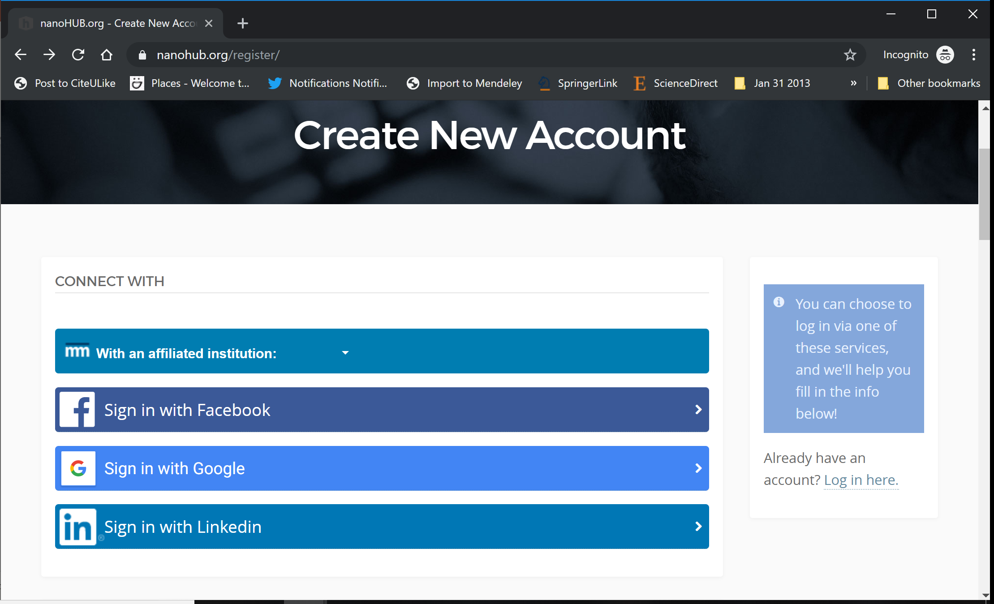
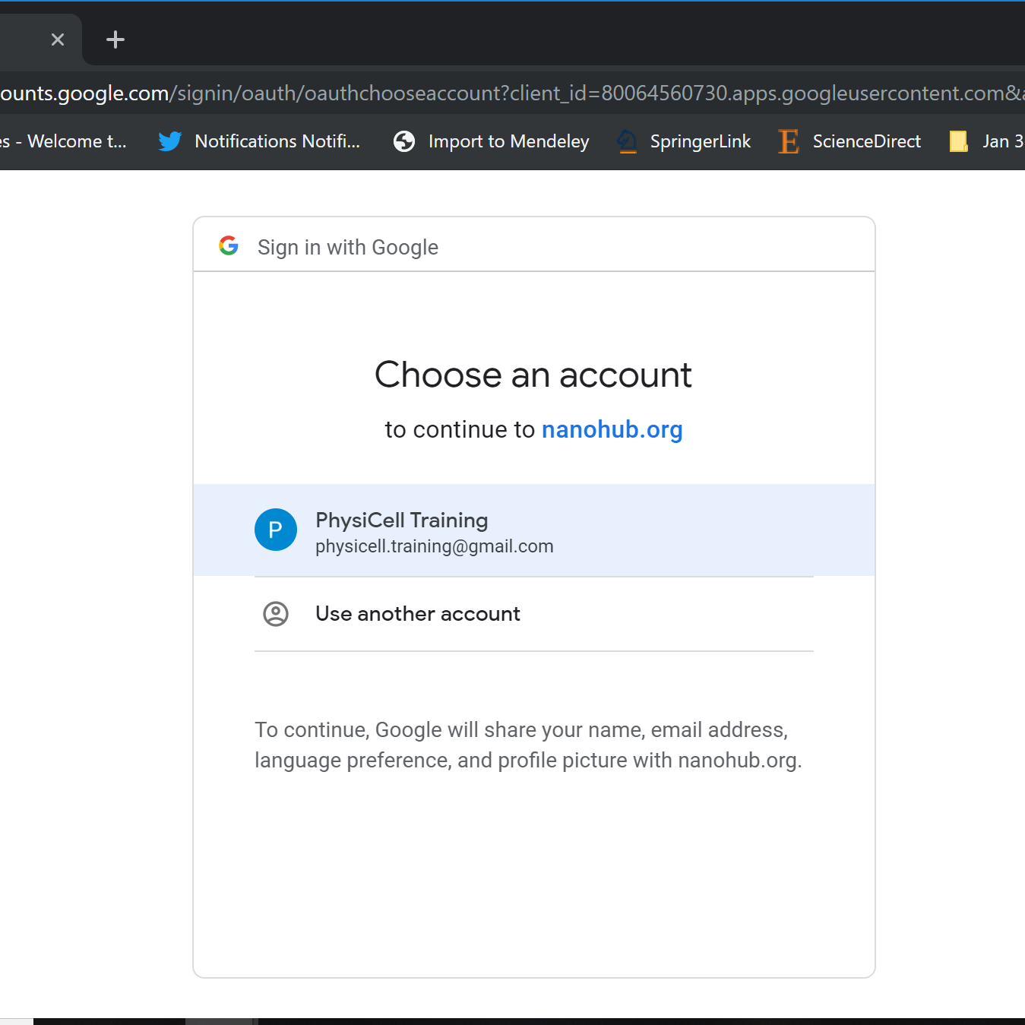
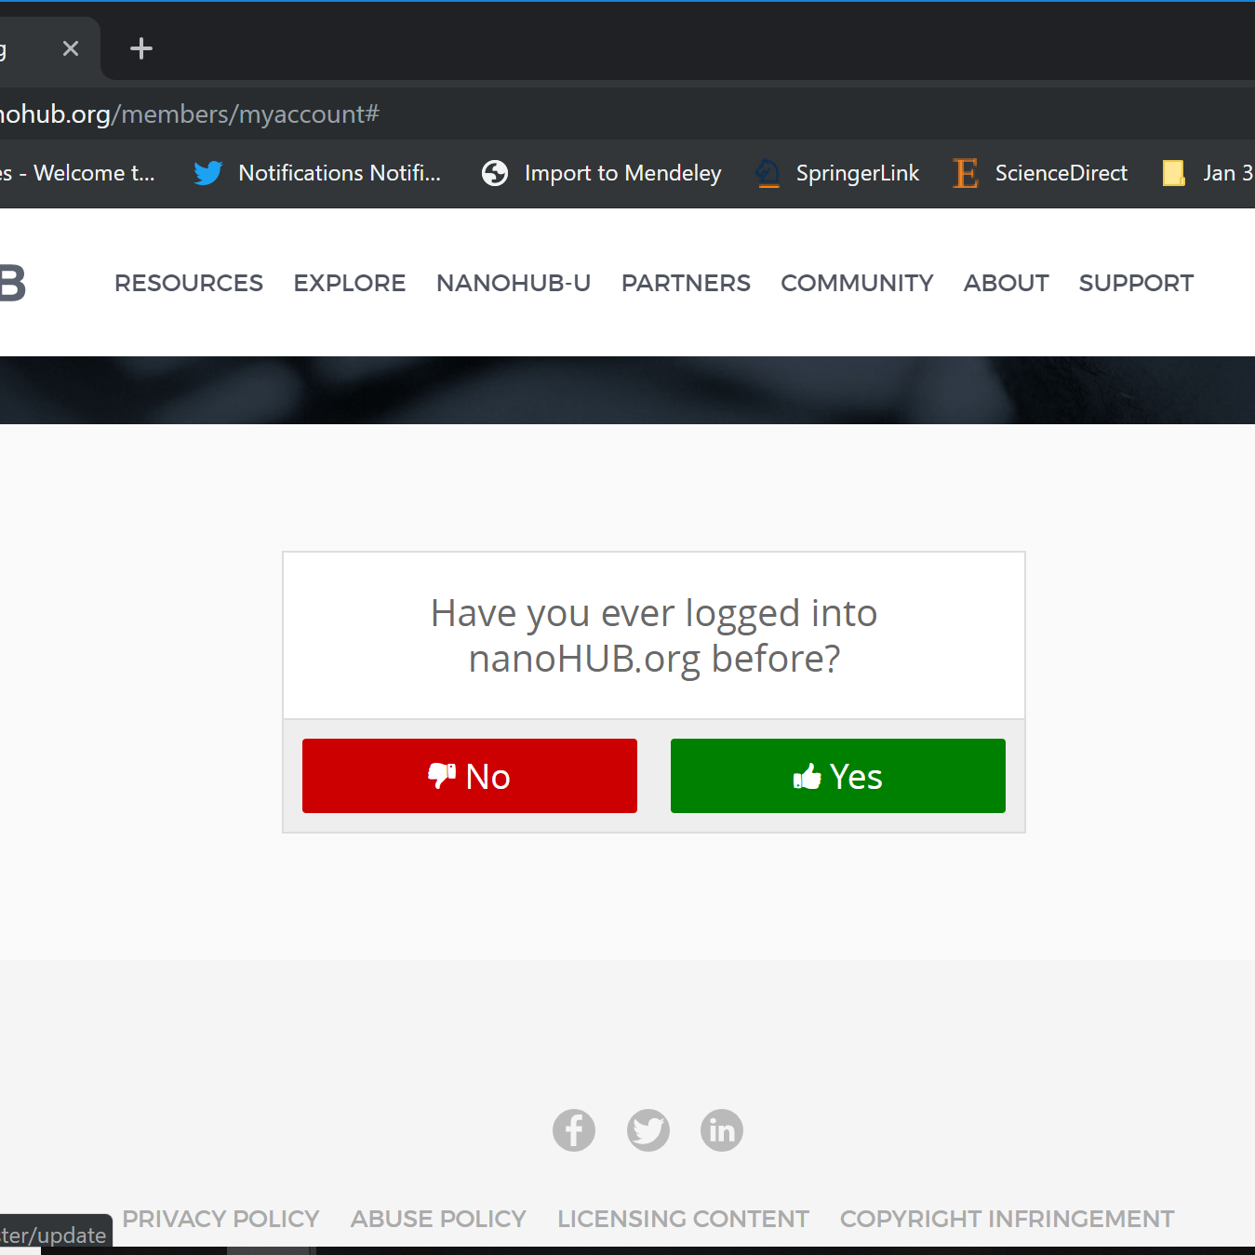
nanoHUB Account
These tutorials use cloud-hosted PhysiCell models on nanoHUB.org.
nanoHUB is free, but it requires a one-time registration.
Steps:
Visit https://nanohub.org/register
Choose "Sign in with Google"
Choose a Google account
Click "No" (so it doesn't try to associate with some other nanoHIB account)
Finish filling in details, and you're done!
Use your google account to sign in in the future.
2
3
4

Slide 6
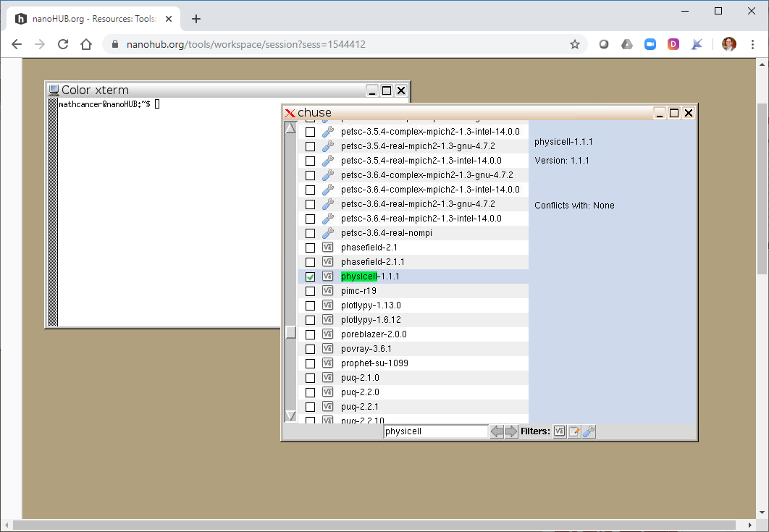
Cloud-hosted environment (1)
nanoHUB created the workspace tool to allow online development
We created a specialized PhysiCell environment in workspace
Request to join the physicelldev group: https://nanohub.org/groups/physicelldev
Go to the workspace tool: http://nanohub.org/tools/workspace
Start the tool
Select the physicell environment using "chuse"
Right-click the desktop
Select "chuse"
Type "physicell" in the bottom search bar
Select physicell-x.y.z (currently 1.1.1)
close chuse and all xterm windows
open a new xterm window, and get PhysiCell by typing "get_PhysiCell.sh" and follow the prompts

Slide 7
Cloud-hosted environment (2)
After running the script, you have a full Linux-based dev environment:
Latest PhysiCell is in ~/PhysiCell
Also installed:
64-bit g++ with OpenMP
Anaconda / Python 3.x
ImageMagick (to batch edit images)
geany (text editor)
gedit (text editor)
nautilus (file browser)
mirage (to view images)
mplayer (to play videos)
povray (for 3D raytracing)

Slide 8
Next steps
Super fast: Please proceed to 2 (How to use a PhysiCell App on nanoHUB) link: https://github.com/physicell-training/02-How-to-nanoHUB
Intermediate: Please proceed to 2 (How to use a PhysiCell App on nanoHUB) link: https://github.com/physicell-training/02-How-to-nanoHUB
Full Training: Please proceed to 2 (How to use a PhysiCell App on nanoHUB) link: https://github.com/physicell-training/02-How-to-nanoHUB
More lessons: https://github.com/physicell-training/master-list

Slide 9




Credits
Lesson Planning: Paul Macklin
Slides: Paul Macklin
Recording: Paul Macklin
Post-production: Paul Macklin, Drew Willis*, Kali Konstantinopoulos*
Microapps: not applicable
* denotes undergraduate researcher
Funding:
PhysiCell Development:
Breast Cancer Research Foundation
Jayne Koskinas Ted Giovanis Foundation for Health and Policy
National Cancer Institute (U01CA232137)
National Science Foundation (1720625)
Training materials:
* Administrative supplement to NCI U01CA232137 (Year 2)

