Slide 1

Module 0: What you need for these training materials
Paul Macklin, Ph.D.
@MathCancer
last updated: August 16, 2019

Slide 2
Checklist
PhysiCell development environment
nanoHUB account
optional tools

Slide 3
PhysiCell development environment
Local install (64-bit g++ environment with OpenMP support)
64-bit g++ (with OpenMP) and standard command-line tools
Your choice of code editing
Ideal for long-term development
Virtual appliance
Pre-configured environment that runs in VirtualBox as a virtual machine
Use this while debugging your local install, but slow
Cloud-hosted environment
Cloud-hosted VM on nanoHUB.org
Ideal for use in short courses and classrooms

Slide 4
Local environment
Minimal tools:
64-bit g++ with OpenMP support (other compilers okay)
Make and zip/unzip (at command line)
Some sort of code editor (I just use a text editor.)
Setup tutorials:
Linux: You probably already have it! Use your package manager as needed.
Windows: We wrote detailed instructions here, based on mingw-w64 and msys:
http://www.mathcancer.org/blog/setting-up-a-64-bit-gcc-environment-on-windows/
OSX: We wrote a tutorial using Homebrew:
Note: OSX has "gcc" which is actually llvm/clang without OpenMP support
Note: OSX users must set an environment variable. So please do use the tutorial
http://www.mathcancer.org/blog/setting-up-gcc-openmp-on-osx-homebrew-edition/

Slide 5
Virtual Appliance
Minimal tools:
64-bit g++ with OpenMP support (other compilers okay)
Make and zip/unzip (at command line)
Some sort of code editor (I just use a text editor.)
Setup tutorials:
Linux: You probably already have it! Use your package manager as needed.
Windows: We wrote detailed instructions here, based on mingw-w64 and msys:
http://www.mathcancer.org/blog/setting-up-a-64-bit-gcc-environment-on-windows/
OSX: We wrote a tutorial using Homebrew:
Note: OSX has "gcc" which is actually llvm/clang without OpenMP support
Note: OSX users must set an environment variable. So please do use the tutorial
http://www.mathcancer.org/blog/setting-up-gcc-openmp-on-osx-homebrew-edition/

Slide 6
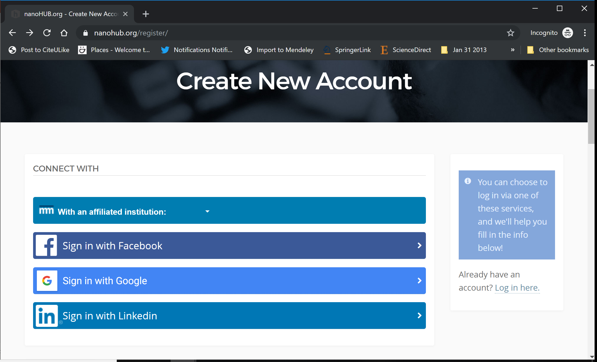
nanoHUB Account
These tutorials use cloud-hosted PhysiCell models on nanoHUB.org.
nanoHUB is free, but it requires a one-time registration.
Steps:
Visit https://nanohub.org/register
If you have a Google account,
For more details, see:

Slide 7
nanoHUB Account
These tutorials extensively use cloud-hosted PhysiCell models, hosted on nanoHUB.org.
nanoHUB is free, but it requires a one-time registration to help them track usage.
Steps:
Visit https://nanohub.org/register
dfdf
For more details, see:

Slide 8
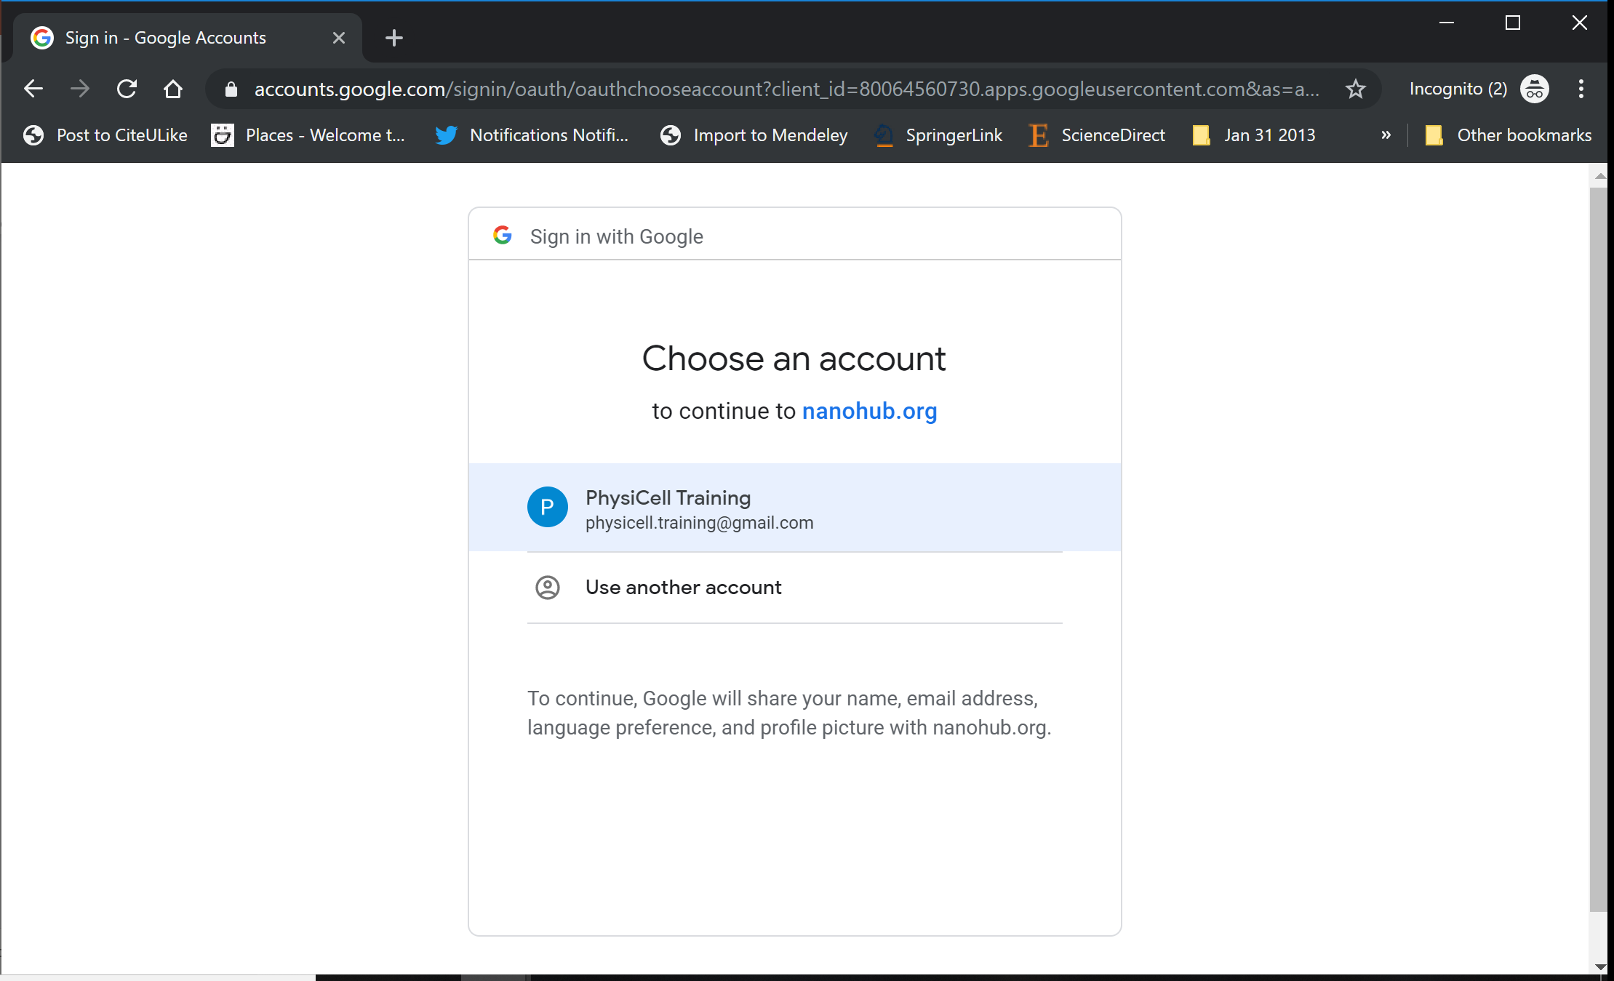
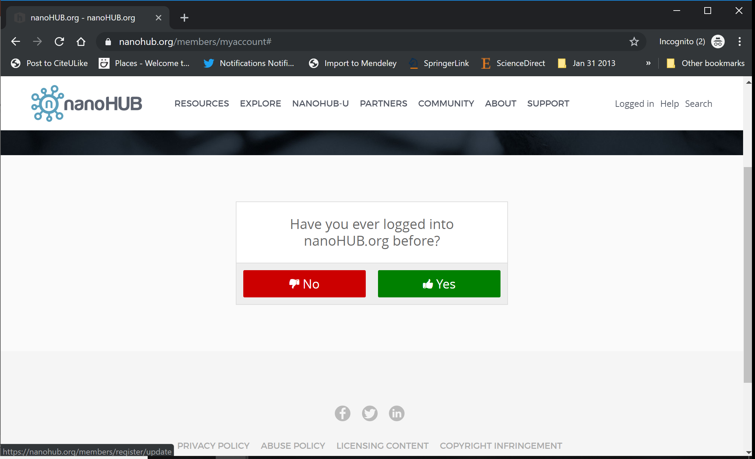
nanoHUB Account
These tutorials extensively use cloud-hosted PhysiCell models, hosted on nanoHUB.org.
nanoHUB is free, but it requires a one-time registration to help them track usage.
Steps:
Visit https://nanohub.org/register
Sign in with Google
Choose an account
Click "no" (so it doesn't try to associate with some other nanoHIB account)
Finish filling in details, and you're done!
Use your google account to sign in in the future.
For more details, see:

