Slide 1
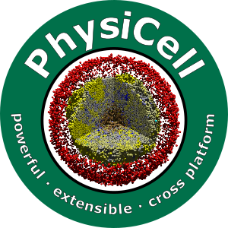

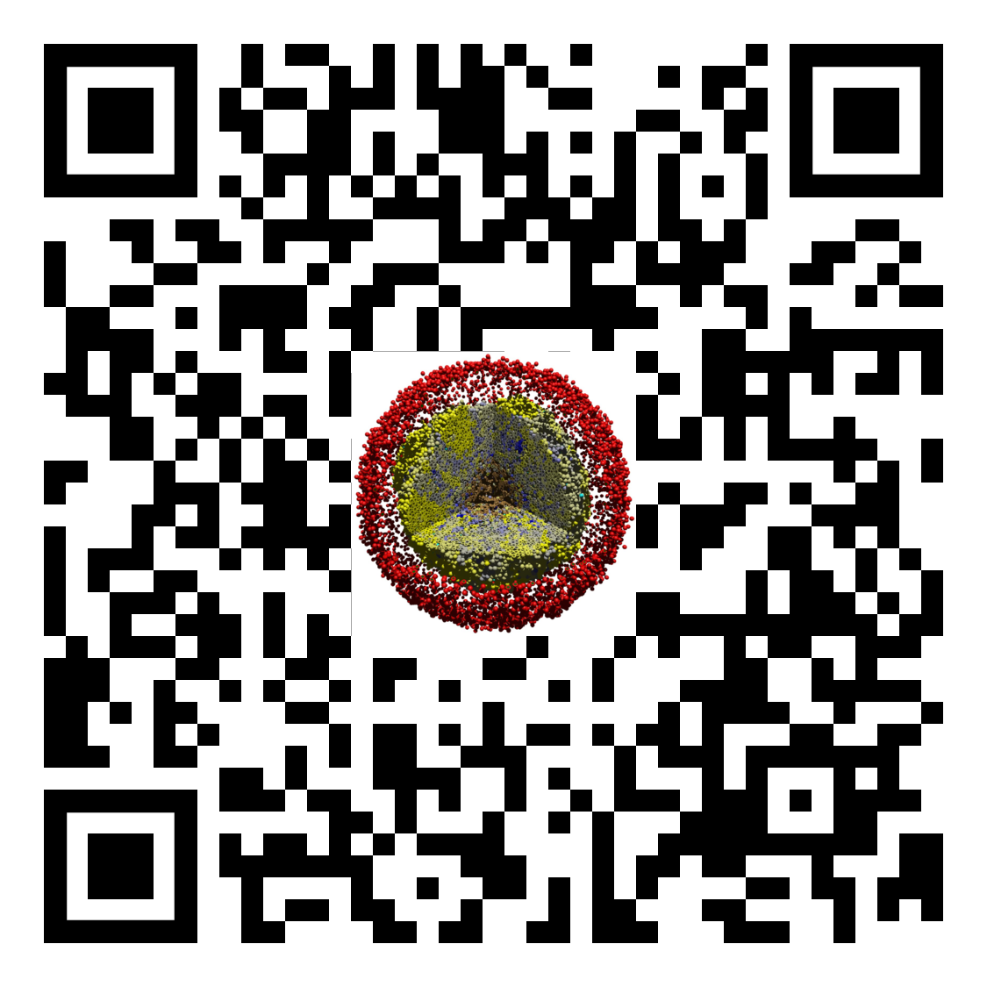
Lesson 02: How to use a PhysiCell nanoHUB app
Slides, videos, links and more:
https://github.com/physicell-training/02-How-to-nanoHUB
Paul Macklin, Ph.D.
@MathCancer
last updated: November 13, 2019

Slide 2
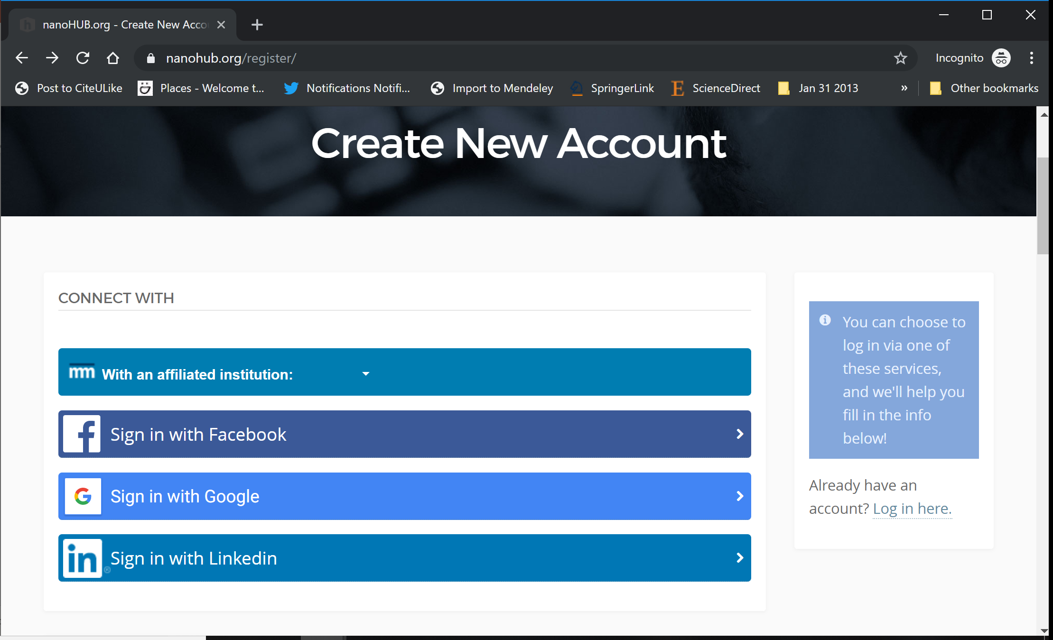
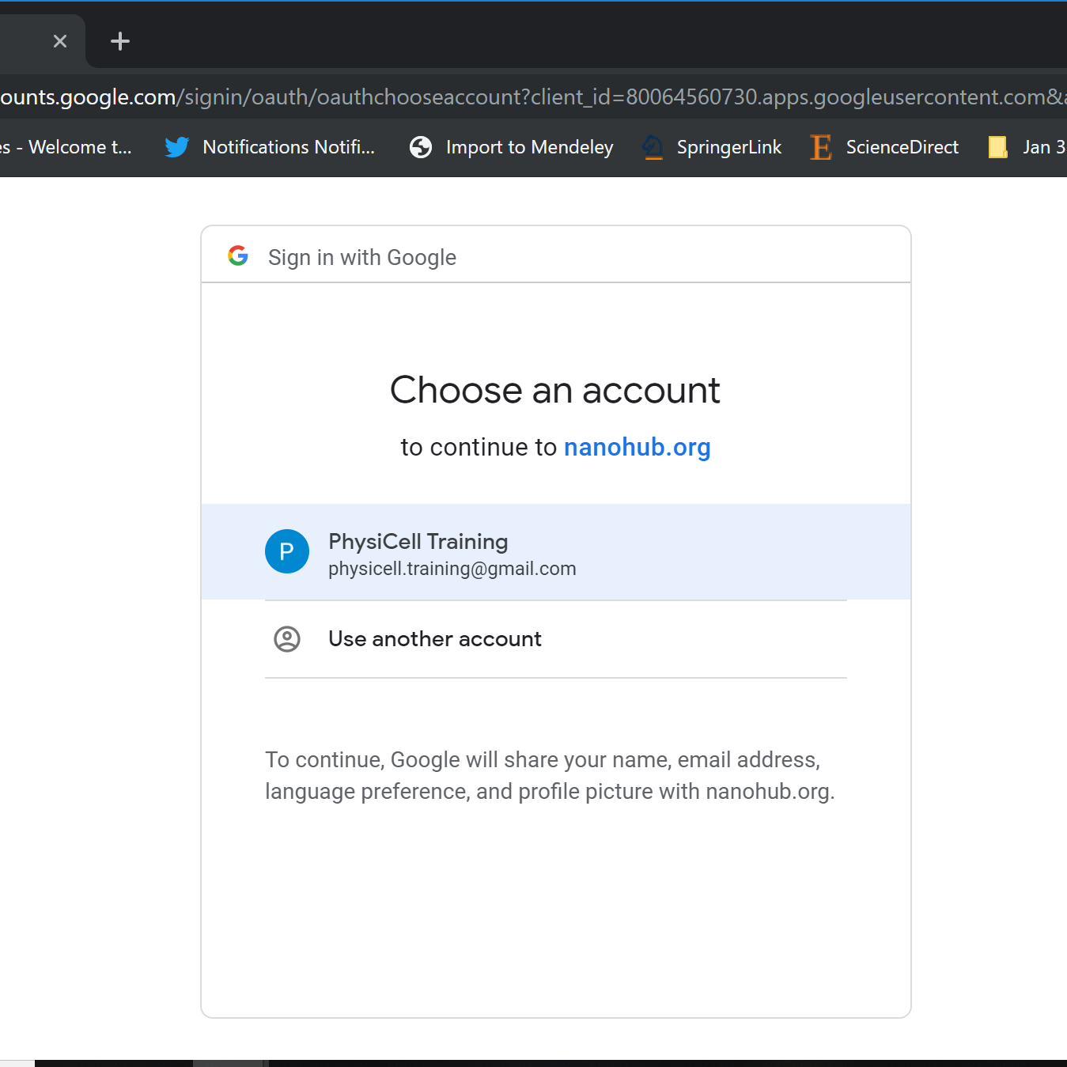
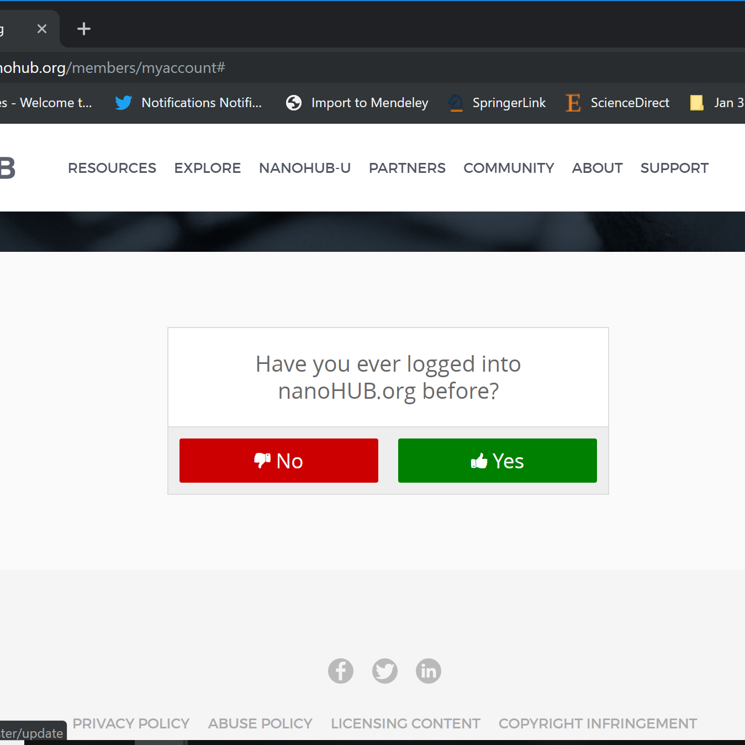
nanoHUB Account
These tutorials use cloud-hosted PhysiCell models on nanoHUB.org.
nanoHUB is free, but it requires a one-time registration.
Steps:
Visit https://nanohub.org/register
Choose "Sign in with Google"
Choose a Google account
Click "No" (so it doesn't try to associate with some other nanoHIB account)
Finish filling in details, and you're done!
Use your google account to sign in in the future.
2
3
4

Slide 3
Sample nanoHUB app
I suggest pcISA or pc4cancerbots
Something fast but reasonably interesting.

Slide 4
Splash screen and launching tool

Slide 5
About tab

Slide 6
Config basics

Slide 7
User parameters

Slide 8
Out: Cell Plots

Slide 9
Out: Substrate Plots

Slide 10
Downloading simulation plots

Slide 11
Live demo

Slide 12
Next steps
Super fast: Please proceed to 04 (Introduction to PhysiCell) link: https://github.com/physicell-training/04-PhysiCell-intro
Intermediate: Please proceed to 04 (Introduction to PhysiCell) link: https://github.com/physicell-training/04-PhysiCell-intro
Full training: Please proceed to 03 (What is an agent-based model?) link: https://github.com/physicell-training/03-What-is-ABM
More materials: https://github.com/physicell-training/master-list

Slide 13




Credits
Module Planning: Paul Macklin, Drew Willis*, Randy Heiland
Slides: Paul Macklin, Drew Willis, Randy Heiland
Recording: Paul Macklin, others?
Post-production: Paul Macklin, Drew Willis*, Kali Konstantinopoulos*
Microapps: https://www.nanohub.org/tools/???
* denotes undergraduate researcher
Funding:
PhysiCell Development:
Breast Cancer Research Foundation
Jayne Koskinas Ted Giovanis Foundation for Health and Policy
National Cancer Institute (U01CA232137)
National Science Foundation (1720625)
Training materials:
* Administrative supplement to NCI U01CA232137 (Year 2)

