Slide 1
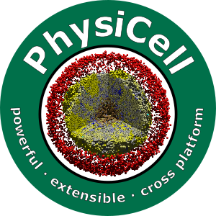

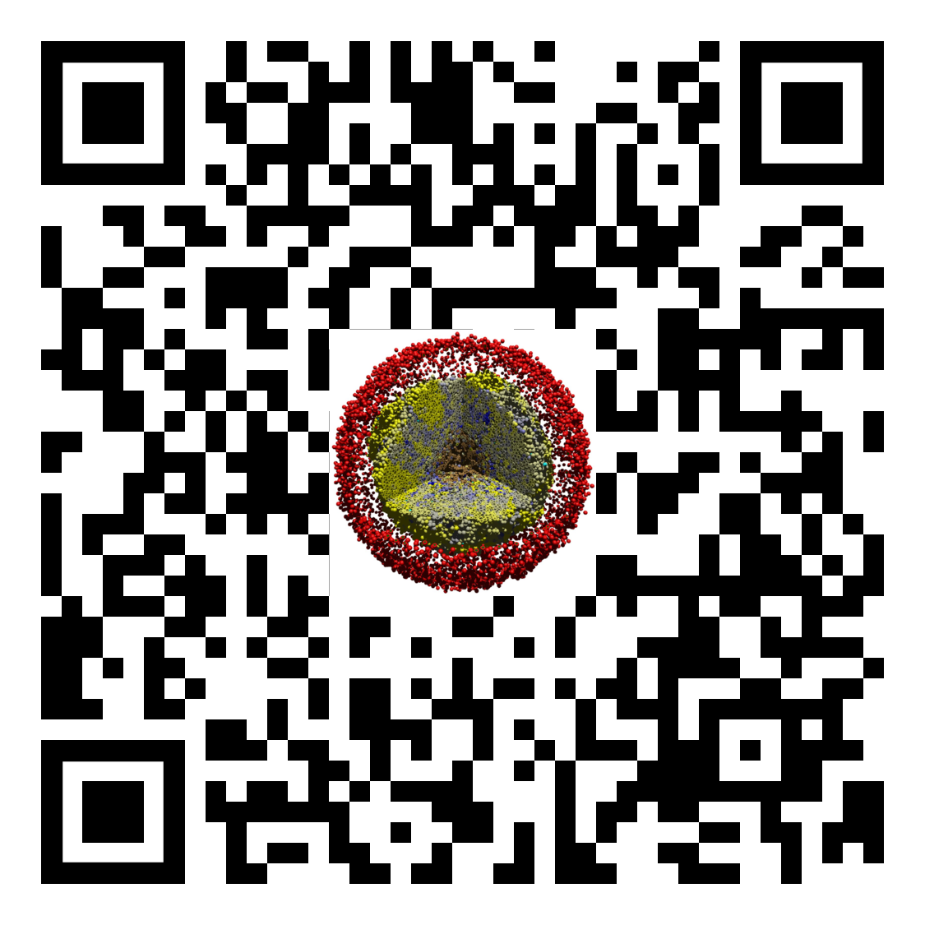
Lesson 2: How to use a PhysiCell nanoHUB app
Slides, videos, links and more:
https://github.com/physicell-training/02-How-to-nanoHUB
Paul Macklin, Ph.D.
@MathCancer
last updated: November 13, 2019

Slide 2
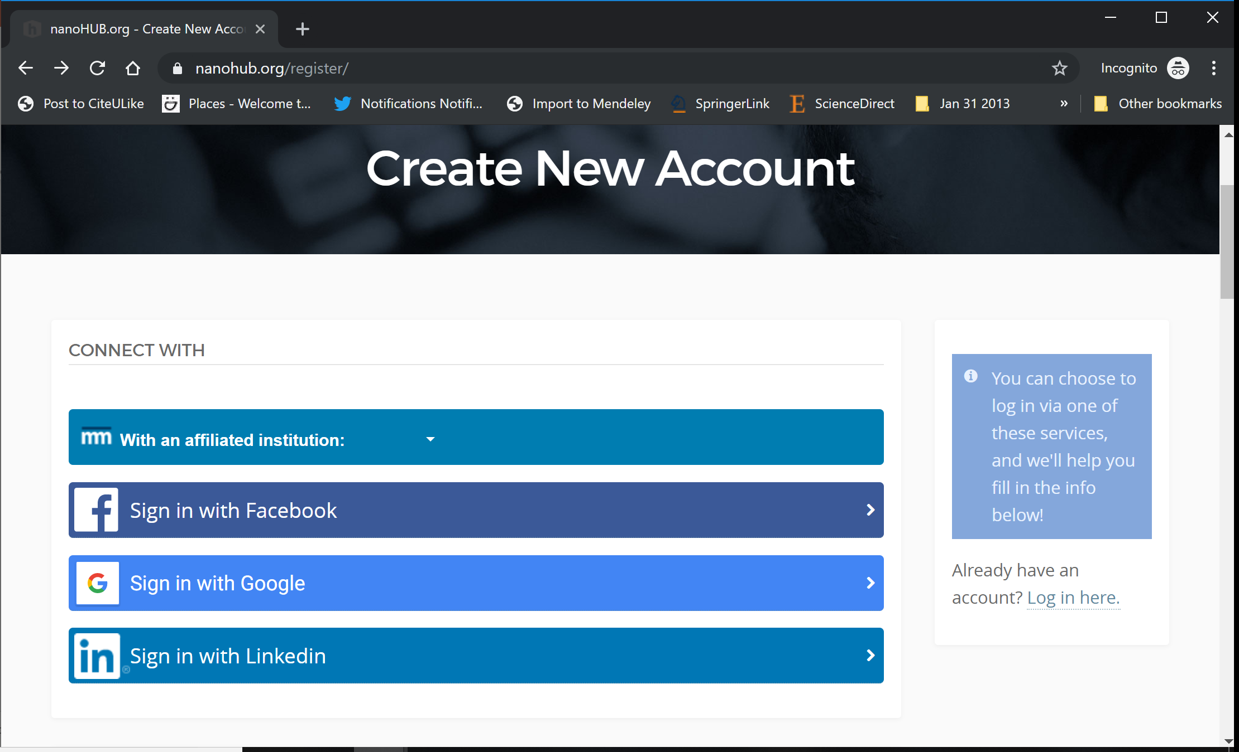
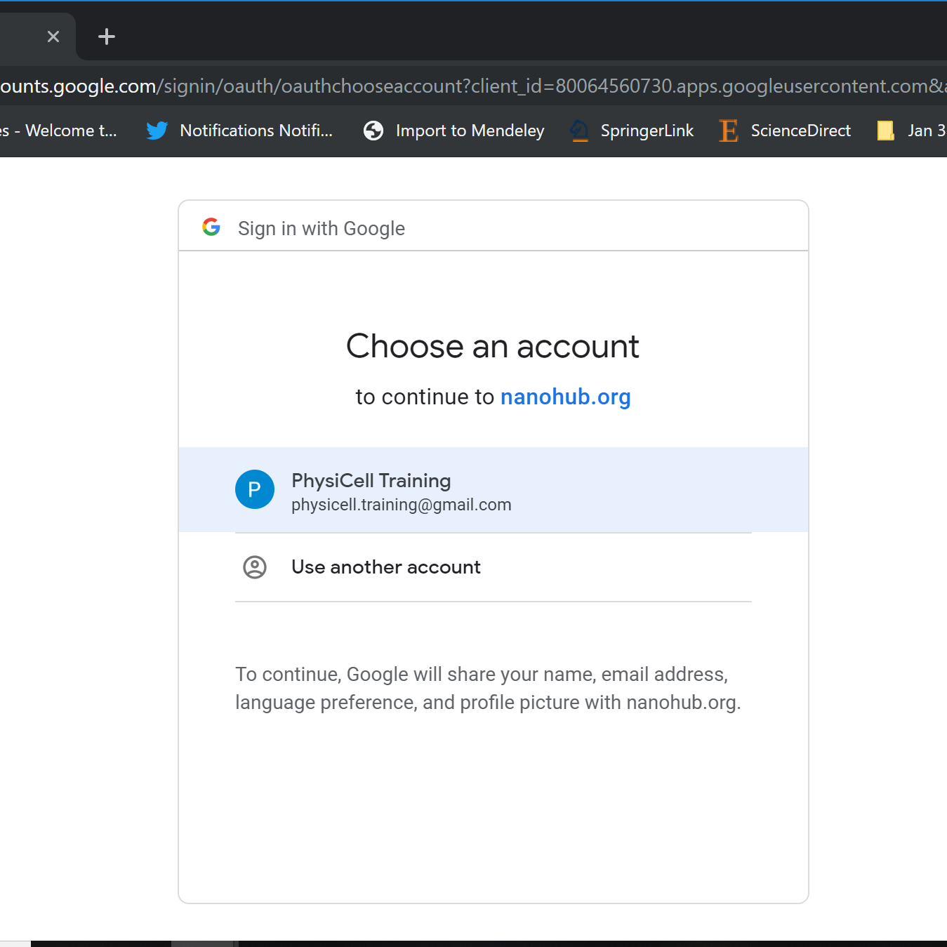
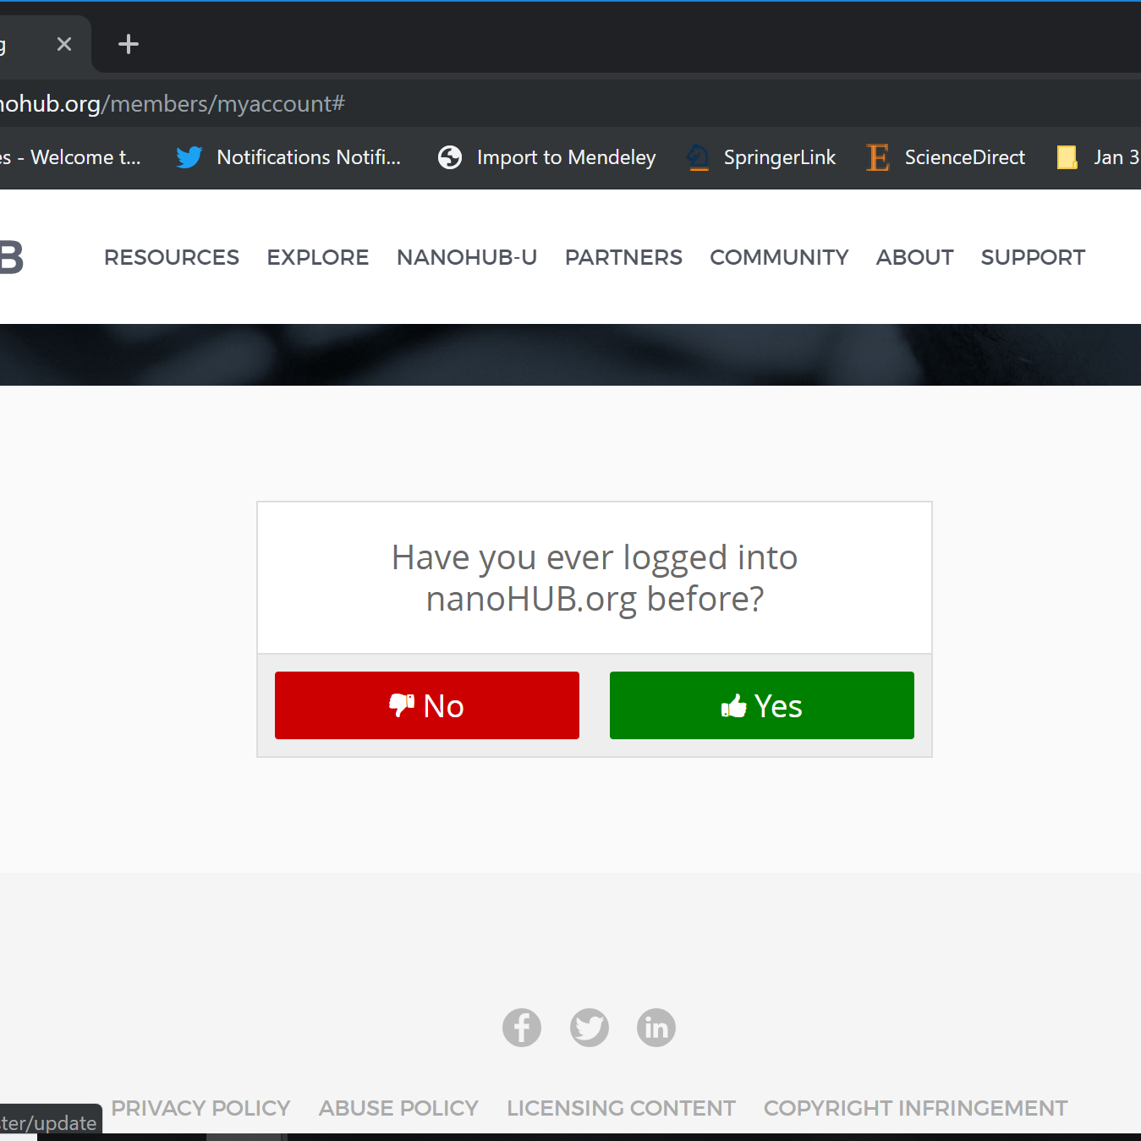
nanoHUB Account
These tutorials use cloud-hosted PhysiCell models on nanoHUB.org.
nanoHUB is free, but it requires a one-time registration.
Steps:
Visit https://nanohub.org/register
Choose "Sign in with Google"
Choose a Google account
Click "No" (so it doesn't try to associate with some other nanoHIB account)
Finish filling in details, and you're done!
Use your google account for future logins.
2
3
4

Slide 3
Goals
Many of the PhysiCell lessons are paired with educational microapps: targeted cloud-hosted models designed to illustrate a core PhysiCell concept.
All PhysiCell-powered nanoHUB apps share common features.
This brief lesson will walk you through those features.

Slide 4
Sample nanoHUB app: biorobots
This model explores how engineered cells could be used as a cargo delivery system.
Director cells:
Cargo cells:
Worker cells:
(directors):
Blue cells (cargo):
Red cells (workers):

Slide 5
Splash screen and launching tool

Slide 6
About tab

Slide 7
Config basics

Slide 8
User parameters

Slide 9
Out: Cell Plots

Slide 10
Out: Substrate Plots

Slide 11
Downloading simulation plots

Slide 12
Live demo

Slide 13
Next steps
Super fast: Please proceed to 4 (Introduction to PhysiCell) link: https://github.com/physicell-training/04-PhysiCell-intro
Intermediate: Please proceed to 4 (Introduction to PhysiCell) link: https://github.com/physicell-training/04-PhysiCell-intro
Full training: Please proceed to 3 (What is an agent-based model?) link: https://github.com/physicell-training/03-What-is-ABM
More lessons: https://github.com/physicell-training/master-list

Slide 14




Credits
Module Planning: Paul Macklin, Drew Willis*, Randy Heiland
Slides: Paul Macklin, Drew Willis, Randy Heiland
Recording: Paul Macklin, others?
Post-production: Paul Macklin, Drew Willis*, Kali Konstantinopoulos*
Microapps: https://www.nanohub.org/tools/???
* denotes undergraduate researcher
Funding:
PhysiCell Development:
Breast Cancer Research Foundation
Jayne Koskinas Ted Giovanis Foundation for Health and Policy
National Cancer Institute (U01CA232137)
National Science Foundation (1720625)
Training materials:
* Administrative supplement to NCI U01CA232137 (Year 2)

