Slide 1
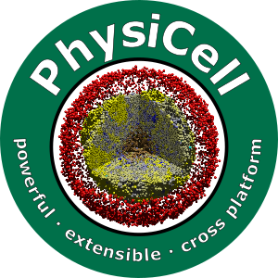

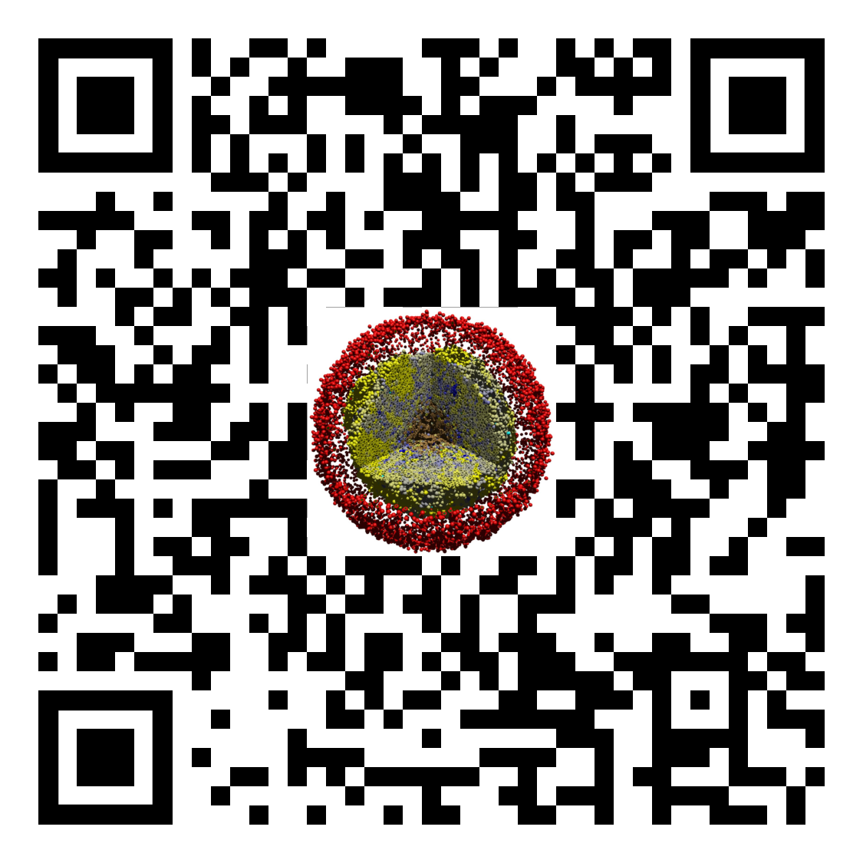
Lesson 04: What is an agent-based model?
Slides, videos, links and more:
https://github.com/physicell-training/04-PhysiCell-intro
Paul Macklin, Ph.D.
@MathCancer
last updated: November 13, 2019

Slide 2
Next steps
Super fast: Please proceed to 05 (PhysiCell codebase structure) link: https://github.com/physicell-training/05-PhysiCell-codebase
Intermediate: Please proceed to 05 (PhysiCell codebase structure) link: https://github.com/physicell-training/05-PhysiCell-codebase
Full training: Please proceed to 05 (PhysiCell codebase structure) link: https://github.com/physicell-training/05-PhysiCell-codebase
More materials: https://github.com/physicell-training/master-list

Slide 3




Credits
Module Planning: Paul Macklin
Slides: Paul Macklin
Recording: Paul Macklin
Post-production: Paul Macklin, Drew Willis*, Kali Konstantinopoulos*
Microapps: https://www.nanohub.org/tools/???
* denotes undergraduate researcher
Funding:
PhysiCell Development:
Breast Cancer Research Foundation
Jayne Koskinas Ted Giovanis Foundation for Health and Policy
National Cancer Institute (U01CA232137)
National Science Foundation (1720625)
Training materials:
* Administrative supplement to NCI U01CA232137 (Year 2)

