Slide 1

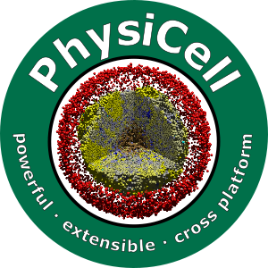
PhysiCell Model Builder
Randy Heiland, Adam Morrow, Grant Waldow, Drew Willis, Kim Crevecoeur
Mentor: Paul Macklin, Ph.D.
@MathCancer
SMB 2021
https://github.com/PhysiCell-Tools/PhysiCell-model-builder/releases

Slide 2
Goals
Design/develop a graphical user interface (GUI) to define a PhysiCell model’s parameters
Generate/save an XML file with a model’s parameters
Involve undergraduates
learn more about PhysiCell (and computational biology)
learn more about tool development:
GUI libraries
UX/UI
software engineering best practices
practice teamwork

Slide 3
PhysiCell model
Cells
Global Variables
Substrates
Boundary Conditions
Custom Data
List of cells
Cell Functions
Domain Size
User Parameters
PhysiCell Constants
SVG options
MultiCellDS options
Default Cell Definition
Default microenvironment
Voxel Size
Cell State
Basic Agent Variables(inherited)
Cell Definition
Microenvironment
Phenotype

Slide 4
GUI libraries
Needs to run on operating systems that PhysiCell supports: Windows, macOS, Linux
Free to use and deploy
Relatively easy to learn and use
Considered Qt, GTK, wxWidgets
Chose Qt; experimented with both the C++ API (+ Qt Creator) and PyQt
Chose PyQt; PyQt5 is provided in the Anaconda Python distribution
If possible, take advantage of our earlier project (xml2jupyter) that uses Jupyter widgets (ipywidgets)

Slide 5
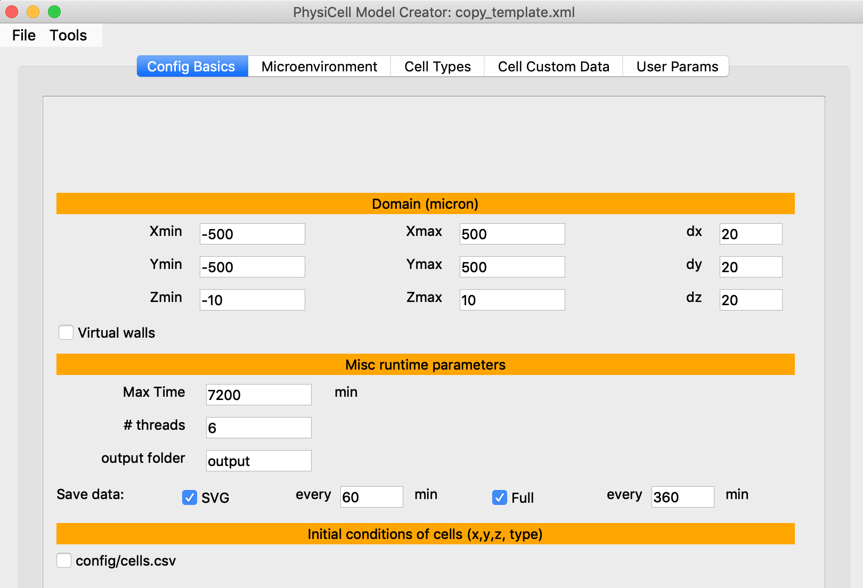
Configuration Basics
GUI will be populated with parameters from a very simple “template” model

Slide 6
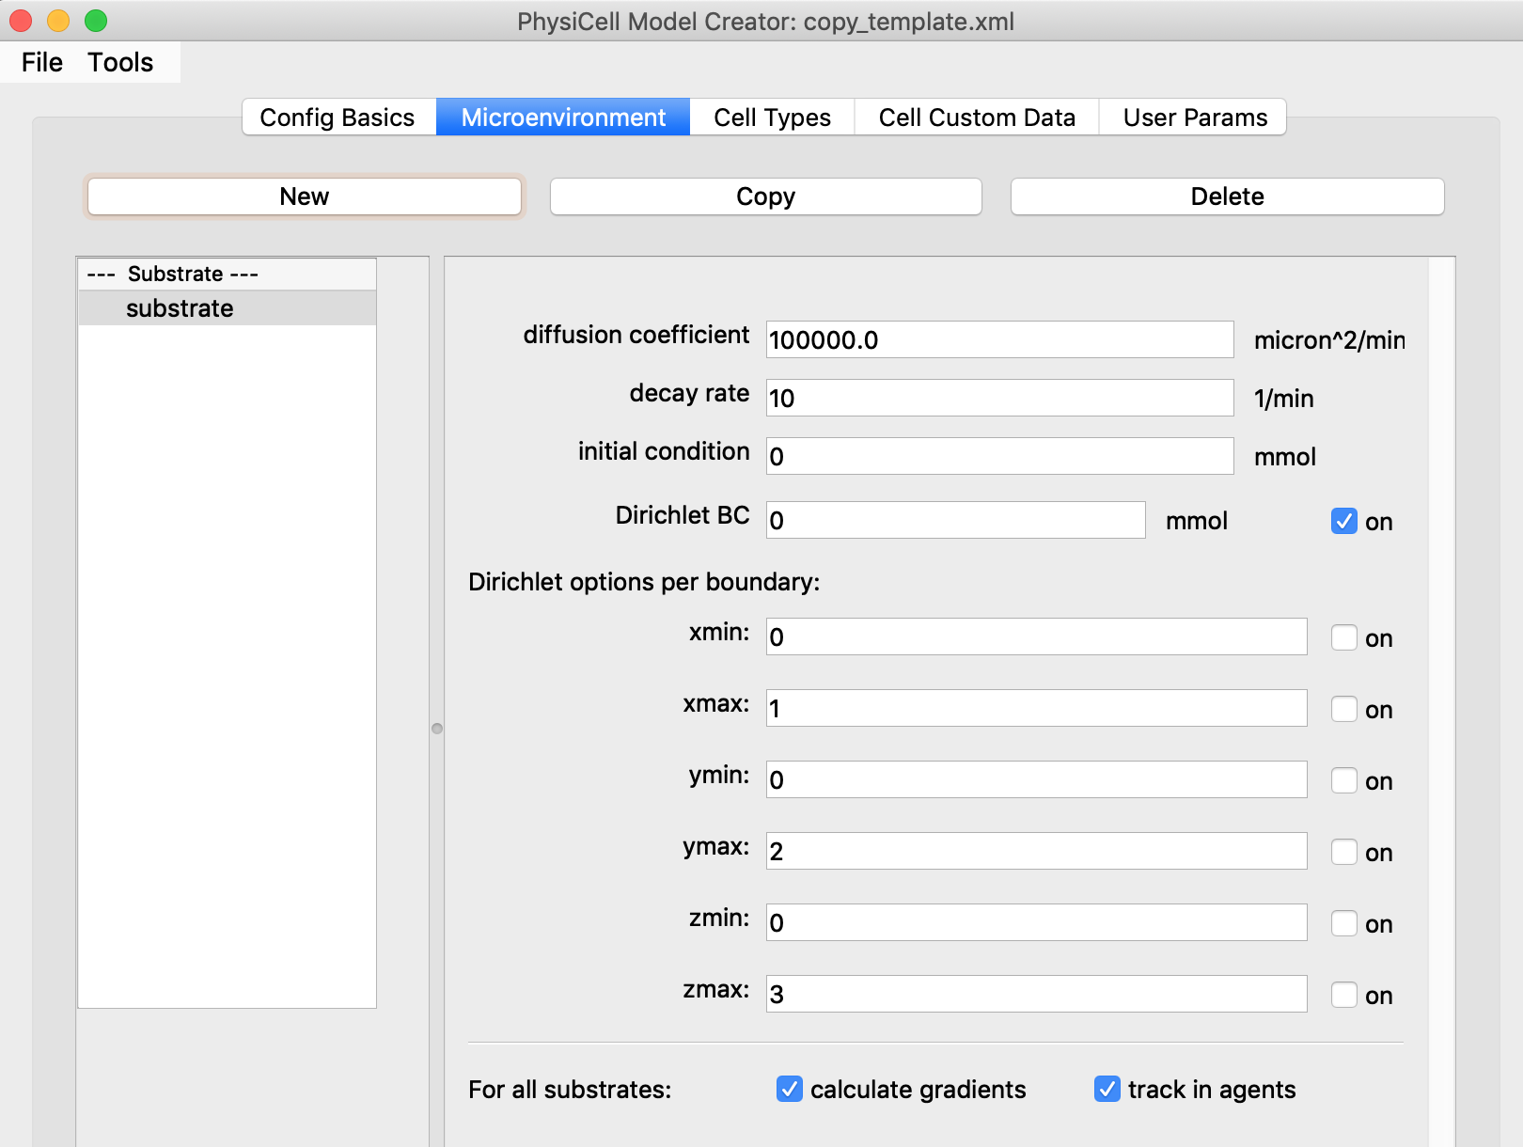
Microenvironment
Create one or more substrates (the “template” model just has one)

Slide 7
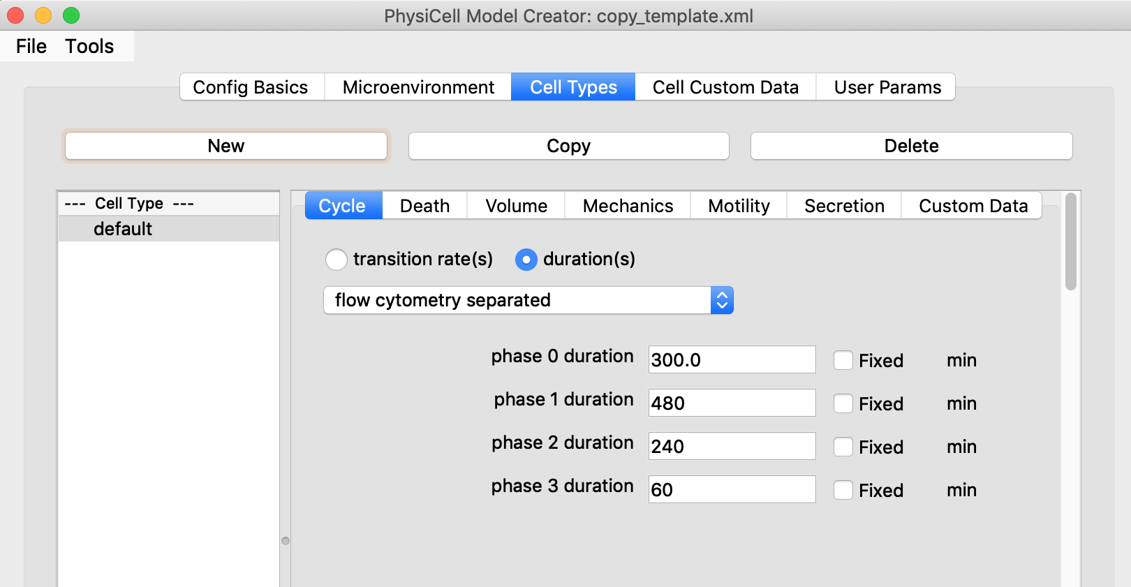
Cell Types
Create one or more cell types (the “template” model just has one)
Sub-tabs to define phenotype

Slide 8
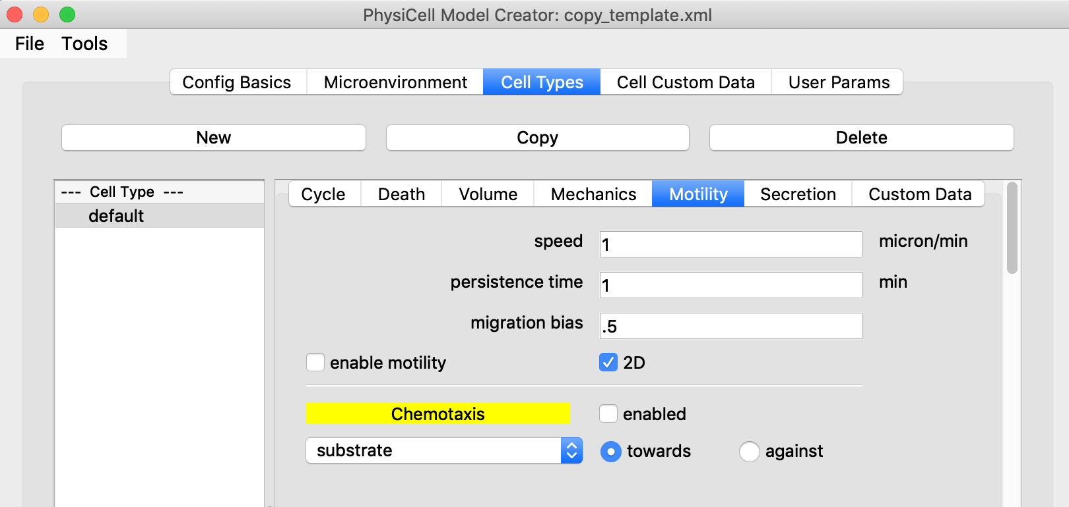
Cell Types: Motility
This cell type is not motile.
If it is motile, should it chemotax to/from a substrate?

Slide 9
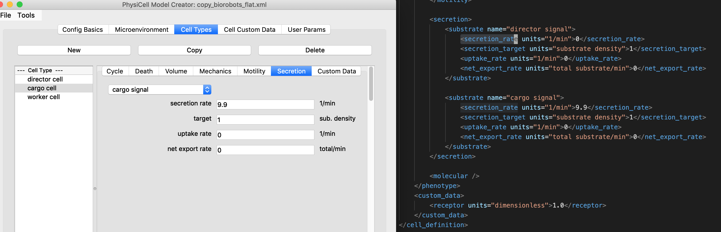
Cell Types: Secretion
Showing the mapping between the GUI and the XML (for the more interesting “biorobots” sample model that is bundled with PhysiCell).

Slide 10
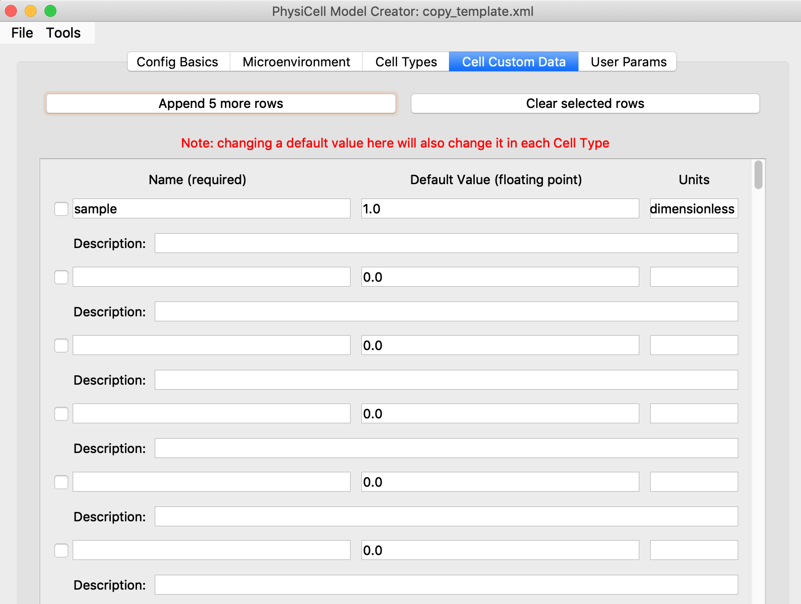
Cell Custom Data
Each cell can have custom data that is model-specific (the “template” model just has one)

Slide 11
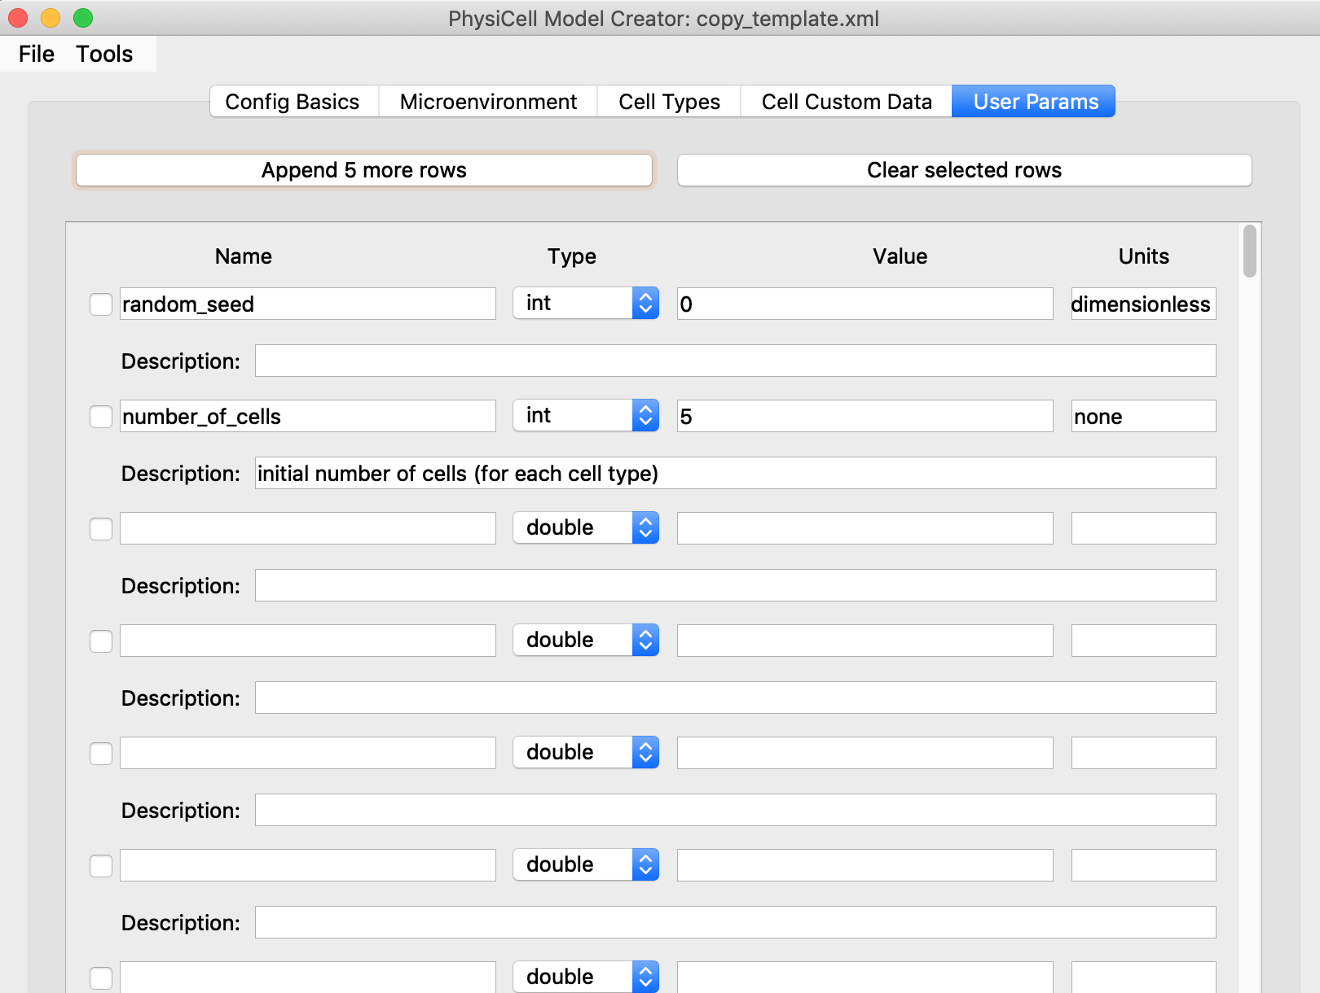
User Parameters
Each model can have user-defined parameters (the “template” model just has two)

Slide 12
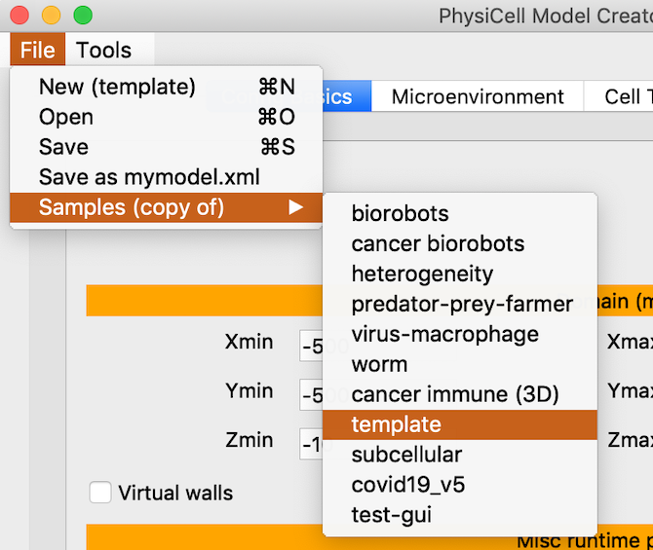
Other sample input models
In addition to the default ”template” model, users can choose one of several other models, most of which come bundled with PhysiCell as sample projects to simulate.

Slide 13
Future
Perform more testing
Please try out the latest release:
https://github.com/PhysiCell-Tools/PhysiCell-model-builder/releases
Demo/use at July workshop: http://physicell.org/ws2021/
Note: applications for funded participants has ended; however, there will be publicly available pre-recorded tutorials.
Automate “flattening” existing hierarchical cell type .xml models (as input to the GUI)
Port to nanoHUB (being tested)
Create a PyQt visualization tool for simulation results

Slide 14




Credits
MathCancer Lab: ideas, conversations, testing
Funding:
PhysiCell Development:
Breast Cancer Research Foundation
Jayne Koskinas Ted Giovanis Foundation for Health and Policy
National Cancer Institute (U01CA232137)
National Science Foundation (1720625)

