Slide 1
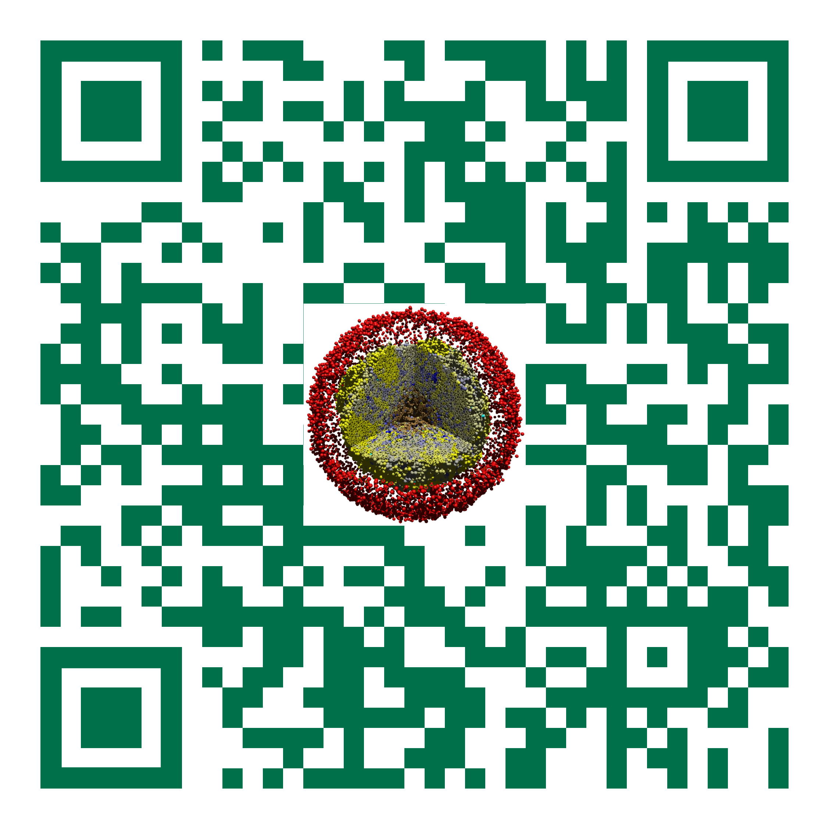

[project title - Tool]
Slides, videos, links and more:
https://github.com/physicell-training/ws2021
[team]
July 26, 2021

Slide 2
Engineering Challenge
[Clearly state the engineering challenge you are addressing. ]

Slide 3
Background
[Discuss key background, assumptions, and/or hypotheses. ]

Slide 4
Design goals: features
"Must have" features:
"Nice to have" features:

Slide 5
Design goals: hackathon
"Must have" features to be implemented this week:
"Nice to have" features for this week:

Slide 6
Expected community impact
[how will your tool be used? how might it empower researchers? How could it connect with other tools and resources in and outside the PhysiCell ecosystem?]

Slide 7
Overall implementation approach
[give the coarse-grained, overall description of your software design / implementation.]
[This could be a good place to include open source software or resources that you are leveraging.]

Slide 8
Key implementation details
[as needed, give any slides that give some details on implementation. Not 100% needed, but can use it if you'd like to call attention to a tough problem you solved!]

Slide 9
Results
[give some results of your tool in use. please do include screen captures. If possible, include any unit tests or related testing.]
[Is your tool working cross-platform? ]

Slide 10
Next steps
[where do you go from here? What's the next step? How close are you to a release?]

Slide 11
Dissemination
[Do you aim for a sustained collaboration?]
[Would you like to integrate this into PhysiCell as an addon, or as an independent but official tool in PhysiCell-Tools?]
[How will you release your tool? Have you chosen a license? (for addons, MIT or BSD. For separate tools, more freedom.]

Slide 12
Tool Metrics [don't include this slide]
Clearly stated challenge 0 to 10
Clearly stated goals for the hackathon 0 to 10
Clearly state longer-term goals 0 to 10
Sensible, well-described approach 0 to 10
Good, working preliminary result 0 to 10
Software is cross-platform 0 to 10
Clear next steps 0 to 10
Dissemination plans 0 to 10

Slide 13




Funding Acknowledgements
PhysiCell Development:
Breast Cancer Research Foundation
Jayne Koskinas Ted Giovanis Foundation for Health and Policy
National Cancer Institute (U01CA232137)
National Science Foundation (1720625)
Training Materials:
Administrative supplement to NCI U01CA232137 (Year 2)

