Slide 1
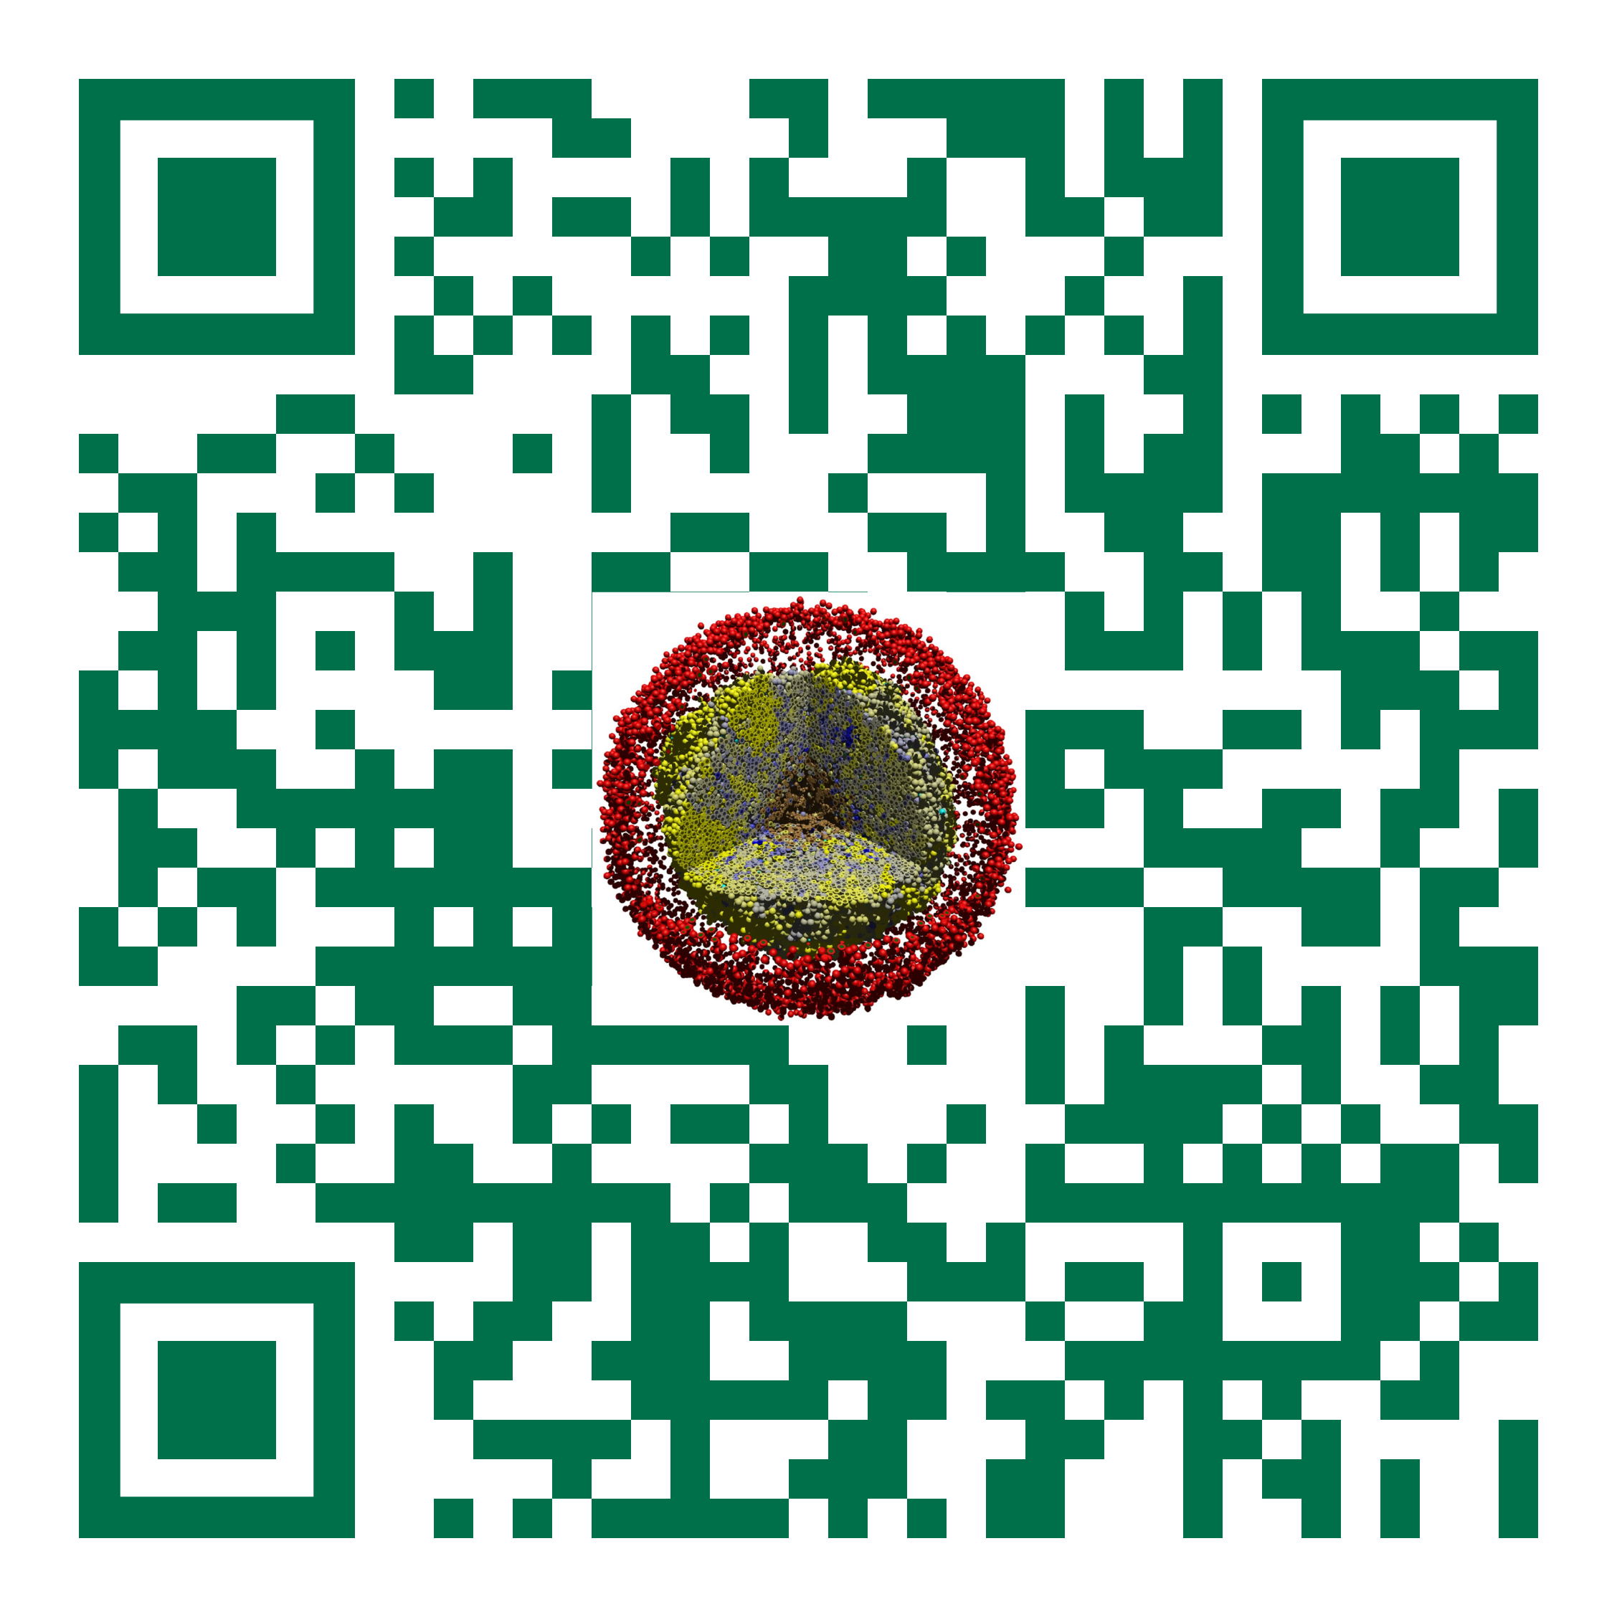
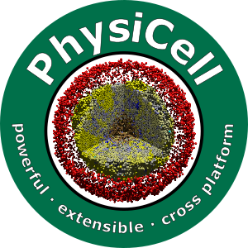

Session 0: Introduction to Agent-Based Modeling and PhysiCell
Slides, videos, links and more:
https://github.com/physicell-training/ws2021
Paul Macklin, Ph.D.
@MathCancer
July 15, 2021

Slide 2
use some stanford slides
what is an agent-based model
players and the stage and script
type of discfete
physicell
focus on microeniorn
focus on playesr (agents)
focus on script (rules / models)
examples

Slide 3




Funding Acknowledgements
PhysiCell Development:
Breast Cancer Research Foundation
Jayne Koskinas Ted Giovanis Foundation for Health and Policy
National Cancer Institute (U01CA232137)
National Science Foundation (1720625)
Training Materials:
Administrative supplement to NCI U01CA232137 (Year 2)

