Slide 1
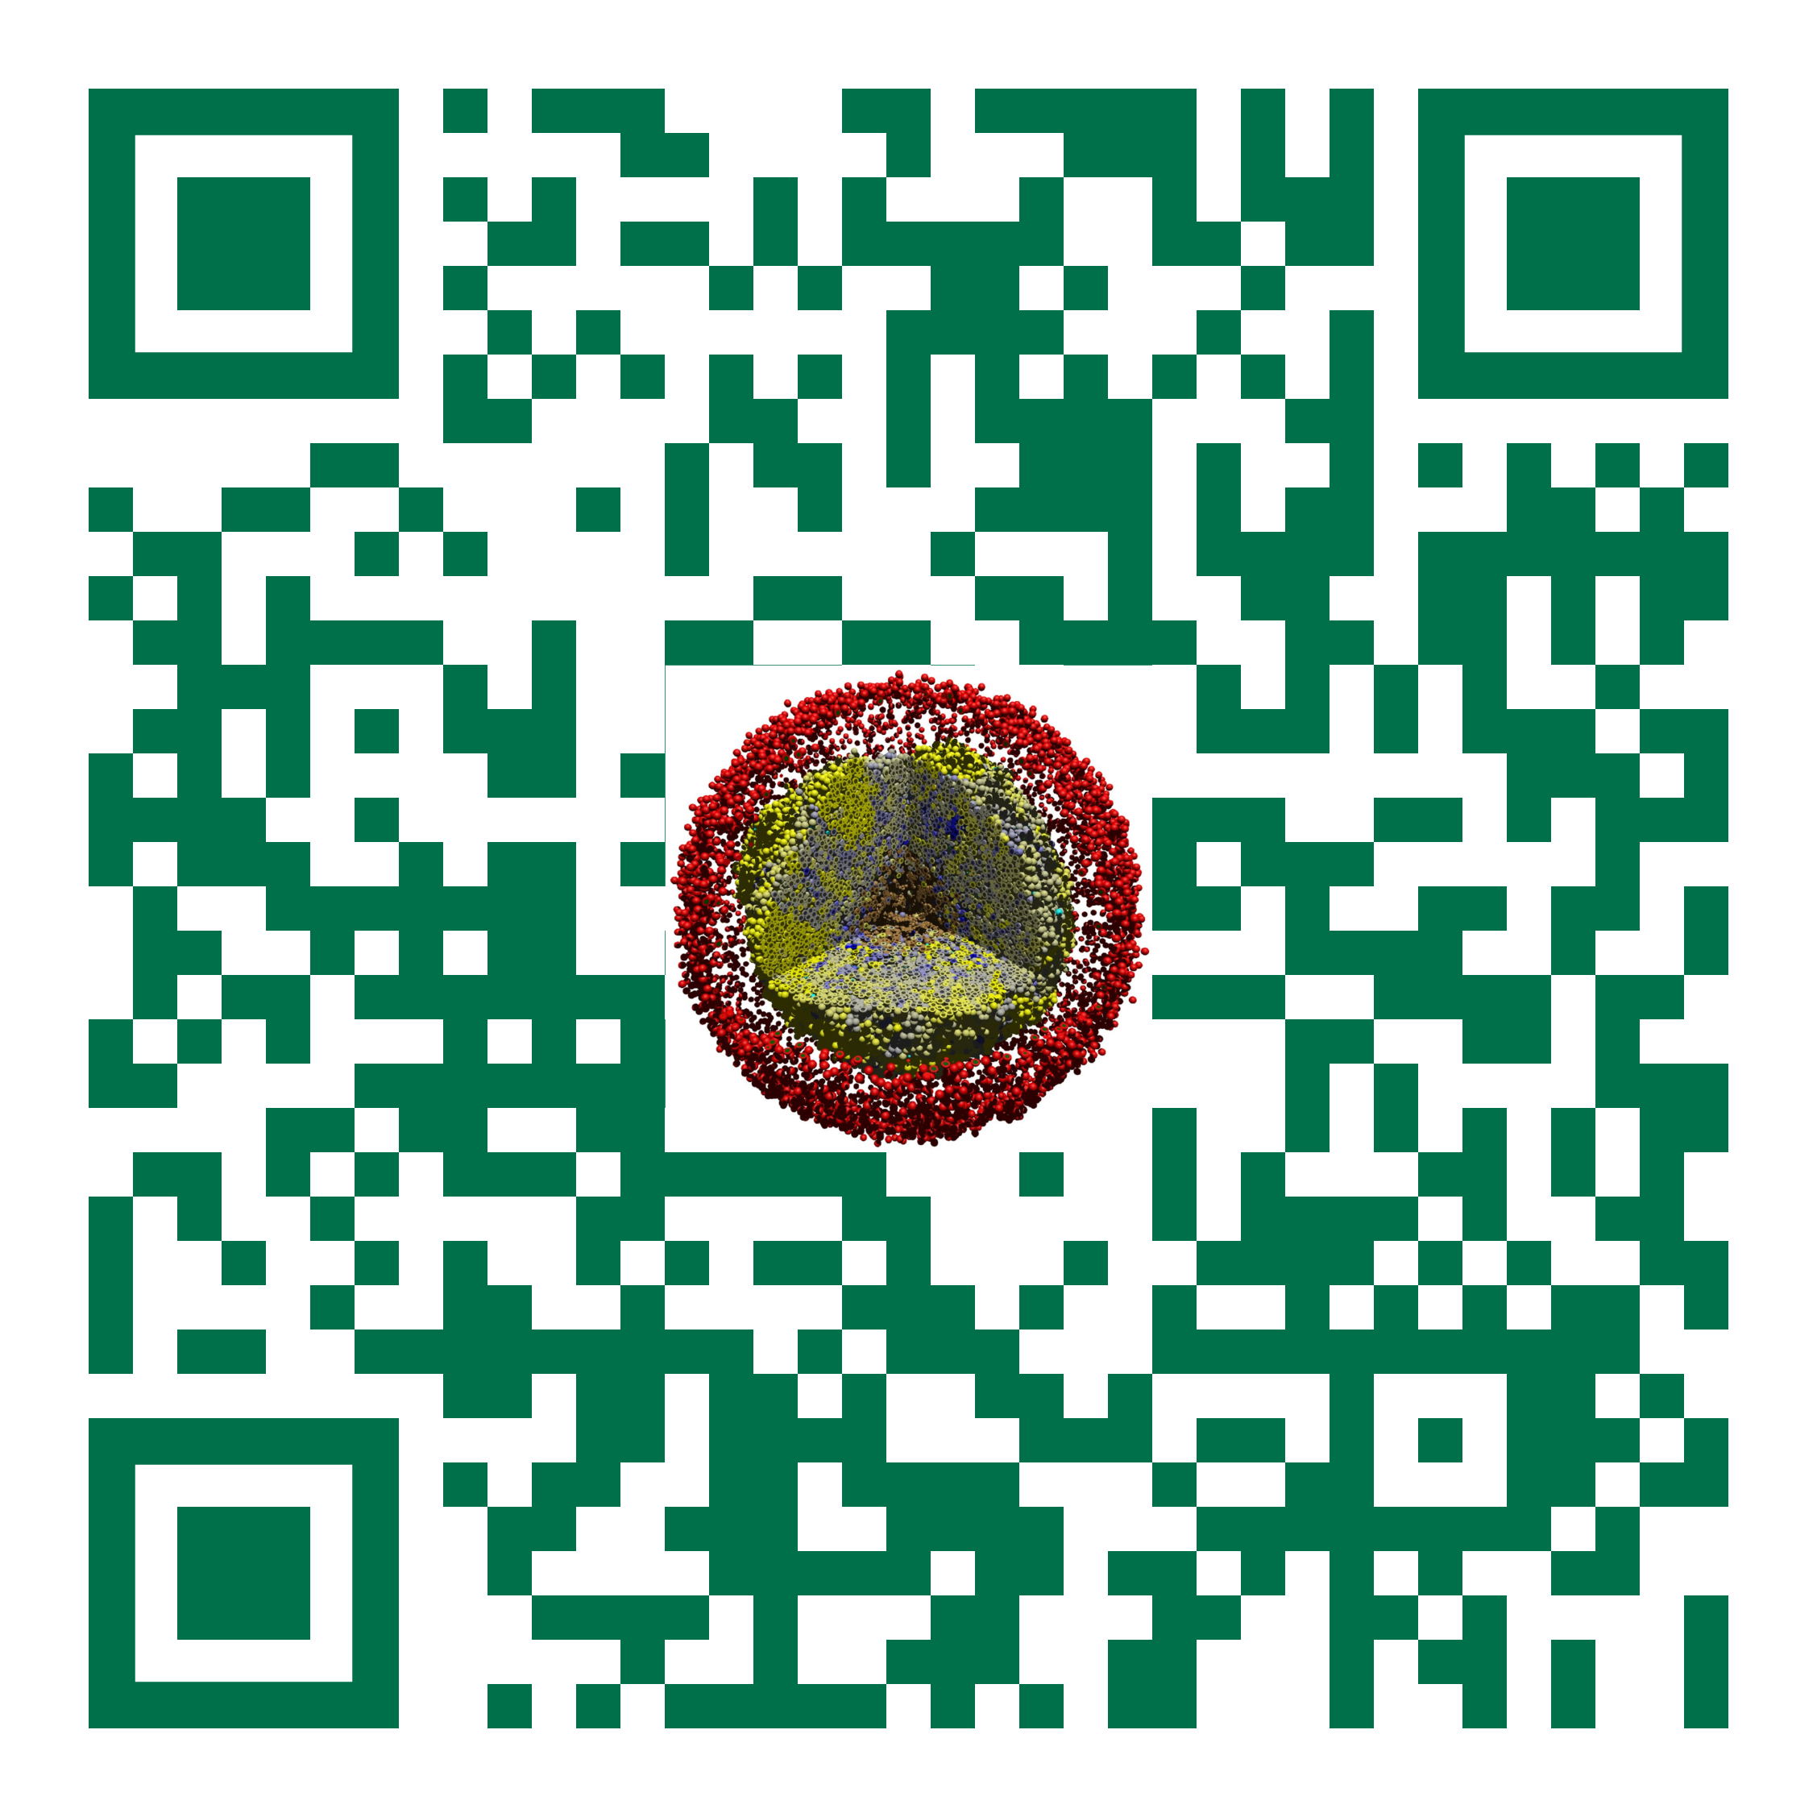
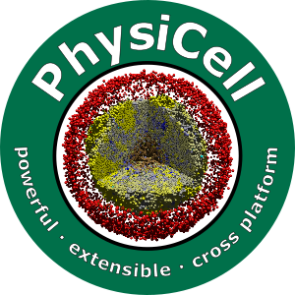

Session 12: Intracellular Modeling
Slides, videos, links and more:
https://github.com/physicell-training/ws2021
Furkan Kurtoglu
@FKurtogluSysBio
July 28, 2021

Slide 2
Agenda
SBML Creation
Populate ode-energy-sample
Let’s remove some parts of the custom module.
Let’s code together

Slide 3
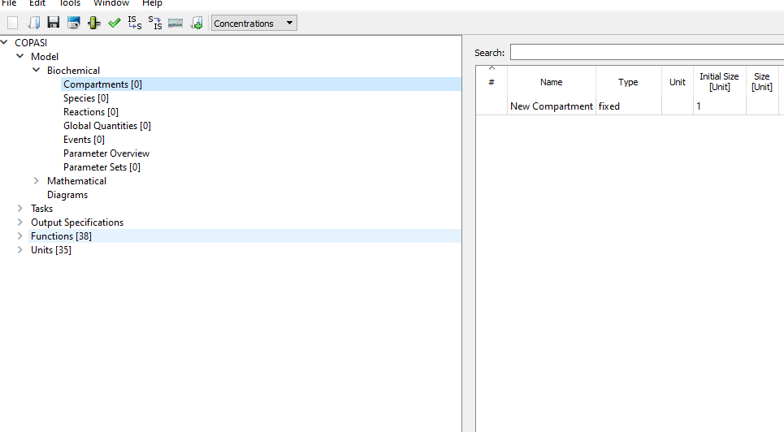
SBML Creation
We need to create our SBML
Let’s start our Copasi

Slide 4
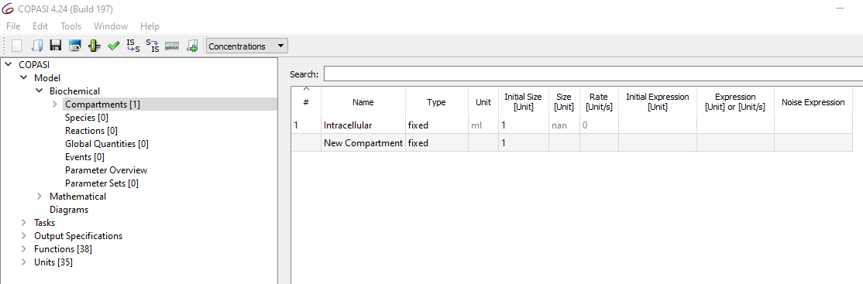
SBML Creation
We will start with compartments
Let’s add “Intracellular” compartment
Volume = 1.0

Slide 5
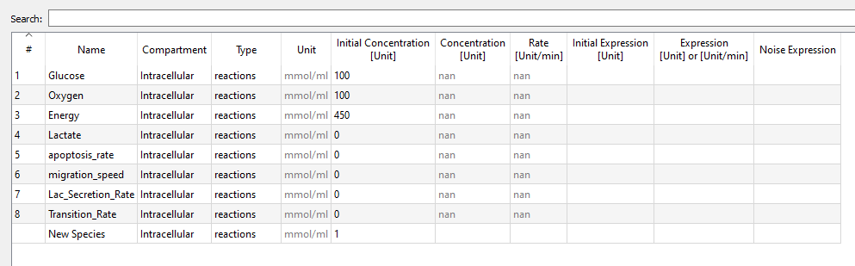
SBML Creation : Species
There will be 8 Species

Slide 6
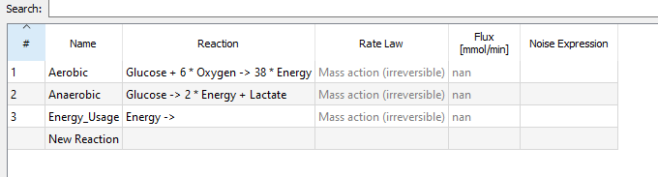
SBML Creation : Reactions
There will be three Reactions

Slide 7
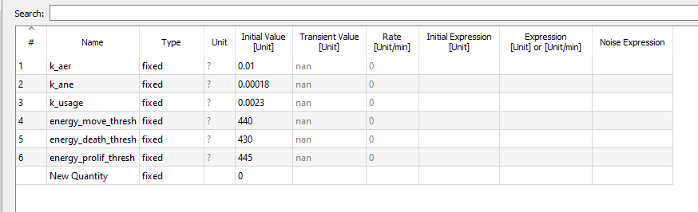
SBML Creation : Global Quantities
There will be 6 Global Quantities

Slide 8
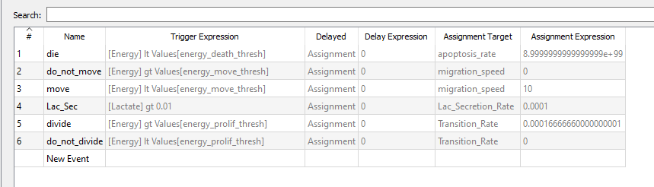
SBML Creation: Events
6 Events to create

Slide 9
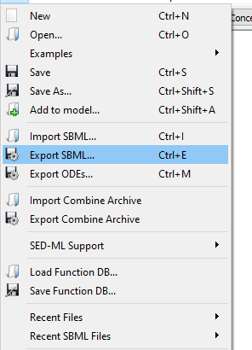
SBML Creation : Save

Slide 10
Populate
make clean
make data-cleanup
make reset
make list-projects
make ode-sample-project
make

Slide 11
Let’s remove important part
In the custom module
Browse through the setup tissue() function
Remove the inner code of the for loop
Starting with Line #166 to #183
Remove the inner part of update_intracellular() function
Starting with Line #192 to #263
That’s all

Slide 12
Coding together
Let’s code together…

Slide 13




Funding Acknowledgements
PhysiCell Development:
Breast Cancer Research Foundation
Jayne Koskinas Ted Giovanis Foundation for Health and Policy
National Cancer Institute (U01CA232137)
National Science Foundation (1720625)
Training Materials:
Administrative supplement to NCI U01CA232137 (Year 2)

