Slide 1
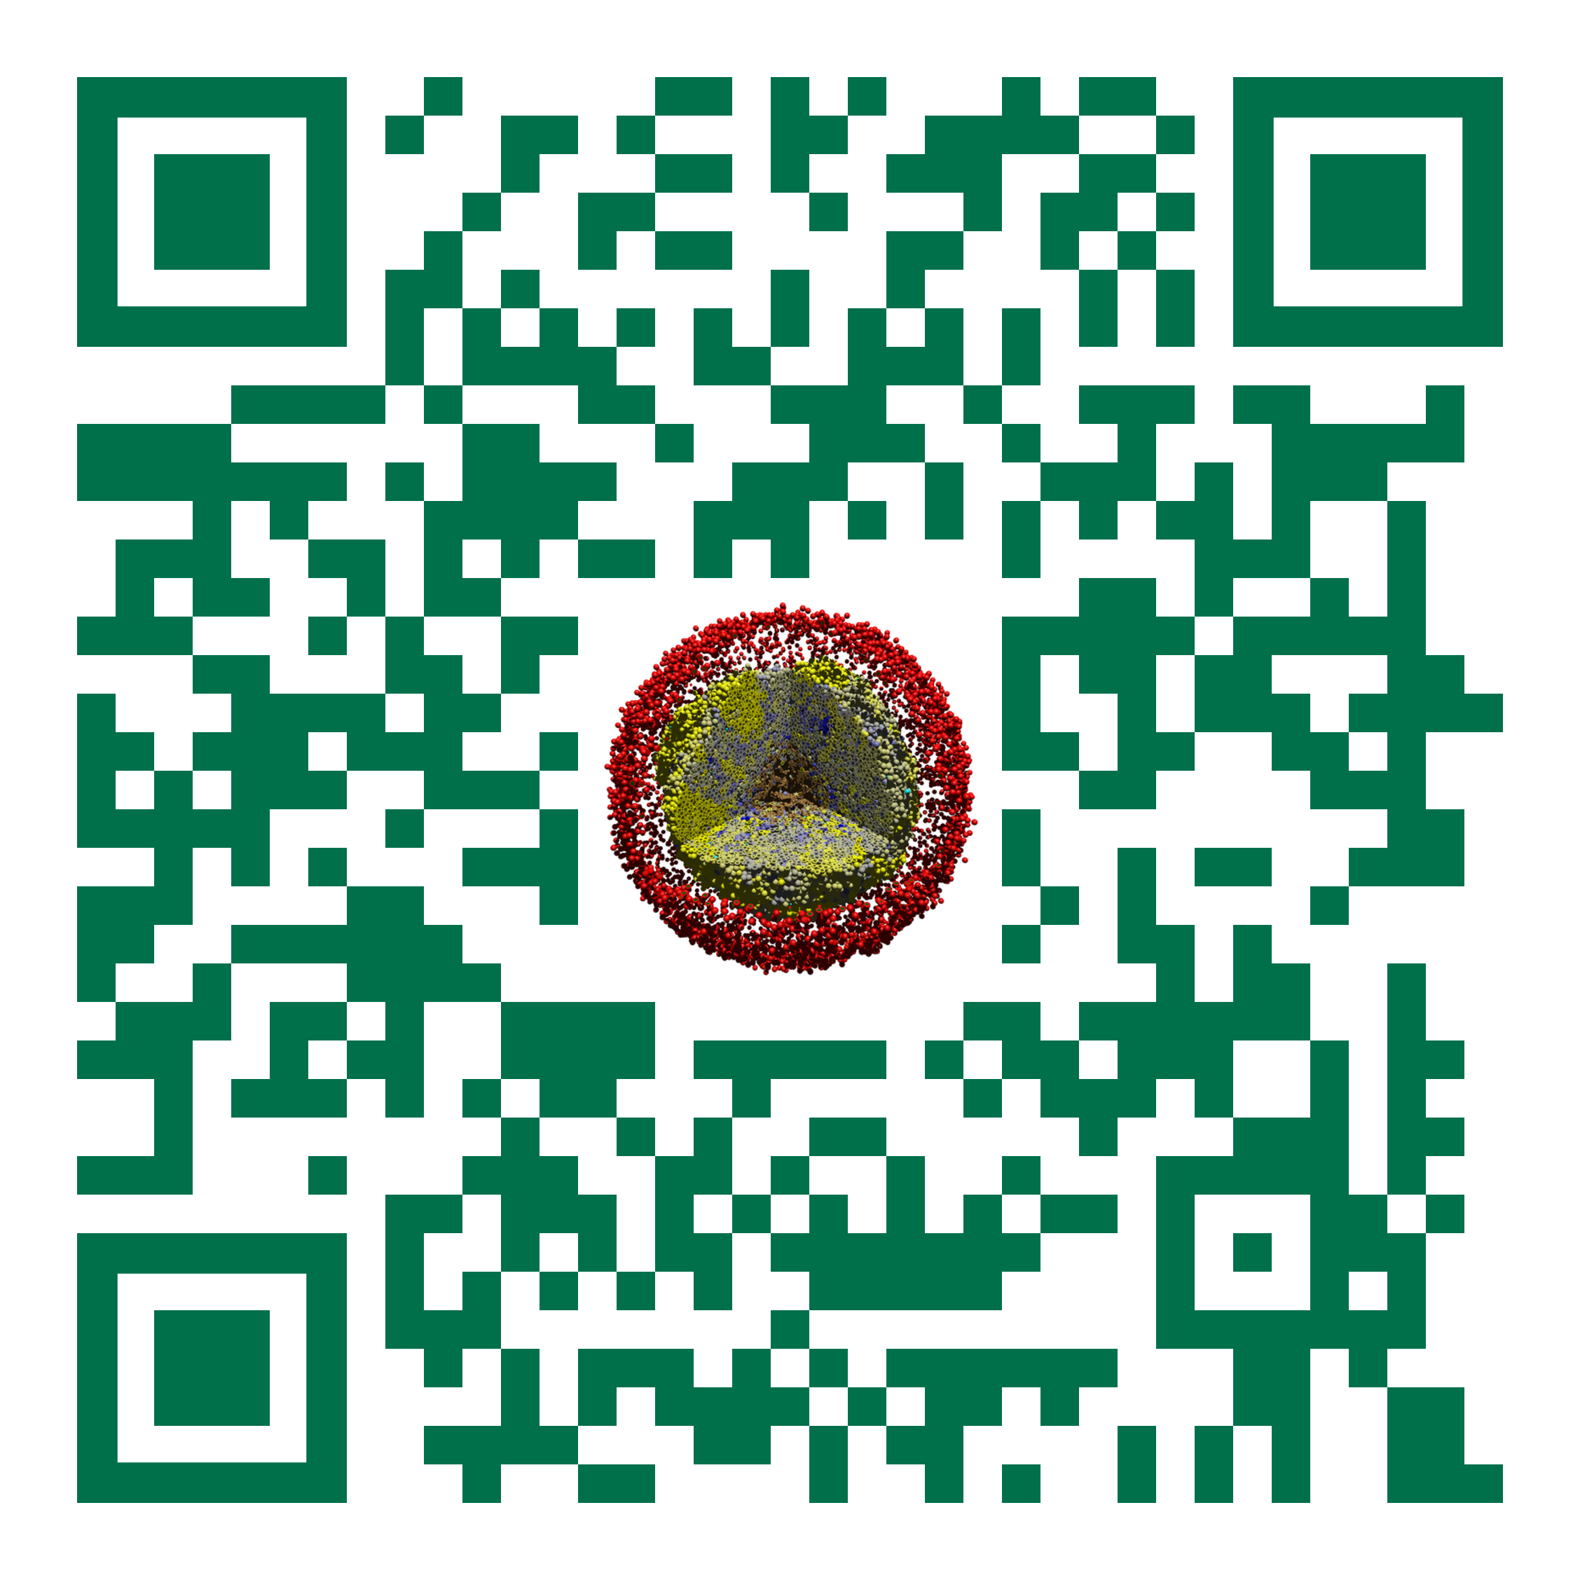

[project title - Tool]
Slides, videos, links and more:
https://github.com/physicell-training/ws2022
[team]
July 29, 2022

Slide 2
Engineering Challenge
Clearly state the engineering challenge you are addressing.
Include background information as needed to contextualize the problem. Examples could include:
Pressing scientific or user-based need
Why it's challenging
What drew you to the problem

Slide 3
Design goals: features
"Must have" features:
"Nice to have" features:
Which of these goals / features did you aim to implement this week?

Slide 4
Expected community impact
How will your tool be used?
How might it empower researchers?
How could it connect with other tools and resources in and outside the PhysiCell ecosystem?

Slide 5
Overall implementation approach
Give the coarse-grained, overall description of your software design / implementation.
This could be a good place to include open source software or resources that you are leveraging.

Slide 6
Key implementation details
As needed, give any slides that give some details on implementation.
Not 100% needed, but you can use it if you'd like to call attention to a tough problem you solved!

Slide 7
Results and Discussion
Give some results of your tool in use.
Please do include screen captures.
If possible, include any unit tests or related testing.
Is your tool working cross-platform?

Slide 8
Next steps
Where do you go from here?
What's the next step?
How close are you to a release?
Would you aim for a software or method article?

Slide 9
Dissemination
Do you aim for a sustained collaboration?
How can we help? How can the community help?
Would you like to integrate this into PhysiCell as an addon, or as an independent but official tool in PhysiCell-Tools?
How can we help? How can the community help?
How will you release your tool? Have you chosen a license?
For addons, MIT or BSD.
For separate or stand-alone tools, you have more license choice freedom.

Slide 10
Metrics [don't include this slide]
Bronze level
Interesting engineering problem
Some preliminary results (might only work on one platform)
Silver level
Bronze, plus
Clear working plan
Excellent use of team skills
Clear presentation and communication
Some things still broken, but clear preliminary results (main results working across platforms)
Clear ideas on next steps
Gold level
Silver, plus
Substantial preliminary results
Clear thinking on ease of use and focus on end users
Some thoughts on wider impact of the work, and where it fits the ecosystem
Clear commitment to continue the project through to publication / dissemination

