Slide 1
Your Name Here
Your picture here.
(optional)
My background: text here
My research interests:
text here
text here
Add a cool picture or animated GIF of your research here.

Slide 2
Your Name Here
My modeling project ideas:
idea
idea
My infrastructure / tool ideas:
idea
idea
A fun hobby or trivia: text here
Add a cool picture or animated GIF of your research or hobbies here.

Slide 3
Example

Slide 4
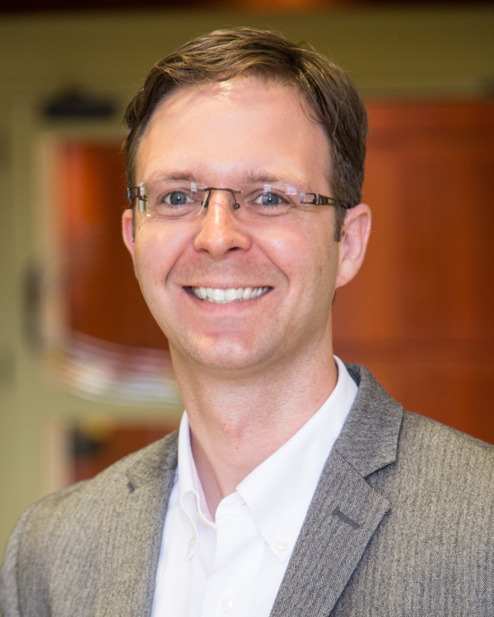
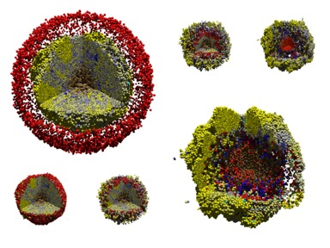
Paul Macklin
Your picture here.
(optional)
My background:
Mathematician with training in mathematical biology and computational mathematics.
Associate Dean of Undergraduate Education
My research interests:
Agent-based modeling
open source and team science
cancer simulations
Immunology / infectious diseases
Integration of research and education

Slide 5
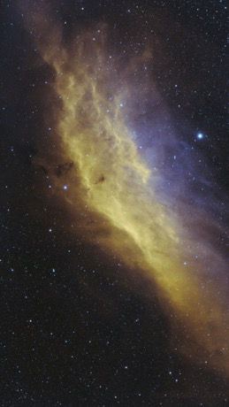
Paul Macklin
My modeling project ideas:
Model fluid flow, couple to cell volume changes
My infrastructure / tool ideas:
Standardized interface for reinforcement learning
Interface with FEBio for finite element support
A fun hobby or trivia: Astrophotography, especially nebulas.
California Nebula, 3-panel mosaic
https://www.astrobin.com/6cazro

