Slide 1
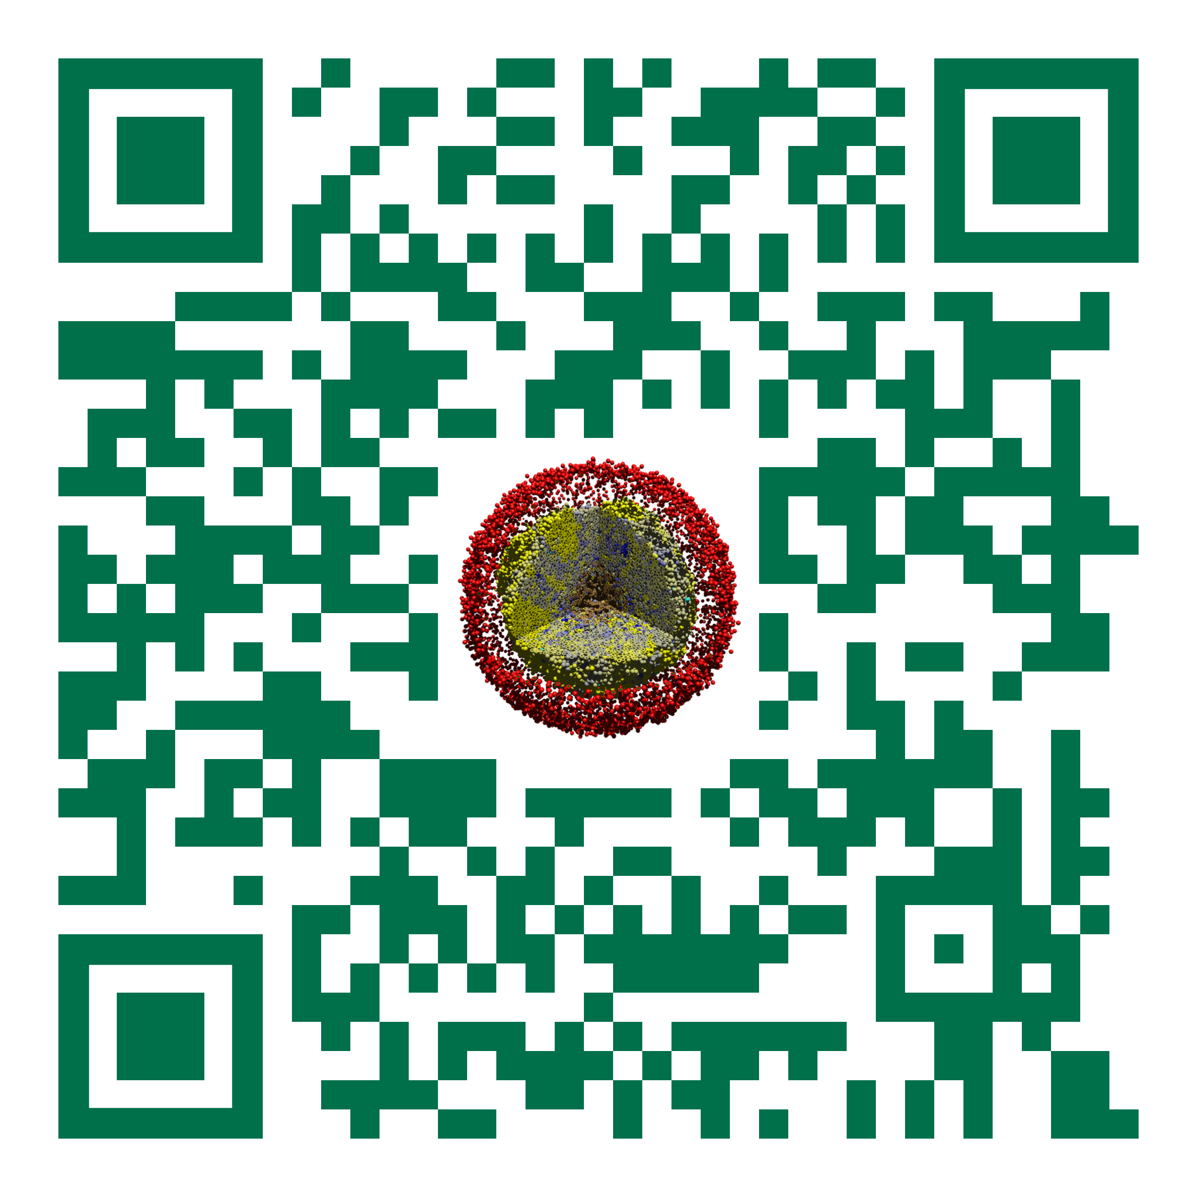
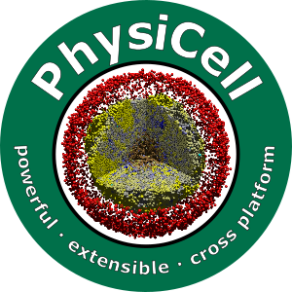

Team Time 1
Slides, videos, links and more:
https://github.com/physicell-training/ws2022
Paul Macklin, Ph.D.
@MathCancer
July 27, 2022

Slide 2
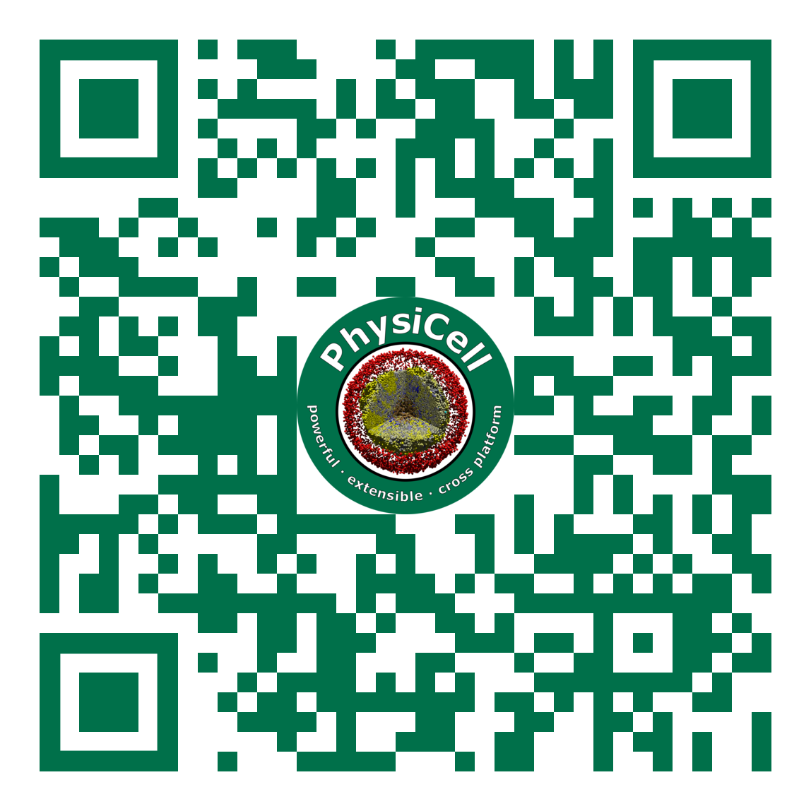
Team Time 1
Slides, videos, links and more:
https://github.com/physicell-training/ws2023
Paul Macklin
@MathCancer
August 9, 2023

Slide 3
Overall Goal
Begin refining your idea into a concrete plan
Identify a preliminary result
Prepare for cross-pollination and feedback
Specific goal for this session: prepare 5-10 minute mini report

Slide 4
Mini report: Part 1
Project title
Team members and key expertise / resources
Scientific or Engineering Question to be addressed
Key hypotheses and/or assumptions (and/or background)

Slide 5
Mini report: Part 2 (model option)
Overall modeling approach:
"must have" versus "nice to have" for all the below
Microenvironment
Cell definitions (and key points on key phenotype)
Custom cell data (as needed):
Custom parameters (as needed)
Important custom cell rules / functions:
Initial cell placement
Cell coloring (as needed)
Custom addons or functions needed outside the standard workflow

Slide 6
Mini report: Part 2 (tool option)
Overall description and design:
What does it do?
Core “must have” features
“Nice to have” features
Open source software to leverage (considering cross-platform and license restrictions)
How/where does it interface with PhysiCell
Key inputs
Key outputs
unit tests
Other thoughts / considerations

Slide 7
Mini report: Part 3
Fast preliminary result or prototype
Describe a first step you can reach by Thursday afternoon to present to the group.
What initial tests can you use to know it’s working?
Any challenges foreseen for the preliminary result?
Expected impact / use of your project

Slide 8




Funding Acknowledgements
PhysiCell Development:
Breast Cancer Research Foundation
Jayne Koskinas Ted Giovanis Foundation for Health and Policy
National Cancer Institute (U01CA232137)
National Science Foundation (1720625)
Training Materials:
Administrative supplement to NCI U01CA232137 (Year 2)

