Slide 1
EQ2341VT201 Pattern Recognition Project Presentation
Shuchan Wang
Lingxaio Wang

Slide 2
Self-Introduction
Shuchan Wang Information and network engineering
Lingxiao Wang Machine Learning

Slide 3

Show the data
Datasource:https://adunna.me/projects/dist/speech-emotion/data/ravdess/Actor_01/
sample:
Kids are talking by the door
sample:
Dogs are sitting by the door

Slide 4
Feature Extraction
Speech
Fast Fourier Transform
Mel Filter Bank Processing
Log energy Computation
Discrete Cosine Transform
Pre-emphasis
Framing
windowing
Mel cspstrums

Slide 5
HMM
Hidden states: 25
Output distributions: Gaussian Distribution
Training Algorithm: Viterbi
Ergordic markov model

Slide 6
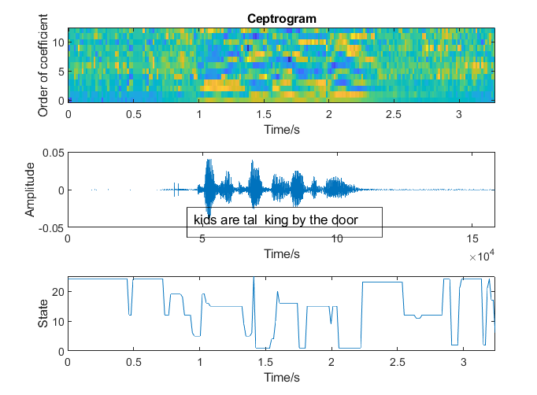
Results

Slide 7

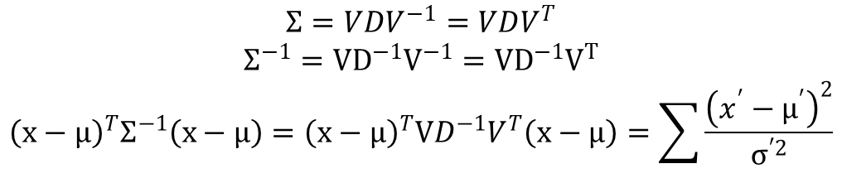
Visualization of Output distributions
$$Σ=VDV^{−1}=VDV^{T}$$
$$Σ^{−1}=VD^{−1}V^{−1}=VD^{−1}V^{T}$$
$${\left(x−μ\right)}^{T}Σ^{−1}\left(x−μ\right)={\left(x−μ\right)}^{T}VD^{−1}V^{T}\left(x−μ\right)=\sum{\frac{{\left(x^{′}−μ^{′}\right)}^{2}}{σ^{′2}}}$$
Component with smallest $σ^{′2}$ dominants the sum

Slide 8
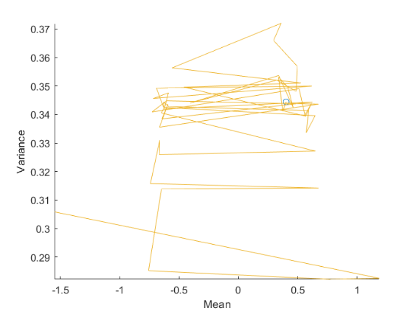
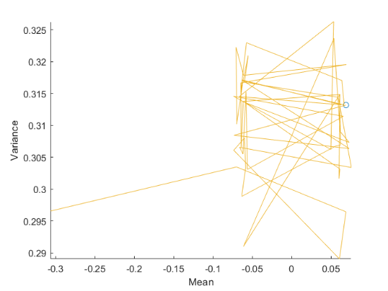
Visualization of Output distributions
Voiced
Unvoiced

Slide 9
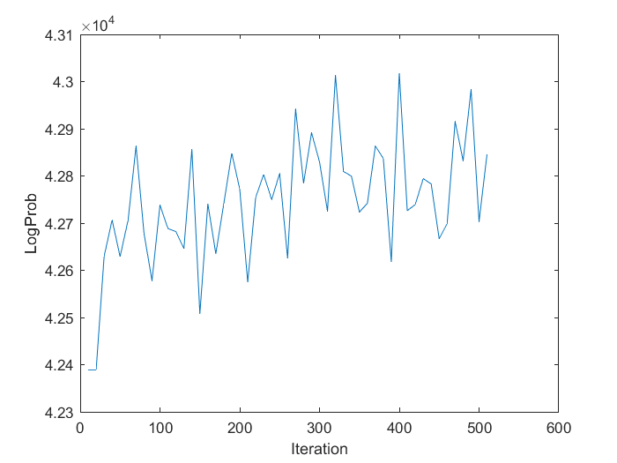
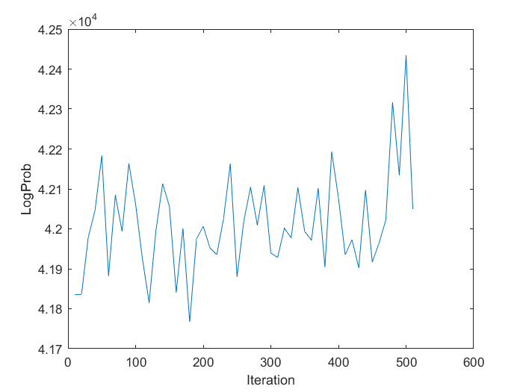
Validation probability
Attempt 1
Attempt 2

Slide 10
Conclusions
Trapped in local minimum
Multiple states correspond to one voice
One state corresponds to multiple voices
Training fast
Convergence is not obvious

