Slide 1
EQ2341VT201 Pattern Recognition Project Presentation
Shuchan Wang
Lingxaio Wang

Slide 2
Self-Introduction
Shuchan Wang Information and network engineering
Lingxiao Wang Machine Learning

Slide 3

Show the data
Datasource:https://adunna.me/projects/dist/speech-emotion/data/ravdess/Actor_01/
sample:
Kids are talking by the door
sample:
Dogs are sitting by the door

Slide 4
Feature Extraction
Speech
Fast Fourier Transform
Mel Filter Bank Processing
Log energy Computation
Discrete Cosine Transform
Pre-emphasis
Framing
windowing
Mel cspstrums

Slide 5
HMM
Hidden states: 25
Output distributions: Gaussian Distribution
Training Algorithm: Viterbi

Slide 6
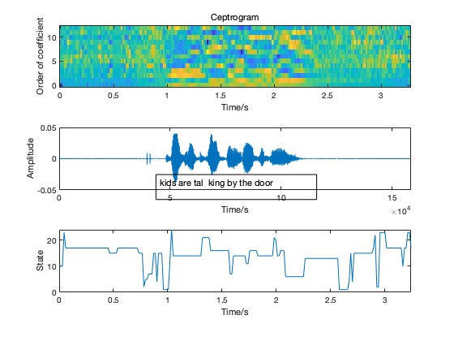
Results

Slide 7
Conclusions

