Slide 1
Machine Learning Lab 1 presentation
Zelin Zhang
Lingxaio Wang

Slide 2
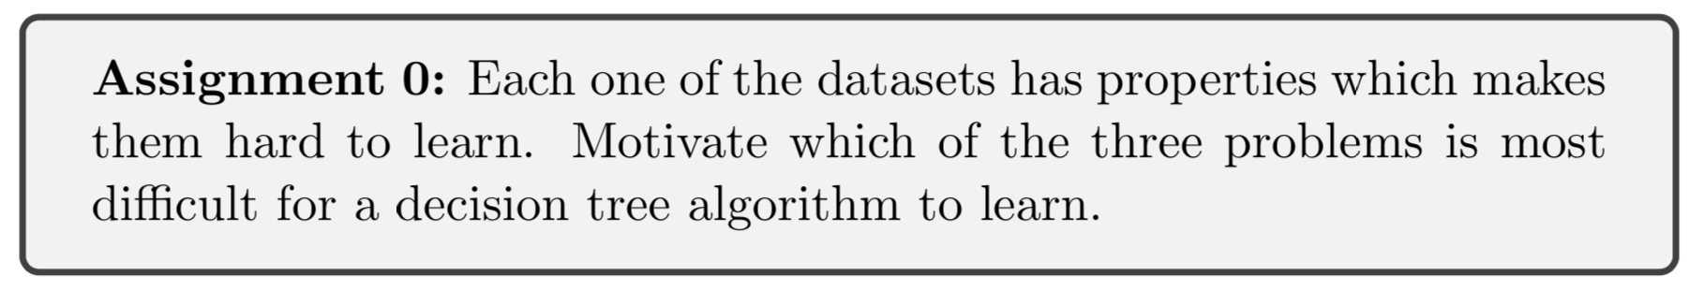
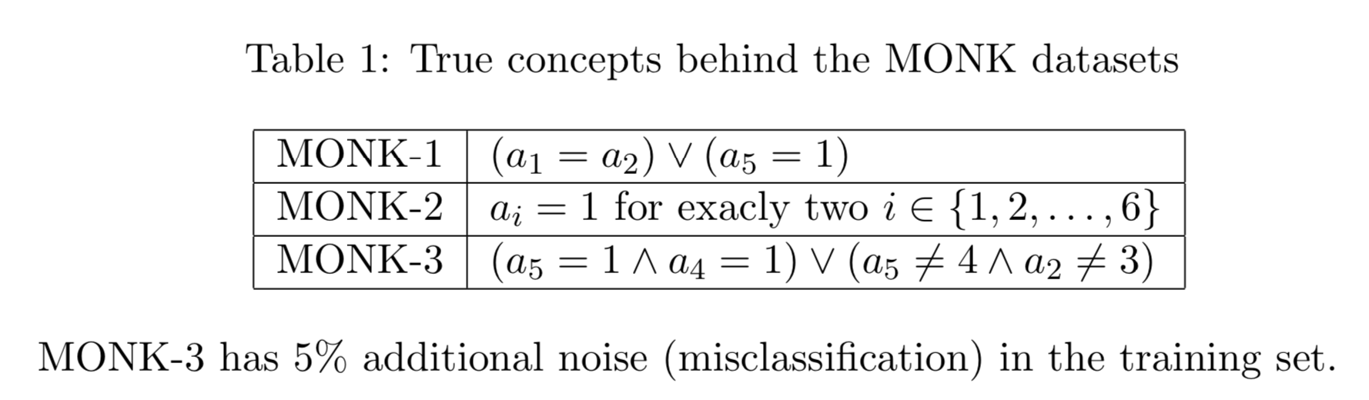
Lab 1 Decision Tree
More randomly

Slide 3
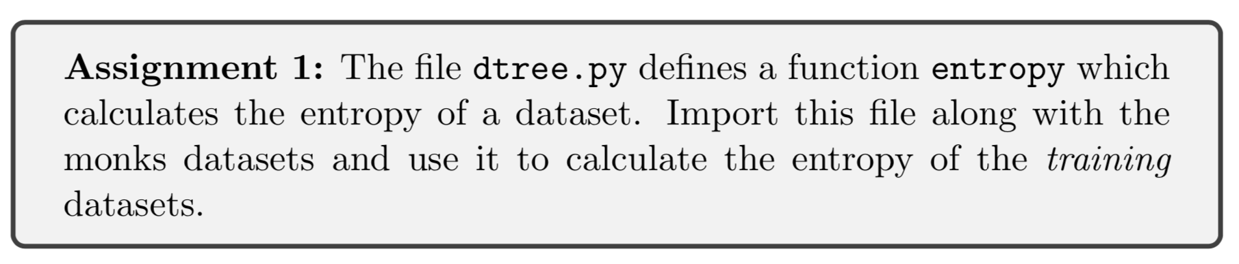
Lab 1 Decision Tree
Data Set | Entropy
MONK-1 | 1.0
MONK-2 | 0.957117428264771
MONK-3 | 0.9998061328047111
Notes:
Assignment 1 :Entropy of MONK-1 1.0Entropy of MONK-2 0.957117428264771Entropy of MONK-3 0.9998061328047111

Slide 4
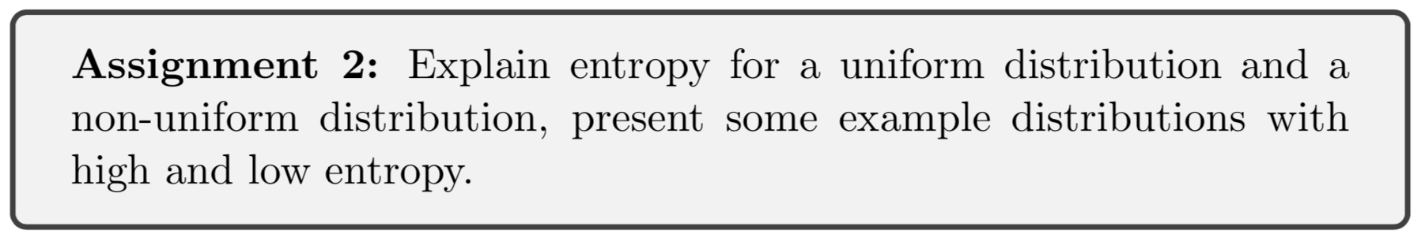
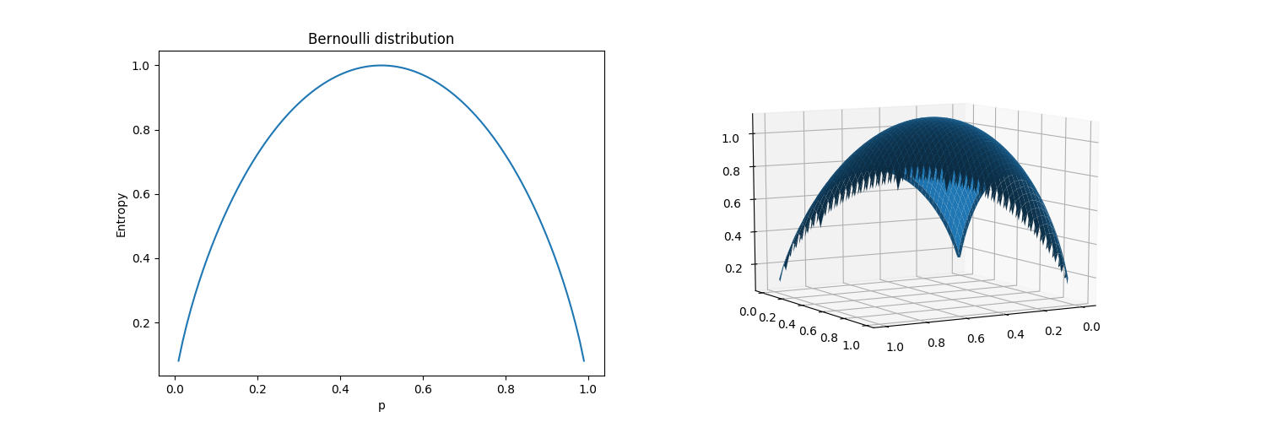
Lab 1 Decision Tree
Notes:
Assignment 2 :Bernoulli distribution q & 1-q

Slide 5
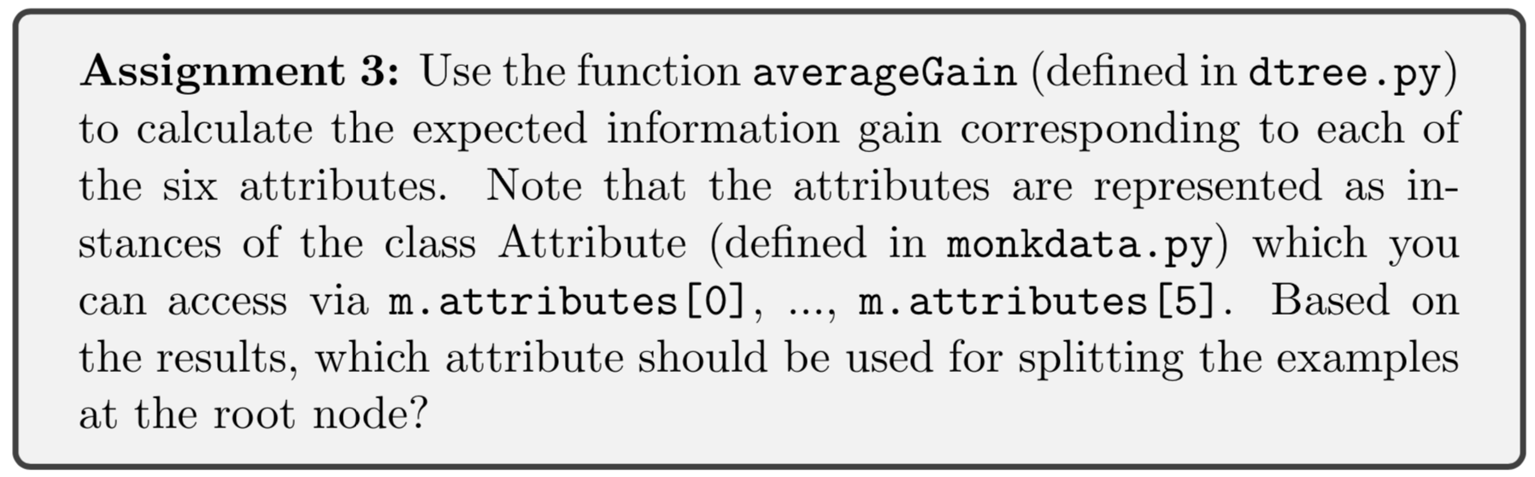
Lab 1 Decision Tree
Dataset | a1 | a2 | a3 | a4 | a5 | a6
MONK-1 | 0.07527256 | 0.00583843 | 0.00470757 | 0.0263117 | 0.28703075 | 0.00075786
MONK-2 | 0.00375618 | 0.0024585 | 0.00105615 | 0.01566425 | 0.01727718 | 0.00624762
MONK-3 | 0.00712087 | 0.29373617 | 0.00083111 | 0.00289182 | 0.25591172 | 0.00707703
Notes:
Assignment 3 :[[0.07527256 0.00583843 0.00470757 0.0263117 0.28703075 0.00075786] [0.00375618 0.0024585 0.00105615 0.01566425 0.01727718 0.00624762] [0.00712087 0.29373617 0.00083111 0.00289182 0.25591172 0.00707703]]best attributes:A5A5A2

Slide 6
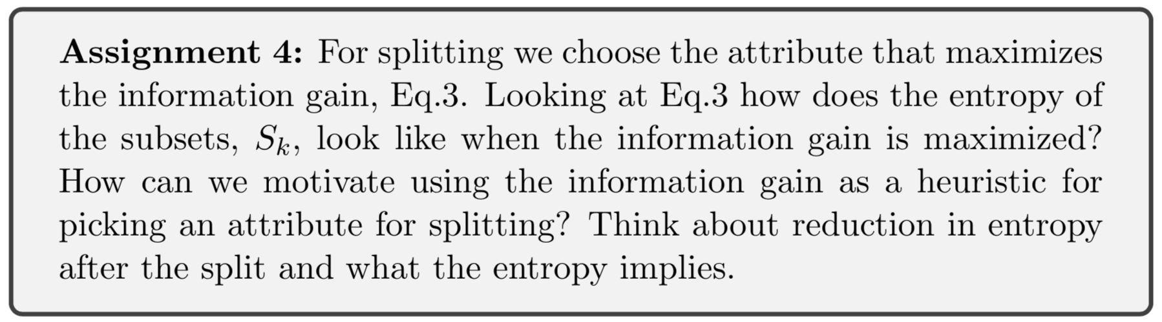
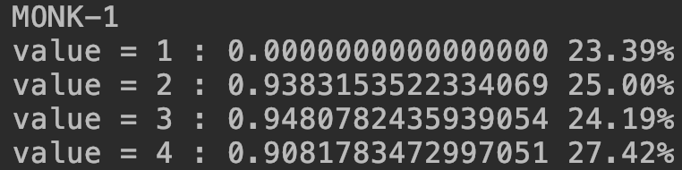
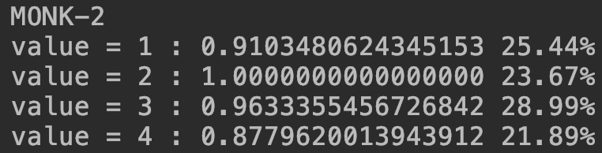
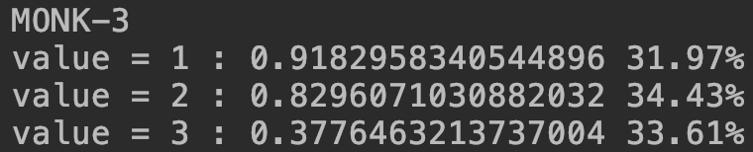
Lab 1 Decision Tree

Slide 7
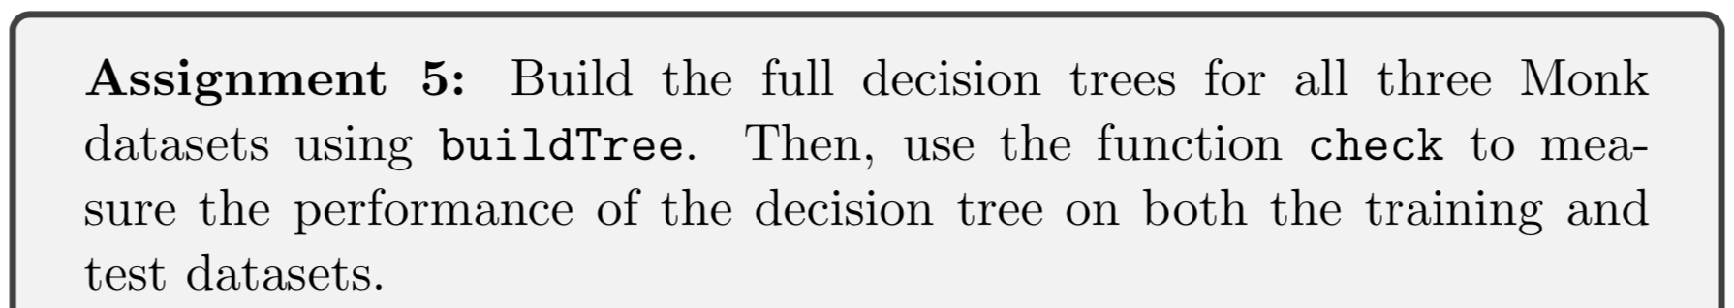
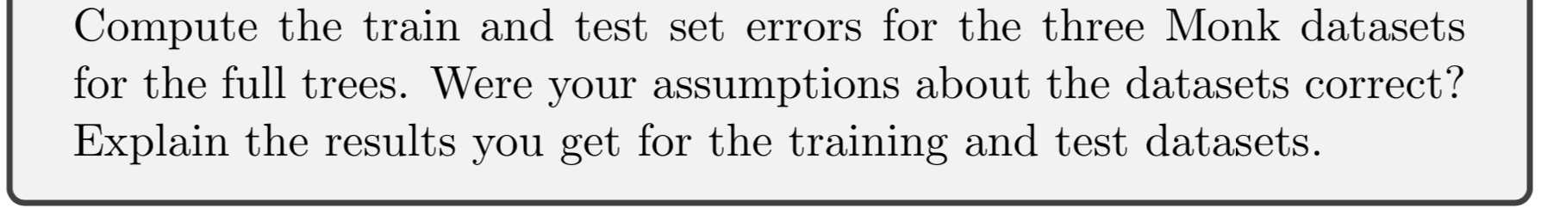
Lab 1 Decision Tree
Dataset | E_train | E_test
MONK-1 | 0 | 0.1712962962962963
MONK-2 | 0 | 0.3078703703703703
MONK-3 | 0 | 0.0555555555555556

Slide 8
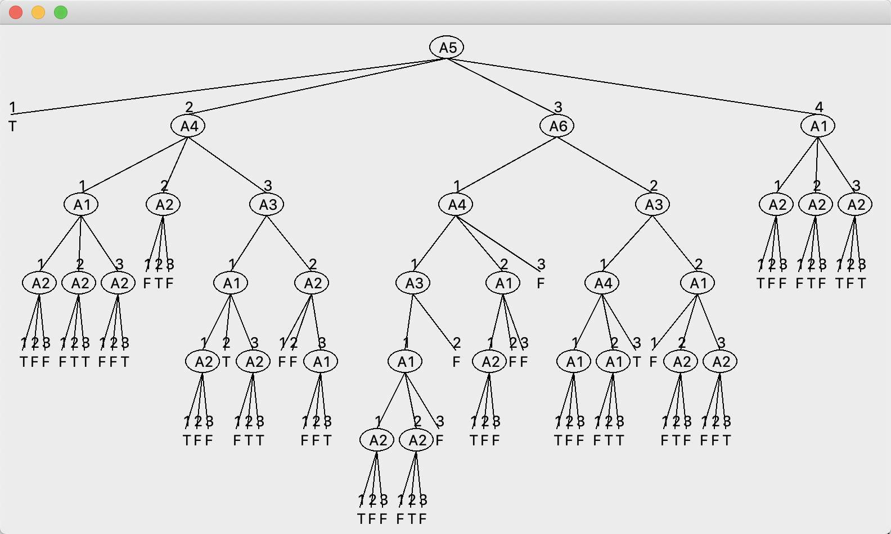
Lab 1 Decision Tree
Tree for Monk-1

Slide 9
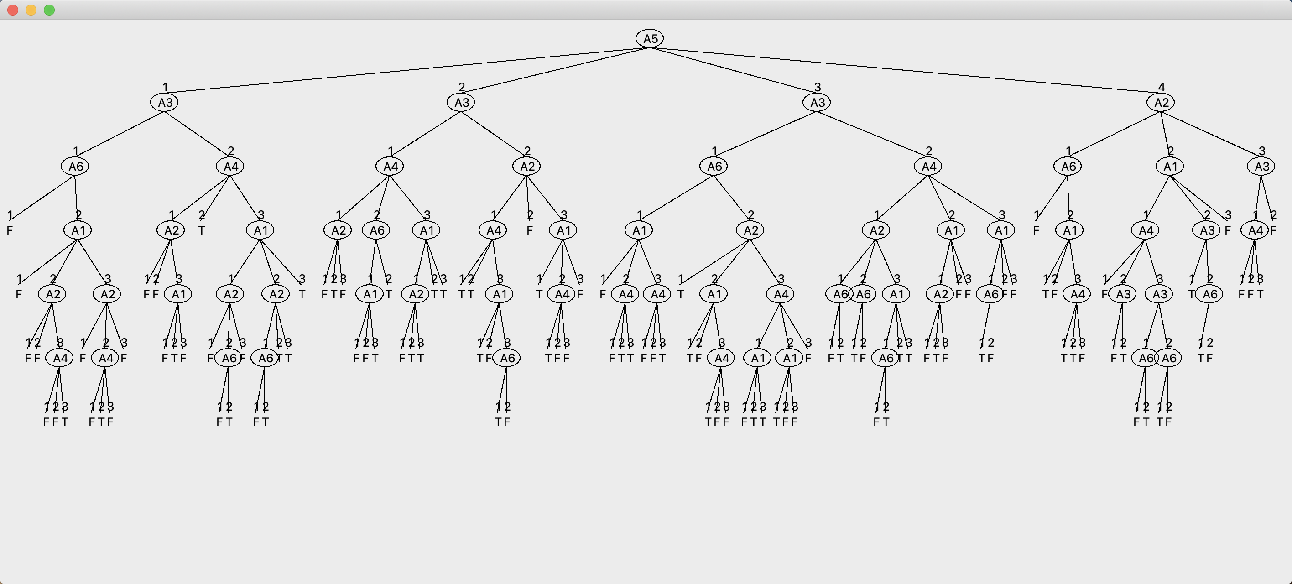
Lab 1 Decision Tree
Tree for Monk-2

Slide 10
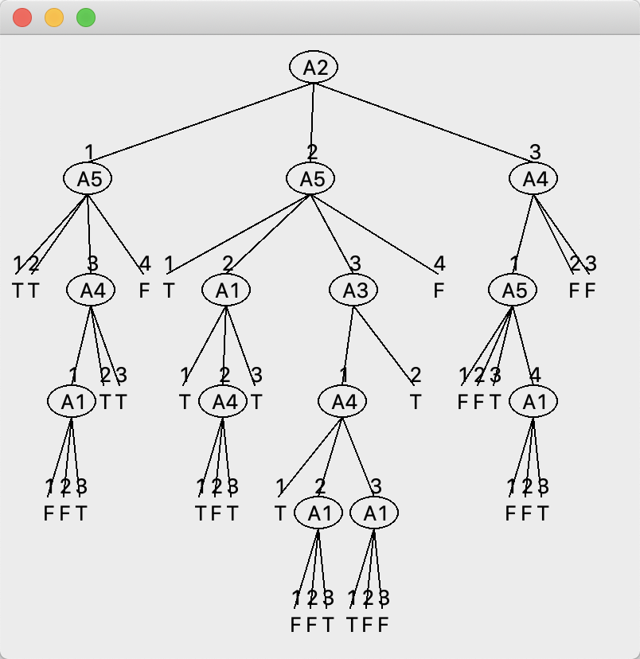
Lab 1 Decision Tree
Tree for Monk-3

Slide 11
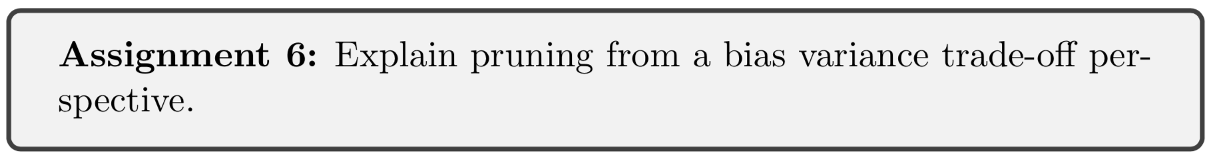
Lab 1 Decision Tree
Error Rate Before and After Pruning (For one try)
Dataset | Train(after) | Validation(before/after) | Test(before/after)
MONK-1 | 0.2432432432432432 | 0.2800000000000000 \0.1400000000000000 | 0.2800000000000000 \0.2222222222222222
MONK-2 | 0.3960396039603961 | 0.5441176470588236 \0.3529411764705882 | 0.5441176470588236 \0.3287037037037037
MONK-3 | 0.0273972602739726 | 0.1428571428571429 \0.1224489795918368 | 0.1428571428571429 \0.1203703703703703

Slide 12
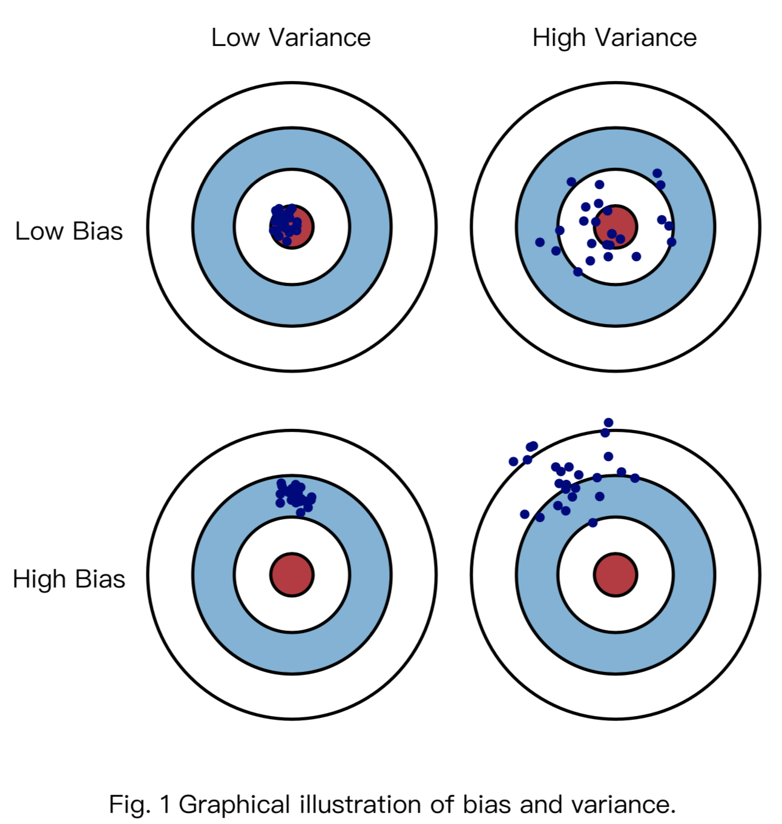
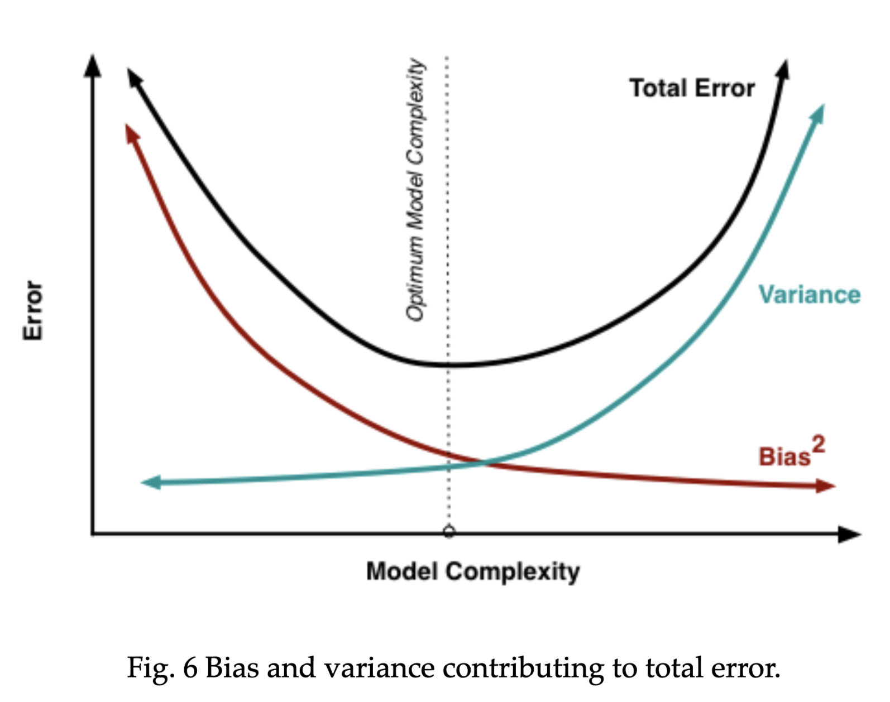
Lab 1 Decision Tree
(figure source: http://scott.fortmann-roe.com/docs/BiasVariance.html)

Slide 13
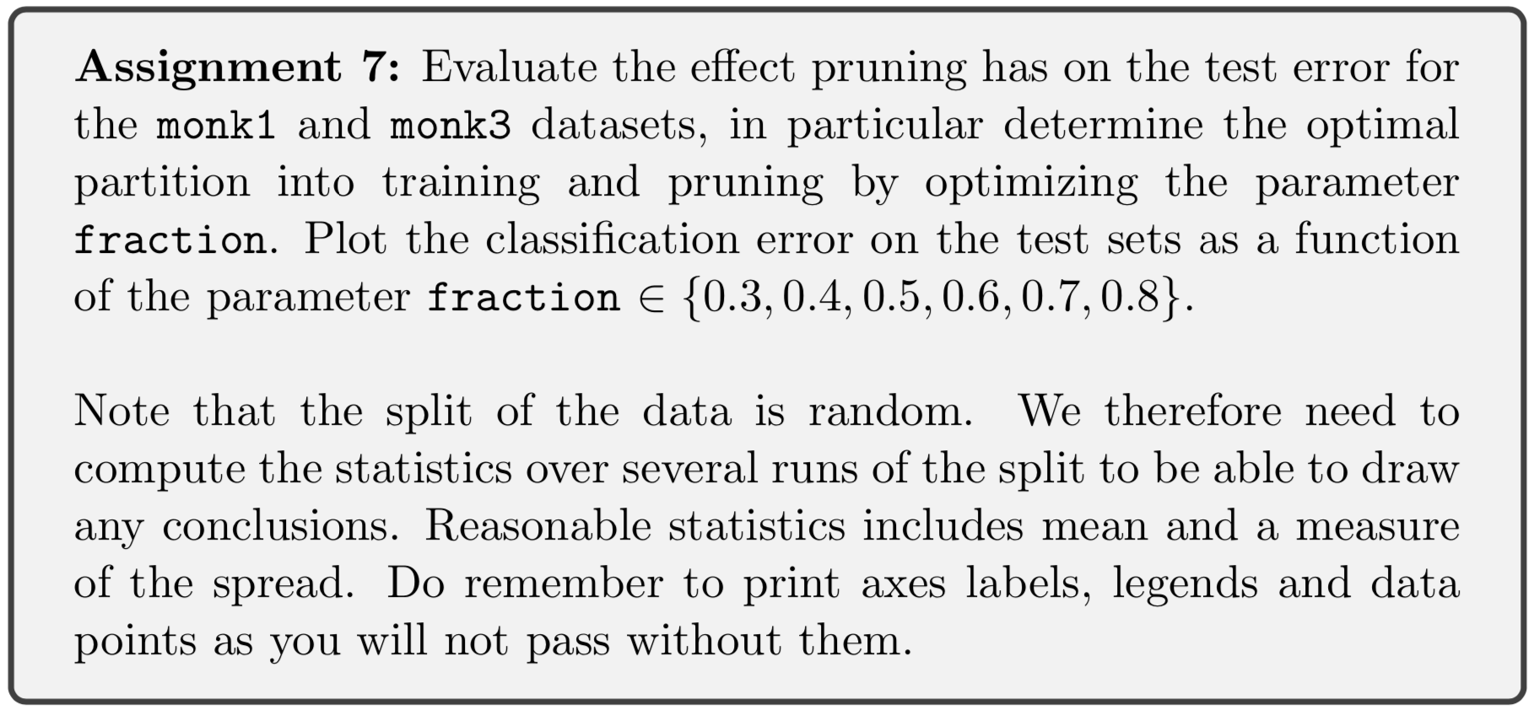
Lab 1 Decision Tree

Slide 14
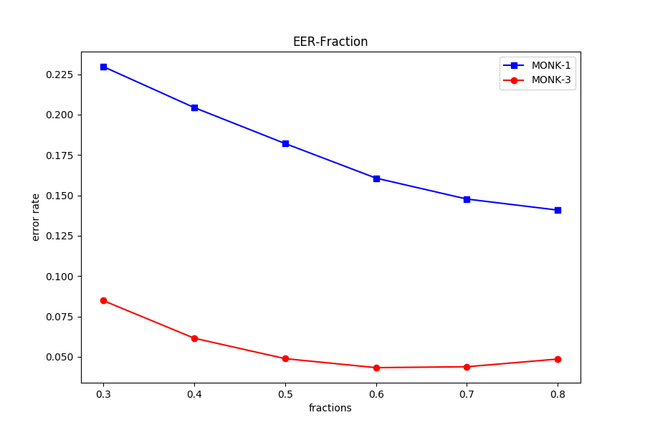
Lab 1 Decision Tree
N=1000 and use the average
Notes:
MONK-1:[0.22966666666666766, 0.20432175925925977, 0.18207175925925945, 0.16065509259259253, 0.14768750000000003, 0.1408541666666667]
MONK-3:[0.08478935185185184, 0.06153009259259309, 0.04887962962962988, 0.04329629629629651, 0.04385648148148173, 0.04862037037037069]

Slide 15
Lab 1 Decision Tree
Thanks!

