Slide 1
Machine Learning Lab 2 presentation
Zelin Zhang
Lingxaio Wang

Slide 2
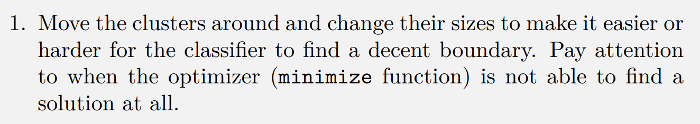
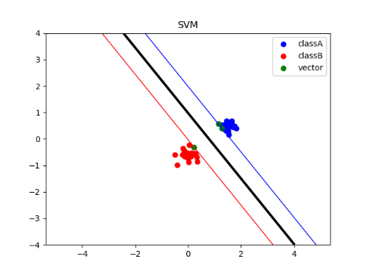
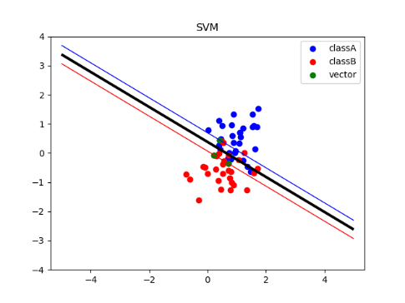
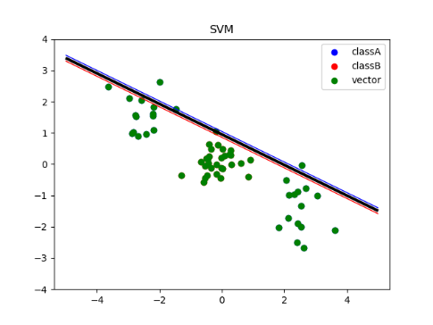
Lab 2 Support Vector Machine

Slide 3
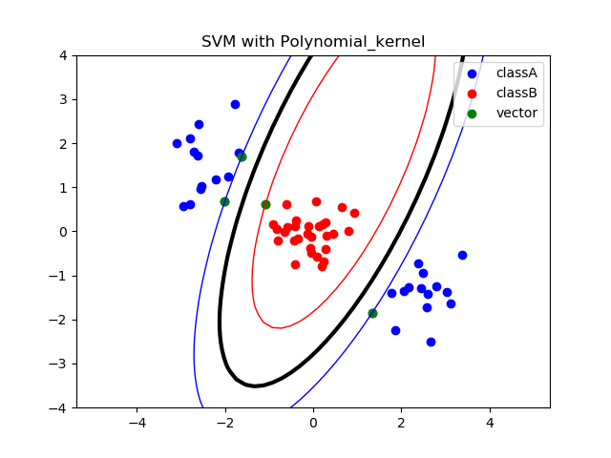
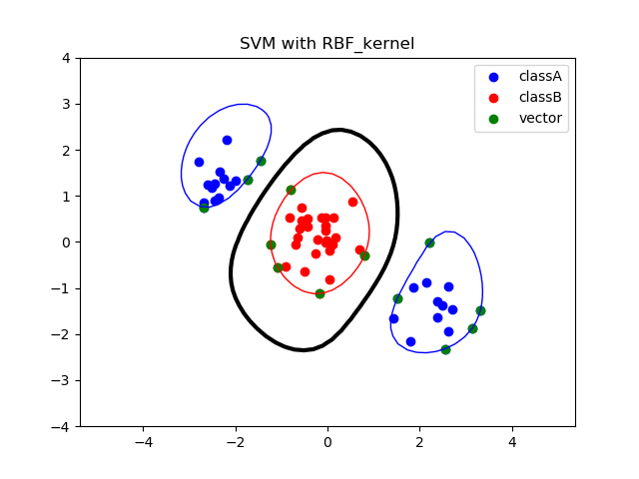
Lab 2 Support Vector Machine
Notes:
Assignment 1 :Entropy of MONK-1 1.0Entropy of MONK-2 0.957117428264771Entropy of MONK-3 0.9998061328047111

Slide 4
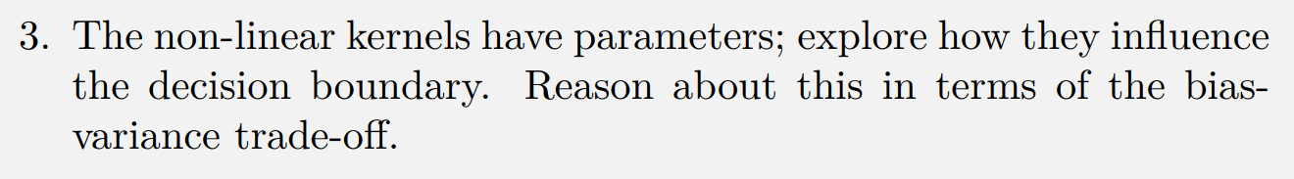
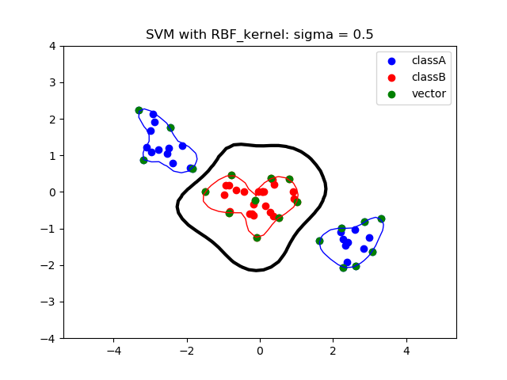
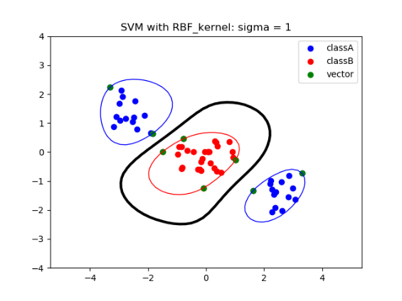
Lab 2 Support Vector Machine
Notes:
Assignment 2 :Bernoulli distribution q & 1-q

Slide 5
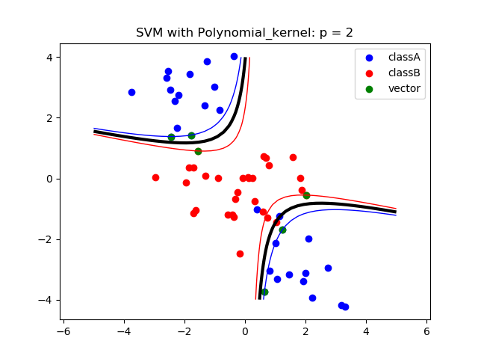
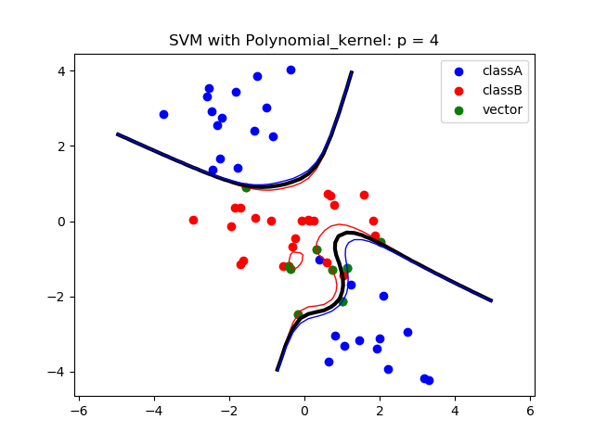
Lab 2 Support Vector Machine
Notes:
Assignment 2 :Bernoulli distribution q & 1-q

Slide 6
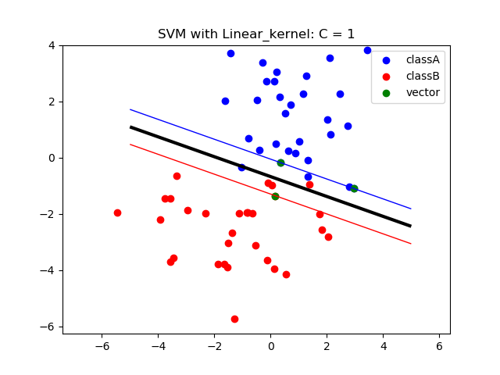
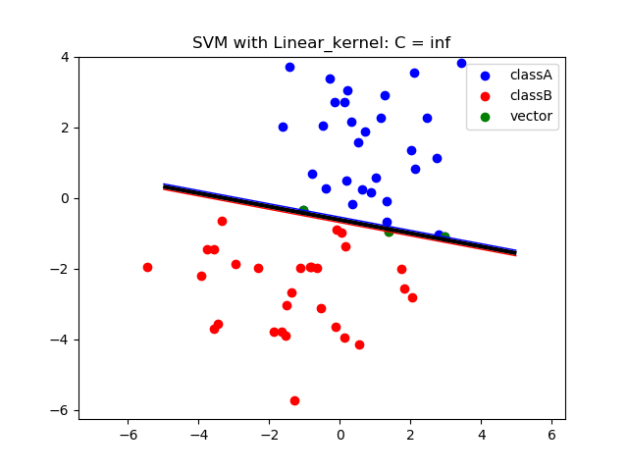
Lab 2 Support Vector Machine
Notes:
Assignment 3 :[[0.07527256 0.00583843 0.00470757 0.0263117 0.28703075 0.00075786] [0.00375618 0.0024585 0.00105615 0.01566425 0.01727718 0.00624762] [0.00712087 0.29373617 0.00083111 0.00289182 0.25591172 0.00707703]]best attributes:A5A5A2

Slide 7
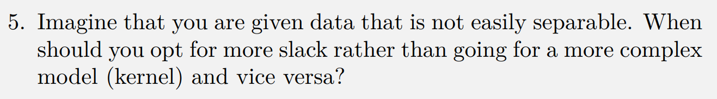
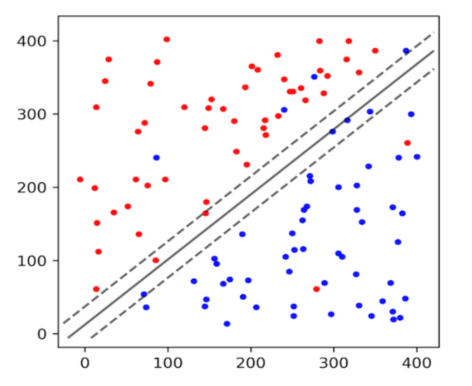
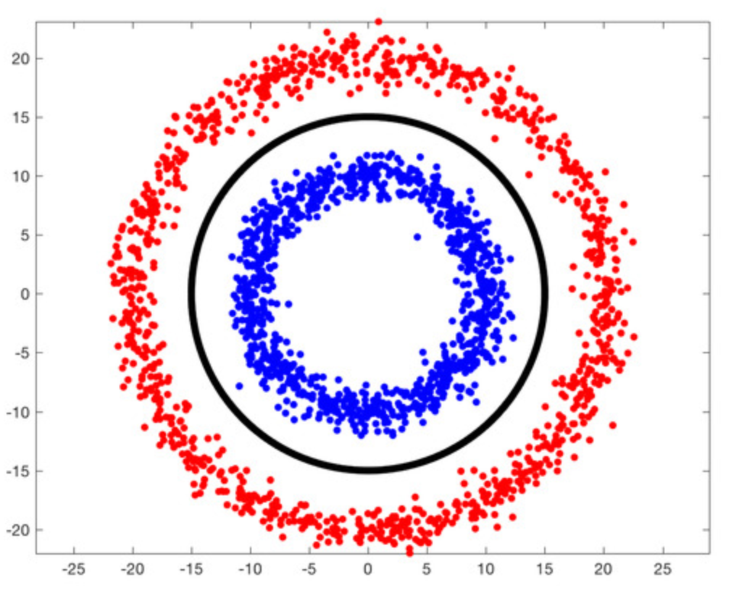
Lab 2 Support Vector Machine

