Slide 1
Project: New York Philharmonic Performance History Dashboard
Publicly accessible interactive dashboard
Recommendations to the New York Philharmonic
What composers should be represented on a program to keep attendance high?
How can the orchestra effectively incorporate works by underrepresented minority composers?
Has the historical grouping of different composers on a program had an affect on programming at the present time?
Given a set of repertoire, how successful will the season be?
Focuses:
Cultural significance
Clear visualization

Slide 2

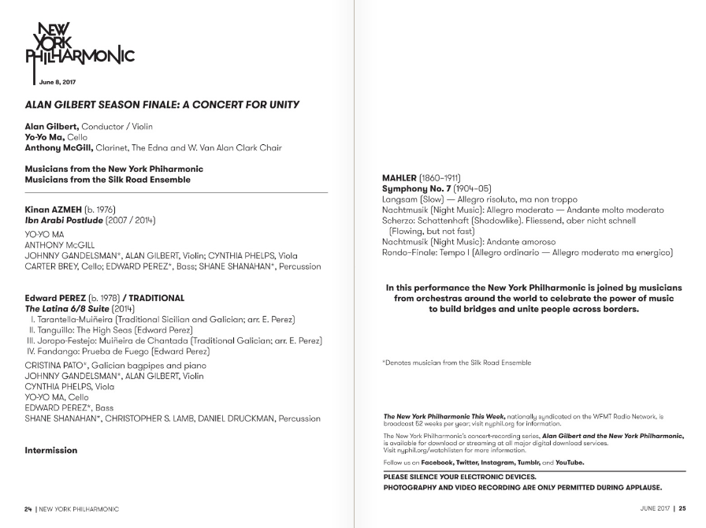

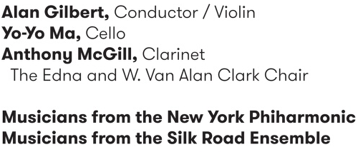
NY Philharmonic Performance History Archive
https://github.com/nyphilarchive/PerformanceHistory
https://archives.nyphil.org/performancehistory/
Sample program from a concert I attended:
Time & Date
Venue
Conductor
&
Soloists
Works performed
(+ composer
+ movements)
https://archives.nyphil.org/index.php/artifact/ff781c1c-6bce-461f-915b-0499603fbaff-0.1?search-type=singleFilter&search-text=13932&doctype=program

Slide 3
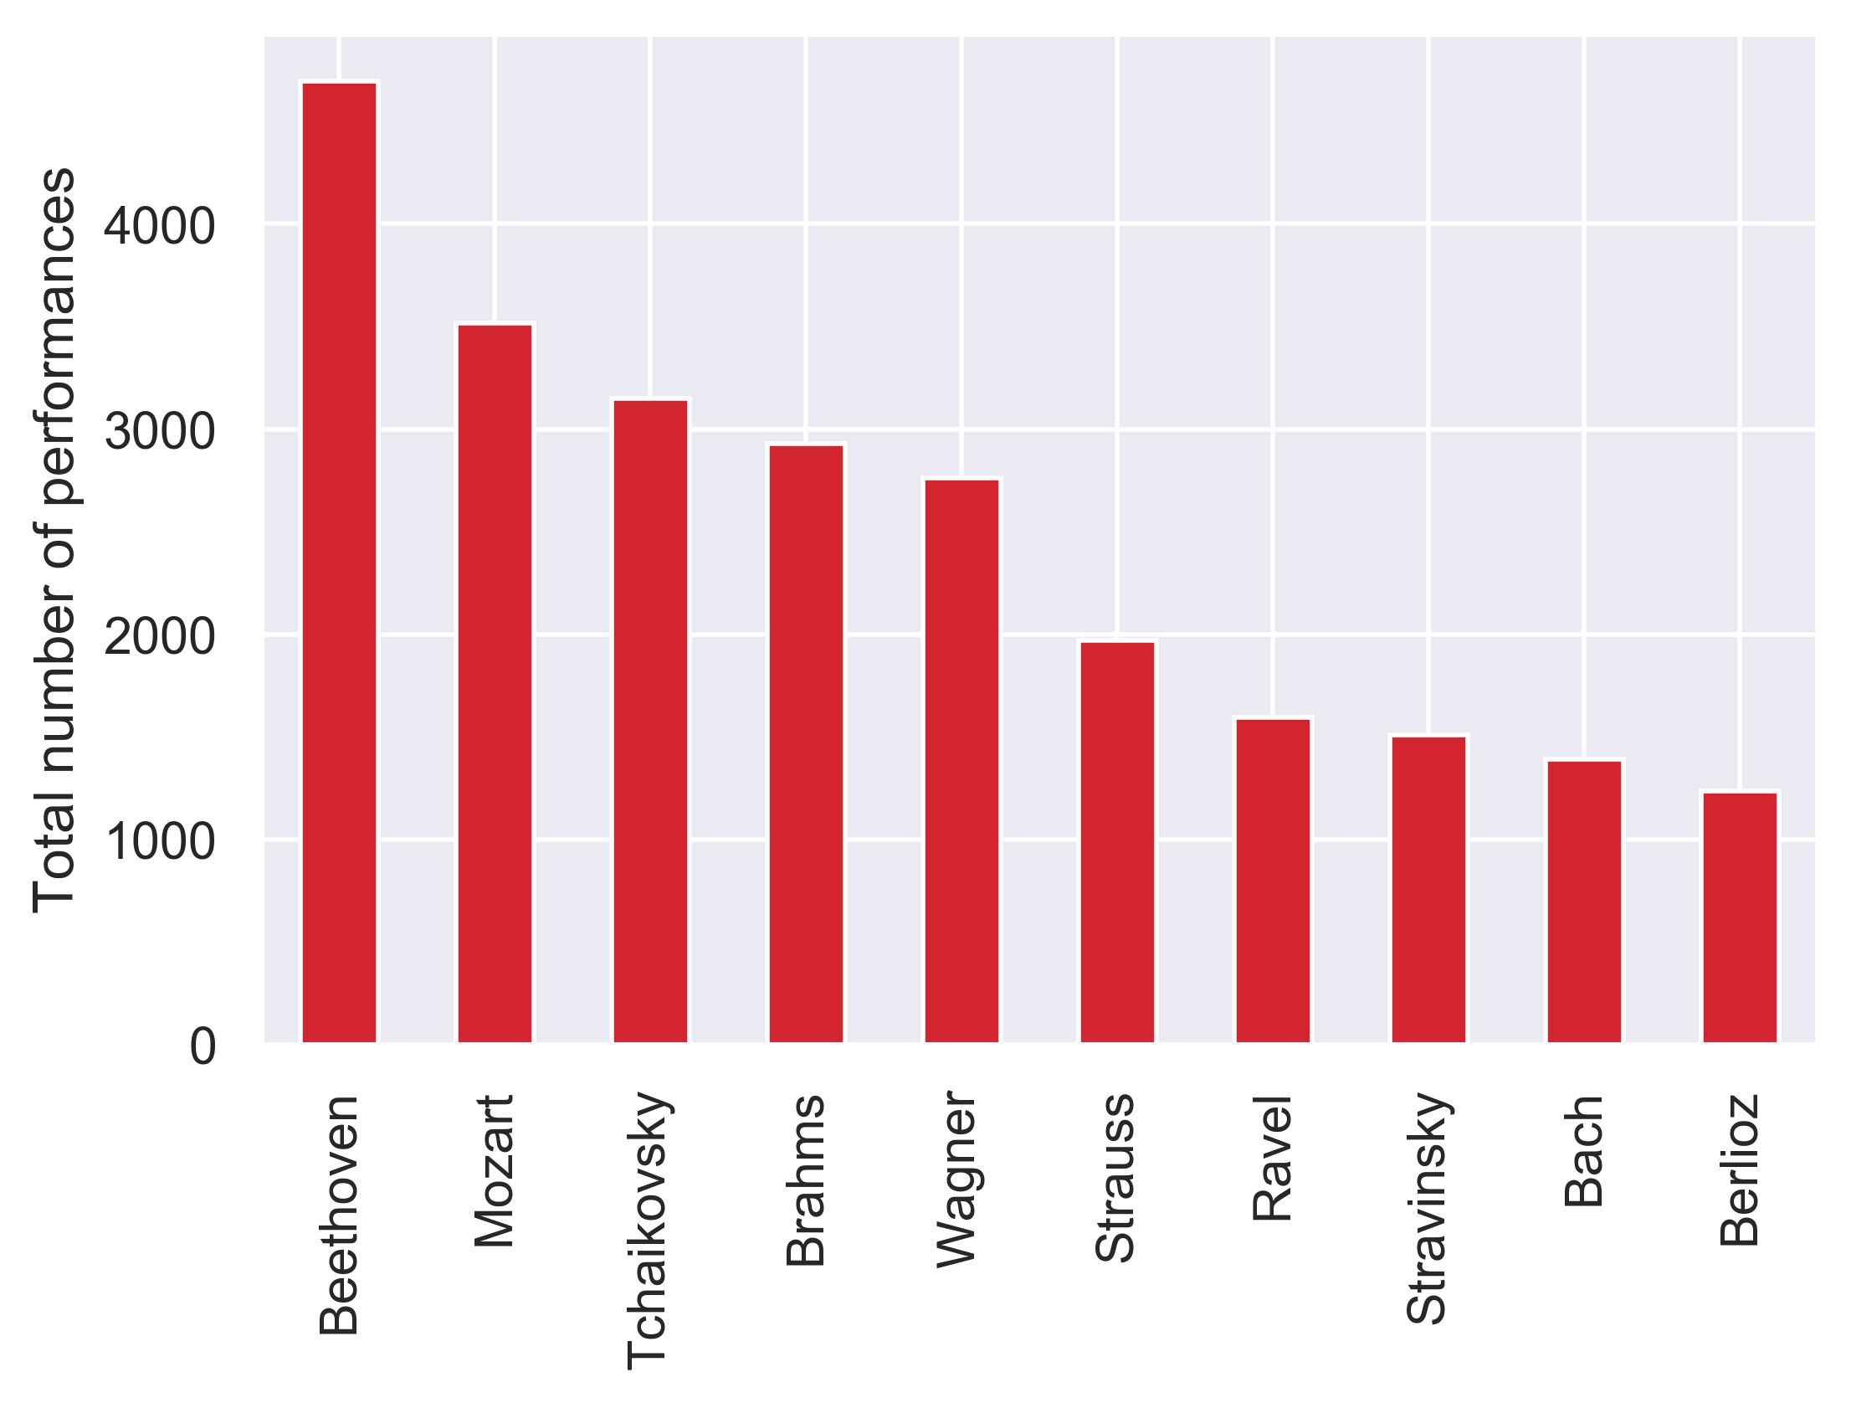
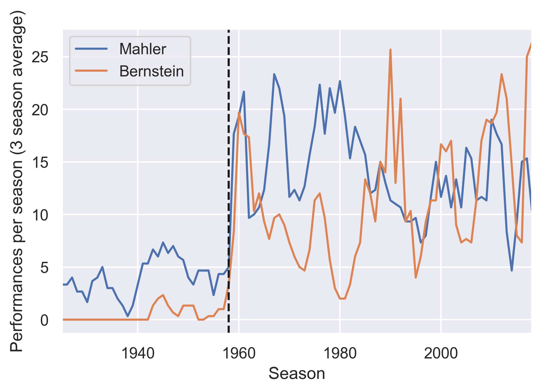
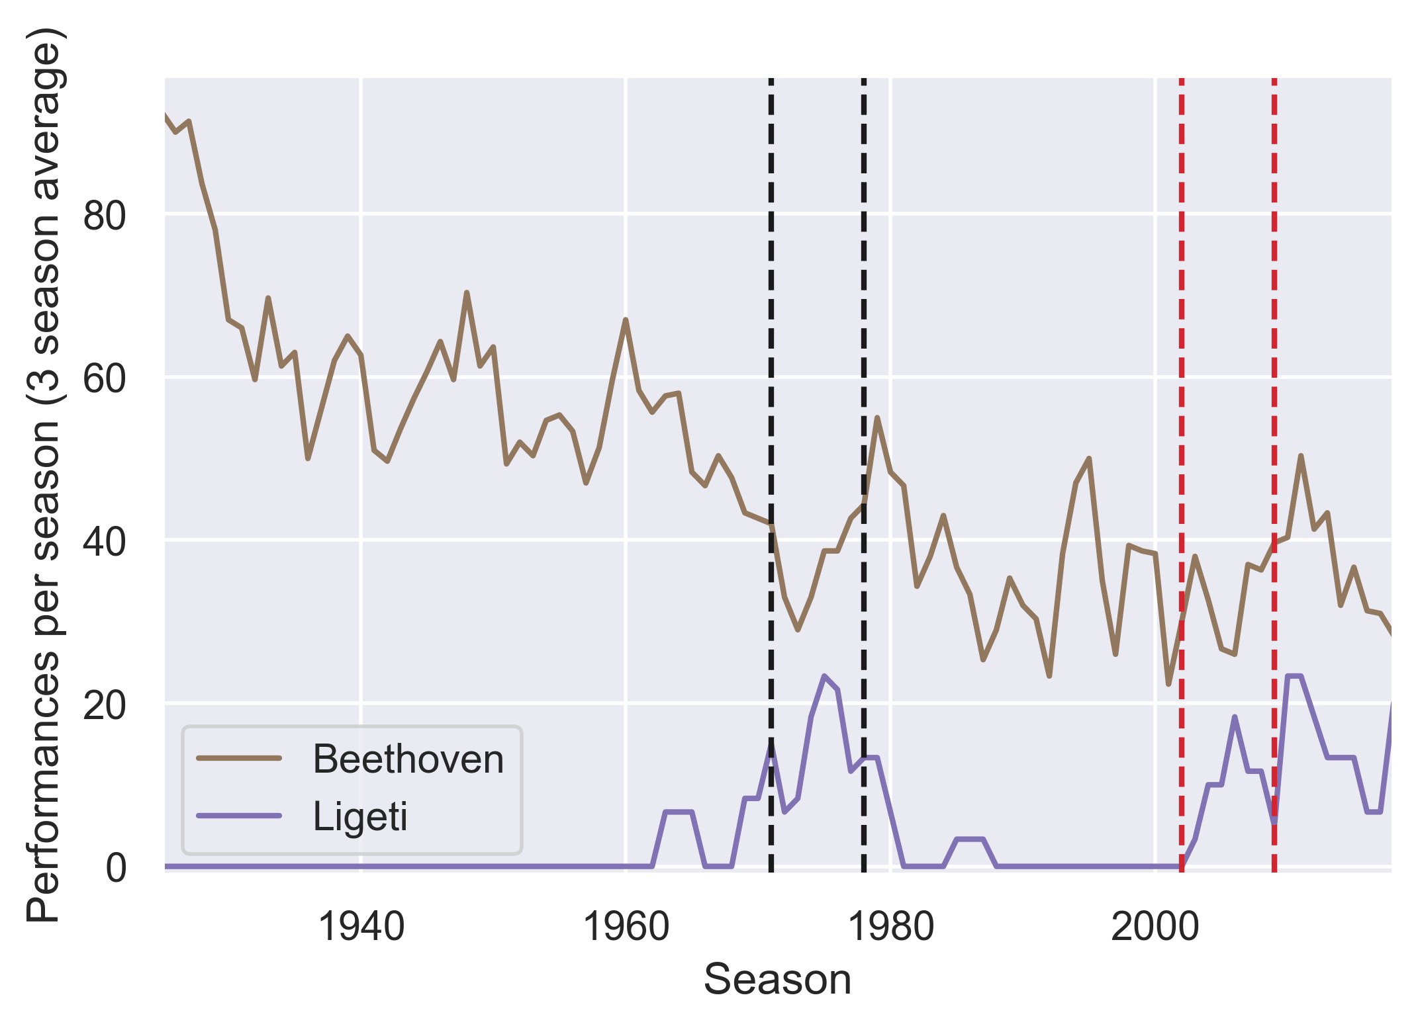
Most often performed composers:
Bernstein popularized the works of Mahler… alongside his own
Relationships between conductors and repertoire choices
Conductor:
Boulez
Maazel
1958: Leonard Bernstein becomes Music Director
Most frequently performed composers from minority groups
Deceased white men
 | Composer | Overall ranking | Number of performances
Hispanic | Manuel de Falla | 40 | 395
Black | Duke Ellington | 83 | 103
Female | Sofia Gubaidulina | 183 | 35
Notes:
Depends on what the user is interested in: a certain conductor, composer, or work

Slide 4
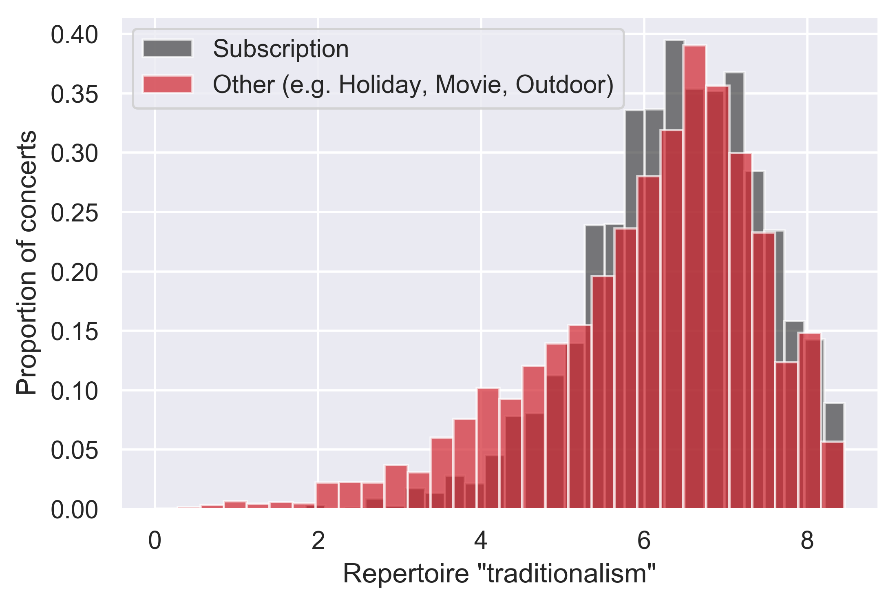
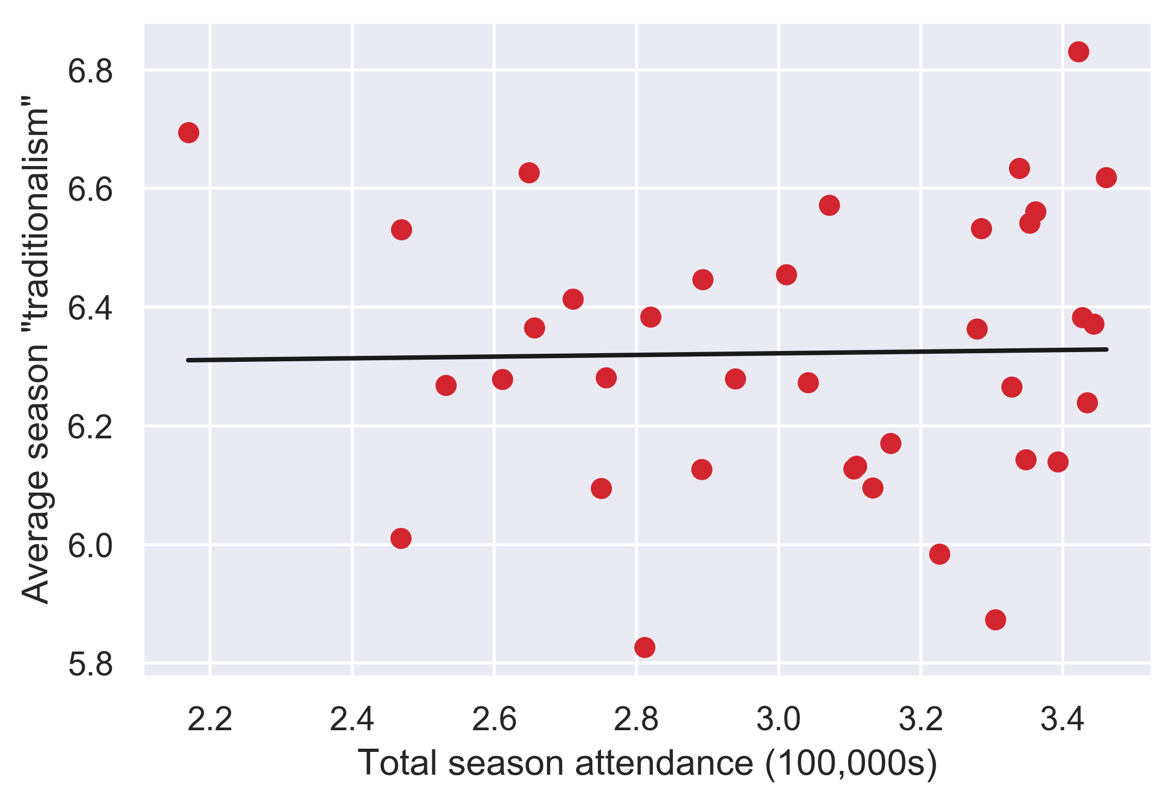
Can the orchestra program more adventurous repertoire?
Repertoire “traditionalism”: the average “popularity” of composers represented on a program
“Popularity” of a composer defined as log(total number of performances)
“Highly traditional” programs more likely to contain works by Beethoven, less likely to contain works by Duke Ellington
Subscription concerts are more uniformly “traditional”
Across entire seasons, “traditionalism” is not correlated with high attendance
r² = 4.2 × 10⁻⁴
p = 0.9
Attendance data from: https://nyphil.org/~/media/pdfs/publications/2018-annual-report-v2.pdf

