Slide 1
Project: New York Philharmonic Performance History Dashboard
Interactive, web-based visualization of the history of each piece of music performed by the NY Phil
Audience
Enthusiasts
Discover rare works and composers
Historians & Musicologists
Identify relationships between pieces of music over time
New York Philharmonic
Current members can better understand their role in the history of the orchestra
Significance
Publicity
Encourages interaction from the public
Business
Help the NY Phil plan diverse repertoire likely to achieve high concert attendance
Culture
Reveals and quantifies underrepresentation of minority composers
1

Slide 2

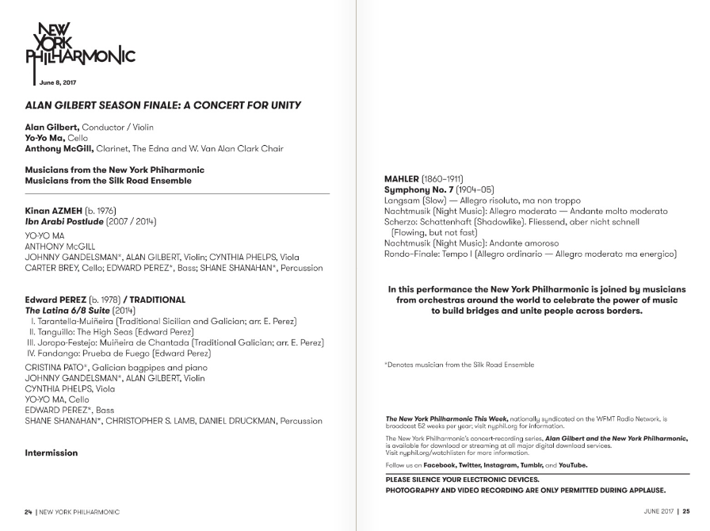

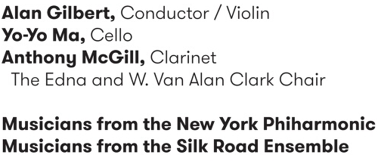
NY Philharmonic Performance History Archive
https://github.com/nyphilarchive/PerformanceHistory
https://archives.nyphil.org/performancehistory/
Sample program from a concert I attended:
Time & Date
Venue
Conductor
&
Soloists
Works performed
(+ composer
+ movements)
https://archives.nyphil.org/index.php/artifact/ff781c1c-6bce-461f-915b-0499603fbaff-0.1?search-type=singleFilter&search-text=13932&doctype=program
2

Slide 3
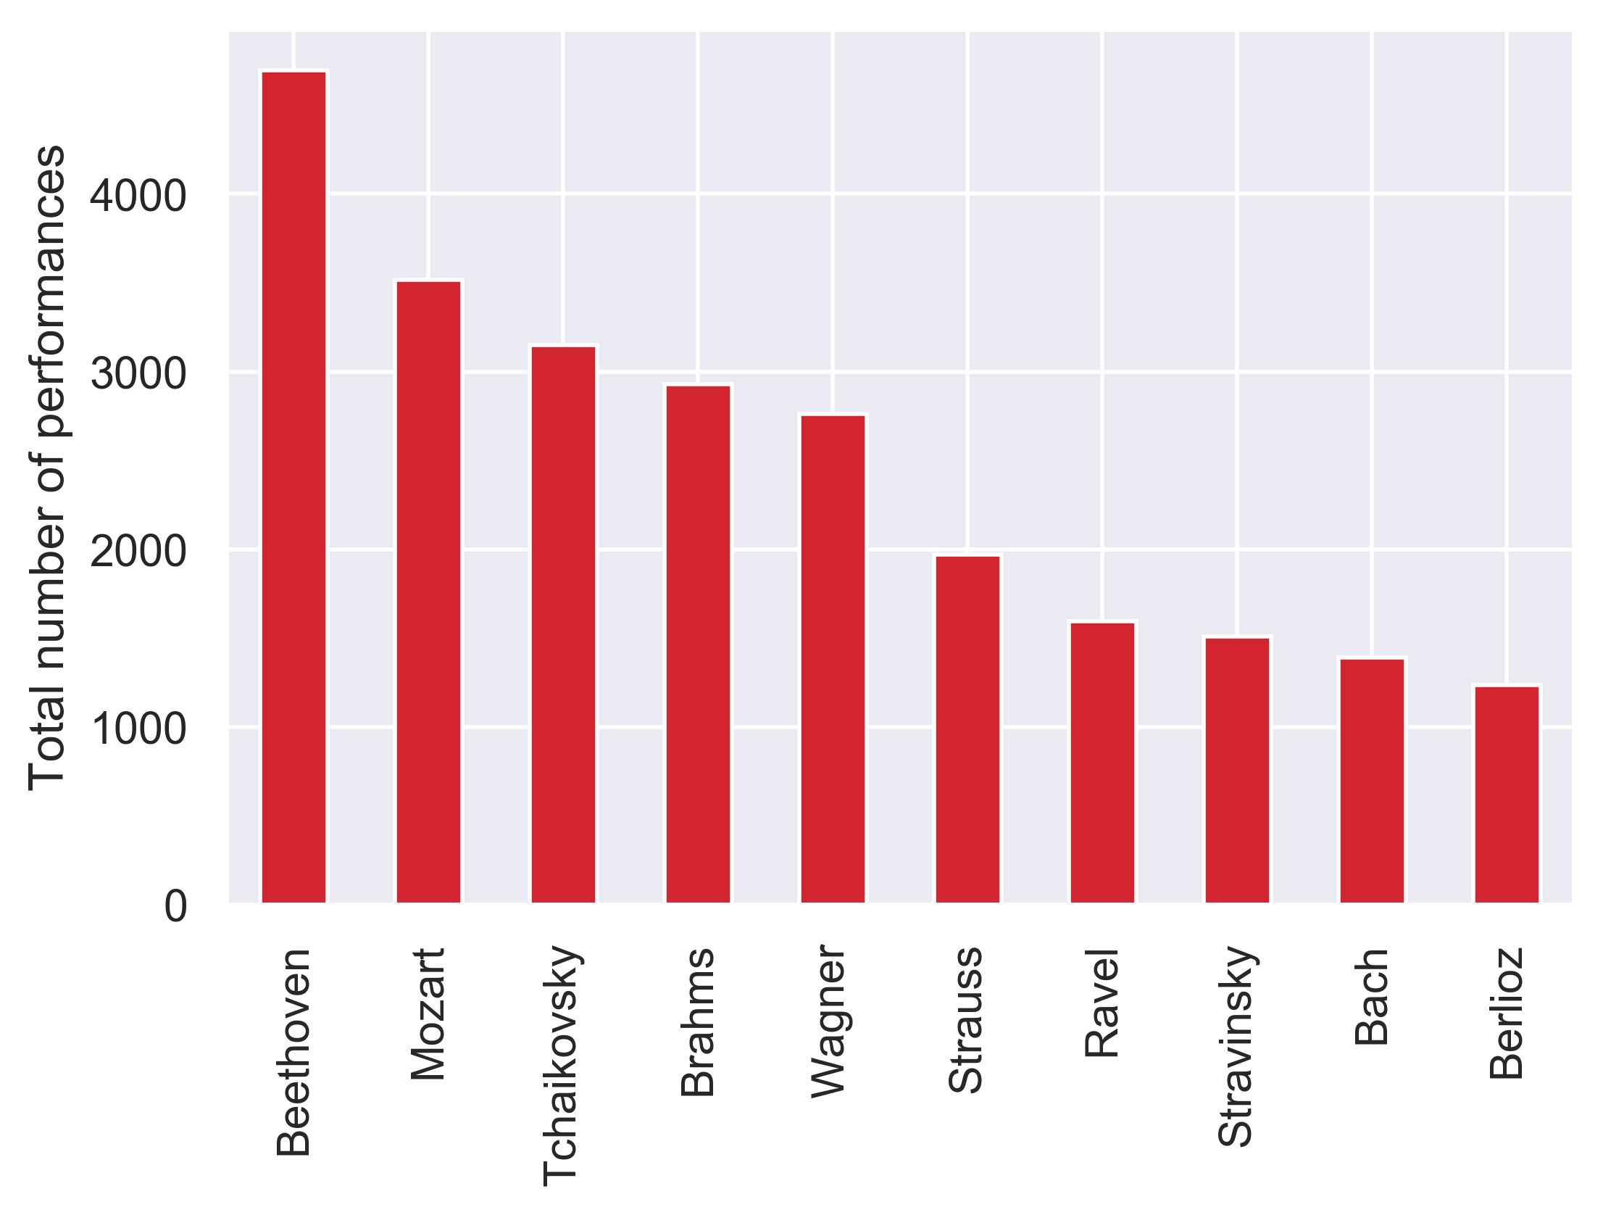
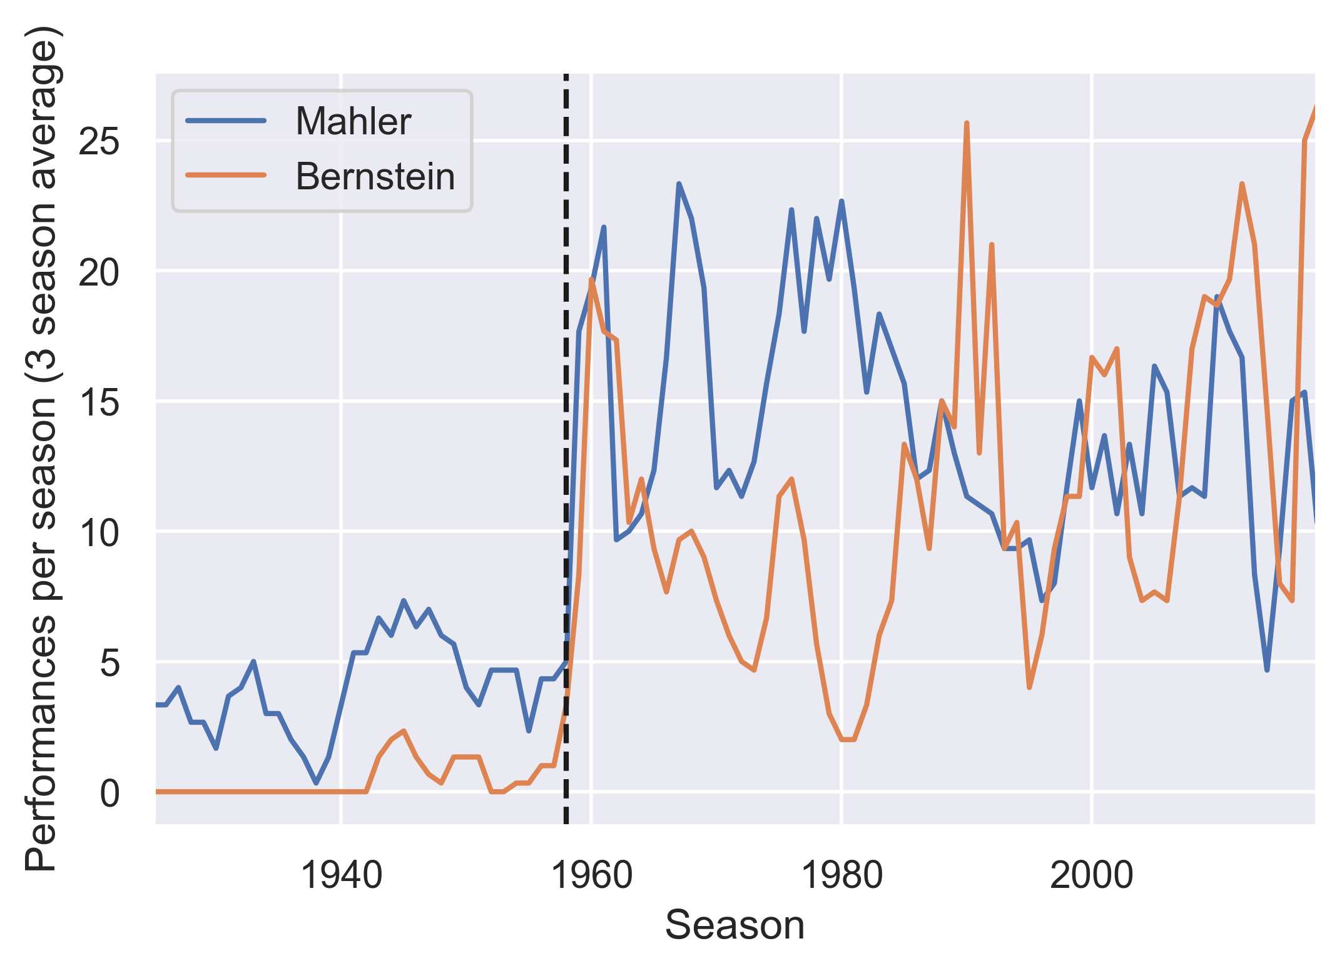
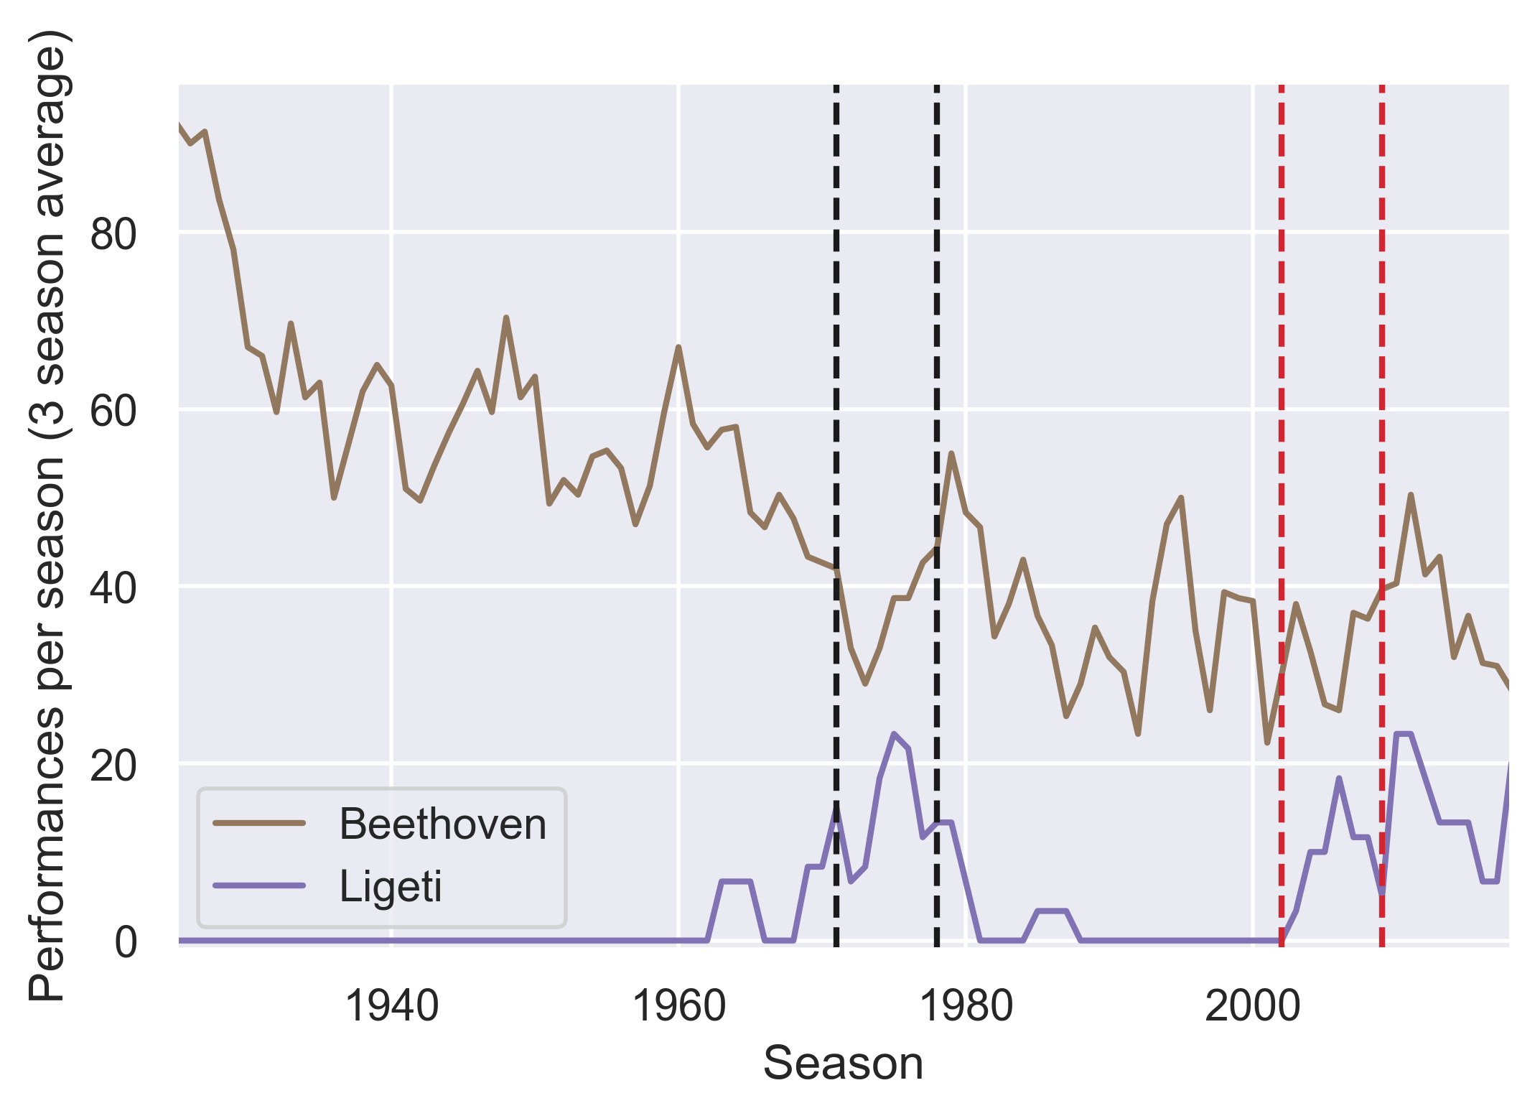
Most often performed composers:
Bernstein popularized the works of Mahler… alongside his own
Relationships between conductors and repertoire choices
Conductor:
Boulez
Maazel
1958: Leonard Bernstein becomes Music Director
Most frequently performed minority composers
Deceased white men
 | Composer | Overall ranking | Number of performances
Hispanic | Manuel de Falla | 40 | 395
Black | Duke Ellington | 83 | 103
Female | Sofia Gubaidulina | 183 | 35
3
Notes:
Depends on what the user is interested in: a certain conductor, composer, or work

Slide 4
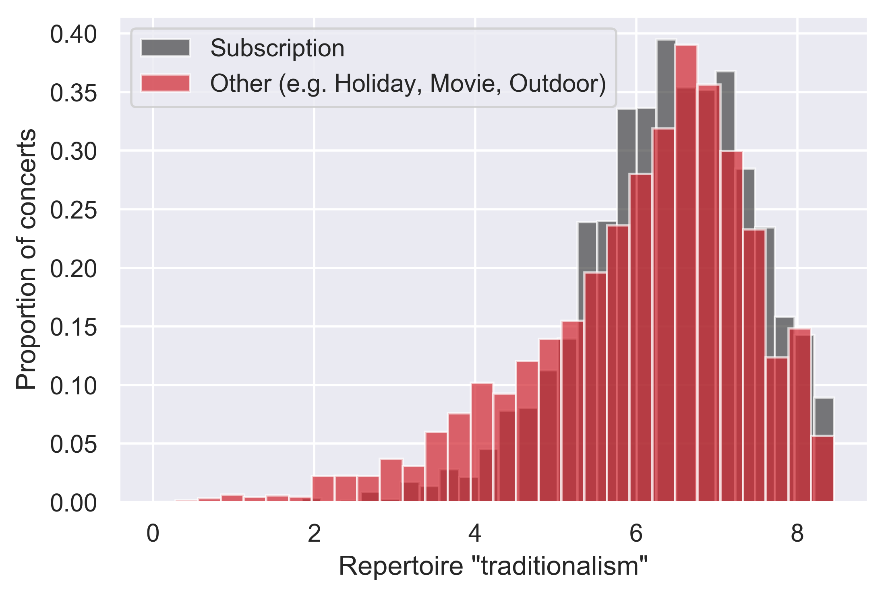
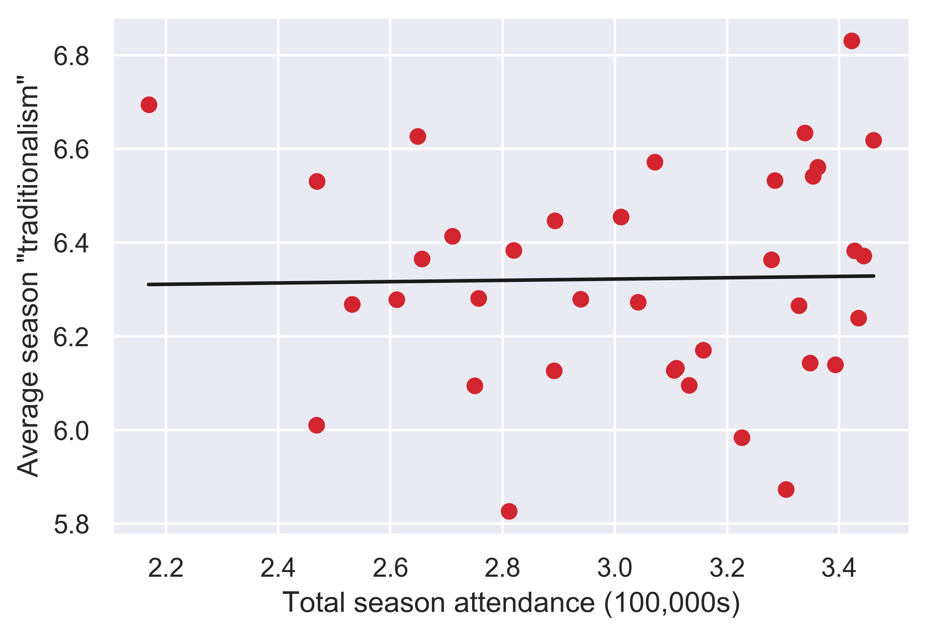
Can the orchestra program more adventurous repertoire?
Repertoire “traditionalism”: the average “popularity” of composers represented on a program
“Popularity” of a composer defined as log(total number of performances)
“Highly traditional” programs more likely to contain works by Beethoven, less likely to contain works by Duke Ellington
Subscription concerts are more uniformly “traditional”
Across entire seasons, “traditionalism” is not correlated with high attendance
r² = 4.2 × 10⁻⁴
p = 0.9
Attendance data from: https://nyphil.org/~/media/pdfs/publications/2018-annual-report-v2.pdf
4

