Slide 1


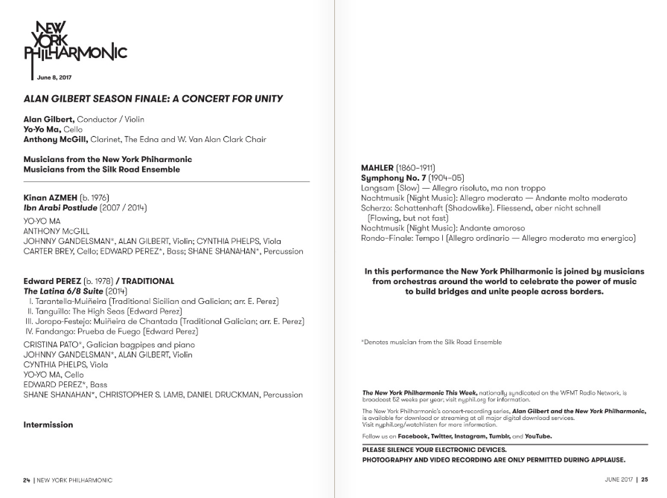
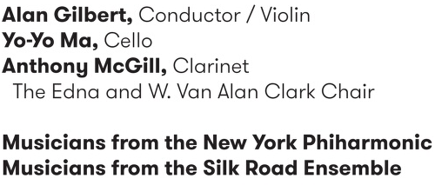
New York Philharmonic Performance History Dashboard
Interactive, web-based visualization of the history of each piece of music performed by the NY Phil
Time & Date
Venue
Significance & Audience
Publicity
Encourages interaction from the public
Business
Help the NY Phil plan diverse repertoire while maintaining high concert attendance
Culture
Helps musicologists and historians identify relationships between works over time
Reveals and quantifies representation of composers over time
Works/composers
Conductor & Soloists
https://github.com/nyphilarchive/PerformanceHistory
https://archives.nyphil.org/performancehistory/
(Season) attendance manually extracted from annual reports
1

Slide 2
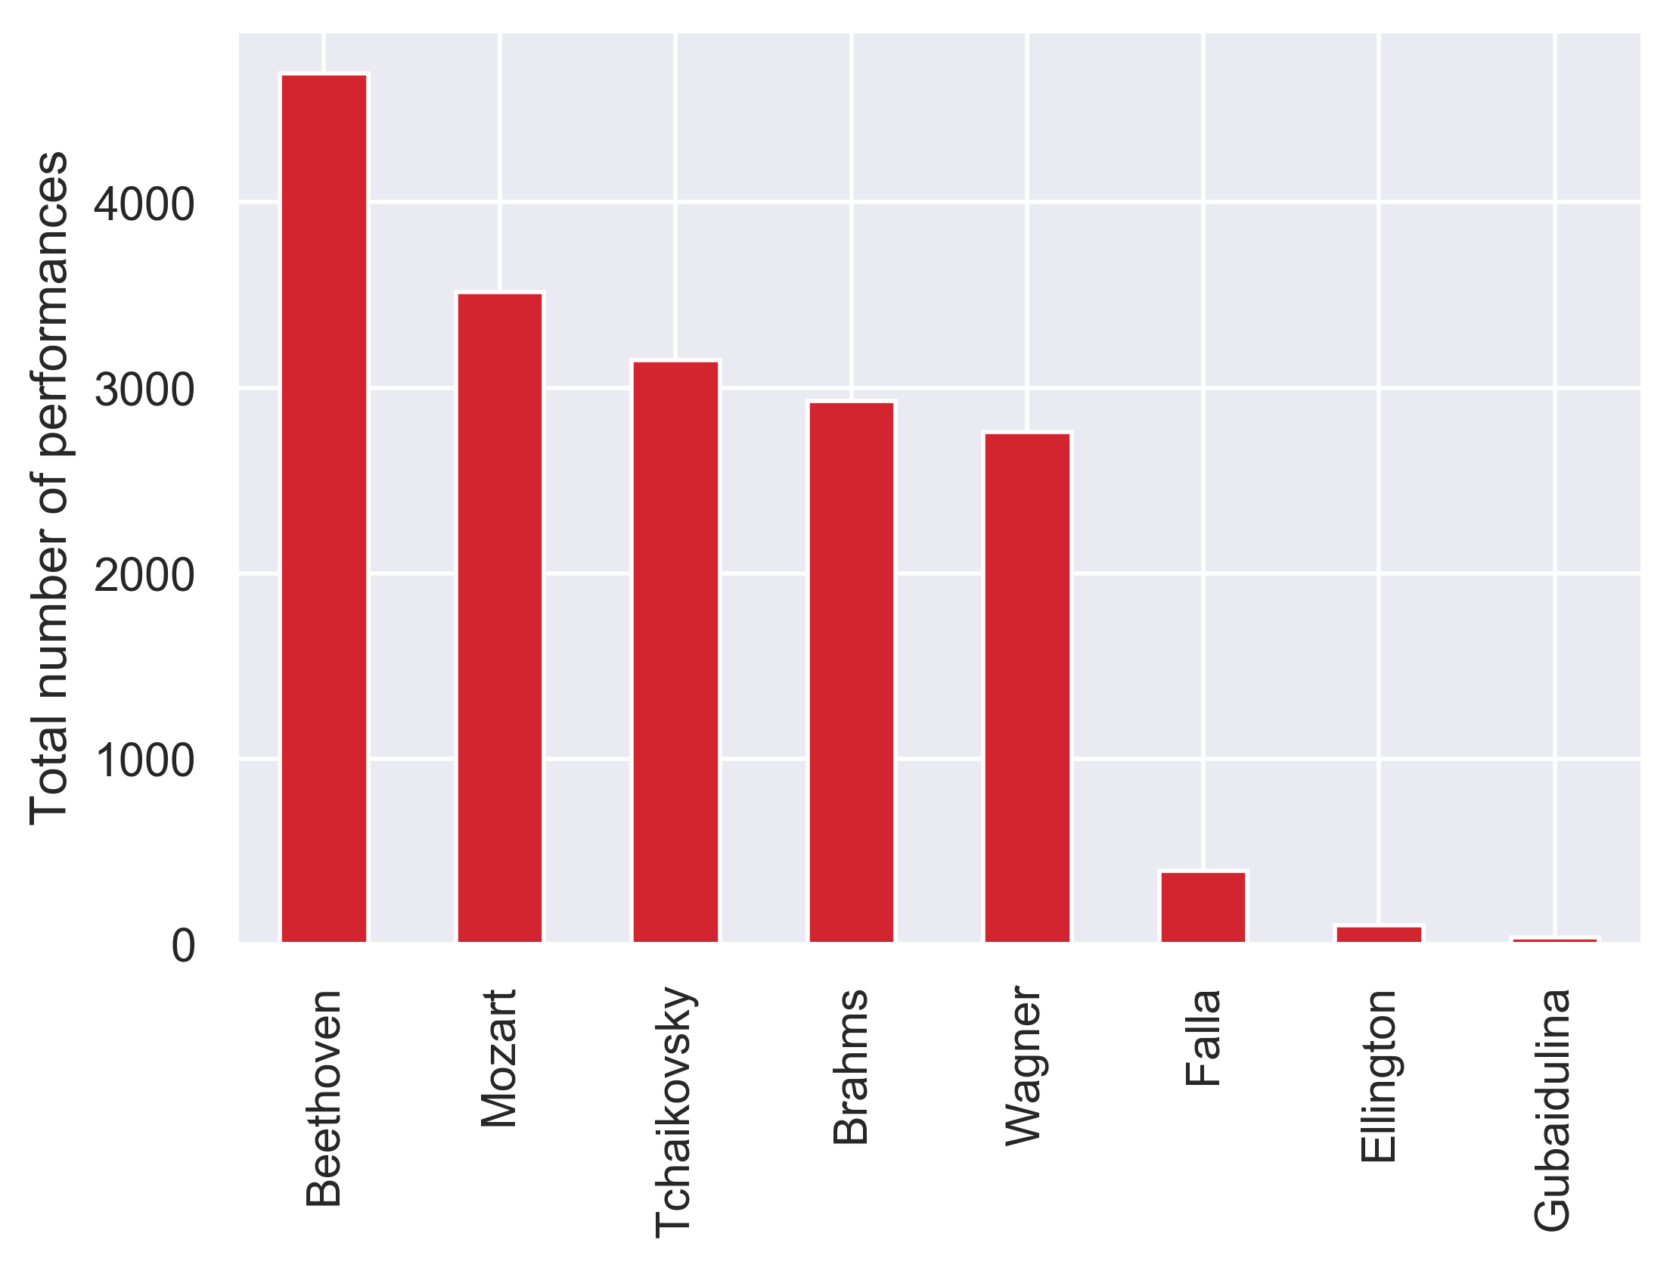
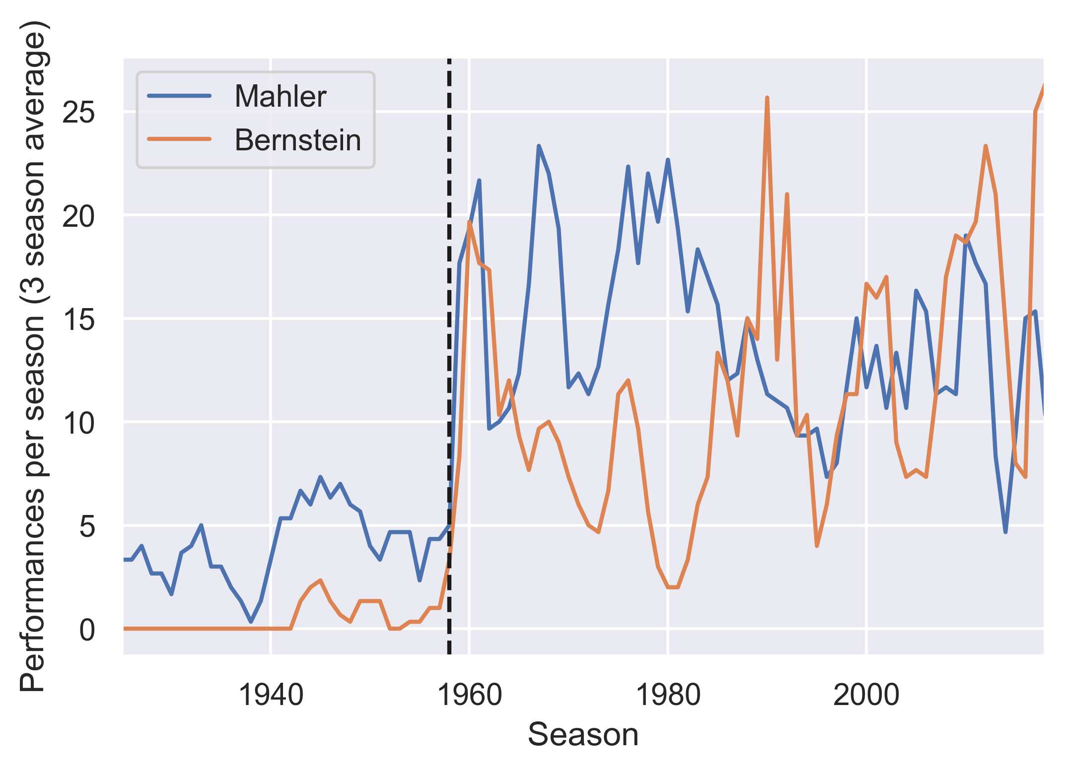
What kind of information can we obtain?
Most performed composers
Most performed minority composers
As conductor, Leonard Bernstein popularized the works of Mahler… alongside his own
Hispanic
Female
Black
1958: Leonard Bernstein becomes Music Director
2

Slide 3
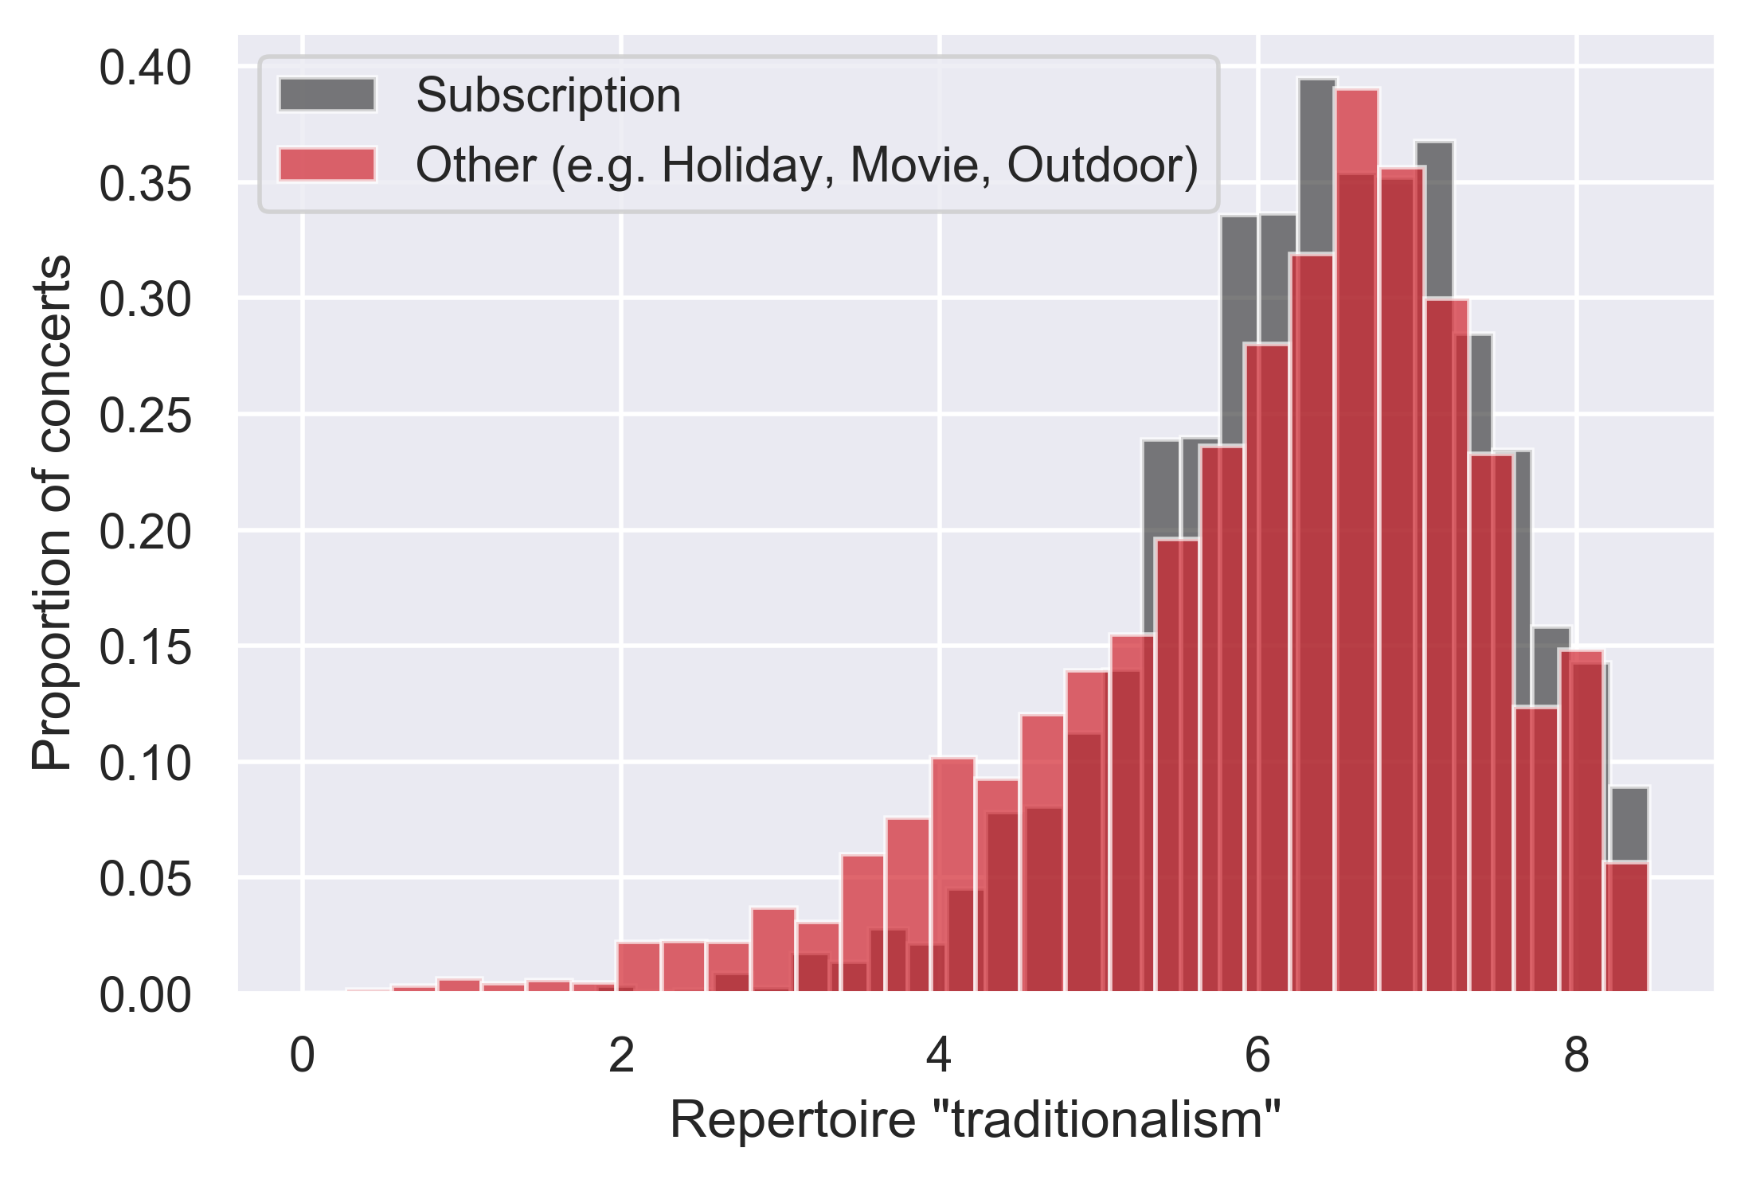
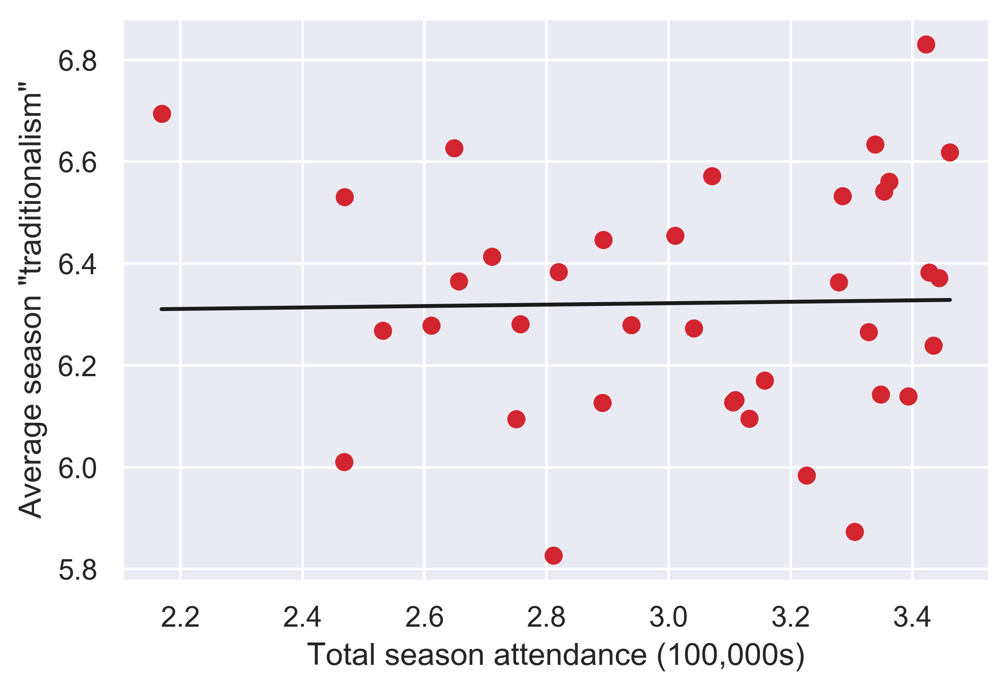
Does the orchestra need to program “safe” repertoire?
“Non-traditional” program
Ellington – Black, Brown, & Beige Suite
de Falla – El Amor Brujo
…
Define “traditionalism” metric:
Average “popularity” of composers represented on a program
“Popularity” = log(total number of performances)
“Traditional” program
Beethoven – Piano Concerto No. 4
Brahms – Symphony No. 1
…
Subscription concerts are more uniformly “traditional”
No correlation between “traditionalism” and attendance for each season
r² = 4.2 × 10⁻⁴
p = 0.9
3
Notes:
Build this dashboard – enthusiasts will find fun and interesting; the orchestra will find useful

