Slide 1
Project: New York Philharmonic Performance History Dashboard
Publicly accessible interactive dashboard
Recommendations to the New York Philharmonic
What composers should be represented on a program to keep attendance high?
How can the orchestra effectively incorporate works by underrepresented minority composers?
Has the historical grouping of different composers on a program had an affect on programming at the present time?
Given a set of repertoire, how successful will the season be?
Focuses:
Cultural significance
Clear visualization

Slide 2

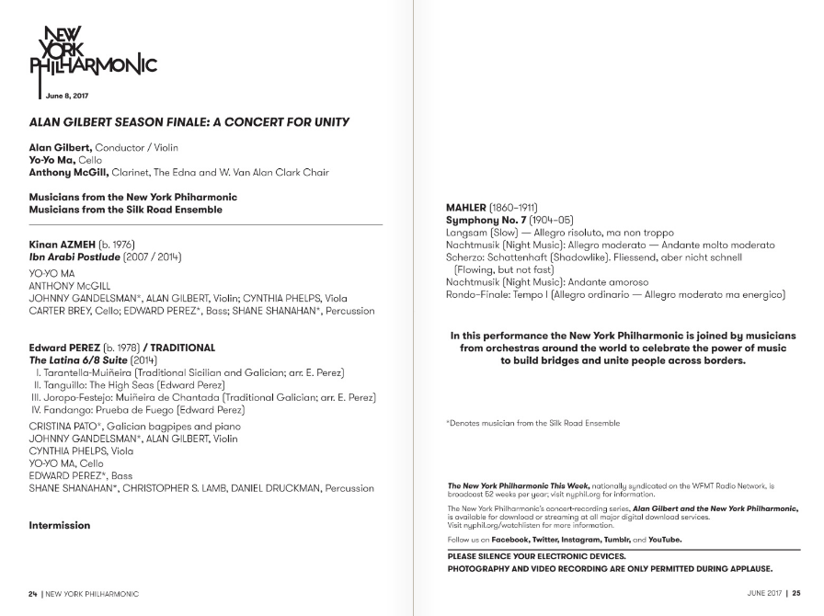

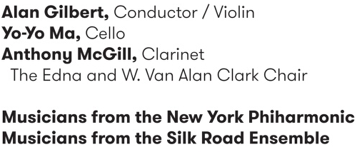
NY Philharmonic Performance History Archive
https://github.com/nyphilarchive/PerformanceHistory
https://archives.nyphil.org/performancehistory/
Sample program from a concert I attended:
Time & Date
Venue
Conductor
&
Soloists
Works performed
(+ composer
+ movements)
https://archives.nyphil.org/index.php/artifact/ff781c1c-6bce-461f-915b-0499603fbaff-0.1?search-type=singleFilter&search-text=13932&doctype=program

Slide 3
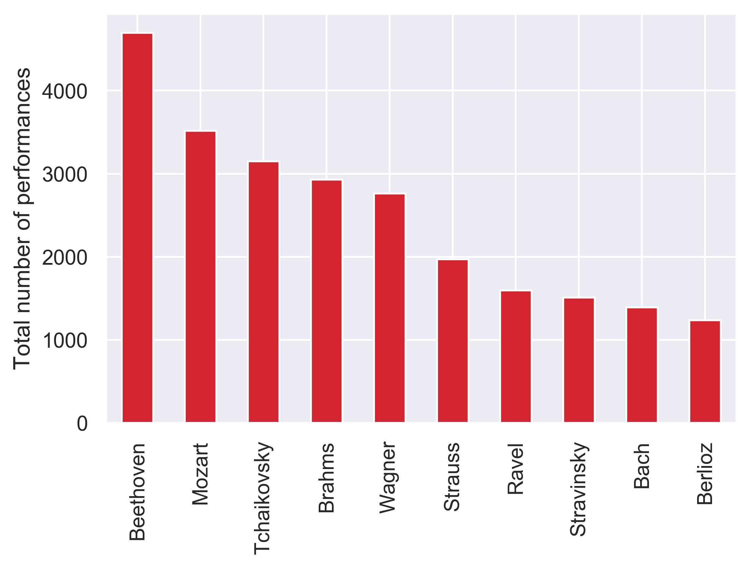
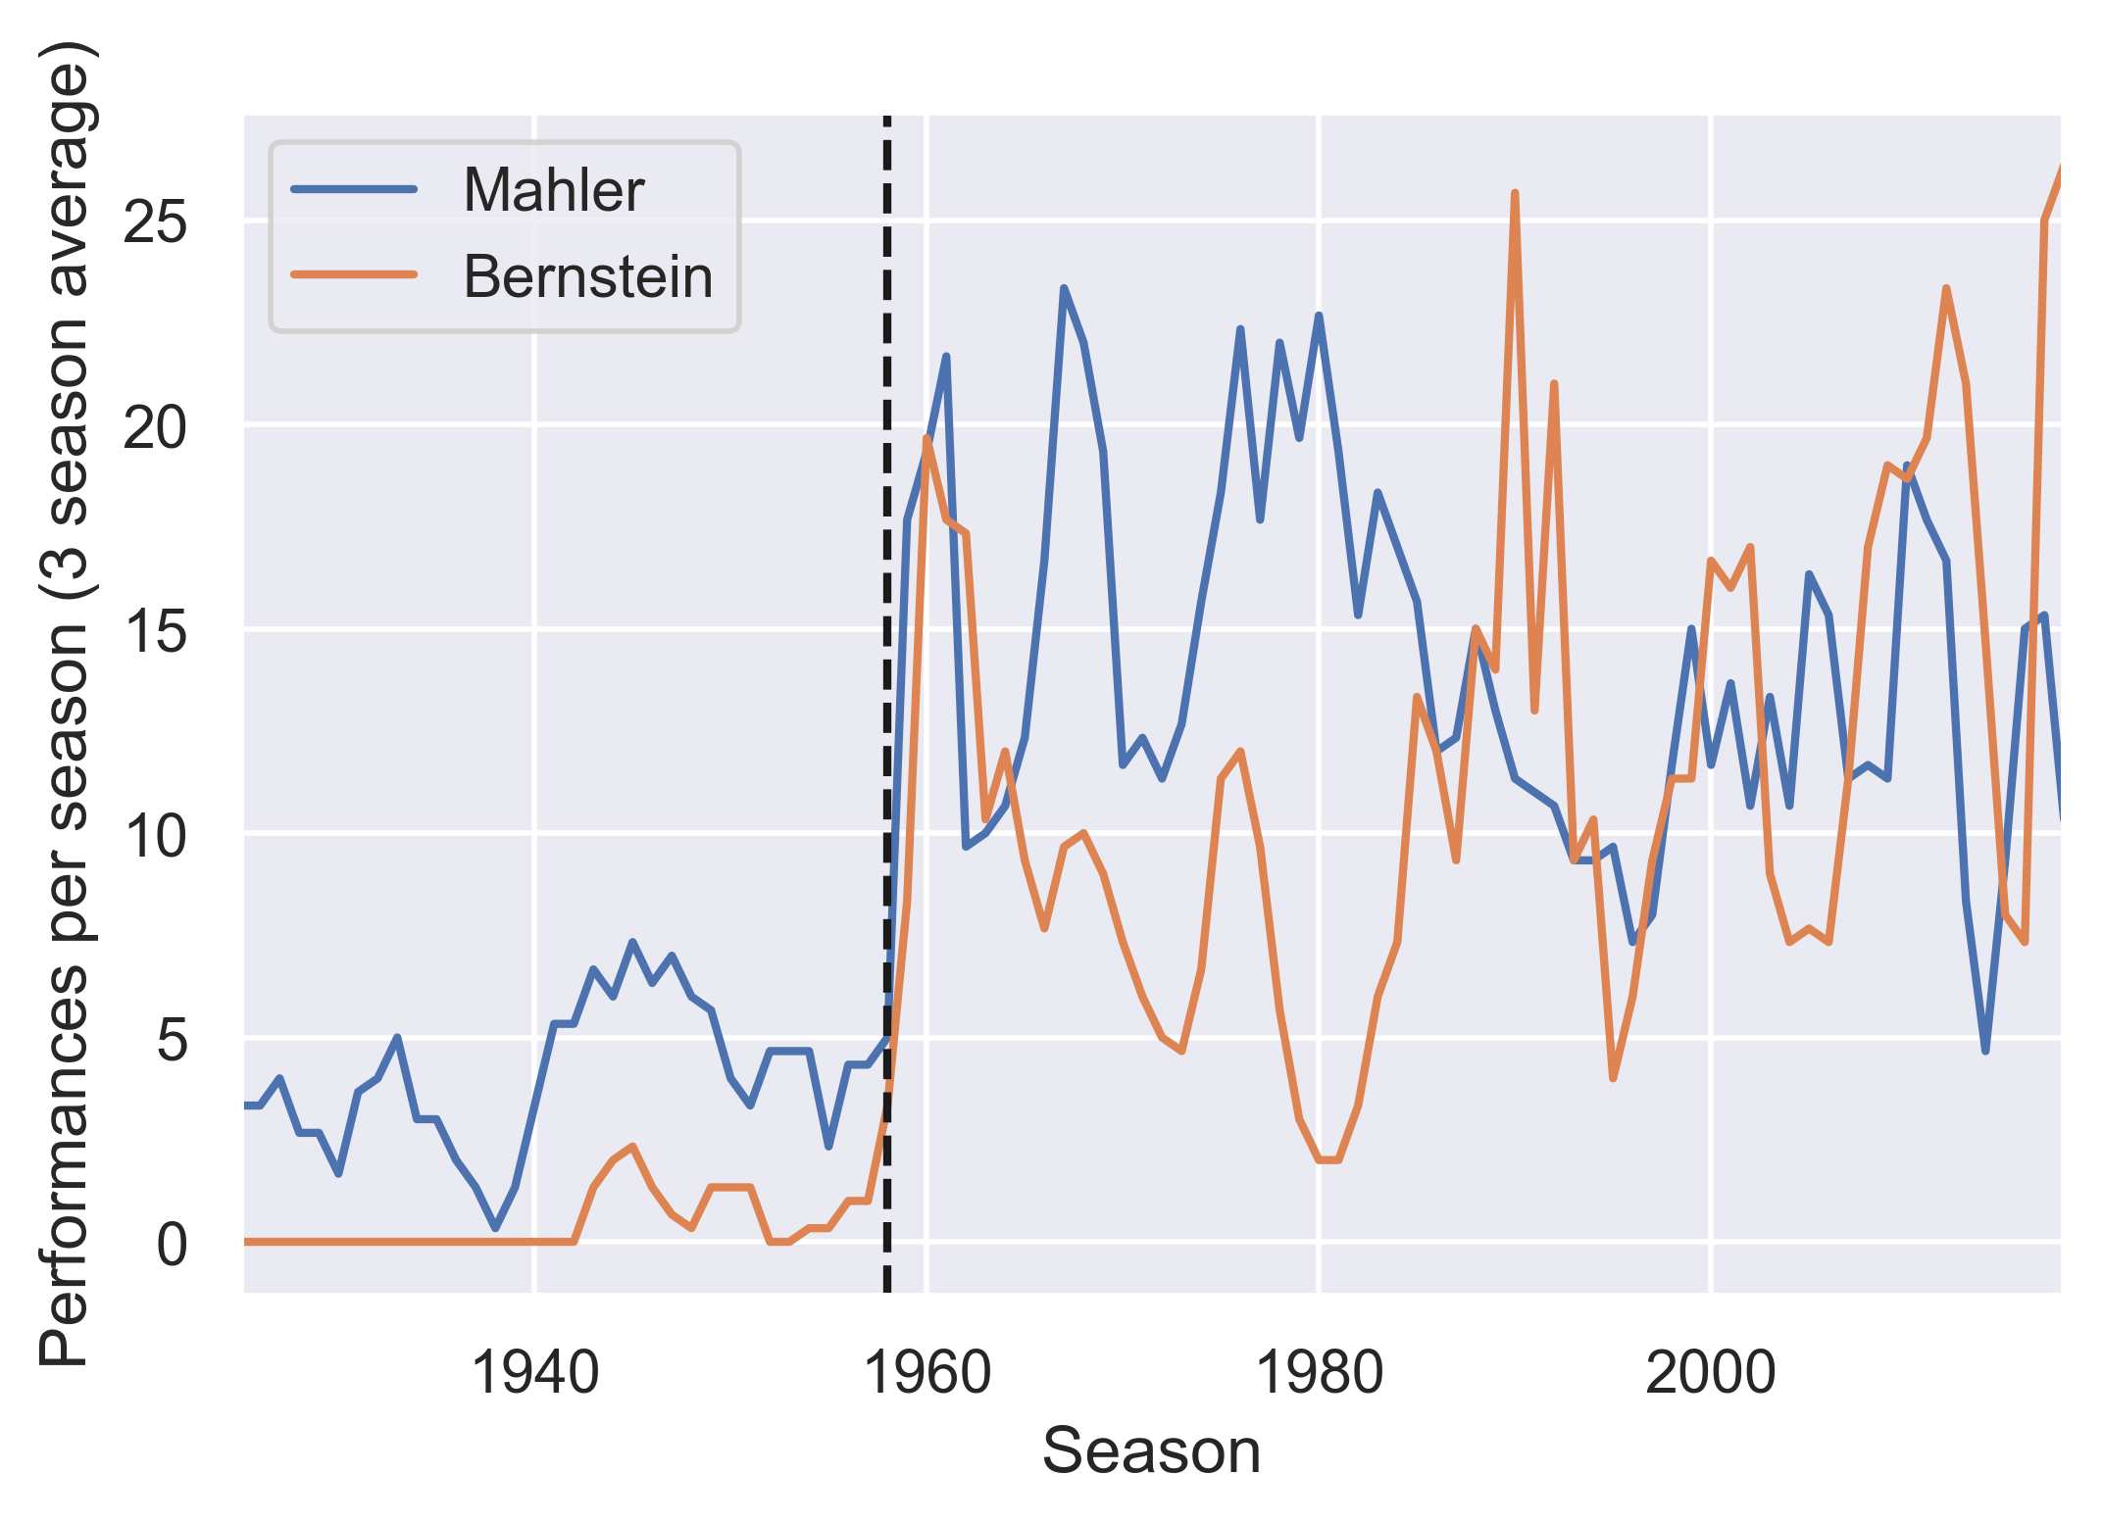
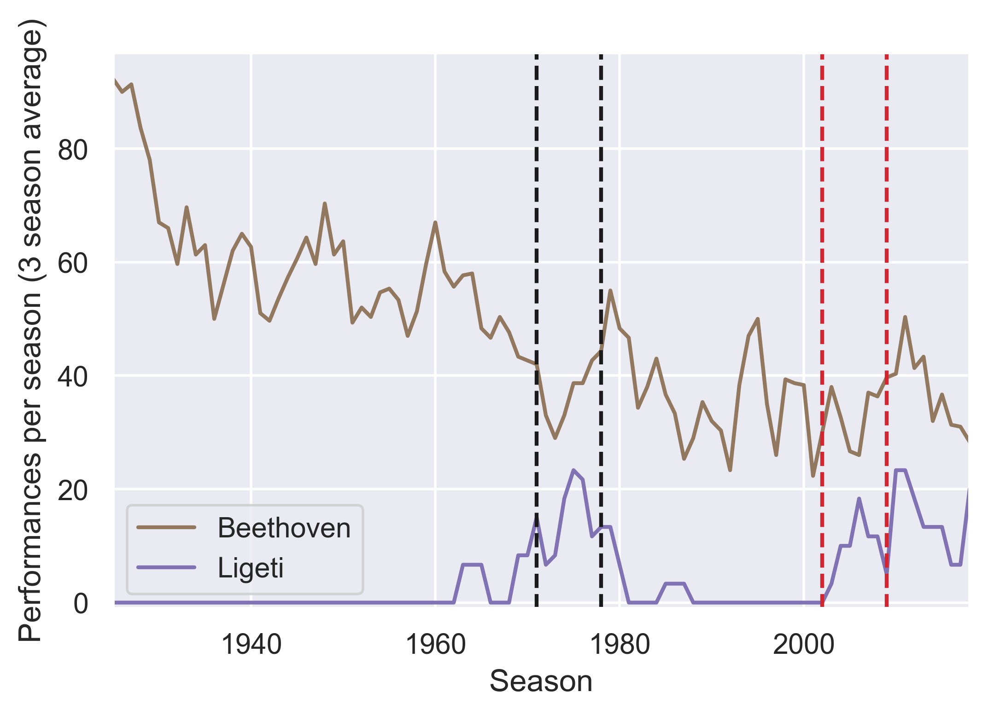
Most often performed composers:
Bernstein popularized the works of Mahler… alongside his own
Relationships between conductors and repertoire choices
Conductor:
Boulez
Maazel
1958: Leonard Bernstein becomes Music Director
Most frequently performed composers from minority groups
Deceased white men
 | Composer | Overall ranking | Number of performances
Hispanic | Manuel de Falla | 40 | 395
Black | Duke Ellington | 83 | 103
Female | Sofia Gubaidulina | 183 | 35
Notes:
Depends on what the user is interested in: a certain conductor, composer, or work

Slide 4
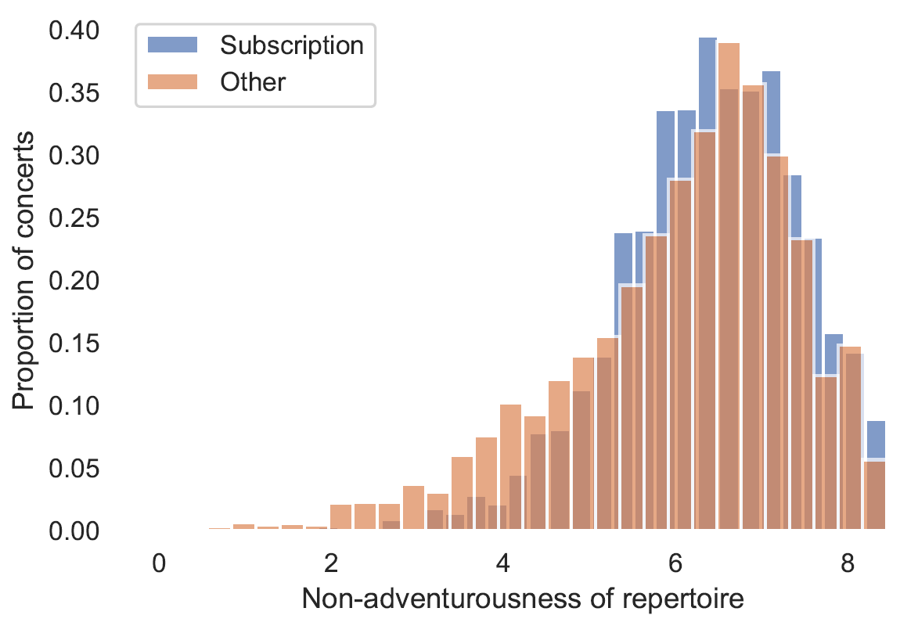
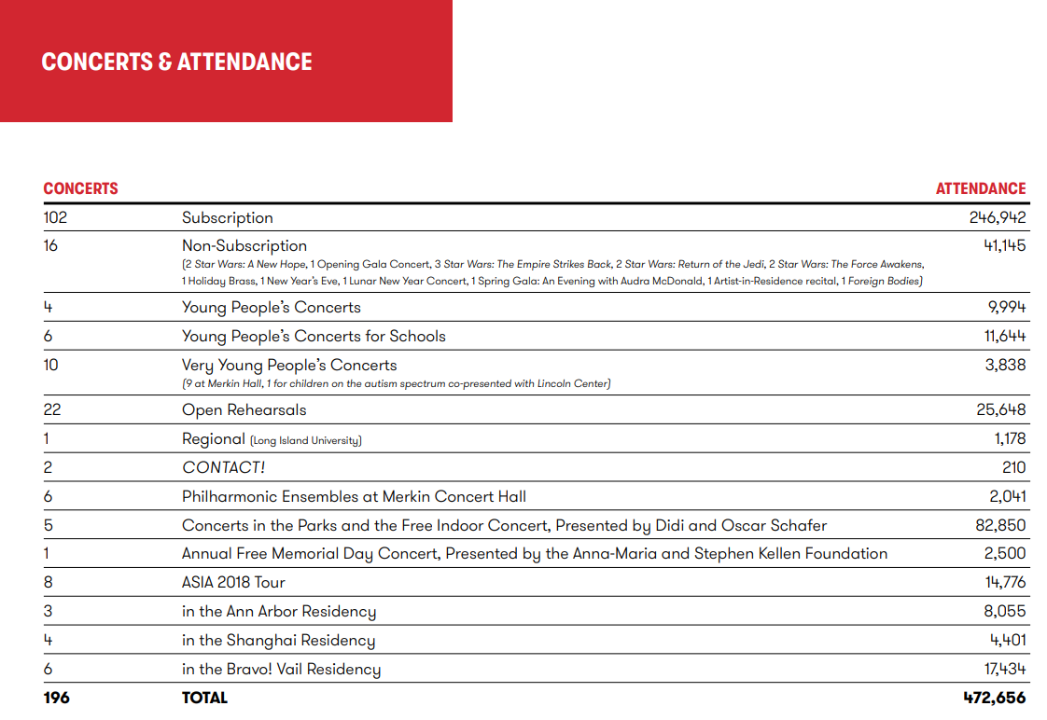
Can the orchestra program more adventurous repertoire?
Is there a relationship between repertoire selection and concert attendance?
From the 2017-2018 Annual Report:
https://nyphil.org/~/media/pdfs/publications/2018-annual-report-v2.pdf

