Slide 1
Introduction to cg_xml
Software Development Organization
Applications Team
January 2008

Slide 2
Agenda
Marketing
How to Run the Scripts
Popular Scripts
Build Your Own

Slide 3
Categorize Memory Usage
C:\dir>ofd6x -x app.out | sectti
Reading from stdin ...
************************************************************
REPORT FOR FILE: app.out
************************************************************
Name : Size (dec) Size (hex) Type Load Addr
-------------------- : ---------- ---------- ---- ----------
.clk : 12 0x0000000c UDATA 0x0000f0b4
.hwi_vec : 512 0x00000200 CODE 0x00000000
.swi : 220 0x000000dc UDATA 0x0000ecd0
.idl : 32 0x00000020 UDATA 0x0000dee0
.bss : 896 0x00000380 UDATA 0x0000d800
.far : 2124 0x0000084c UDATA 0x0000c340
<snip ...>
------------------------------------------------------------
Totals by section type
------------------------------------------------------------
Uninitialized Data : 7604 0x00001db4
Initialized Data : 9478 0x00002506
Code : 48800 0x0000bea0

Slide 4
See Library Memory Footprint
C:\dir>lib_footprint app_map.xml
algrf.l62
CODE ---------------------------------------
.text: 2336 0x00000920
DATA ---------------------------------------
.cinit: 44 0x0000002c
UDATA ---------------------------------------
.far: 16 0x00000010
========== ==========
LIB TOTAL : 2396 0x0000095c
biosi.a62
CODE ---------------------------------------
.bios: 20352 0x00004f80
.sysinit: 224 0x000000e0
.text: 512 0x00000200
DATA ---------------------------------------
.cinit: 1400 0x00000578
.const: 110 0x0000006e
...

Slide 5
See Stack Usage
C:\dir> call_graph arm_hello.xml | more
Call Graph for arm_hello.out
**********************************************************************
_c_int00 : wcs = 668
| __args_main : wcs = 668
| | _main : wcs = 668
| | | _printf : wcs = 664
| | | | __printfi : wcs = 632
| | | | | __pproc_fflags : wcs = 0
| | | | | __pproc_fwp : wcs = 36
| | | | | | _atoi : wcs = 4
| | | | | | _memset : wcs = 8
| | | | | __pproc_str : wcs = 56
| | | | | | _free : wcs = 20
| | | | | | | _minit : wcs = 8
| | | | | | | _minsert : wcs = 8
| | | | | | | _mremove : wcs = 0
| | | | | | _malloc : wcs = 20
| | | | | | | _minit : wcs = 8
| | | | | | | _minsert : wcs = 8
| | | | | | | _mremove : wcs = 0
...

Slide 6
See Stack Usage of a Library
C:\dir>call_graph --stack_max rts6400.xml
_strftime : wcs = 1248

Slide 7
Compare Libraries
C:\dir>coffdiff -v l1.lib l2.lib ofd6x
Processing l1.lib ...
Processing l2.lib ...
Comparing files ...
************************************************************
Filename: algrf_exit.o62
************************************************************
============================================================
Comparing Sections
============================================================
Raw data in section .text:exit is different
Byte 0 is different
l1.lib: 0x62
l2.lib: 0x30
Files are different

Slide 8
How can you do all that cool stuff?

Slide 9
Agenda
Marketing
How to Run the Scripts
Popular Scripts
Build Your Own

Slide 10
Install cg_xml
External Link
  Requires my.ti.com login
  Fully accessible to customers
Internal Link
Supports Windows and Linux x86
First class installation
  Requires clicking a license agreement
  Built with InstallJammer
These slides are in the package

Slide 11
Execute Binaries
Executable binaries are located in install_root/bin
  install_root: where cg_xml is installed
Execute like any other binary
  Perl not required
  Typically add install_root\bin to path
System temporary directory is used
  Files added the first time an executable runs
  Subsequent runs use those files

Slide 12
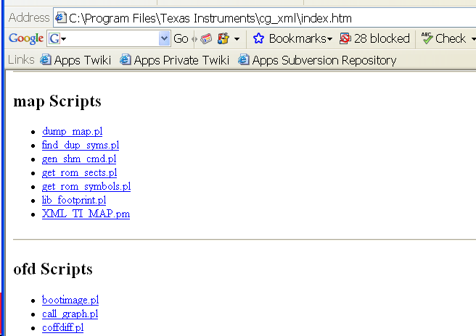
HTML Documentation
Point browser to install_root/index.htm

Slide 13
A Bit of Background
Developed as Perl scripts
  They started small. Now they’re pretty big.
Thus, they are called “scripts” even when you might be running executables

Slide 14
Two Kinds of Scripts
OFD
  Input is XML from Object File Display Utility
  Can process object, executable (.out), and library files
    Some scripts do not process libraries
MAP
  Input is XML form of the linker map file

Slide 15
Run OFD Scripts
Must use OFD -x option to create XML
Can create separate XML file
C:\dir>ofd6x -x app.out > app.xml
C:\dir>sectti app.xml
...
Or pipe it in
  Slower on Windows systems
C:\dir> ofd6x -x app.out | sectti
Reading from stdin ...
…
Some scripts also require -g
C:\dir>ofd6x -g -x app.out | call_graph
Reading from stdin ...
…

Slide 16
Cut Big XML Files Down to Size
Sometimes the XML is huge
  100+ MB has been seen!
Can make a script very slow
Each script documents OFD options which reduce XML size
  Specific to the script
OFD OPTIONS (from sectti.pl documentation)
Recent releases of OFD support options for filtering the XML
output down to what is strictly of interest. The best options
to use in combination with this script are:
-x --xml_indent=0 --obj_display=none,sections,header
Requires recent release of OFD
  One is available in install_root\utils

Slide 17
Run MAP Scripts
Create XML version of the map file
Linker option: --xml_link_info=file.xml
Supply on command line
C:\dir>lib_footprint app_map.xml
...
No need to pipe XML in
  Linker XML always supplied in a file

Slide 18
Agenda
Marketing
How to Run the Scripts
Popular Scripts
Build Your Own

Slide 19
Popular OFD Scripts
sectti.pl: Prints info on each section. Also totals by section type. Can output in .csv format for loading into Excel.
call_graph.pl: Shows function call relationships and stack usage
bootimage.pl: Creates boot image of .out file
coffdiff.pl: Compares two files or libraries

Slide 20
Popular MAP Scripts
lib_footprint.pl: Finds all the libraries and reports their sizes
gen_shm_cmd.pl: Automates sharing MEMORY definitions between processors on OMAP or similar systems

Slide 21
Questions?

Slide 22
Build Your Own
Remaining slides first prepared for TI Developer’s Conference in February 2005
Updated to current state of the scripts
These slides are for those interested in:
  XML
  How the scripts work
  Executing directly from Perl
  Extending a script
  Writing your own script

Slide 23
Agenda: Build Your Own
Introduce XML
XML Files Generated by TI Tools
  Linker Map File
  Object File Display Utility (OFD)
Examples of How to Write Cool Utilities that Solve Interesting Problems
  Memory Footprint of Libraries in Application
  Size of Library Members
  Creating a Boot Image
Huge OFD XML Files
References and Summary

Slide 24
Why XML?
Standard: http://www.w3.org/XML (link)
  XML: EXtensible Markup Language
Simple
  Text file
  Well defined structure
Separates information from its end use
  Separates Content from Display (unlike HTML)
  Content is easy to scan and repurpose
Don’t need to write custom XML parsers
  VB: DOMDocument class (msxml.dll)
  Perl: XML::Simple, XML::Twig, XML::DOM, etc.

Slide 25
XML Example
<?xml version="1.0"?>
<FavouriteMovies>
  <Customer>
  <Name> Jelena </Name>
    <Movie>
      <Title> Dogville </Title>
      <Director> Lars Von Trier </ Director >
      <ProductionYear> 2003 </ProductionYear>
      <Award >
        <Forum> European Film Festival</Forum>
        <Year> 2003 </Year>
      </Award>
    </Movie>
  </Customer>
  <Customer>
  <Name> George </Name>
    <Movie>
      <Title> Life of Brian </Title>
      <Director> Terry Jones </ Director >
      <ProductionYear> 1979 </ProductionYear>
    </Movie>
  </Customer>
</FavouriteMovies>
Tag
Data

Slide 26
Agenda: Build Your Own
Introduce XML
XML Files Generated by TI Tools
  Linker Map File
  Object File Display Utility (OFD)
Examples of How to Write Cool Utilities that Solve Interesting Problems
  Memory Footprint of Libraries in Application
  Size of Library Members
  Creating a Boot Image
Huge OFD XML Files
References and Summary

Slide 27
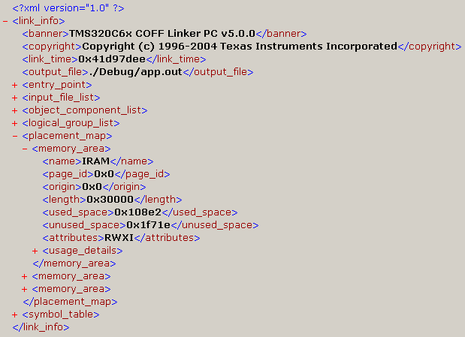
Linker MAP file in XML
Option: --xml_link_info=filename.xml
Example viewed in Internet Explorer:

Slide 28
Agenda: Build Your Own
Introduce XML
XML Files Generated by TI Tools
  Linker Map File
  Object File Display Utility (OFD)
Examples of How to Write Cool Utilities that Solve Interesting Problems
  Memory Footprint of Libraries in Application
  Size of Library Members
  Creating a Boot Image
Huge OFD XML Files
References and Summary

Slide 29
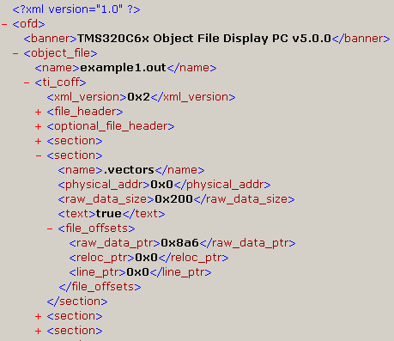
Object File Display Utility
.out
.xml
File Headers
Section Headers
Section 1 Raw Data
Section 1 Raw Data
ofd6x -x
…
Section n Raw Data
…
Debug Info

Slide 30
Object File Display Utility
version
xml_version
target_id
banner
file_header
section_count
copyright
endian
section
object_file
ofd
name
section
name
physical_addr
ti_coff
raw_data_size
section
bss
raw_data_ptr
text
symbol_table
reloc_ptr
copy
string_table
line_ptr
file_offsets

Slide 31
Agenda: Build Your Own
Introduce XML
XML Files Generated by TI Tools
  Linker Map File
  Object File Display Utility (OFD)
Examples of How to Write Cool Utilities that Solve Interesting Problems
  Memory Footprint of Libraries in Application
  Size of Library Members
  Creating a Boot Image
Huge OFD XML Files
References and Summary

Slide 32
Problem: Memory Used by Libs
Libraries in your application use how much memory?
OFD info insufficient for this problem
  Output section information does not include what parts come from libraries
  Memory map info only indirect
Can run OFD on libraries
ofd6x –x –o=george_code.xml george_code.lib # C6000 specific
  Determine size of every member ➔ inaccurate
  Only want members actually used in app
  Inspect each library separately ➔ inconvenient

Slide 33
Linker Map File Information
Linker map file details relationships
  Files or libraries ➔ Input sections
  Input sections ➔ Output sections
  Output sections➔ Memory map
Only includes library members actually used ➔ accurate
Info on all the libraries is in the map file
Linker option: --xml_link_info=file.xml
  Due to bug, usage in command file is different
  --xml_link_info file.xml /* no ‘=‘ */

Slide 34
XML_TI_MAP.pm
Perl module that wraps usage of XML::Simple
Used by all map file XML Perl scripts
Builds Perl data structure that is:
  Consistent
  As flat as possible
  Easier to use

Slide 35
dump_map.pl
Perl script that uses XML_TI_MAP.pm
Reads in XML file and dumps out Perl data structure representation
Use this script to see the data structure and understand how to traverse it
$VAR1 = {
'banner' => 'TMS320C6x COFF Linker PC v5.0.0',
'entry_point' => {
'address' => '0x7b80',
'name' => '_c_int00'
},
'input_file_list' => {
'fl-1' => {
'file' => 'rts6400.lib',
'kind' => 'archive',
'name' => 'boot.obj',

Slide 36
lib_footprint.pl Outline
In Perl-ish pseudo-code
XML_TI_MAP::process_xml_file($xml_file);
foreach $osect (loop through output sections)
{
$osect_type = classify_section($osect->{'name'});
foreach $isect (loop through input sections)
{
if (came from a library)
{
$lib_name = $file_rec->{'file'};
$lib_data{$lib_name}->{$osect_type} += oct($isect->{'size'});
}
}
}
# Print out totals computed in '%lib_data' ...
Notes:
The point here is not to expect the attendees to understand this
code in the 30 seconds or so they get to look at it. Rather, they
should get a good idea of the effort involved. Which is not that
much, really. It is definitely less complicated than typical DSP
loop code.

Slide 37
lib_footprint.pl Output
algrf.l62
CODE ---------------------------------------
.text: 2336 0x00000920
DATA ---------------------------------------
.cinit: 44 0x0000002c
UDATA ---------------------------------------
.far: 16 0x00000010
========== ==========
LIB TOTAL : 2396 0x0000095c
biosi.a62
CODE ---------------------------------------
.bios: 20352 0x00004f80
.sysinit: 224 0x000000e0
.text: 512 0x00000200
DATA ---------------------------------------
.cinit: 1400 0x00000578
.const: 110 0x0000006e
UDATA ---------------------------------------
.bss: 1096 0x00000448
========== ==========
LIB TOTAL : 23694 0x00005c8e
c6x1x_edma_mcbsp.l67
…

Slide 38
Agenda: Build Your Own
Introduce XML
XML Files Generated by TI Tools
  Linker Map File
  Object File Display Utility (OFD)
Examples of How to Write Cool Utilities that Solve Interesting Problems
  Memory Footprint of Libraries in Application
  Size of Library Members
  Creating a Boot Image
Huge OFD XML Files
References and Summary

Slide 39
Problem: Size of Library Members
How big is each member in a library?
  Different from lib memory footprint in application
  Especially important for library developers
OFD is perfect for this task
  No link map file from library members
  Works on libs built with old codegen tools
XML_TI_OFD.pm is Perl module for converting OFD XML to Perl data structures
dump_ofd.pl is script for seeing the Perl data structures

Slide 40
sectti.pl Output
====================================================================
REPORT FOR LIBRARY: rts6200.lib
====================================================================
************************************************************
REPORT FOR FILE: abs.obj
************************************************************
Name : Size (dec) Size (hex) Type
------------------------------ : ---------- ---------- ----
.text:_abs : 32 0x00000020 CODE
.text:_labs : 32 0x00000020 CODE
.text:_llabs : 64 0x00000040 CODE
… snip …
------------------------------------------------------------
Totals by section type
------------------------------------------------------------
Uninitialized Data : 4454 0x00001166
Initialized Data : 5018 0x0000139a
Code : 166432 0x00028a20

Slide 41
Agenda: Build Your Own
Introduce XML
XML Files Generated by TI Tools
  Linker Map File
  Object File Display Utility (OFD)
Examples of How to Write Cool Utilities that Solve Interesting Problems
  Memory Footprint of Libraries in Application
  Size of Library Members
  Creating a Boot Image
Huge OFD XML Files
References and Summary

Slide 42
Creating a Boot Image: Problem
Applicable when booting DSP via PCI or HPI
DSP application (boot image) is part of host application (.c/.h)
Have: .out file; Need: .c/.h file
const unsigned char _vectors[0x200] = {
0x2a, 0x60, 0x46, 0x00, 0x6a, 0x00, 0x00, 0x00, 0x62, 0x03, 0x00,
... }
const unsigned char _text[0x8c00] = {
0xf1, 0x18, 0xbc, 0x0f, 0xf4, 0xd4, 0x3d, 0x06, 0x45, 0x61, 0x7c,
... }
const unsigned char _cinit[0x35c] = {
0x30, 0x02, 0x00, 0x00, 0xd8, 0x9b, 0x00, 0x00, 0x00, 0x00, 0x00,
....}
…

Slide 43
Creating a Boot Image: Solution
Possible Solutions:
  Write a custom COFF parser
  Manipulate hex6x –a output
    Appendix B of Application Note SPRA512 (link)
Preferred Solution:
  Use OFD’s XML output
  Perl script that uses functions in XML_TI_OFD.pm
  bootimage.pl

Slide 44
Creating a Boot Image: Perl Script
Convert XML to Perl data structure
For each section
  Find section length
  Find file pointer into .out file
  Determine if it is initialized
  If yes, copy from .out
  file to .c/.h file
$xml_data =
ofd_process_xml_file($xml_file);
foreach $sect
(ofd_each_section($file_data))
$size = oct($sect->{'raw_data_size'});
$ptr = oct($sect->{'file_offsets'}
->{'raw_data_ptr'});
if ( (not defined $sect->{'bss'}) &&
(not defined $sect->{'copy'}))
read(OBJFILE, $buff, $size);
print_c_struct($sectname, $size, $buff)
Notes:
The code shown omits several details that are addressed in the

Slide 45
Result: .h/.c files
extern const unsigned char _vectors[0x200];
extern const unsigned char _const[0x138];
extern const unsigned char _text[0x8c00];
extern const unsigned char _cinit[0x35c];
/*********************************************************
** _vectors[0x200]: paddr = 0x00000000 vaddr = 0x00000000
**********************************************************/
const unsigned char _vectors[0x200] = {
0x2a, 0x60, 0x46, 0x00, 0x6a, 0x00, 0x00, 0x00, 0x62, 0x03, 0x00, 0x00, 0x00,
0x00, 0x00, 0x00, 0x00, 0x00, 0x00, 0x00, 0x00, 0x00, 0x00, 0x00, 0x00, 0x00,
... }
/*********************************************************
** _text[0x8c00]: paddr = 0x00000200 vaddr = 0x80000000
**********************************************************/
const unsigned char _text[0x8c00] = {
0xf1, 0x18, 0xbc, 0x0f, 0xf4, 0xd4, 0x3d, 0x06, 0x45, 0x61, 0x7c, 0x05, 0xa0,
0x06, 0x10, 0x05, 0x64, 0x02, 0xa8, 0x03, 0x00, 0x00, 0x00, 0x00, 0xf6, 0x42,
0x60, 0x8d, 0x00, 0x00, 0x00, 0x00, 0x00, 0x00, 0x04, 0x00, 0x00, 0x00, 0x60,
0xa5, 0x00, 0x00, 0xd8, 0x97, 0x00, 0x00, 0x00, 0x00, 0x00, 0x00, 0x00, 0x00,
... }
/*********************************************************
** _cinit[0x35c]: paddr = 0x00009220 vaddr = 0x00009220
**********************************************************/
const unsigned char _cinit[0x35c] = {
0x30, 0x02, 0x00, 0x00, 0xd8, 0x9b, 0x00, 0x00, 0x00, 0x00, 0x00, 0x00, 0x00,
0x00, 0x00, 0x00, 0x00, 0x00, 0x00, 0x00, 0x00, 0x00, 0x00, 0x00, 0x00, 0x00,
....}

Slide 46
Agenda: Build Your Own
Introduce XML
XML Files Generated by TI Tools
  Linker Map File
  Object File Display Utility (OFD)
Examples of How to Write Cool Utilities that Solve Interesting Problems
  Memory Footprint of Libraries in Application
  Size of Library Members
  Creating a Boot Image
Huge OFD XML Files
References and Summary

Slide 47
Huge OFD XML Files
OFD may create huge XML files
  Especially when using –g to see Dwarf info
  ofd6x –g –x rts6400.lib creates 40 MB file!
  Without –g file is 8 MB
  Scripts that require –g info
    call_graph.pl
    func_info.pl
    etc …
Naive processing of such large files can take a long time, if it works at all

Slide 48
OFD XML Filtering Options
New OFD options can vastly reduce amount of XML output
Currently available only in alpha release versions of OFD
  In utils\ directory
  OK to replace OFD of older toolsets
  OK to use ofd6x on non-C6000 files
Use –h option to see option summary

Slide 49
OFD XML Filtering Options
Optimal filtering options vary by script
Details in perldoc for script …
C:\>perldoc sectti.pl
...snip...
OFD OPTIONS
Recent releases of OFD support options for filtering the XML
output down to what is strictly of interest. The best options to
use in combination with this script are:
-x --xml_indent=0 --obj_display=none,sections,header
Filtering the XML in this way reduces the amount of data
processed by this script, thus making it run faster.
...snip…
C:\>ofd6x –o=rts6200.xml -x --xml_indent=0
--obj_display=none,sections,header rts6200.lib
C:\>sectti.pl rts6200.xml

Slide 50
More XML Filtering in .pm
Use these functions in XML_TI_OFD.pm to further filter XML before it is parsed
ofd_filter_xml – Specify what to keep
ofd_strip_xml – Specify what to delete
ofd_filter_and_parse_xml
  Filters and parses XML in a way that reduces overall script memory usage
Using these functions requires good knowledge of COFF and DWARF structure
  Work from existing examples

Slide 51
Agenda: Build Your Own
Introduce XML
XML Files Generated by TI Tools
  Linker Map File
  Object File Display Utility (OFD)
Examples of How to Write Cool Utilities that Solve Interesting Problems
  Memory Footprint of Libraries in Application
  Size of Library Members
  Creating a Boot Image
Huge OFD XML Files
References and Summary

Slide 52
References
Perl Cookbook, 2nd edition, Chapter 22
  Excellent summary
http://www.w3schools.com (link)
  Good tutorials on XML and other web technologies
http://www.activestate.com (link)
  The Perl implementation for Windows
http://msdn.microsoft.com/XML (link)
  For fans of VB

Slide 53
Summary
Introduced XML
XML files produced by TI tools
  Object File Display Utility
  Linker Map File
What information is available in each
Cool Utilities based on XML processing
  Examples
  Modules to build on
So go write your own!

Slide 54
Questions?

Slide 55
Backup Slides

Slide 56
Other Approaches
Many alternatives to Perl and XML::Simple
Other Perl modules
  More powerful
  Steeper learning curve
  XML::Twig, XML::DOM, XML::LibXML
Visual Basic based on msxml.dll
Java used in the first SAX parsers
  SAX: Simple Access to XML
Start with the language you know best
Do not write your own XML parser!

Slide 57
What Version of Tools Built Lib?
How to see the version of the compiler tools used to build a library …
Use OFD with –g ➔ exposes debug info
% ofd6x –g rts6400.lib | grep DW_AT_producer # Unix
DW_AT_producer TMS320C6x C/C++ Codegen Unix v5.0.0 Copyright …
DW_AT_producer TMS320C6x C/C++ Codegen Unix v5.0.0 Copyright …
…
Use find on Windows
C:\> ofd6x –g rts6400.lib | find "DW_AT_producer"
Works only on libraries built with compiler tools from CCS 3.00 or higher

