Slide 1
Breaking Badge
PRESENTED BY:
Tim & Phyushin
Definitely not replicants

Slide 2
Who are we?
Tim Wilkes and Phyushin
Celebrity look-a-likes for Andy Craine and Edd the duck.
One is an ex-sysadmin turned managment, the other a Security Tester
@TimmehWimmy and @Phyushin on twitter

Slide 3
The Badge
Based on SLE4442 (the cards are compat)
“An Intelligent 256-Byte EEPROM with Write Protect Function and Programmable Security Code (PSC)”
Compatible with ISO 7816
Data can only be changed after entry of the correct 3-Byte Programmable Security Code (Security Memory)

Slide 4
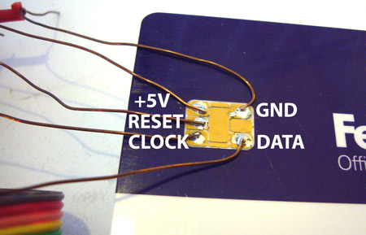
The Badge – Pic with pin out
http://dangerousprototypes.com/docs/SLE4442_(FedEx_Kinko%27s)_smart_card_update

Slide 5
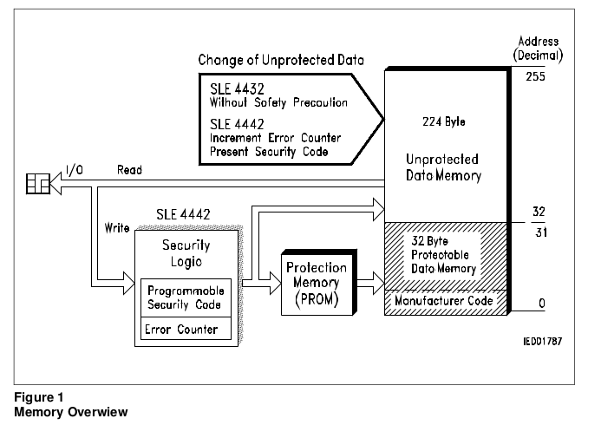
The Badge – Memory Overview

Slide 6
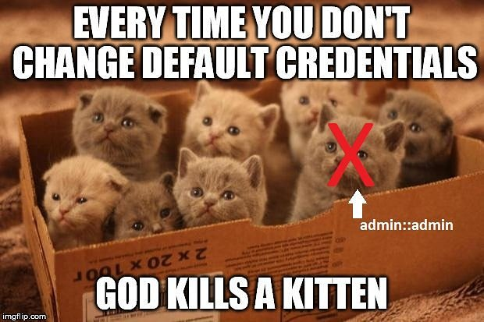
Default Security key
The 3 Byte key is 0xFF 0xFF 0xFF
Can and should be changed.

Slide 7

Not all card readers are equal...
Broadcom chipsets do not play well

Slide 8
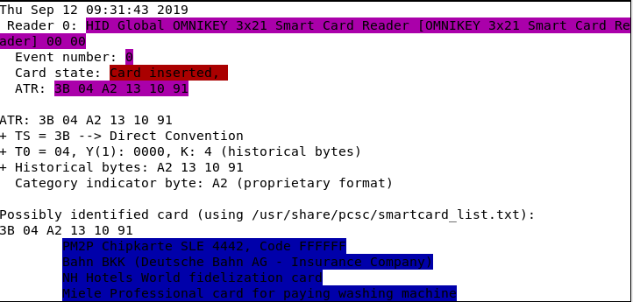
Card readers that do work….
HID Omnikey 3021

Slide 9
Software - Linux
Pcscd
Pcsc-tools

Slide 10
Software - Windows
The base is part of the OS (Since XP)

Slide 11
Man in the Middle

Slide 12
Steps to read a card

Slide 13
Steps to write a card

Slide 14
Security Model
Confidentiality
Integrity
Availability

Slide 15
Security Model
Confidentiality
  Clearly not a thing… Card can be read regardless of security control
Integrity
Availability

Slide 16
Security Model
Confidentiality
  Clearly not a thing… Card can be read regardless of security control
Integrity
  Protections in place on changing the data
Availability

Slide 17
Security Model
Confidentiality
  Clearly not a thing… Card can be read regardless of security control.
Integrity
  Protections in place on changing the data
Availability
  Needs to be easily replacable. Card loss impacts usability.

Slide 18
Possible Secure(*) Usage
Hold an encrypted value which is then validated at a backend.

Slide 19
Questions?
CONTACT:
example@fedoraproject.org
License statement goes here. Creative Commons licenses are good.

Slide 20
Live Demo ???
Clearly, we have been drinking too much.

