Slide 1

X-Com - Editing Save Game Files is Still Strategy REDUX

Slide 2
#whoami
Hackspace Director
Security Consultant at Digital Interruption
Crew regular at various cons.
Member of Manchester GreyHats

Slide 3
Why?
The was the first game I ever played on a “REAL” PC.
I wanted to do a talk that was loosely hacking related but not too in the weeds.
I’ve never completed this game and I’ve owned it since the mid 90s (yes I’m that old).
I actually made a start on the save game editor and want to share my progress

Slide 4
Let’s Get Into It!
Enough about why! How about what it is?
Mostly my ramblings around the exploration of reverse engineering the save game format for the X-Com TFTD game
The announcement of my planned tool that will remove the need to manually edit these files in a hex editor (T’lethpathy)
Discussion of where T’lethpathy is at the moment
P.S. it should work on UFO Enemy Unknown but certain names will be different (aliens etc.)

Slide 5
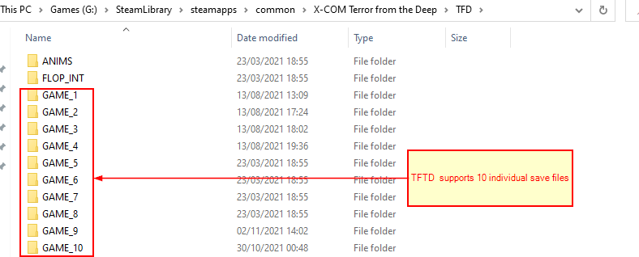
Save Game Files
X-COM Terror From The Deep uses a save game system where the files for each save are stored in their own folder with the prefix GAME_ and then the save slot number like so:

Slide 6
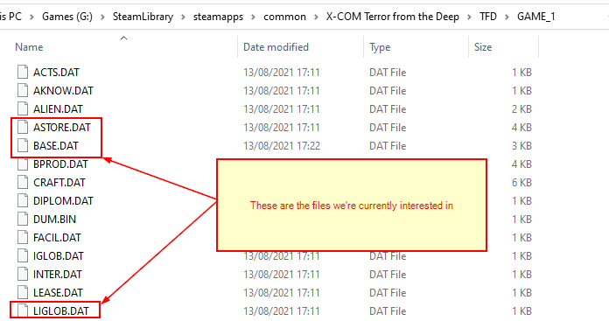
Save Game Files cont.
There are several files in the save game folder of interest; for this talk we’re going to focus on three:
ASTORE.DAT
BASE.DAT
LIGLOB.DAT

Slide 7
The Initial Plan
Initially, we opened up these save files using a hex editor and painstakingly edited specific bytes, saved the file and reloaded the save to see the effects.
This was pretty tedious… and like with lots of tedious things… I wanted to script it

Slide 8
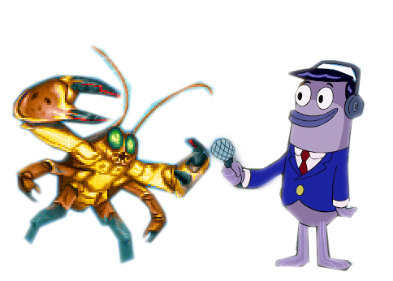
LIGLOB.DAT
Most importantly we need money!
Editing the first 4 bytes of the libglob.dat file with the value 0xFFFFFF10 will give you around 285M which should be more than sufficient … if not we can always load the file up again and add more!
Careful though! You can overflow the integer where the money is stored and end up with -$1 !

Slide 9
LIGLOB.DAT V2
Initially, we were going to do this manually with a hex editor like animals!
From the previous slide, we know that the first 4 bytes of LIGLOB.DAT contain the money.
We also know that 4 Bytes is 32bits
This means the max (signed) value we can have is just over $2.1 Billion so we create a function to insert the value FFFFFF7F into the first 4 bytes – don’t forget it’s little endian!

Slide 10
LIGLOB.py
The interaction with this file is relatively simple – load the first 4 bytes, change them to an appropriate value, and save.

Slide 11
LIGLOB
Live DEMO!?

Slide 12
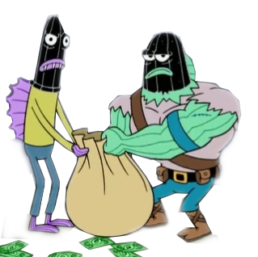
So, we’ve got the cash – now what?
Now we can deck out base with some new facilities – like an additional sub pen; alien containment facilities; even submersible weapons platforms for tactical missions… anything we need!

Slide 13
BASE.DAT
The BASE.dat file contains up to 8 bases each 296 bytes.
Each base has 4 sections we want to look at:
Name
Stores
Layout (technically 2 sections)
Staff (again technically 2 sections technicians and scientists)

Slide 14
BASE.DAT
First we will rename the base to something recognisable

Slide 15
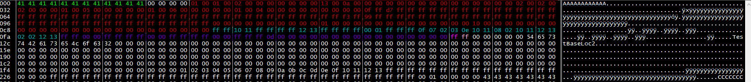
BASE.DAT Structure
Base name
Stores
Base Layout
Base Build Times
Technician
Scientist
Note: This structure is repeated for each base

Slide 16
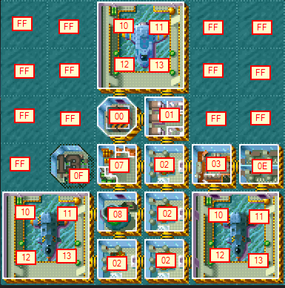
Base layout
The base layout is split into two sections:
The facility
The build time (0x00 for built)
To finish building a facility just find the corresponding build timer
(current offset + 36) and set the value to 0x00
13 days build time or 0x0D
Note: This structure is repeated for each base

Slide 17
Instant build
Offset 0xED is under construction – if we move 37 bytes forward to 0x111 we can see a value of 0x0D
If we set this to 0x00 and reload the game the facility will be built
We wont be worrying about this
13 days build time or 0x0D
Note: This structure is repeated for each base

Slide 18
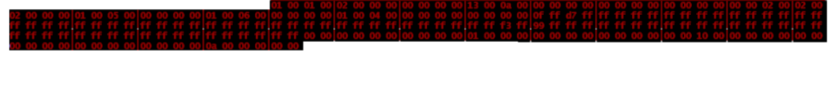
Stores
The store is 202 Bytes long
Each item is 2 bytes *Little Endian
Some items don’t exist and if you add qty’s to them it prints out weird text:
0x6c, 0x6e, 0x70, 0xa8, 0xaa, 0xac, 0xae (each of these is 2 bytes “wide”)
In total there are 188 bytes that affect the inventory
I won’t be listing them all here as I don’t want death by wall of text but they’ll be in the repo!
Note: This structure is repeated for each base

Slide 19
Staff
Scientist
Technician
Technicians and Scientists numbers are stored in these single byte each giving a max of 255 of both per base
They are located at offset 0x122 and 0x123.
Caveats:
Care should be taken when filling up your base with “workers” as they get paid at the end of each month which could be costly.
They also take up space in the living quarters meaning if you have 255 scientists you’ll have no living quarters left for additional aquanauts.
More workers require more workshop/lab space too.
Note: This structure is repeated for each base

Slide 20
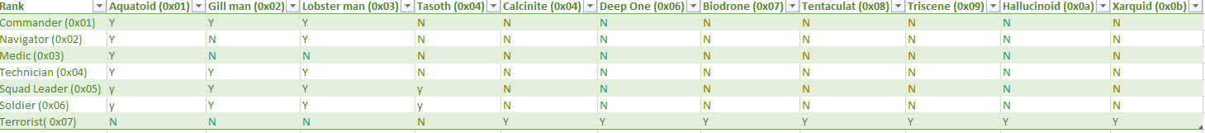
ASTORE.DAT
The Aliens in the ASTORE.DAT are stored in 12 byte sections only the first two bytes are of interest to us, these are Race and Rank respectively
After some back and forward editing the alien’s records the following table was compiled of valid race and rank combinations (Y signifies if the race/rank combination is valid)
C:\Users\w_lua\Desktop\2021-11-02 15_58_18-GAME_1.png

Slide 21
More On Alien Containment
To progress past certain points you are required to interrogate live aliens, at first this can be any alien.
Progressing to “T’leth” requires interrogating commanders (highest ranking aliens) and it probably has to be lobstermen because of course it does!

Slide 22
More On Alien Containment
Another live demo!?

Slide 23
What Next?
Editing research possibly
Editing soldiers too
Some refactor work
Cool ASCII Art banner – is it really a CLI without one?
TUI – it’s python so why not use RICH ☺

Slide 24
References
https://www.ufopaedia.org/index.php/Game_Files
https://en.wikipedia.org/wiki/X-COM:_Terror_from_the_Deep
https://openxcom.org/
https://github.com/phyushin/T-lethpathy
You can also buy the complete set of original games on steam for less than a tenner! What value!
https://store.steampowered.com/sub/964/

Slide 25
Keybase: keybase.io/phyushin
GitHub: github.com/phyushin
Mastodon: @phyushin@mastodon.social

