Slide 1
Week 10,
Generative AI

Slide 2
Outline
Three methods of generating samples from a learned distribution
  GAN
  Normalizing flow
  Diffusion models

Slide 3
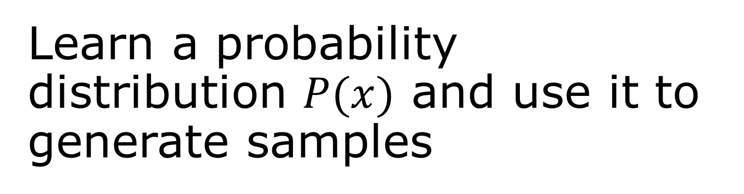
Learn a probability distribution $P(x)$ and use it to generate samples
Generative adversarial networks (GAN) – beat the real thing
Normalizing flows – drive a distribution by Gaussian
Diffusion models – learn to remove noise

Slide 4
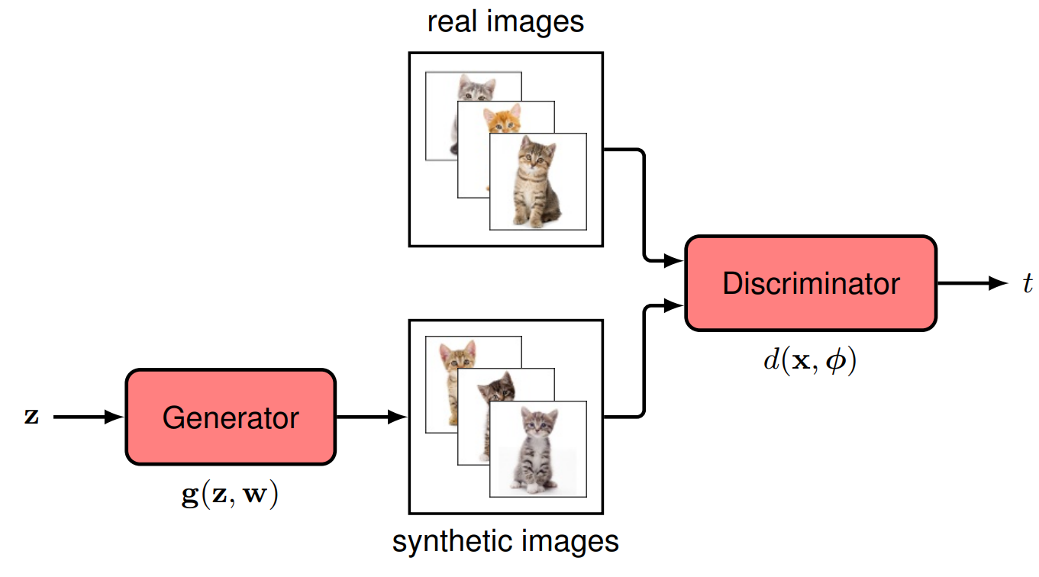
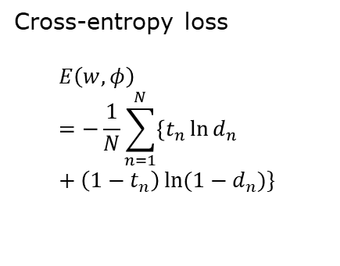
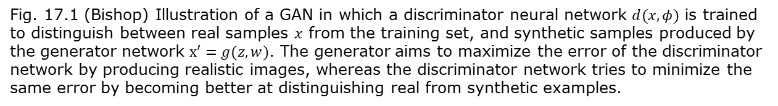




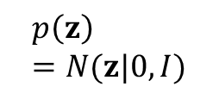

Generative adversarial network architecture
Cross-entropy loss
$$E\left(w,φ\right)=−\frac{1}{N}\sum_{n=1}^{N}{\left\{t_{n}\ln{d_{n}}+\left(1−t_{n}\right)\ln{(1−d_{n})}\right\}}$$
$$p_{data }(x)$$
$$x$$
$$p\left(z\right)=N(z|0,I)$$
$t=1$ real data
$t=0$ synthetic data
A logistic classifier
$$x′$$
Probability of being real data
$w,φ$: network parameters
Fig. 17.1 (Bishop) Illustration of a GAN in which a discriminator neural network $d(x,φ)$ is trained to distinguish between real samples $x$ from the training set, and synthetic samples produced by the generator network $x′=g(z,w)$. The generator aims to maximize the error of the discriminator network by producing realistic images, whereas the discriminator network tries to minimize the same error by becoming better at distinguishing real from synthetic examples.

Slide 5
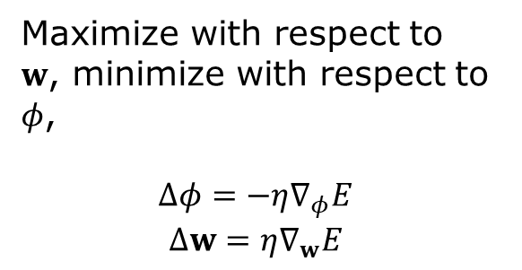


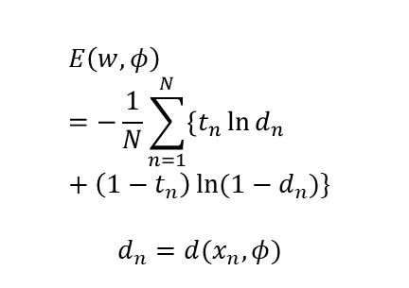


GAN training
$$E\left(w,φ\right)=−\frac{1}{N}\sum_{n=1}^{N}{\left\{t_{n}\ln{d_{n}}+\left(1−t_{n}\right)\ln{(1−d_{n})}\right\}}$$
$$d_{n}=d(x_{n},φ)$$
$$x_{n}$$
or
$t=1$ real data
$t=0$ synthetic data
$$z_{n}$$
$$x_{n}^{′}$$
Maximize with respect to $w$, minimize with respect to $φ$,
$$Δφ=−η∇_{φ}E$$
$$Δw=η∇_{w}E$$
$η$: learning rate

Slide 6
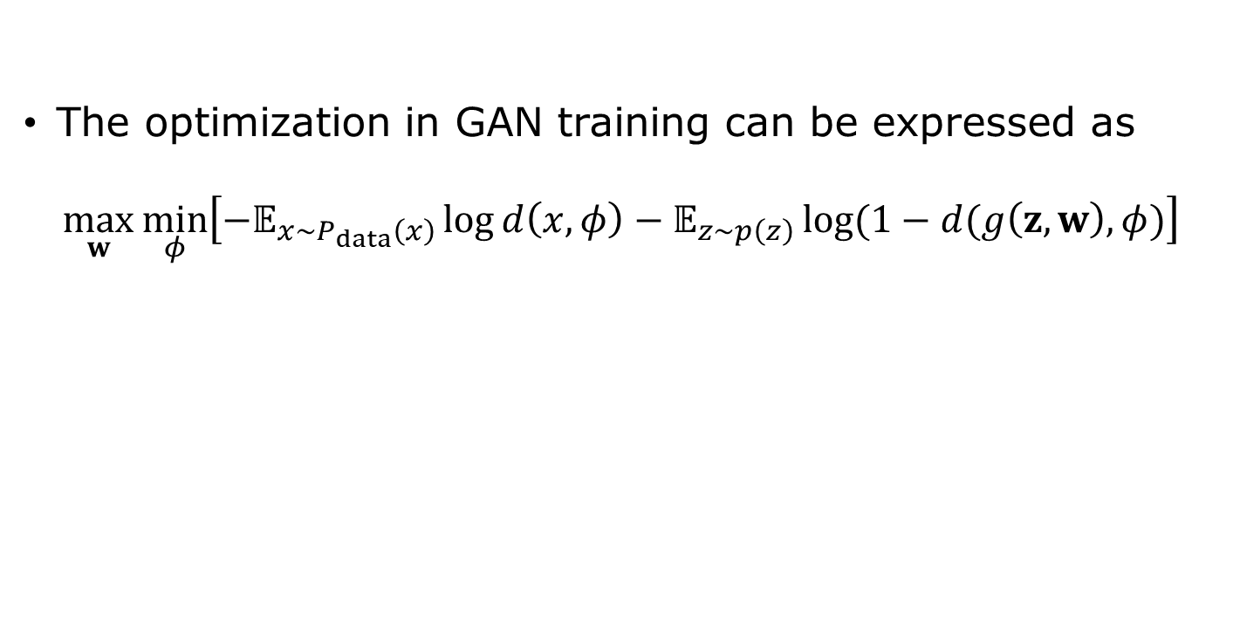
GAN as a zero-sum game
The optimization in GAN training can be expressed as
$$\max_{w}{\min_{φ}\left[−𝔼_{x∼P_{data}\left(x\right)}\log{d\left(x,φ\right)−𝔼_{z∼p\left(z\right)}\log{(1−d(g\left(z,w\right),φ)}}\right]}$$

Slide 7
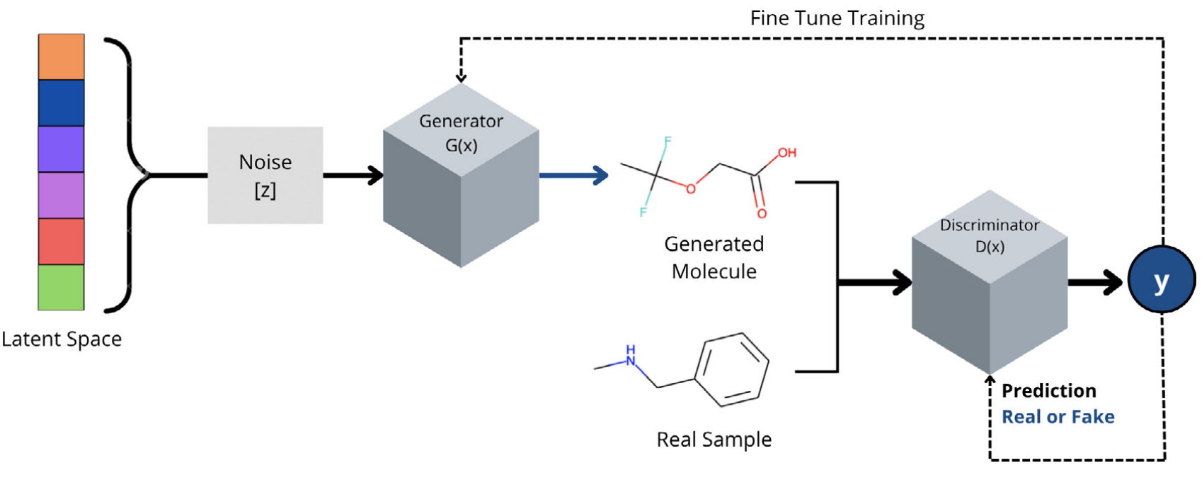
GAN for molecular discovery
From S. Tripathi, et al,
“Artificial Intelligence in the Life Science 2, 100045 (2022).
https://insilico.com/

Slide 8


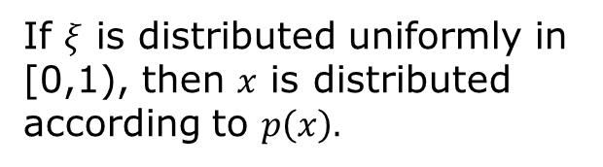

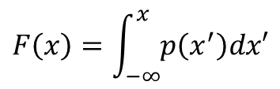
Inverse transform sampling
$$F\left(x\right)=\int_{−∞}^{x}{p\left(x^{′}\right)dx′}$$
1
$$ξ$$
$$x$$
$$x=F^{−1}(ξ)$$
If $ξ$ is distributed uniformly in [0,1), then $x$ is distributed according to $p\left(x\right).$

Slide 9
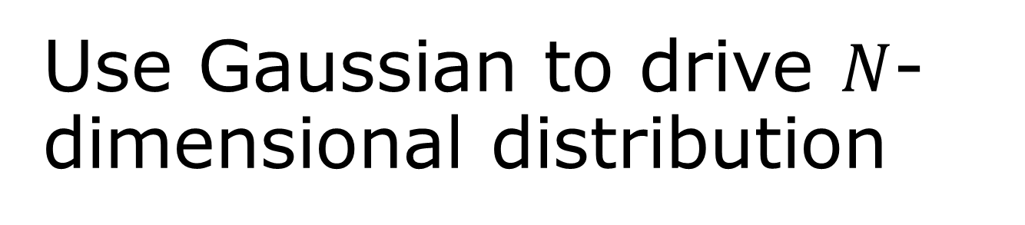
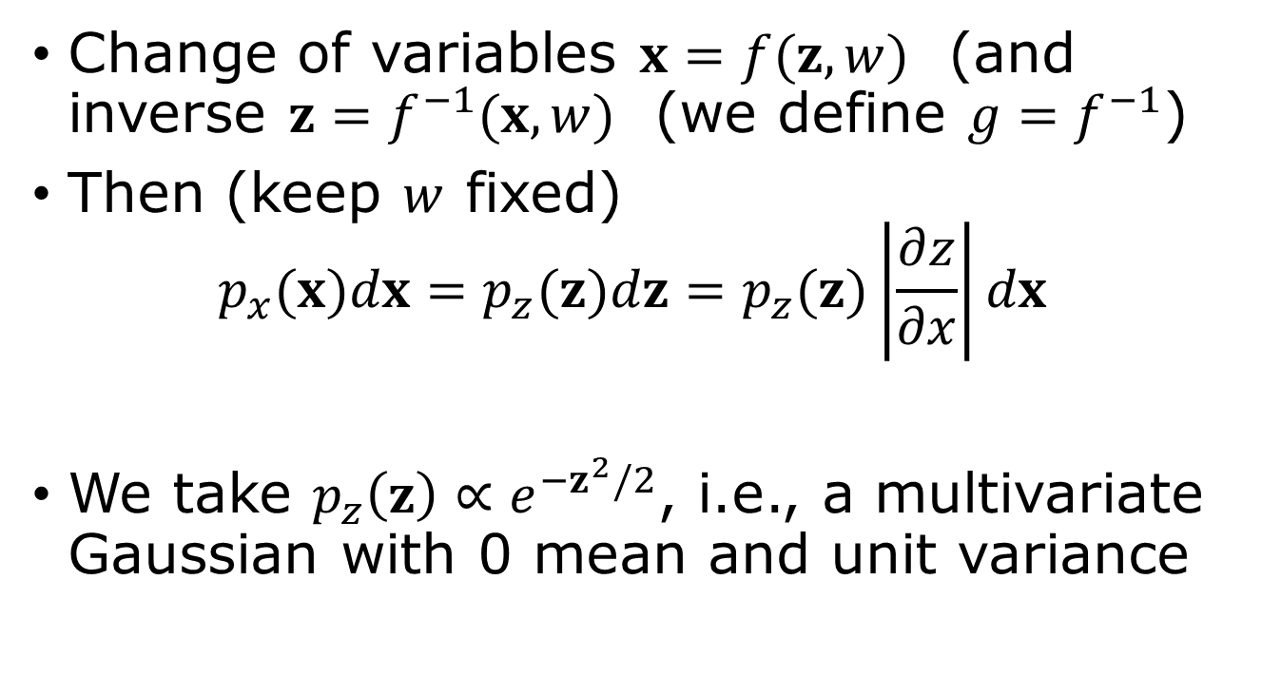
Use Gaussian to drive $N$-dimensional distribution
Change of variables $x=f(z,w)$ (and inverse $z=f^{−1}(x,w)$ (we define $g=f^{−1}$)
Then (keep $w$ fixed)
$$p_{x}(x)dx=p_{z}(z)dz=p_{z}(z)\left|\frac{∂z}{∂x}\right|dx$$
We take $p_{z}\left(z\right)∝e^{−z^{2}/2}$, i.e., a multivariate Gaussian with 0 mean and unit variance
Jacobian of the transform
Notes:
What is the Jacobian? It is the determinant of the matrix of all the partial derivatives partial z_i /partial x_j. See next slide

Slide 10
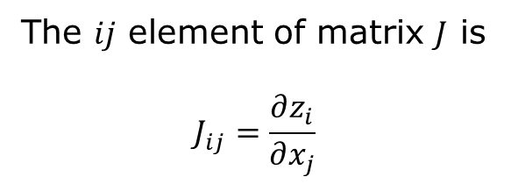
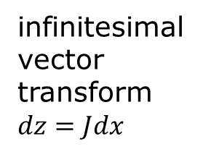
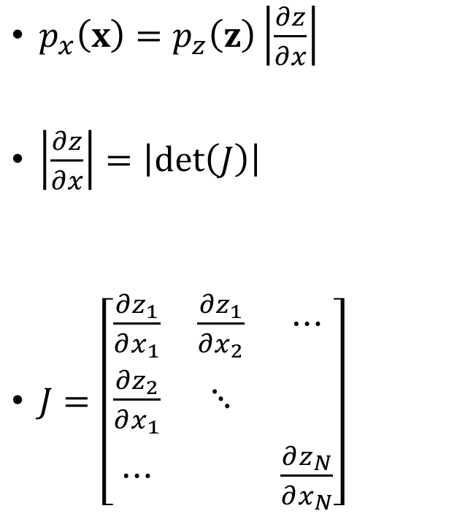
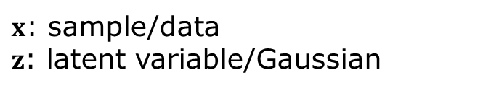
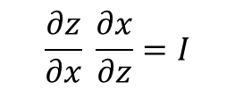
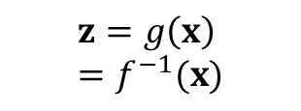
Jacobian
$x$: sample/data
$z$: latent variable/Gaussian
$$z=g\left(x\right)=f^{−1}(x)$$
$p_{x}\left(x\right)=p_{z}\left(z\right)\left|\frac{∂z}{∂x}\right|$
$\left|\frac{∂z}{∂x}\right|=\left|\det\left(J\right)\right|$
$J=\left[\begin{matrix}\frac{∂z_{1}}{∂x_{1}} & \frac{∂z_{1}}{∂x_{2}} & ⋯ \\ \frac{∂z_{2}}{∂x_{1}} & ⋱ & \\ ⋯ & & \frac{∂z_{N}}{∂x_{N}}\end{matrix}\right]$
The $ij$ element of matrix $J$ is
$$J_{ij}=\frac{∂z_{i}}{∂x_{j}}$$
$$\frac{∂z}{∂x} \frac{∂x}{∂z}=I$$
infinitesimal vector transform $dz=Jdx$

Slide 11
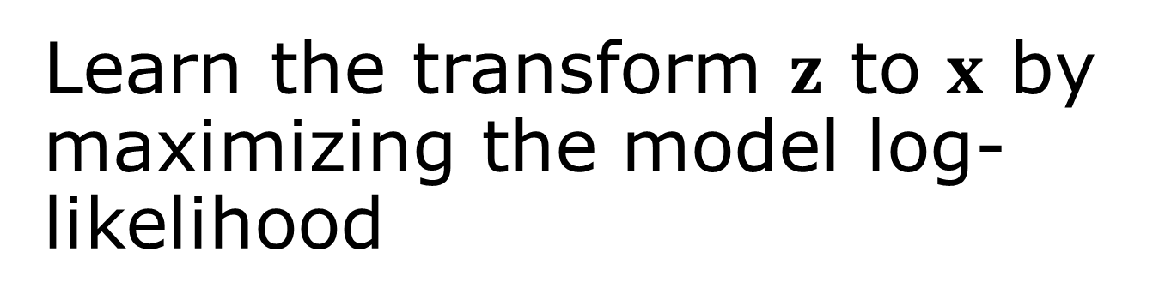

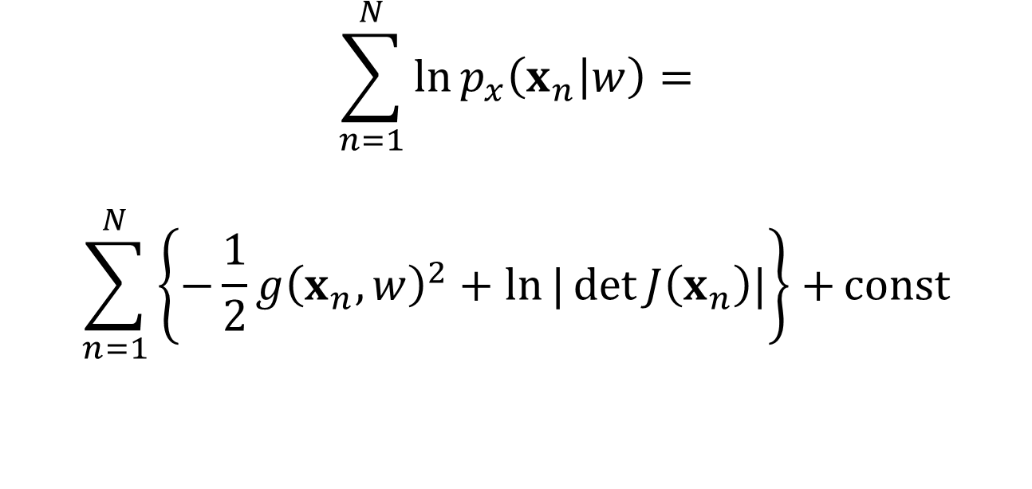
Learn the transform $z$ to $x$ by maximizing the model log-likelihood
$$\sum_{n=1}^{N}{\ln{p_{x}\left(x_{n} | w\right)=}}$$
$$\sum_{n=1}^{N}{\left\{−\frac{1}{2}g{\left(x_{n},w\right)}^{2}+\ln{|\det{J\left(x_{n}\right)|}}\right\}+}const$$
$x=f(z,w)$, $z=g(x,w)$
Notes:
This is the negative of NLL.

Slide 12
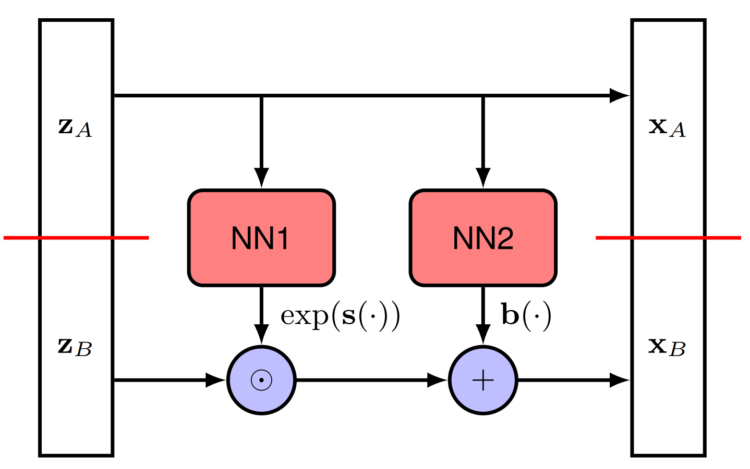
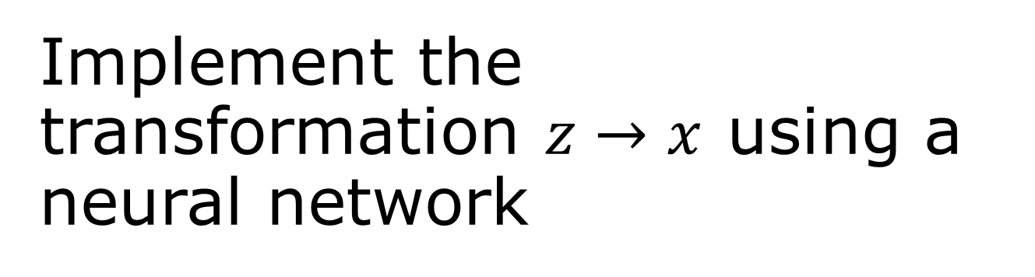
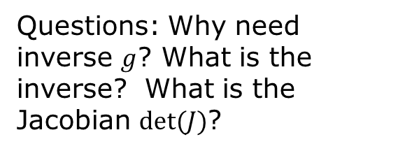
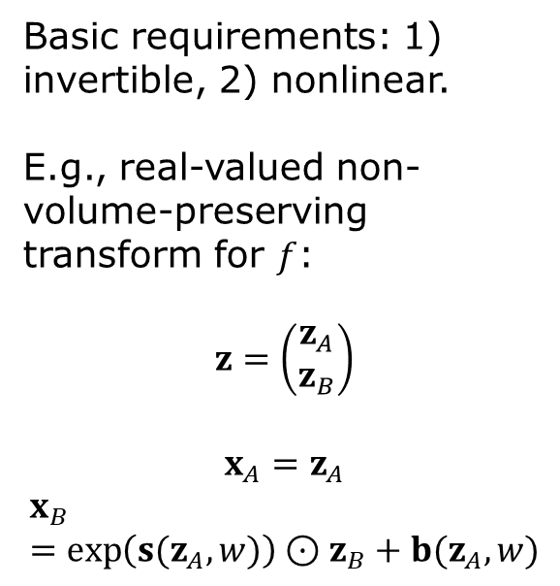
Implement the transformation $z→x$ using a neural network
Basic requirements: 1) invertible, 2) nonlinear.
E.g., real-valued non-volume-preserving transform for $f$:
$$z=\left(\begin{matrix}z_{A} \\ z_{B}\end{matrix}\right)$$
$$x_{A}=z_{A}$$
$$x_{B}=\exp\left(s(z_{A},w)\right)⊙z_{B}+b(z_{A},w)$$
Questions: Why need inverse $g$? What is the inverse? What is the Jacobian $det⁡(J)$?

Slide 13
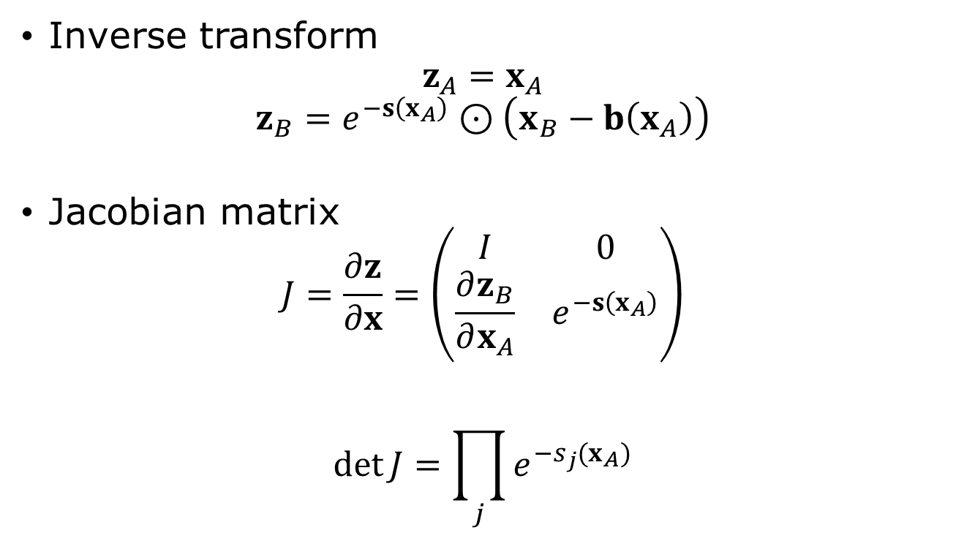
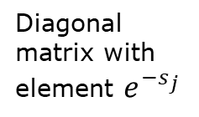
Real NVP
Inverse transform
$$z_{A}=x_{A}$$
$$z_{B}=e^{−s\left(x_{A}\right)}⊙\left(x_{B}−b\left(x_{A}\right)\right)$$
Jacobian matrix
$$J=\frac{∂z}{∂x}=\left(\begin{matrix}I & 0 \\ \frac{∂z_{B}}{∂x_{A}} & e^{−s\left(x_{A}\right)}\end{matrix}\right)$$
$$\det{J}=\prod_{j}{e^{−s_{j}(x_{A})}}$$
Diagonal matrix with element $e^{−s_{j}}$
Notes:
See also https://bjlkeng.io/posts/normalizing-flows-with-real-nvp/

Slide 14
State-of-the-art normalizing flow architecture
From arXiv:2412.06329, S. Zhai, et al.

Slide 15
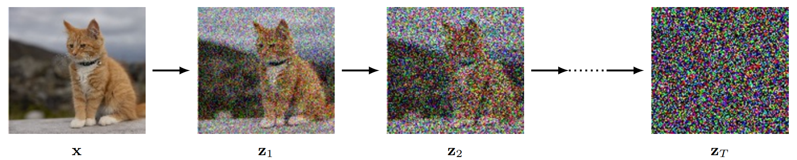
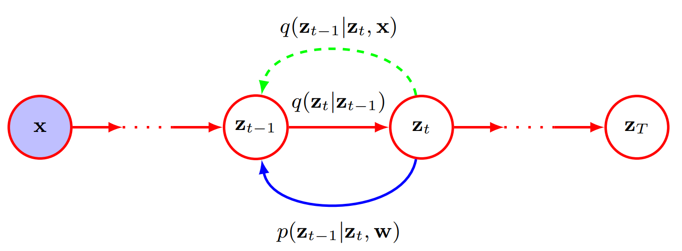

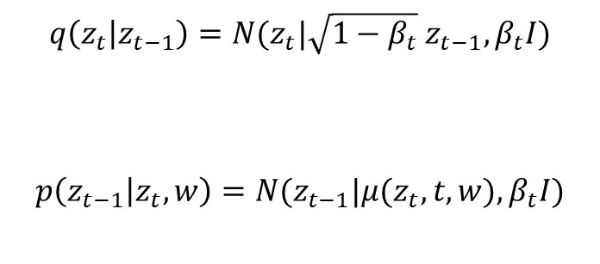
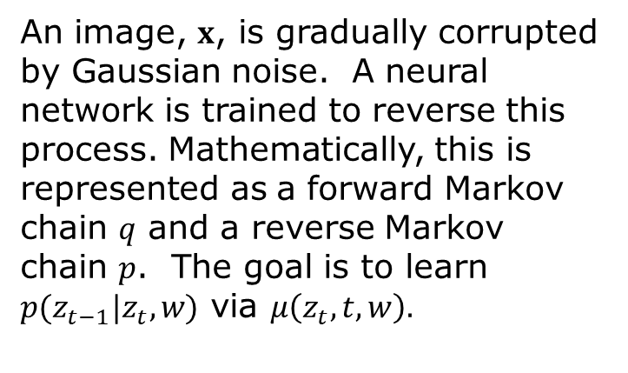
Diffusion models
$$q\left(z_{t} | z_{t−1}\right)=N(z_{t}|\sqrt{1−β_{t}} z_{t−1},β_{t}I)$$
$$p\left(z_{t−1} | z_{t},w\right)=N(z_{t−1}|μ(z_{t},t,w),β_{t}I)$$
An image, $x$, is gradually corrupted by Gaussian noise. A neural network is trained to reverse this process. Mathematically, this is represented as a forward Markov chain $q$ and a reverse Markov chain $p$. The goal is to learn $p(z_{t−1}|z_{t}, w)$ via $μ\left(z_{t}, t,w\right).$
$z_{t}$, $t=1,⋯, T$ are latent variables
Notes:
See books in Bishop, “Deep Learning”, Chapter 20, or S. J. D. Prince, “Understanding Deep Learning”, Chapter 18, or arXiv:2312.10393, or arXiv:2402.04384.

Slide 16
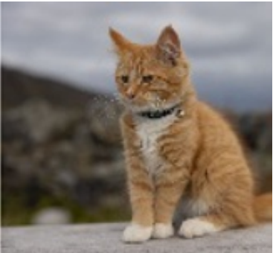
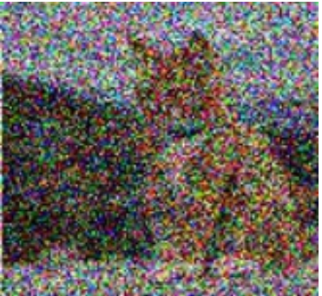

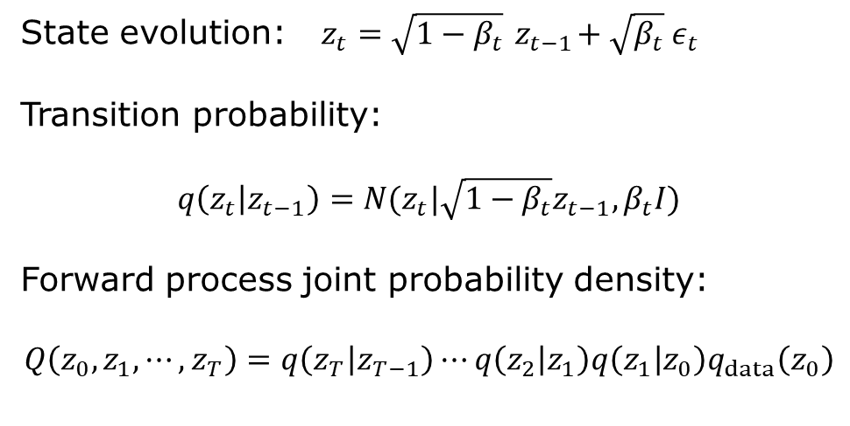











Forward Markov chain
add noise
add noise
$$z_{0}$$
$$z_{1}$$
$$z_{2}$$
…
$$z_{t−1}$$
$$z_{t}$$
…
$$z_{T}$$
$$z_{0}=x$$
$$\left\langle z_{t}\right\rangle$$
State evolution: $z_{t}=\sqrt{1−β_{t}}{ z}_{t−1}+\sqrt{β_{t}} ε_{t}$
Transition probability:
$$q\left(z_{t} | z_{t−1}\right)=N(z_{t}|\sqrt{1−β_{t}}z_{t−1},β_{t}I)$$
Forward process joint probability density:
$$Q\left(z_{0},z_{1},⋯, z_{T}\right)=q\left(z_{T} | z_{T−1}\right)⋯q\left(z_{2} | z_{1}\right)q\left(z_{1} | z_{0}\right)q_{data}\left(z_{0}\right)$$
$$var\left(z_{t}\right)$$
$$e^{−βt/2}$$
$$t$$

Slide 17
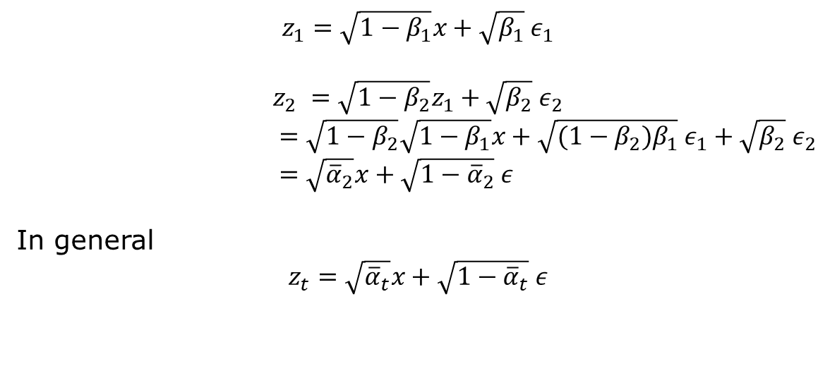
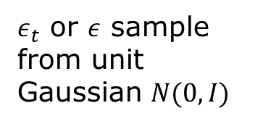


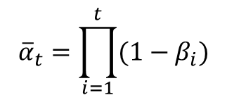
Faster update (diffusion kernel)
add noises
$$z_{0}$$
$$z_{t}$$
$${\overline{α}}_{t}=\prod_{i=1}^{t}{(1−β_{i}})$$
$$z_{0}=x$$
$$z_{1}=\sqrt{1−β_{1}}x+\sqrt{β_{1}} ε_{1}$$
$$z_{2} =\sqrt{1−β_{2}}z_{1}+\sqrt{β_{2}} ε_{2}$$
$=\sqrt{1−β_{2}}\sqrt{1−β_{1}}x+\sqrt{{(1−β_{2})β}_{1}} ε_{1}+\sqrt{β_{2}} ε_{2}$
$=\sqrt{{\overline{α}}_{2}}x+\sqrt{1−{\overline{α}}_{2}} ε$
In general
$$z_{t}=\sqrt{{\overline{α}}_{t}}x+\sqrt{1−{\overline{α}}_{t}} ε$$
$ε_{t}$ or $ε$ sample from unit Gaussian $N(0,I)$

Slide 18
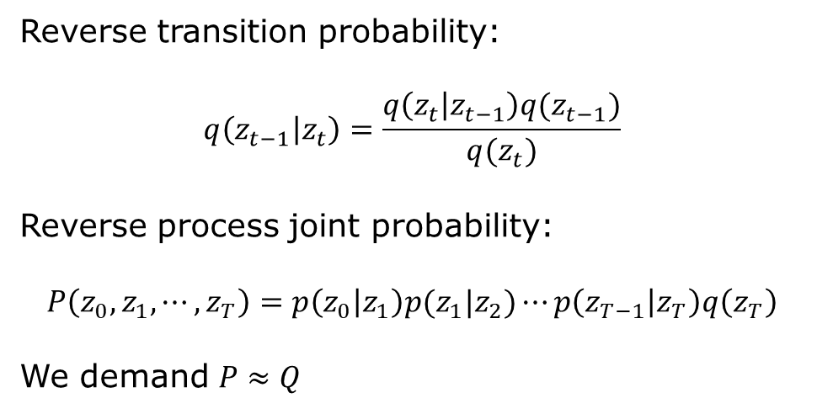

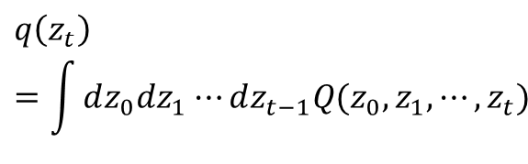
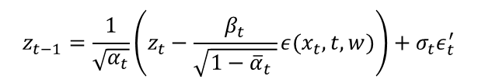
Reverse Markov chain
subtract noise
subtract noise
$$z_{0}$$
$$z_{1}$$
$$z_{2}$$
…
$$z_{t−1}$$
$$z_{t}$$
…
$$z_{T}$$
$$z_{t−1}=\frac{1}{\sqrt{α_{t}}}\left(z_{t}−\frac{β_{t}}{\sqrt{1−{\overline{α}}_{t} }}ε(x_{t},t,w)\right)+σ_{t}ε_{t}^{′}$$
Reverse transition probability:
$$q\left(z_{t−1} | z_{t}\right)=\frac{q\left(z_{t} | z_{t−1}\right)q(z_{t−1})}{q(z_{t})}$$
Reverse process joint probability:
$$P\left(z_{0},z_{1},⋯, z_{T}\right)=p\left(z_{0} | z_{1}\right)p(z_{1}|z_{2})⋯p\left(z_{T−1} | z_{T}\right)q\left(z_{T}\right)$$
We demand $P≈Q$
$$ε_{t}^{′}∼N(0,I)$$
$$q\left(z_{t}\right)=\int{dz_{0}dz_{1}⋯dz_{t−1}Q(z_{0},z_{1},⋯,z_{t})}$$

Slide 19
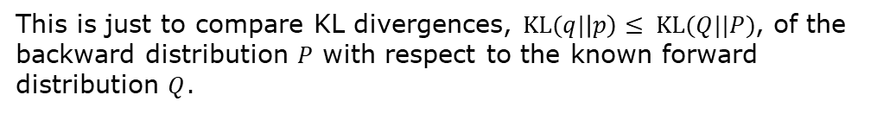
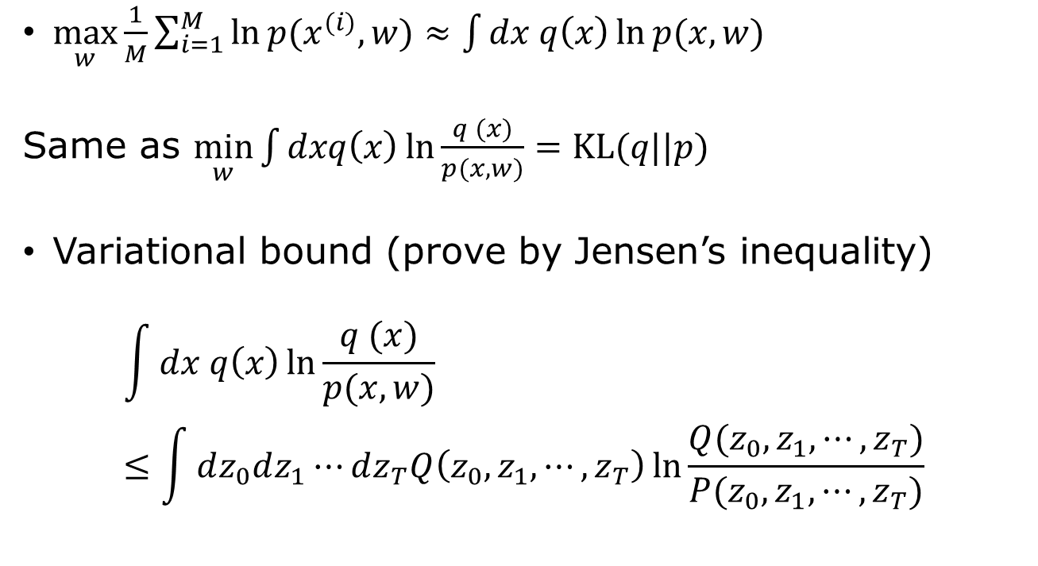


Likelihood/KL divergence
$\max_{w}{\frac{1}{M}\sum_{i=1}^{M}{\ln{p(x^{(i)},w)}}≈\int{dx q\left(x\right)\ln{p(x,w)}}}$
Same as $\min_{w}{\int{dxq\left(x\right)\ln{\frac{q (x)}{p(x,w)}}}=KL(q||p)}$
Variational bound (prove by Jensen’s inequality)
$$\int{dx q\left(x\right)\ln{\frac{q (x)}{p(x,w)}}}≤\int{dz_{0}dz_{1}⋯dz_{T}Q\left(z_{0},z_{1},⋯,z_{T}\right)\ln{\frac{Q(z_{0},z_{1},⋯, z_{T})}{P(z_{0},z_{1},⋯, z_{T})}}}$$
$$q(x)≡q_{data}(x)$$
$$z_{0}=x$$
This is just to compare KL divergences, $KL(q|\left|p\right)≤ KL(Q||P)$, of the backward distribution $P$ with respect to the known forward distribution $Q$.

Slide 20
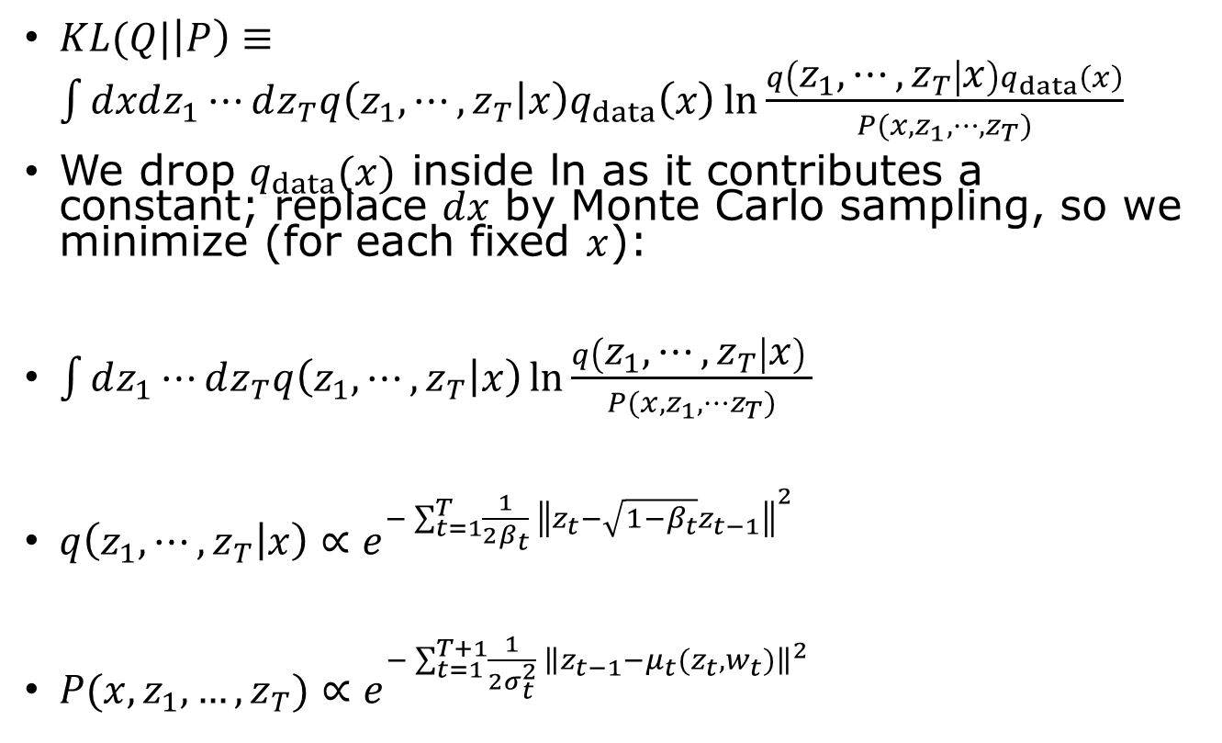



Minimizing KL($Q||P$)
$KL(Q|\left|P\right)≡\int{dxdz_{1}⋯dz_{T}q\left(z_{1},⋯, z_{T} | x\right)q_{data}\left(x\right)}\ln{\frac{q\left(z_{1}, ⋯, z_{T} | x\right)q_{data}\left(x\right)}{P(x,z_{1},⋯, z_{T})}}$
We drop $q_{data}(x)$ inside ln as it contributes a constant; replace $dx$ by Monte Carlo sampling, so we minimize (for each fixed $x$):
$\int{dz_{1}⋯dz_{T}q\left(z_{1},⋯, z_{T} | x\right)}\ln{\frac{q\left(z_{1}, ⋯, z_{T} | x\right) }{P(x,z_{1},⋯z_{T})}}$
$q\left(z_{1},⋯, z_{T} | x\right)∝e^{−\sum_{t=1}^{T}{\frac{1}{2β_{t}} {\left\|z_{t}−\sqrt{1−β_{t}}z_{t−1}\right\|}^{2} }}$
$P(x,z_{1},…, z_{T})∝e^{−\sum_{t=1}^{T+1}{\frac{1}{2σ_{t}^{2}} {\left\|z_{t−1}−{μ_{t}(z}_{t},w_{t})\right\|}^{2} }}$
$$z_{0}≡x$$
Forward is a free spring
Backward is a tethered spring
$$μ_{T+1}=0$$

Slide 21
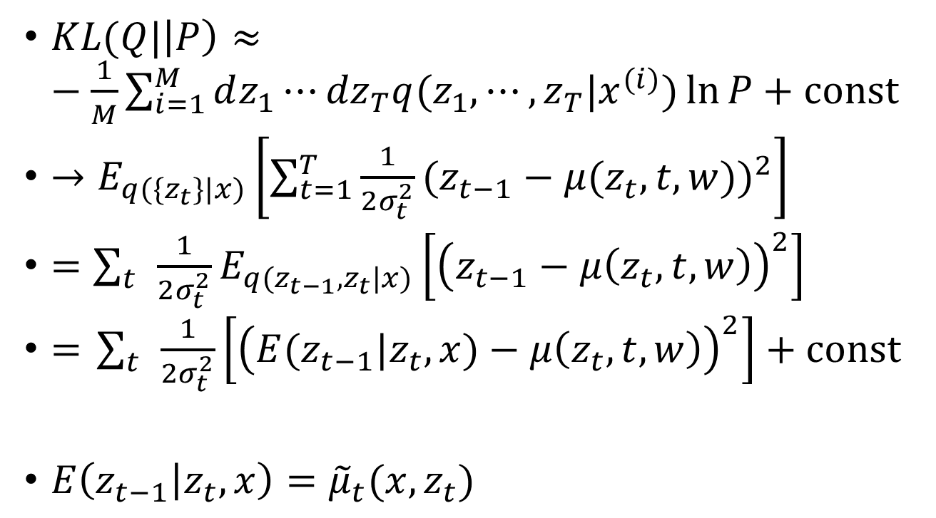
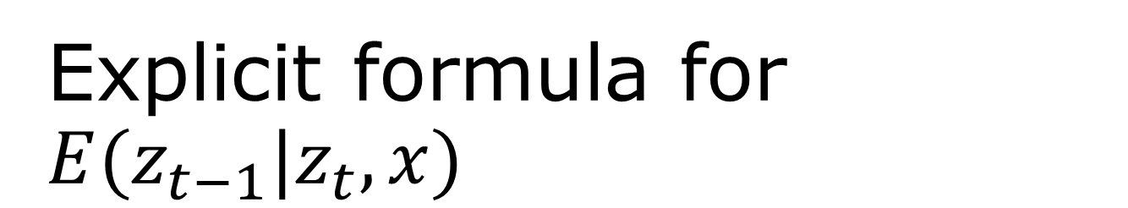
Explicit formula for $E(z_{t−1}|z_{t},x)$
$KL(Q|\left|P\right)≈−\frac{1}{M}\sum_{i=1}^{M}{dz_{1}⋯{dz}_{T}q(z_{1},⋯, z_{T}|x^{(i)})\ln{P}+const}$
$→E_{q(\{z_{t}\}|x)}\left[\sum_{t=1}^{T}{\frac{1}{2σ_{t}^{2}}}{(z_{t−1}−μ(z_{t}, t,w))}^{2}\right]$
$=\sum_{t}{\frac{1}{2σ_{t}^{2}}E_{q(z_{t−1},z_{t}|x)}\left[{\left(z_{t−1}−μ\left(z_{t},t,w\right)\right)}^{2}\right]}$
$=$ $\sum_{t}{\frac{1}{2σ_{t}^{2}}\left[{\left(E(z_{t−1}|z_{t},x)−μ\left(z_{t},t,w\right)\right)}^{2}\right]+const}$
$E\left(z_{t−1} | z_{t},x\right)={\tilde{μ}}_{t}(x,z_{t})$
can be calculated explicitly

Slide 22
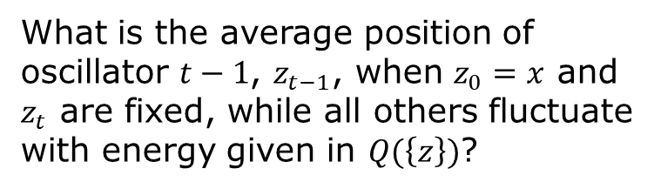


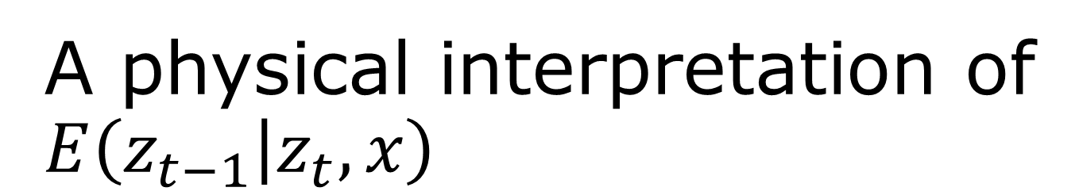




A physical interpretation of $E\left(z_{t−1} | z_{t},x\right)$
$$\left\langle z_{t−1}\right\rangle ={\tilde{μ}}_{t}=az_{0}+bz_{t}$$
$$x$$
$${ z}_{1}$$
…
$$z_{t−2}$$
$$z_{t−1}$$
$$z_{t}$$
What is the average position of oscillator $t−1$, $z_{t−1}$, when $z_{0}=x$ and $z_{t}$ are fixed, while all others fluctuate with energy given in $Q(\left\{z\right\})$?

Slide 23

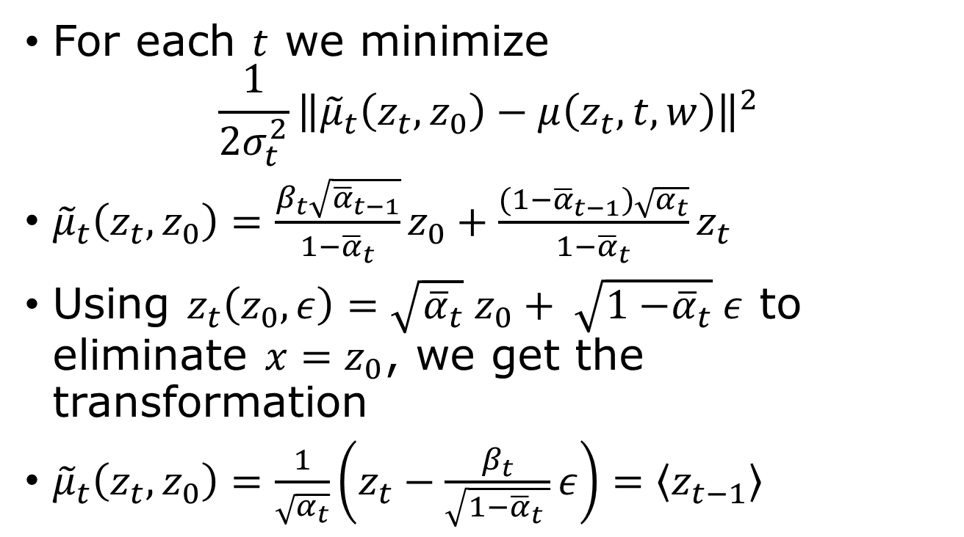
Loss function and re-parametrization
For each $t$ we minimize
$$\frac{1}{{2σ}_{t}^{2}}{\left\|{\tilde{μ}}_{t}\left(z_{t},z_{0}\right)−μ\left(z_{t}, t,w\right)\right\|}^{2}$$
${\tilde{μ}}_{t}\left(z_{t},z_{0}\right)=\frac{β_{t}\sqrt{{\overline{α}}_{t−1}}}{1−{\overline{α}}_{t}}z_{0}+\frac{(1−{\overline{α}}_{t−1})\sqrt{α_{t}}}{1−{\overline{α}}_{t}}z_{t}$
Using $z_{t}\left(z_{0},ε\right)=\sqrt{{\overline{α}}_{t}} z_{0}+ \sqrt{1{−\overline{α}}_{t}}ε$ to eliminate ${x=z}_{0}$, we get the transformation
${\tilde{μ}}_{t}\left(z_{t}, z_{0}\right)=\frac{1}{\sqrt{α_{t}}}\left(z_{t}−\frac{β_{t}}{\sqrt{1−{\overline{α}}_{t} }}ε\right)=\left\langle z_{t−1}\right\rangle$
$${\overline{α}}_{t}=α_{1}α_{2}⋯α_{t}$$

Slide 24
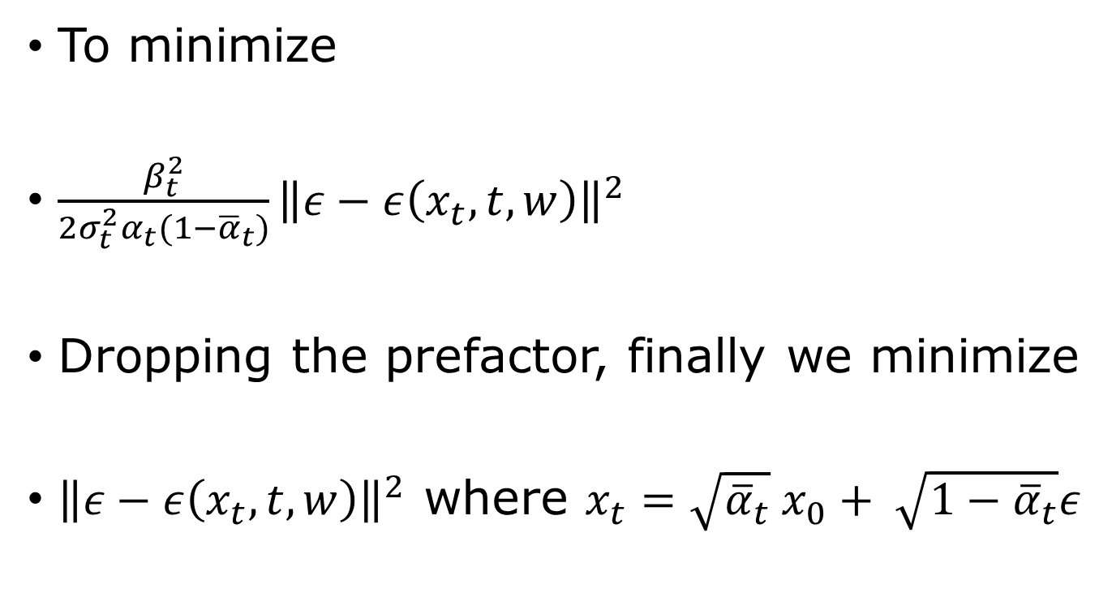
Final loss function
To minimize
$\frac{β_{t}^{2}}{2σ_{t}^{2}α_{t}(1−{\overline{α}}_{t})}{\left\|ε−ε\left(x_{t},t,w\right)\right\|}^{2}$
Dropping the prefactor, finally we minimize
${\left\|ε−ε\left(x_{t},t,w\right)\right\|}^{2}$ where $x_{t}=\sqrt{{\overline{α}}_{t}} x_{0}+ \sqrt{1−{\overline{α}}_{t}}ε$
Notes:
Thus training a diffusion model reduces to a supervised regression problem: generate known Gaussian noise \(\epsilon\), corrupt \(x_0\), and train the network to predict the noise that was added. This is the central result of DDPM.

Slide 25
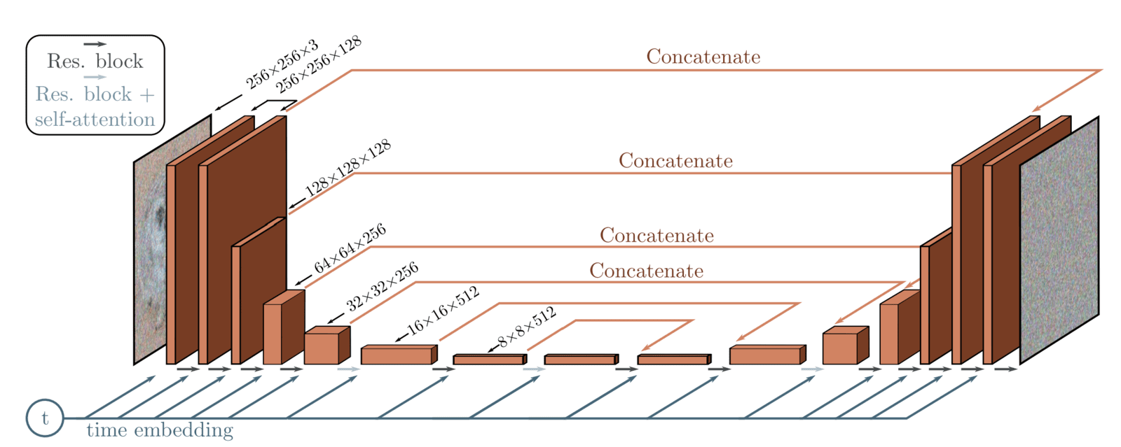

U-Net to learn $ε(z_{t},t,w)$
What is “concatenate” and what is “time embedding”?
From https://learnopencv.com/denoising-diffusion-probabilistic-models/

Slide 26


Training and sampling
The neural network learns the function $ε_{θ}(x,t)$
(called $g(z,w,t)$ in Bishop)
$$α_{t}+β_{t}=1$$
From arXiv:2006.11239, J. Ho, et al.

Slide 27



Continuous-time diffusion models
for DDPM:
$$f=−\frac{1}{2}β_{t}x_{t}$$
$$g=\sqrt{β_{t}}$$
$W$: standard Wiener process
Forward move
$$dx=f\left(x,t\right)dt+g\left(t\right)dW$$
Reverse reconstruction
$$dx=\left[f\left(x,t\right)−g{\left(t\right)}^{2}∇_{x}\log{p_{t}(x)}\right]dt+g\left(t\right)dW$$
Or deterministic ODE
$dx=\left[f\left(x,t\right)−\frac{1}{2} g{\left(t\right)}^{2}∇_{x}\log{p_{t}(x)}\right]dt$
$$<0$$
Notes:
See Y. Song, et al, https://arxiv.org/abs/2011.13456

Slide 28
Summary
GAN: learn a generator indirectly through a discriminator; the probability density need not be explicit.
Normalizing flow: learn an invertible transformation; density is explicitly computable from the Jacobian.
Diffusion: learn the reverse/noise-removal process; generation is iterative.

