Slide 1
Week 11,
Boltzmann Machine
Notes:
See Haykin, “Neural Networks”, 2nd ed, Chap 11.7; or Fischer and Igel. “Training Restricted
Boltzmann Machines: An Introduction,” in Pattern Recognition 47:25-39, 2014

Slide 2
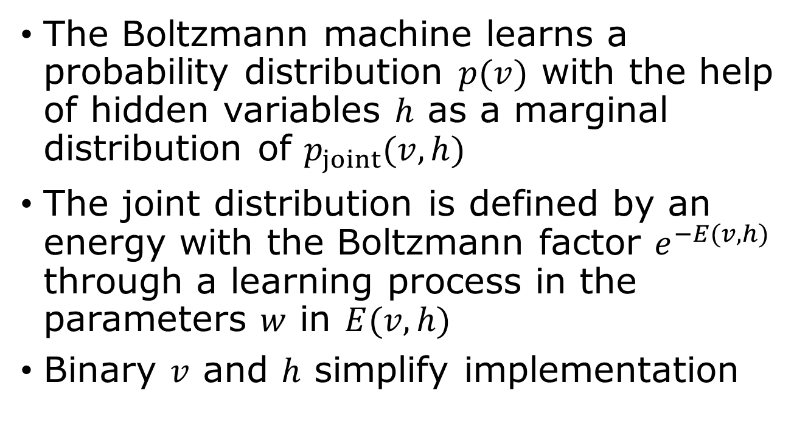
Modeling data distributions
The Boltzmann machine learns a probability distribution $p(v)$ with the help of hidden variables $h$ as a marginal distribution of $p_{joint}(v,h)$
The joint distribution is defined by an energy with the Boltzmann factor $e^{−E(v,h)}$ through a learning process in the parameters $w$ in $E(v,h)$
Binary $v$ and $h$ simplify implementation
Notes:
See chapter 20, “Deep Learning”, Goodfellow, et al

Slide 3
What can a Boltzmann machine do?
Recommendation systems: predict user preferences by analyzing past user-item interactions, allowing for personalized recommendations on online platforms
Image recognition and processing: extract meaningful features from images and used for tasks like image denoising, reconstruction, and general pattern recognition
Natural Language processing and generative modeling

Slide 4

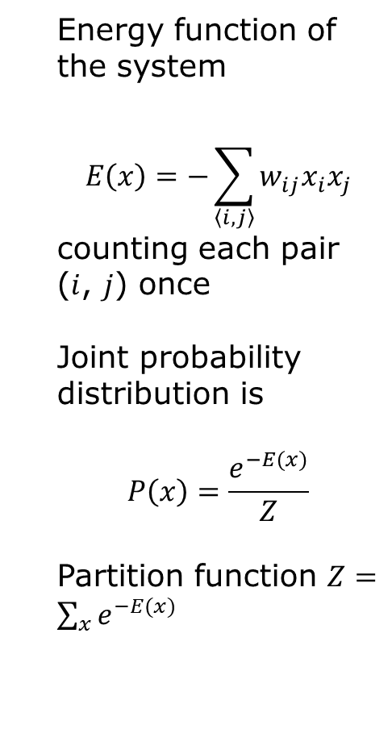





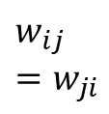

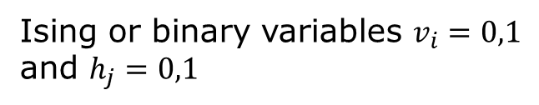


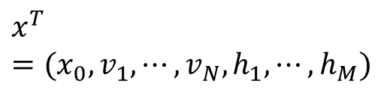
Visible and hidden units
$$x^{T}=(x_{0}, v_{1},⋯, v_{N},h_{1},⋯, h_{M})$$
Energy function of the system
$$E\left(x\right)=−\sum_{\left\langle i,j\right\rangle }{w_{ij}x_{i}x_{j}}$$
counting each pair ($i$, $j$) once
Joint probability distribution is
$$P\left(x\right)=\frac{e^{−E(x)}}{Z}$$
Partition function $Z=\sum_{x}{e^{−E(x)}}$
$$x_{0}=1$$
$${ h}_{1}$$
$${ h}_{2}$$
…
$${ h}_{j}$$
…
$${ h}_{M}$$
$$w_{ij}=w_{ji}$$
$${ v}_{1}$$
$${ v}_{2}$$
…
$${ v}_{i}$$
…
$${ v}_{N}$$
Ising or binary variables $v_{i}=0,1$ and $h_{j}=0,1$

Slide 5
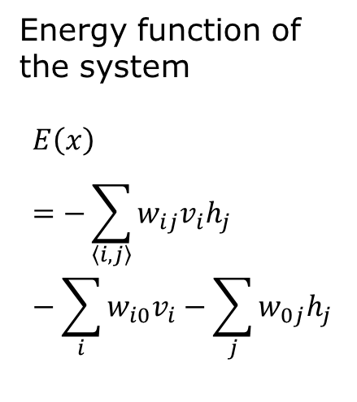


Restricted Boltzmann machine – no self-interaction
$$x^{T}=(x_{0}, v_{1},⋯, v_{N},h_{1},⋯, h_{M})$$
Energy function of the system
$$E\left(x\right)=−\sum_{\left\langle i,j\right\rangle }{w_{ij}v_{i}h_{j}}−\sum_{i}{w_{i0}v_{i}}−\sum_{j}{w_{0j}h_{j}}$$
$$v_{0}=h_{0}=x_{0}$$
$$x_{0}=1$$
$${ h}_{1}$$
$${ h}_{2}$$
…
$${ h}_{j}$$
…
$${ h}_{M}$$
$$w_{ij}$$
$${ v}_{1}$$
$${ v}_{2}$$
…
$${ v}_{i}$$
…
$${ v}_{N}$$
bipartite
Ising or binary variables $v_{i}=0,1$ and $h_{j}=0,1$

Slide 6
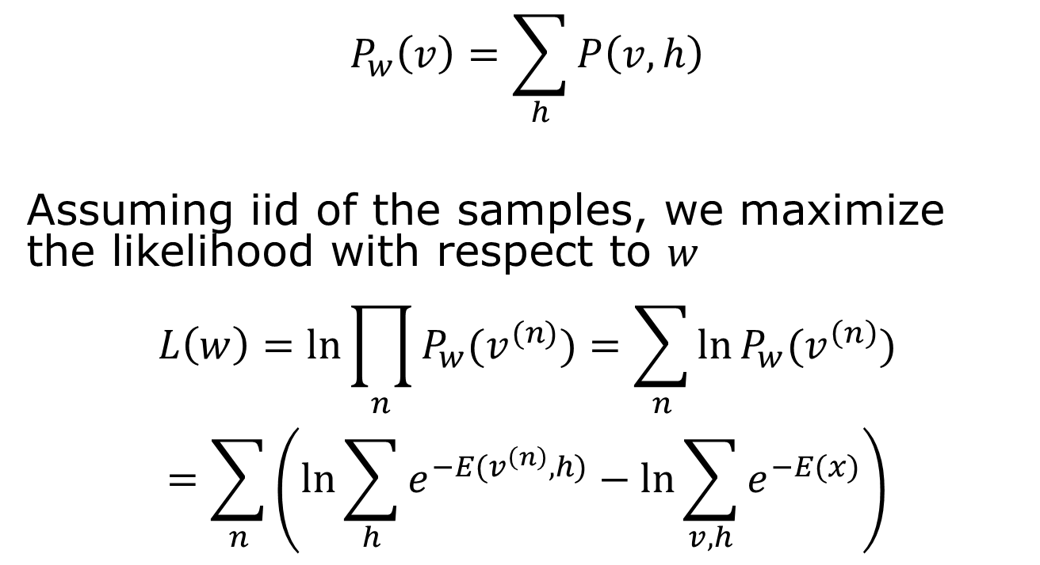

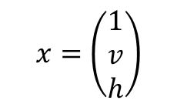
Learn sample probability from data
$$x=\left(\begin{matrix}1 \\ v \\ h\end{matrix}\right)$$
$$P_{w}\left(v\right)=\sum_{h}{P\left(v,h\right)}$$
Assuming iid of the samples, we maximize the likelihood with respect to $w$
$$L\left(w\right)=\ln{\prod_{n}{P_{w}(v^{(n)})}}=\sum_{n}{\ln{P_{w}(v^{\left(n\right)})}}$$
$$=\sum_{n}{\left(\ln{\sum_{h}{e^{−E(v^{\left(n\right)},h)}}}−\ln{\sum_{v,h}{e^{−E(x)}}}\right)}$$
By marginalization
$$\underset{Z}{\underbrace{ }}$$
Notes:
Z is the partition function

Slide 7
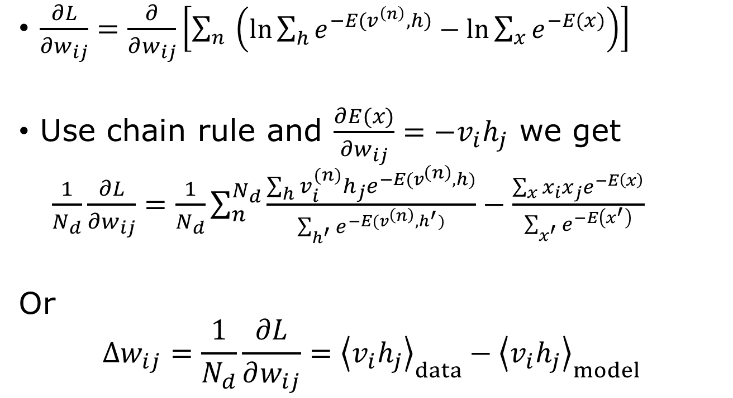
Compute gradient
$\frac{∂L}{∂w_{ij}}=\frac{∂}{∂w_{ij}}\left[\sum_{n}{\left(\ln{\sum_{h}{e^{−E(v^{\left(n\right)},h)}}}−\ln{\sum_{x}{e^{−E(x)}}}\right)}\right]$
Use chain rule and $\frac{∂E(x)}{∂w_{ij}}=−v_{i}h_{j}$ we get
$\frac{1}{N_{d}}\frac{∂L}{∂w_{ij}}=\frac{1}{N_{d}}\sum_{n}^{N_{d}}{\frac{\sum_{h}{v_{i}^{(n)}h_{j}e^{−E(v^{\left(n\right)},h)}}}{\sum_{h^{′}}{e^{−E(v^{\left(n\right)},h^{′})}}}}−\frac{\sum_{x}{{x_{i}x_{j}e}^{−E\left(x\right)}}}{\sum_{x^{′}}{e^{−E\left(x^{′}\right)}}}$
Or
$$Δw_{ij}=\frac{1}{N_{d}}\frac{∂L}{∂w_{ij}}={\left\langle v_{i}h_{j}\right\rangle }_{data}−{\left\langle v_{i}h_{j}\right\rangle }_{model}$$

Slide 8
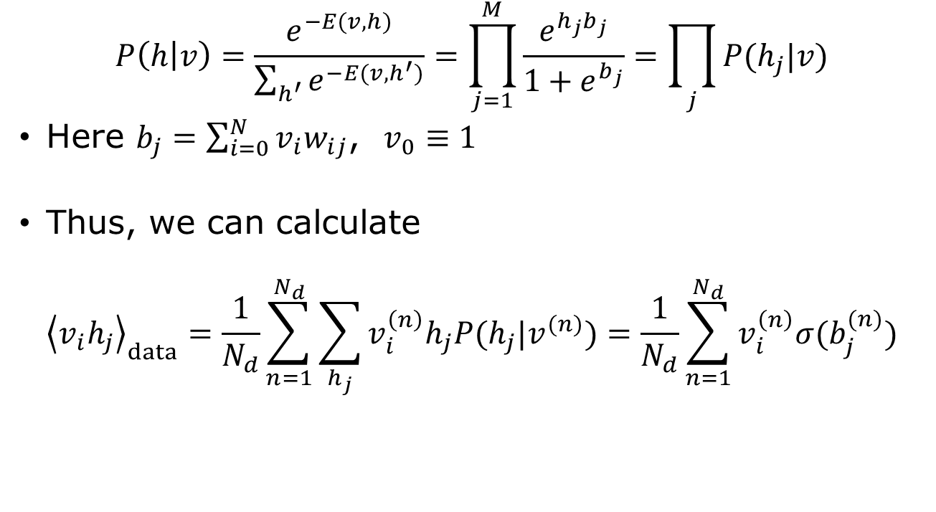
Conditional probability of h given data
$$P\left(h | v\right)=\frac{e^{−E(v,h)}}{\sum_{h^{′}}{e^{−E(v,h^{′})}}}=\prod_{j=1}^{M}{\frac{e^{{h_{j}b}_{j}}}{1+e^{b_{j}}}}=\prod_{j}{P(h_{j}|v)}$$
Here $b_{j}=\sum_{i=0}^{N}{v_{i}w_{ij}}$, $v_{0}≡1$
Thus, we can calculate
$${\left\langle v_{i}h_{j}\right\rangle }_{data}=\frac{1}{N_{d}}\sum_{n=1}^{N_{d}}{\sum_{h_{j}}{v_{i}^{\left(n\right)}h_{j}P(h_{j}|v^{(n)})}}=\frac{1}{N_{d}}\sum_{n=1}^{N_{d}}{v_{i}^{\left(n\right)}σ(b_{j}^{(n)})}$$

Slide 9
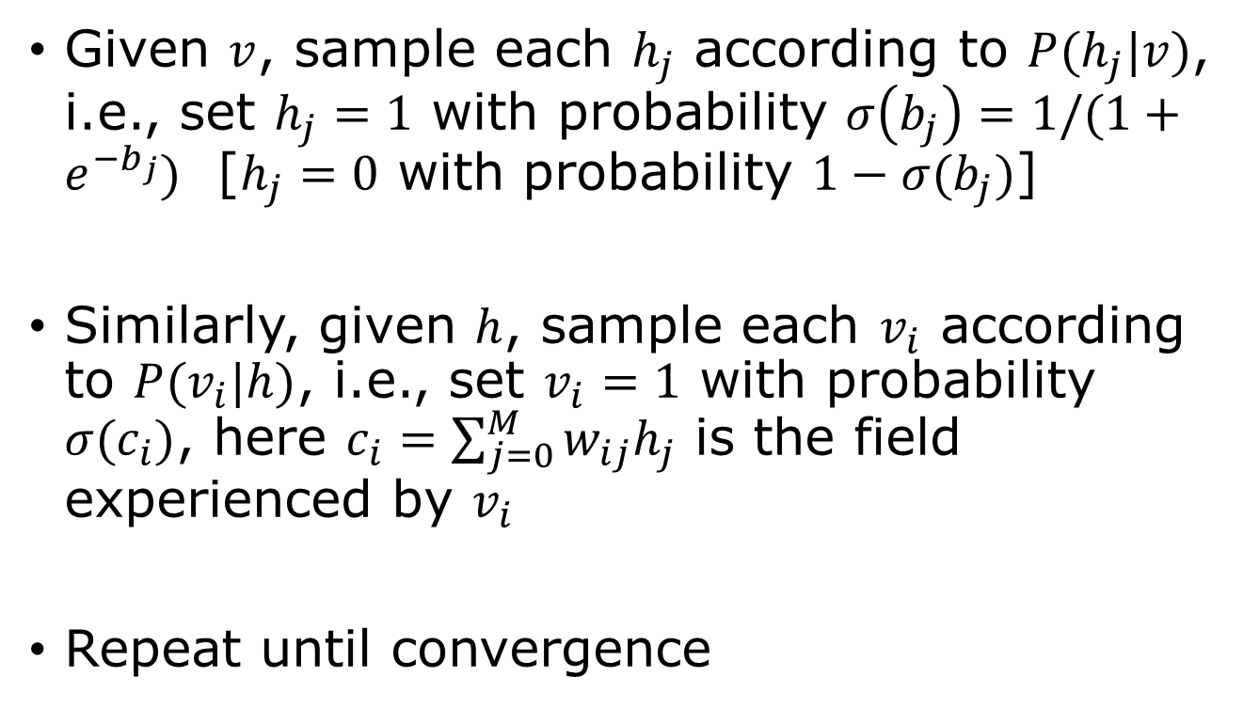
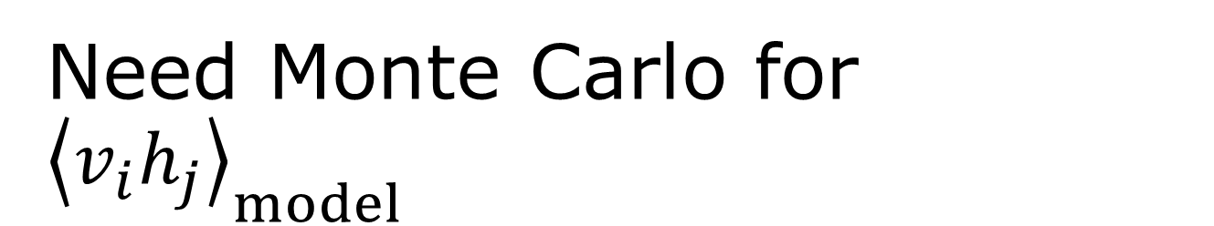
Need Monte Carlo for ${\left\langle v_{i}h_{j}\right\rangle }_{model}$
Given $v$, sample each $h_{j}$ according to $P(h_{j}|v)$, i.e., set $h_{j}=1$ with probability $σ\left(b_{j}\right)=1/(1+e^{−b_{j}})$ [$h_{j}=0$ with probability $1−σ(b_{j})$]
Similarly, given $h$, sample each $v_{i}$ according to $P(v_{i}|h)$, i.e., set $v_{i}=1$ with probability $σ(c_{i})$, here $c_{i}=\sum_{j=0}^{M}{w_{ij}h_{j}}$ is the field experienced by $v_{i}$
Repeat until convergence

Slide 10
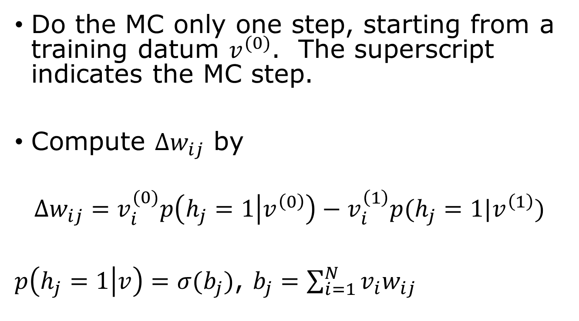
Contrastive divergence
Do the MC only one step, starting from a training datum $v^{(0)}$. The superscript indicates the MC step.
Compute $Δw_{ij}$ by
$${Δw_{ij}=v}_{i}^{(0)}p\left(h_{j}=1 | v^{\left(0\right)}\right)−v_{i}^{\left(1\right)}p(h_{j}=1|v^{\left(1\right)})$$
$p\left(h_{j}=1 | v\right)=σ(b_{j})$, $b_{j}=\sum_{i=1}^{N}{v_{i}w_{ij}}$
Notes:
As usual, in machine learning, we update the weight with a learning rate, i.e., w_ij -> w_ij + eta Delta w_ij (eta small).

Slide 11
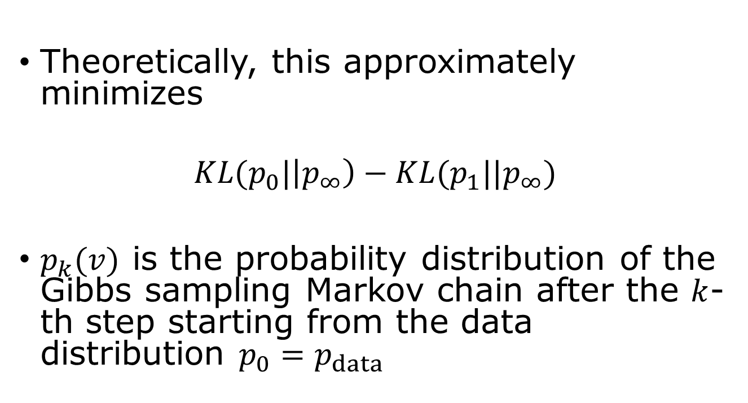
Contrastive divergence
Theoretically, this approximately minimizes
$$KL(p_{0}|\left|p_{∞}\right)−KL(p_{1}||p_{∞})$$
$p_{k}(v)$ is the probability distribution of the Gibbs sampling Markov chain after the $k$-th step starting from the data distribution $p_{0}=p_{data}$

Slide 12
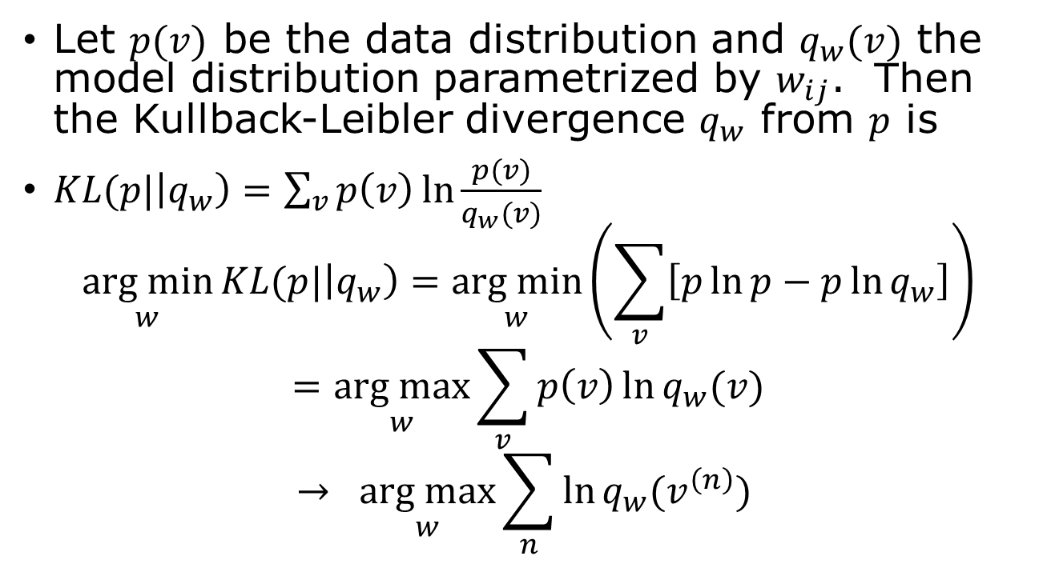
Maximising Likelihood is equivalent to minimizing KL Divergence
Let $p(v)$ be the data distribution and $q_{w}(v)$ the model distribution parametrized by $w_{ij}$. Then the Kullback-Leibler divergence $q_{w}$ from $p$ is
$KL(p|\left|q_{w}\right)=\sum_{v}{p\left(v\right)\ln{\frac{p(v)}{q_{w}(v)}}}$
$$\underset{w}{arg min}{KL(p|\left|q_{w}\right)=\underset{w}{arg min}\left(\sum_{v}{\left[p\ln{p}−p\ln{q_{w}}\right]}\right)}$$
$$=\underset{w}{arg max}{\sum_{v}{p\left(v\right)\ln{q_{w}(v)}}}$$
$$→ \underset{w}{arg max}{\sum_{n}{\ln{q_{w}(v^{\left(n\right)}) }}}$$
Replace probability average by sample average

Slide 13
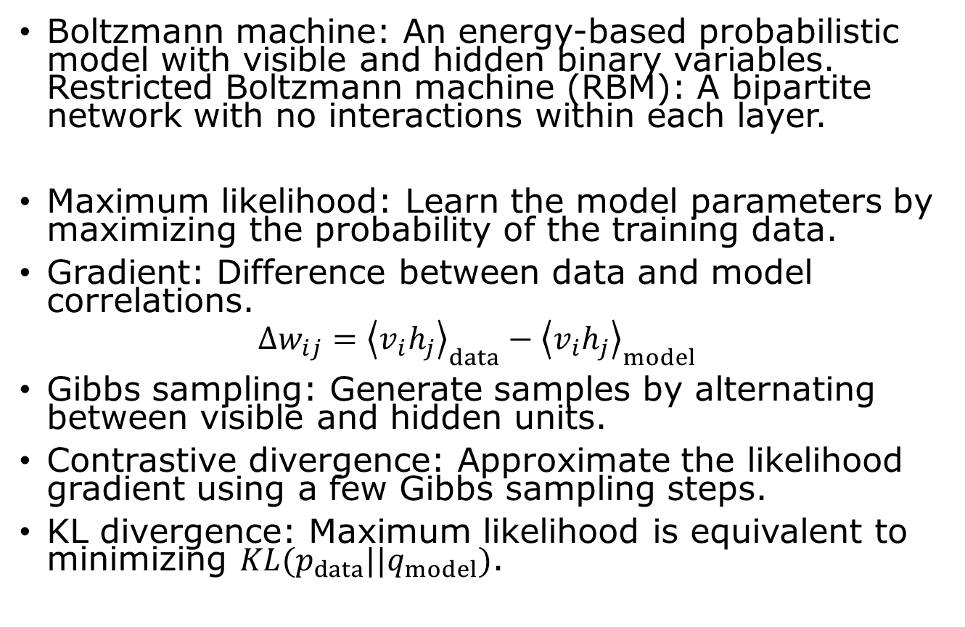
Summary: Boltzmann Machines
Boltzmann machine: An energy-based probabilistic model with visible and hidden binary variables. Restricted Boltzmann machine (RBM): A bipartite network with no interactions within each layer.
Maximum likelihood: Learn the model parameters by maximizing the probability of the training data.
Gradient: Difference between data and model correlations.
$$Δw_{ij}={\left\langle v_{i}h_{j}\right\rangle }_{data}−{\left\langle v_{i}h_{j}\right\rangle }_{model}$$
Gibbs sampling: Generate samples by alternating between visible and hidden units.
Contrastive divergence: Approximate the likelihood gradient using a few Gibbs sampling steps.
KL divergence: Maximum likelihood is equivalent to minimizing $KL(p_{data}||q_{model})$.

Slide 14
Revision Suggestions
The PPT slides define the “scope” only
Focus on the relevant chapters of Bishop’s book
Memorizing formulas is unlikely to be helpful, focus on the conceptual understanding
Format of final exam: 1) multiple choices, 2) Python programming, 3,4) Bishop book style problems (mostly math)
The contents you can ignore: week 1 biological neurons, regularization, diffusion model, and Boltzmann machine

