Slide 1
Week 8,
Recurrent Neural Networks

Slide 2
Outline
Neural networks for sequential data of variable length (e.g., text) – RNN
Parameter sharing over time
Probability models for sequential data
Vanishing and exploding gradients; long short-term memory (LSTM) networks to overcome them

Slide 3
Handling sequential data
Examples:
  Time series, such as audio or stock prices
  Video
  Natural language processing
  Predicting the next state for a dynamic system
  …

Slide 4

Recurrent neural network (RNN)
output output 1 output 2 output 3 …
unfold
Hidden state $h_{t}$
Hidden state 1
Hidden state 2
Hidden state 3
Hidden
state 4
. . .
input input 1 input 2 input 3 …

Slide 5
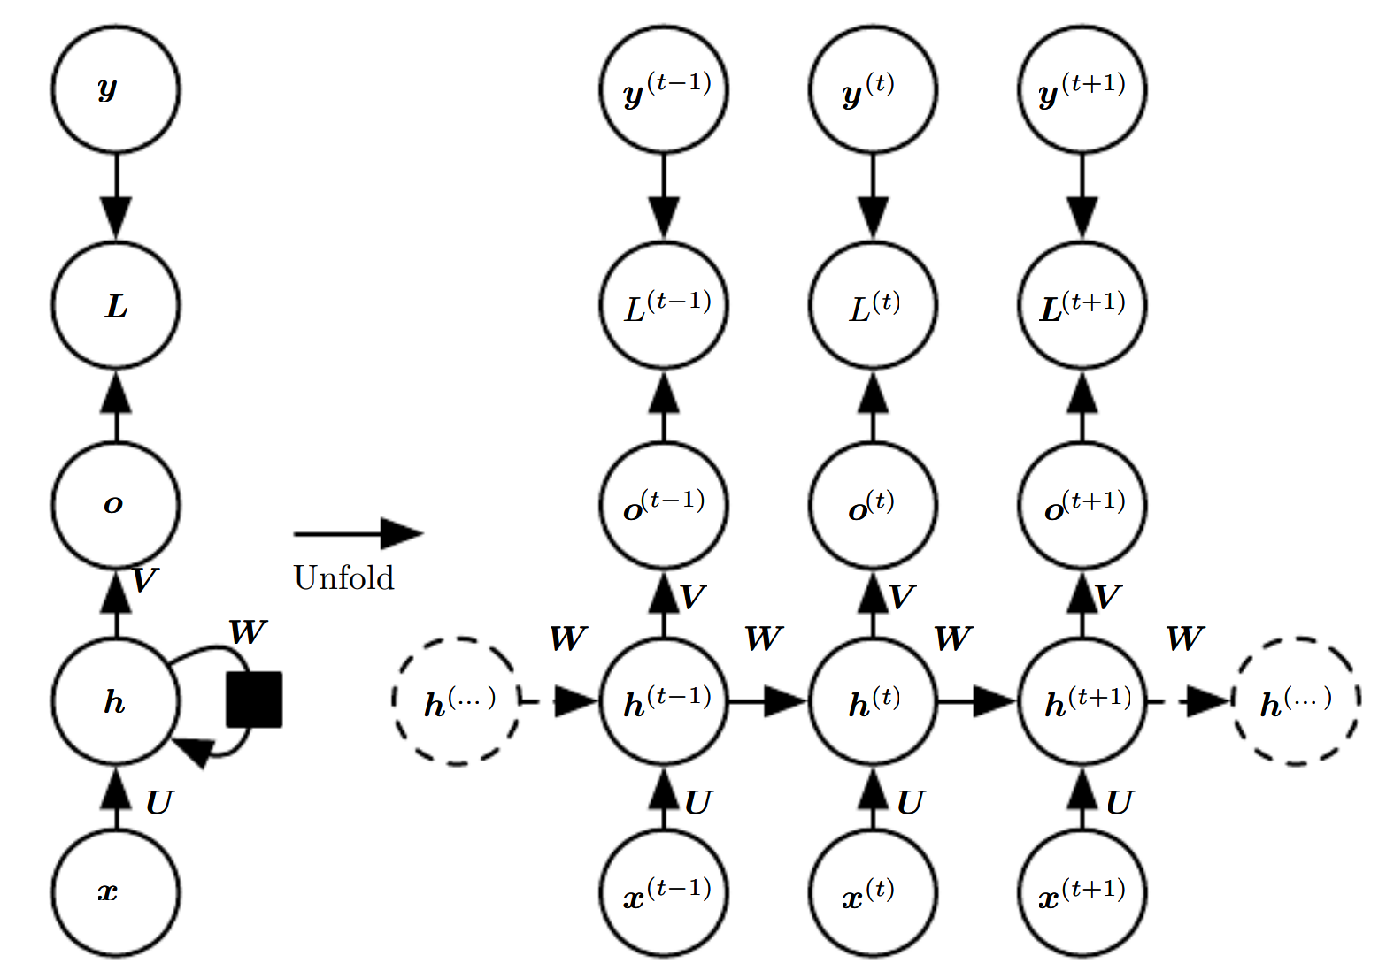
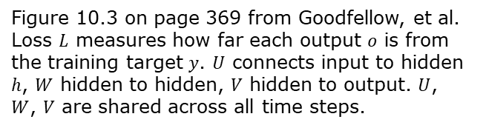
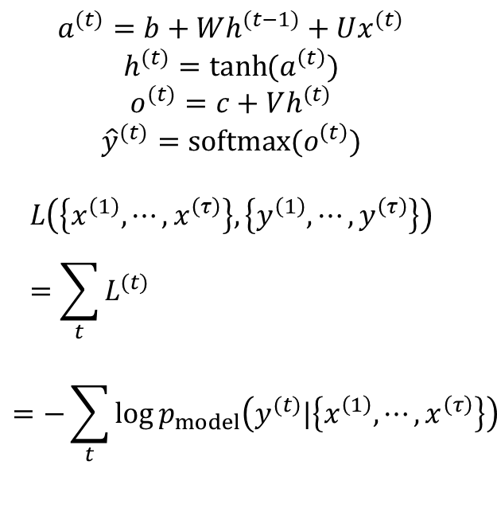
A concrete RNN and its unfolding
$$a^{(t)}=b+Wh^{(t−1)}+Ux^{(t)}$$
$$h^{(t)}=\tanh{(a^{\left(t\right)})}$$
$$o^{(t)}=c+Vh^{(t)}$$
$${\hat{y}}^{(t)}=softmax(o^{\left(t\right)})$$
$$L\left(\left\{x^{\left(1\right)},⋯,x^{\left(τ\right)}\right\},\left\{y^{\left(1\right)},⋯,y^{\left(τ\right)}\right\}\right)=\sum_{t}{L^{(t)} }$$
$$=−\sum_{t}{\log{p_{model}\left(y^{(t)}|\left\{x^{\left(1\right)},⋯,x^{\left(τ\right)}\right\}\right)}}$$
Figure 10.3 on page 369 from Goodfellow, et al. Loss $L$ measures how far each output $o$ is from the training target $y$. $U$ connects input to hidden $h$, $W$ hidden to hidden, $V$ hidden to output. $U$, $W$, $V$ are shared across all time steps.

Slide 6
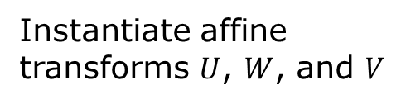
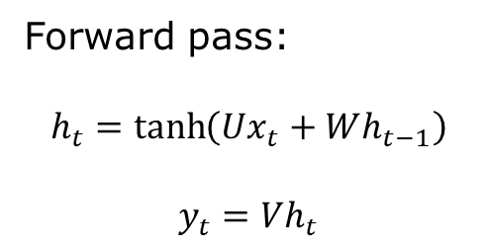
PyTorch code for a simple RNN
Forward pass:
$$h_{t}=\tanh\left(Ux_{t}+Wh_{t−1}\right)$$
$$y_{t}=Vh_{t}$$
import torch
import torch.nn as nn
class RNN(nn.Module):
def __init__(self, n_in, n_hidden, n_out):
super().__init__()
self.U = nn.Linear(n_in, n_hidden)
self.W = nn.Linear(n_hidden, n_hidden)
self.V = nn.Linear(n_hidden, n_out)
def forward(self, x):
# x: (batch, time, n_in)
h = torch.zeros(x.size(0), self.W.out_features)
outputs = []
for t in range(x.size(1)):
h = torch.tanh(self.U(x[:, t, :]) + self.W(h))
y = self.V(h)
outputs.append(y)
return torch.stack(outputs, dim=1)
Instantiate affine transforms $U$, $W$, and $V$

Slide 7
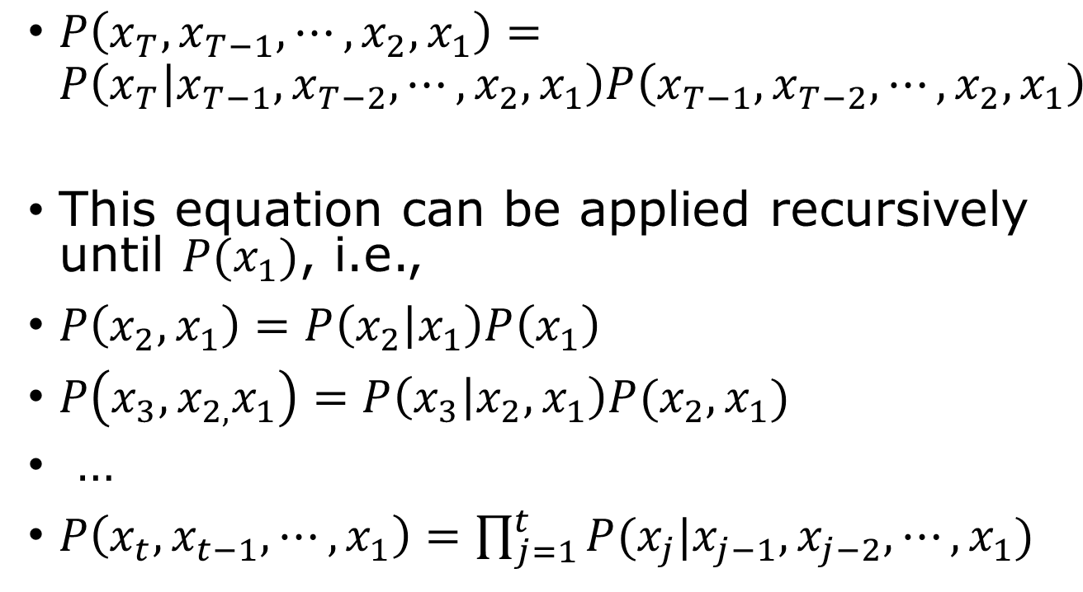
Using neural networks to represent joint probabilities of sequences
$P\left(x_{T},x_{T−1},⋯,x_{2},x_{1}\right)=P\left(x_{T} | x_{T−1},x_{T−2},⋯,x_{2},x_{1}\right)P\left(x_{T−1},x_{T−2},⋯,x_{2},x_{1}\right)$
This equation can be applied recursively until $P(x_{1})$, i.e.,
$P\left(x_{2},x_{1}\right)=P\left(x_{2} | x_{1}\right)P\left(x_{1}\right)$
$P\left(x_{3},x_{2,}x_{1}\right)=P\left(x_{3} | x_{2},x_{1}\right)P(x_{2},x_{1})$
…
$P\left(x_{t},x_{t−1},⋯, x_{1}\right)=\prod_{j=1}^{t}{P(x_{j}|x_{j−1},x_{j−2},⋯,x_{1})}$

Slide 8





Markov process
Assuming that the conditional probability depends only on the immediately preceding state:
$P\left(x_{t} | x_{t−1},x_{t−2},⋯, x_{1}\right)=P(x_{t}|x_{t−1})$
$${ x}_{1}$$
$${ x}_{2}$$
$${ x}_{3}$$
$${ x}_{4}$$
?

Slide 9
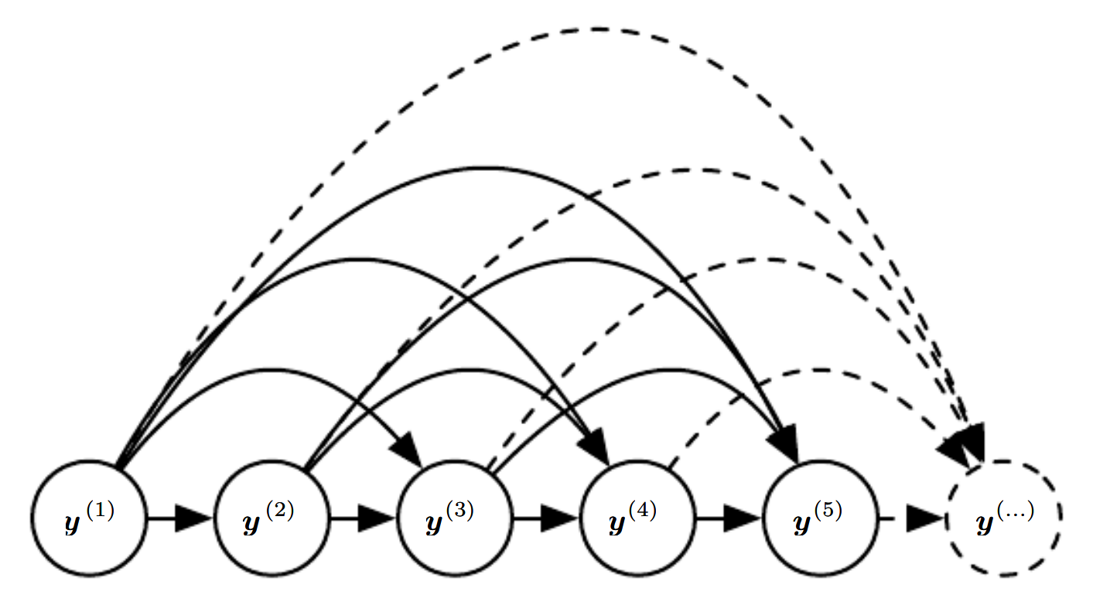
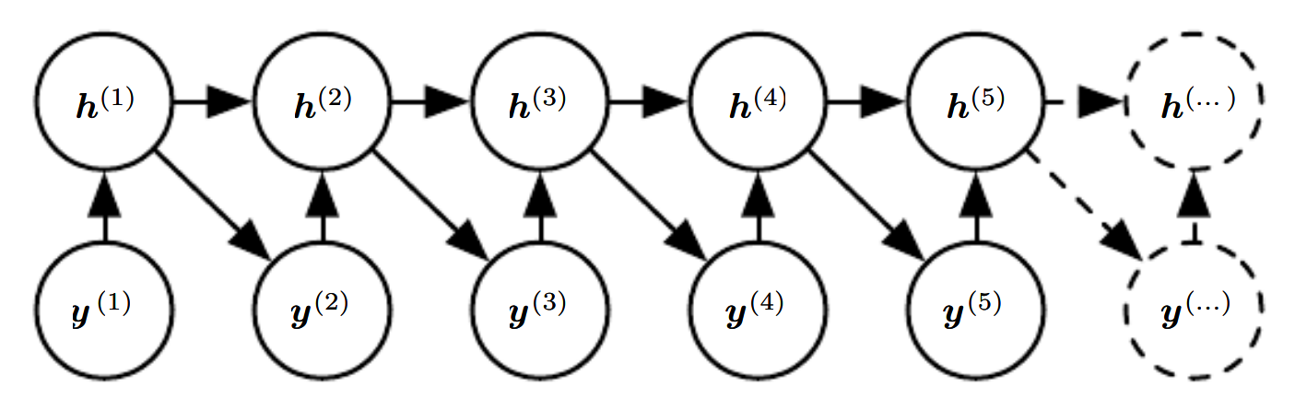
Fully connected model vs. hidden Markov chain
Directly representing all dependencies becomes inefficient for long sequences.
RNN summarizes the past using a hidden state. It reuses the same parameters at every time step.
Figures 10.7 & 10.8 of Goodfellow et al.

Slide 10
Compute gradient in RNN

Slide 11
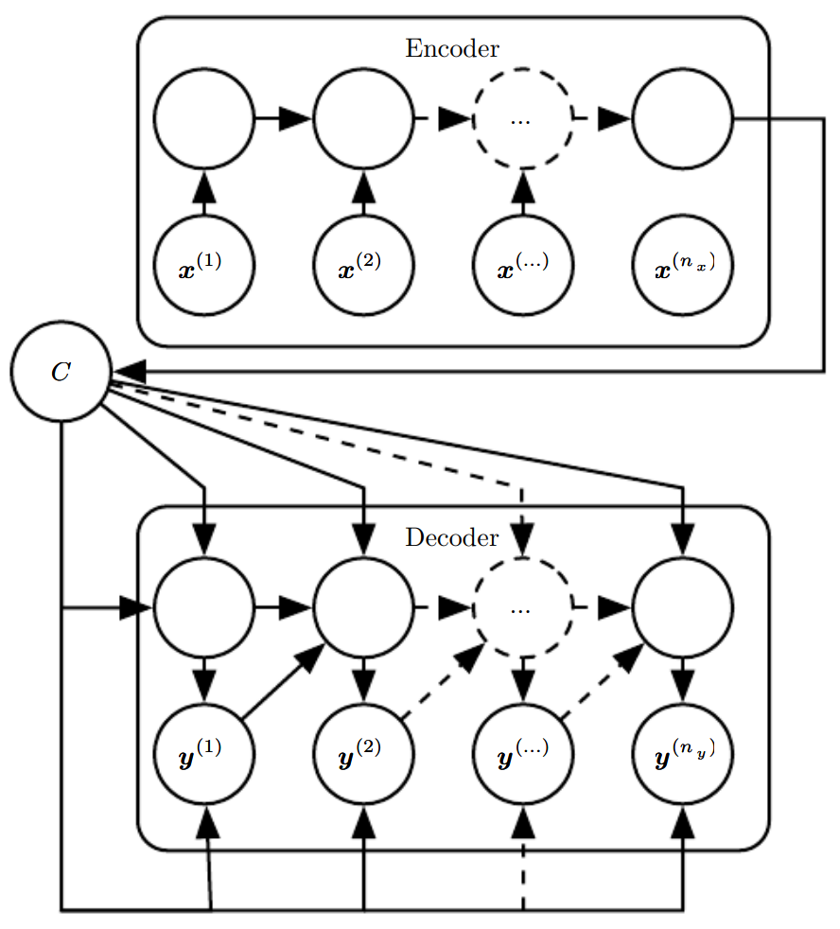
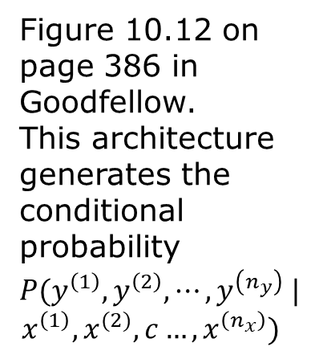
Encoder-decoder sequence-to-sequence architecture
Figure 10.12 on page 386 in Goodfellow. This architecture generates the conditional probability $P(y^{\left(1\right)},y^{\left(2\right)},⋯,y^{\left(n_{y}\right)} |$
$$x^{\left(1\right)},x^{(2)},c…, x^{\left(n_{x}\right)})$$

Slide 12
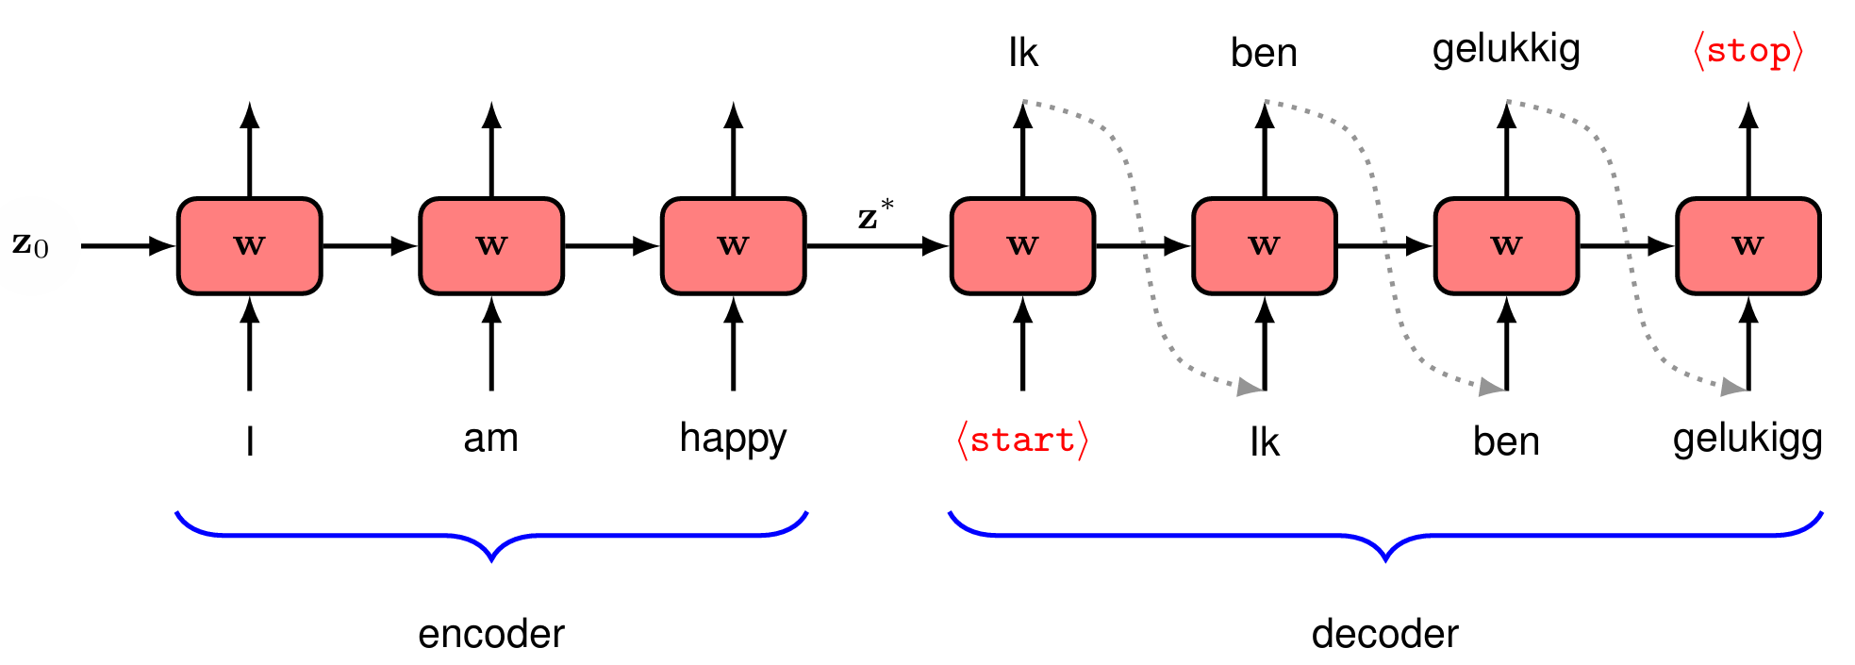
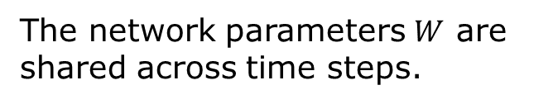
Machine translation using RNN
Fig. 12.14 from Bishop, “Deep learning.”
The network parameters $W$ are shared across time steps.

Slide 13
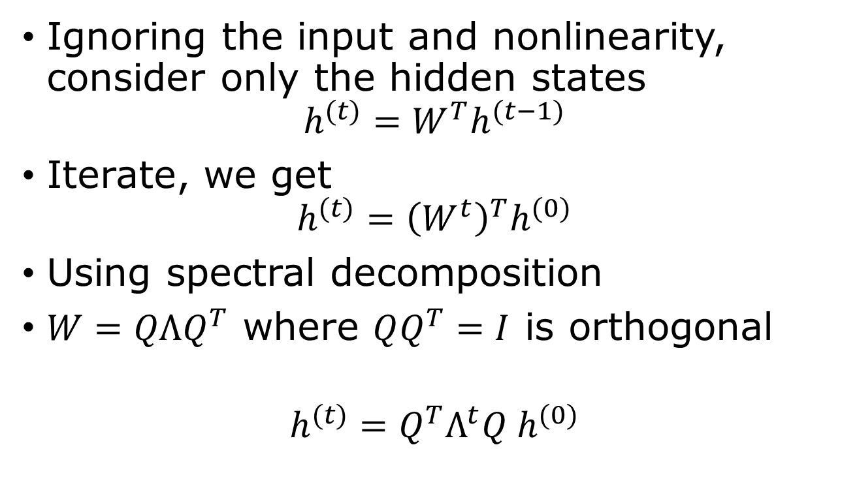
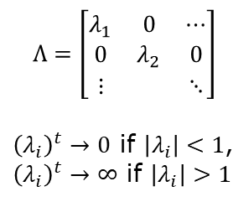
Vanishing or exploding gradients in RNNs
Ignoring the input and nonlinearity, consider only the hidden states
$$h^{(t)}=W^{T}h^{(t−1)}$$
Iterate, we get
$$h^{(t)}={\left(W^{t}\right)}^{T}h^{(0)}$$
Using spectral decomposition
$W=QΛQ^{T}$ where $QQ^{T}=I$ is orthogonal
$$h^{(t)}=Q^{T}Λ^{t}Q h^{(0)}$$
$$Λ=\left[\begin{matrix}λ_{1} & 0 & ⋯ \\ 0 & λ_{2} & 0 \\ ⋮ & & ⋱\end{matrix}\right]$$
${\left(λ_{i}\right)}^{t}→0$ if $\left|λ_{i}\right|<1$,
${\left(λ_{i}\right)}^{t}→∞$ if $\left|λ_{i}\right|>1$
Notes:
We assume $W=W^{T}$ for simplicity. \partial h^(t)/\partial h^(0) appears the gradient.

Slide 14
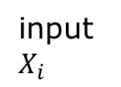
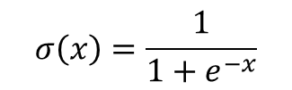



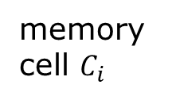

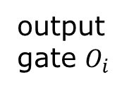

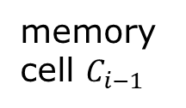

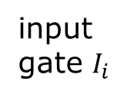
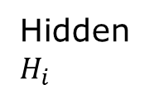
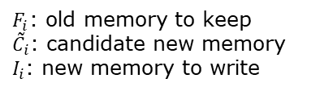

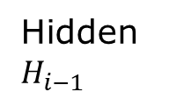
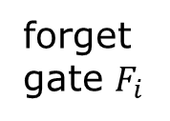
Long short-term memory (LSTM)
$$C_{i}=F_{i}⨀C_{i−1}+I_{i}⨀{\tilde{C}}_{i}$$
$F_{i}$: old memory to keep
${\tilde{C}}_{i}$: candidate new memory
$I_{i}$: new memory to write
memory cell $C_{i−1}$
memory cell $C_{i}$
*
+
$$tanh$$
input gate $I_{i}$
forget gate $F_{i}$
*
$$\tilde{C_{i}}$$
*
$$σ$$
$$σ$$
$$tanh$$
$$σ$$
Hidden $H_{i−1}$
Hidden $H_{i}$
output gate $O_{i}$
input $X_{i}$
$$σ\left(x\right)=\frac{1}{1+e^{−x}}$$
Notes:
See https://colah.github.io/posts/2015-08-Understanding-LSTMs/ for a nice explanation.

Slide 15
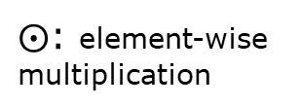
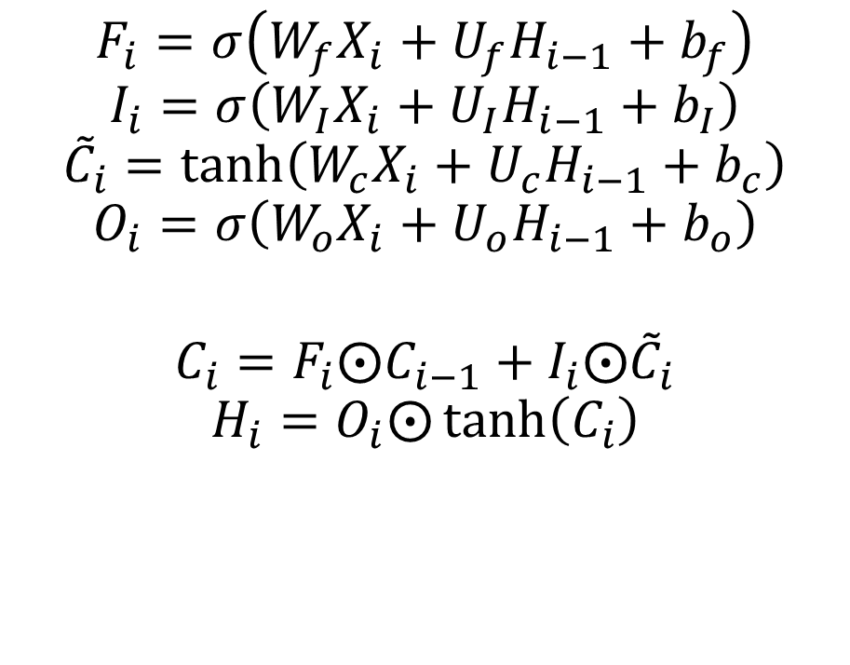
Formulas corresponding the LSTM diagram
$$F_{i}=σ\left(W_{f}X_{i}+U_{f}H_{i−1}+b_{f}\right)$$
$$I_{i}=σ\left(W_{I}X_{i}+U_{I}H_{i−1}+b_{I}\right)$$
$${\tilde{C}}_{i}=\tanh\left(W_{c}X_{i}+U_{c}H_{i−1}+b_{c}\right)$$
$$O_{i}=σ\left(W_{o}X_{i}+U_{o}H_{i−1}+b_{o}\right)$$
$$C_{i}=F_{i}⨀C_{i−1}+I_{i}⨀{\tilde{C}}_{i}$$
$$H_{i}=O_{i}⨀\tanh\left(C_{i}\right)$$
$⨀$: element-wise multiplication

Slide 16
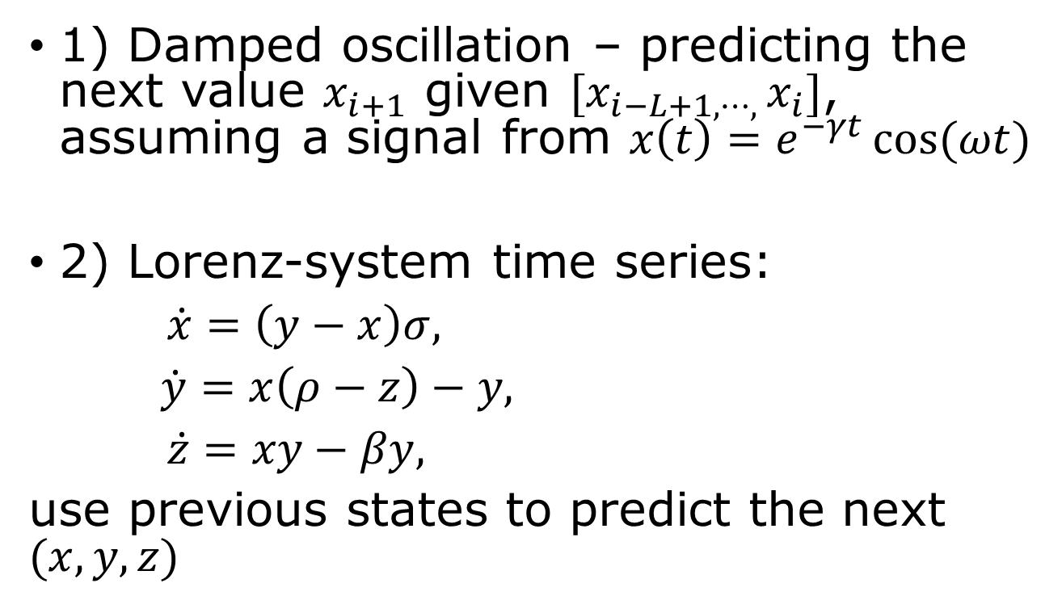
Examples using LSTM
1) Damped oscillation – predicting the next value $x_{i+1}$ given $[x_{i−L+1,⋯, }x_{i}]$, assuming a signal from $x\left(t\right)=e^{−γt}\cos{(ωt)}$
2) Lorenz-system time series:
$\dot{x}=\left(y−x\right)σ,$
$\dot{y}=x\left(ρ−z\right)−y,$
$\dot{z}=xy−βy,$
use previous states to predict the next $(x,y,z)$

Slide 17
Example, damped-oscillation
class LSTM(nn.Module):
def __init__(self, n_hidden):
super().__init__()
self.lstm = nn.LSTM(1, n_hidden, batch_first=True)
self.fc = nn.Linear(n_hidden, 1)
def forward(self, x):
h, _ = self.lstm(x)
y = self.fc(h[:, -1, :])
return y
See complete code in LSTM-damped-oscillation.ipynb

Slide 18
Questions and Answers
1) What is an RNN, 2) how is CNN similar/differ from RNN? 3) how to construct the loss function in RNN? 4) what is the vanishing/exploding gradient problems? 5) What is the use of LSTM? How does it differ from RNN? 6) What is a Markov chain; what is a hidden Markov chain? 7) What is an encoder-decoder architecture?

