Slide 1
AIS5103,
Foundations of Deep Learning
Prof. Wang Jian-Sheng

Slide 2
Outline
Course logistics and requirements
Real biological neurons and the brain
Artificial neurons (started 1943 McCulloch & Pitts) in math and computer science

Slide 3
Format/assessment, etc
Lectures on Tue/Fri 2:00-3:40
Use Canvas to submit assignments, etc
Homeworks and quizzes (%40)/ midterm (%20)/ final (%40) (both closed book)
TA: Ren Yuhua, Yuan Siyu
Course webpage: https://phyweb.physics.nus.edu.sg/~phywjs/AIS5103/ais5103.html

Slide 4
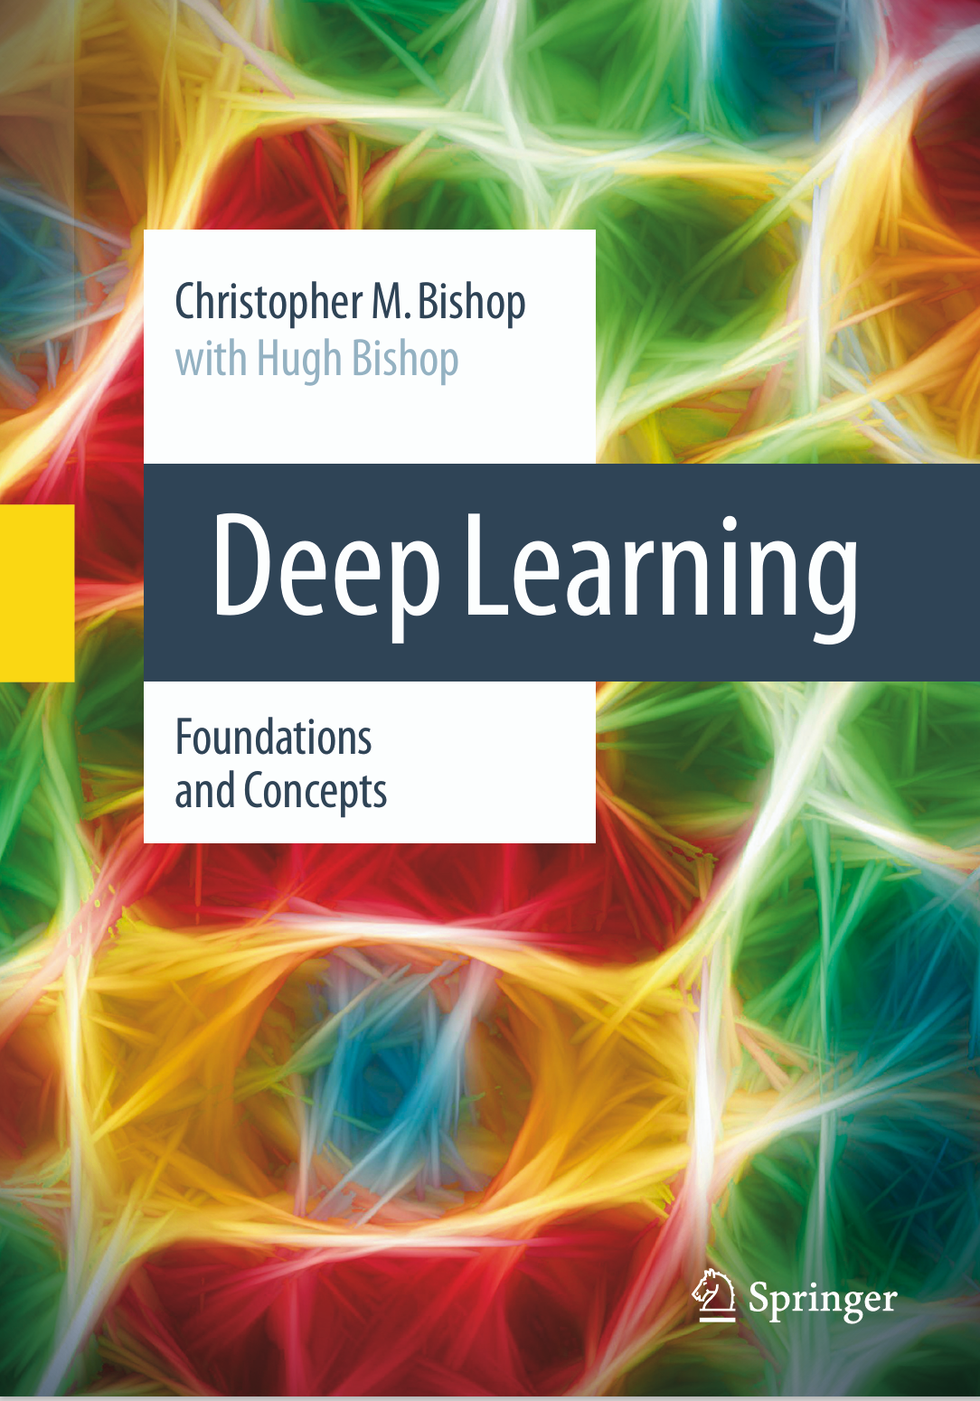
Textbook
https://www.bishopbook.com/
“Deep Learning,” C. M. Bishop (2024)

Slide 5
General remarks
No lecture notes, read textbooks instead, (slides only define the scope)
Lectures are recorded
Background needed: matrix algebra, probability and statistics, multi-variable calculus, Python programming.
Learning the concepts/theory

Slide 6
Week 1,
The Neuron: cell and molecular biology

Slide 7
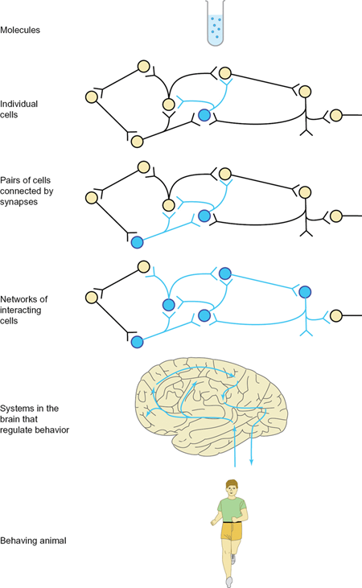
Levels of organization
Function of the neuron system: (1) sense information about its environment, (2) import this information into its brain where it can be processed, and (3) generate a behavioral response.
From “The Neuron”, Levitan, et al.

Slide 8
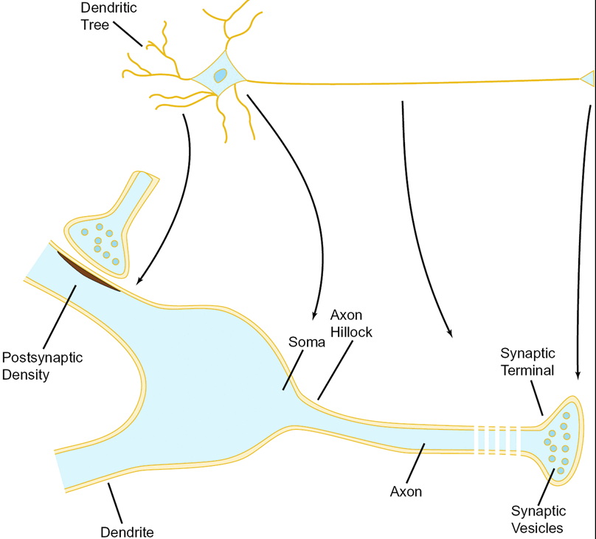
Structure of neurons
Axon: a long tube (micrometer to the meter) connects the cell center to the end (synapse).
Dendrite: many branches and tree-like structure, mostly to receive information (from other synapses).
Synapse: point of unidirectional information transfer between neurons. Acetylcholine (neurotransmitter) vs ion movement.
Myelin Sheath

Slide 9
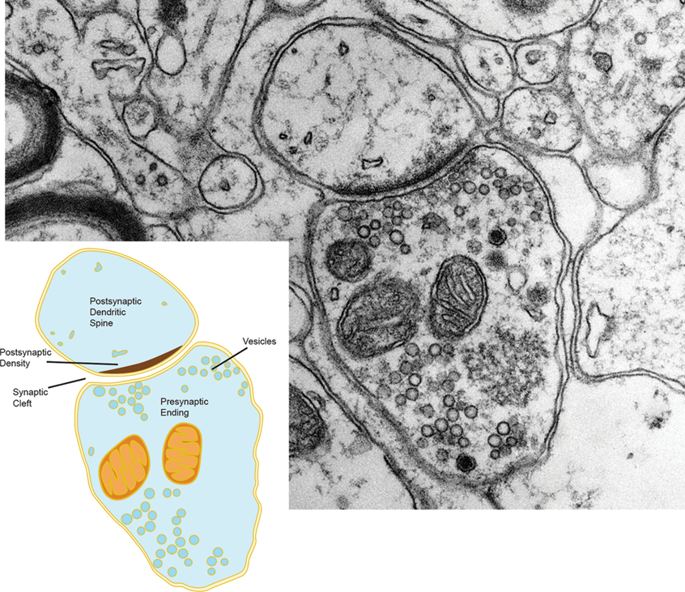
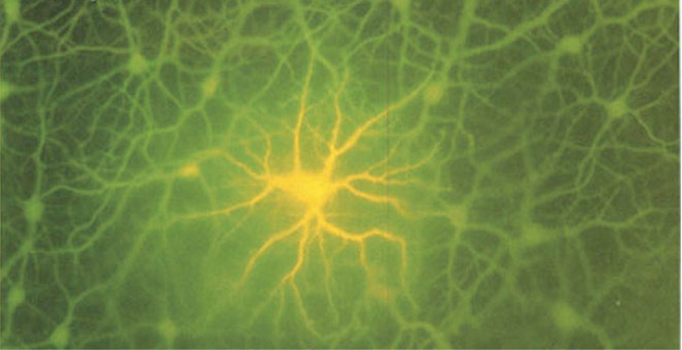
Chemical vs electric synapses
mitochondria
The electric synapses are symmetric and bi-directional, and fast.
Release of chemicals from presynaptic ending to postsynaptic density with a gap about 200 Å. Slow (millisecond)

Slide 10
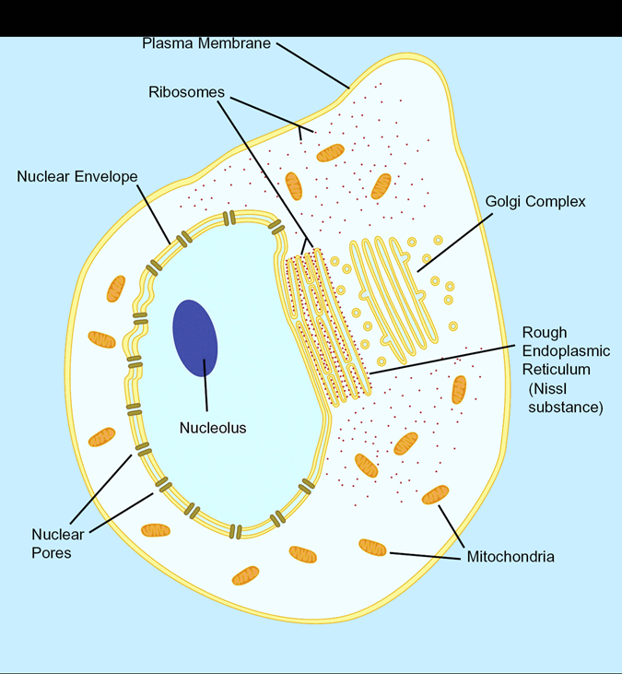
Brain consists of neurons and glia
Cells in the brain are divided into two distinct groups: (1) neurons, and (2) a far more numerous group of cells called glia (glue).
Neuron cells are like other cells. The genomic DNA in the nucleus is identical to that in other cells.
Ribosomes manufacture proteins by reading mRNA

Slide 11
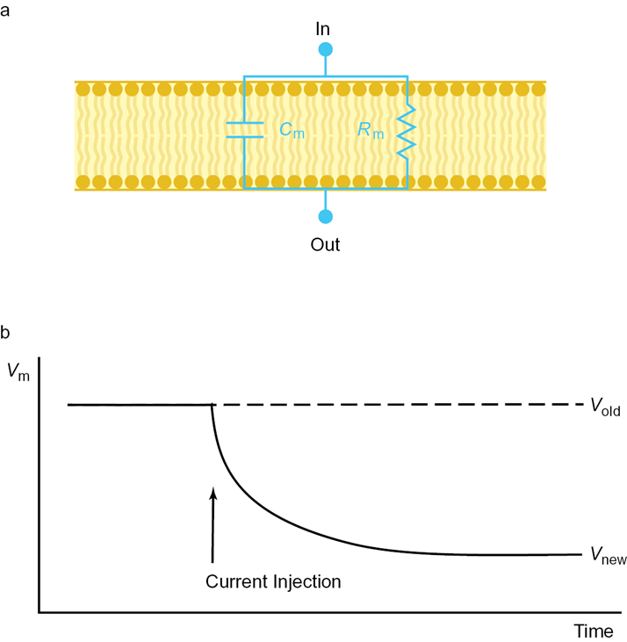
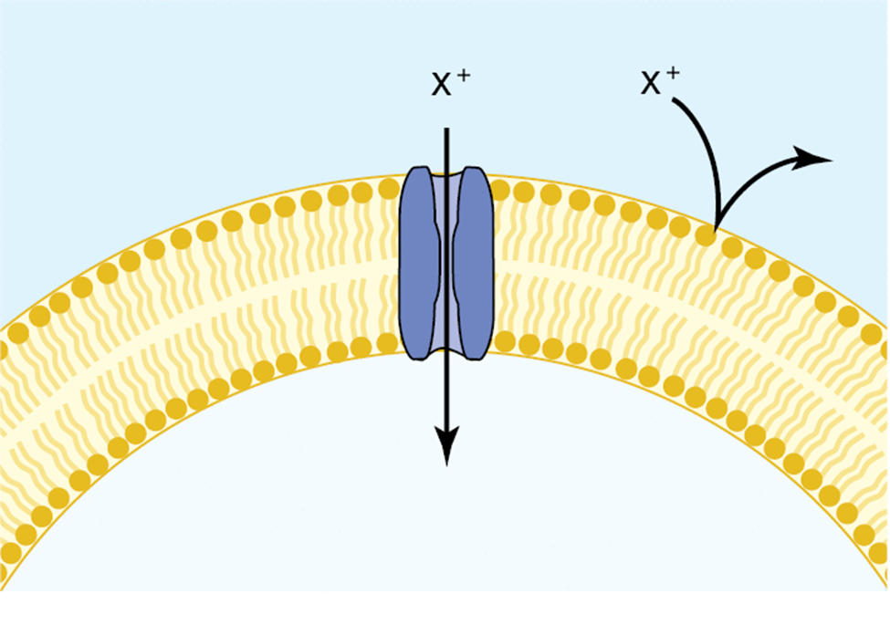
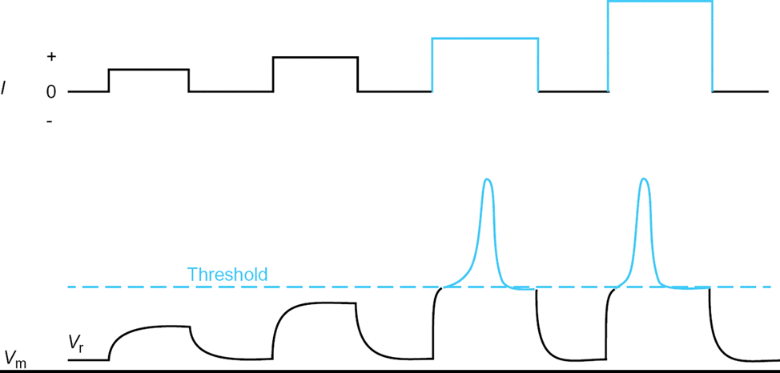
Axon transits information by potential
Na⁺
The inside of a neuron has more negative ions than positive ions and maintains a -70 mV voltage difference. Pumping in current larger than a threshold produces uniform pulse, which travels up to 100 meters per second.

Slide 12
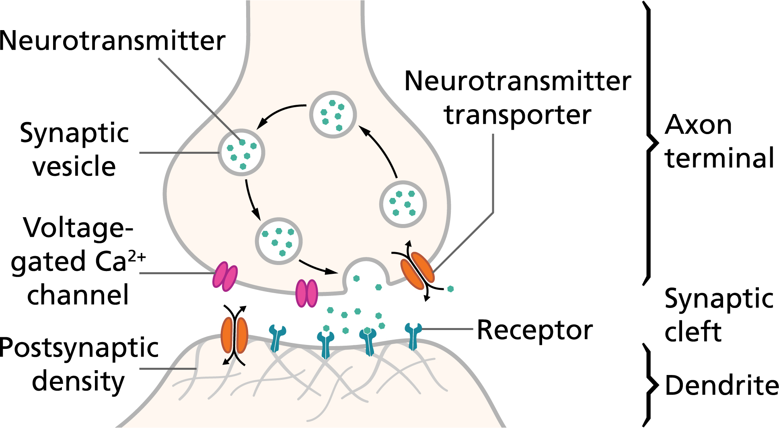
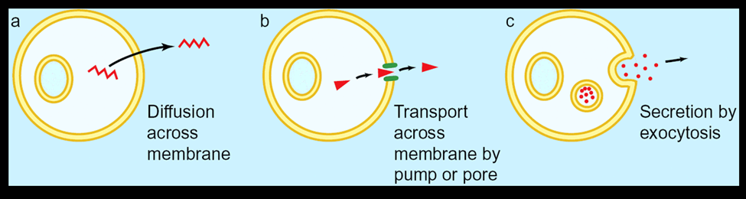
Transmission of information chemically between cells
Neurotransmitters: dopamine, serotonin, opioids, etc.
Image from : synapse

Slide 13
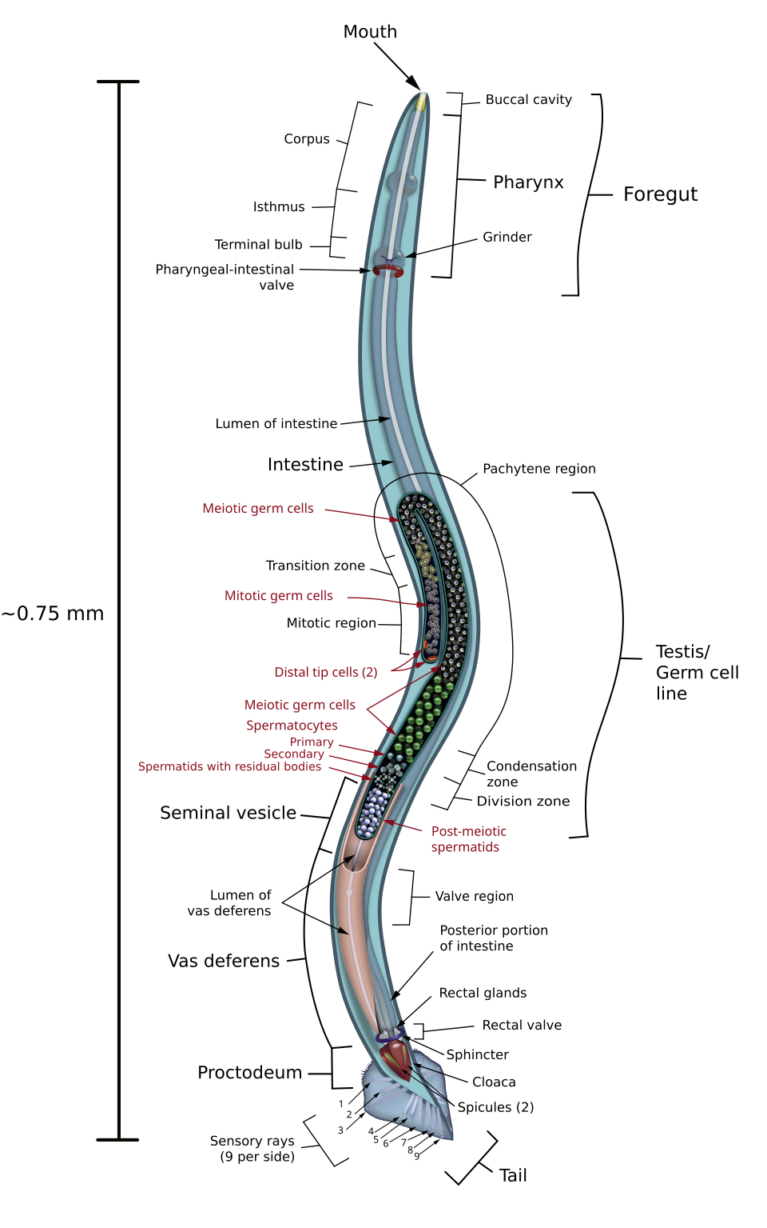
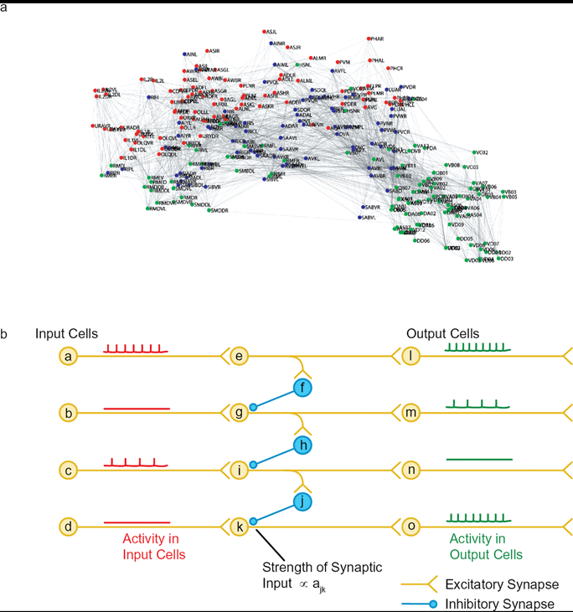
Neuron network
The entire nervous system of the nematode C. elegans (a kind of simple worm), consists of 302 neurons.
Human brains has 10¹¹ neurons.
Notes:
The number of neurons in human brain is 86 billion, to be more precise. Figure for nematode from https://en.wikipedia.org/wiki/Nematode#/media/File:C_elegans_male.svg

Slide 14
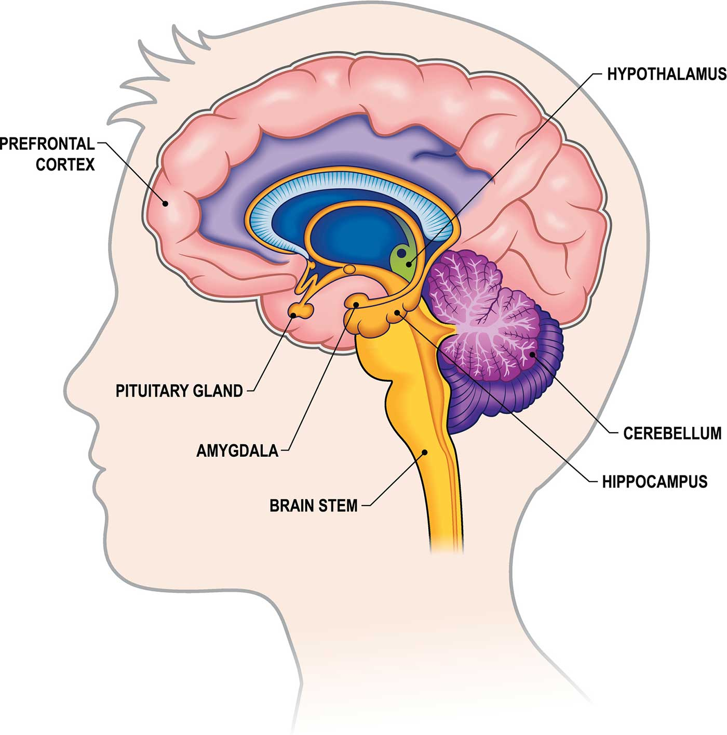
Human brain
Brain consists of neurons and glial cells; blood vessels, and is 60% fat.
Cerebrum: movement, speech, thinking, etc.
Cerebellum: voluntary muscle movement, balance, …
Hippocampus: memory, ..
Amygdala: regulates emotion, memory, reward, stress, ..
Thalamus: signal relay station.
Neocortex: thought, perception, language, …
Basal ganglia

Slide 15
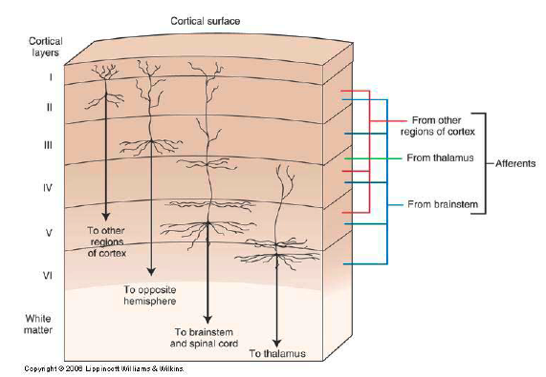
Six layers in the neocortex

Slide 16
Mathematical Neurons in AI

Slide 17
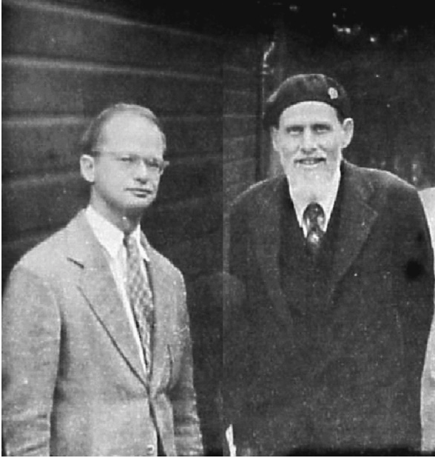
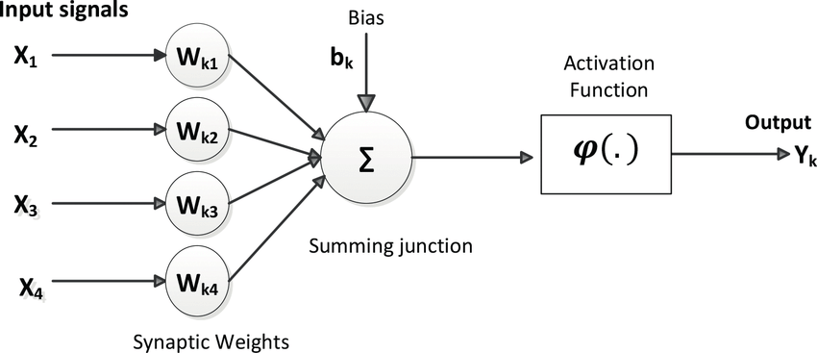
McCulloch & Pitts 1943
The 1943 paper showed that the fundamental, binary activity of brain cells can be modeled as a system of mathematical logic, arguing that mental processes can be studied as computation.

Slide 18

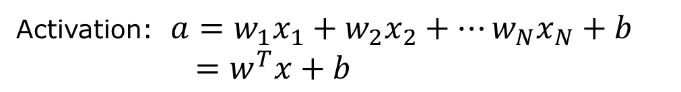

A “mathematical” neuron
x₁
w₁
McCulloch & Pitts, 1943
x₂
w₂
output
input
…
f(.)
$$y$$
w_{N}
x_{N}
f (ReLU)
weight
$$y=f(a)$$
0
a
Activation: $a=w_{1}x_{1}+w_{2}x_{2}+⋯w_{N}x_{N}+b$
$=w^{T}x+b$
Notes:
The function F is called activation, and the particular form F=0 if S < 0 and F=S is called rectified linear unit or reLU.

Slide 19
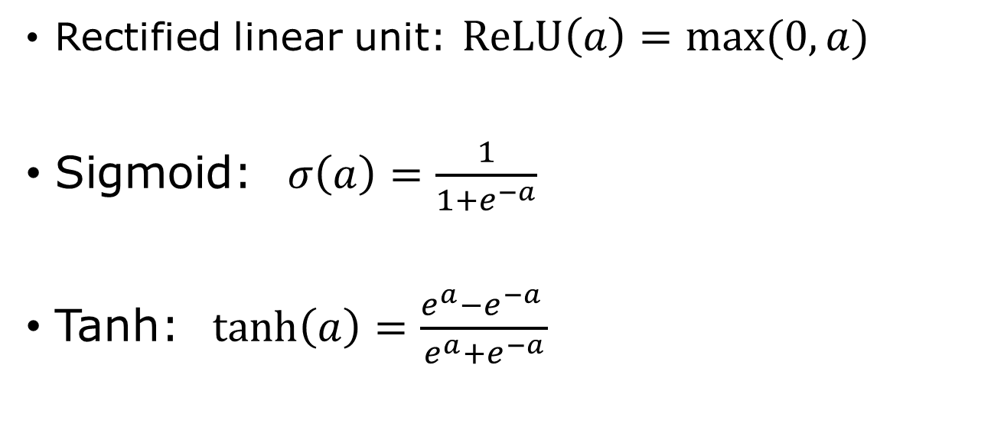
Activation functions
Rectified linear unit: $ReLU\left(a\right)=\max{(0,a)}$
Sigmoid: $σ\left(a\right)=\frac{1}{1+e^{−a}}$
Tanh: $\tanh\left(a\right)=\frac{e^{a}−e^{−a }}{e^{a}+e^{−a}}$

Slide 20
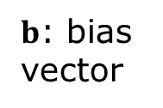




Feedforward Neural Network
$$y^{(1)}$$
$$y^{(2)}$$
$x$ (input layer)
x₁
$y$ (output layer)
x₂
x₃
$b$: bias vector
$$y^{(1)}=h\left(W^{\left(1\right)}x+b^{\left(1\right)}\right), y^{(2)}=f\left(W^{\left(2\right)}y^{(1)}+b^{\left(2\right)}\right), y=W^{(3)}y^{(2)}+b^{(3)}$$
boldface denotes vectors or matrices
Notes:
The neural network represents a function X -> Y; this function is not known explicitly but we can present it with W and b by “training” the network. The function F( ) take a vector and produces a vector, i.e., F is applied elementwise, y_j =F(a_j) if Y = F(a), where Y and a are vector, y_j and a_j are their j-th component.

Slide 21

Matrix notation
$y=Wx$, i.e., $y_{i}=\sum_{j=1}^{N}{w_{ij}x_{j}}$
or
$\left(\begin{matrix}y_{1} \\ ⋮ \\ y_{M}\end{matrix}\right)=\left(\begin{matrix}w_{11} & w_{12} & ⋯ & w_{1N} \\ w_{21} & w_{22} & & \\ ⋮ & & ⋱ & ⋮ \\ & & ⋯ & w_{MN}\end{matrix}\right)\left(\begin{matrix}x_{1} \\ ⋮ \\ x_{N}\end{matrix}\right)$

Slide 22
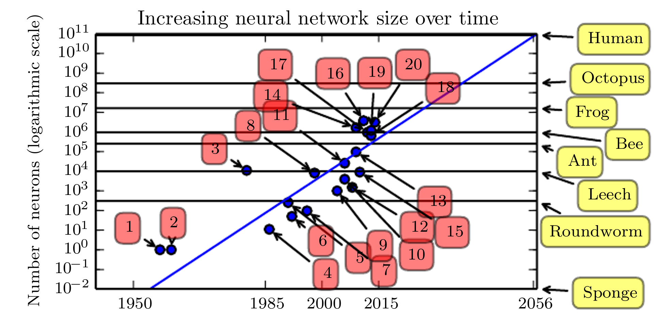
Increasing neural network size over time
GPT 3
1: perception, 3: neocognitron, 8: Lenet-5, 12: deep Boltzmann machine. 20: GoogLeNet.
GPT 3, 175 billion parameters
Recent trend: doubling every 6 months
Fig.1.11, from Goodfellow, et al, “Deep Learning”, page 23.

Slide 23
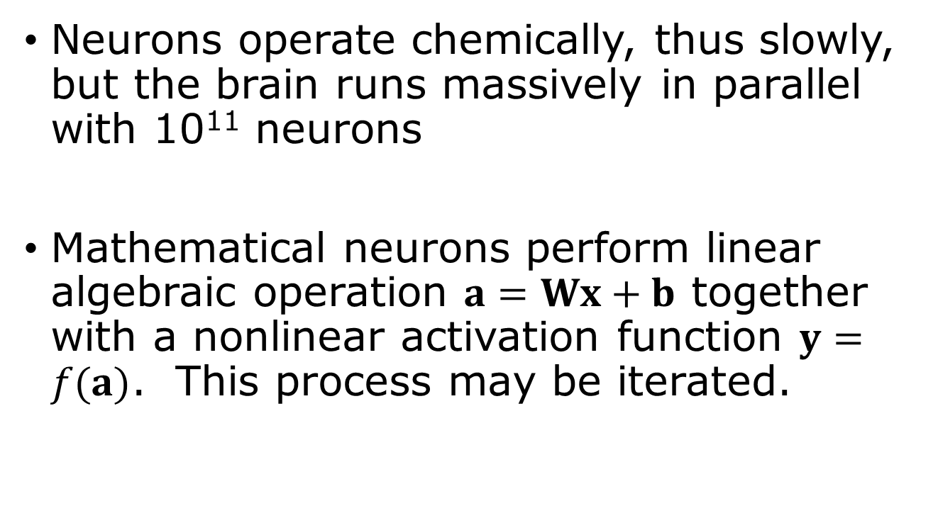
Summary
Neurons operate chemically, thus slowly, but the brain runs massively in parallel with 10¹¹ neurons
Mathematical neurons perform linear algebraic operation $a=Wx+b$ together with a nonlinear activation function $y=f(a)$. This process may be iterated.

Slide 24
Questions & Answers
1) What is a biological cell? 2) what is a neural cell and how it differs from normal cell? 3) what is the function of hippocampus? 4) what is the area size of neocortex if flattened out? 5) how many neurons in a human brain, how many connections? 6) what is ReLU, 7) what is a sigmoid function? 8) who invented the first mathematical neural network? 9) what is an action potential? 10) what is the role of myelin sheath?

Slide 25
Reading
Bishop book Chapter 1.3 page 16 – 22

