Slide 1
Week 3,
Machine learning fundamentals
Notes:
Read chapter 5, Goodfellow, Bengio, and Courville, “Deep Learning”.

Slide 2
Outline
Linear models, design matrix, and the exact solution
Gradient descent method
Basics of the theory of probability
  Joint distribution, conditional probability, average, variance, bias
Maximum-likelihood principle
KL divergence
Training and performance measures

Slide 3
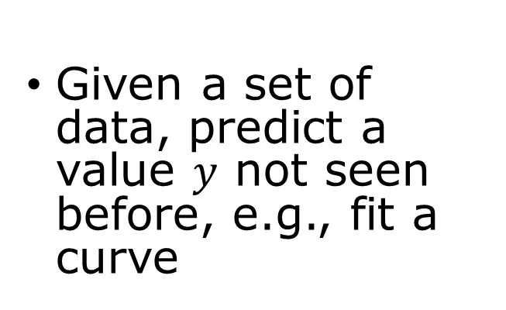
Problem to solve
Regression
Classification
Given a set of data, predict a value $y$ not seen before, e.g., fit a curve
Identify which one it is (discrete output). E.g., recognize handwritten digits
Generative AI
Learn probability distributions from data

Slide 4
Task, Performance, Experience
Task: perform a task without being explicitly programmed
Performance: how well it does (e.g., training and testing accuracy)
Experience: supervised, unsupervised learning; reinforcement learning; generative AI

Slide 5
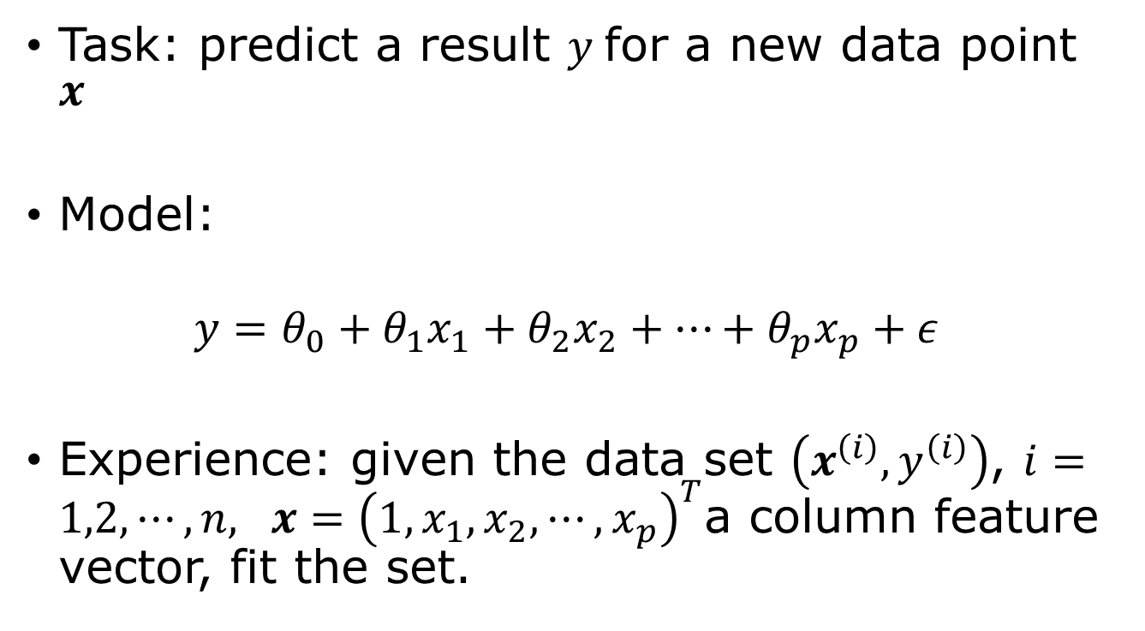
Linear regression as machine learning
Task: predict a result $y$for a new data point $x$
Model:
$$y=θ_{0}+θ_{1}x_{1}+θ_{2}x_{2}+…+θ_{p}x_{p}+ε$$
Experience: given the data set $\left(x^{\left(i\right)},y^{\left(i\right)}\right)$, $i=1,2,⋯,n,$ $x={\left(1,x_{1},x_{2},⋯, x_{p}\right)}^{T}$a column feature vector, fit the set.
random error
Notes:
The notations followed here are that of "Machine Learning", Lindholm, et al. Not that of Bishop. Linear regression can be viewed as a neural network with one linear layer and no activation function. The concepts introduced here—model, loss function, and gradient descent—carry over directly to deep learning.

Slide 6


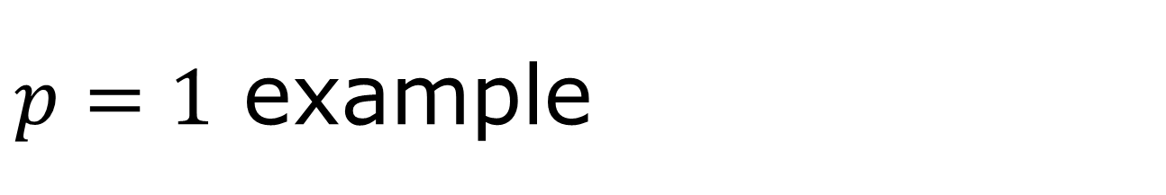
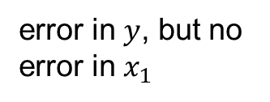


$p=1$ example
$$y$$
error in $y$, but no error in $x_{1}$
Data do not lie exactly on a straight line. The basic assumption in linear regression (least squares fit) is that the deviations ε are independent Gaussian random variables with zero mean.
ε
fitting to $y=θ_{0}+θ_{1}x_{1}$
$$x_{1}$$
$$ε_{i}\sim N(0,σ^{2})$$

Slide 7
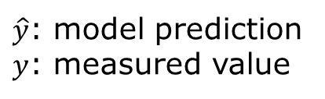
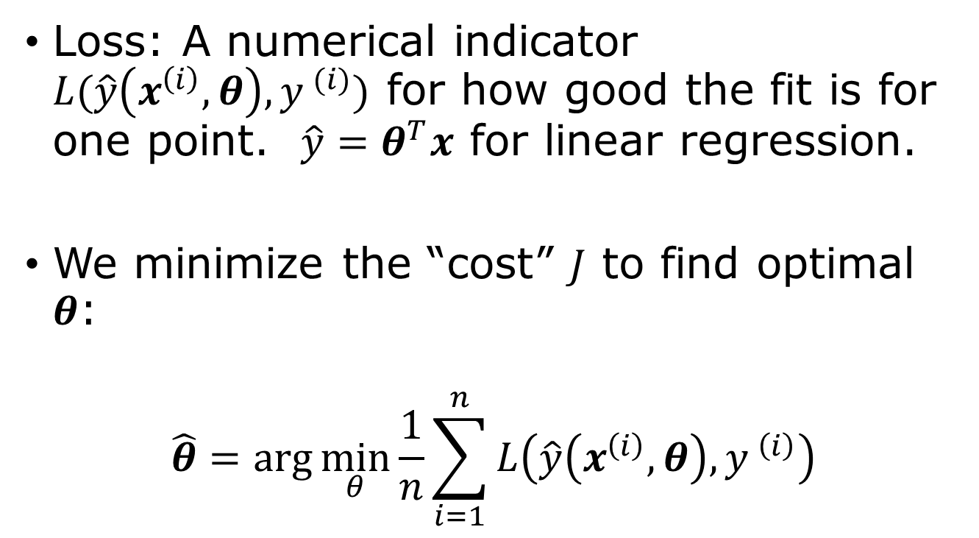

Loss function
$\hat{y}$: model prediction
$y$: measured value
Loss: A numerical indicator $L(\hat{y}\left(x^{\left(i\right)},θ\right),y^{ (i)})$ for how good the fit is for one point. $\hat{y}=θ^{T}x$ for linear regression.
We minimize the “cost” $J$ to find optimal $θ$:
$$\hat{θ}=\arg{\min_{θ}{\frac{1}{n}\sum_{i=1}^{n}{L\left(\hat{y}\left(x^{\left(i\right)},θ\right),y^{ \left(i\right)}\right)}}}$$
$$J=\frac{1}{n}\sum{L^{(i)}}$$

Slide 8
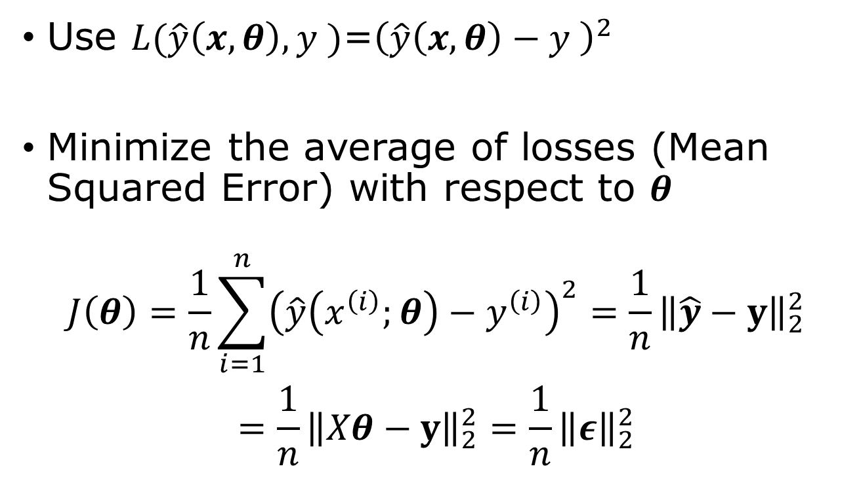
Least squares loss and exact solution
Use $L(\hat{y}\left(x,θ\right),y^{ })$=${\left(\hat{y}\left(x,θ\right)−y^{ }\right)}^{2}$
Minimize the average of losses (Mean Squared Error) with respect to $θ$
$$\begin{aligned}J\left(θ\right)=\frac{1}{n}\sum_{i=1}^{n}{{\left(\hat{y}\left(x^{\left(i\right)};θ\right)−y^{\left(i\right)}\right)}^{2}}=\frac{1}{n}{\left\|\hat{y}−y\right\|}_{2}^{2} \\ =\frac{1}{n}{\left\|Xθ−y\right\|}_{2}^{2}=\frac{1}{n}{\left\|ε\right\|}_{2}^{2}\end{aligned}$$
2-norm squared

Slide 9
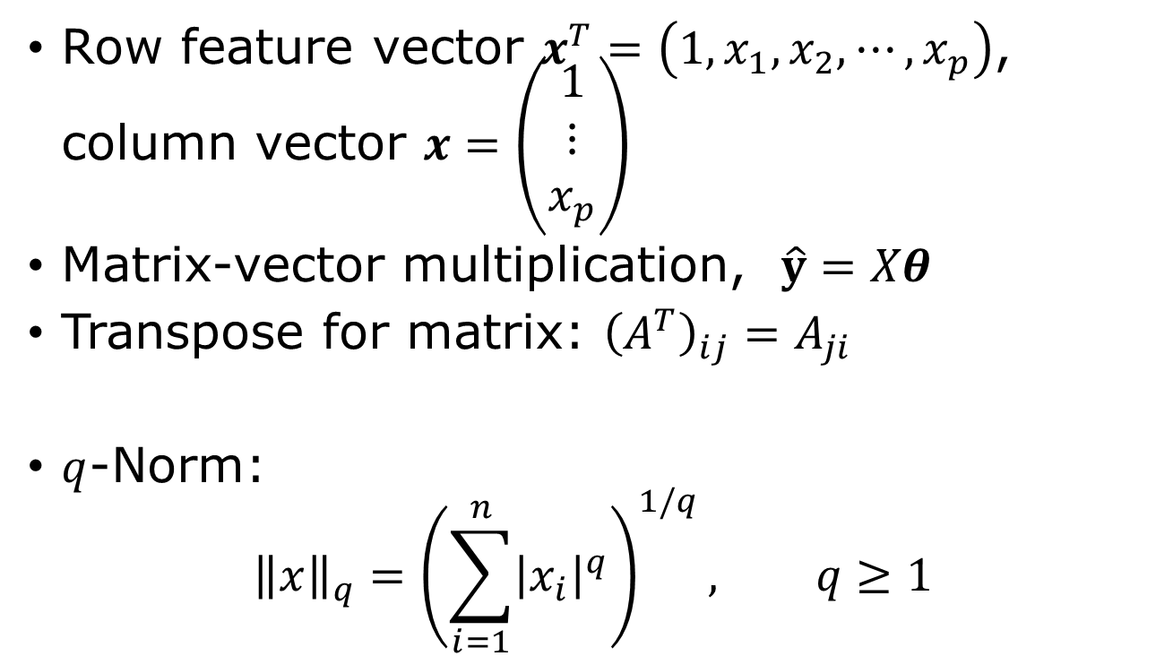
Linear algebra notation
Row feature vector $x^{T}=\left(1,x_{1},x_{2},⋯, x_{p}\right)$, column vector $x=\left(\begin{matrix}1 \\ ⋮ \\ x_{p}\end{matrix}\right)$
Matrix-vector multiplication, $\hat{y}=Xθ$
Transpose for matrix: ${\left(A^{T}\right)}_{ij}=A_{ji}$
$q$-Norm:
$${\left\|x\right\|}_{q}={\left(\sum_{i=1}^{n}{{\left|x_{i}\right|}^{q}}\right)}^{1/q}, q≥1$$

Slide 10




The design matrix $X$
feature vector
  $$X=\left(\begin{matrix}1 & x_{1}^{\left(1\right)} & ⋯ & x_{p}^{\left(1\right)} \\ 1 & x_{1}^{\left(2\right)} & ⋯ & ⋯ \\ ⋯ & ⋯ & & \\ 1 & x_{1}^{(n)} & ⋯ & x_{p}^{(n)}\end{matrix}\right)$$
  $$=\left(\begin{matrix}{(x^{(1)})}^{T} \\ ⋮ \\ {\left(x^{\left(n\right)}\right)}^{T}\end{matrix}\right)$$
data point
$$θ=\left(\begin{matrix}θ_{0} \\ ⋮ \\ θ_{p}\end{matrix}\right)$$
$$y=\left(\begin{matrix}y^{(1)} \\ ⋮ \\ y^{(n)}\end{matrix}\right)$$
$$Xθ=y ?$$

Slide 11



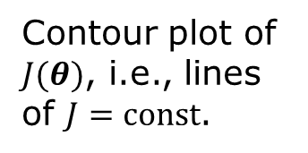
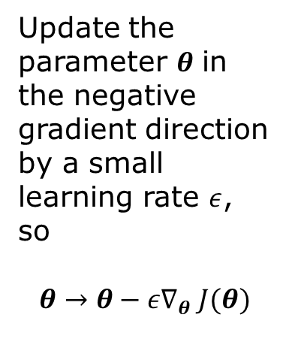
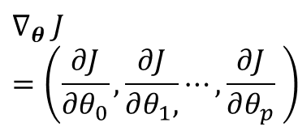
Gradient descent
$$dJ=\sum_{j}{dθ_{j}\frac{∂J}{∂θ_{j}}}$$
$$∇_{θ} J=\left(\frac{∂J}{∂θ_{0}},\frac{∂J}{∂θ_{1},}⋯,\frac{∂J}{∂θ_{p}} \right)$$
$$θ_{1}$$
Update the parameter $θ$ in the negative gradient direction by a small learning rate $ε$, so
$$θ→θ−ε∇_{θ} J(θ)$$
Contour plot of $J(θ)$, i.e., lines of $J=const$.
$$θ_{0}$$

Slide 12

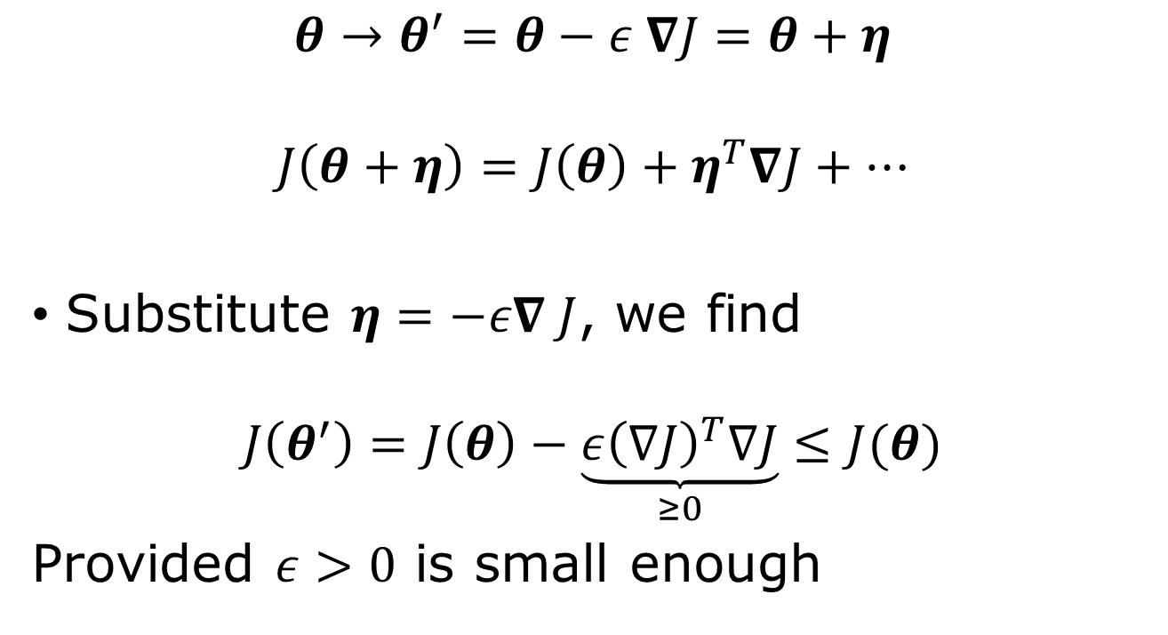
Negative-gradient move lower the objective $J$
$$θ→θ^{′}=θ−ε ∇J=θ+η$$
$$J\left(θ+η\right)=J\left(θ\right)+η^{T}∇J+⋯$$
Substitute $η=−ε∇ J$, we find
$$J\left(θ^{′}\right)=J\left(θ\right)−\underset{≥0}{\underbrace{ε{\left(∇J\right)}^{T}∇J}}≤J(θ)$$
Provided $ε>0$ is small enough
Notes:
The idea is attributed to Cauchy, 1847.

Slide 13

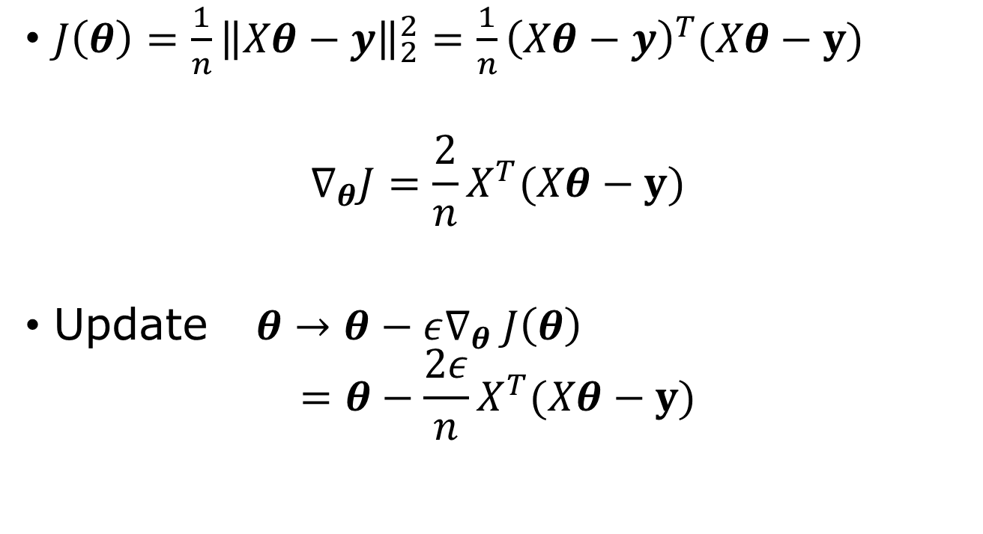
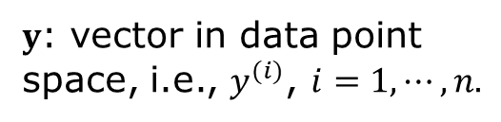

Gradient in linear regression problem
$J\left(θ\right)=\frac{1}{n}{\left\|Xθ−y\right\|}_{2}^{2}=\frac{1}{n}{\left(Xθ−y\right)}^{T}(Xθ−y)$
$$∇_{θ}J=\frac{2}{n}X^{T}(Xθ−y)$$
Update $θ→θ−ε∇_{θ} J\left(θ\right)$
$=θ−\frac{2ε}{n}X^{T}(Xθ−y)$
$$∇_{θ}=\frac{∂}{∂θ}$$
$$∇_{θ}θ^{T}=I$$
$y$: vector in data point space, i.e., $y^{(i)}$, $i=1,⋯, n.$
$$\hat{y}=Xθ$$

Slide 14

Normal equation
$∇_{θ}J=0$ at the minimum, so
$X^{T}\left(Xθ−y\right)=0$
Or
$X^{T}Xθ=X^{T}y$ $→$ $\hat{θ}={\left(X^{T}X\right)}^{−1}X^{T}y$
Moore-Penrose pseudo-inverse

Slide 15
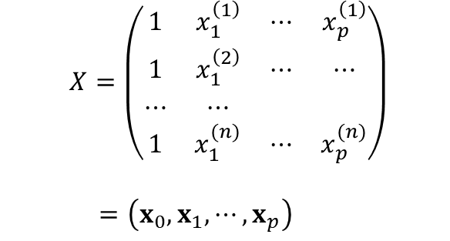
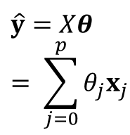
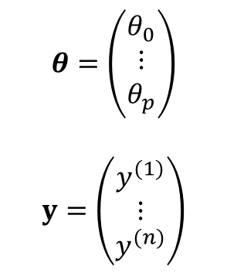




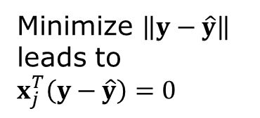
Geometric interpretation of normal solution
$$θ=\left(\begin{matrix}θ_{0} \\ ⋮ \\ θ_{p}\end{matrix}\right)$$
$$y=\left(\begin{matrix}y^{(1)} \\ ⋮ \\ y^{(n)}\end{matrix}\right)$$
  $$X=\left(\begin{matrix}1 & x_{1}^{\left(1\right)} & ⋯ & x_{p}^{\left(1\right)} \\ 1 & x_{1}^{\left(2\right)} & ⋯ & ⋯ \\ ⋯ & ⋯ & & \\ 1 & x_{1}^{(n)} & ⋯ & x_{p}^{(n)}\end{matrix}\right)$$
  $$=\left(x_{0},x_{1},⋯, x_{p}\right)$$
design matrix
$$y$$
$$y−\hat{y}$$
$$x_{1}$$
Minimize $\left\|y−\hat{y}\right\|$ leads to $x_{j}^{T}\left(y−\hat{y}\right)=0$
$$\hat{y}=Xθ= \sum_{j=0}^{p}{θ_{j}x_{j}}$$
$$x_{0}$$

Slide 16
Normal equation vs gradient descent
Normal equation | Gradient Descent
Exact solution | Iterative solution
Solve a linear system | No matrix inverse
Works well for small models | Scales to millions of parameters
Rarely used in deep learning | Standard method for deep learning

Slide 17
Least-squares fitting, machine learning way (code)
n = 3 # three fitting parameters
w = torch.rand((n),requires_grad=True)
def fit(x,w):
…
lr = 0.01
# loop over epochs; compute loss
loss.backward()
with torch.no_grad():
w -= lr*w.grad
w.grad.zero_()

Slide 18
Why Probability
Machine learning models are never perfect. Data contain noise and uncertainty. Probability provides a mathematical language for describing uncertainty and leads naturally to maximum-likelihood estimation.
A common assumption in machine learning is that the data are generated from an underlying (possibly unknown) probability distribution.

Slide 19
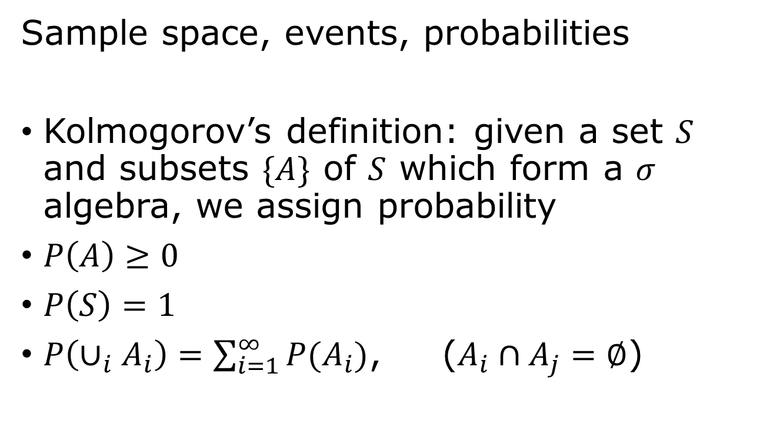
Probability
outcome
event
Sample space, events, probabilities
Kolmogorov’s definition: given a set $S$ and subsets $\{A\}$ of $S$ which form a $σ$ algebra, we assign probability
$P\left(A\right)≥0$
$P\left(S\right)=1$
$P\left(∪_{i}A_{i}\right)=\sum_{i=1}^{∞}{P(A_{i})}$, ($A_{i}∩A_{j}=∅$)
Notes:
What is a sigma algebra? The set F of subsets of S is such that 0, S is in F. If A is in F, then its complement is in F. If a sequence A_i is in F, its union is in F. The outcome of an experiment is an element of the set S, the sample space. And the event is a subset A which we assign probability.

Slide 20
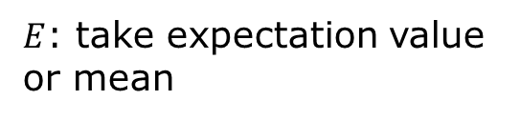

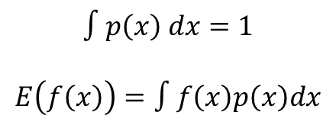



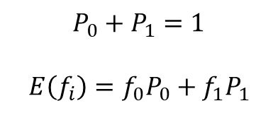

Discrete vs continuous distributions
$$P_{0}$$
$$P_{1}$$
$$P_{0}+P_{1}=1$$
$$E\left(f_{i}\right)=f_{0}P_{0}+f_{1}P_{1}$$
0
1
$E$: take expectation value or mean
$$p(x)$$
$$∫p\left(x\right) dx=1$$
$$E\left(f\left(x\right)\right)=∫f\left(x\right)p\left(x\right)dx$$
$$dx$$
$$x$$

Slide 21
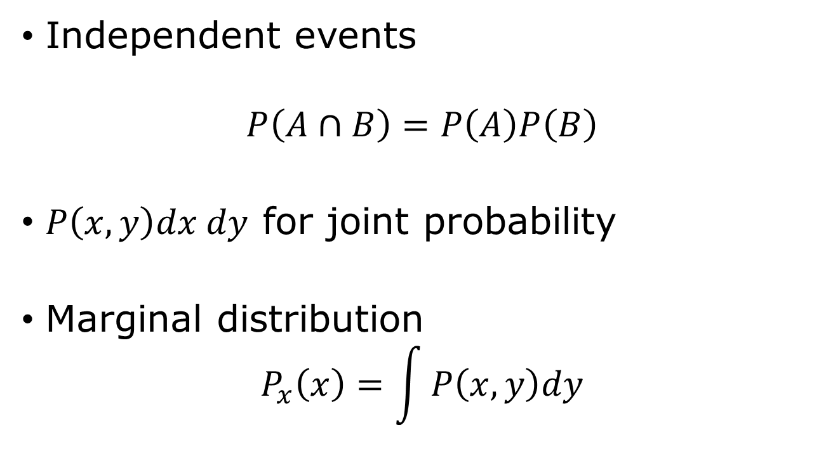
Joint distribution, marginal probability
Independent events
$$P\left(A∩B\right)=P\left(A\right)P\left(B\right)$$
$P\left(x,y\right)dx dy$ for joint probability
Marginal distribution
$$P_{x}\left(x\right)=\int{P\left(x,y\right)dy}$$
Notes:
Here we show the continuous variable case.

Slide 22
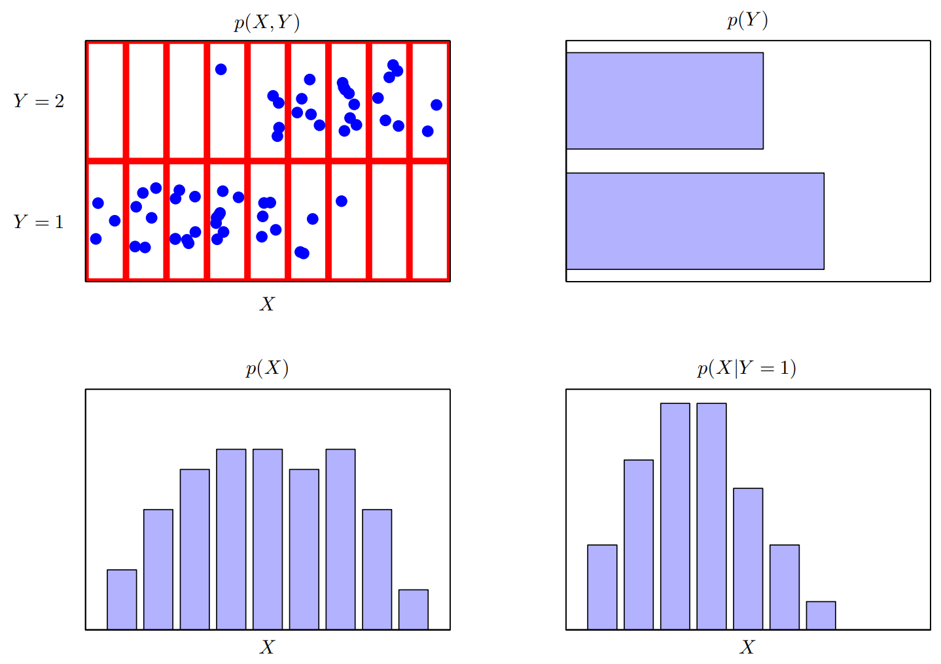
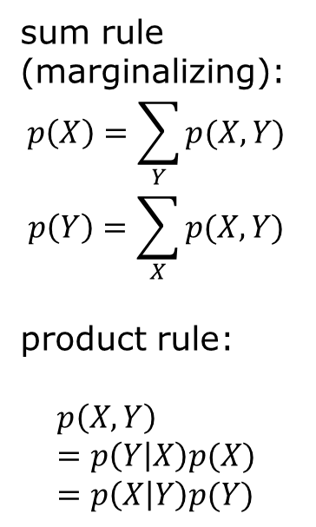
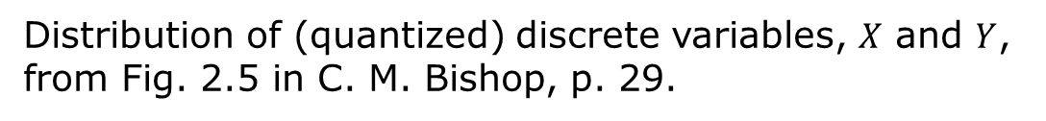
Joint, marginal, conditional distributions
sum rule (marginalizing):
$$p\left(X\right)=\sum_{Y}{p(X,Y)}$$
$$p\left(Y\right)=\sum_{X}{p(X,Y)}$$
product rule:
$$p\left(X,Y\right)=p\left(Y | X\right)p(X)=p\left(X | Y\right)p(Y)$$
Distribution of (quantized) discrete variables, $X$ and $Y$, from Fig. 2.5 in C. M. Bishop, p. 29.

Slide 23

Conditional probability
$$P\left(A | B\right)≝ \frac{P(A∩B)}{P(B)}$$
Bayes’ theorem
$$P\left(B | A\right)=\frac{P(A|B) P(B)}{P(A)}$$

Slide 24
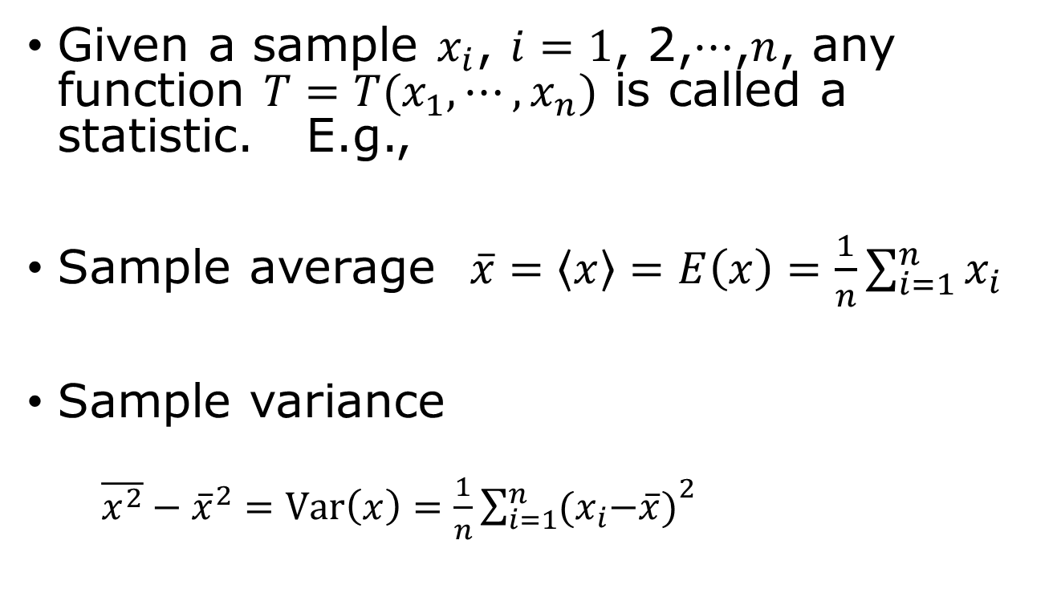
Statistic
Given a sample $x_{i}$, $i=1$, 2,$⋯$,$n$, any function $T=T(x_{1},⋯,x_{n})$ is called a statistic. E.g.,
Sample average $\overline{x}=\left\langle x\right\rangle =E\left(x\right)=\frac{1}{n}\sum_{i=1}^{n}{x_{i}}$
Sample variance
  $\overline{x^{2}}−{\overline{x}}^{2}=Var\left(x\right)=\frac{1}{n}{\sum_{i=1}^{n}{{(x}_{i}−\overline{x})}}^{2}$

Slide 25
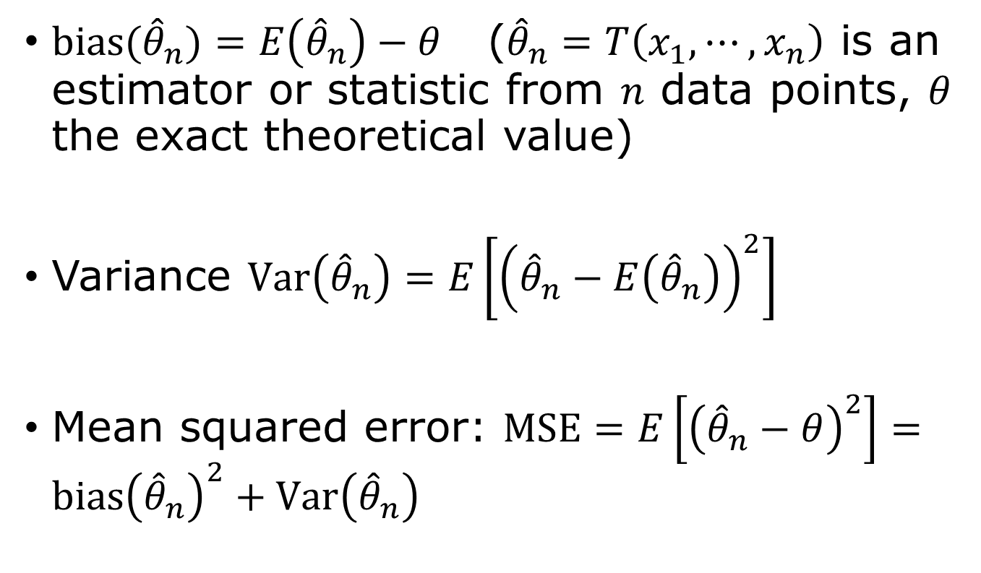
Bias, variance
$bias({\hat{θ}}_{n})=E\left({\hat{θ}}_{n}\right)−θ$ (${\hat{θ}}_{n}=T\left(x_{1},⋯, x_{n}\right)$ is an estimator or statistic from $n$ data points, $θ$ the exact theoretical value)
Variance $Var\left({\hat{θ}}_{n}\right)=E\left[{\left({\hat{θ}}_{n}−E\left({\hat{θ}}_{n}\right)\right)}^{2}\right]$
Mean squared error: $MSE=E\left[{\left({\hat{θ}}_{n}−θ\right)}^{2}\right]=bias{\left({\hat{θ}}_{n}\right)}^{2}+Var\left({\hat{θ}}_{n}\right)$

Slide 26
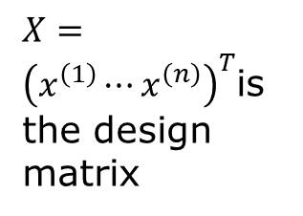
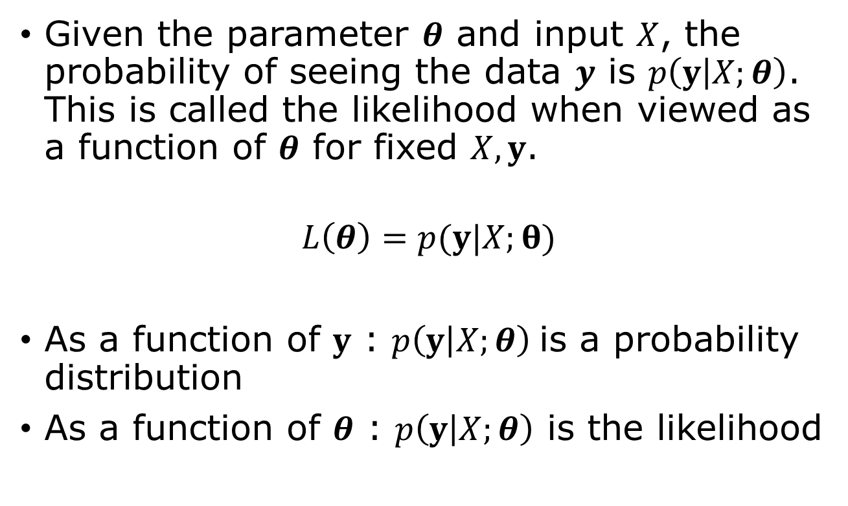
Likelihood function
$X={\left(x^{\left(1\right)}⋯x^{\left(n\right)}\right)}^{T}$is the design matrix
Given the parameter $θ$ and input $X$, the probability of seeing the data $y$ is $p\left(y | X;θ\right)$. This is called the likelihood when viewed as a function of $θ$ for fixed $X,y$.
$$L\left(θ\right)=p(y|X;θ)$$
As a function of $y$ : $p\left(y | X;θ\right)$is a probability distribution
As a function of $θ$ : $p\left(y | X;θ\right)$ is the likelihood

Slide 27
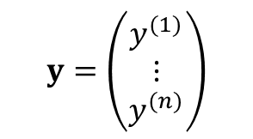
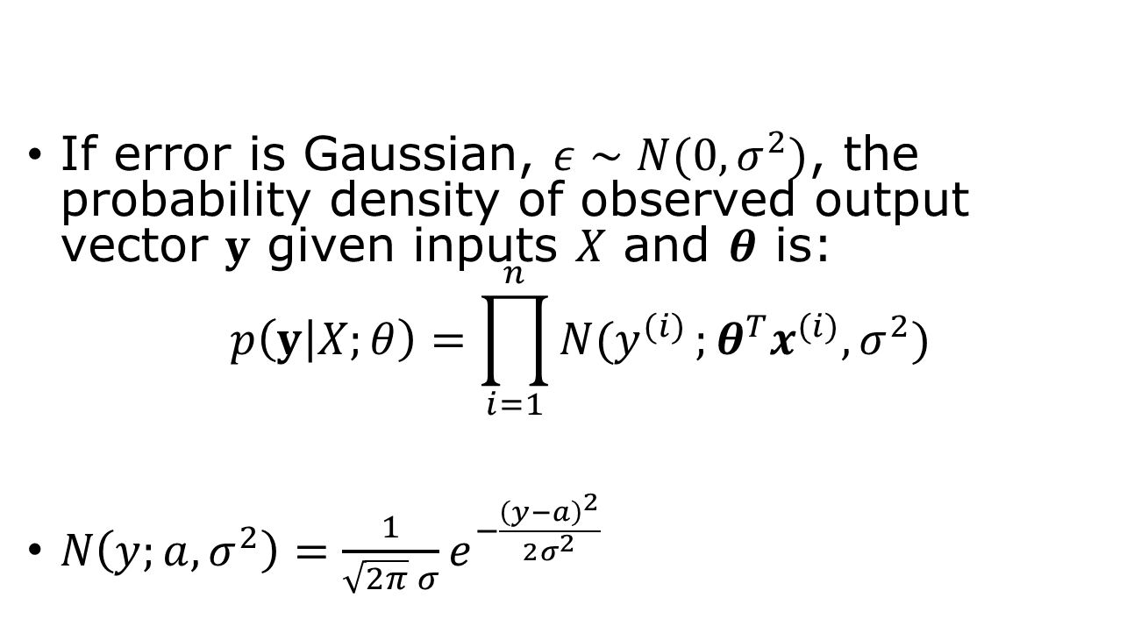
Maximum Likelihood perspective
If error is Gaussian, $ε∼N(0,σ^{2})$, the probability density of observed output vector $y$ given inputs $X$ and $θ$ is:
$$p\left(y | X;θ\right)=\prod_{i=1}^{n}{N(y^{(i)}};θ^{T}x^{(i)},σ^{2})$$
$N\left(y;a,σ^{2}\right)=\frac{1}{\sqrt{2π} σ}e^{−\frac{{\left(y−a\right)}^{2}}{2σ^{2}}}$
$$y=\left(\begin{matrix}y^{(1)} \\ ⋮ \\ y^{(n)}\end{matrix}\right)$$

Slide 28
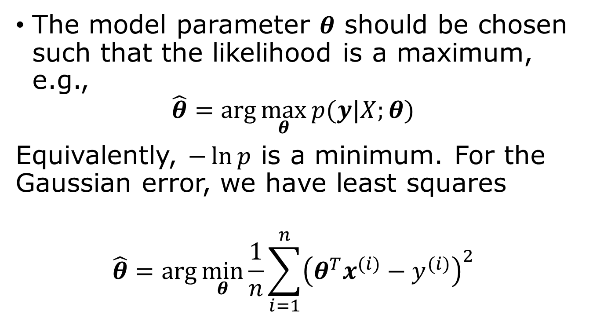
Maximum likelihood principle
Why maximum likelihood estimator? 1) consistent, 2) efficient, 3) asymptotic normality.
The model parameter $θ$ should be chosen such that the likelihood is a maximum, e.g.,
$$\hat{θ}=\arg{\max_{θ}{p(y|X;θ)}}$$
Equivalently, $−\ln{p}$ is a minimum. For the Gaussian error, we have least squares
$$\hat{θ}=\arg{\min_{θ}{\frac{1}{n}}}\sum_{i=1}^{n}{{\left(θ^{T}x^{(i)}−y^{(i)}\right)}^{2}}$$
Notes:
- ln p is called NLL (negative log likelihood)

Slide 29
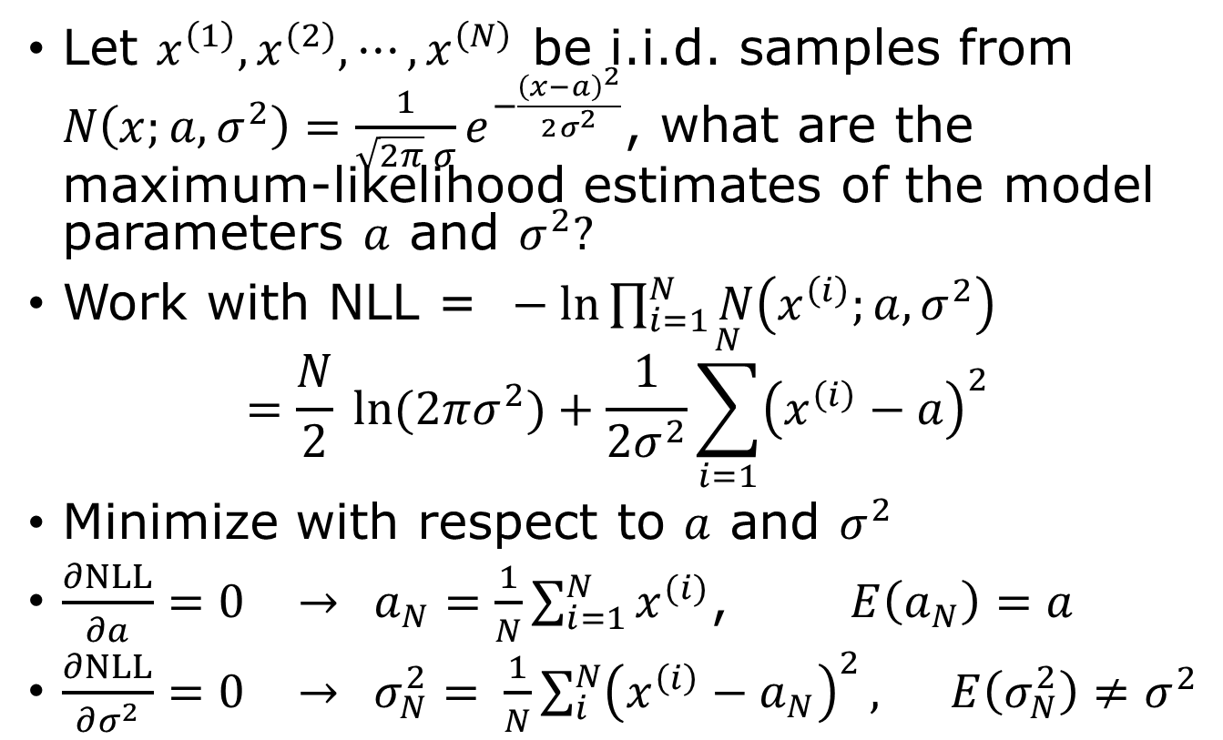
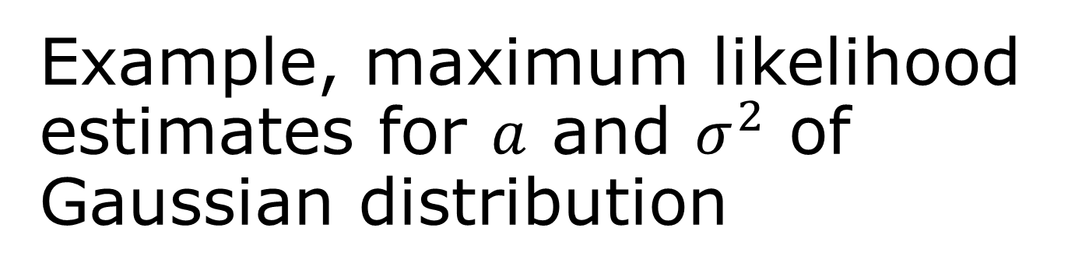
Example, maximum likelihood estimates for $a$ and $σ^{2}$ of Gaussian distribution
Let $x^{\left(1\right)},x^{(2)},⋯,x^{\left(N\right)}$ be i.i.d. samples from $N\left(x;a,σ^{2}\right)=\frac{1}{\sqrt{2π} σ}e^{−\frac{{\left(x−a\right)}^{2}}{2σ^{2}}}$, what are the maximum-likelihood estimates of the model parameters $a$ and $σ^{2}?$
Work with NLL = $− ln\prod_{i=1}^{N}{N\left(x^{\left(i\right)};a,σ^{2}\right)}$
$$=\frac{N}{2} ln{(2πσ^{2})}+\frac{1}{2σ^{2}}\sum_{i=1}^{N}{{\left(x^{\left(i\right)}−a\right)}^{2}}$$
Minimize with respect to $a$ and $σ^{2}$
$\frac{∂NLL}{∂a}=0$ $→$ $a_{N}=\frac{1}{N}\sum_{i=1}^{N}{x^{(i)}}$, $E\left(a_{N}\right)=a$
$\frac{∂NLL}{∂σ^{2}}=0$ $→$ $σ_{N}^{2}= \frac{1}{N}\sum_{i}^{N}{{\left(x^{\left(i\right)}−a_{N}\right)}^{2}},$ $E\left(σ_{N}^{2}\right)≠σ^{2}$
unbiased
biased

Slide 30
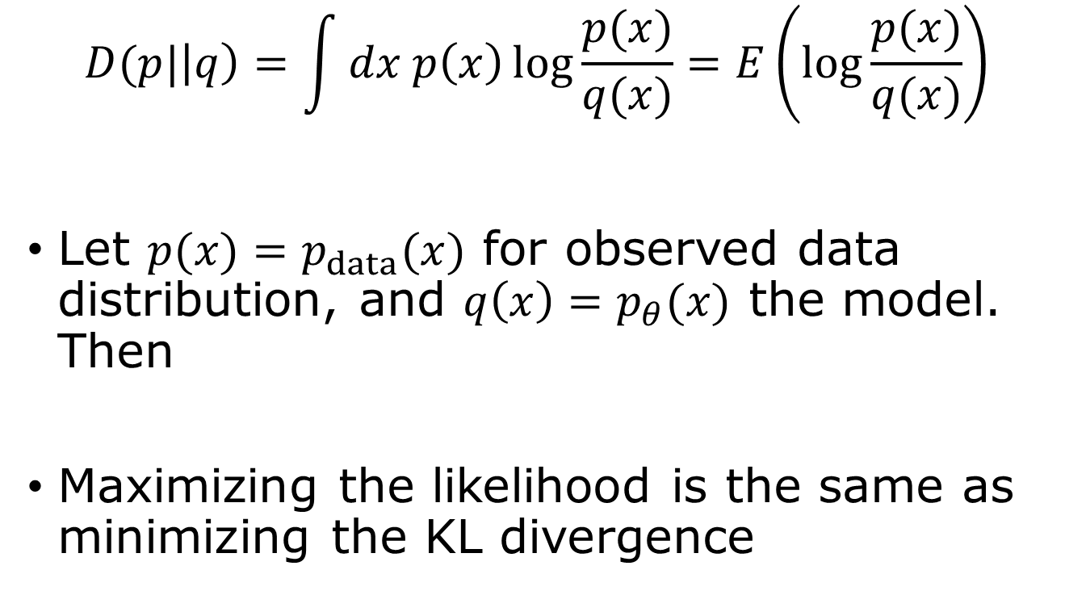
Kullback-Leibler divergence
$$D(p|\left|q\right)=\int{dx p\left(x\right)\log{\frac{p(x)}{q(x)}}=E\left(\log{\frac{p(x)}{q(x)}}\right)}$$
Let $p(x)=p_{data}(x)$ for observed data distribution, and $q\left(x\right)=p_{θ}(x)$ the model. Then
Maximizing the likelihood is the same as minimizing the KL divergence
Notes:
How to show (prove) that D(P||Q) >= 0? (Hint: use Jensen’s inequality). The Jensen inequality is f(E[x]) <= E[ f(x) ], if f is convex.

Slide 31
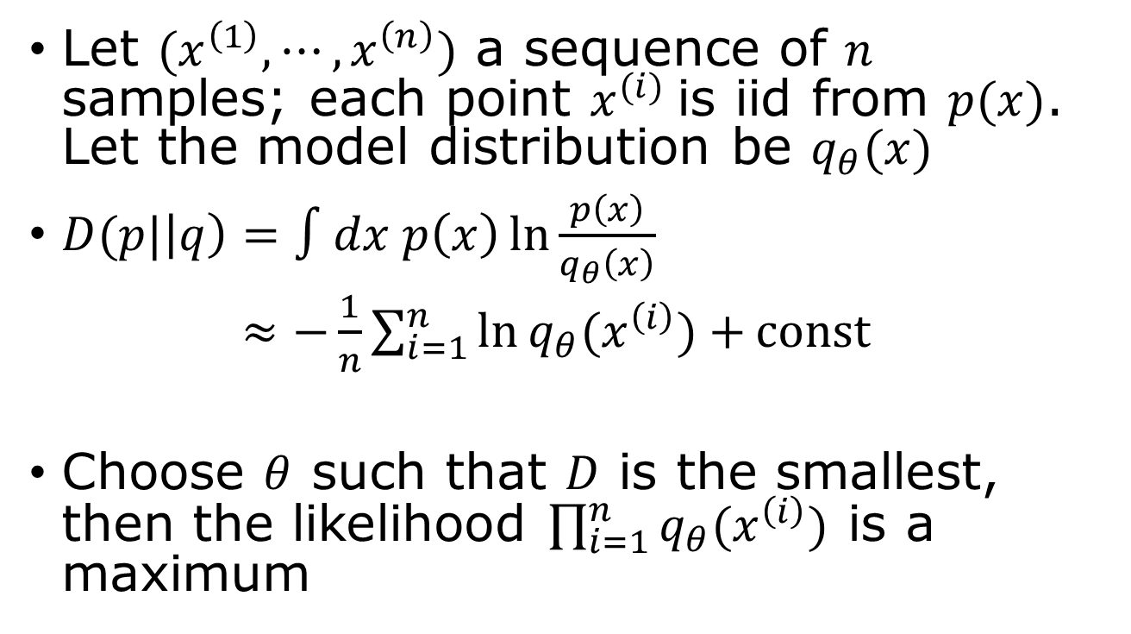
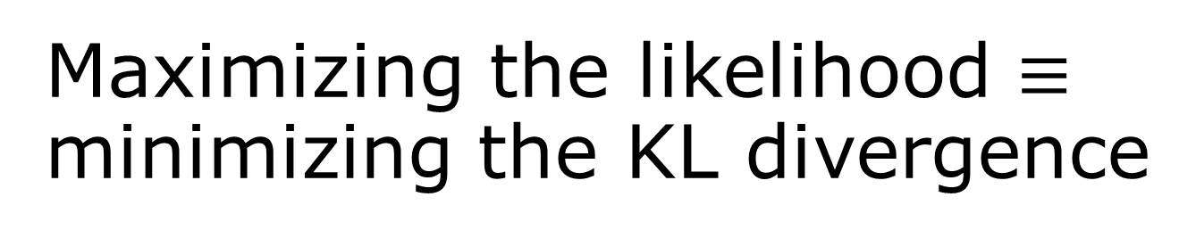
Maximizing the likelihood $≡$ minimizing the KL divergence
Let $(x^{\left(1\right)},⋯,x^{\left(n\right)})$ a sequence of $n$ samples; each point $x^{(i)}$is iid from $p(x)$. Let the model distribution be $q_{θ}(x)$
$D(p|\left|q\right)=∫dx p\left(x\right)\ln{\frac{p\left(x\right)}{q_{θ}\left(x\right)}}$
$≈−\frac{1}{n}\sum_{i=1}^{n}{\ln{q_{θ}(x^{\left(i\right)})}+}const$
Choose $θ$ such that $D$ is the smallest, then the likelihood $\prod_{i=1}^{n}{q_{θ}(x^{\left(i\right)})}$ is a maximum
MC sampling

Slide 32
Testing performance
Training error
Testing error
Generalization gap

Slide 33
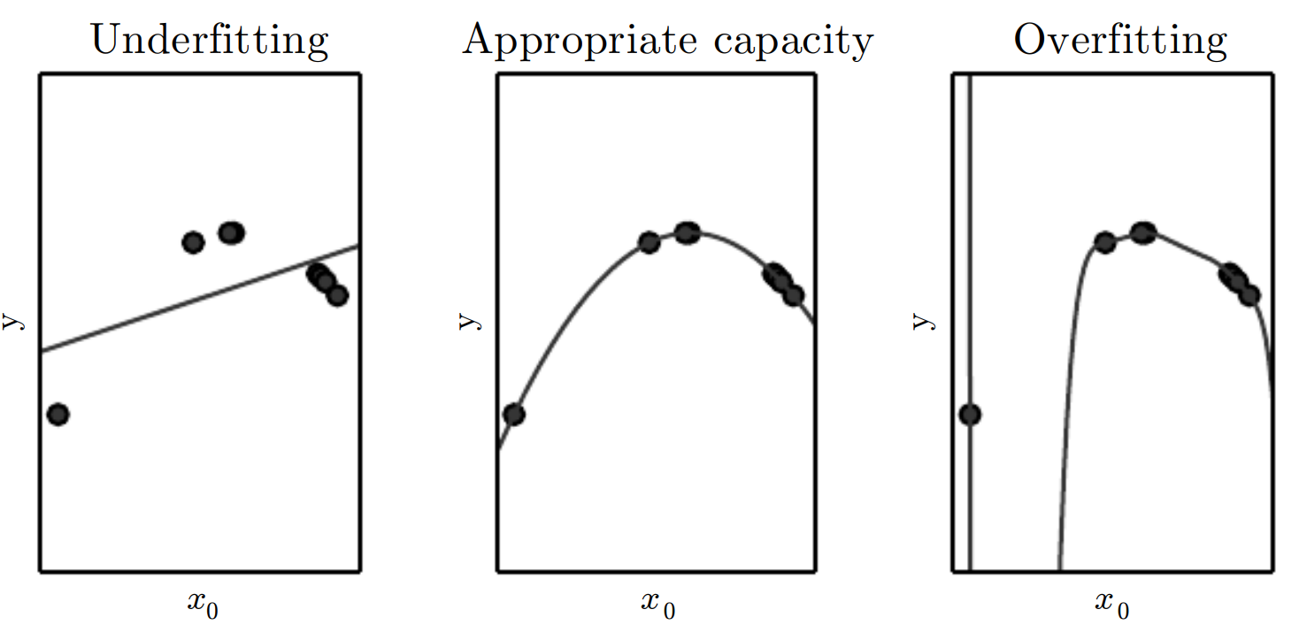
Underfit, overfit, capacity
Data follow a quadratic curve. Left: fit to a line (underfit), middle: fit to a quartic curve, right: fit to a polynomial of degree 9 (overfit). From fig 5.2 “Deep Learning,” Goodfellow, et al.

Slide 34



Performance evaluation
underfit
overfit
$$E_{test}$$
error
Generalization gap
$$E_{train}$$
Model complexity capacity (or training iterations)
error is $J=E$

Slide 35
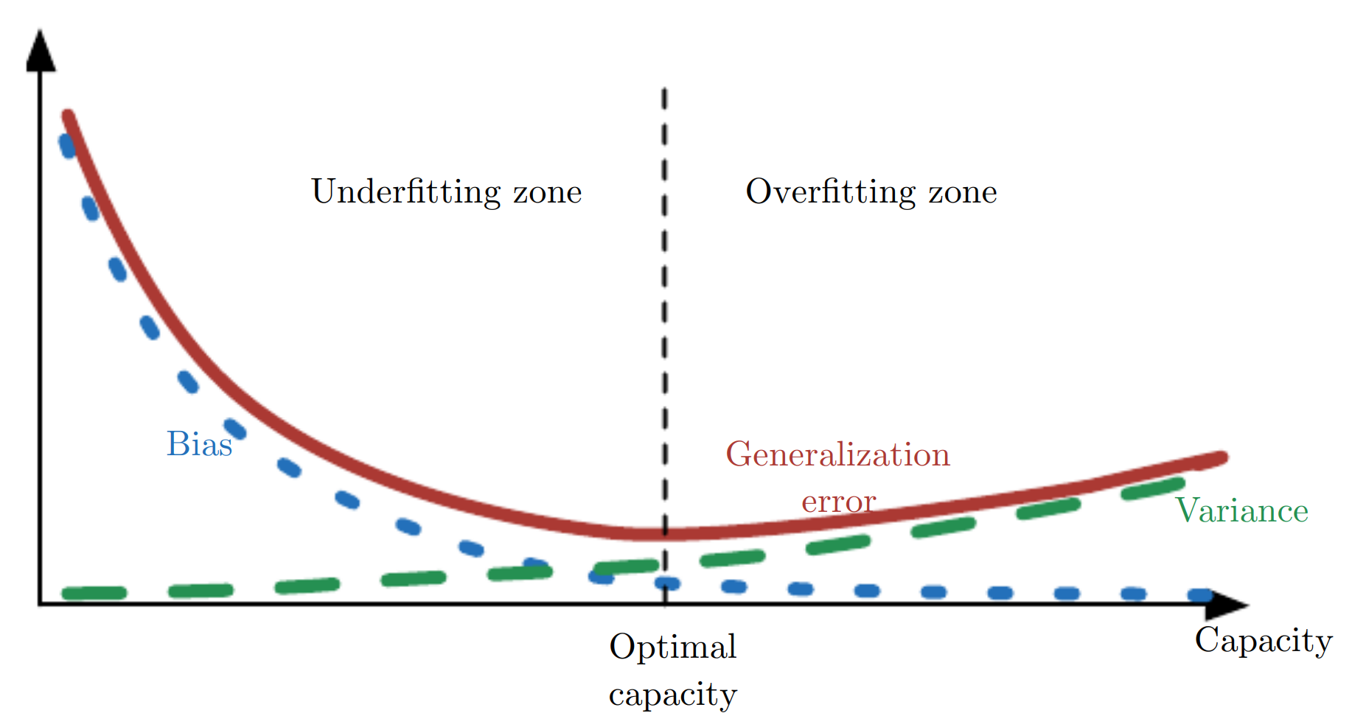
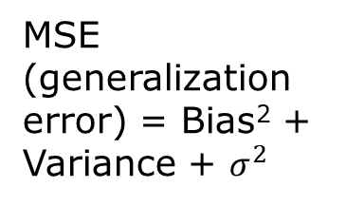
Bias-variance trade-off
MSE (generalization error) = Bias² + Variance + $σ^{2}$
As capacity increases, bias (blue dotted) decreases and variance (green dashed) increases. There is an optimal model capacity. From Fig. 5.6, Goodfellow, et al.
Notes:
Here sigma is data intrinsic error that cannot be reduced.

Slide 36

Regularization
Any modification to the learning algorithm to reduce generalization error. Help control the effective capacity.
$L^{2}$ regularisation $J→J+λ{\left\|θ\right\|}_{2}^{2}$
LASSO, or $L^{1}$ regularization
$$J→J+λ{\left\|θ\right\|}_{1}$$
Notes:
We learn this again in week 6.

Slide 37

$k$-fold cross-validation for error estimate $E_{test}$
all data
1
2
3
4
5
Split the data into k parts (or k-folds), use the i-th fold as validation data, the rest as training data, i = 1, 2,..., k. The final performance is the average of k cases.

Slide 38
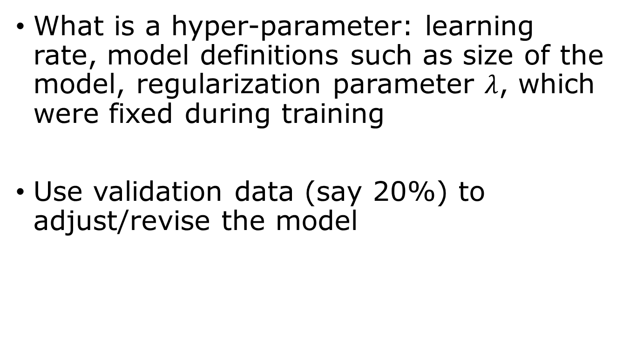
Hyperparameter optimization
What is a hyper-parameter: learning rate, model definitions such as size of the model, regularization parameter $λ$, which were fixed during training
Use validation data (say 20%) to adjust/revise the model
Training data/validation data/testing data

Slide 39

From Fig.2, Levine & Tu, PNAS, 2024.

Slide 40
Summary
Learning task: predict outputs or discover patterns from data.
Linear regression: the simplest machine learning model.
Loss function: quantify prediction errors using the mean squared error (MSE).
Optimization: minimize the loss using the normal equation or gradient descent.
Probability: provides a mathematical framework for uncertainty.
Maximum likelihood: explains why least-squares fitting is statistically justified for Gaussian noise.
KL divergence: measures the difference between probability distributions.
Generalization: good models perform well on unseen data.
Regularization and cross-validation: reduce overfitting and improve model selection.

Slide 41
Questions & Answers
1) design matrix, 2) basis function, 3) 2-norm, 4) loss function, 5) normal equation, 6) Kolmogorov definition of probability, 7) event?, 8) define conditional probability, 9) what is a likelihood function? 10) MLE? 11) statistic, 12) mean, variance, bias, MSE? 13) estimator, biased and unbiased estimator, 14) Kullback-Leibler divergence, 15) generalization gap, 16) hyperparameters, 17) cross-validation

Slide 42
Reading (Bishop “Deep Learning”)
Probabilities, maximum likelihood: pages 23-42
KL divergence: pages 51-53
Linear model: pages 111-117

