Slide 1
Week 4,
Deep Neural Networks
Notes:
Bishop, chapter 6.

Slide 2
Outline
Limitation of fixed basis and why we go to multilayer networks
Universal approximation theorem
Error (or loss) function from negative log likelihood for regression and classification
Stochastic gradient descent and other optimization methods
PyTorch training loop

Slide 3
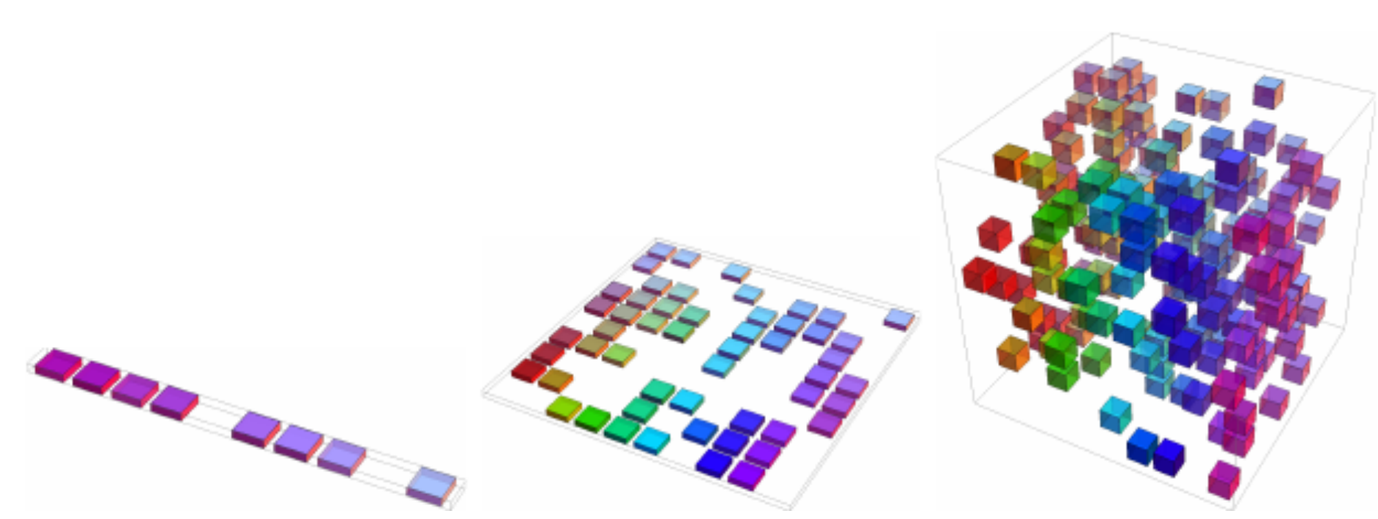
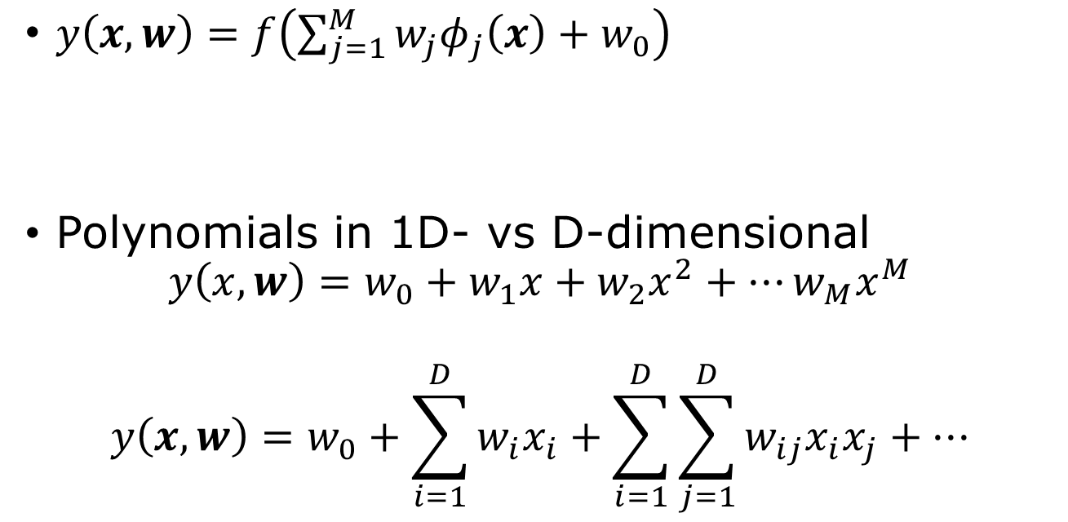
Limitations of fixed basis functions/curse of dimensionality
$y\left(x,w\right)=f\left(\sum_{j=1}^{M}{w_{j}φ_{j}\left(x\right)+w_{0}}\right)$
Polynomials in 1D- vs D-dimensional
$$y\left(x,w\right)=w_{0}+w_{1}x+w_{2}x^{2}+⋯w_{M}x^{M}$$
$$y\left(x,w\right)=w_{0}+\sum_{i=1}^{D}{w_{i}x_{i}+\sum_{i=1}^{D}{\sum_{j=1}^{D}{w_{ij}x_{i}x_{j}+…}}}$$
Fig.5.9 Goodfellow, et al.
XOR problem
Notes:
Read chapter 6, Bishop, “Deep Learning”. Limitation of linear model, XOR problem, see Minsky and Papert, “Perceptrons,” (1969).

Slide 4








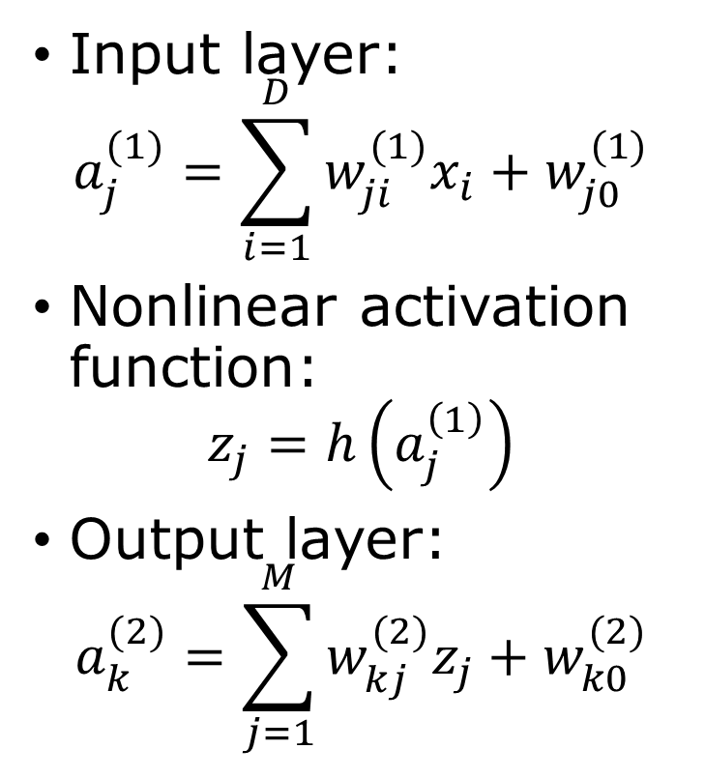














Multilayer Networks
input hidden output
$$b$$
Input layer:
$$a_{j}^{(1)}=\sum_{i=1}^{D}{w_{ji}^{(1)}x_{i}+w_{j0}^{(1)}}$$
Nonlinear activation function:
$$z_{j}=h\left(a_{j}^{\left(1\right)}\right)$$
Output layer:
$$a_{k}^{(2)}=\sum_{j=1}^{M}{w_{kj}^{(2)}z_{j}+w_{k0}^{(2)}}$$
$$w_{MD}^{\left(1\right)}$$
$$x_{D}$$
$$z_{M}$$
$$w_{KM}^{\left(2\right)}$$
$$⋮$$
$$w_{M2}^{\left(1\right)}$$
$${ y}_{K}$$
$$⋮$$
$$⋮$$
$$x_{2}$$
$$w_{M0}^{\left(1\right)}$$
$$x_{1}$$
$${ y}_{1}$$
$$z_{1}$$
$$f$$
$$x_{0}$$
$$w_{10}^{\left(2\right)}$$
$$z_{0}$$
$$x_{0}=z_{0}=1$$
$$h$$
$$y_{k}=f(a_{k}^{\left(2\right)})$$

Slide 5
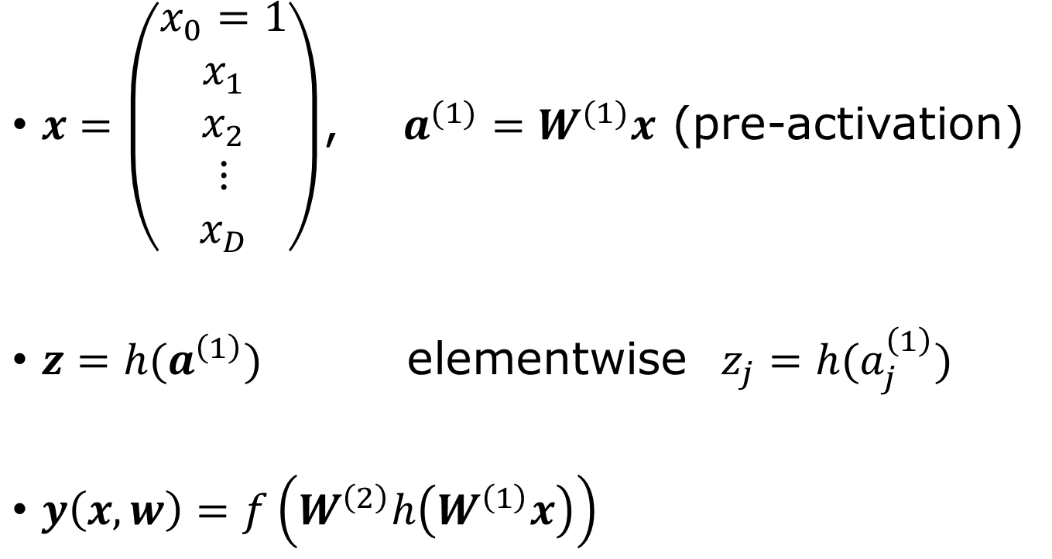

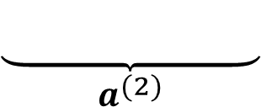
Parameters in matrix notation
$x=\left(\begin{matrix}x_{0}=1 \\ x_{1} \\ x_{2} \\ ⋮ \\ x_{D}\end{matrix}\right)$, $a^{(1)}=W^{(1)}x$ (pre-activation)
$z=h(a^{\left(1\right)})$ elementwise $z_{j}=h(a_{j}^{\left(1\right)})$
$y\left(x,w\right)=f\left(W^{\left(2\right)}h\left(W^{\left(1\right)}x\right)\right)$
$$w=\left(\begin{matrix}W^{(1)} \\ W^{(2)}\end{matrix}\right)$$
$$\underset{a^{(2)}}{\underbrace{ …………… }}$$
Notes:
Show that if f and h are identity maps, the deep network has no real advantage, why?

Slide 6



Hidden unit activation functions h(.)
Rectified linear unit (ReLU)
$h\left(a\right)=\max\left(0,a\right)$
Logistic sigmoid
$$σ\left(a\right)=\frac{1}{1+e^{−a}}$$
$$h(a)$$
$$a$$

Slide 7
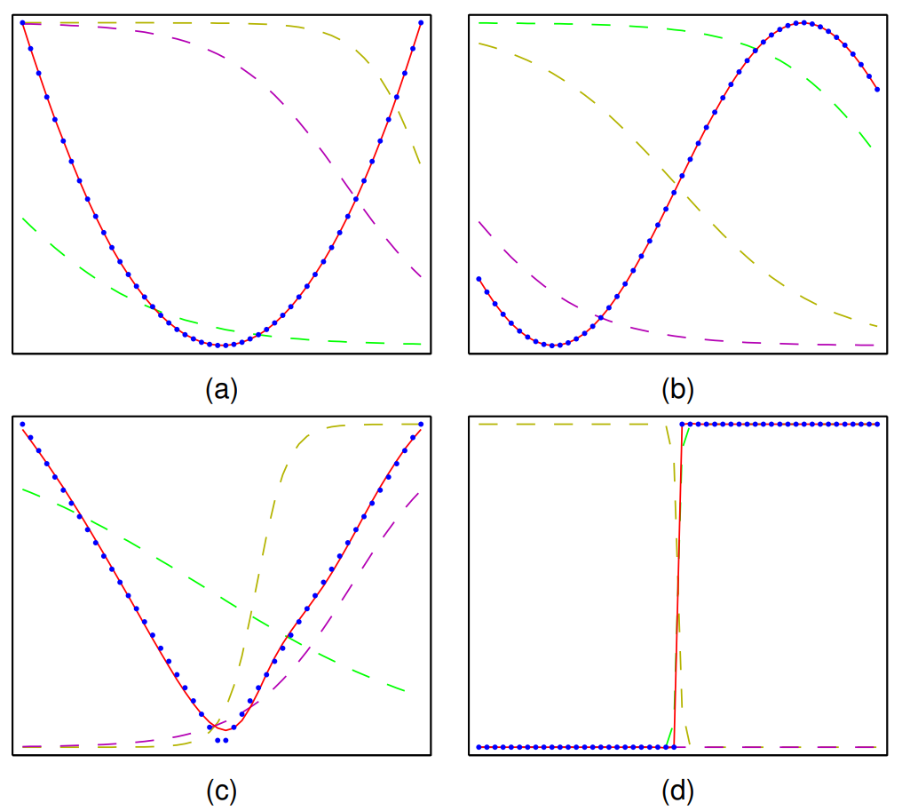

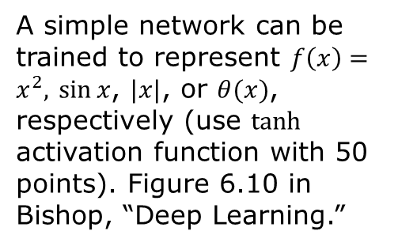




Universal approximation
With suitable activation functions, one hidden-layer network can approximate any continuous function on a compact domain given enough hidden layer units.
$$z_{3}$$
$$x$$
$$z_{2}$$
$$y$$
$$z_{1}$$
A simple network can be trained to represent $f\left(x\right)=x^{2},$ $\sin{x}$, $|x|$, or $θ(x)$, respectively (use $tanh$ activation function with 50 points). Figure 6.10 in Bishop, “Deep Learning.”

Slide 8





PyTorch code 3-unit hidden layer
import torch
x = torch.linspace(0, 2*torch.pi, 50).reshape(-1, 1)
y = torch.sin(x)
model = torch.nn.Sequential(
torch.nn.Linear(1, 3),
torch.nn.Tanh(),
torch.nn.Linear(3, 1))
loss_fn = torch.nn.MSELoss()
optimizer = torch.optim.SGD(model.parameters(), lr=0.05)
for epoch in range(30000):
y_pred = model(x) # forward
loss = loss_fn(y_pred, y)
optimizer.zero_grad()
loss.backward() # backward
optimizer.step() # update W,b
$$z_{3}$$
$$x$$
$$z_{2}$$
$$y$$
$$z_{1}$$
1 input, 1 output, three hidden units, (6+4)=10 fitting parameters
Notes:
.reshape(-1,1) changes the row vector to column vector of 50 by 1. This is needed in input to nn.Linear(1,3). Where are the parameters and how can we access them?

Slide 9
No free lunch theorem
No single optimization or machine learning algorithm is universally superior to all others across all possible problems.
“algorithm” – method for generalizing from past observations.
Inductive bias : assumptions that enable generalization

Slide 10
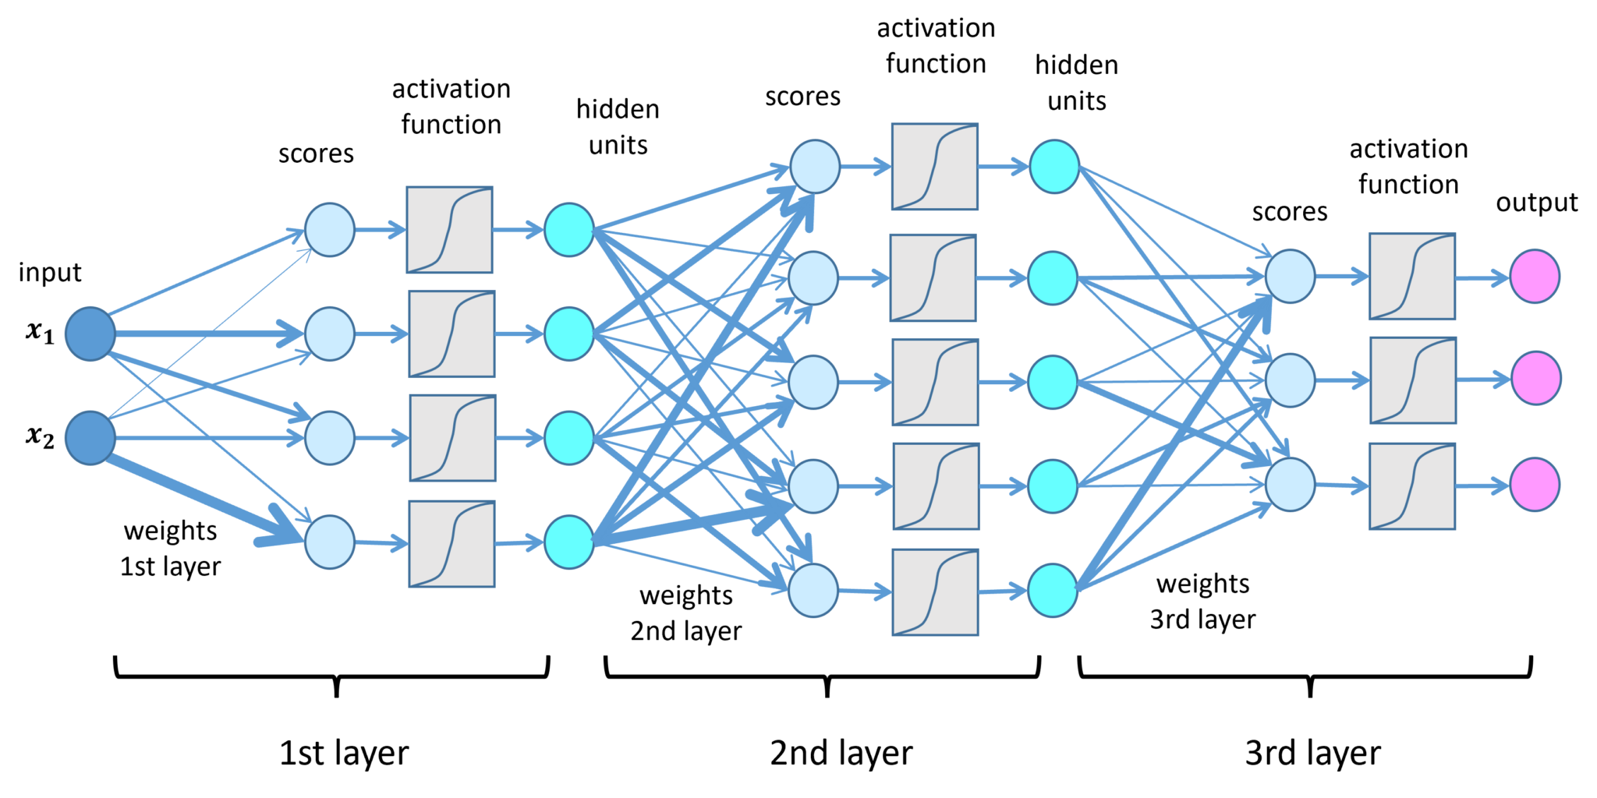
Deep network: how deep is deep?
representation learning, transfer learning, contrastive learning
https://lamarr-institute.org/blog/deep-neural-networks/

Slide 11
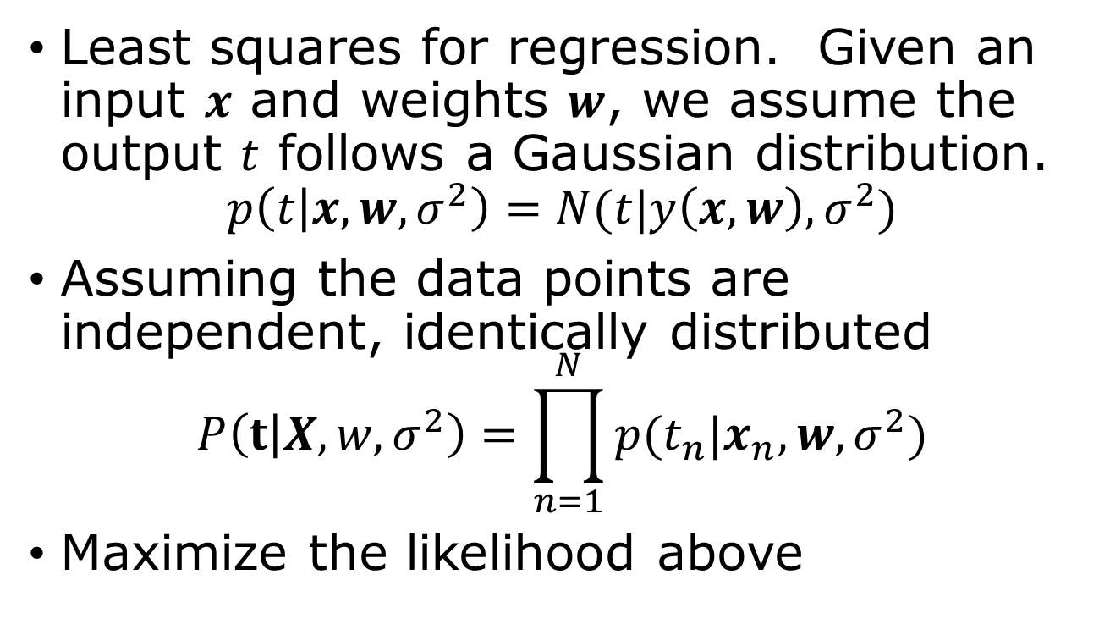
Error/loss/cost function
Least squares for regression. Given an input $x$ and weights $w$, we assume the output $t$ follows a Gaussian distribution.
$$p\left(t | x,w,σ^{2}\right)=N(t|y\left(x,w\right),σ^{2})$$
Assuming the data points are independent, identically distributed
$$P\left(t | X,w,σ^{2}\right)=\prod_{n=1}^{N}{p(t_{n}|x_{n},w,σ^{2})}$$
Maximize the likelihood above
Notes:
Bishop’s book uses the term Error, instead of the more popular loss or cost function.

Slide 12

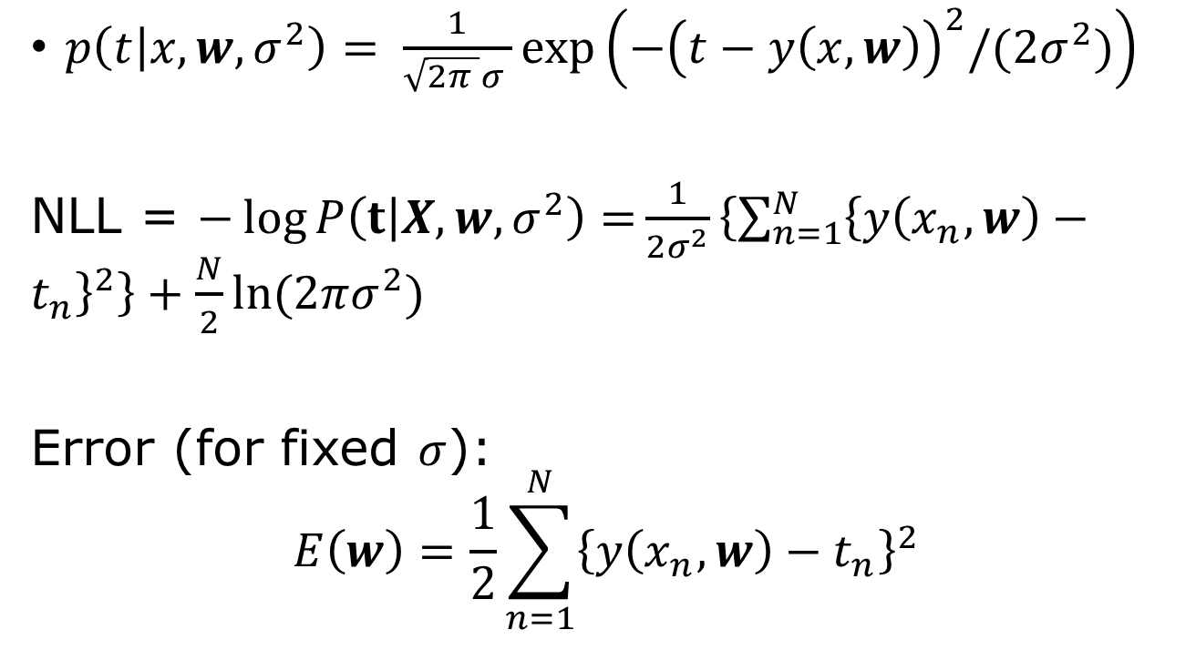
Maximize likelihood $→$ minimize error
$p\left(t | x,w,σ^{2}\right)= \frac{1}{\sqrt{2π }σ }\exp\left(−{\left(t−y\left(x,w\right)\right)}^{2}/(2σ^{2})\right)$
NLL = $−\log{P\left(t | X,w,σ^{2}\right)=}\frac{1}{2σ^{2}}\left\{\sum_{n=1}^{N}{{\left\{y\left(x_{n},w\right)−t_{n}\right\}}^{2}}\right\}+\frac{N}{2}\ln{(2πσ^{2}) }$
Error (for fixed $σ$):
$$E\left(w\right)=\frac{1}{2}\sum_{n=1}^{N}{{\left\{y\left(x_{n},w\right)−t_{n}\right\}}^{2}}$$
Notes:
What is the likelihood function if, 1) y and t are vectors and sigma is a matrix?

Slide 13

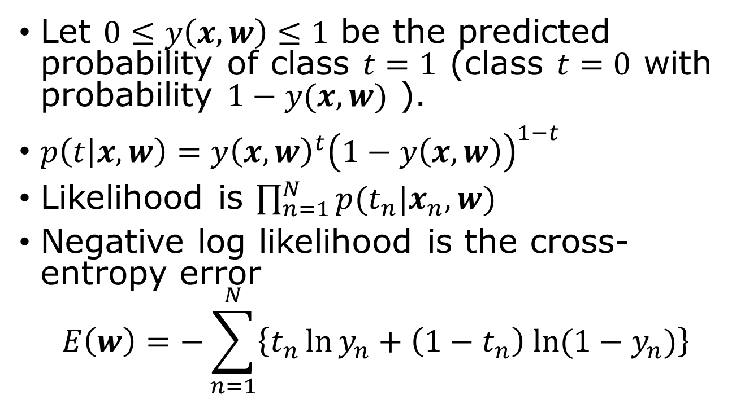

Binary classification
$$y=σ(z)$$
Let $0≤y\left(x,w\right)≤1$ be the predicted probability of class $t=1$ (class $t=0$ with probability $1−y(x,w)$ ).
$p\left(t | x,w\right)=y{\left(x,w\right)}^{t}{\left(1−y\left(x,w\right)\right)}^{1−t}$
Likelihood is $\prod_{n=1}^{N}{p(t_{n}|x_{n},w)}$
Negative log likelihood is the cross-entropy error
$$E\left(w\right)=−\sum_{n=1}^{N}{\left\{t_{n}\ln{y_{n}+\left(1−t_{n}\right) ln⁡(1−y_{n})}\right\}}$$
$t=0$ or $1$

Slide 14


A classification problem
Handwritten digits in 28$×$28 grey-scale pixels
With 10 output neurons answering the question: is it 0? is it 1? …, is it 9?
60000 for a training set, 10000 examples for testing set.
MNIST dataset
Notes:
From MNIST dataset.

Slide 15
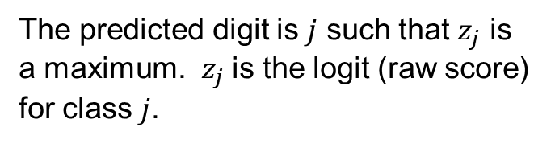
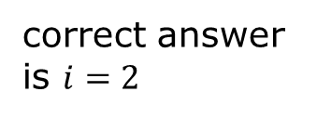
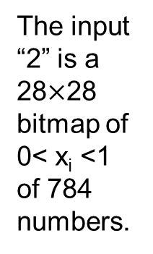
Network
correct answer is $i=2$
x₁
z₀
The input “2” is a 28$×$28 bitmap of 0< x_{i} <1 of 784 numbers.
x₂
…
z₁
z₂
…
…
x₇₈₄
z₉
The predicted digit is $j$ such that $z_{j}$ is a maximum. $z_{j}$ is the logit (raw score) for class $j$.

Slide 16

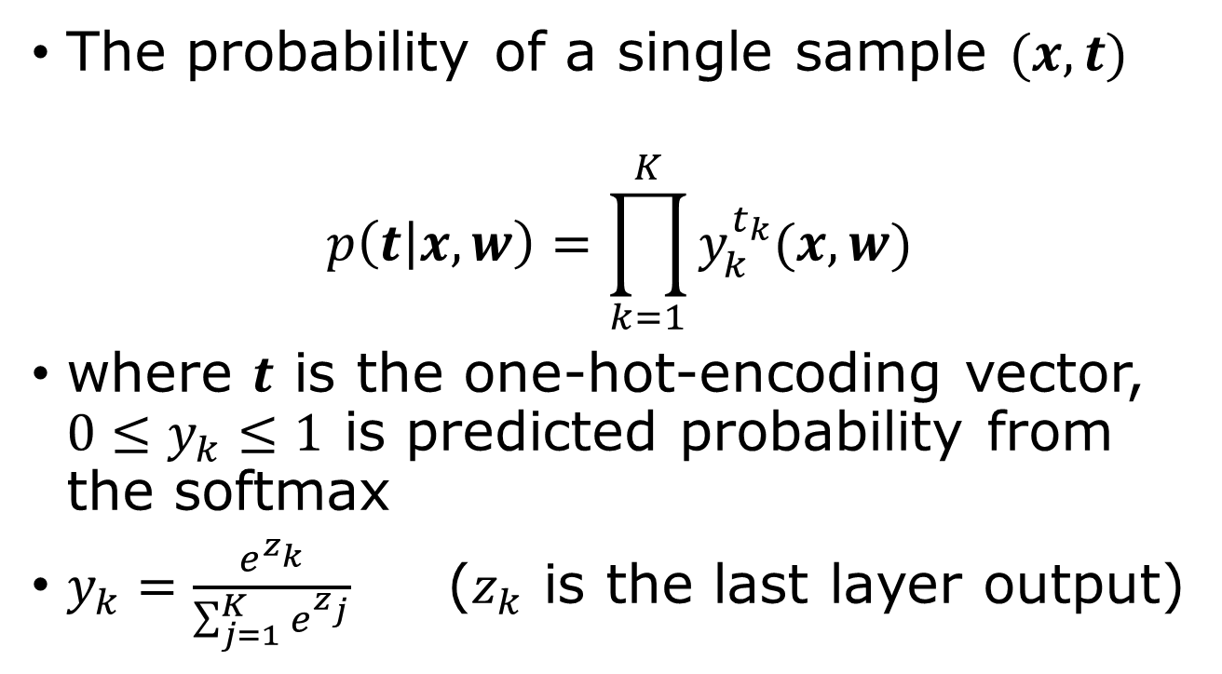
$K$ different categories, e.g., recognize the handwritten digits from 0 to 9
The probability of a single sample $(x,t)$
$$p\left(t | x,w\right)=\prod_{k=1}^{K}{y_{k}^{t_{k}}(x,w)}$$
where $t$ is the one-hot-encoding vector, $0≤y_{k}≤1$ is predicted probability from the softmax
$y_{k}=\frac{e^{z_{k}}}{\sum_{j=1}^{K}{e^{z_{j}}}}$ ($z_{k}$ is the last layer output)
Notes:
Show that this formula for p agrees with the previous slide when K = 2. The likelihood is the product of p(t_n|x_n,w) over n with the same w.

Slide 17
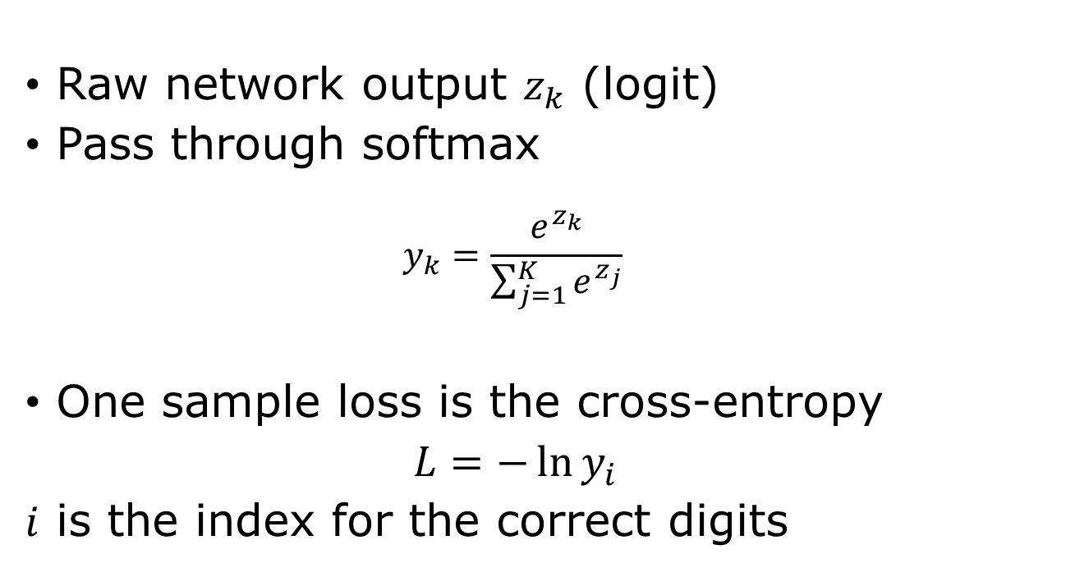
K-different categories, what is the error function?
Raw network output $z_{k}$ (logit)
Pass through softmax
  $$y_{k}=\frac{e^{z_{k}}}{\sum_{j=1}^{K}{e^{z_{j}}}}$$
One sample loss is the cross-entropy
$L=−\ln{y_{i}}$
$i$ is the index for the correct digits
PyTorch:
loss_fn = torch.nn.CrossEntropyLoss()
loss = loss_fn(logits, targets)

Slide 18
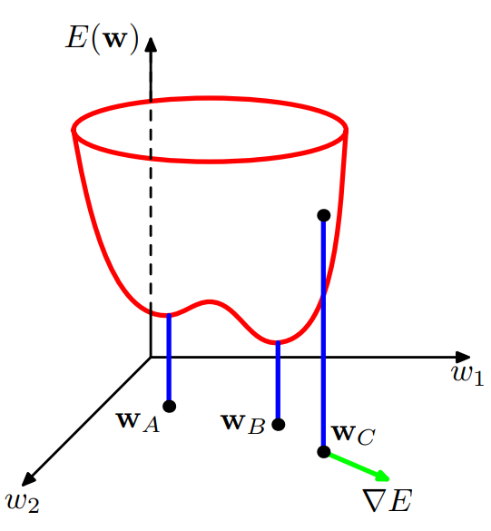

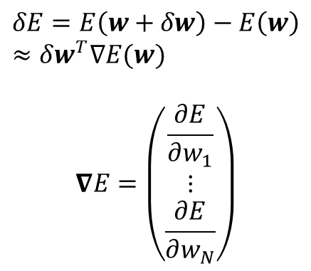


Gradient descent (find minimum of error function)
$$δE=E\left(w+δw\right)−E\left(w\right)≈δw^{T}∇E(w)$$
$$∇E=\left(\begin{matrix}\frac{∂E}{∂w_{1}} \\ ⋮ \\ \frac{∂E}{∂w_{N}}\end{matrix}\right)$$
$$w_{1}$$
$$∇E$$
$$w_{2}$$

Slide 19
Stochastic Gradient Descent
SGD is arguably the most important method in machine learning to find optimal parameters
PyTorch class: torch.optim.SGD( … )

Slide 20
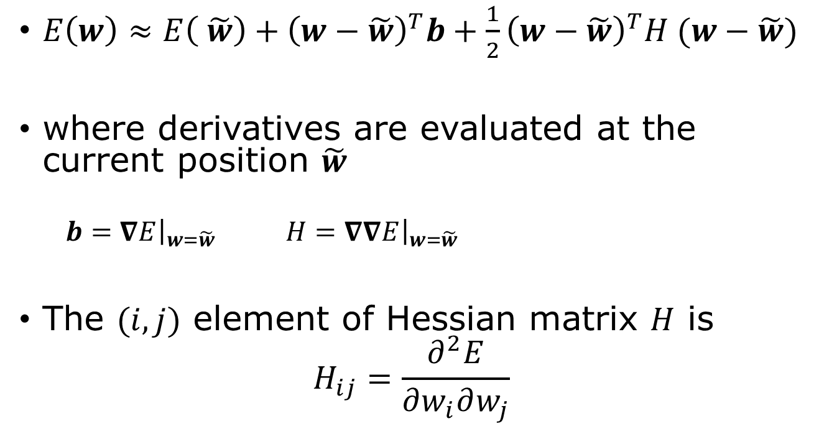
Local quadratic approximation
$E\left(w\right)≈E\left( \tilde{w}\right)+{\left(w−\tilde{w}\right)}^{T}b+\frac{1}{2}{\left(w−\tilde{w}\right)}^{T}H (w−\tilde{w})$
where derivatives are evaluated at the current position $\tilde{w}$
  $b={\left.∇E\right|}_{w=\tilde{w}}$ $H={\left.∇∇E\right|}_{w=\tilde{w}}$
The $(i,j)$ element of Hessian matrix $H$ is
$$H_{ij}=\frac{∂^{2}E}{∂w_{i}∂w_{j}}$$

Slide 21
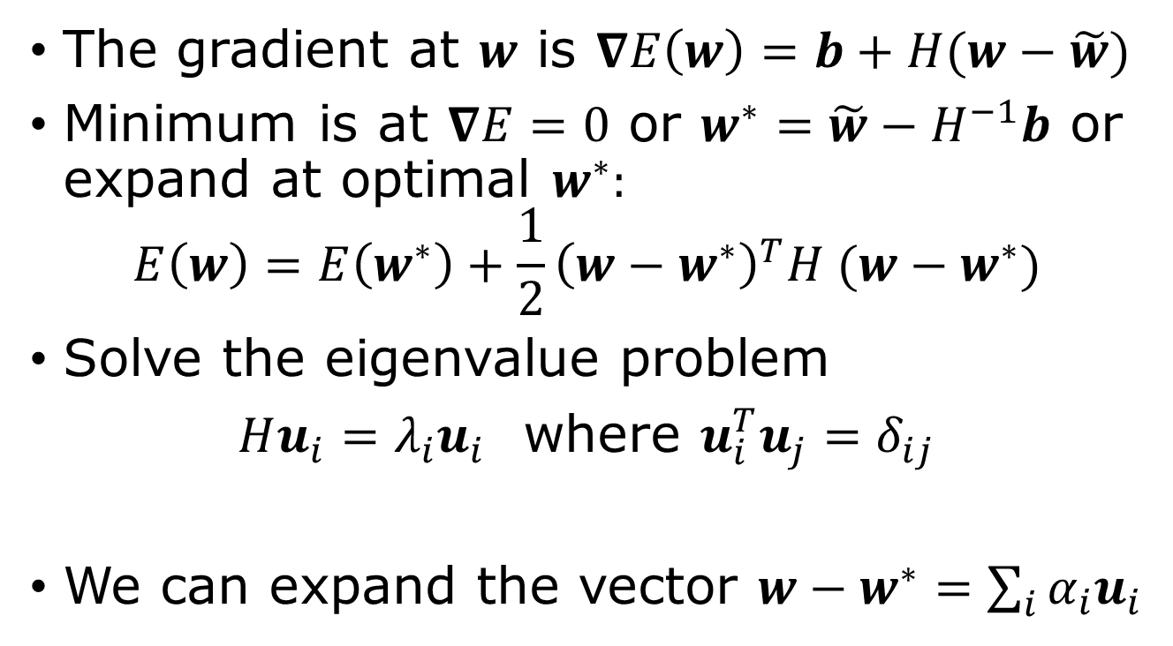
Gradient, eigenvectors
The gradient at $w$ is $∇E\left(w\right)=b+H(w−\tilde{w})$
Minimum is at $∇E=0$ or $w^{∗}=\tilde{w}−H^{−1}b$ or expand at optimal $w^{∗}:$
$$E\left(w\right)=E\left(w^{∗}\right)+\frac{1}{2}{\left(w−w^{∗}\right)}^{T}H (w−w^{∗})$$
Solve the eigenvalue problem
$Hu_{i}=λ_{i}u_{i}$ where $u_{i}^{T}u_{j}=δ_{ij}$
We can expand the vector $w−w^{∗}=\sum_{i}{α_{i}u_{i}}$
Notes:
Note u_i span the full space of w if H is not singular.

Slide 22
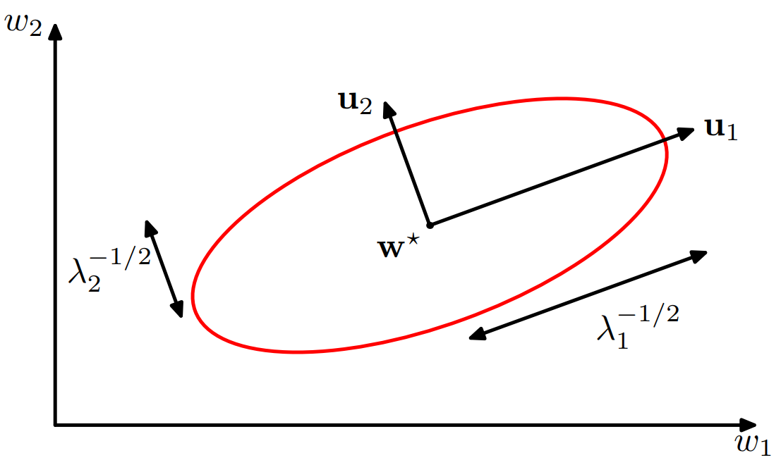

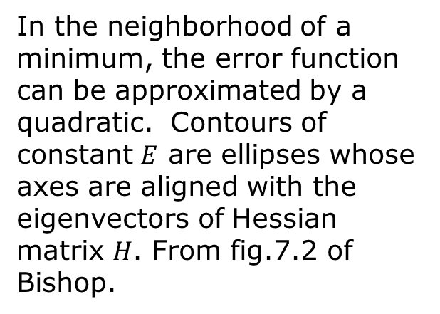
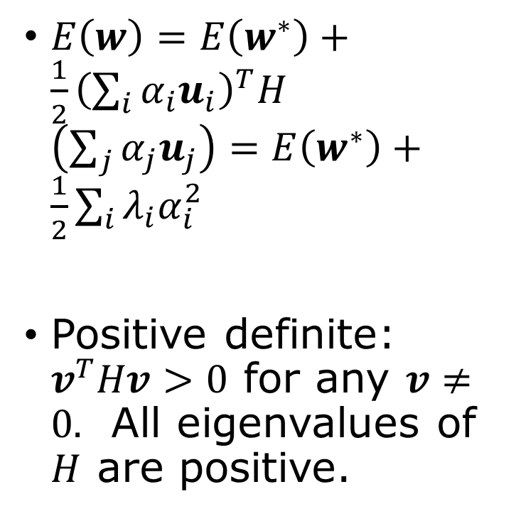
Property of $E(w)$ near a minimum
$E\left(w\right)=E\left(w^{∗}\right)+\frac{1}{2}{\left(\sum_{i}{α_{i}u_{i}}\right)}^{T}H$ $\left(\sum_{j}{α_{j}u_{j}}\right)=E\left(w^{∗}\right)+\frac{1}{2}\sum_{i}{λ_{i}α_{i}^{2}}$
Positive definite: $v^{T}Hv>0$ for any $v≠0.$ All eigenvalues of $H$ are positive.
In the neighborhood of a minimum, the error function can be approximated by a quadratic. Contours of constant $E$ are ellipses whose axes are aligned with the eigenvectors of Hessian matrix $H$. From fig.7.2 of Bishop.
Notes:
Note: E(w) is locally convex.

Slide 23
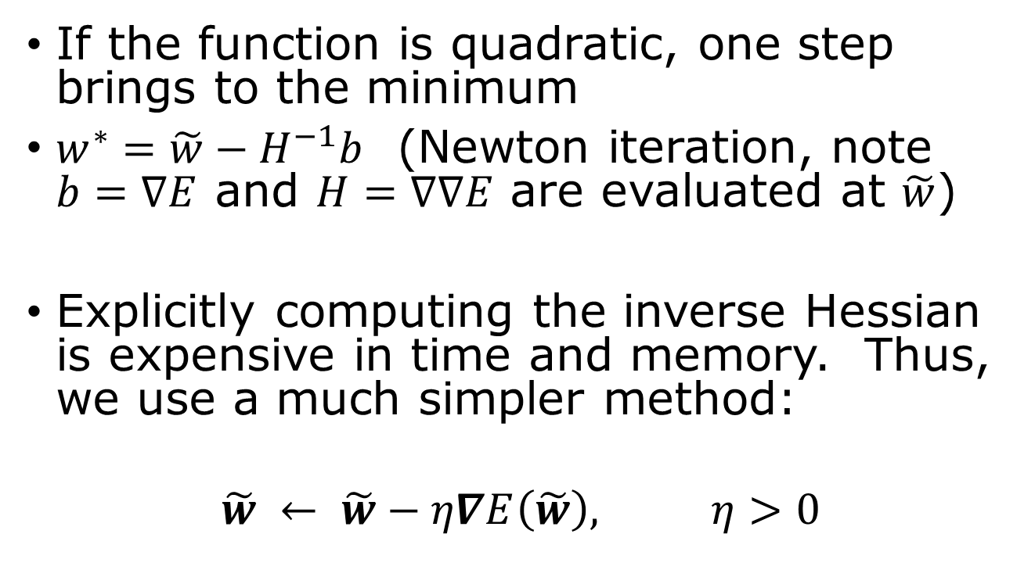
Gradient Descent Optimization
If the function is quadratic, one step brings to the minimum
$w^{∗}=\tilde{w}−H^{−1}b$ (Newton iteration, note $b=∇E$ and $H=∇∇E$ are evaluated at $\tilde{w}$)
Explicitly computing the inverse Hessian is expensive in time and memory. Thus, we use a much simpler method:
$$\tilde{w} ← \tilde{w}−η∇E\left(\tilde{w}\right), η>0$$
The gradient descent effectively replaces $H^{−1}$ by $ηI$

Slide 24

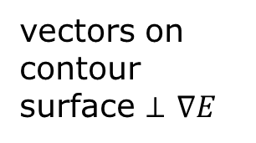




Going in the negative gradient direction
vectors on contour surface $⊥$ $∇E$
$$w_{2}$$
$E\left(w\right)=const$ contour
$$δE=δw^{T}∇E$$
$$∇E$$
$$w_{1}$$

Slide 25
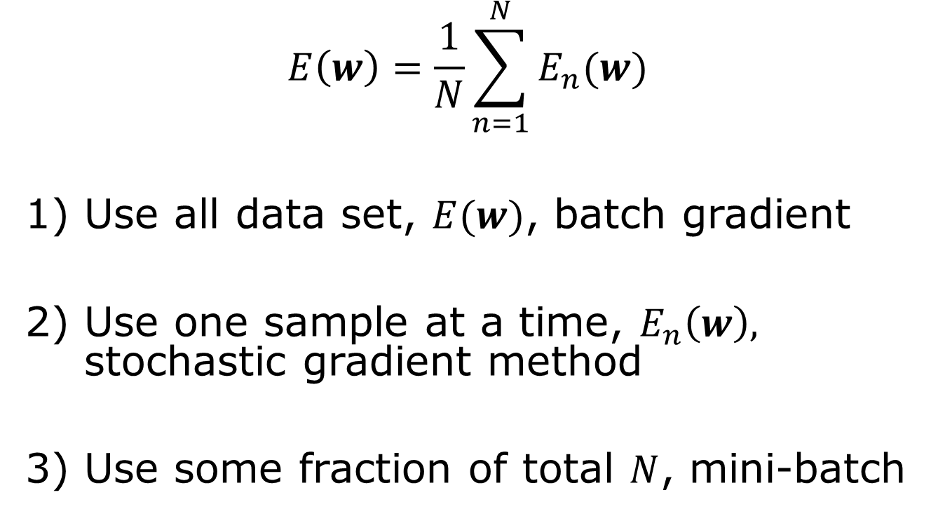
Batch gradient or stochastic gradient descent
$$E\left(w\right)=\frac{1}{N}\sum_{n=1}^{N}{E_{n}(w)}$$
Use all data set, $E(w)$, batch gradient
Use one sample at a time, $E_{n}\left(w\right),$ stochastic gradient method
Use some fraction of total $N$, mini-batch

Slide 26
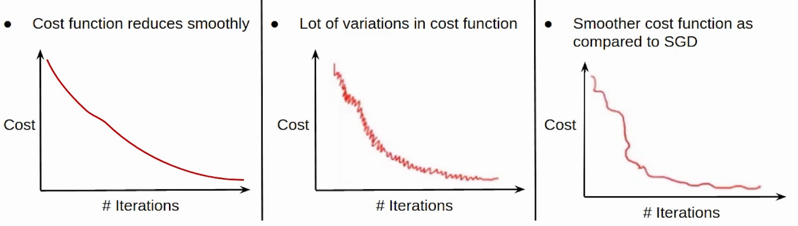
Compare batch, stochastic, and mini-batch
Epoch: one pass through dataset
Stochastic gradient descent (SGD): faster but noisier
Mini-batch: somewhere in between
Batch: use all data, slow but smooth decrease
https://www.analyticsvidhya.com/blog/2021/03/variants-of-gradient-descent-algorithm/

Slide 27
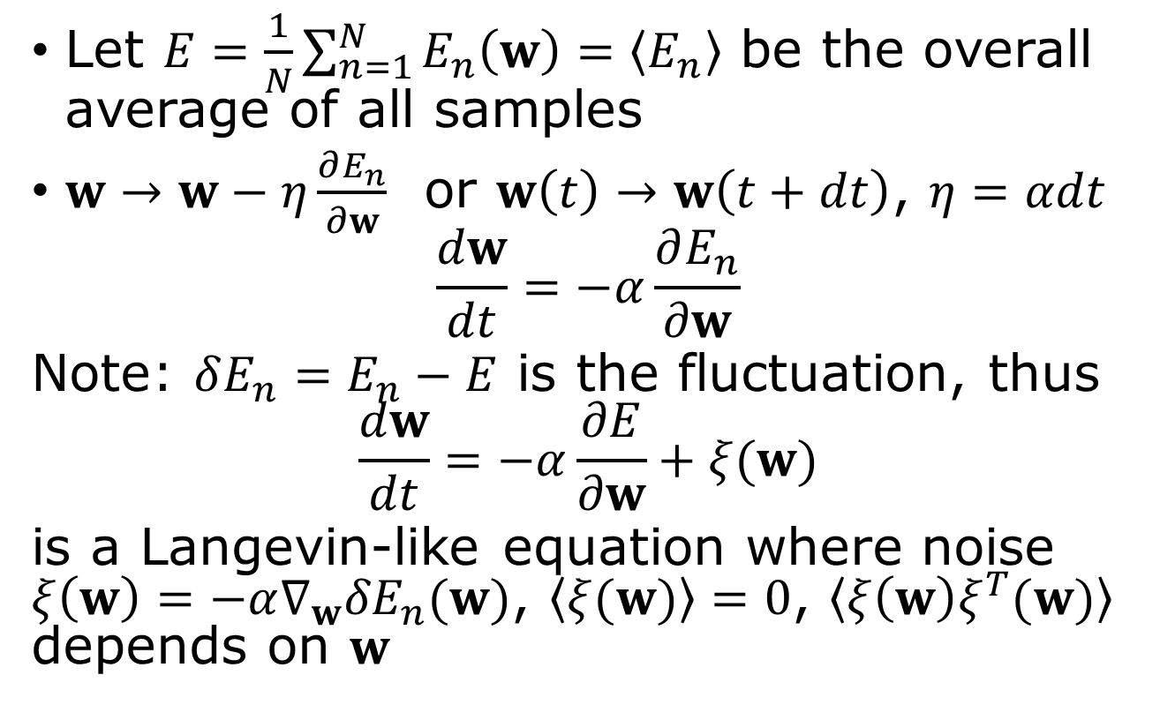
Why use one data point at a step mean “stochastic”?
Let $E=\frac{1}{N}\sum_{n=1}^{N}{E_{n}\left(w\right)=\left\langle E_{n}\right\rangle }$ be the overall average of all samples
$w→w−η\frac{∂E_{n}}{∂w}$ or $w\left(t\right)→w\left(t+dt\right)$, $η=αdt$
$$\frac{dw}{dt}=−α\frac{∂E_{n}}{∂w}$$
Note: $δE_{n}=E_{n}−E$ is the fluctuation, thus
$$\frac{dw}{dt}=−α\frac{∂E}{∂w}+ξ(w)$$
is a Langevin-like equation where noise $ξ\left(w\right)=−α∇_{w}{δE}_{n}(w)$, $\left\langle ξ(w)\right\rangle =0$, $\left\langle ξ{\left(w\right)ξ}^{T}(w)\right\rangle$ depends on $w$

Slide 28
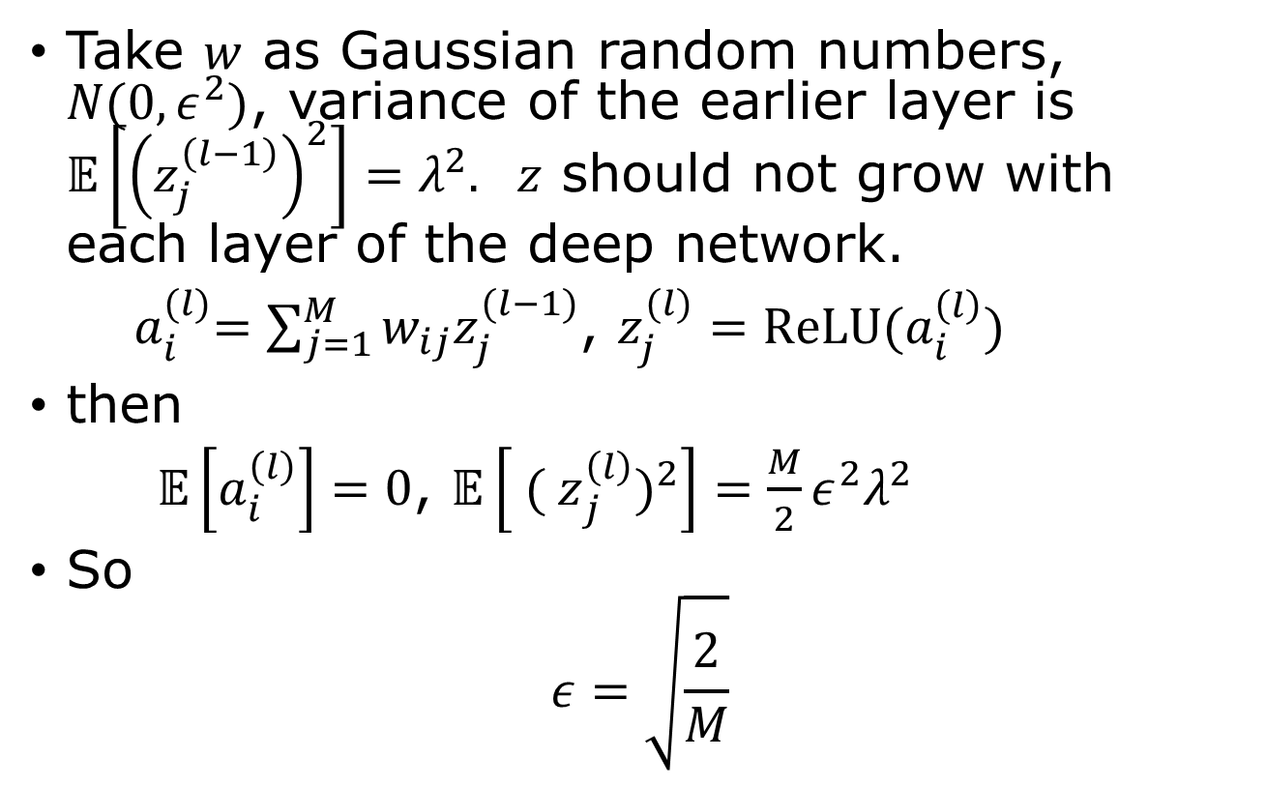

Parameter $w$ – `He’ initialization for ReLU
Take $w$ as Gaussian random numbers, $N(0,ε^{2})$, variance of the earlier layer is $𝔼\left[{\left(z_{j}^{\left(l−1\right)}\right)}^{2}\right]=λ^{2}.$ $z$ should not grow with each layer of the deep network.
${ a}_{i}^{(l)}=\sum_{j=1}^{M}{w_{ij}z_{j}^{(l−1)}}$, $z_{j}^{(l)}=ReLU(a_{i}^{\left(l\right)})$
then
$𝔼\left[a_{i}^{\left(l\right)}\right]=0$, $𝔼\left[{{ ( z}_{j}^{\left(l\right)})}^{2}\right]=\frac{M}{2}ε^{2}λ^{2}$
So
$$ε=\sqrt{\frac{2}{M}}$$

Slide 29
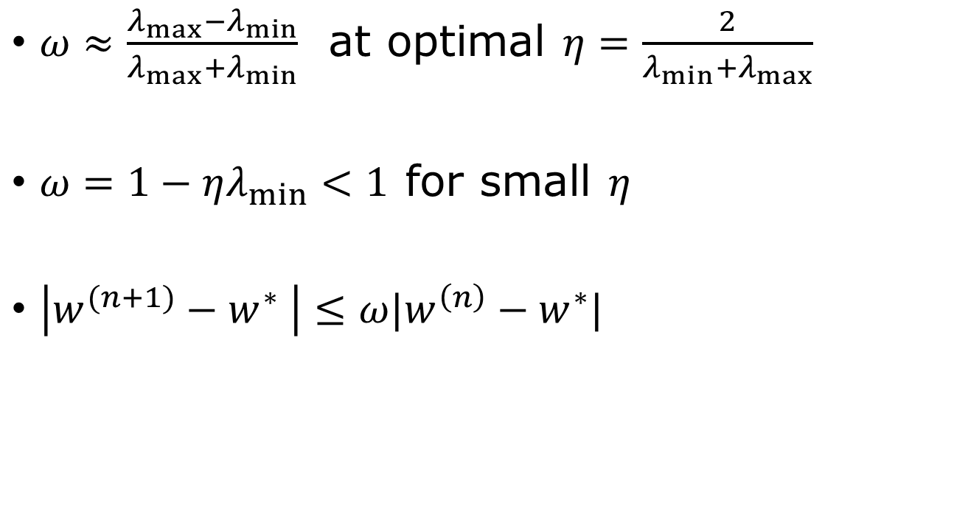
Linear convergence (GD)
$ω≈\frac{λ_{max}−λ_{min}}{λ_{max}+λ_{min}}$ at optimal $η=\frac{2}{{λ_{min}+λ}_{max}}$
$ω=1−ηλ_{min}<1$ for small $η$
$\left|w^{(n+1)}−w^{∗} \right|≤ω|w^{\left(n\right)}−w^{∗}|$

Slide 30
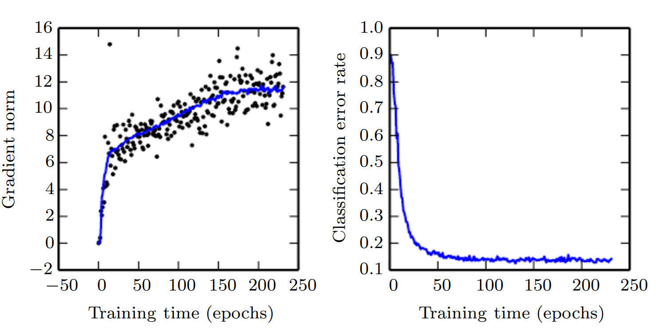
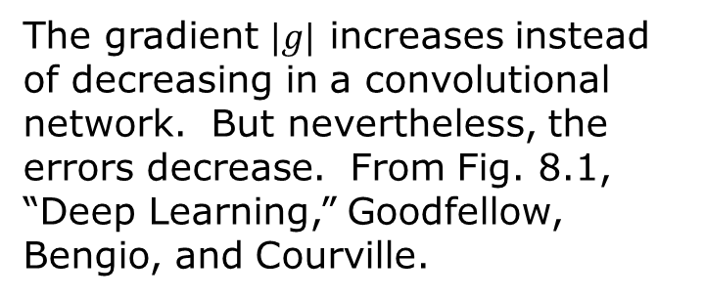
Some general comments on optimization
In a deep neural network, are we really able to find the global minimum?
There are more saddle points than minima in higher dimensions.
SGD works on complex loss landscapes, why does it work at all?
Ill conditioning
The gradient $|g|$ increases instead of decreasing in a convolutional network. But nevertheless, the errors decrease. From Fig. 8.1, “Deep Learning,” Goodfellow, Bengio, and Courville.

Slide 31
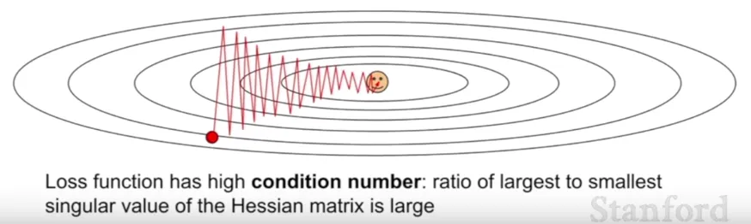
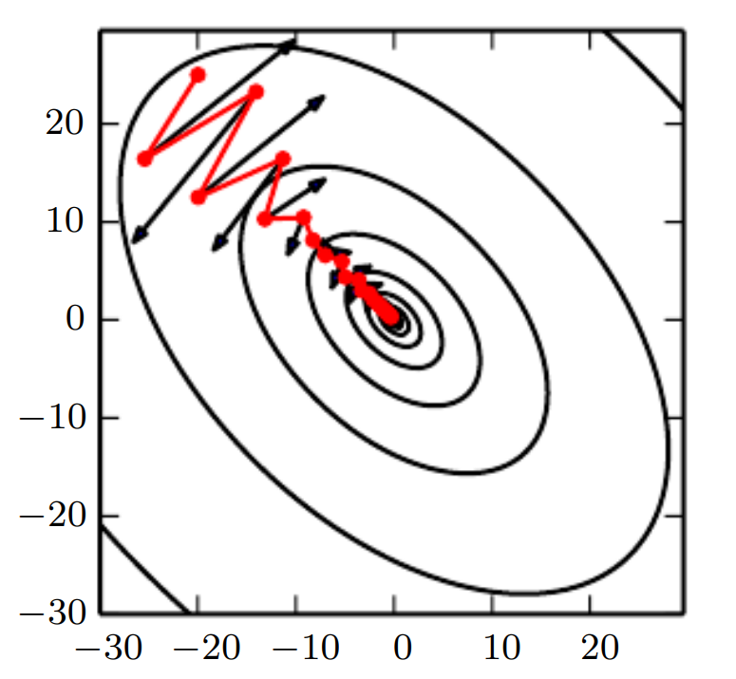
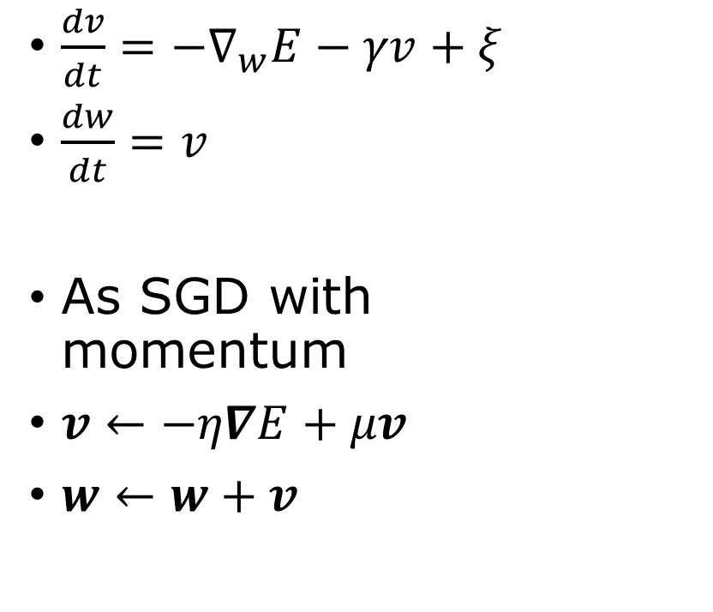
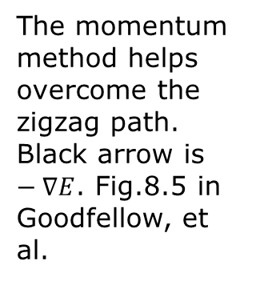
Momentum
Stochastic Langevin equation
$\frac{dv}{dt}=−∇_{w}E−γv+ξ$
$\frac{dw}{dt}=v$
As SGD with momentum
$v←−η∇E+μv$
$w←w+v$
The momentum method helps overcome the zigzag path. Black arrow is $−∇E$. Fig.8.5 in Goodfellow, et al.

Slide 32
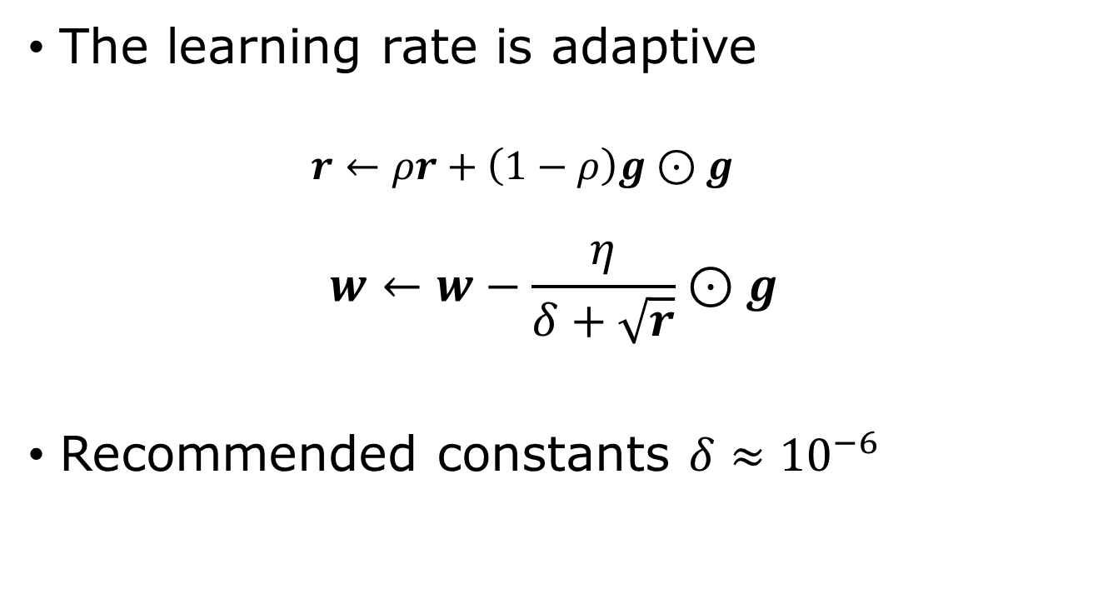



RMSProp
$⊙$ : elementwise multiplication
$$g=∇E$$
The learning rate is adaptive
  $$r←ρr+\left(1−ρ\right)g⊙g$$
$$w←w−\frac{η}{δ+\sqrt{r}}⊙g$$
Recommended constants $δ≈{10}^{−6}$
$ρ$: decay rate, $η$: learning rate,
$δ$ : avoid zero denominator.
Notes:
RMSProp: root mean squared propagation.

Slide 33
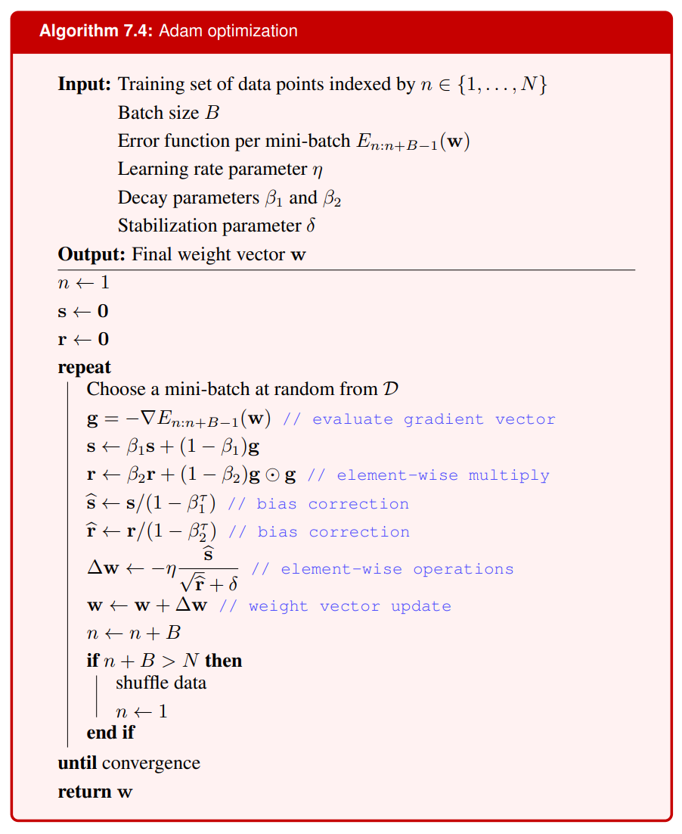
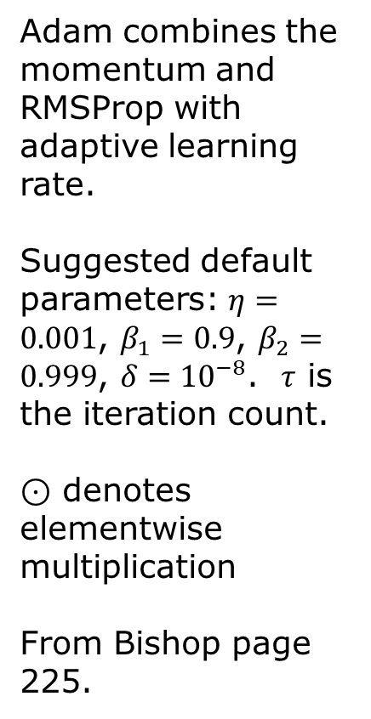

Adam
Adam combines the momentum and RMSProp with adaptive learning rate.
Suggested default parameters: $η=0.001$, $β_{1}=0.9$, $β_{2}=0.999$, $δ={10}^{−8}$. $τ$ is the iteration count.
$⊙$ denotes elementwise multiplication
From Bishop page 225.
$$+$$

Slide 34
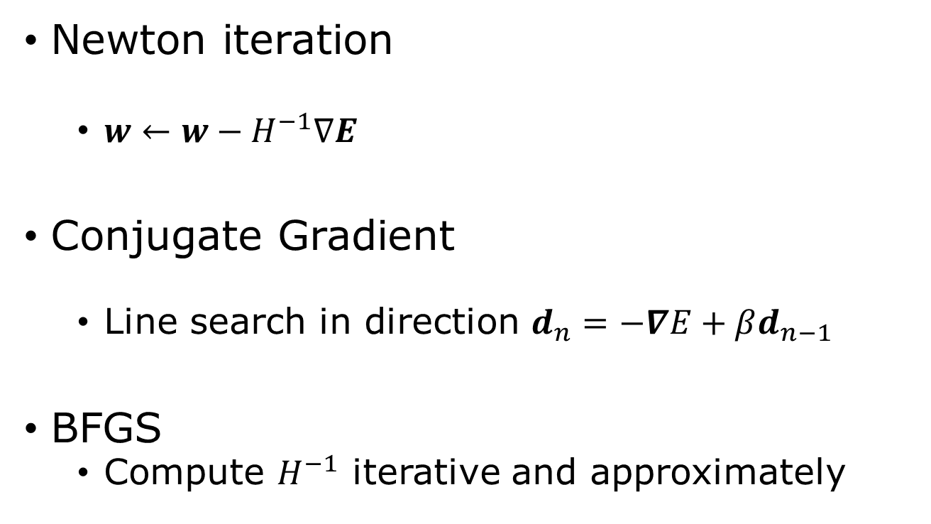
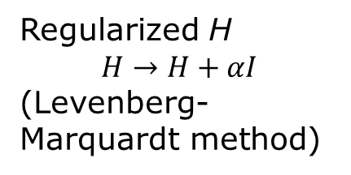
Second order methods
Newton iteration
  $w←w−H^{−1}∇E$
Conjugate Gradient
  Line search in direction $d_{n}=−∇E+βd_{n−1}$
BFGS
  Compute $H^{−1}$ iterative and approximately
Regularized H
$$H→H+αI$$
(Levenberg-Marquardt method)
Notes:
For a deeper understanding on optimization algorithms, see J. Nocedal and S. J. Wright, “Numerical Optimization”, Springer (1999).

Slide 35
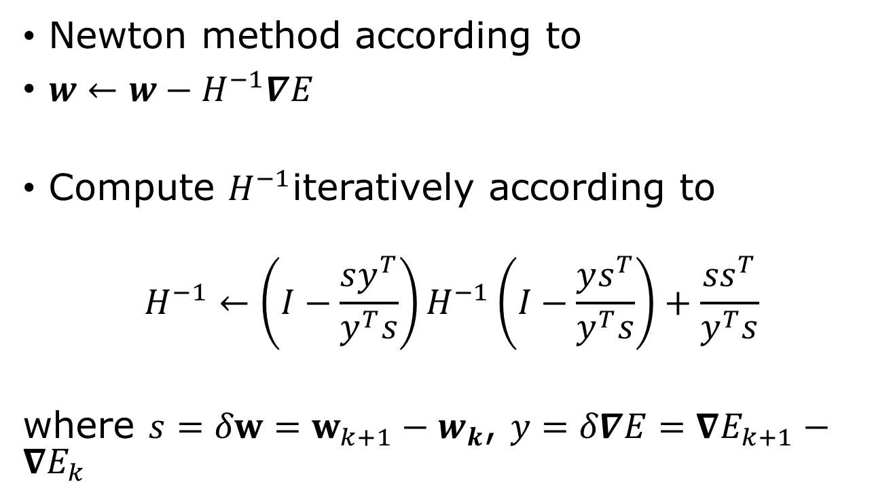
Broyden-Fletcher-Goldfarb-Shanno (BFGS)
Newton method according to
$w←w−H^{−1}∇E$
Compute $H^{−1}$iteratively according to
$$H^{−1}←\left(I−\frac{sy^{T}}{y^{T}s}\right)H^{−1}\left(I−\frac{ys^{T}}{y^{T}s}\right)+\frac{ss^{T}}{y^{T}s}$$
where $s=δw=w_{k+1}−w_{k}$, $y=δ∇E=∇E_{k+1}−∇E_{k}$

Slide 36
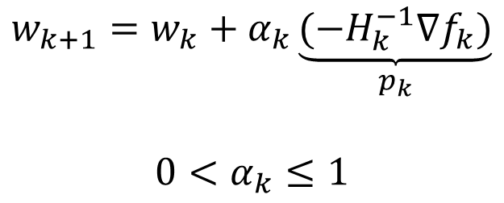
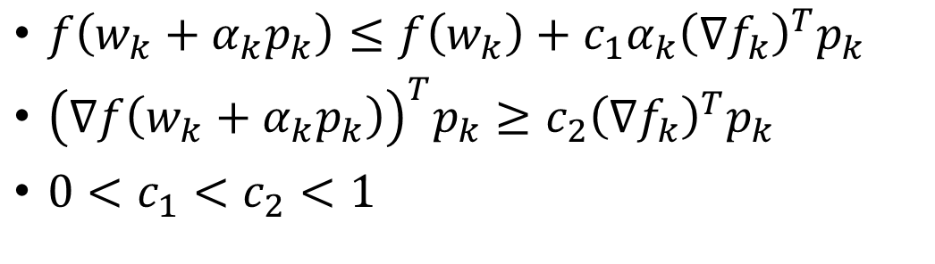

Wolfe conditions
$$f=E(w)$$
$$w_{k+1}=w_{k}+α_{k}\underset{p_{k}}{\underbrace{{(−H}_{k}^{−1}∇f_{k})}}$$
$$0<α_{k}≤1$$
$f\left(w_{k}+α_{k}p_{k}\right)≤f\left(w_{k}\right)+c_{1}α_{k}{\left(∇f_{k}\right)}^{T}p_{k}$
${\left(∇f\left(w_{k}+α_{k}p_{k}\right)\right)}^{T}p_{k}≥c_{2}{\left(∇f_{k}\right)}^{T}p_{k}$
$0<c_{1}<c_{2}<1$

Slide 37
Optimization classes in PyTorch
import torch.optim as optim
optimizer = optim.SGD(params, lr = 0.001, momentum = 0, dampening=0, weight_decay = 0, …)
Or
optimizer = optim.RMSprop([x], lr=0.3)
Or optim.Adam(params, lr=0.001) or optim.LBFGS(…)
Call optimizer.step() to update parameters.
Notes:
The meaning of hyperparameters in SGD is by v = momentum*v + (1-dampening)*g, followed by w -= lr*v (v is velocity, and g = grad E is the gradient, lr is learning rate).

Slide 38
Example of training steps
num_epochs = 100
for epoch in range(num_epochs):
for inputs, labels in dataloader:
# Forward pass
outputs = model(inputs)
loss = criterion(outputs, labels)
# Backward and optimize
optimizer.zero_grad() # Clear gradient
loss.backward() # Compute gradients
optimizer.step() # Update weights

Slide 39
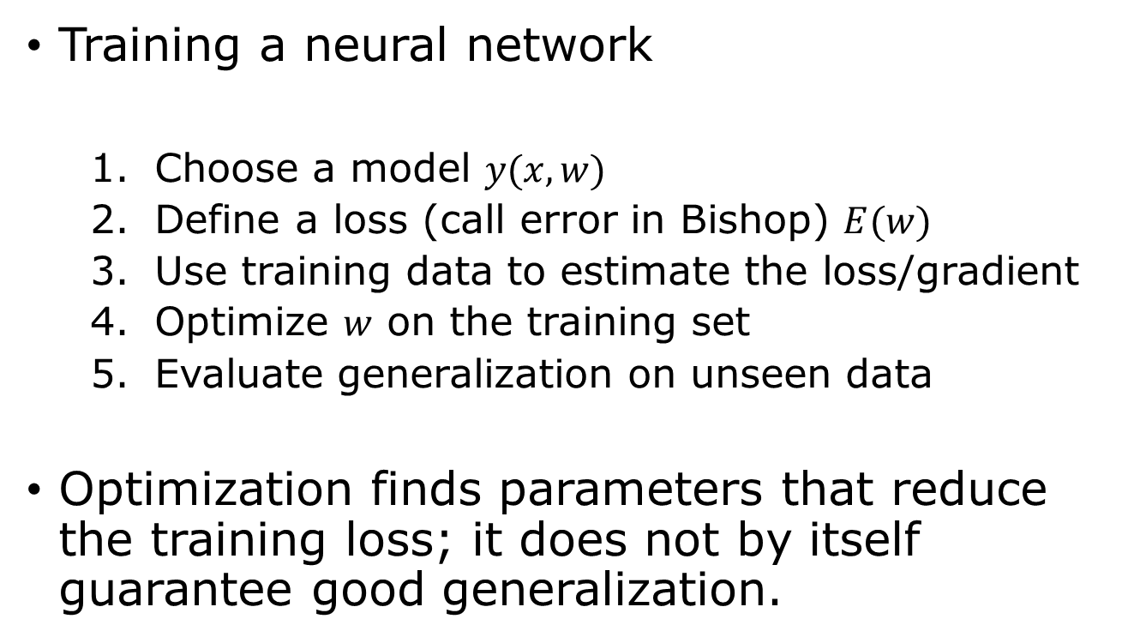

Optimization $≠$ learning
Training a neural network
  Choose a model $y(x,w)$
  Define a loss (call error in Bishop) $E(w)$
  Use training data to estimate the loss/gradient
  Optimize $w$ on the training set
  Evaluate generalization on unseen data
Optimization finds parameters that reduce the training loss; it does not by itself guarantee good generalization.

Slide 40
Questions & Answers
1) why can neural network approximate any function, what are the limitations? 2) what is the relation between error (loss) and log-likelihood? 3) what is the fundamental property of a gradient? 4) what does the function looks like locally when gradient is 0? 5) why go in negative gradient direction? 6) Why is SGD noisy? 7) why one sample at a time is called stochastic? 8) What is a Newton method? 9) how does BFGS relate to Newton? 10) what is a typical training loop in PyTorch?

Slide 41
Summary
Deep networks: nonlinear layers enable powerful representation learning.
Loss functions: maximum likelihood → least-squares and cross-entropy.
Optimization: gradient descent, SGD, and mini-batch methods minimize the loss.
Improved optimization: momentum, RMSProp, Adam, and second-order methods accelerate training.
Key idea: Learning = choosing a flexible model + defining a loss + optimizing its parameters.

Slide 42
Reading
Bishop book “Deep Learning”
Chapter 6, pp. 171-185, 194-198
Chapter 7, pp.209-225

