Slide 1
Week 5,
Backpropagation
Notes:
See Chapter 8, Bishop, “Deep Learning”.

Slide 2
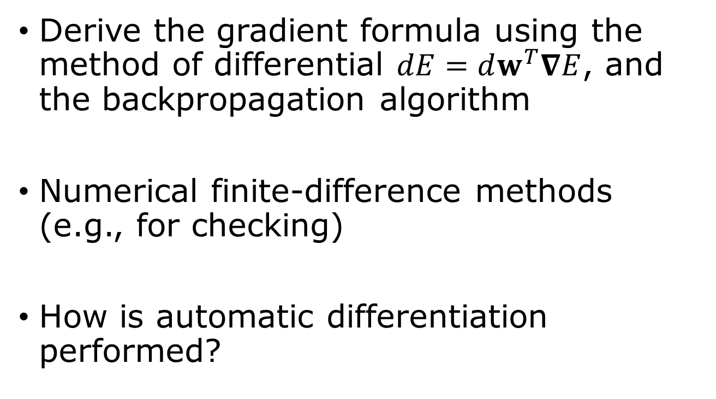
Outline
Derive the gradient formula using the method of differential $dE=dw^{T}∇E$, and the backpropagation algorithm
Numerical finite-difference methods (e.g., for checking)
How is automatic differentiation performed?

Slide 3
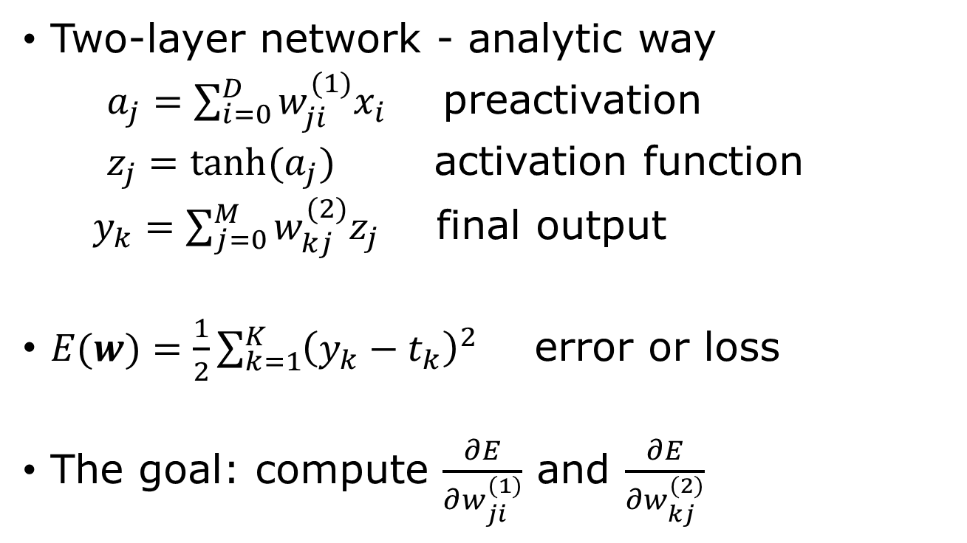

Compute the gradient $∇E$
Two-layer network - analytic way
$a_{j}=\sum_{i=0}^{D}{w_{ji}^{(1)}x_{i}}$ preactivation
$z_{j}=\tanh{(a_{j})}$ activation function
$y_{k}=\sum_{j=0}^{M}{w_{kj}^{(2)}z_{j}}$ final output
$E(w)=\frac{1}{2}\sum_{k=1}^{K}{{\left(y_{k}−t_{k}\right)}^{2}}$ error or loss
The goal: compute $\frac{∂E}{∂w_{ji}^{(1)}}$ and $\frac{∂E}{∂w_{kj}^{(2)}}$

Slide 4

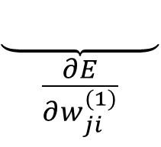
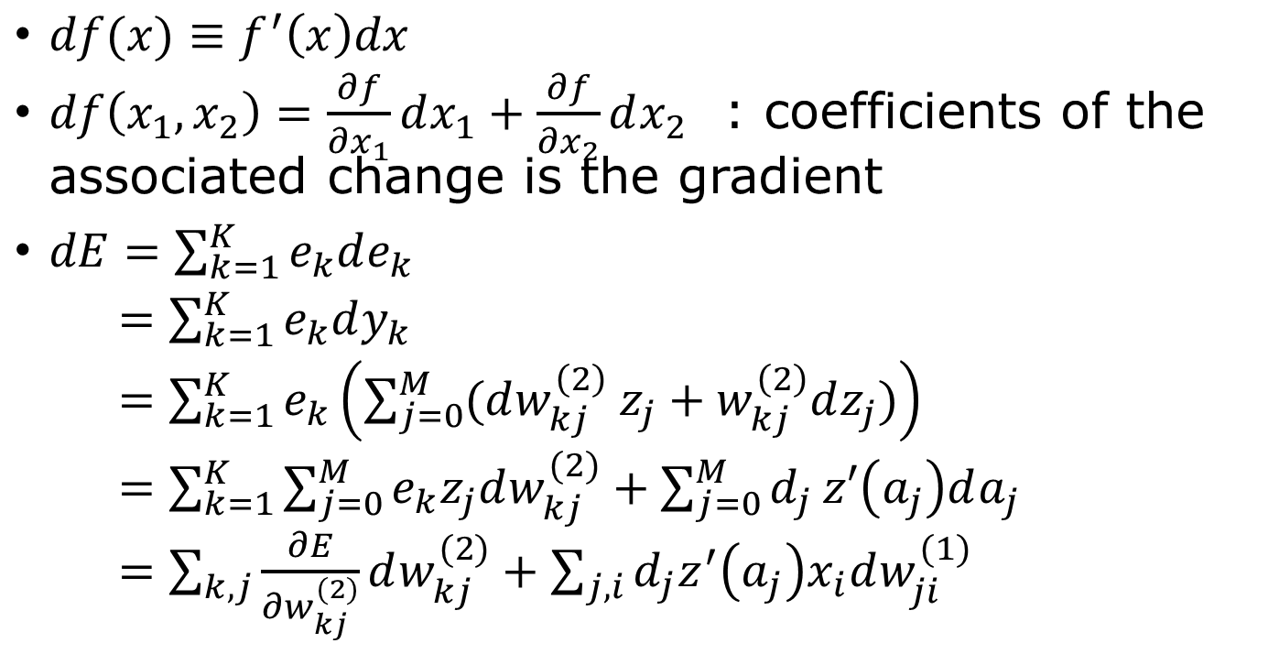


Find partial derivatives by differential
$$z=\tanh{(a)}$$
$$E=\frac{1}{2}e^{T}e$$
$df(x)≡f^{′}\left(x\right)dx$
$df\left(x_{1},x_{2}\right)=\frac{∂f}{∂x_{1}}dx_{1}+\frac{∂f}{∂x_{2}}dx_{2}$ : coefficients of the associated change is the gradient
$dE=\sum_{k=1}^{K}{e_{k}de_{k}}$
$=\sum_{k=1}^{K}{e_{k}dy_{k}}$
$=\sum_{k=1}^{K}{e_{k}\left(\sum_{j=0}^{M}{(dw_{kj}^{\left(2\right)} z_{j}+w_{kj}^{\left(2\right)}dz_{j}})\right)}$
$=\sum_{k=1}^{K}{\sum_{j=0}^{M}{e_{k}z_{j}dw_{kj}^{(2)}}+\sum_{j=0}^{M}{d_{j}}z′\left(a_{j}\right)da_{j}}$
$=\sum_{k,j}{\frac{∂E}{∂w_{kj}^{(2)}}dw_{kj}^{(2)}}+\sum_{j,i}{d_{j}z^{′}\left(a_{j}\right)x_{i}dw_{ji}^{(1)}}$
$a=w^{(1)}x,$ $y=w^{(2)}z$
$$e=y−t$$
$$d^{T}=e^{T}w^{(2)}$$
$$\frac{∂E}{∂w^{(2)}}=e z^{T}$$
$$\frac{∂E}{∂w^{(1)}}=δ x^{T}$$
$$\underset{\frac{∂E}{∂w_{ji}^{(1)}}}{\underbrace{ }}$$

Slide 5



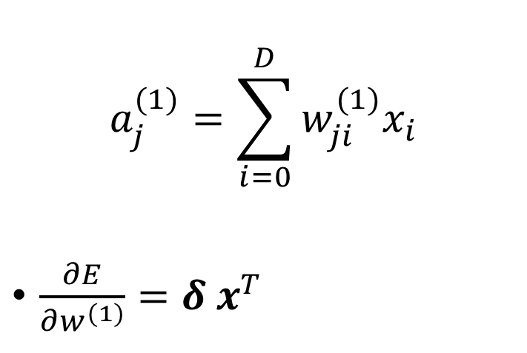
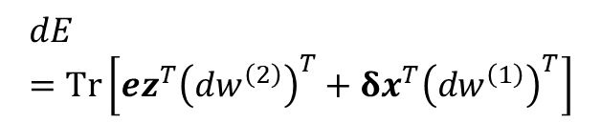







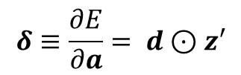




Gradient formula
Rules of differential:
$$d\left(f+g\right)= df+ dg$$
$$d\left(fg\right)=fdg+gdf$$
$$df\left(g\right)=f^{′}\left(g\right)dg$$
$$a_{j}^{(1)}=\sum_{i=0}^{D}{w_{ji}^{(1)}x_{i}}$$
$\frac{∂E}{∂w^{(1)}}=δ x^{T}$
$$w_{MD}^{\left(1\right)}$$
$$x_{D}$$
$$a_{M}$$
$${ z}_{M}$$
$$⋮$$
$$w_{M2}^{\left(1\right)}$$
$$⋮$$
vector of input
$$x_{2}$$
$$w_{M0}^{\left(1\right)}$$
$$x_{1}$$
$$a_{1}$$
$${ z}_{1}$$
$$x_{0}$$
Error in the output
$$dE=Tr\left[ez^{T}{\left(dw^{\left(2\right)}\right)}^{T}+δx^{T}{\left(dw^{\left(1\right)}\right)}^{T}\right]$$
$$δ≡\frac{∂E}{∂a}= d⊙z′$$
Notes:
Circle with dot denotes elementwise multiplication, while ez^T is a matrix (outer product). The trace Tr(…) means the sum of the diagonal elements.

Slide 6


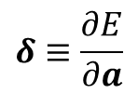




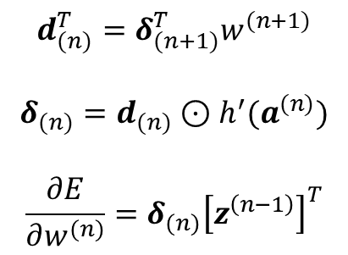





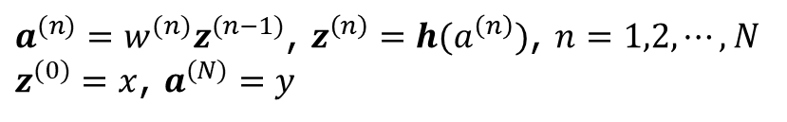
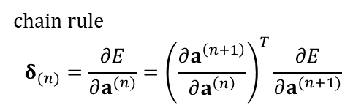





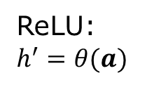
General feedforward network
${{a^{(n)}=w}^{(n)}z}^{(n−1)}$, $z^{\left(n\right)}=h(a^{\left(n\right)})$, $n=1,2,⋯, N$
$z^{(0)}=x$, $a^{(N)}=y$
$$w^{(1)}$$
$$h$$
$$w^{(2)}$$
$$h$$
$$w^{(N)}$$
$$y$$
$$x$$
$$a^{(1)}$$
$$z^{(1)}$$
$$a^{(2)}$$
$$z^{(2)}$$
$$⋯$$
$$z^{(N−1)}$$
$$δ_{(1)}$$
$$δ_{(2)}$$
$$δ_{(N)}$$
Backpropagation
$$d_{(n)}^{T}=δ_{(n+1)}^{T}w^{(n+1)}$$
$$δ_{(n)}=d_{(n)}⊙h^{′}(a^{(n)})$$
$$\frac{∂E}{∂w^{(n)}}=δ_{(n)}{\left[z^{\left(n−1\right)}\right]}^{T}$$
chain rule
$$δ_{(n)}=\frac{∂E}{∂a^{(n)}}={\left(\frac{∂a^{\left(n+1\right)}}{∂a^{\left(n\right)}}\right)}^{T}\frac{∂E}{∂a^{(n+1)}}$$
$$δ≡\frac{∂E}{∂a}$$
ReLU: $h^{′}=θ(a)$
Notes:
Here we need to use the chain rule of differentiation, see Eq.(8.12) in Bishop. delta_n = dE/da^n = dE/da^(n+1) da^(n+1)/da^n. Note, there is no z^(N).

Slide 7
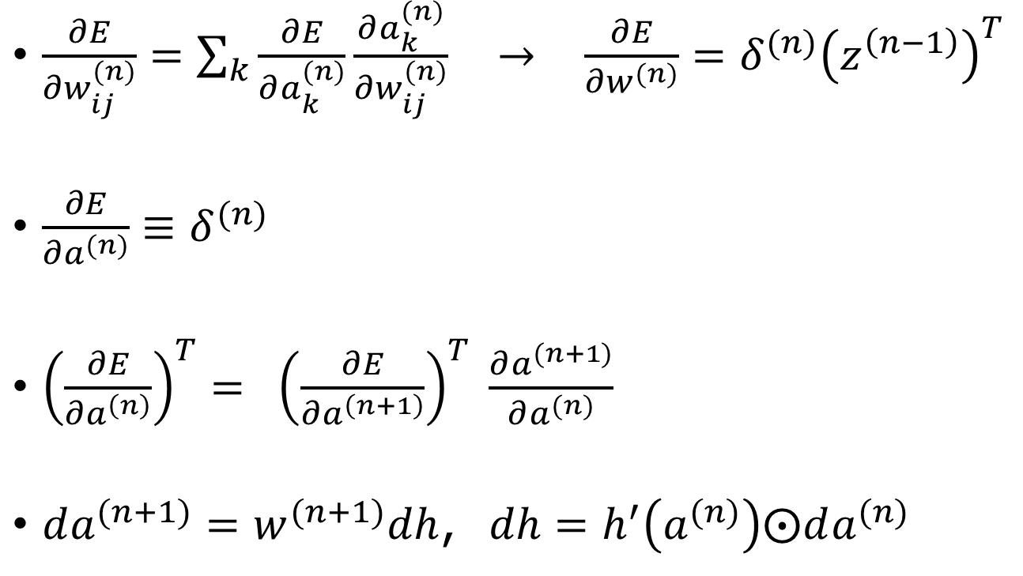

Apply chain rule
$\frac{∂E}{∂w_{ij}^{(n)}}=\sum_{k}{\frac{∂E}{∂a_{k}^{(n)}}\frac{∂a_{k}^{(n)}}{∂w_{ij}^{(n)}}}$ $→$ $\frac{∂E}{∂w^{(n)}}=δ^{(n)}{\left(z^{\left(n−1\right)}\right)}^{T}$
$\frac{∂E}{∂a^{(n)}}≡δ^{(n)}$
${\left(\frac{∂E}{∂a^{\left(n\right)}}\right)}^{T}= {\left(\frac{∂E}{∂a^{\left(n+1\right)}}\right)}^{T} \frac{∂a^{(n+1)}}{∂a^{(n)}}$
$da^{(n+1)}=w^{(n+1)}dh$, $dh=h^{′}\left(a^{(n)}\right)⨀da^{(n)}$
$$a^{(n)}=w^{(n)}z^{(n−1)}$$
$$z^{\left(n\right)}=h\left(a^{\left(n\right)}\right)$$
$$a^{(n+1)}=w^{(n+1)}z^{(n)}$$
Notes:
If you find these equations confusing, work in component form, i.e., put the index I,j,k explicitly. a, h are vectors, and w’s are matrices.

Slide 8
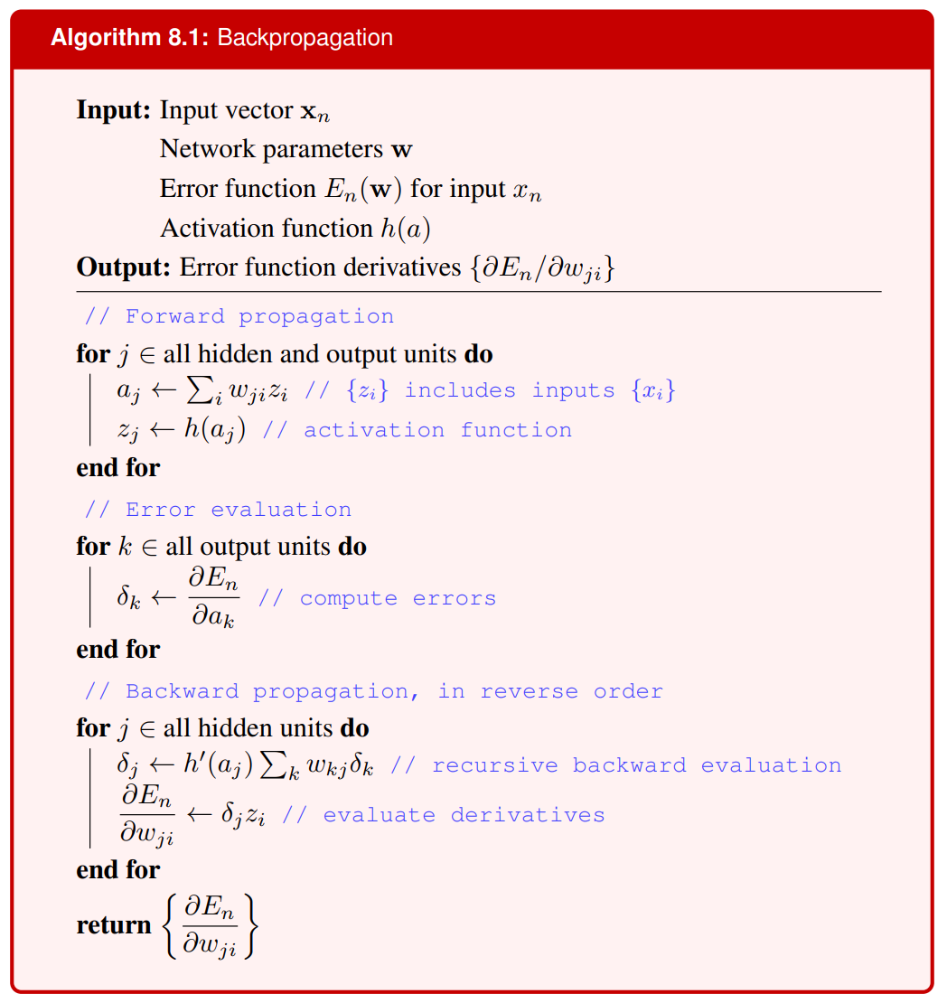
From page 237 in Bishop

Slide 9

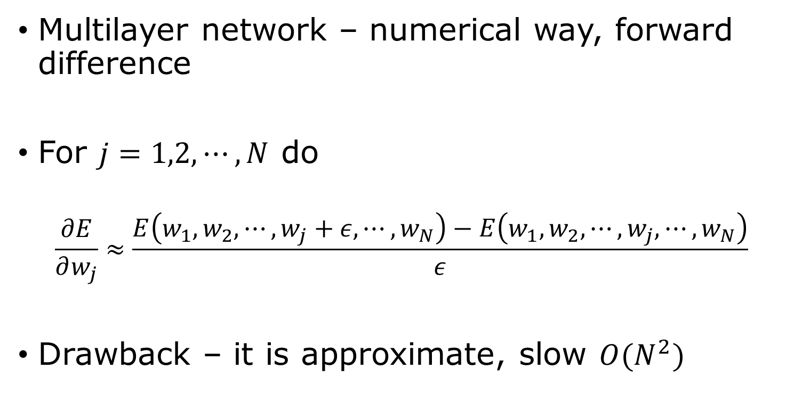
Compute the gradient $∇E$
Multilayer network – numerical way, forward difference
For $j=1,2,⋯, N$ do
$$\frac{∂E}{∂w_{j}}≈\frac{E\left(w_{1},w_{2},⋯,w_{j}+ε,⋯,w_{N}\right)−E\left(w_{1},w_{2},⋯,w_{j},⋯,w_{N}\right)}{ε}$$
Drawback – it is approximate, slow $O(N^{2})$
$w_{j}$ : flattened version of $w_{jk}^{(n)}$
Notes:
W_j here is the flattened version of the matrices w_{ij}^{(n)}

Slide 10
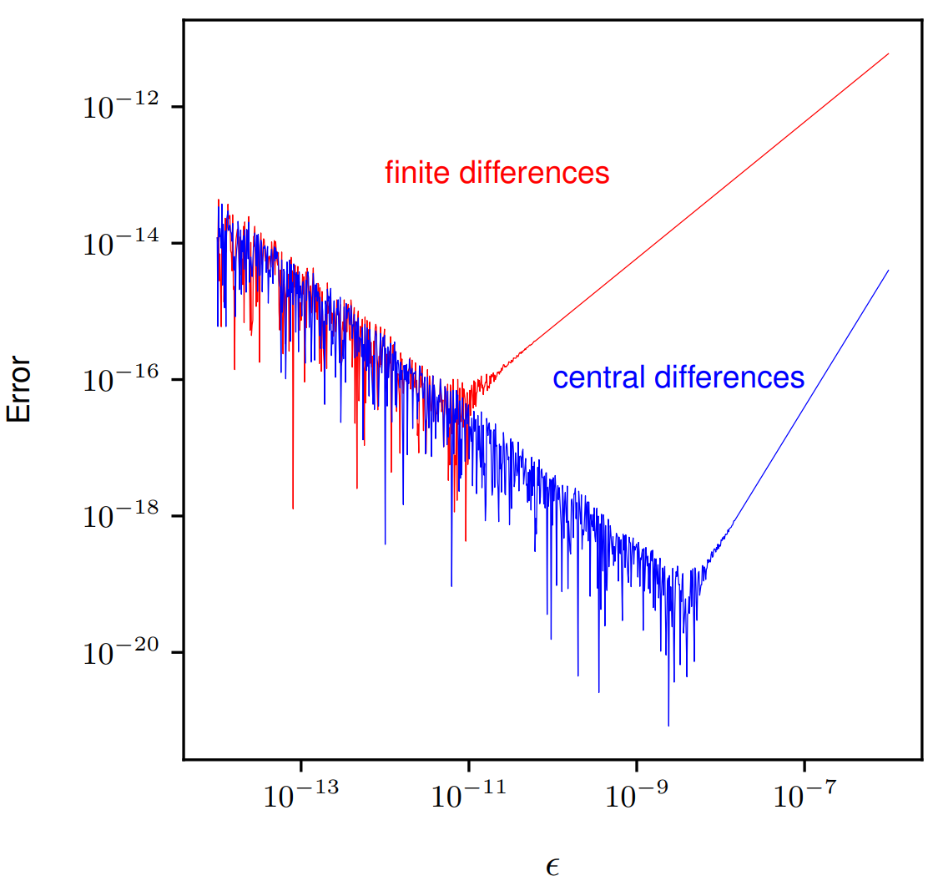
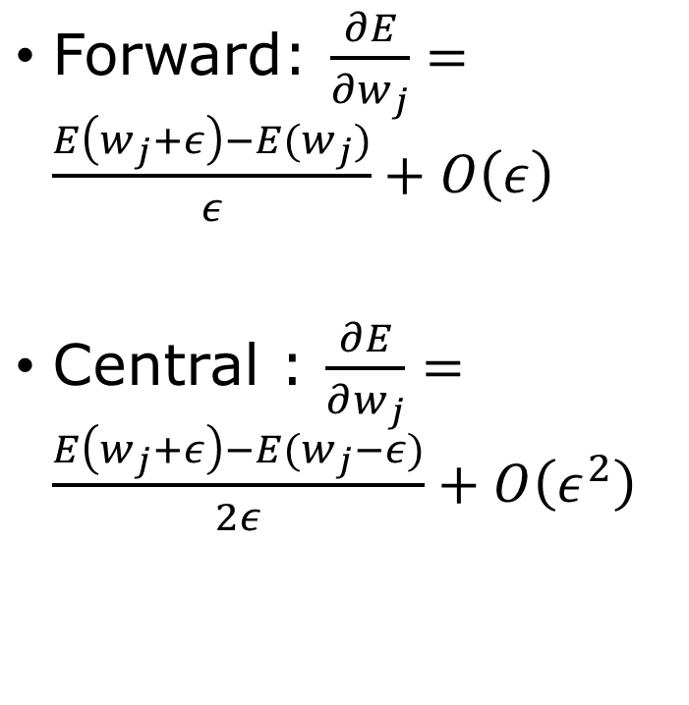
Forward difference vs central difference
Forward: $\frac{∂E}{∂w_{j}}=\frac{E\left(w_{j}+ε\right)−E(w_{j})}{ε}+O\left(ε\right)$
Central : $\frac{∂E}{∂w_{j}}=\frac{E\left(w_{j}+ε\right)−E(w_{j}−ε)}{2ε}+O\left(ε^{2}\right)$

Slide 11
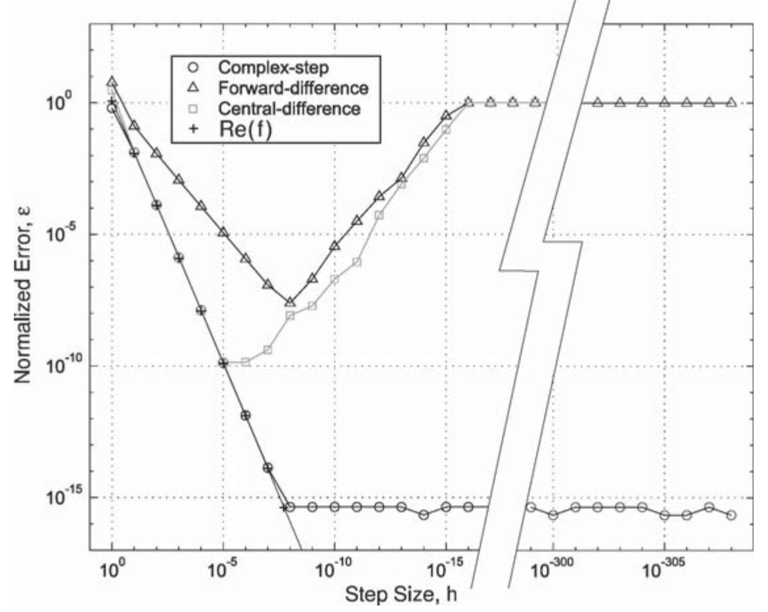
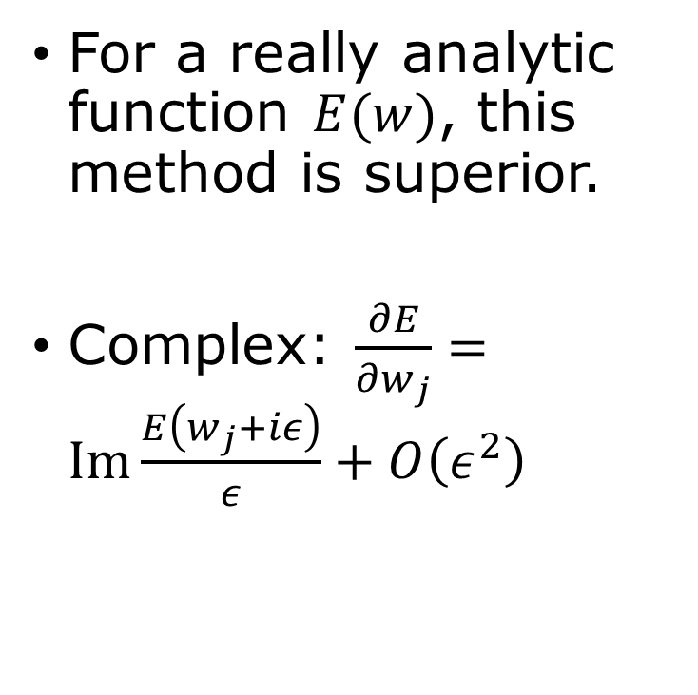

Use complex $iε$
For a really analytic function $E(w)$, this method is superior.
Complex: $\frac{∂E}{∂w_{j}}=Im\frac{E\left(w_{j}+iε\right)}{ε}+O\left(ε^{2}\right)$
Martins, Sturdza, Alonso, ACM Transactions on Mathematical Software, 2003

Slide 12
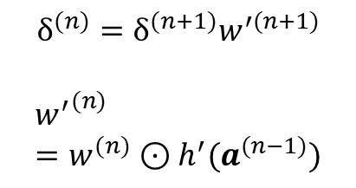
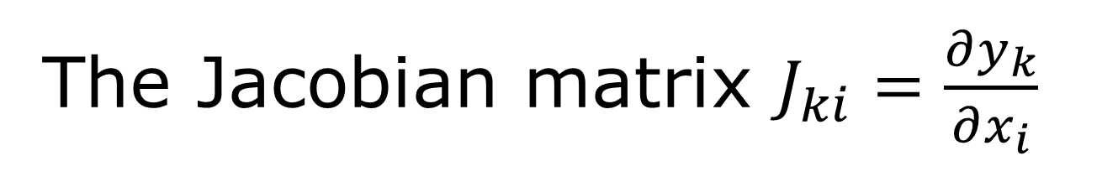




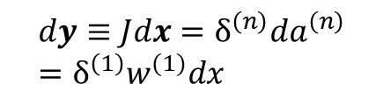
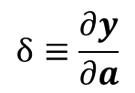

The Jacobian matrix $J_{ki}=\frac{∂y_{k}}{∂x_{i}}$
${{a^{(n)}=w}^{(n)}z}^{(n−1)}$, $z^{\left(n\right)}=h(a^{\left(n\right)})$, $n=1,2,⋯, N$
$z^{(0)}=x$, $a^{(N)}=y$
$$w^{(1)}$$
$$h$$
$$w^{(2)}$$
$$h$$
$$w^{(N)}$$
$$y$$
$$x$$
$$a^{(1)}$$
$$z^{(1)}$$
$$a^{(2)}$$
$$z^{(2)}$$
$$⋯$$
$$z^{(N−1)}$$
$$δ_{(1)}$$
$$δ_{(2)}$$
$$δ_{(N)}=I$$
$$dy≡Jdx=δ^{\left(n\right)}da^{\left(n\right)}=δ^{\left(1\right)}w^{(1)}dx$$
$$δ^{(n)}=δ^{(n+1)}w^{′(n+1)}$$
$${w^{′}}^{(n)}=w^{(n)}⊙h^{′}(a^{(n−1)})$$
$$δ≡\frac{∂y}{∂a}$$
$$δ_{kj}^{(n)}=δ_{kl}^{(n+1)}w_{lj}^{(n+1)}h′(a_{j}^{(n)})$$
$δ$ is matrix now
Notes:
The Jacobian matrix describes the variation of the output y with respect to the input x, keeping w fixed. I.e., dy = J dx.

Slide 13
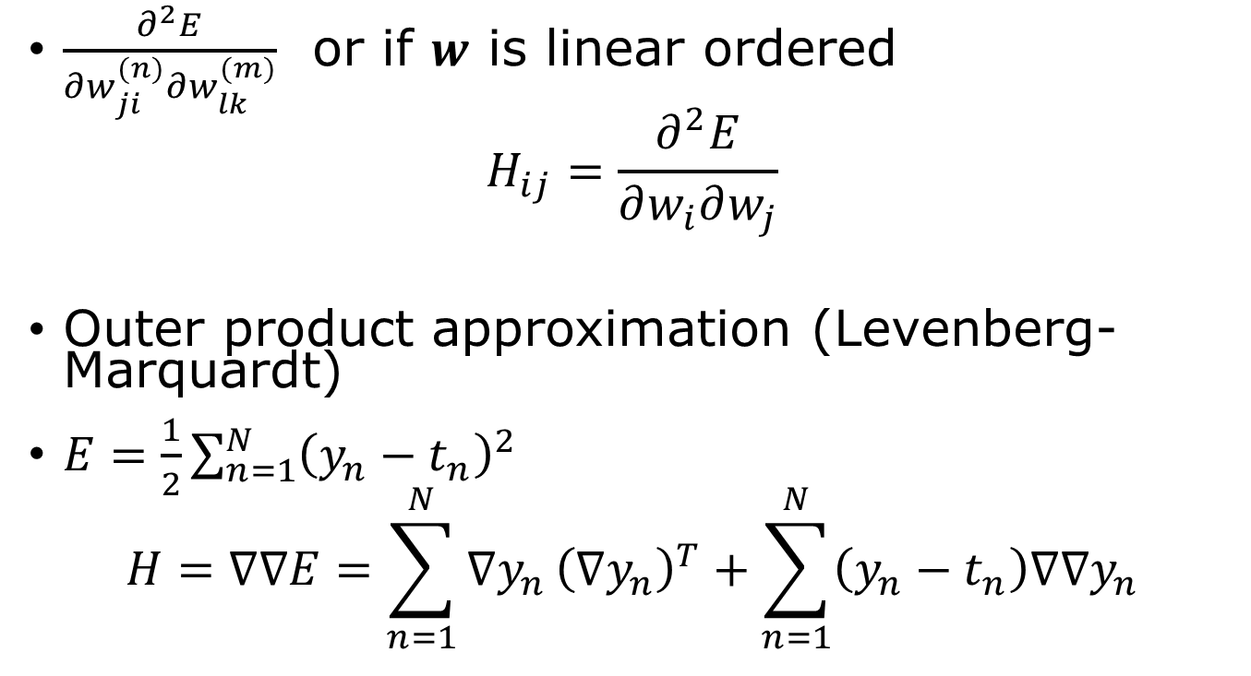
The Hessian matrix
$\frac{∂^{2}E}{∂w_{ji}^{(n)}∂w_{lk}^{(m)}}$ or if $w$ is linear ordered
$$H_{ij}=\frac{∂^{2}E}{∂w_{i}∂w_{j}}$$
Outer product approximation (Levenberg-Marquardt)
$E=\frac{1}{2}\sum_{n=1}^{N}{{\left(y_{n}−t_{n}\right)}^{2}}$
$$H=∇∇E=\sum_{n=1}^{N}{∇y_{n}}{\left(∇y_{n}\right)}^{T}+\sum_{n=1}^{N}{\left(y_{n}−t_{n}\right)∇∇y_{n}}$$

Slide 14
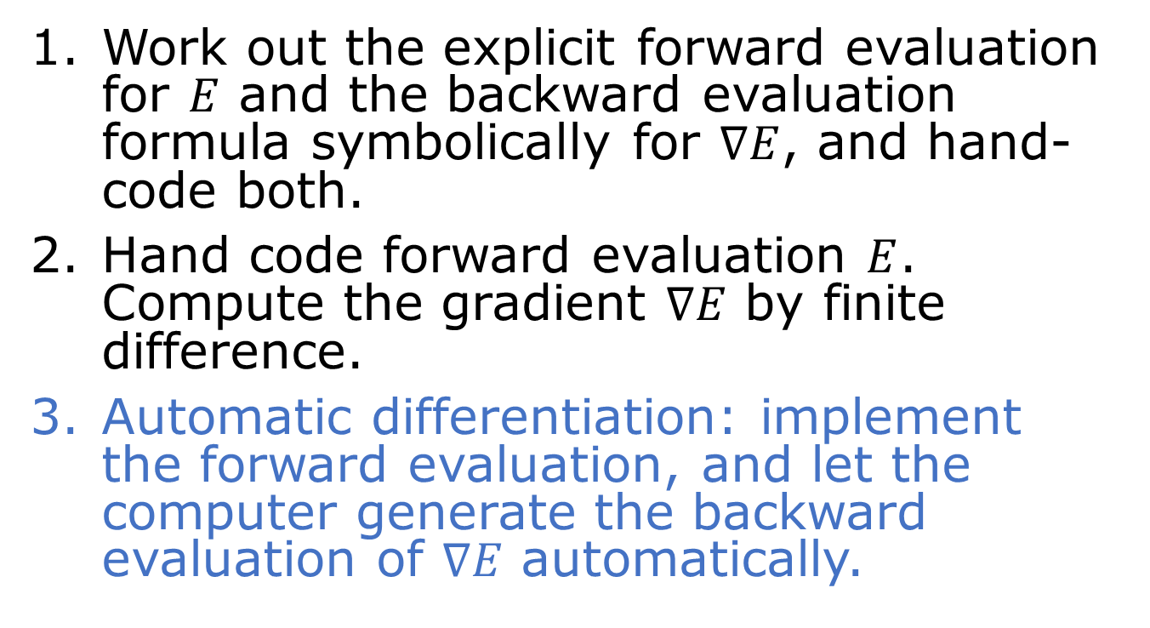

Compute gradient $∇E$
Work out the explicit forward evaluation for $E$ and the backward evaluation formula symbolically for $∇E$, and hand-code both.
Hand code forward evaluation $E$. Compute the gradient $∇E$ by finite difference.
Automatic differentiation: implement the forward evaluation, and let the computer generate the backward evaluation of $∇E$ automatically.

Slide 15
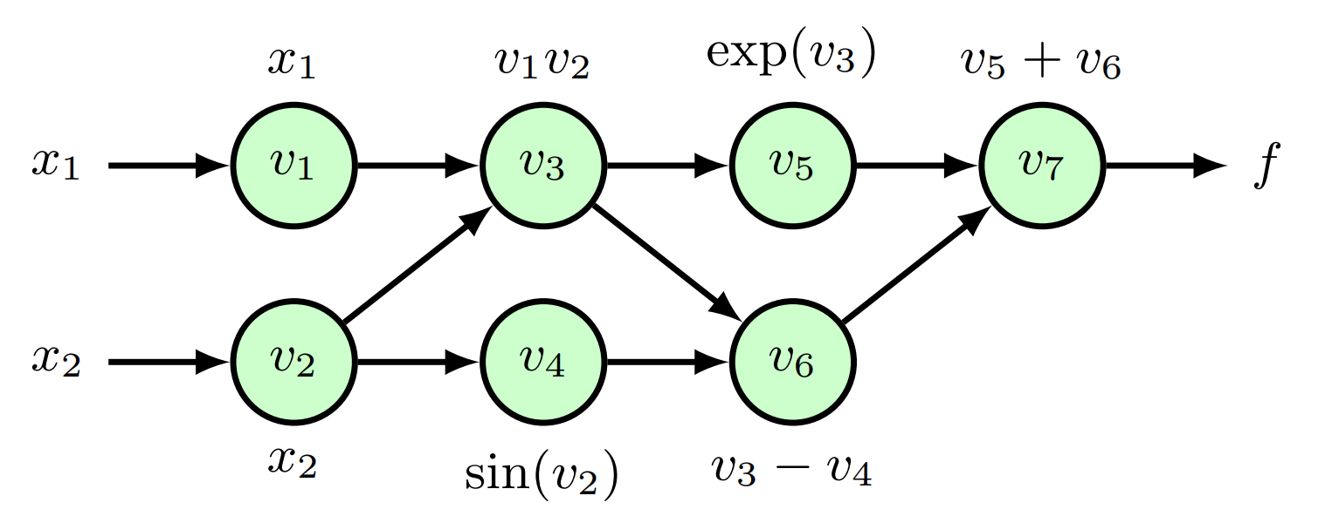



Reverse-mode automatic differentiation
$f\left(x_{1},x_{2}\right)=x_{1}x_{2}+\exp\left(x_{1}x_{2}\right)−\sin\left(x_{2}\right)$
primal variables $v_{i}$ adjoint variables ${\overline{v}}_{i}=\frac{∂f}{∂v_{i}}$
$v_{1}=x_{1}$
$v_{2}=x_{2}$
$v_{3}=v_{1}v_{2}$
$v_{4}=\sin\left(v_{2}\right)$
$v_{5}=exp⁡(v_{3})$
$v_{6}=v_{3}−v_{4}$
$v_{7}=v_{5}+v_{6}$
$f=v_{7}$
${\overline{v}}_{7}=1$
${\overline{v}}_{6}={\overline{v}}_{7}$
${\overline{v}}_{5}={\overline{v}}_{7}$
${\overline{v}}_{4}=−{\overline{v}}_{6}$
${\overline{v}}_{3}={\overline{v}}_{5}v_{5}+{\overline{v}}_{6}$
${\overline{v}}_{2}={\overline{v}}_{2}v_{1}+{\overline{v}}_{4}\cos{(v_{2})}$
${\overline{v}}_{1}={\overline{v}}_{3}v_{2}$
$${\overline{v}}_{i}=\sum_{j∈ch(i)}{{\overline{v}}_{j}\frac{∂v_{j}}{∂v_{i}}}$$
sum over the child nodes
Notes:
Automatic differentiation evaluates exact derivatives of a computational graph using the chain rule. Backpropagation is reverse-mode automatic differentiation specialized to feedforward neural networks.

Slide 16
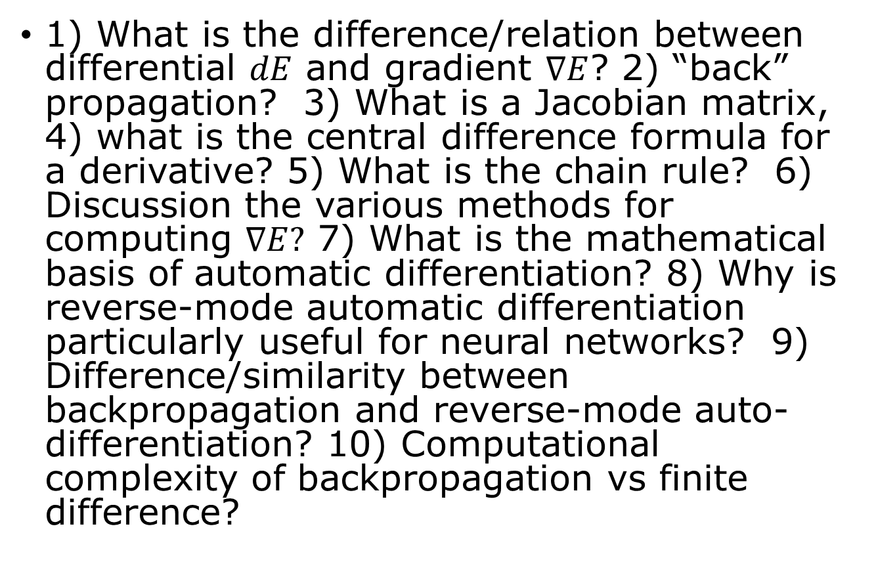
Questions and answers
1) What is the difference/relation between differential $dE$ and gradient $∇E$? 2) “back” propagation? 3) What is a Jacobian matrix, 4) what is the central difference formula for a derivative? 5) What is the chain rule? 6) Discussion the various methods for computing $∇E?$ 7) What is the mathematical basis of automatic differentiation? 8) Why is reverse-mode automatic differentiation particularly useful for neural networks? 9) Difference/similarity between backpropagation and reverse-mode auto-differentiation? 10) Computational complexity of backpropagation vs finite difference?

Slide 17
Summary
Differentials & chain rule -> compute gradient systematically
Backpropagation-> efficiently propagate gradients backward through network
Numerical differential -> useful for checking
Automatic differentiation -> automates the chain rule on a computational graph
Key learning outcome: know how to compute the gradient efficiently.

Slide 18
Reading
Bishop’s book
Chapter 8, pages 233 - 250

