Slide 1
Week 6,
Regularization
Notes:
Bishop, Chapter 9; Goodfellow, et al, Chapter 7.

Slide 2
outline
Inductive bias
Bias-variance trade-off
Discuss various ways for neural networks to generalize better
Methods for improving generalization
  Weight decay
  L₁ norm
  Early stopping
  Bagging, dropout

Slide 3
Inductive bias
A set of assumptions about the data in order to predict well in machine learning, e.g., smoothness of the data, certain symmetries, etc.
  Inverse problem – infer a function or probability distribution from data
  No free lunch theorem – averaged uniformly over all possible problems, all learning algorithms perform equally well.

Slide 4
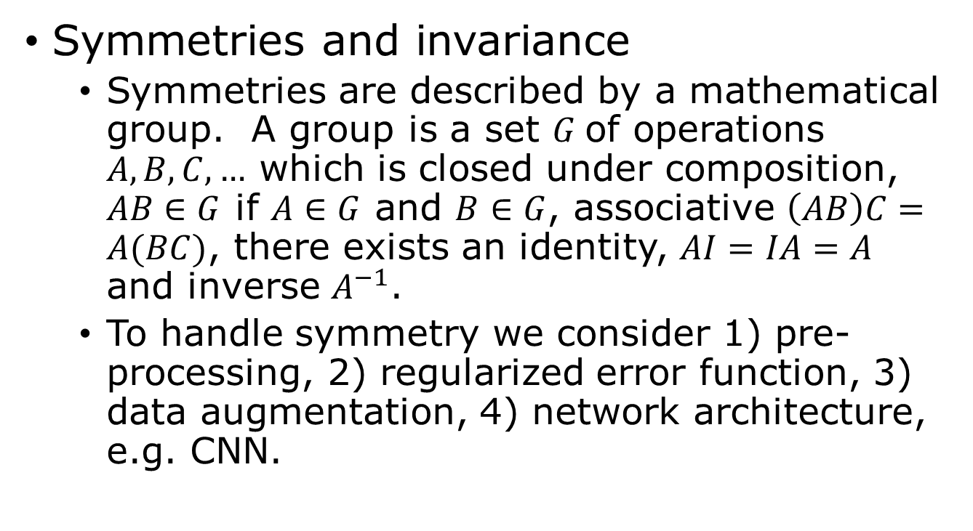
Inductive bias - continued
Symmetries and invariance
  Symmetries are described by a mathematical group. A group is a set $G$of operations $A, B, C, …$ which is closed under composition, $AB∈G$ if $A∈G$ and $B∈G$, associative $\left(AB\right)C=A(BC)$, there exists an identity, $AI=IA=A$ and inverse $A^{−1}$.
  To handle symmetry we consider 1) pre-processing, 2) regularized error function, 3) data augmentation, 4) network architecture, e.g. CNN.

Slide 5
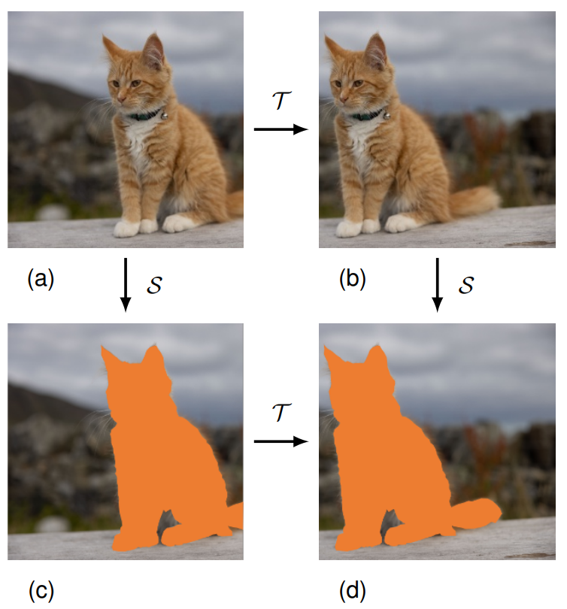
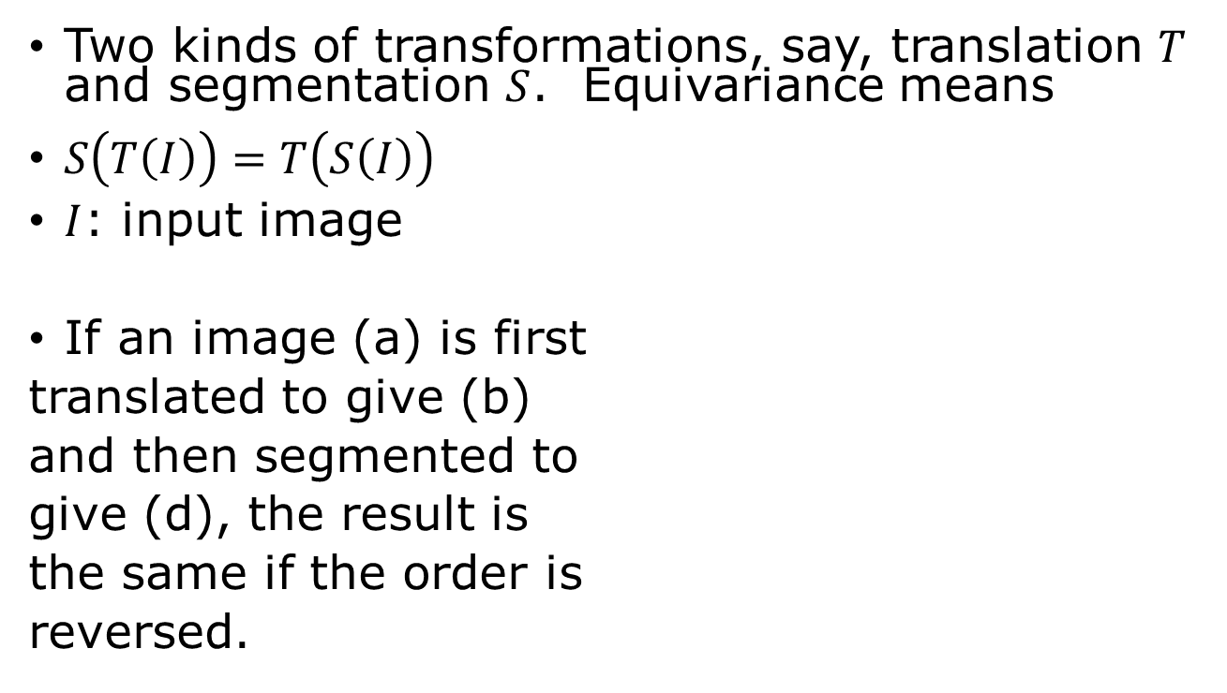
Equivariance
Two kinds of transformations, say, translation $T$ and segmentation $S$. Equivariance means
$S\left(T\left(I\right)\right)=T\left(S\left(I\right)\right)$
$I$: input image
If an image (a) is first
translated to give (b)
and then segmented to
give (d), the result is
the same if the order is
reversed.

Slide 6
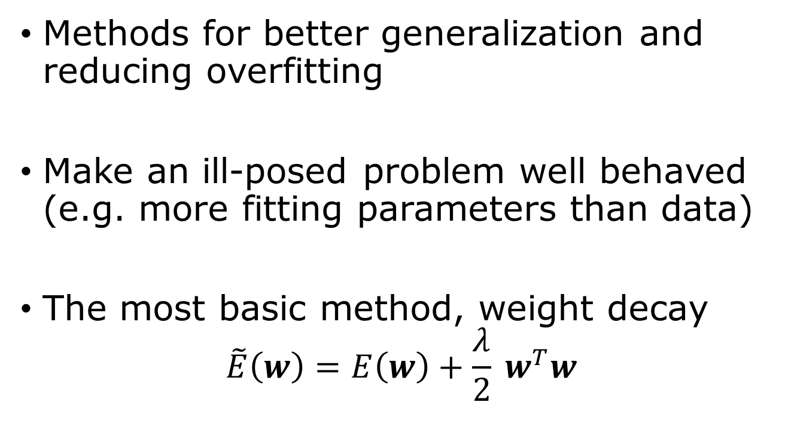
Regularization
Methods for better generalization and reducing overfitting
Make an ill-posed problem well behaved (e.g. more fitting parameters than data)
The most basic method, weight decay
$$\tilde{E}\left(w\right)=E\left(w\right)+\frac{λ}{2} w^{T}w$$
Notes:
Why weight decay? 1) prefer a simpler model with small w (e.g. low order polynomials), 2) small prior for w, 3) make stable fit in linear regression when number of data is less than the number of parameters.

Slide 7
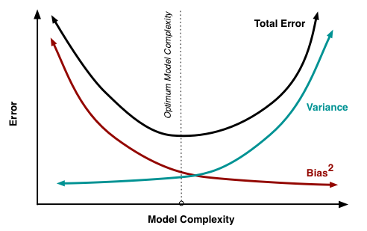
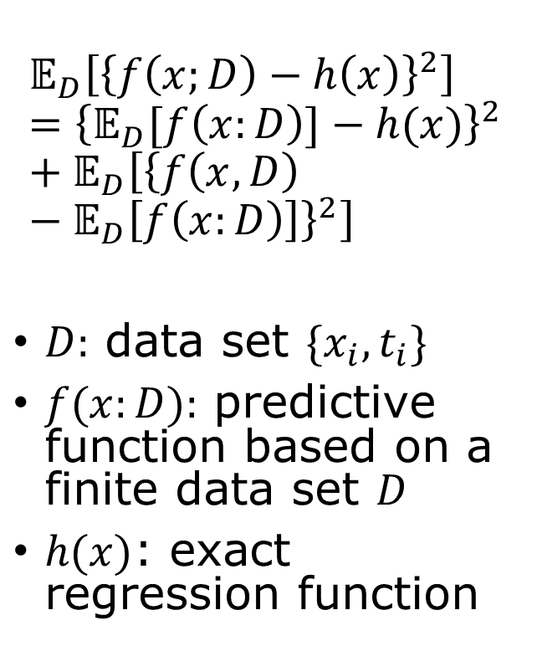

Bias-Variance trade-off
$$𝔼_{D}\left[{\left\{f\left(x;D\right)−h\left(x\right)\right\}}^{2}\right]={\left\{𝔼_{D}[f\left(x:D\right)]−h(x)\right\}}^{2}+𝔼_{D}\left[{\left\{f\left(x,D\right)−𝔼_{D}\left[f\left(x:D\right)\right]\right\}}^{2}\right]$$
$D:$ data set $\{x_{i},t_{i}\}$
$f(x:D):$ predictive function based on a finite data set $D$
$h(x)$: exact regression function
large $λ$ small $λ$
Total Error = Bias² + Variance
(expected test MSE)
https://www.cs.cornell.edu/courses/cs4780/2018fa/lectures/lecturenote12.html
Notes:
Noise in the data? To get a 3rd term?

Slide 8
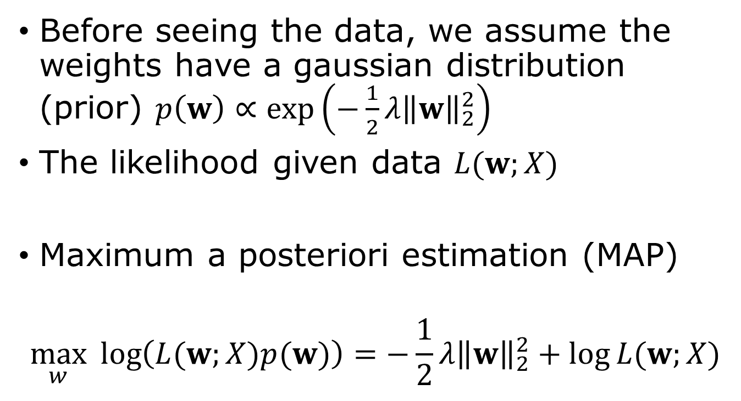
Weight decay as a Gaussian prior
Before seeing the data, we assume the weights have a gaussian distribution (prior) $p\left(w\right)∝\exp\left(−\frac{1}{2}λ{\left\|w\right\|}_{2}^{2}\right)$
The likelihood given data $L(w;X)$
Maximum a posteriori estimation (MAP)
$$\max_{w}{\log\left(L(w;X)p(w)\right)=−\frac{1}{2}}λ{\left\|w\right\|}_{2}^{2}+\log{L(w;X)}$$
Notes:
Note the posterior distribution is p(w|X) = p(X|w) p(w)/p(X), according to Bayes’ theorem. p(X|w) = L(w;X) is the likelihood. Max p(w|X) with respect to w is the same as max L(w;X)p(w) since P(X) is a constant.

Slide 9
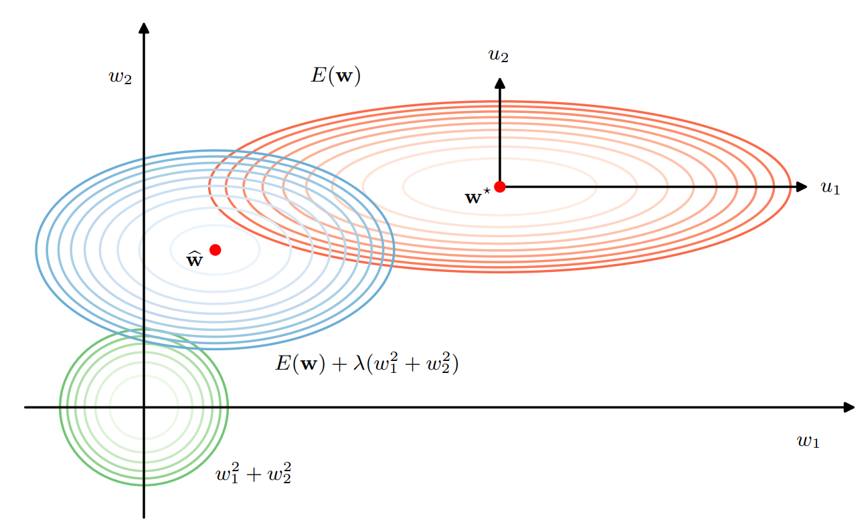


The effect of $w^{2}$ regularizer
Larger weight is pushed to smaller value
$$\overline{2}$$

Slide 10
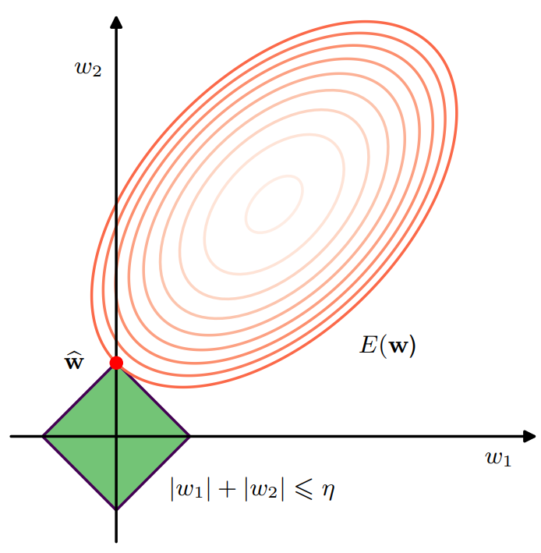
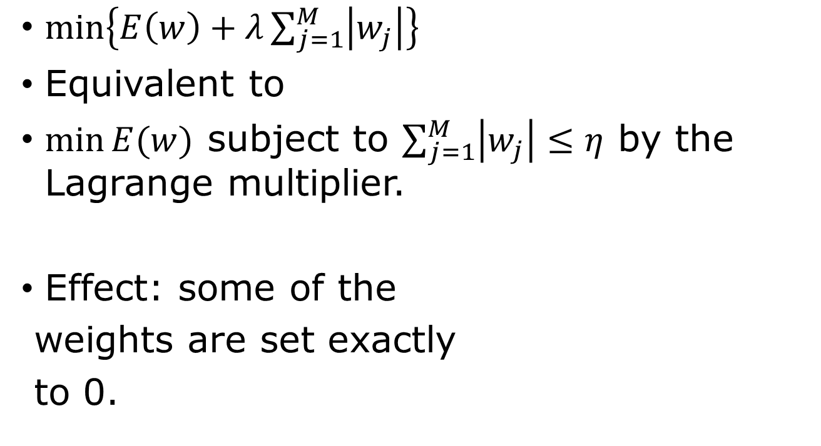
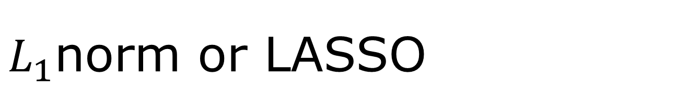
$L_{1}$norm or LASSO
$\min\left\{E\left(w\right)+λ\sum_{j=1}^{M}{\left|w_{j}\right|}\right\}$
Equivalent to
$\min{E(w)}$ subject to $\sum_{j=1}^{M}{\left|w_{j}\right|}≤η$ by the Lagrange multiplier.
Effect: some of the
weights are set exactly
to 0.

Slide 11

L₂ vs L₁ norm regularization, 1D examples
$$\min_{w}{\frac{1}{2}λw^{2}+\frac{1}{2}H{\left(w−w^{∗}\right)}^{2}}$$
vs $\min_{w}{λ\left|w\right|+\frac{1}{2}H{\left(w−w^{∗}\right)}^{2}}$
Notes:
L2: the minimum w* is shifted to 1/(lambda/H+1) w*. L1: Assume w*> 0, w* is shifted down to a smaller value of w* - lambda/H. If w*-lambda/H < 0, the minimum is at 0.

Slide 12
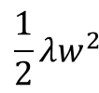

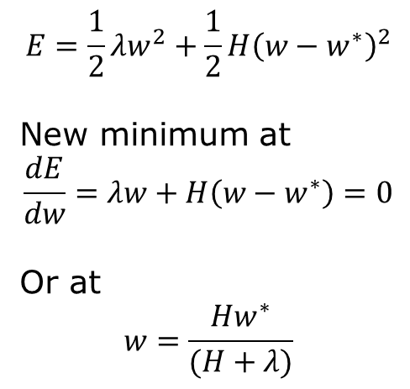
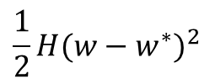
L₂ norm regularization
regularization term
original loss
$$\frac{1}{2}H{(w−w^{∗})}^{2}$$
$$\frac{1}{2}λw^{2}$$
$$E=\frac{1}{2}λw^{2}+\frac{1}{2}H{\left(w−w^{∗}\right)}^{2}$$
New minimum at
$$\frac{dE}{dw}=λw+H\left(w−w^{∗}\right)=0$$
Or at
$$w=\frac{Hw^{∗}}{(H+λ)}$$
0
$$w^{∗}$$
w

Slide 13

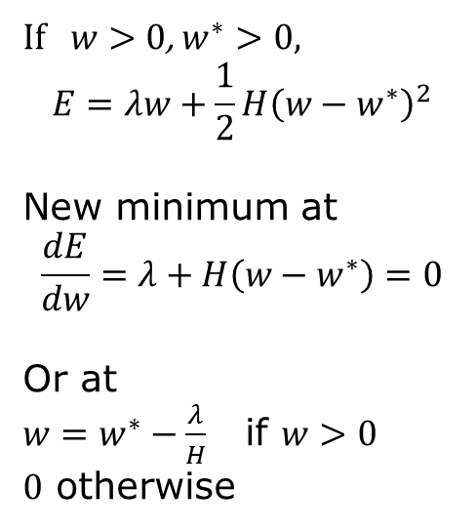
L₁ norm regularization
$$\frac{1}{2}H{(w−w^{∗})}^{2}$$
$$λ|w|$$
If $w>0$, $w^{∗}>0,$
$$E=λw+\frac{1}{2}H{\left(w−w^{∗}\right)}^{2}$$
New minimum at
$$\frac{dE}{dw}=λ+H\left(w−w^{∗}\right)=0$$
Or at
$w=w^{∗}−\frac{λ}{H}$ if $w>0$
$0$ otherwise
0
$$w^{∗}$$
w

Slide 14
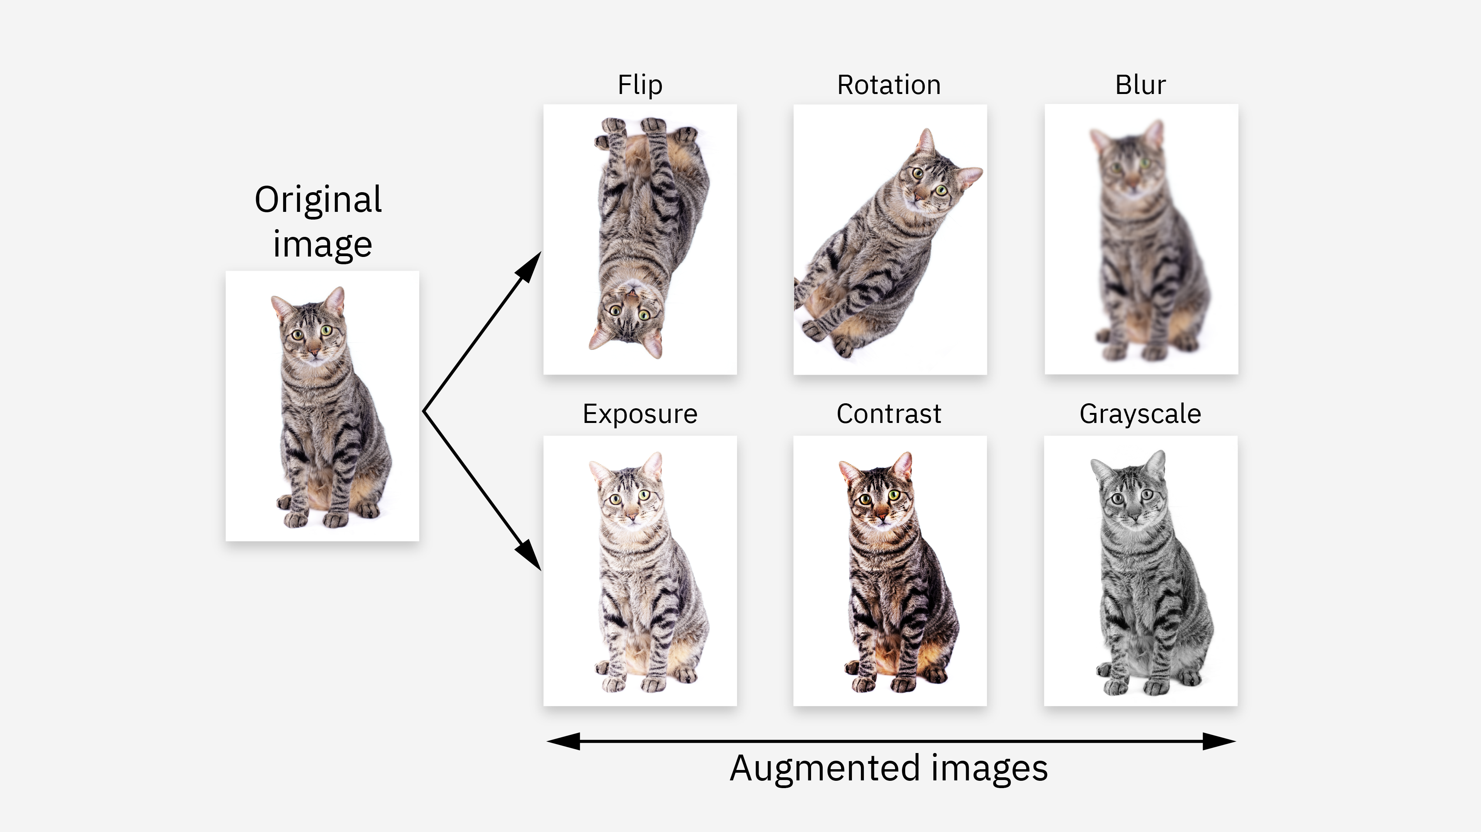
Dataset augmentation
Generate additional training data by, such as translations, rotations, …
Add noise
…
https://www.ibm.com/think/topics/data-augmentation

Slide 15
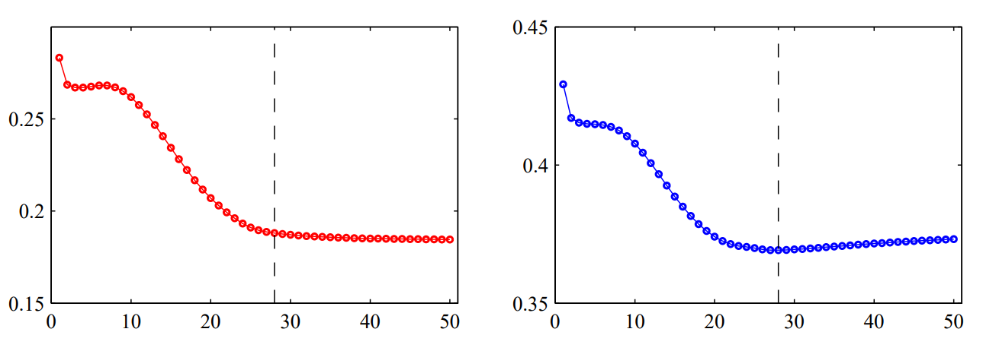
Early stopping as a way of regularization
training set error
validation set error
epoch or iteration
Stop at the minimum validation error

Slide 16
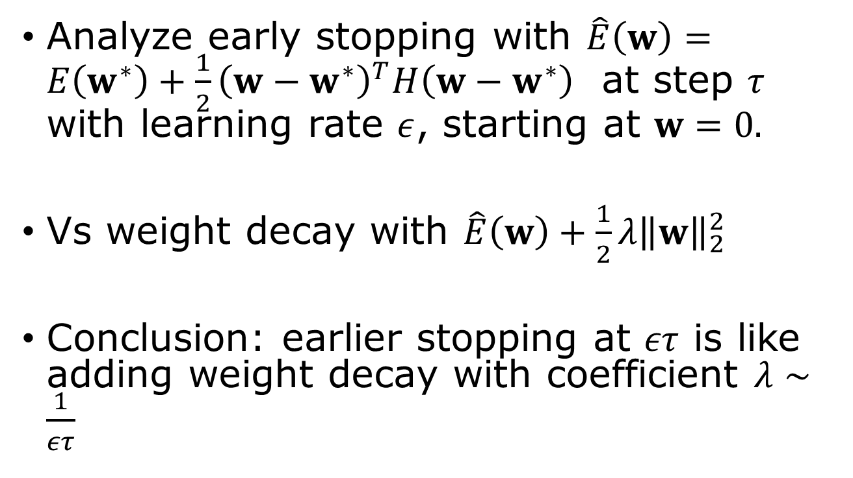
Early stopping is equivalent to weight decay
Analyze early stopping with $\hat{E}\left(w\right)=E\left(w^{∗}\right)+\frac{1}{2}{\left(w−w^{∗}\right)}^{T}H\left(w−w^{∗}\right)$ at step $τ$ with learning rate $ε$, starting at $w=0.$
Vs weight decay with $\hat{E}\left(w\right)+\frac{1}{2}λ{\left\|w\right\|}_{2}^{2}$
Conclusion: earlier stopping at $ετ$ is like adding weight decay with coefficient $λ∼\frac{1}{ετ}$
See Goodfellow et al, page 242 – 245.
Notes:
This is so if we start from w close to 0, of course.

Slide 17
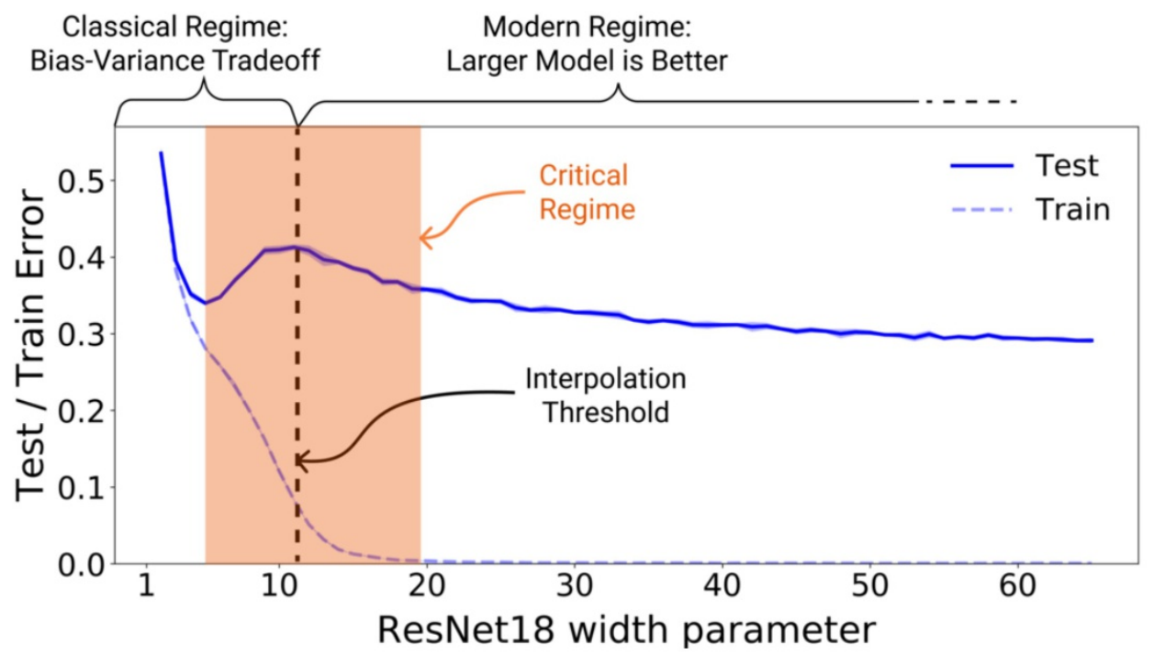
Double descent
Notes:
This is not a regularization, just an observation for large models.

Slide 18

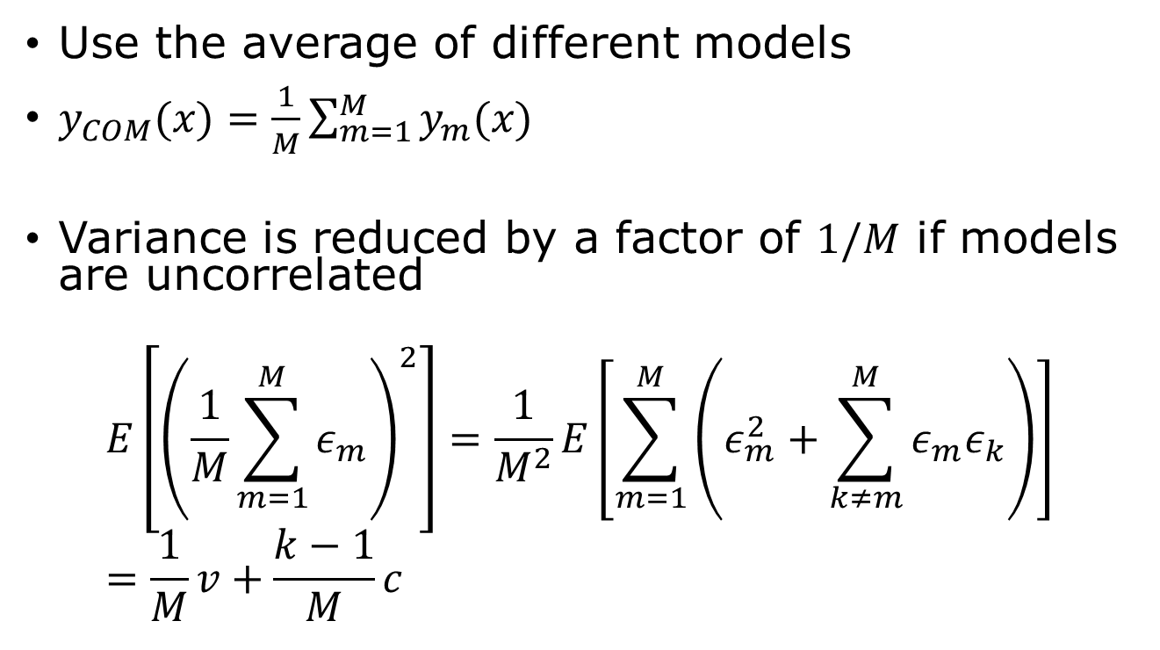
Bagging & model averaging
Use the average of different models
$y_{COM}(x)=\frac{1}{M}\sum_{m=1}^{M}{y_{m}(x)}$
Variance is reduced by a factor of $1/M$ if models are uncorrelated
$$E\left[{\left(\frac{1}{M}\sum_{m=1}^{M}{ε_{m}}\right)}^{2}\right]=\frac{1}{M^{2}}E\left[\sum_{m=1}^{M}{\left(ε_{m}^{2}+\sum_{k≠m}^{M}{ε_{m}ε_{k}}\right)}\right]=\frac{1}{M}v+\frac{k−1}{M}c$$
Assuming $E\left[ε_{m}^{2}\right]=v$, $E\left[ε_{m}ε_{k}\right]=c$

Slide 19
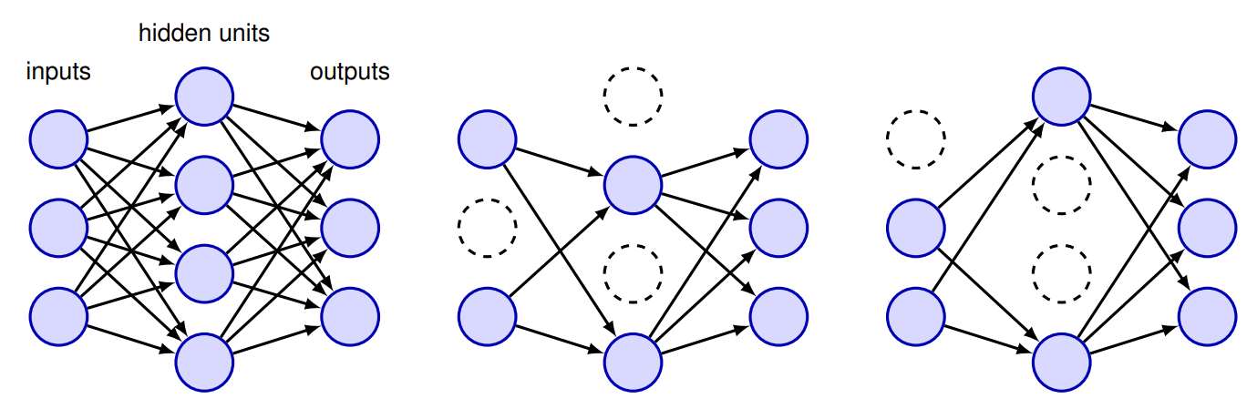
Dropout
Nodes and their connections are deleted at random for each train iteration. It is an implicit way to perform approximate model average over exponentially many models.

Slide 20
Questions and answers
1) inductive bias, 2) invariance vs equivariance, 3) what is regularization? 4) what is bias-variance trade-off? 5) what is weight decay, 6) difference/similarity of L₂ vs L₁ regularization, 7) double descent? 8) early stopping, 9) bagging? 10) dropout?

Slide 21
Summary
Inductive bias – assumptions that help generalization
Regularization – control model complexity, overcome overfitting
L₂/weight decay – shrink weights
L₁ – promote sparsity
Early stopping/dropout/bagging – can reduce overfitting
Key idea: good generalization requires the right balance between fitting the data and controlling model complexity.

Slide 22
Reading
Bishop’s book, Chapter 9, pages 253-281

