Slide 1
Week 6.5,
Physics-Informed Neural Networks (PINN)
Notes:
For Physics-Informed neural network (PINN), read M. Raissi et al., Journal of Computational Physics, {378}, 686 (2019); and H. Baty, arXiv:2403.00599, or Humagain et al., arXiv:2508.13216. See also the book, “Deep learning methods of mathematical physics”, by O. Calin, World Scientific, 2026.

Slide 2
Outline
Physics problems described by ODEs or PDEs, examples of these
Traditional numerical methods vs. Physics-Informed Neural Networks (PINN)
PINN examples

Slide 3





Importance of ODEs
Mechanics, Newton’s law
$$a=\frac{d^{2}x}{dt^{2}}=\frac{dv}{dt}$$
$$F=ma$$
$$x_{2}$$
In PINN, a neural network predicts $x$ given $t$with the equation of motion incorporated into the loss function.
$$x_{1}$$
Notes:
PINN: map t to x(t).

Slide 4

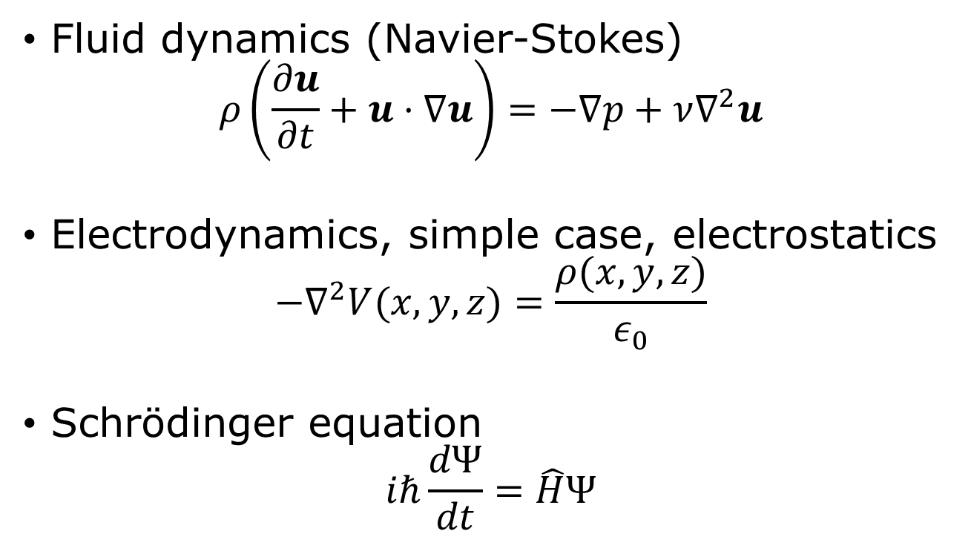
Importance of PDEs
Fluid dynamics (Navier-Stokes)
$$ρ\left(\frac{∂u}{∂t}+u⋅∇u\right)=−∇p+ν∇^{2}u$$
Electrodynamics, simple case, electrostatics
$$−∇^{2}V(x,y,z)=\frac{ρ(x,y,z)}{ε_{0}}$$
Schrödinger equation
$$iℏ\frac{dΨ}{dt}=\hat{H}Ψ$$
Hamiltonian
$$\hat{H}=−\frac{ℏ^{2}}{2m}∇^{2}+V$$

Slide 5
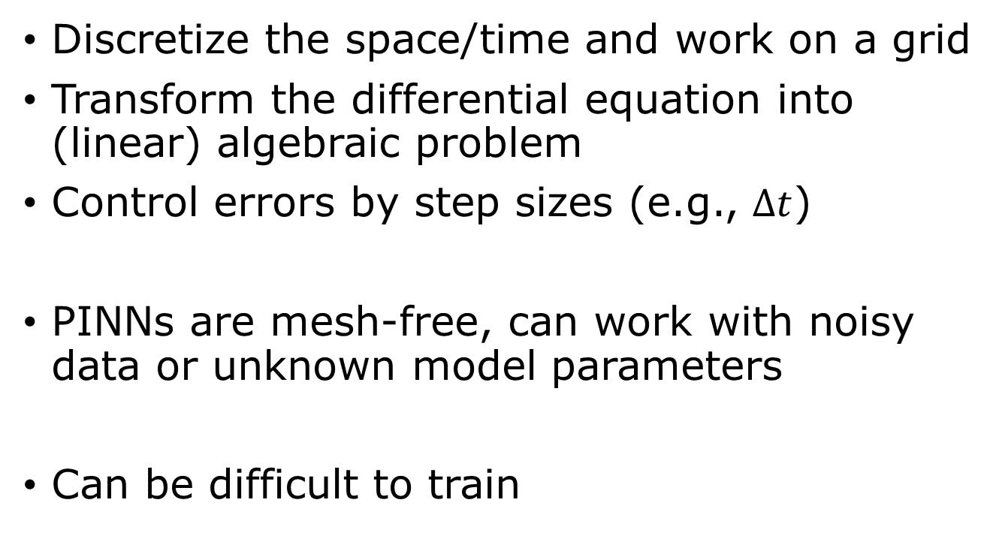
Traditional ODE/PDE solver vs PINN
Discretize the space/time and work on a grid
Transform the differential equation into (linear) algebraic problem
Control errors by step sizes (e.g., $Δt$)
PINNs are mesh-free, can work with noisy data or unknown model parameters
Can be difficult to train

Slide 6
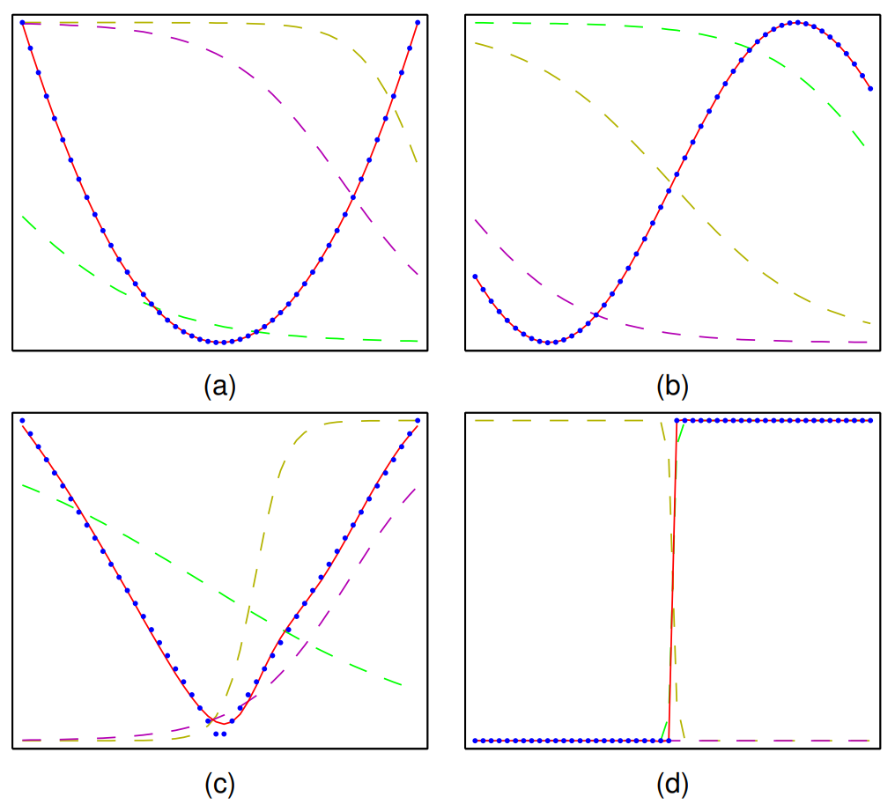

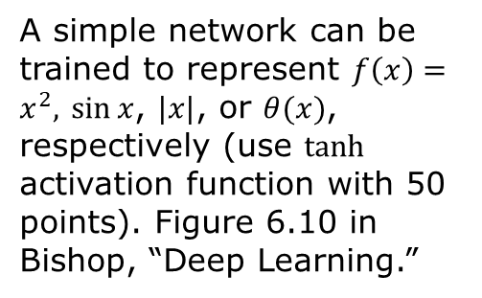




MLP as a universal approximator of smooth functions
$$z_{3}$$
$$x$$
$$z_{2}$$
$$y$$
$$z_{1}$$
A simple network can be trained to represent $f\left(x\right)=x^{2},$ $\sin{x}$, $|x|$, or $θ(x)$, respectively (use $tanh$ activation function with 50 points). Figure 6.10 in Bishop, “Deep Learning.”
Need to work in a bounded domain

Slide 7
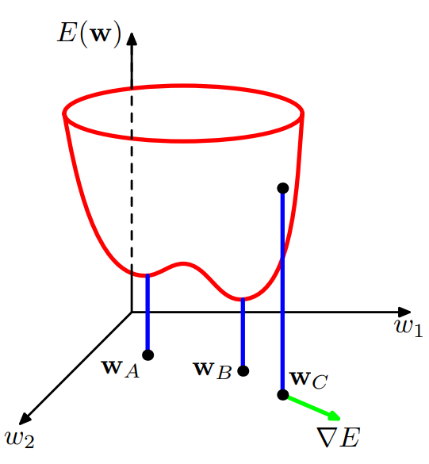
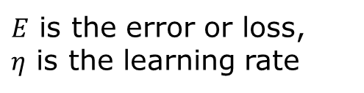


Determine network parameters by SGD
$$w←w−η∇_{w}E$$
$E$ is the error or loss,
$η$ is the learning rate
$$δE=E\left(w+δw\right)−E\left(w\right)=δw^{T}∇E(w)$$
$$∇_{w}E=\left(\begin{matrix}\frac{∂E}{∂w_{1}} \\ ⋮ \\ \frac{∂E}{∂w_{N}}\end{matrix}\right)$$

Slide 8
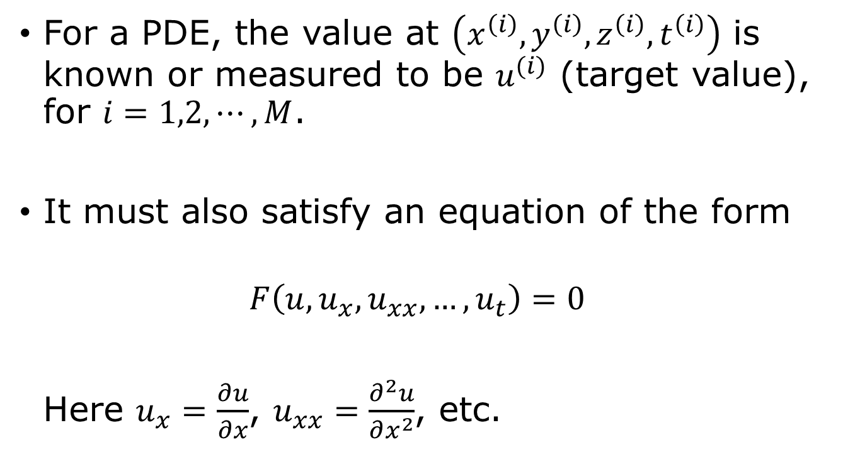

(Experimental) Data & physical constraints
For a PDE, the value at $\left(x^{\left(i\right)},y^{\left(i\right)},z^{\left(i\right)},t^{\left(i\right)}\right)$ is known or measured to be $u^{(i)}$ (target value), for $i=1,2,⋯,M$.
It must also satisfy an equation of the form
$$F\left(u,u_{x},u_{xx}, …, u_{t}\right)=0$$
Here $u_{x}=\frac{∂u}{∂x}$, $u_{xx}=\frac{∂^{2}u}{∂x^{2}}$, etc.
E.g., $F=ρ\left(\frac{∂u}{∂t}+u⋅∇u\right)+∇p−ν∇^{2}u=0$
Notes:
u can be the three velocities in the Navier-Stokes equations, or the real and imaginary parts of the wave function in the Schrodinger equation, i.e., u can be a vector instead of a scalar number.

Slide 9
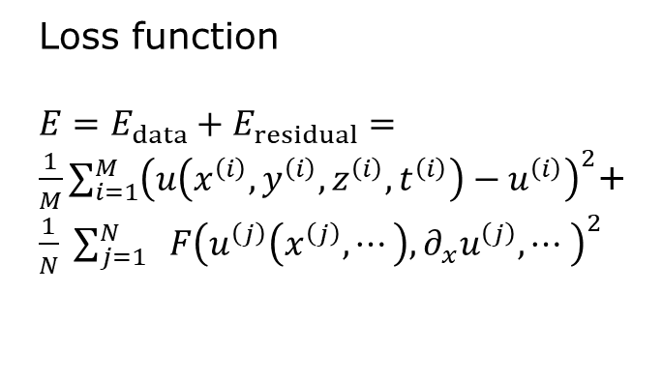

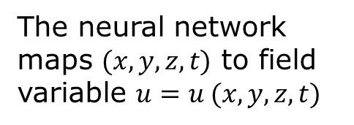



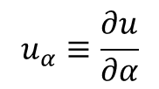

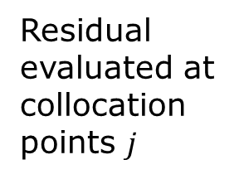
Physics-informed neural network (PINN)
compute partial derivatives using autograd
$$(x,y,z,t)$$
Loss function
$E=E_{data}+E_{residual}=\frac{1}{M}\sum_{i=1}^{M}{{\left(u\left(x^{\left(i\right)},y^{\left(i\right)},z^{\left(i\right)},t^{\left(i\right)}\right)−u^{\left(i\right)}\right)}^{2}}$+ $\frac{1}{N} \sum_{j=1}^{N}{ F{\left(u^{\left(j\right)}\left(x^{\left(j\right)},⋯\right),{∂_{x}u}^{\left(j\right)},⋯ \right)}^{2}}$
$${ u}_{x}$$
x
$$u_{y}$$
y
u
$${ u}_{z}$$
z
$${ u}_{t}$$
t
Residual evaluated at collocation points $j$
The neural network maps $(x,y,z,t)$ to field variable $u=u (x,y,z,t)$
$$u_{α}≡\frac{∂u}{∂α}$$

Slide 10
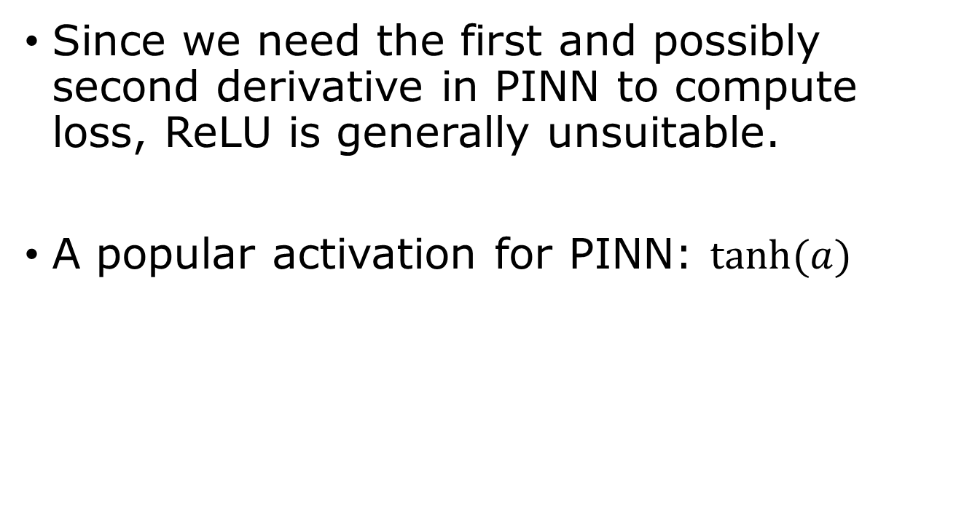


Smooth activation requirement for PINN
Since we need the first and possibly second derivative in PINN to compute loss, ReLU is generally unsuitable.
A popular activation for PINN: $\tanh{(a)}$
$$tanh⁡(a)$$
$$a$$
Notes:
Show tanh(a) and sigmoid are equivalent for a neural network. Note that ReLU’’(x) = 0 for all x except when x = 0.

Slide 11
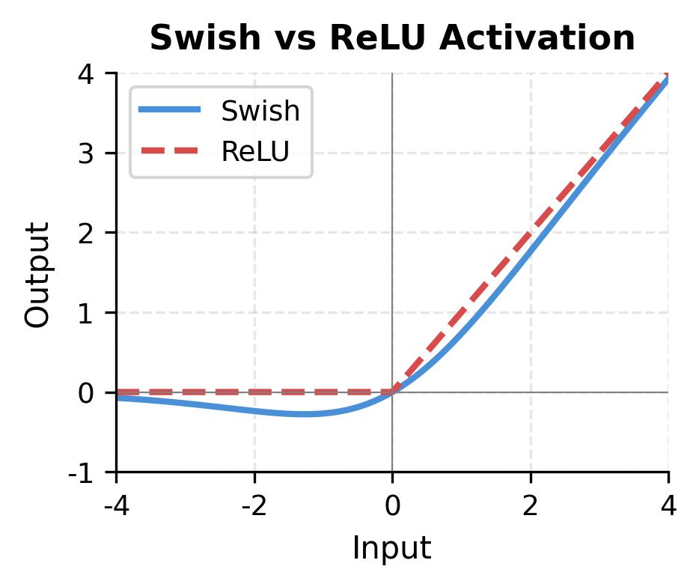

Another smooth choice - Swish
$$Swish\left(a\right)=a σ\left(a\right)=\frac{a}{1+e^{−a}}$$
In PyTorch
torch.nn.SiLU()

Slide 12

How to compute derivative in PyTorch?
$u=u\left(x\right),$ $u_{x}=\frac{∂u}{∂x},$ $u_{xx}=\frac{∂^{2}u}{∂x^{2}}$
x.requires_grad_(True)
u = model(x)
u_x = torch.autograd.grad(u, x, torch.ones_like(u), create_graph=True)[0]
u_xx = torch.autograd.grad(u_x, x, torch.ones_like(u_x), create_graph=True)[0]
torch.autograd.grad() returns a tuple
Notes:
Note: torch.autograd.grad() returns a tuple of the partial derivatives of u with respect to x, [0] extracts the first tensor and assigns it to variable u_x (or u_xx). So, [0] is needed here.

Slide 13
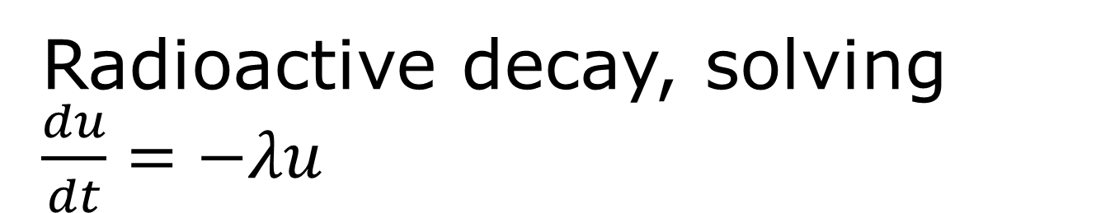
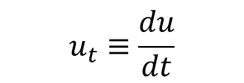
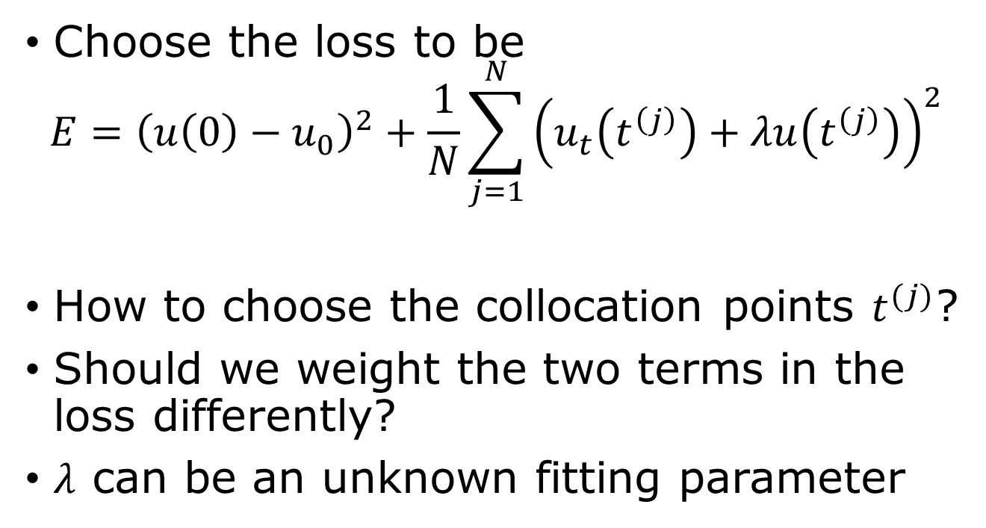
Radioactive decay, solving $\frac{du}{dt}=−λu$
$$u_{t}≡\frac{du}{dt}$$
Choose the loss to be
$$E={\left(u\left(0\right)−u_{0}\right)}^{2}+\frac{1}{N}\sum_{j=1}^{N}{{\left(u_{t}\left(t^{\left(j\right)}\right)+λu\left(t^{\left(j\right)}\right)\right)}^{2}}$$
How to choose the collocation points $t^{(j)}$?
Should we weight the two terms in the loss differently?
$λ$ can be an unknown fitting parameter
Notes:
Forward problem: known lambda, solve for u(t), inverse problem: observed u(t), infer lambda.

Slide 14
PyTorch for decay problem
See decay.ipynb

Slide 15
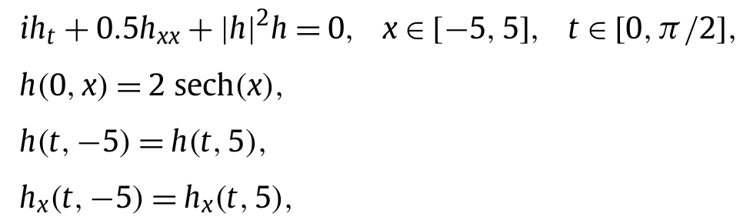
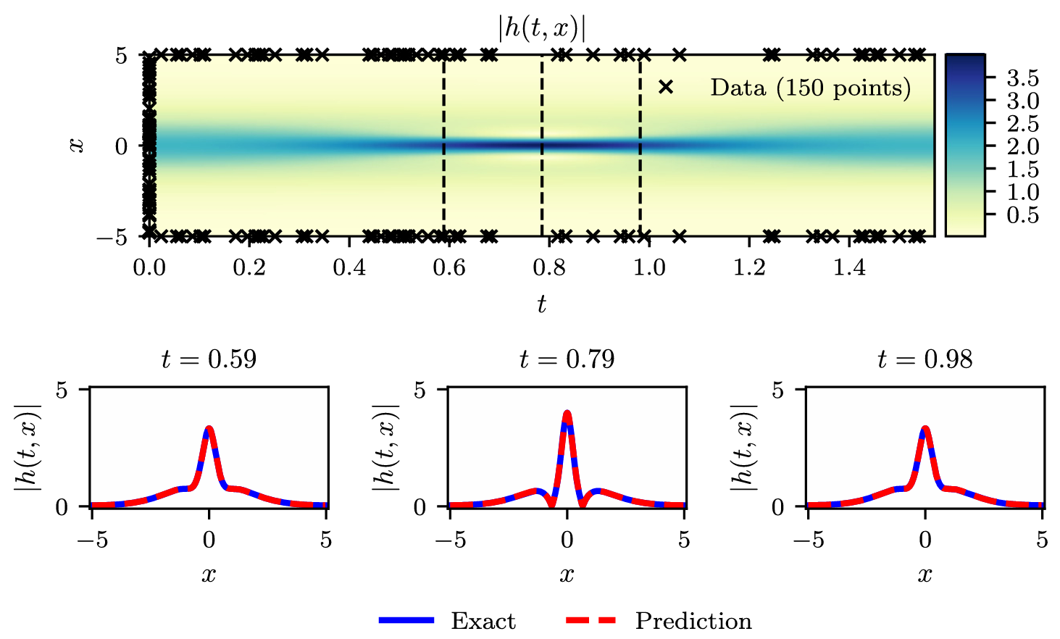
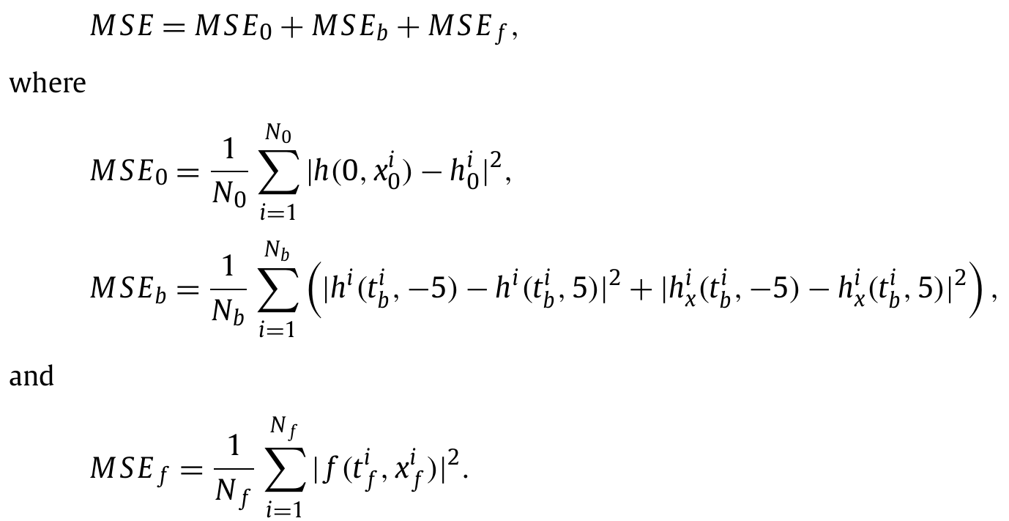

Nonlinear Schrödinger equation
From Raissi et al, JCP 2019
$f≔ih_{t}+0.5h_{xx}+{\left|h\right|}^{2}h,$ $h∈ℂ$
Notes:
From Raissi, et al., J Comp. Phys. 378 (2019) 686.

Slide 16
Questions and Answers
1) What is PINN, 2) why not use ReLU in PINN, 3) how to enforce initial condition in PINN, 4) how to choose loss function in PINN? 5) What is a forward problem, 6) what is an inverse problem, 7) …

Slide 17
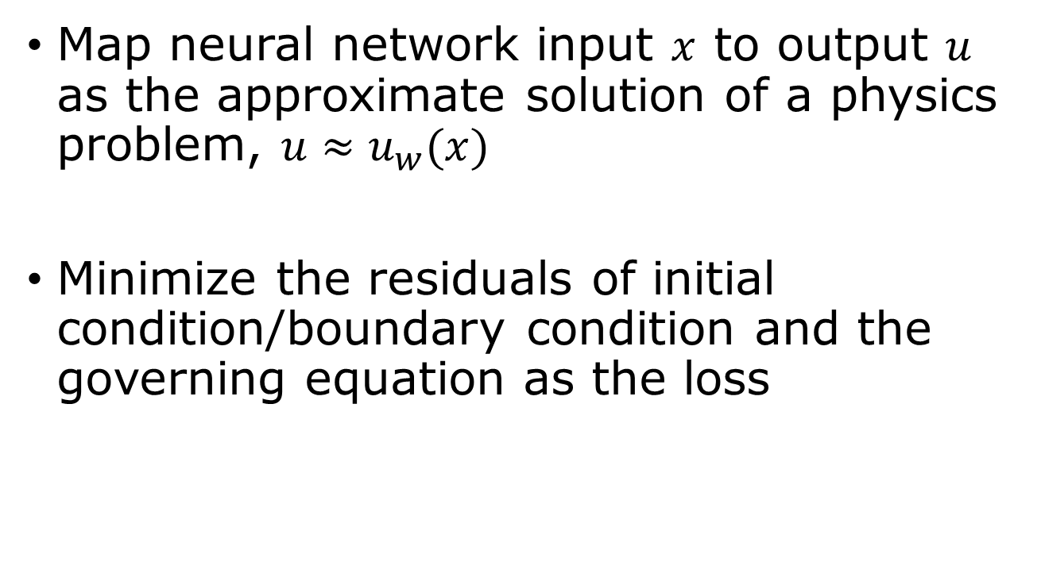
Summary
Map neural network input $x$ to output $u$ as the approximate solution of a physics problem, $u≈u_{w}(x)$
Minimize the residuals of initial condition/boundary condition and the governing equation as the loss

