Slide 1
Week 7,
Convolutional Neural Networks (CNNs)
Notes:
Chapter 10, Bishop, “Deep Learning, Foundations and Concepts”.

Slide 2
Outline
Inductive bias; CNN as an example
Mathematical convolution and convolutional neural networks
Kernel size, stride, padding, channels, and pooling
Problems with deep networks and how to mitigate them
  Residual networks
  Batch and layer normalization

Slide 3
What can deep networks do?
Computer Vision
  Classification
  Detection
  Segmentation
  Image captioning
Large language models
Protein folding
ML-based force fields, etc

Slide 4
MLP and inductive bias
In principle, with enough width and depth, multi-layer perceptrons (MLPs) can approximate a very broad class of functions
However, in practice, it is inefficient due to the larger number of parameters needed
Thus, a strong “inductive bias” is required for image processing/classification. Translational equivariance is particularly important
Notes:
Question: Can an MLP learn a random function from limited data? No generalization is possible.

Slide 5







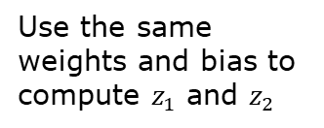
Inductive biases for image processing in CNNs
Translation equivariance
Locality (sparse connectivity)
Parameter sharing
$$f\left(g\left(x\right)\right)=g(f\left(x\right))$$
Use the same weights and bias to compute $z_{1}$ and $z_{2}$
$${ x}_{1}$$
$${ z}_{1}$$
$${ x}_{2}$$
$${ x}_{3}$$
$${ z}_{2}$$
$${ x}_{4}$$

Slide 6
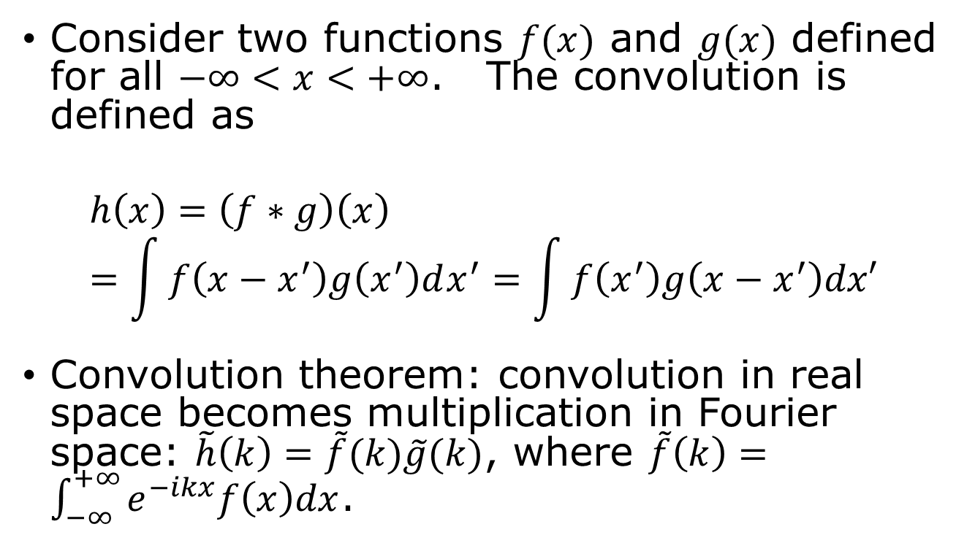
Convolution in 1D
Consider two functions $f(x)$ and $g(x)$ defined for all $−∞<x<+∞$. The convolution is defined as
$$h\left(x\right)=\left(f∗g\right)\left(x\right)=\int{f\left(x−x^{′}\right)g\left(x^{′}\right)dx^{′}=\int{f\left(x^{′}\right)g\left(x−x^{′}\right)dx′}}$$
Convolution theorem: convolution in real space becomes multiplication in Fourier space: $\tilde{h}\left(k\right)=\tilde{f}(k)\tilde{g}(k)$, where $\tilde{f}\left(k\right)=\int_{−∞}^{+∞}{e^{−ikx}f\left(x\right)dx}$.
Notes:
What is the inverse Fourier transform, from tilde f to f?

Slide 7

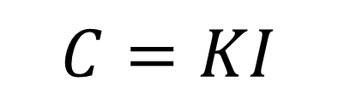



Convolution in 2D images
$$C=KI$$
Kernel $K$
1 | 0 | 1
0 | 1 | 0
1 | 0 | 1
kernel size 3, stride 1,
padding 0, channel 1
The point of a CNN is to learn the kernel by training.
$$I$$
$$C$$
Notes:
The kernel K is also called a filter.

Slide 8
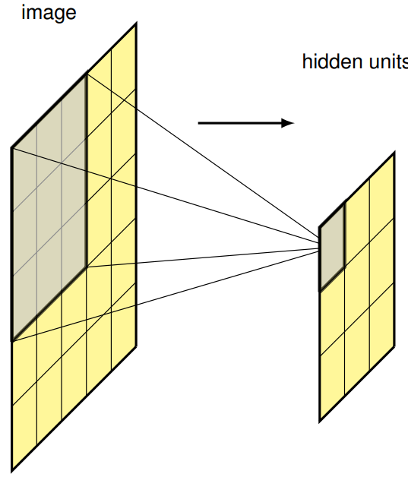
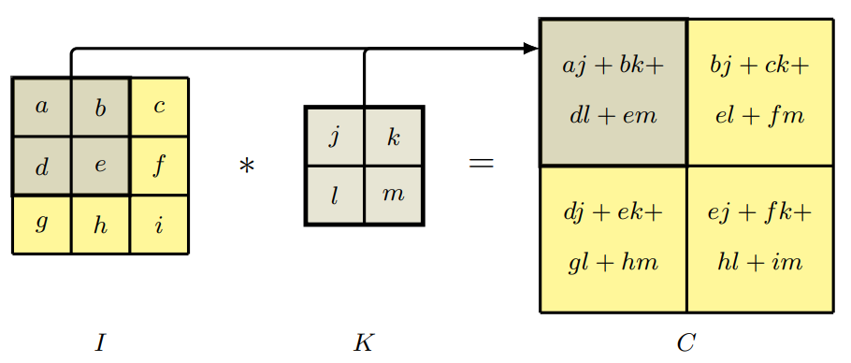

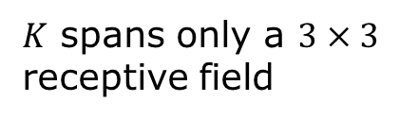
CNN operation: cross-correlation
$$C\left(j,k\right)=\sum_{l}{\sum_{m}{\underset{input image}{\underbrace{I(j+l,k+m)}}\underset{kernel}{\underbrace{K(l,m)}}}}$$
output
dot product
$K$ spans only a $3×3$ receptive field
Notes:
CNNs usually use cross-correlation, conventionally called convolution.

Slide 9
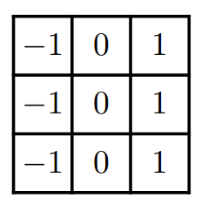
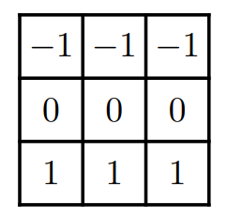
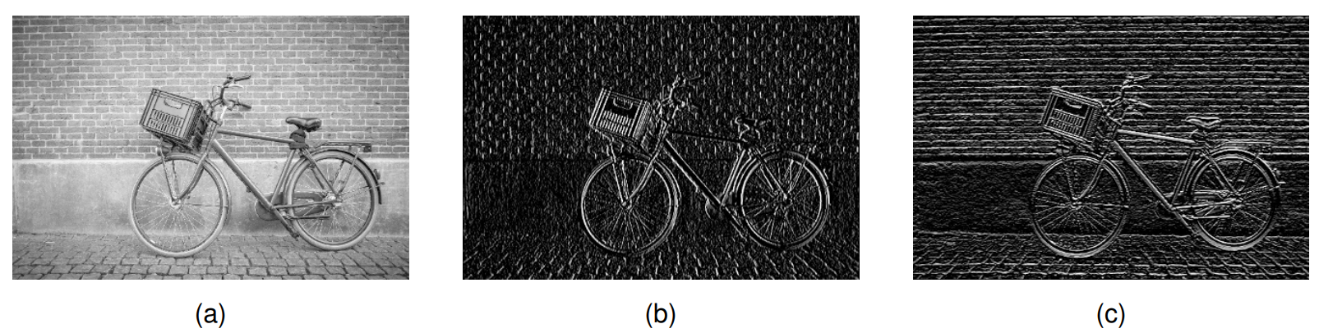

Convolution as a discrete derivative – edge detection
$3×3$ kernels
original image
Central point of CNNs: Kernels are learned.

Slide 10
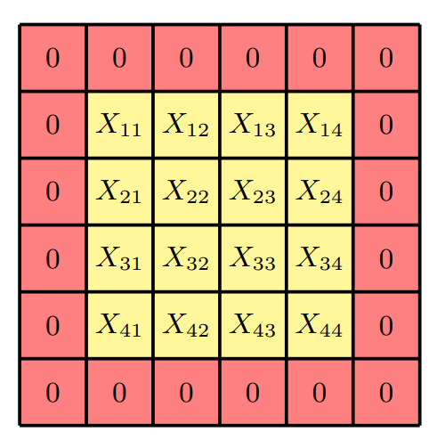
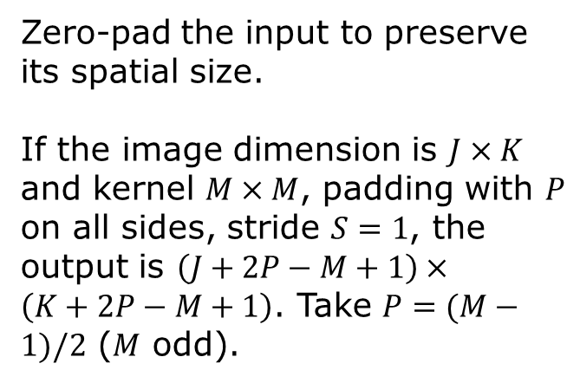
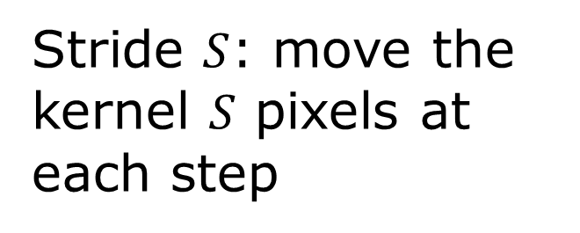
Padding and Stride
Zero-pad the input to preserve its spatial size.
If the image dimension is $J×K$ and kernel $M×M$, padding with $P$ on all sides, stride $S=1$, the output is $\left(J+2P−M+1\right)×\left(K+2P−M+1\right)$. Take $P=(M−1)/2$ ($M$ odd).
Stride $S$: move the kernel $S$ pixels at each step

Slide 11
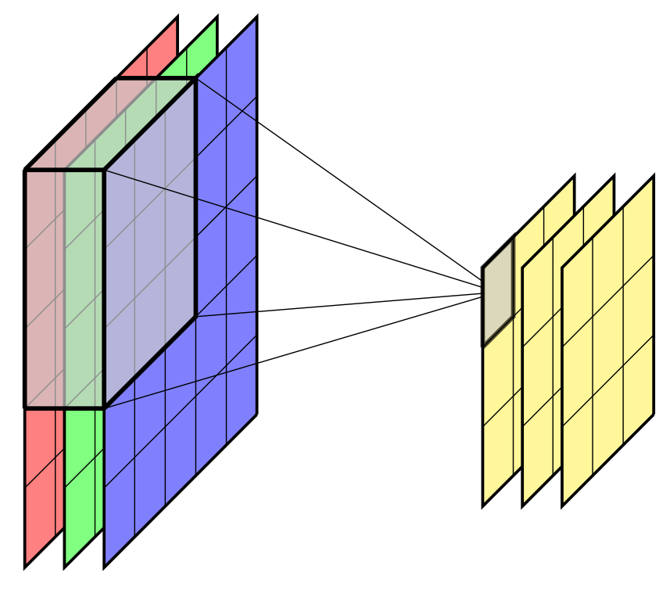
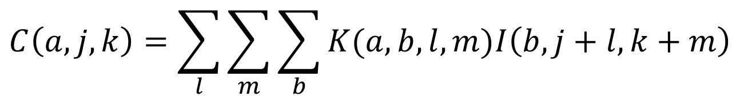
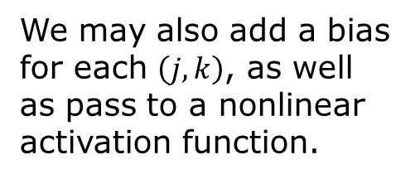
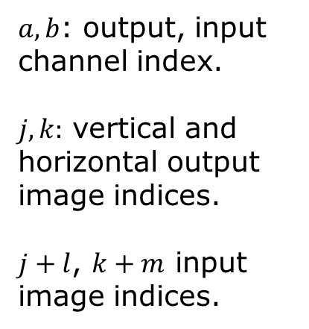
Channels
We may also add a bias for each $\left(j,k\right)$, as well as pass to a nonlinear activation function.
$$C\left(a,j,k\right)=\sum_{l}{\sum_{m}{\sum_{b}{K(a,b,l,m)I\left(b,j+l,k+m\right)}}}$$
$a,b$: output, input channel index.
$j,k:$ vertical and horizontal output image indices.
$j+l$, $k+m$ input image indices.
Notes:
In PyTorch, the images have four indices, imag[n,c,h,w]: n is batch index, c is channel, h is height index, w is width index.

Slide 12
Convolution layer in PyTorch
class torch.nn.Conv2d(in_channels, out_channels, kernel_size, stride=1, padding=0, dilation=1, groups=1, bias=True, padding_mode='zeros', device=None, dtype=None)
E.g.
conv = torch.nn.Conv2d(1,1,3)
Notes:
Dilation: if larger than 1, it skips d-1 input positions between kernel elements, increasing the receptive field without increasing the kernel size.

Slide 13
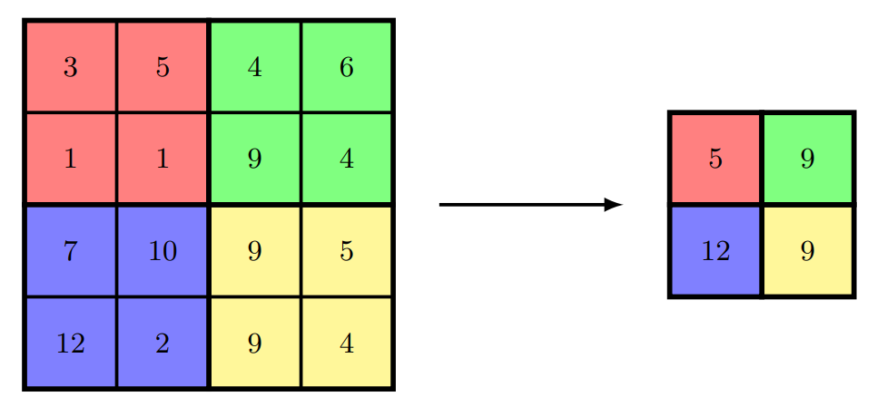
Pooling
Purpose: reduce sensitivity to small translations
max pool
Size : 2
Stride: 2
Analogy: coarse-graining in the renormalization group

Slide 14
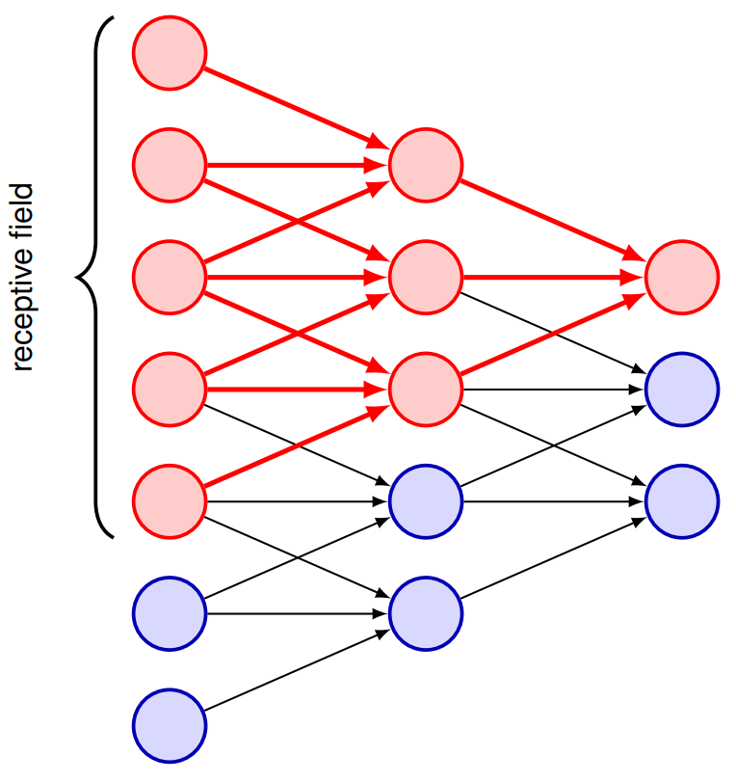
Multiple convolutional layers increase the receptive field
Receptive field grows with depth in a multilayer convolutional network. For 3×3, stride-1 convolution, it increases by 2 per layer.

Slide 15
MNIST digit classification with a CNN

Slide 16
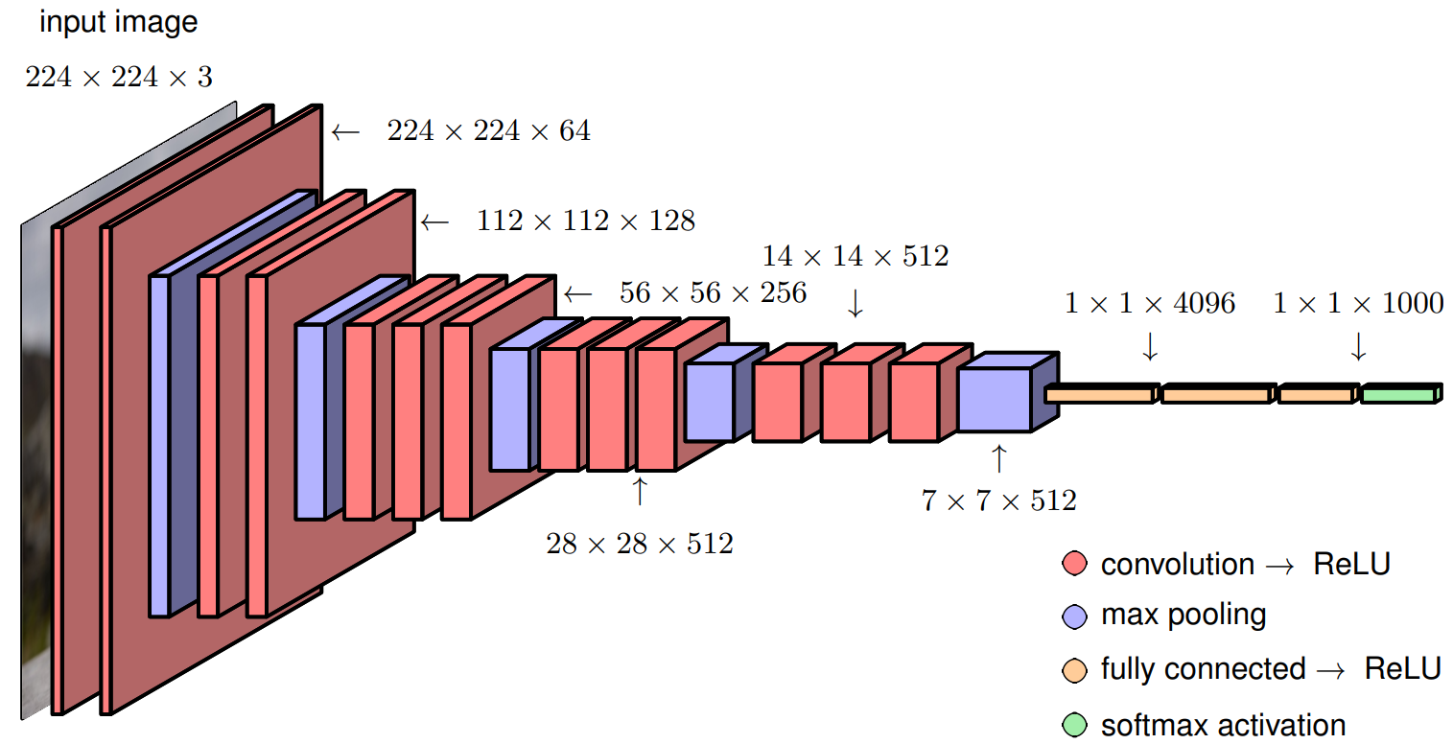
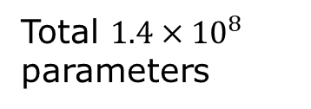
Typical CNN architecture, VGG-16
H: height
W: width
C: channel
H W C
Total $1.4×{10}^{8}$ parameters

Slide 17
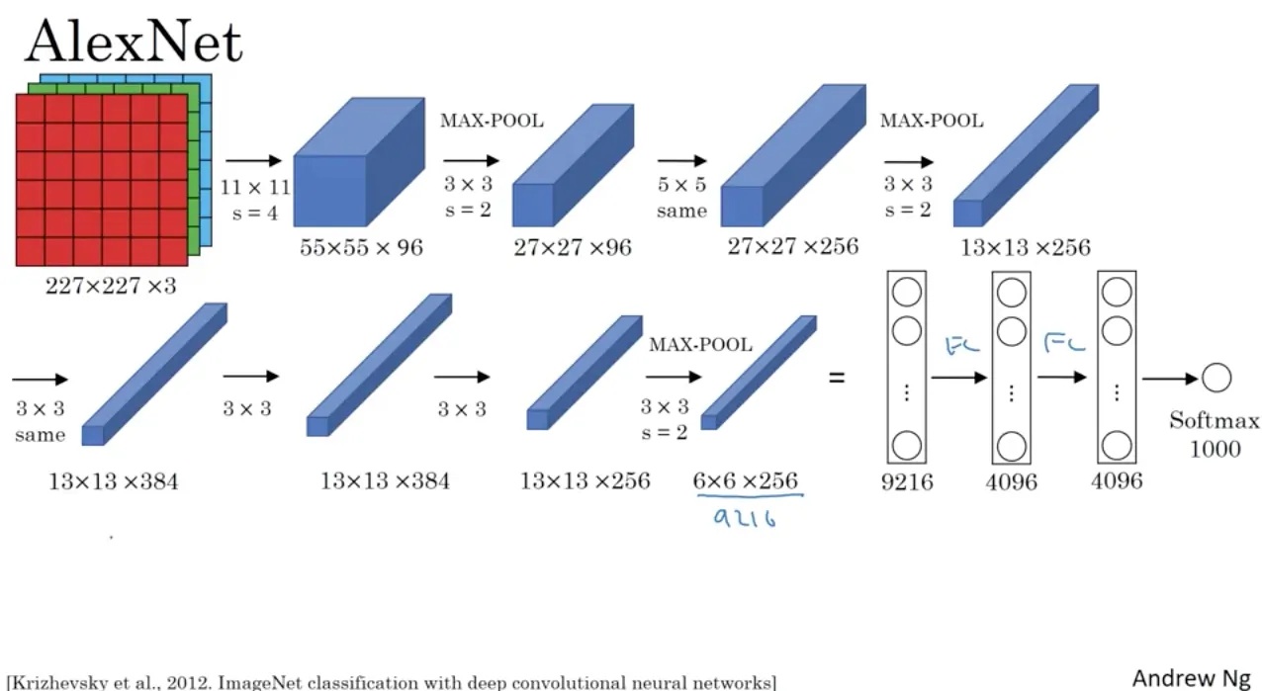
AlexNet and ChatGPT
The moment we stopped understanding AI [AlexNet]
https://youtu.be/UZDiGooFs54

Slide 18
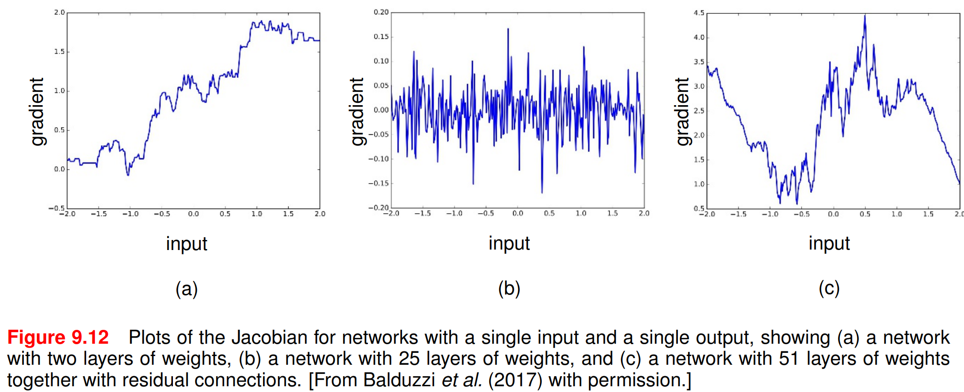
Problems with deep networks
1) Vanishing or exploding gradients
2) Shattered gradients
From Bishop, “Deep Learning”, p. 274.

Slide 19
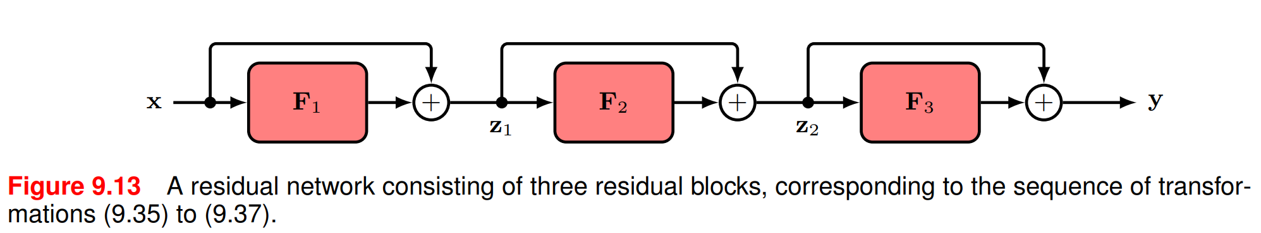

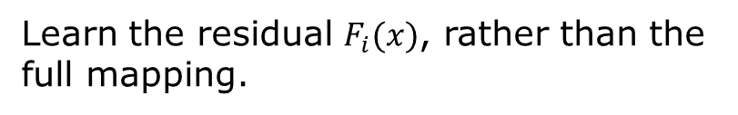
Residual connections
$$z_{1}=F_{1}\left(x\right)+x$$
$$z_{2}=F_{2}\left(z_{1}\right)+z_{1}$$
$$y=F_{3}\left(z_{2}\right)+z_{2}$$
Learn the residual $F_{i}(x)$, rather than the full mapping.

Slide 20
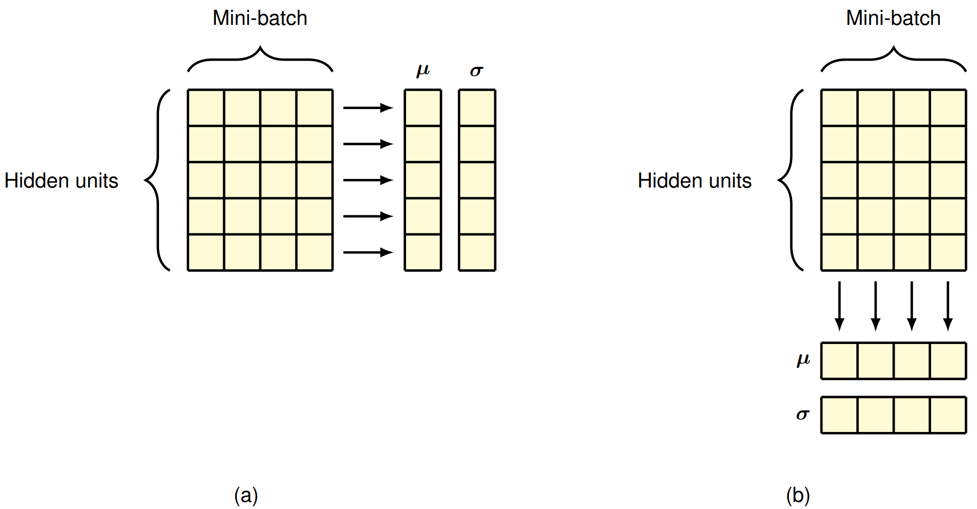
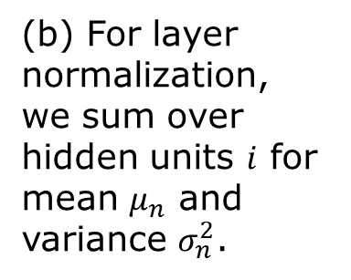


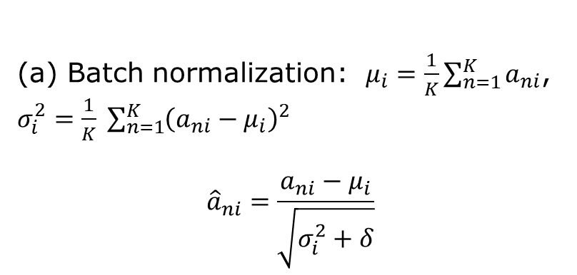
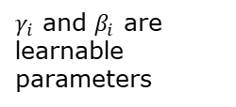


Batch normalization/Layer normalization
Row: samples
Column: hidden units
$$i$$
$$=X^{T}$$
$$n$$
$γ_{i}$ and $β_{i}$ are learnable parameters
$${\tilde{a}}_{ni}=γ_{i}{\hat{a}}_{ni}+β_{i}$$
(a) Batch normalization: $μ_{i}=\frac{1}{K}\sum_{n=1}^{K}{a_{ni}}$, $σ_{i}^{2}=\frac{1}{K} \sum_{n=1}^{K}{{\left(a_{ni}−μ_{i}\right)}^{2}}$
$${\hat{a}}_{ni}=\frac{a_{ni}−μ_{i}}{\sqrt{σ_{i}^{2}+δ}}$$
(b) For layer normalization, we sum over hidden units $i$ for mean $μ_{n}$ and variance $σ_{n}^{2}$.
Notes:
The matrix shown by the box is usually the preactivation in the form of X^T, the design matrix transposed. BatchNorm: statistics over samples in a batch.LayerNorm: statistics over hidden units within each sample.

Slide 21
Questions and Answers
1) What is parameter sharing? 2) what is an inductive bias, 3) Fully connected layer vs convolutional layer: how many parameters? 4) what is a channel? Why do we need channels? 5) what is a receptive field? 6) what is layer normalization? How is it performed? 7) what is a residual network? 8) Why does the gradient tend to diverge (or vanish) in an MLP?

Slide 22
Summary
CNNs use inductive biases for images
  Locality, parameter sharing, translation equivariance
Kernels are learned from data
  Stride, padding, channels control convolution
  Pooling reduces sensitivity to small translations
  Deeper CNNs have larger receptive fields
Deep networks can suffer from unstable gradients
  Vanishing, exploding, or shattered gradients
  Residual connections improve gradient flow
  Batch and layer normalization improve training

Slide 23
Reading
Bishop book “Deep Learning”
CNN: Chapter 10, pp. 287-302
Normalization: Chapter 7, pp. 226-229
Residual connections: Sec. 9.5

