Slide 1

Monte Carlo Methods in Scientific Computing
3-7 November 2003
Beijing International Center for Computational Physics
Notes:
These set of powerpoint slides MC-0 to MC-15 is copyright J.-S. Wang. I thank Dr Yu Xijun for his kind invitation to organize this workshop. I also thank the other lectures Profs Bo Zheng, Junni Zhang and Pei Lucheng for their contributions to this workshop.
The background Monte Carlo carpet is from http://valuecarpetonline.com/montecarlo_bg.jpg.

Slide 2
Homework 1
Prove that the probability p = 2L/(πD) in the Buffon needle experiment.
Cauchy distribution is P(x) = c/(a²+x²) for -∞ < x < + ∞. a is a parameter. (a) determine the constant c by normalization; (b) generate the random variable x from a uniform random number 0 < ξ < 1.
Generate points distributed uniformly on a unit sphere (x²+y²+z²=1).

Slide 3
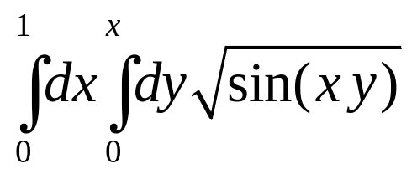
Homework 2
Given that ξ₁ and ξ₂ are independent, uniformly distributed random variables between 0 and 1, what are the probability distributions of the random variables ξ₁ + ξ₂ and ξ₁ * ξ_{2.}
Outline with pseudo-code a simple sampling Monte Carlo integration of the following two-dimensional integral,
Notice that the upper limit for y is x.

Slide 4
Homework 3
Write a Monte Carlo program to compute S(n) of the random sequential adsorption problem.
Write down the transition matrix W for a one-dimensional 4-spin system with periodic boundary condition using Metropolis flip rate.

Slide 5
Homework 4
Let assume W_{i} has invariant distribution P for all i, i.e., P = P W_{i}, i=1,2,..,N. show that both W_{s} = Σλ_{i}W_{i} and W_{p}=ΠW_{i} has invariant distribution P, where Σλ_{i}=1. How to implement W_{s} and W_{p} on computer?
If W_{i} satisfies detailed balance with respect to P, does W_{s} and/or W_{p} satisfy detailed balance?

Slide 6
Homework 5
Implement a version of single-spin flip Metropolis algorithm for the 2D Ising model. Compute average energy and heat capacity.
Implement the Swendsen-Wang algorithm for 2D Ising. Compare results with Metropolis algorithm.

Slide 7
Homework 6
Implement Ferrenberg-Swendsen single histogram method for Ising model, and compare with standard Metropolis or Swendsen-Wang. Compute heat capacity C.

