Slide 1

10. Quantum Monte Carlo Methods
Notes:
Books: “Quantum Monte Carlo Methods: algorithms for lattice models,” J Gubernatis et al. “Quantum Monte Carlo Methods in …”, M. Suzuki. “Monte Carlo Methods in Quantum Problems,” M. H. Kalos.

Slide 2
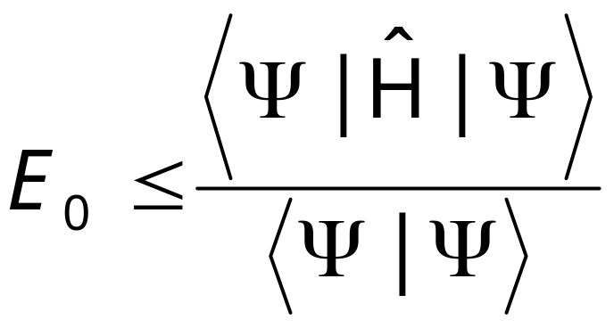
Variational Principle
For any trial wave-function Ψ, the expectation value of the Hamiltonian operator Ĥ provides an upper bound to the ground state energy E₀:
Notes:
See a review article by W. M.C. Foulkes, L. Mitas, R. J. Needs, and G. Rajagopal, Rev. Mod. Phys. 73 (2001) 33, for application in solids.

Slide 3
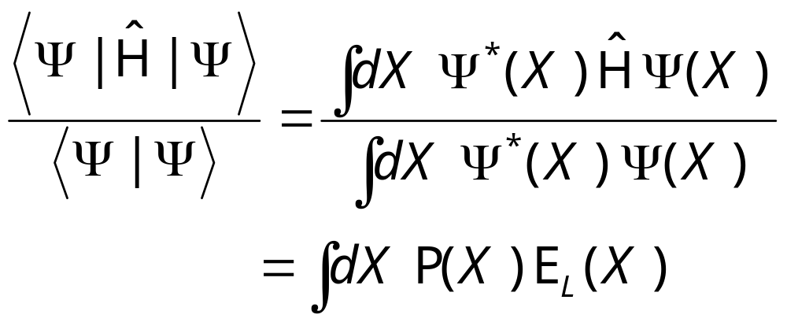
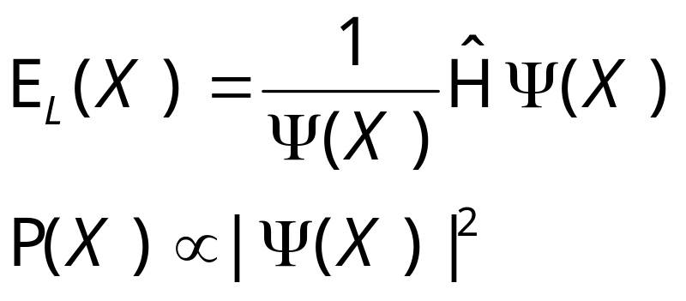
Quantum Expectation by Monte Carlo
where
Notes:
Changing Ψ to minimize <E_{L}> to find E₀. E_{L}(X) is called local energy.

Slide 4
Zero-Variance Principle
The variance of E_{L}(X) approaches zero as Ψ approaches the ground state wave-function Ψ₀.
σ_{E}² = <E_{L}²>-<E_{L}>² ≈ <E₀²>-<E₀>² = 0
Notes:
See R. Assaraf and M. Caffarel [Phys Rev Lett 83 (1999) 4682] for the use of this principle for better quantum MC algorithm.

Slide 5
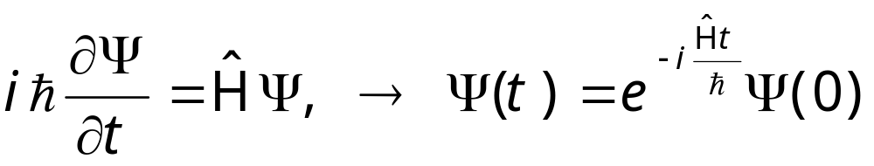
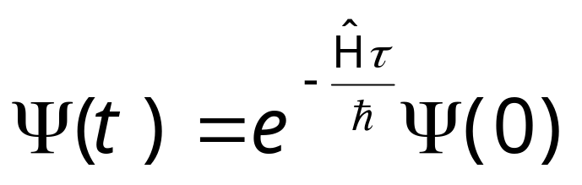
Schrödinger Equation in Imaginary Time
Let τ = it, the evolution becomes
Notes:
This projects out the ground-state as τ goes to infinity. Thus diffusion quantum Monte Carlo only found ground state, so it is a zero temperature algorithm.

Slide 6
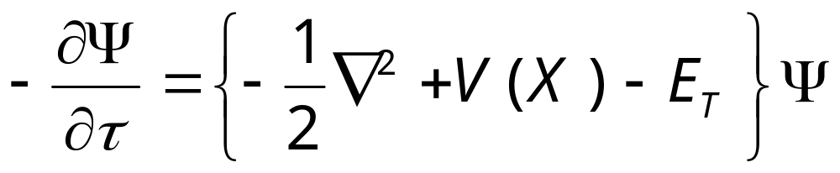
Diffusion Equation with Drift
The Schrödinger equation in imaginary time τ becomes a diffusion equation:
We have let ħ=1, mass m =1 for N identical particles, X is set of all coordinates (may including spins). We also introduce a energy shift E_{T}.
Notes:
We cannot solve the equation by probabilistic means yet, as Ψ can be positive or negative.

Slide 7
Fixed Node/Fixed Phase Approximation
We introduce a non-negative function f, such that
f = Ψ Φ_{T}* ≥ 0
f
f is interpreted as walker density.
Ψ
Φ_{T}
Notes:
f cannot be interpreted as probability, since the normalization condition ∫f(X)dX = constant does not hold. For Bosons, the ground-state wavefunction Ψ is always positive, so we don’t need fixed node approximation. The diffusion quantum Monte Carlo gives the minimum energy consistent with the constraint of fixed node.

Slide 8
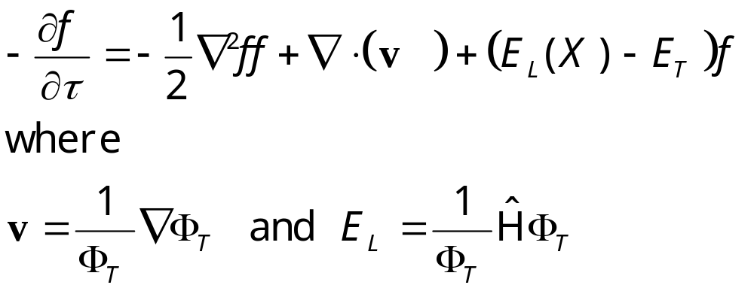
Equation for f
Notes:
This equation is valid for fixed-node approximation only, i.e. Φ_{T} is real.

Slide 9
Monte Carlo Simulation of the Diffusion Equation
If we have only the first term -½∇²f, it is a pure random walk.
If we have first and second term, it describes a diffusion with drift velocity v.
The last term represents birth-death of the walkers.
Notes:
Why don’t we solved it by traditional numerical methods, e.g., finite-difference method?

Slide 10
Walker Space
X
The population of the walkers is proportional to the solution f(X).

Slide 11
Diffusion Quantum Monte Carlo Algorithm
Initialize a population of walkers {X_{i}}
X’ = X + η τ^{½} + v(X) τ
Duplicate X’ to M copies: M = int( ξ + exp[-τ((E_{L}(X)+E_{L}(X’))/2-E_{T}) ] )
Compute statistics
Adjust E_{T} to make average population constant.
Notes:
η is a Gaussian random number with zero mean and unit variance, ξ is a uniformly distributed random number between 0 and 1. A rejection step may be introduce after 3, see Foulkes et al. int( ) is the same of the floor function, i.e., integer part of a number. The theoretical basis of the method is from Green-function solution of the Schrődinger equation.

Slide 12
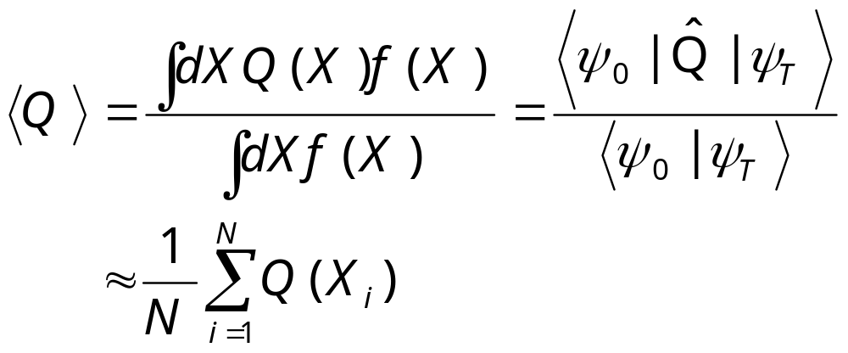
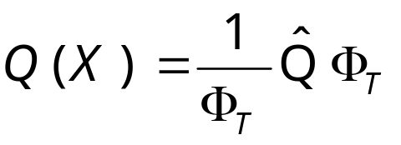
Statistics
The diffusion Quantum Monte Carlo provides estimator for
Where

Slide 13
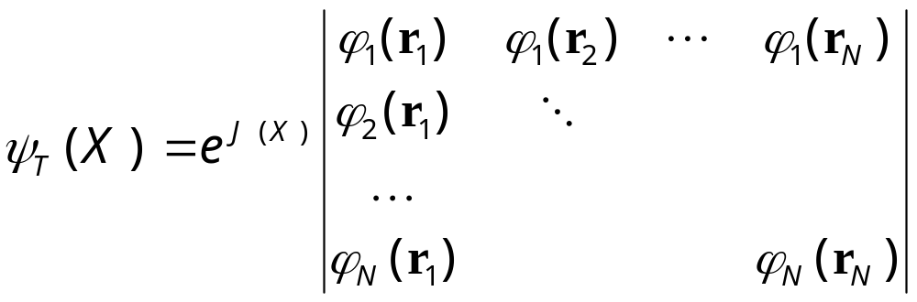
Trial Wave-Function
The common choice for interacting fermions (electrons) is the Slater-Jastrow form:
Notes:
J(X) is known as Jastrow factor.

Slide 14
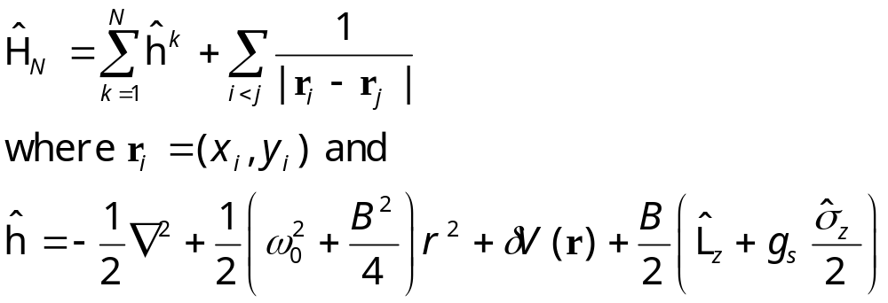
Example: Quantum Dots
2D electron gas with Coulomb interaction
We have used atomic units: ħ=c=m=e=1.
Notes:
A computer implementation for this problem and other supporting programs (Hartree-Fock and exact diagonalisation) is in the tarred and zip file QMC.tar.gz.

Slide 15
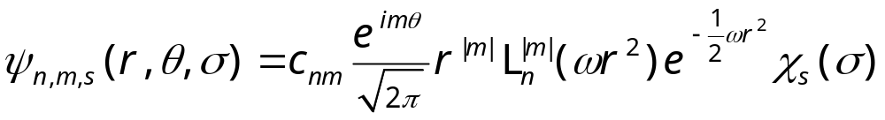
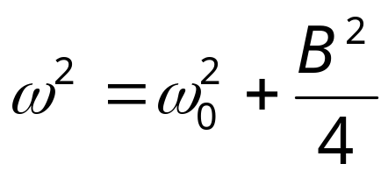
Trial Wave-Function
A Slater determinant of Fock-Darwin solution:
where
Notes:
We set J(X) = 0. L_{n}^{|m|}(ρ) is Laguerre Polynomial. Χ_{s}(σ) is spin part of the wavefunction.

Slide 16
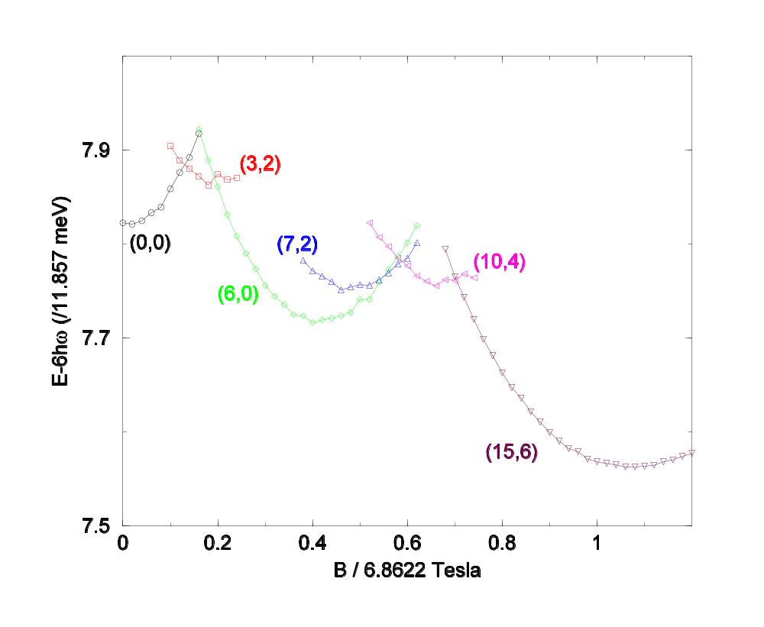
Six-Electron Ground-state Energy
The (L,S) values are the total orbital angular momentum L and total Pauli spin S.
From J S Wang, A D Güçlü and H Guo, unpublished
Notes:
Results shown are for perfect parabolic confining potential, i.e., δV=0. (L,S) states differ from current-spin DFT calculation of O. Steffens et al, Europhys Lett. 42 (1998) 529, at round B/6.86 = 0.5 to 0.5.

Slide 17
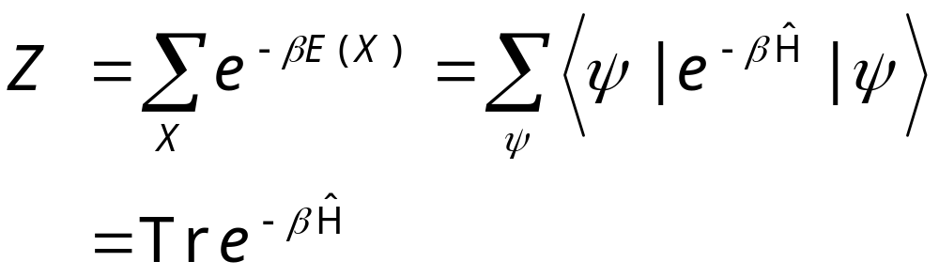
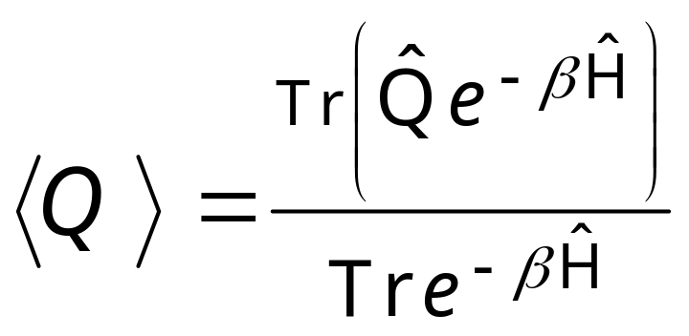
Quantum System at Finite Temperature
Partition function
Expectation value
Notes:
Note that trace Tr is invariant with respect to the set of complete states.

Slide 18
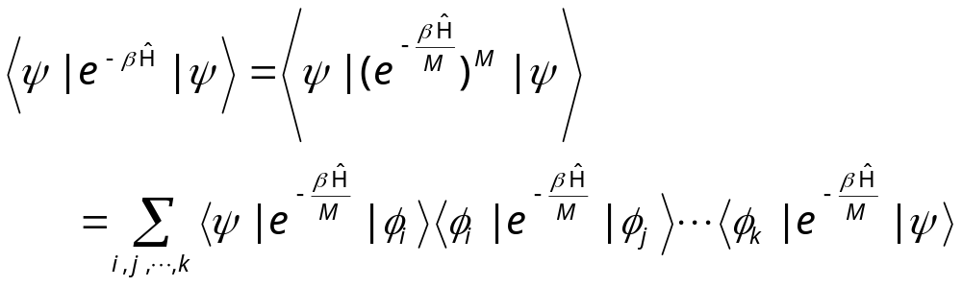
D-Dimensional Quantum System to D+1 Dimensional Classical system
Φ_{i} is a complete set of wave-functions
Notes:
We can consider this as β is divided into small interval of length β/M. Each term is a transfer matrix.

Slide 19
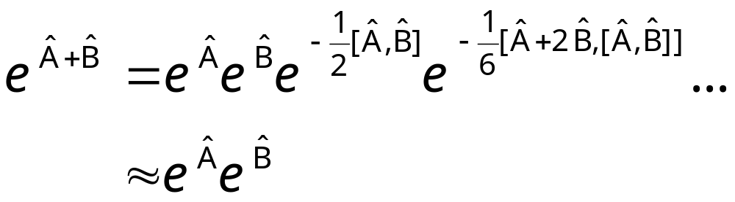
Zassenhaus formula
If the operators Â and Bˆ are order 1/M, the error of the approximation is of order O(1/M²).
Notes:
Actually, the top formula is known as Zassenhaus formula and another similar for exp(A)exp(B) is called Baker-Campbell-Hausdorff formula. The Trotter-Suzuki formula refers to the limit M -> ∞.

Slide 20
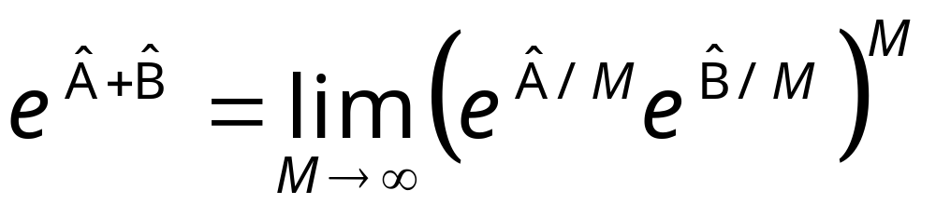
Trotter-Suzuki Formula
where Â and Bˆ are non-commuting operators

Slide 21
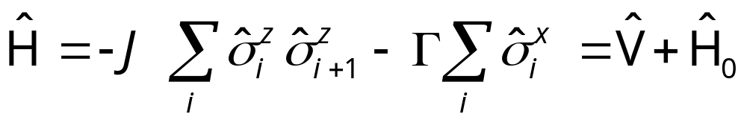
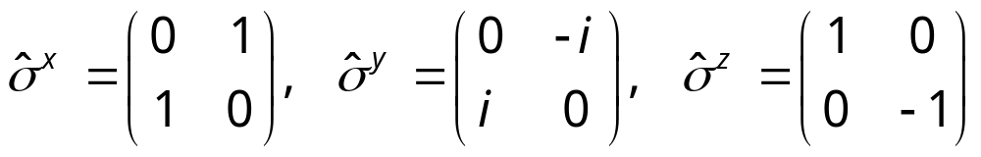
Quantum Ising Chain in Transverse Field
Hamiltonian
where
Pauli matrices at different sites commute.
Notes:
See B. K. Chakrabarti, A. Dutta and P. Sen, “Quantum Ising phase and transitions in transverse Ising models”, Springer, 1996.

Slide 22
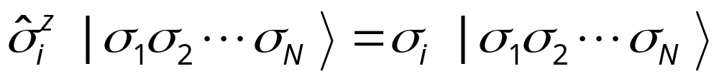
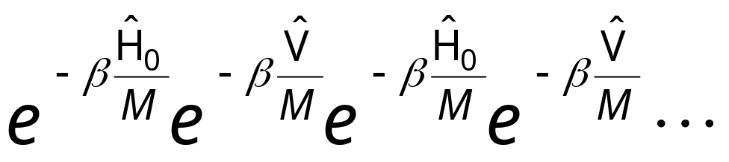
Complete Set of States
We choose the eigenstates of operator σ^{z}:
Insert the complete set in the products:

Slide 23
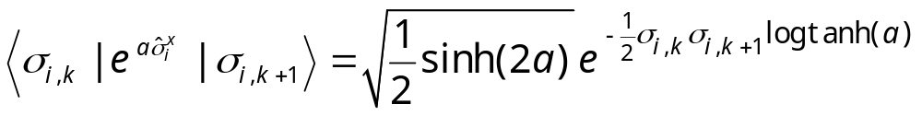
A Typical Term
Trotter or β direction
(i,k)
Space direction

Slide 24
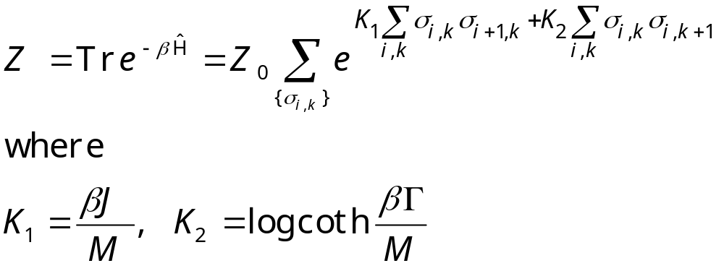
Classical Partition Function
Note that K₁ ∝1/M, K₂ ∝ log M for large M.

Slide 25
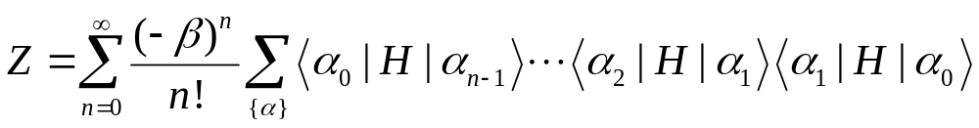
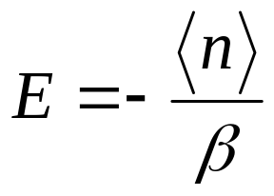
Stochastic Series Expansion (SSE)
Base on the simple idea of series expansion for the partition
Works for models when weights can be made positive.
Notes:
See Sandvik, arxiv:1101.3281.

Slide 26
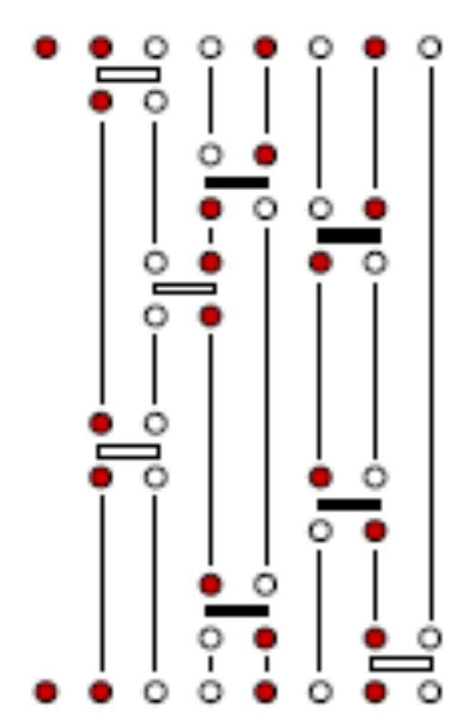
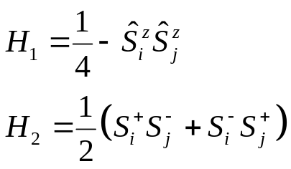
Spin ½ Heisenberg Model, “World Lines”
H_{b} = I + H₁ + H₂, open bar indicates diagonal part of the Hamiltonian H₁, solid bar off-diagonal Hamiltonian H₂, flipping the spins. Red dot - spin up, open dot - down spin.
“time” or β
“space”
Notes:
Figure 55 in Sandivk, arXiv:1101.3281

