Slide 1
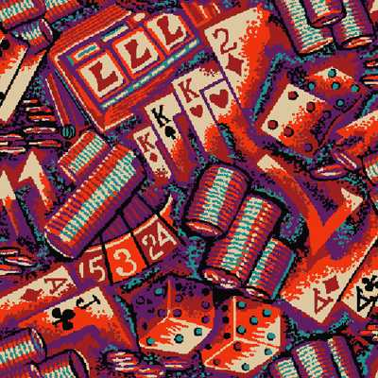
11. Cluster Algorithms

Slide 2
Percolation Model
Each pair of nearest neighbor sites is occupied by a bond with probability p. The probability of the configuration X is
p^{b} (1-p)^{N-b}.
b is number of occupied bonds, N is total number of bonds
Notes:
See D Stauffer, “Introduction to Percolation Theory”, for more information.

Slide 3
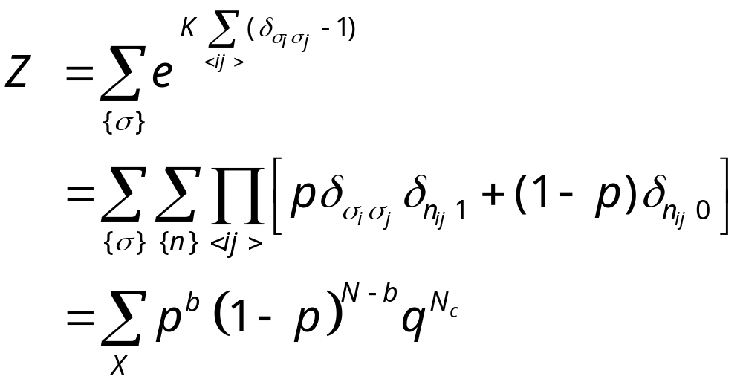
Fortuin-Kasteleyn Mapping
where K = J/(k_{B}T), p =1-e^{-K}, and q is number of Potts states, N_{c} is number of clusters.
Notes:
For Potts models, see F. Wu, Rev. Mod. Phys. 54 (1982) 235.

Slide 4
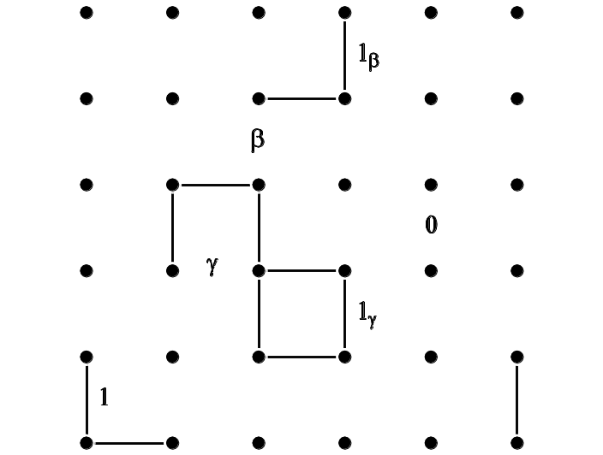
Sweeny Algorithm (1983)
“Flip” rates:
w(· ->1_{γ}) = p
w(· -> γ) = 1 – p
w(· -> 1_{β}) = p/( (1-p)q +p )
w(· -> β) = (1-p)q/( (1-p)q + p )
P(X) ∝ ( p/(1-p) )^{b} q^{Nc}
Notes:
Sweeny algorithm is a heat-bath algorithm in the bond percolation representation of the Potts model.
F Gliozzi, Phys Rev E 66 (2002) 016115, proposed a similar rates.

Slide 5
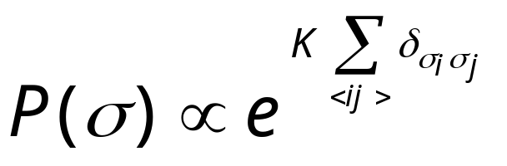
Swendsen-Wang Algorithm
+
-
-
+
-
+
-
-
-
-
-
An arbitrary Ising configuration according to
+
+
+
+
+
+
+
-
+
-
-
+
-
+
+
-
+
+
-
-
+
-
-
-
-
+
+
-
-
+
+
+
+
-
+
-
-
-
Notes:
For a review, see R. H. Swendsen, J.-S. Wang and A. M. Ferrenberg, in “The Monte Carlo Method in Condensed Matter Physics”, K Binder, ed, Springer 1992. For a complete working program on Swenden-Wang, as well as Sweeny and Gliozzi, see the C program sw-oner-gg.c. The Fortran program sw2d.f was used mainly for timing computers.

Slide 6
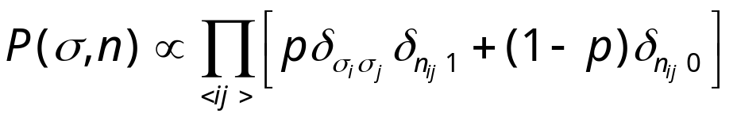
Swendsen-Wang Algorithm
+
-
-
+
-
+
-
-
-
-
-
Put a bond with probability p = 1-e^{-K}, if σ_{i} = σ_{j}
No bond if σ_{i} ≠ σ_{j}
+
+
+
+
+
+
+
-
+
-
-
+
-
+
+
-
+
+
-
-
+
-
-
-
-
+
+
-
-
+
+
+
+
-
+
-
-
-
Notes:
Note that there is a factor of 2 difference between Ising Hamiltonian –JΣσ_{i}σ_{j} and Potts Hamiltonian –JΣδ(σ_{i},σ_{j}). Thus p = 1 –exp(-2J/(kT)) in standard Ising model, but p = 1 – exp(-K) for Potts model.

Slide 7
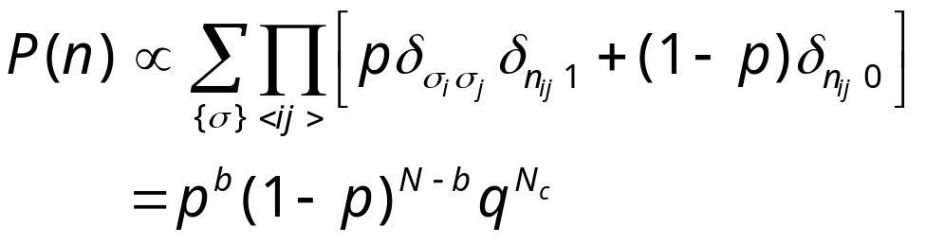
Swendsen-Wang Algorithm
Erase the spins

Slide 8
Swendsen-Wang Algorithm
-
+
-
-
-
-
+
Assign new spin for each cluster at random. Isolated single site is considered a cluster.
-
+
-
-
+
+
+
+
-
-
+
-
-
+
+
+
-
+
+
-
+
+
-
-
-
+
-
-
-
+
+
-
+
-
-
+
+
-
+
+
-
-
Go back to P(σ,n) again.
Notes:
If a magnetic field is present, the probability of new spins will be based on the field energy.

Slide 9
Swendsen-Wang Algorithm
-
+
-
-
-
-
+
Erase bonds to finish one sweep.
-
+
-
-
+
+
+
+
-
-
+
-
-
+
+
+
-
+
+
-
+
+
-
-
-
+
-
-
-
+
+
-
+
-
-
+
+
-
+
+
-
-
Go back to P(σ) again.

Slide 10
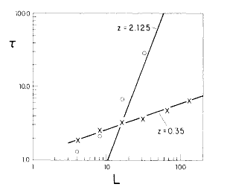
Much Reduced Critical Slowing Down
Comparison of correlation times of Swendsen-Wang with single-spin flip at T_{c} for 2D Ising model
From R H Swendsen and J S Wang, Phys Rev Lett 58 (1987) 86.

Slide 11
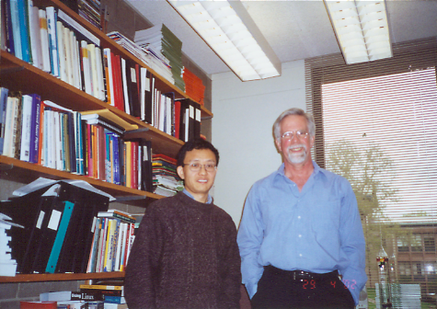
Robert H Swendsen and Jian-Sheng Wang in 2002

Slide 12
Wolff Single-Cluster Algorithm
void flip(int i, int s0)
{
int j, nn[Z];
s[i] = - s0;
neighbor(i,nn);
for(j = 0; j < Z; ++j) {
if(s0 == s[nn[j]] && drand48() < p)
flip(nn[j], s0);
}
Notes:
Wolff cluster algorithm grows a cluster on the spins of same sign with probability p. Wolff also generalizes to the case of continuum symmetry, e.g., for XY (classical rotor) model. See, Phys Rev Lett, 62 (1989) 361. A complete program is in the file Wolff.c.

Slide 13
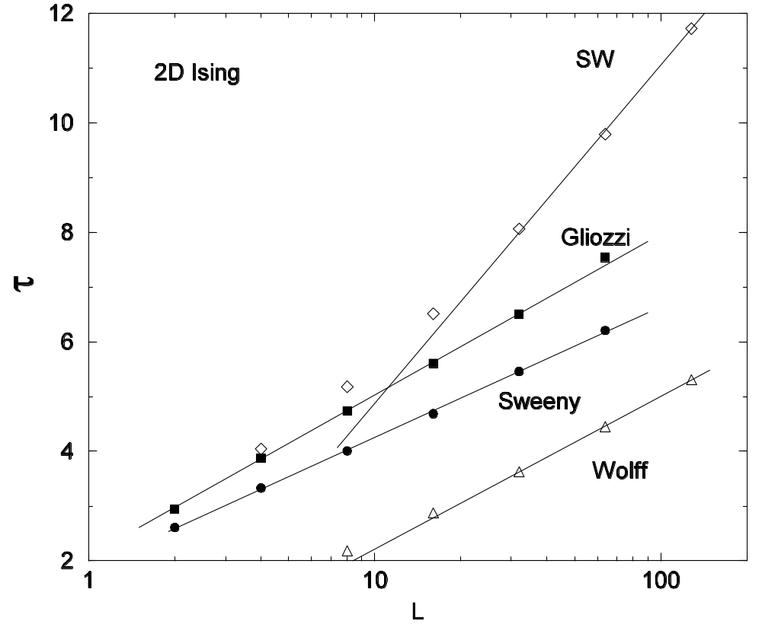
Comparison of integrated autocorrelation times at T_{c} for 2D Ising model.
J.-S. Wang, O. Kozan, and R. H. Swendsen, Phys Rev E 66 (2002) 057101.

Slide 14

Peierls’ Contour
-
-
+
+
+
-
The bonds in Ising model is nothing but the Peierls’ contours separating + spin domains from – spin domains. The weight of the configuration is
-
-
-
+
+
-
+
+
-
-
-
-
+
-
+
+
+
-
+
+
-
-
-
-
+
+
-
-
+
-
b_{ij} =1 if there is a bond, 0 if not.

Slide 15
Worm Algorithms
Worm algorithms were first proposed for quantum systems and classical ferro-magnetic systems:
  Prokof’ev and Svistunov, PRL 87 (2001) 160601
  Alet and Sørensen, PRE 67, 015701 (2003)

Slide 16
Worm Algorithm for
2D Ising/Spin-Glass
Pick a site i₀ at random. Set i = i₀
Pick a nearest neighbor j with equal probability, move it there with probability w^{1-b}_{ij}. If accepted, flip the bond variable b_{ij} (1 to 0, 0 to 1). i = j.
If i = i₀ and winding numbers are even, exit, else go to step 2.
See, J-S Wang, PRE 72 (2005) 036706

Slide 17
The Loop
b=1
b=1
b=0
b=0
i₀
i₀
Erase a bond with probability 1, create a bond with probability w = exp[-2J/(kT)].

Slide 18
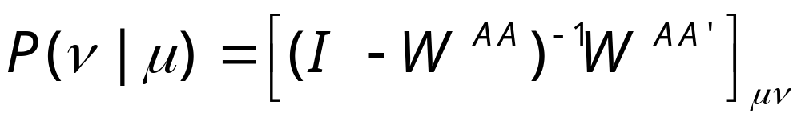
N-fold Way Acceleration
Sample an n-step move with exit probability:
where A is a set of states reachable in n-1 steps of move. A’ is complement of A. W is associated transition matrix.

Slide 19
General Formulation
Let S be spin configuration and G a graph configuration
Partition function Z = Σ_{S}W(S)
Introduce W(S,G) such that
Σ_{G}W(S,G) = W(S), W(S,G) ≥ 0
This generalizes Fortuin-Kasteleyn mapping:
Z = Σ_{S} Σ_{G}W(S,G)
Notes:
Due to Kandel, Domany, as well as Kawashima et al. The graph G can be interpreted as a mapping from current state to a new state (on a group of sites, such as bond or plaquette).

Slide 20
General Cluster Algorithm
Given a configuration S, choose graph G with probability
w[S->(S,G)] = W(S,G)/W(S)
Given S and G, make a move for S such that w[(S,G)->(S ’,G)] satisfies detailed balance with respect to W(S,G).

Slide 21
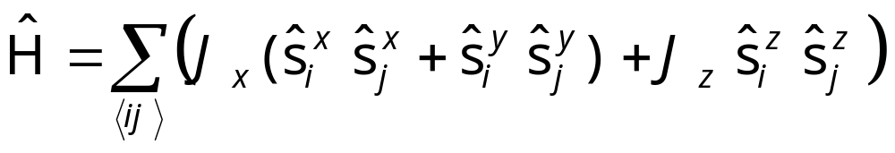
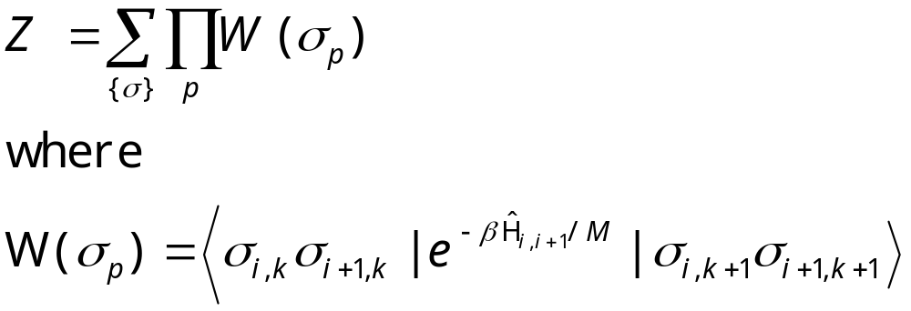
Example of Quantum nonlocal algorithms
XXZ quantum spin ½ chain
Apply Trotter-Suzuki formula to break H into even and odd sites, we get
Notes:
s^{z} ⁼σħ/2.

Slide 22
Worldline and Vertex
+
imaginary time
+
+
+
+
-
+
+
-
+
space
6-vertex model
W(++,++) = a = exp(-ΔτJ_{z}/4)
W(+-,-+) = b = exp(+ΔτJ_{z}/4) sinh(Δτ|J_{x}|/2)
W(+-,+-) = c = exp(+ΔτJ_{z}/4) cosh(Δτ|J_{x}|/2)
Notes:
The mapping from worldline to vertex is one-to-one, + spin gives up arrow, - spin maps to down arrow (on the shadowed plaquettes only).

Slide 23
Loop Algorithm
Given a state at a plaquette
We consider forming graphs
We decide which graph to realize with some weight w_{ij.}
Notes:
See H. G. Evertz, “The loop algorithm”, Advances in Physics, 52(1), (2003) 1 for an excellent recent review.

Slide 24
Choice of Weights
Let i = 1, 2, …, be states with distinct plaquette weight w(S_{p})
We index a graph by G^{ij} if it is generated by current state i and flip of the spins/arrows leads to state j. Let the weight of the graph be w^{ij}. The graph is choosing with probability w^{ij}/w(i).
Then we must find w^{ij} = w^{ji} such that
Σ_{j} w^{ij =} w(i), w^{ij} ≥ 0, and w^{ii} is minimized

Slide 25
Example for Anti-ferromagnetic Model
When J_{z} ≥ |J_{x}|, the optimal choice is
w¹²=w¹² = a (vertical breakup)
w²³ = w³² = b (horizontal breakup)
w²² = c – a – b (freezing opposite spins)
The rest of w^{ij} = 0. The states are:
+
+
+
-
-
+
+
+
+
-
+
-
1
2
3
Notes:
The choice for efficient algorithm depends on the model parameters. For other models, see Evertz’s review article.

