Slide 1

12. Reweighting Methods

Slide 2
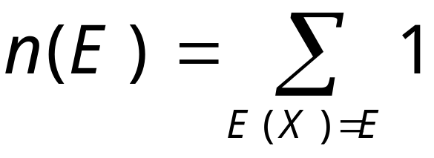
Density of States
We define density of states n(E) as the number of (microscopic) states with energy E, assuming discrete energy levels.

Slide 3
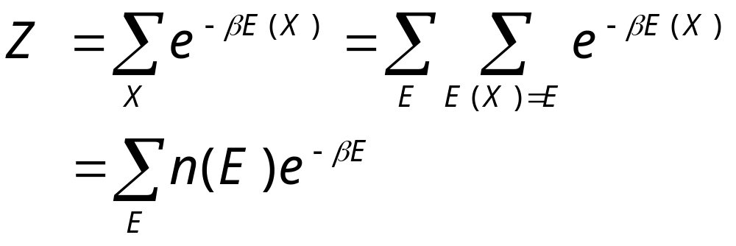
Partition Function in n(E)
We can express partition function in terms of density of states:
Thus if n(E) is calculated, we effectively solved the statistical-mechanics problem.

Slide 4
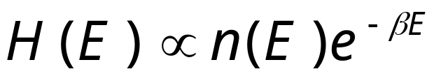
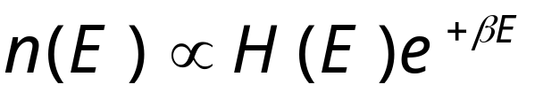
Ferrenberg-Swendsen Histogram Reweighting
Do a canonical ensemble simulation at temperature T=1/(k_{B}β), and collect energy histogram, i.e., the counts of occurrence of energy E.
Thus, density of states can be determined up to a constant:
Notes:
What is the proportionality constant? If the Hamiltonian is the form S + hM, we can also consider joint histogram H(S,M) and reweight both in T and h.

Slide 5
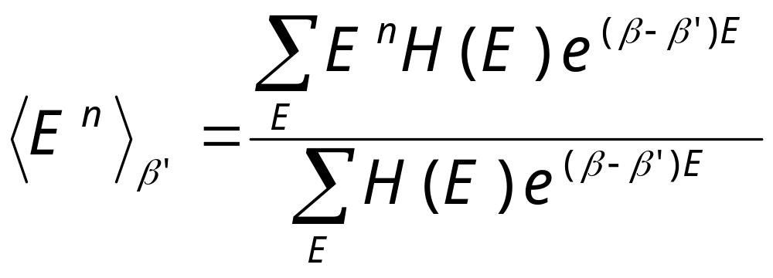
Calculate Moments of Energy
From the density of states, we can calculate moments of energy at any other temperature,
Notes:
The unknown constant (M/Z) is not needed, as it cancels from numerator and denominator in the above formula. Any other quantities Q(X) can also be calculated, if we take histogram of Q as a function of E as well.

Slide 6
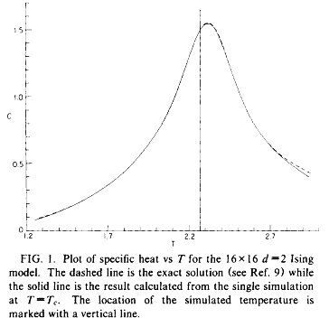
Reweighting Result
Result from a single simulation of 2D Ising model at T_{c}, extrapolated to other temperatures by reweighting
From Ferrenberg and Swendsen, Phys Rev Lett 61 (1988) 2635.

Slide 7
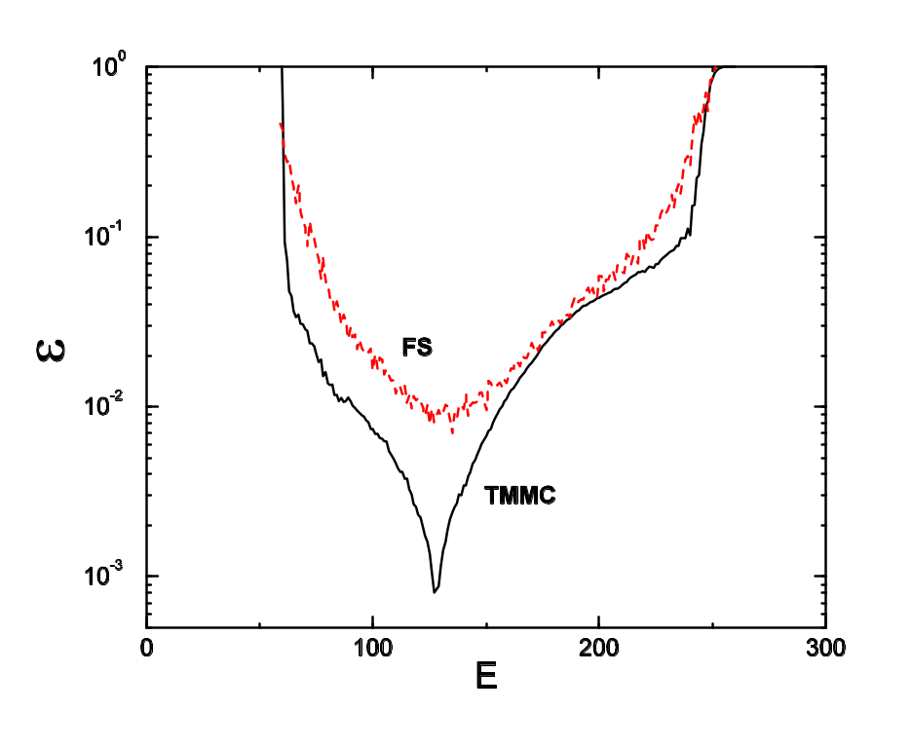
Range of Validity of n(E)
Relative error of density of states |n_{MC}/n_{exact}-1| from Ferrenberg-Swendsen method and transition matrix Monte Carlo, 2D 32×32 Ising at T_{c}.
From J S Wang and R H Swendsen, J Stat Phys 106 (2002) 245.
Red curve marked FS is from Ferrenberg-Swendsen method

Slide 8
Multiple Histogram Method
Conduct several simulations at different temperatures T_{i}
How to combine histogram results H_{i}(E) properly at different temperatures?
Notes:
See A. M. Ferrenberg and R. H. Swendsen, Phy Rev Lett 63 (1989) 1195.

Slide 9
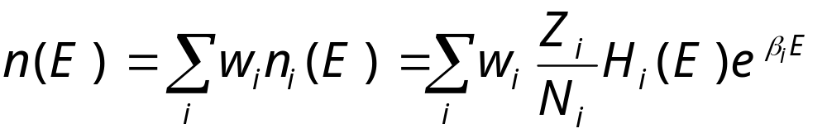
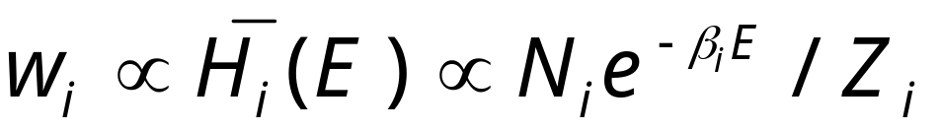
Minimize error at each E
We do a weighted average from M simulations
The optimal weight is
Where the proportionality constant is fixed by normalization Σw_{i} = 1, and Z_{i}= Σ_{E} n(E) exp(-β_{i}E)
Notes:
N_{i} is the length (number of histogram samples) of i-th run, and Z_{i} is the partition function at temperature T_{i}. H_{i} with bar denotes the average of histogram of fixed length N_{i} over (infinitely) many runs. See M. E. J. Newman & G. T. Barkema, “Monte Carlo Methods in Statical Physics”, sec.8.2, for a derivation.

Slide 10
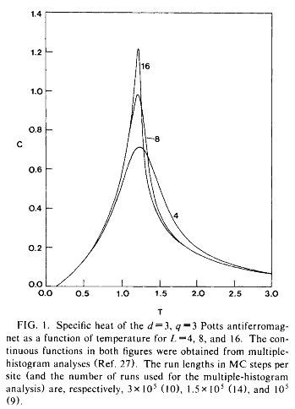
Multiple Histogram Example
Multiple histogram calculation of the specific heat of the 3D three-state anti-ferromagnetic Potts model, using a cluster algorithm.
From J S Wang, R H Swendsen, and R Kotecký, Phys Rev Lett 63 (1989) 109.

