Slide 1

13. Extended Ensemble Methods
Notes:
For a review of extended ensemble methods, see Y. Iba, Internal J Mod Phys C 12 (2001) 623.

Slide 2
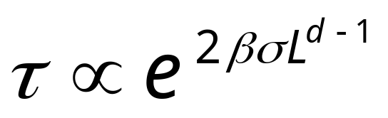
Slow Dynamics at First-Order Phase Transition
At first-order phase transition, the longest time scale is controlled by the interface barrier
where β=1/(k_{B}T), σ is interface free energy, d is dimension, L is linear size
Notes:
The multi-canonical ensemble simulation due to Berg et al overcomes this problem.

Slide 3
Multi-Canonical Ensemble
We define multi-canonical ensemble as such that the (exact) energy histogram is a constant
h(E) = n(E) f(E) = const
This implies that the probability of configuration is
P(X) ∝ f(E(X)) ∝ 1/n(E(X))
Notes:
This concept was first introduced by B. Berg. Such ensemble do not correspond to real physical systems. It is used as a simulation device to reconstruct the original canonical ensemble. Compare, micro-canonical, P(X) = const for all states with fixed E(X)=E, canonical P(X) = exp(-E(X)/(k_{B}T))/Z.

Slide 4
Multi-Canonical Simulation
Do simulation with probability weight f_{n}(E), using Metropolis algorithm acceptance rate min[1, f_{n}(E’)/f_{n}(E) ]
Collection histogram H(E)
Re-compute weight by
f_{n+1}(E) = f_{n}(E)/H(E)
Iterate until H(E) is flat
Notes:
This method is due to B. A. Berg and T. Neuhaus, Phys Rev Lett 68 (1992) 9. For a review, see B. A. Berg, Field Institute Communication 26 (2000) 1. Determine new weight f_{n+1} from the simulation data and old weight f_{n} can be complicated for a stable algorithm. The problem is that what to do if there is no sample, H(E) = 0 for some E. The above is an over-simplification.

Slide 5
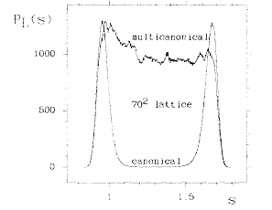
Multi-Canonical Simulation and Reweighting
Multicanonical histogram and reweighted canonical distribution for 2D 10-state Potts model
From A B Berg and T Neuhaus, Phys Rev Lett 68 (1992) 9.
Notes:
Interfacial free energy can be determined very accurately by this method.

Slide 6
Simulated Tempering
Simulated tempering treats parameters as dynamical variables, e.g., β jumps among a set of values β_{i.} We enlarge sample space as {X, β_{i}}, and make move {X,β_{i}} -> {X’,β’_{i}} according to the usual Metropolis rate.
Notes:
See E. Marinari and G. Parisi Europhys Lett 19 (1992) 451.

Slide 7
Probability Distribution
Simulated tempering samples
P(X,i) ∝ exp(-β_{i}E(X) + F_{i})
Adjust F_{i} so that p_{i} = Σ_{X}P(X,i) ≈ const
F_{i} is related to the free energy at temperature T_{i}.
Notes:
What is the exact relation between free energy and F_{i}? To get the property at fixed temperature T_{i}, we only collect data at i.

Slide 8
Temperature Jump Move
We propose a move β_{i} -> β_{i+1}, fixing X
Using Metropolis rate, we accept the move with probability
min[1, exp( -(β_{i+1}-β_{i})E(X) + (F_{i+1}-F_{i})) ]

Slide 9
Replica Monte Carlo
A collection of M systems at different temperatures is simulated in parallel, allowing exchange of information among the systems.
β₁
β₂
β₃
. . .
β_{M}
Notes:
Replica Monte Carlo [R. H. Swendsen and J.-S. Wang, Phys Rev Lett 57 (1986) 2607] is one of the earliest idea that simulates many systems in parallel for efficiency.

Slide 10
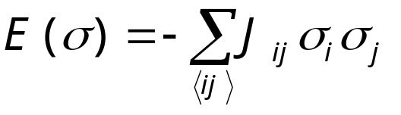
Spin Glass Model
+
-
-
+
-
+
-
-
+
-
+
+
-
-
+
+
+
+
-
+
-
A random interaction Ising model - two types of random, but fixed coupling constants (ferro J_{ij} > 0) and (anti-ferro J_{ij} < 0)
-
+
-
+
+
-
+
+
-
-
+
-
-
-
-
+
+
-
-
+
+
+
+
-
+
-
-
-
Notes:
See K. Binder and A. P. Young, Rev Mod Phys 58 (1986) 801, for a review.

Slide 11
Moves between Replicas
Consider two neighboring systems, σ¹ and σ², the joint distribution is
P(σ¹,σ²) ∝ exp[-β₁E(σ¹) –β₂E(σ²)]
= exp[-H_{pair}(σ¹, σ²)]
Any valid Monte Carlo move should preserve this distribution

Slide 12
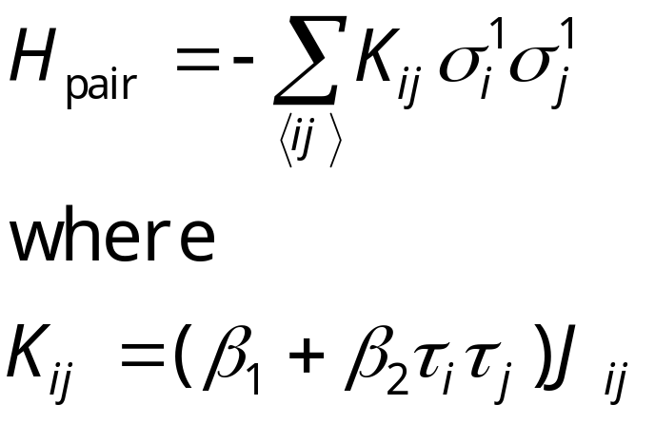
Pair Hamiltonian in Replica Monte Carlo
We define τ_{i}=σ_{i}¹σ_{i}², then H_{pair} can be rewritten as
The H_{pair} again is a spin glass. If β₁≈β₂, and two systems have consistent signs, the interaction is twice as strong; if they have opposite sign, the interaction is small.

Slide 13
Cluster Flip in Replica Monte Carlo
Clusters are defined by the values of τ_{i} of same sign, The effective Hamiltonian for clusters is
H_{cl} = - Σ k_{bc} s_{b}s_{c}
Where k_{bc} is the interaction strength between cluster b and c, k_{bc}= sum over boundary of cluster b and c of K_{ij}.
τ = +1
τ = -1
^{b}
^{c}
Metropolis algorithm is used to flip the clusters, i.e., σ_{i}¹ -> -σ_{i}¹, σ_{i}² -> -σ_{i}² fixing τ for all i in a given cluster.
Notes:
Before the cluster move, s_{b} = +1, for all clusters b. To ensure ergodicity, other single spin flips within a single system has to be used. Swendsen-Wang mapping can be used inside each tau cluster to produce non-interacting clusters as well.

Slide 14
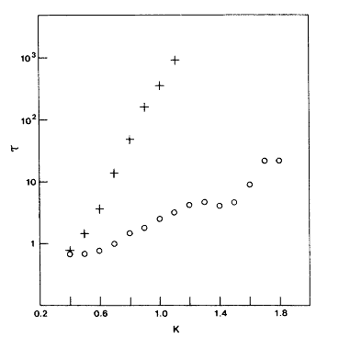
Comparing Correlation Times
Single spin flip
Correlation times as a function of inverse temperature β on 2D, ±J Ising spin glass of 32x32 lattice.
From R H Swendsen and J S Wang, Phys Rev Lett 57 (1986) 2607.
Replica MC
Notes:
A replica Monte Carlo program is in glassibm.for. It is a legacy code specially for the IBM 3083 computer.

Slide 15
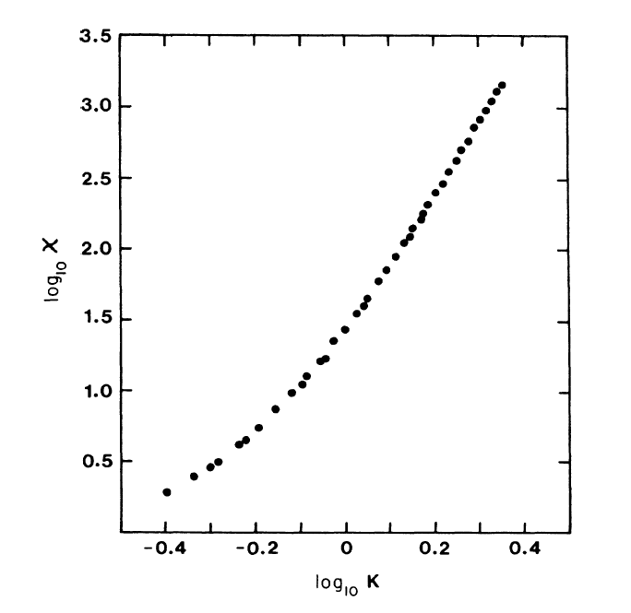
2D Spin Glass Susceptibility
2D +/-J spin glass susceptibility on 128x128 lattice, 1.8x10⁴ MC steps.
From J S Wang and R H Swendsen, PRB 38 (1988) 4840.
χ ∝ K^{5.11} was concluded.

Slide 16
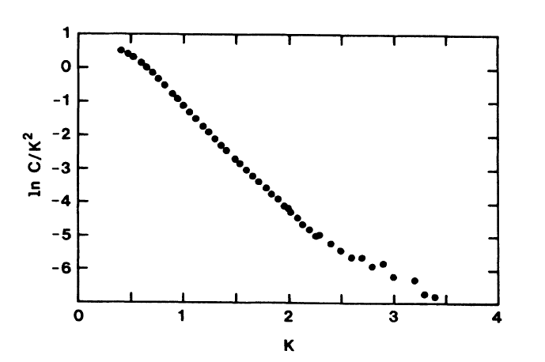
Heat Capacity at Low T
c ∝ T ²exp(-2J/T)
This result is confirmed recently by Lukic et al, PRL 92 (2004) 117202.
slope = -2

Slide 17
Replica Exchange (or Parallel Tempering)
A simple move of exchange configuration (or equivalently temperature) with Metropolis acceptance rate
σ¹ <-> σ²
The move is accepted with probability
min{ 1, exp[(β₂-β₁)(E(σ²)-E(σ¹))] }
Notes:
The replica exchange algorithm is due to K. Hukushima and Y. Nemoto, J Phys Soc Jpn 65 (1996) 1604. Replica exchange is equivalent a replica Monte Carlo move where all the tau=-1 clusters are flipped. In two dimensions, replica MC is much more efficient than replica exchange; in three and higher dimension, they are about the same.

Slide 18
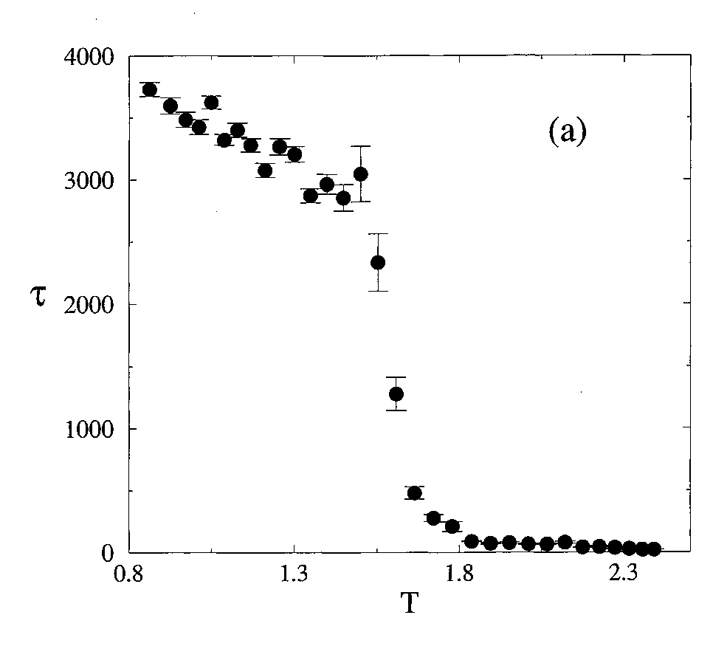
Replica Exchange
Spin-spin relaxation time for replica exchange MC on 12³ lattice.
From K Hukushima and K Nemoto, J Phys Soc Jpn, 65 (1996) 1604.
Notes:
The correlation times of single-spin flip for the same size would be of order 10⁶ MCS.

