Slide 1

14. TMMC, Flat-Histogram and Wang-Landau Method

Slide 2
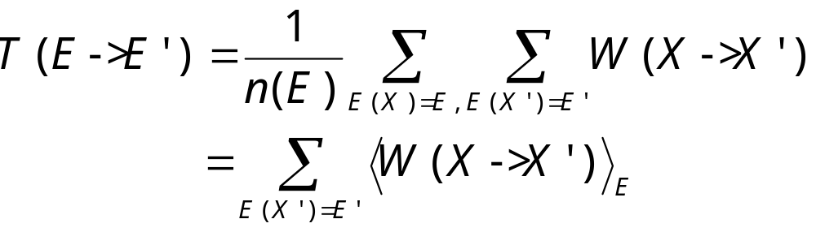
Transition Matrix
(in energy)
We define transition matrix
which has the property
h(E) T(E->E ’) = h(E ’) T(E ’->E)
h(E) is energy distribution or exact energy histogram.

Slide 3
Transition Matrix Monte Carlo
Compute T(E->E ’) with any valid MC algorithms that have micro-canonical property that configuration with “equal energy has equal probability”
Obtain h(E), or equivalently n(E) from energy detailed balance equation
Notes:
The transition matrix Monte Carlo was proposed in J.-S. Wang, T. K. Tay, and R. H. Swendsen, Phys Rev Lett 82 (1999) 476. See also, J.-S. Wang and R. H. Swendsen, J Stat Phys 106 (2002) 245.

Slide 4
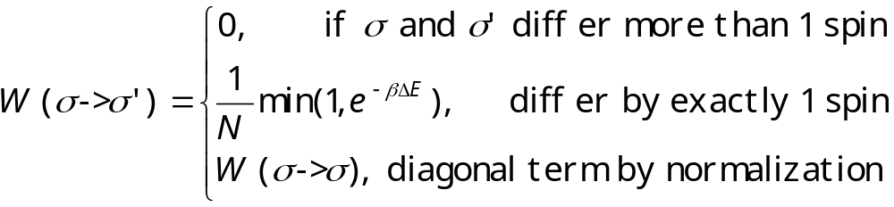
Example for Ising Model
Using single-spin-flip dynamics, the transition matrix W in spin configuration space is
N = L^{d} is the number of sites.
Notes:
The diagonal term is from Σ_{σ’} W(σ->σ’) = 1. The factor 1/N means we pick a site at random.

Slide 5
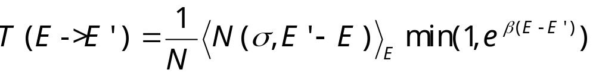
Transition Matrix for Ising model
where <N (σ,E ’-E )>_{E} is micro-canonical average of number of ways that the system goes to a state with energy E ’ given the current energy is E.

Slide 6
The Ising Model
ΔE=0
-
-
+
-
+
-
Total energy is
E(σ) = - J ∑_{<ij>} σ_{i} σ_{j}
sum over nearest neighbors, σ = ±1
N(σ,ΔE) is the number of sites, such that flip spin costs energy ΔE.
-
-
-
+
+
-
+
+
-
-
-
+
+
-
+
+
+
-
+
+
-
-
-
-
ΔE=-8J
+
+
-
-
+
-
σ = {σ₁, σ₂, …, σ_{i}, … }
Notes:
In 1925, physicist W. Lenz asked his student E. Ising to solve a statistical mechanics problem relevant to the magnetic properties of matter. Ising was able to solve it on a one-dimensional lattice. Almost twenty years were passed before L. Onsager found analytic solution to the two-dimensional version of the problem. The three-dimensional Ising model which is most relevant in the physical world has denied any serious attempt. Thus, any information we have is from approximations and numerical simulations.
Ising model and its generalizations are extremely important in our understanding of the properties of matter, especially the phenomena of phase transitions. Ising model is still actively used in various ways to model systems in condensed matter physics.

Slide 7
Broad Histogram Equation
n(E)<N(σ,E ’-E)>_{E} = n(E ’)<N(σ’,E-E ’)>_{E ’}
This equation is used to determine density of states
Notes:
This equation was first proposed by P. M. C de Oliveira et al, Braz J Phys 26 (1996) 677.

Slide 8
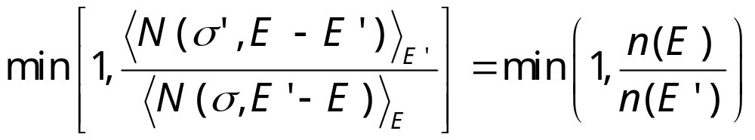
Flat Histogram Algorithm
Pick a site at random
Flip the spin with probability
Where E is current and E ’ is new energy
Accumulate statistics for <N(σ,E ’-E)>_{E}
Notes:
See J-S Wang, Eur Phys J B 8 (1999) 287. Since <N(σ, E’-E)>_{E} is both the quantity that we are going to collect statistics and input to the algorithm, we can not do it without approximation. In real simulation, we replace the exact micro-canonical average by running average.

Slide 9
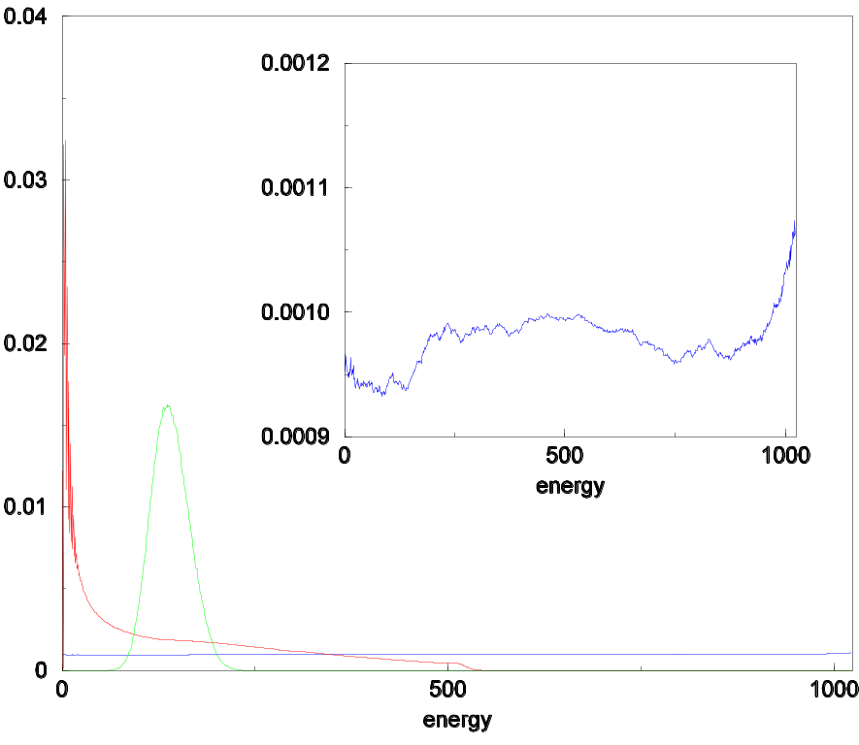
Histograms
Histograms for 2D Ising 32x32 with 10⁷ Monte Carlo steps. Insert is a blow-up of the flat-histogram.
From J-S Wang and L W Lee, Computer Phys Comm 127 (2000) 131.
Broad histogram
Flat-histogram
Canonical
Notes:
The program tmmc_n_conv.c was used to calculate and compare density of states n(E).

Slide 10
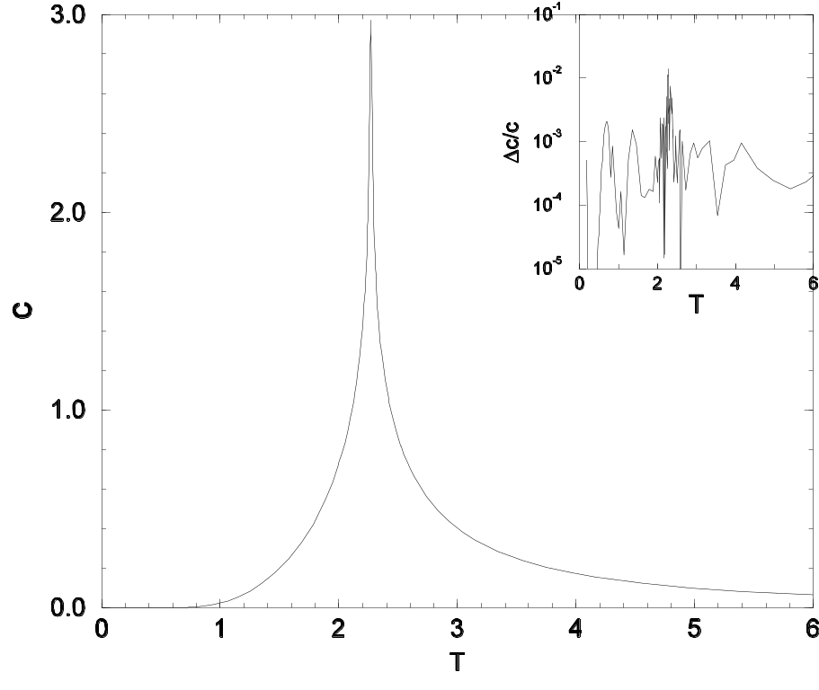
2D Ising Result
Specific heat of a 256x256 2D Ising model, using flat-histogram/multi-canonical method. Insert shows relative error.
From J-S Wang, “Monte Carlo and Quasi-Monte Carlo Methods 2000,” K-T Fang et al, eds.
Notes:
The Wang-Landau method was able to do similar calculations.

Slide 11
Wang-Landau Method
Work directly with n(E), starting with some initial guess, n(E) ≈ const, f = f₀ > 1 (say 2.7)
Flip a spin according to acceptance rate min[1, n(E)/n(E ’)]
And also update n(E) by
n(E) <- n(E) f
Reduce f by f <-f ^{1/2} after certain number of MC steps, when the histogram H(E) is “flat”.
Notes:
See F. Wang and D. P. Landau, Phys Rev Lett 86 (2001) 2050.

Slide 12
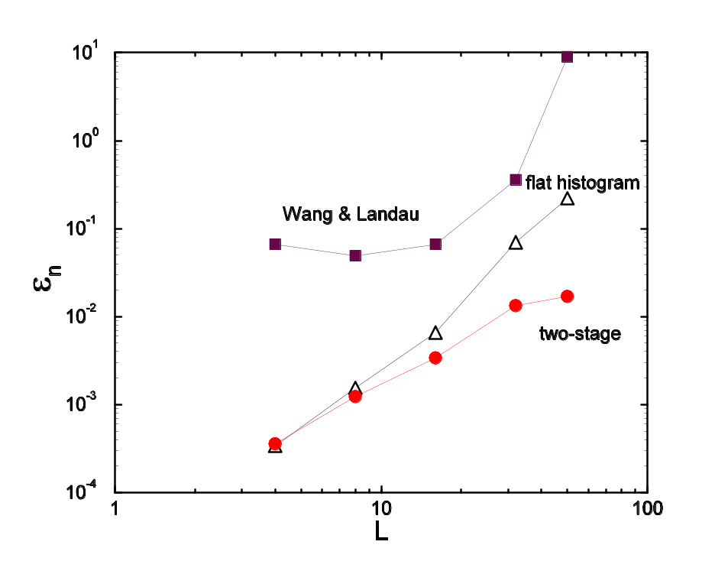
Comparison
Errors in 2D Ising density of states ε_{n} = (1/N)Σ|n(E)/n_{exact} (_{E})-1|. Two-stage is flat-histogram pass plus a multi-canonical pass, all have 10⁶ Monte Carlo sweeps.
From J S Wang and R H Swendsen, J Stat Phys 106 (2002) 245.

