Slide 1

5. Quasi-Monte Carlo Method
Notes:
For a complete and mathematical introduction to quasi-Monte Carlo method, see the book by H Niederreiter, “Random Number Generation and Quasi-Monte Carlo Methods”, SIAM, (1992).

Slide 2
Quasi-Monte Carlo
Using specially designed so-called low discrepancy sequences X₀, X₁, …, X_{N} in d dimensions
Fast convergence of (log N)^{d}/N
Applicable for relatively small dimension d (e.g., about 10)

Slide 3
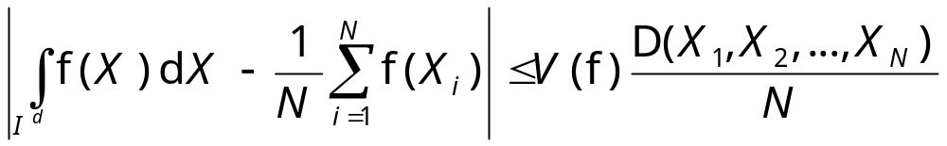
Koksma-Hlawka theorem
where the integral domain I^{d} is over an unit hypercube in d dimensions, V(f) is total variation of f, D(…) is discrepancy. Lower bound
D(X₀, X₁, …) > O( (log N)^{(d-1)/2}).

Slide 4
Discrepancy
D(X₁,X₂,…,X_{N}) = sup_{J}| A(J) – N V(J) |
here J is a subset ∏_{i=1}^{d}[0,y_{i}) of I^{d}, A(J) is the number of point X_{i} belonging to J. V(J) is the volume of J.
The discrepancy D(…) is the max difference between expected and exact numbers among all set J.
Notes:
Sup (supremum, also known as least upper bound) of a set S is the smallest y such that for every x in S, x <= y. The opposite is inf(imum).

Slide 5
Discrepancy, 2D example
(0,1)
D is the maximum difference between the number of points and their enclosing area times N in the rectangular area, for all possible shapes of rectangles starting at the lower left corner.
(0,0)
(1,0)

Slide 6
Low Discrepancy Sequence
In an infinite sequence, if the first N points satisfy
D(X₀, X₁, …., X_{N}) ≤ C_{d} (log N)^{d}
for every N, then it is called a low discrepancy sequence. C_{d} is some constant independent of N.
Notes:
What is D if X_{i} is completely random (uniformly distributed)?

Slide 7
Halton Sequence
n binary reverse decimal
0 00000 0.00000 0.000
1 00001 0.10000 0.500
2 00010 0.01000 0.250
3 00011 0.11000 0.750
4 00100 0.00100 0.125
00101 0.10100 0.625
00110 0.01100 0.375
00111 0.11100 0.875
…
Notes:
The Halton sequence can be constructed in any base b for b a prime number. For the n-th number, we take the base b representation of the n, n=∑_{r}a_{r}(n)b^{r-1}, and using this sequence (in reverse order) to construction a base b decimal number, ∑_{r} a_{r}(n) b^{-r}. For a d-dimensional point, we use d different bases for each of the dimensions.

Slide 8
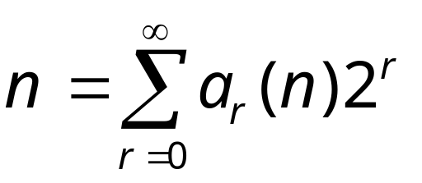
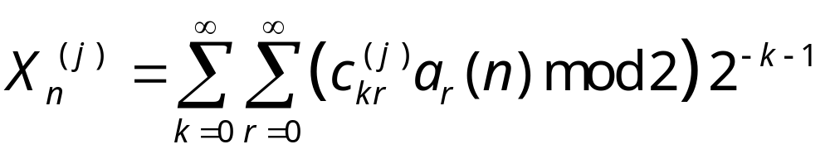
Generalized Faure Sequence
Write integer n =0, 1, 2, …, in its binary expansion:
The jth dimension of nth number is computed from
Notes:
We can use general base b ≥ 2 as well.

Slide 9
Generator Matrices
The matrices C^{(j)} defines the sequence. The Faure sequence is defined by taking
C^{(j)} = P^{j-1}
where [P]_{kr} = (k+r)!/(k! r!)

