Slide 1

9. Convergence and Monte Carlo Errors

Slide 2
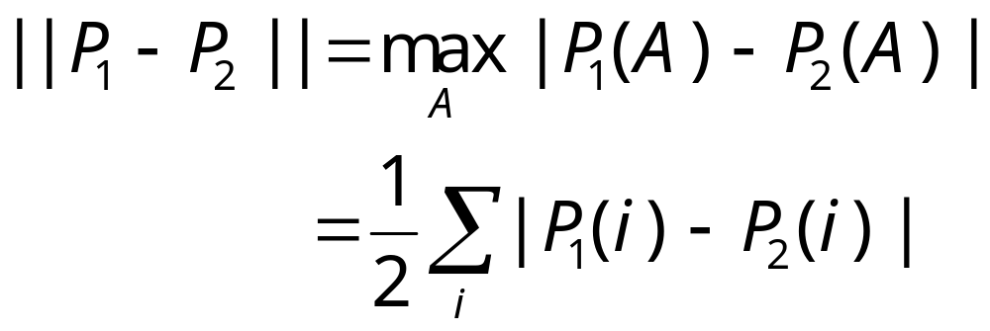
Measuring Convergence to Equilibrium
Variation distance
where P₁ and P₂ are two probability distributions, A is a set of states, i is a single state.
Notes:
For a more complete treatment of convergence of Markov chain see the book, D Aldous and J Fill, “Reversible Markov Chains and Random Walks on Graphs,” (unpublished) http://stat-www.berkeley.edu/users/aldous/RWG/book.html
Variation distance is just ½ of the L¹ norm. The concept of variation distance is most useful for analytical treatment of Markov chain.
Try to proof this!

Slide 3
Eigenvalue Problem
Consider the matrix S defined by
[S]_{ij} = p_{i}^{½} W(i->j) p_{j}^{-½}
then S is real and symmetric and eigenvalues of S satisfy
|λ_{n}| ≤ 1
One of the eigenvalue must be λ₀=1 with eigenvector p_{j}^{½}.
Notes:
P is such that P = P W, i.e., P is the equilibrium or stationary distribution. Thus P is a left eigenvector with eigenvalue 1.

Slide 4
Spectrum Decomposition
Then we have
U^{T}SU = Λ, or S = U Λ U^{T}
where Λ is a diagonal matrix with diagonal elements λ_{k} and U is orthonormal matrix, U U^{T} = I.
W can be expressed in U, P, and Λ as
W = P^{-½}UΛU^{T}P^{½}
Notes:
Note that P^{½} is defined as a diagonal matrix with elements p_{i}^{½}.

Slide 5
Evolution in terms of eigen-states
P_{n}= P₀W^{n}
= P₀ P^{-½}UΛU^{T}P^{½} P^{-½}UΛU^{T}P^{½}…
= P₀ P^{-½}UΛ^{n}U^{T}P^{½}
In component form, this means
P_{n}(j) = ∑_{i}P₀(i) p_{i}^{-½}p_{j}^{½}∑_{k}λ_{k}^{n} u_{ik}u_{jk}
Notes:
Sorry for the notations. P_{n} is a row vector, but P is diagonal matrix. States are labeled by integer indices, i, j, k.

Slide 6
Discussion
In the limit n goes to ∞,
P_{n}(j) ≈ ∑_{i}P₀(i) p_{i}^{-½}p_{j}^{½} u_{i0}u_{j0} = p_{j}
The leading correction to the limit is
P_{n}(j) ≈ p_{j} + a λ₁^{n} = p_{j} + a e^{-n/τ}
Notes:
Since the eigenvector corresponding to eigenvalue 1 is u_{j0}=p_{j}^{½}.

Slide 7
Exponential Correlation Time
We define τ by the next largest eigenvalue
τ = - 1/log λ₁
This number characterizes the theoretical rate of convergence in a Markov chain.

Slide 8
Measuring Error
Let Q_{t} be some quantity of interest at time step t, then sample average is
Q_{N} = (1/N) ∑_{t} Q_{t}
We treat Q_{N} as a random variable. By central limit theorem, Q_{N} is normal distributed with a mean <Q_{N}>=<Q> and variance σ_{N}² = <Q_{N}²>-<Q_{N}>².
<…> standards for average over the exact distribution.
Notes:
Normal distributed: i.e., Gaussian distribution with mean <Q> and variance. <Q> is the exact mean, and < … > can also be interpreted as average over infinite number of independent (equilibrated) Monte Carlo runs of length N each. Also note, Q_{N} is an unbiased estimator of
<Q>, that is <Q_{N}> = <Q>, but <Q_{N}²>-<Q_{N}>² is not an unbiased estimator of the true variance of Q_{N}. (But this point is unimportant when N is large). σ_{N} is the standard deviation.

Slide 9
Confidence Interval
The chance that the actual mean <Q> is in the interval
[ Q_{N} – σ_{N}, Q_{N} + σ_{N} ]
is about 68 percents.
σ_{N} cannot be computed (exactly) in a single MC run of length N.
Notes:
While 3σ_{N} would make the confidence to 99.9 percents. By definition, σ_{N} is an average over many runs of length N, thus cannot be estimated from a single run. But if we compute correlation time, it can be computed approximately in a single run of length N.

Slide 10
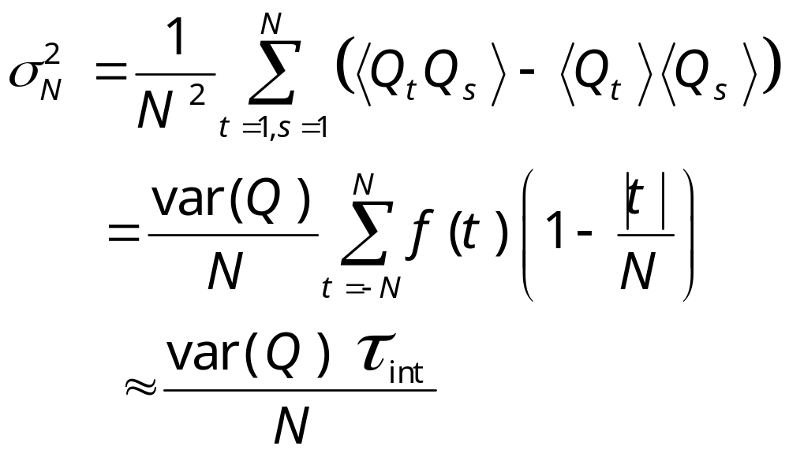
Estimating Variance
The calculation of var(Q) = <Q²>-<Q>² and τ_{int} can be done in a single run of length N.
Notes:
As long as τ_{int} << N. In deriving the equality, we used the fact that the Markov chain is already in equilibrium, so that the time-translational invariance is used, i.e., <Q_{t}Q_{s}> is a function of the difference |t-s| only. This formula was derived first by H Müler-Krumbhaar and K Binder, J Stat Phys 8 (1973) 1. The approximate sign ≈ is due to the fact that we omitted the |t|/N term and letting N goes to infinity in the definition of integrated correlation time τ_{int}, which is justified for τ_{int} << N.

Slide 11
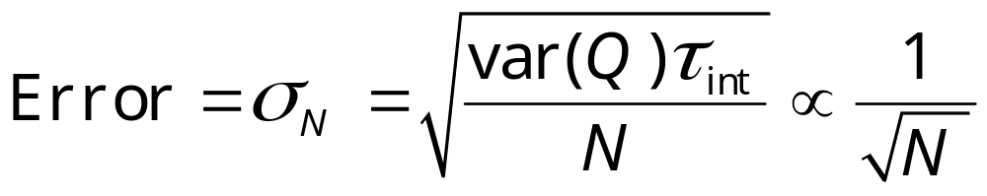
Error Formula
The above derivation gives the famous error estimate in Monte Carlo as:
where var(Q) = <Q²>-<Q>² can be estimated by sample variance of Q_{t}.
Notes:
I.e. var(Q) ≈ (1/N) ∑_{t}Q_{t}² - Q_{N}², that is, square average minus the average squared.

Slide 12
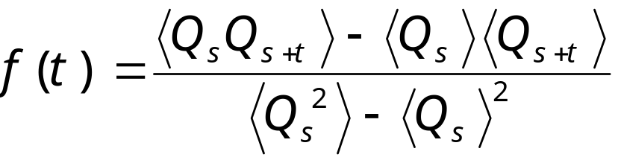
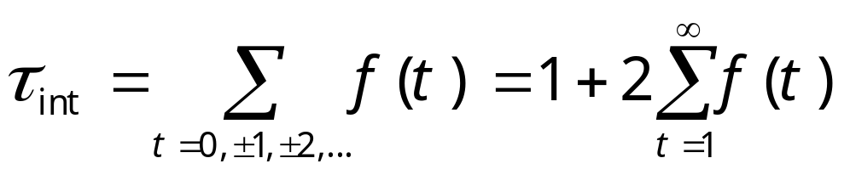
Time-Dependent Correlation function and integrated correlation time
We define
and
Notes:
Some people define the second term, ∑_{t=1}∞ f(t) as the integrated correlation time. We can call τ_{int} de-correlation time, as it is the number of steps needed to generate effectively independent sample. We can interpret the average < … > as over the history of a Markov chain (which requires the joint distribution of the chain from time s to s+t), or can be estimated from a simulation as average over time, i.e.,
<Q_{s}Q_{s+t}> ≈ (1/N) ∑_{s=1}^{N} Q_{s}Q_{s+t}.
What is τ_{int} for completely uncorrelated sample?

Slide 13
Circular Buffer for Calculating f(t)
We store the values of Q_{s} of the previous M-1 times and the current value Q_{t}
Q_{s}
Q_{t-1} Previous time t-1
Q_{t}, Current time t
Earliest time t-(M-1)
Notes:
We need to compute the product of the current value Q_{t} with earlier values Q_{s}.

Slide 14
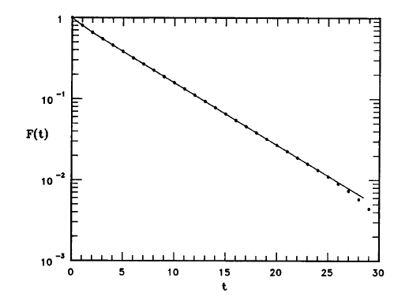
An Example of f(t)
Time-dependent correlation function for 3D Ising at T_{c} on a 16³ lattice; Swendsen-Wang dynamics.
From J S Wang, Physica A 164 (1990) 240.

Slide 15
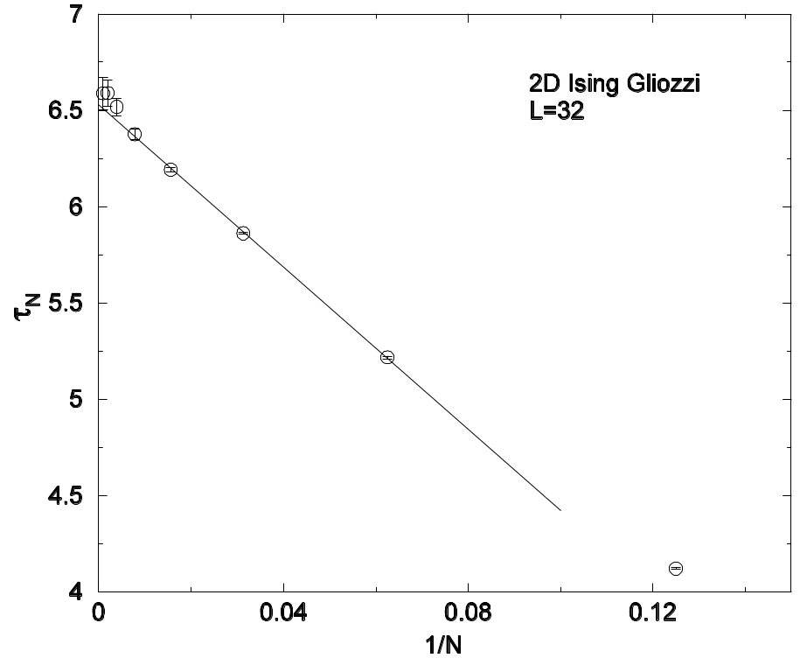
Efficient Method for Computing τ_{int}
We compute τ_{int} by the formula
τ_{int} = N σ_{N}²/var(Q)
For small value N and then extrapolating N to ∞.
From J S Wang, O Kozan and R H Swendsen, Phys Rev E 66 (2002) 057101.
Notes:
The τ_{int} computed is for the 2D Ising model with Gliozzi dynamics [F Gliozzi, Phys Rev E 66 (2002) 016115].

Slide 16
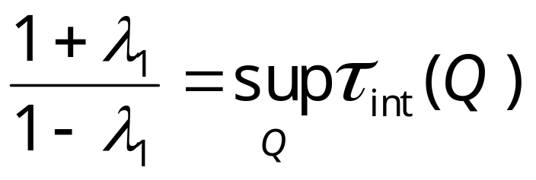
Exponential and integrated correlation times
where λ₁ < 1 is the second largest eigenvalue of W matrix. This result says that exponential correlation time τ (=-1/logλ₁) is related to the largest integrated correlation time.
Notes:
Remember that λ₀=1. The result is proved in D Aldous and J A Fill’s unpublished book, Chap 4 and Chap on MCMC. τ_{int}(Q) is the integrated correlation time for the quantity Q. Sup_{Q} means we search for all possible Qs and take the maximum.

Slide 17
Critical Slowing Down
τ
The correlation time becomes large near T_{c}. For a finite system τ(T_{c}) ∝ L^{z}, with dynamical critical exponent z ≈ 2 for local moves
T_{c}
T
Notes:
The figure is only schematic. z is about 2 for order parameter non-conserving dynamics and 4 for order parameter conserving dynamics. For first-order phase, τ diverges exponentially with size L.

Slide 18
Relaxation towards Equilibrium
Magnetization m
Schematic curves of relaxation of the total magnetization as a function of time. At T_{c} relaxation is slow, described by power law:
m ∝ t ^{-β/(zν)}
T < T_{c}
T = T_{c}
T > T_{c}
Time t
Notes:
See, e.g., N. Ito et al, J Phys Soc. Jpn, 69 (2000) 1931. See also B Zheng, Int. J. Mod. Phys B12 (1998) 1419 for short-time dynamics.
Figure is schematic. β is the magnetization exponent, ν is correlation length exponent, and z is dynamical critical exponent.

Slide 19
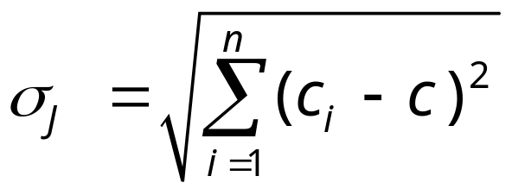
Jackknife Method
Let n be the number of independent samples
Let c be some estimate using all n samples
Let c_{i} be the same estimate but using n-1 samples, with i-th sample removed
Then Jackknife error estimate is
Notes:
How to get independent samples from correlated samples of Markov chain?
The advantage of Jackknife method is that the estimator c need not be an unbiased estimator, e.g., specific heat.
See, the book by B. Efron, “The Jackknife, the Bootstrap, and Other Resampling Plans” (1982).
See also M. E. J. Newman & G. T. Barkema, “Monte Carlo Methods in Statistical Physics”, sec.3.4.4. Other chapters are interesting to read.
Is the formula given above completely correct?

