Slide 1
Universal Behavior of
Critical Dynamics far from Equilibrium
Bo ZHENG
Physics Department, Zhejiang University
P. R. China

Slide 2
Contents
I Introduction
II Short-time dynamic scaling
III Applications
* second order transitions
* Kosterlitz-Thouless transitions
* disordered systems, spin glasses
* weak first-order phase transitions
IV Deterministic dynamics
V Concluding remarks

Slide 3
I Introduction
Many-body Systems
It is difficult to solve the Eqs. of motion
Statistical Physics
Equilibrium Ensemble theory
Non-equilibrium e .g. Langevin equations
Monte Carlo dynamics

Slide 4
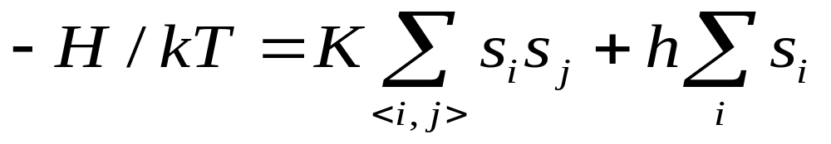
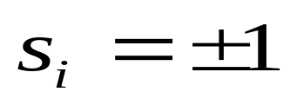
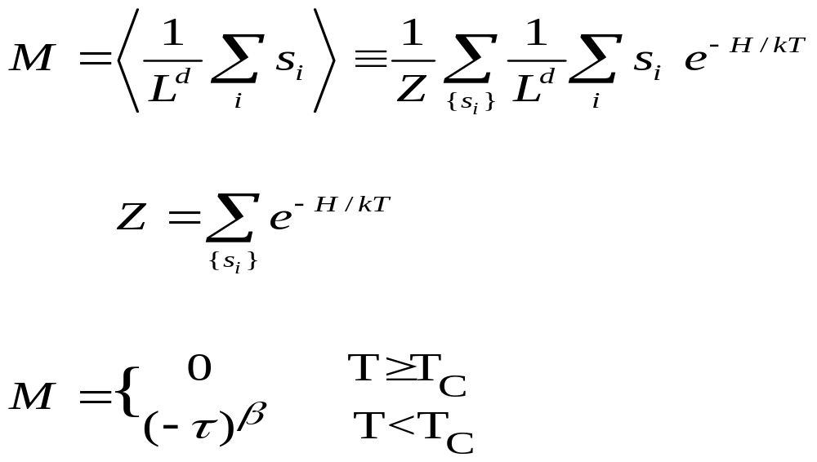

Ising model
M
Tc T

Slide 5
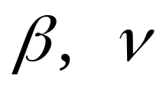
Features of second order transitions
* Scaling form
It represents self-similarity
are critical exponents
* Universality
Scaling functions and critical exponents
depend only on symmetry and spatial dim.
Physical origin
divergent correlation length, fluctuations

Slide 6
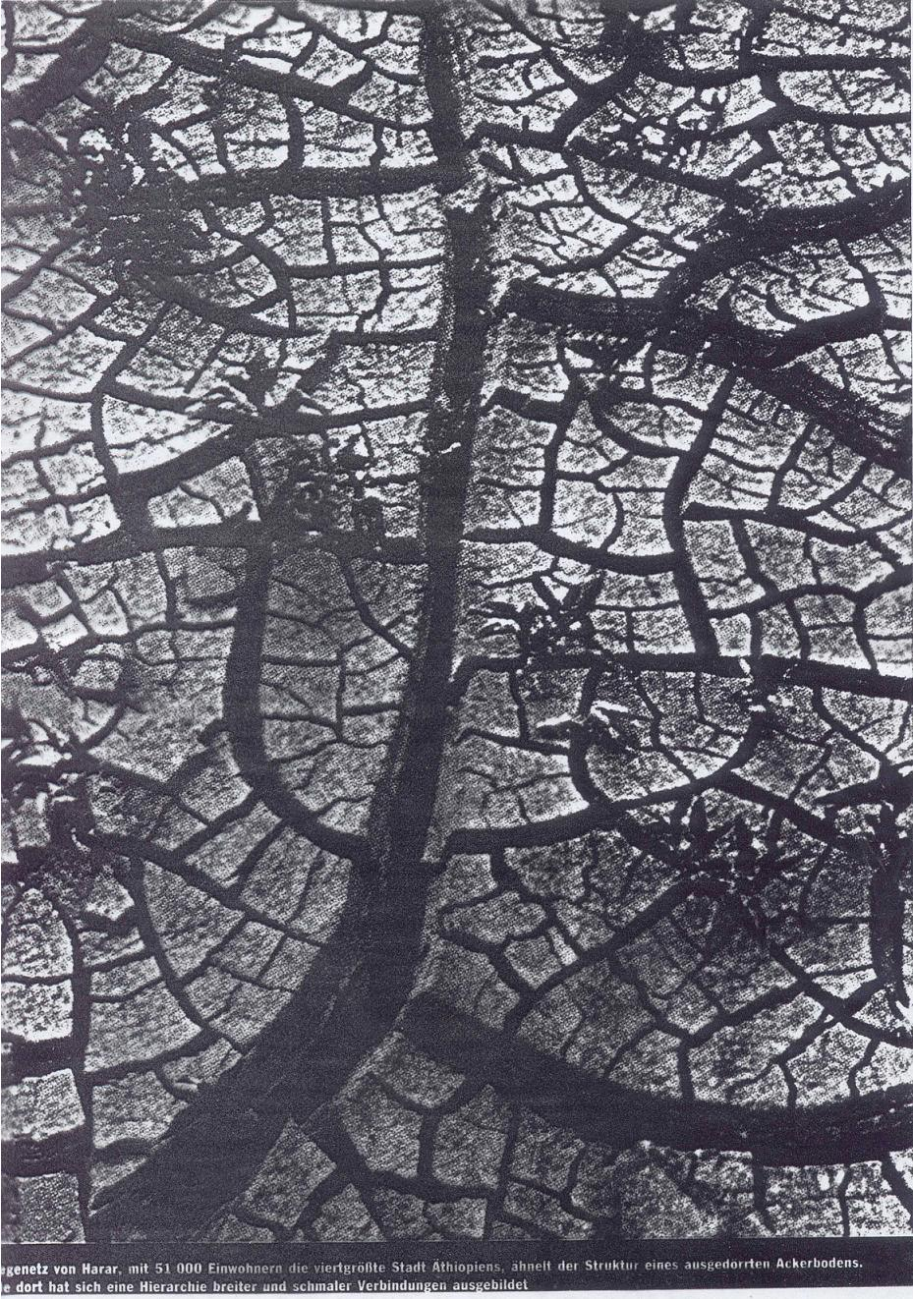
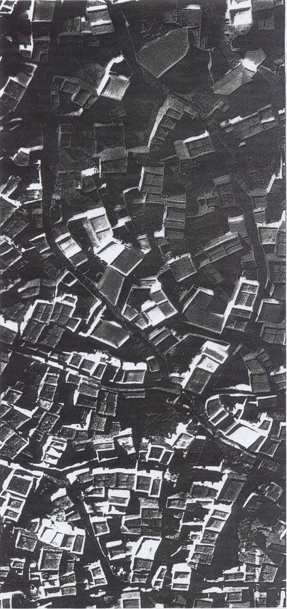

Slide 7
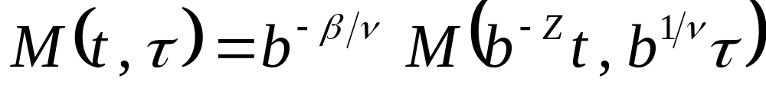
Dynamics
Dynamic scaling form
z : the dynamic exponent .. Landau PRB36(87)567
PRB43(91)6006
Condition: t sufficiently large
Origin : both correlation length and
correlating time are divergent

Slide 8
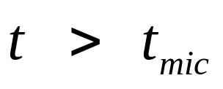
II Short-time dynamic scaling
Is there universal scaling behavior in
the short-time regime?
Recent answer: YES
Theory: renormalization group methods
Janssen, Z.Phys. B73(89)539
Experiments: spin glasses
“phase ordering” of KT systems …
Simulation: Ising model, Stauffer (92), Ito (93)
Important:
* macroscopic short time
* macroscopic initial conditions

Slide 9


Dynamic process far from equilibrium
e.g. t = 0 , T =
t > 0 , T = Tc
Langevin dynamics
Monte Carlo dynamics
Dynamic scaling form
: a “new” critical exponent
Origin: divergent correlating time

Slide 10
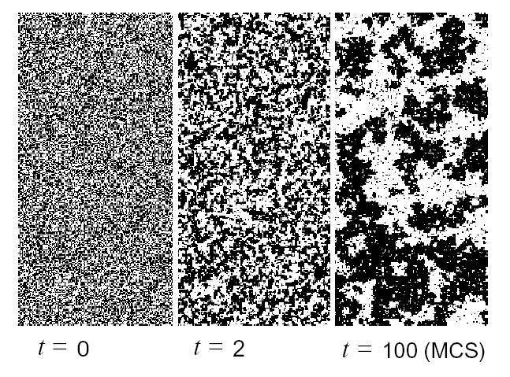
Self-similarity in time direction, Ising model

Slide 11
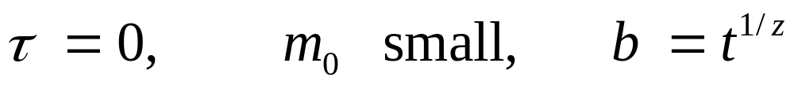
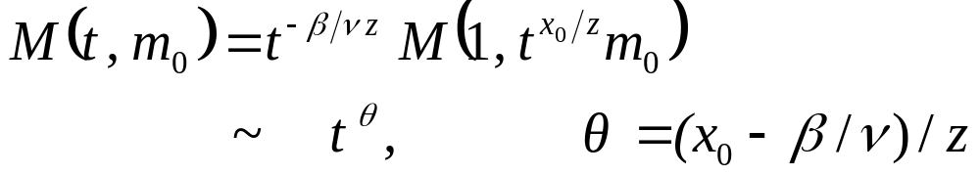


In most cases,
Initial increase of the magnetization! Janssen (89)
Zheng (98)
3D Ising model
 | .06 | .04 | .02 | .00
θ | .1014(5) | .1035(4) | .1059(20) | .108(2)
Grassberger (95), 0.104(3)

Slide 12
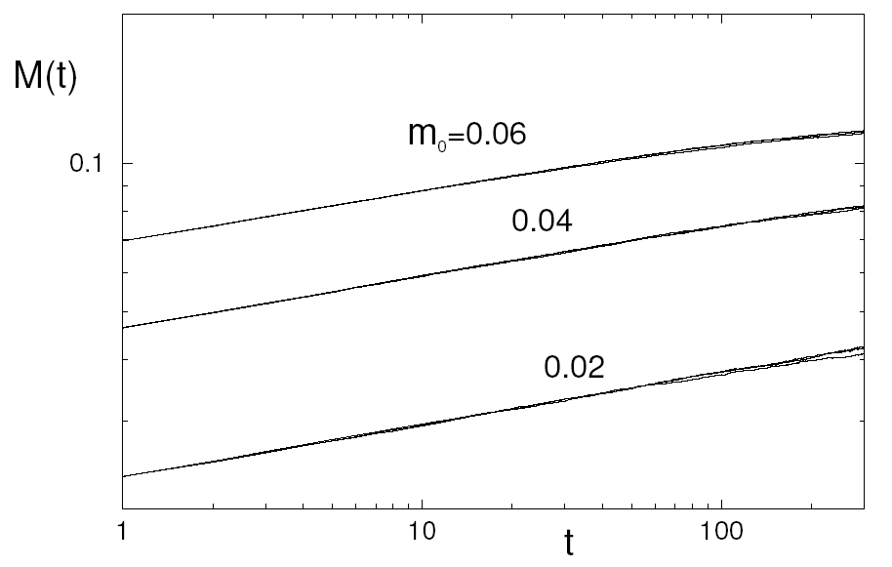
3D Ising Model

Slide 13
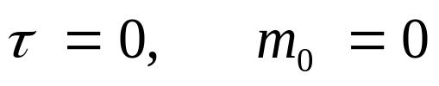
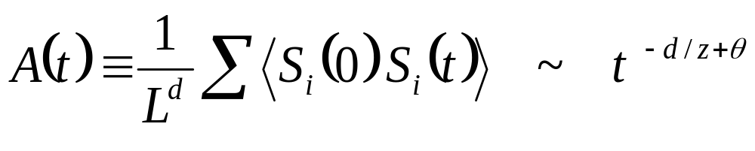
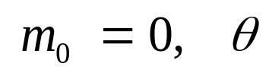
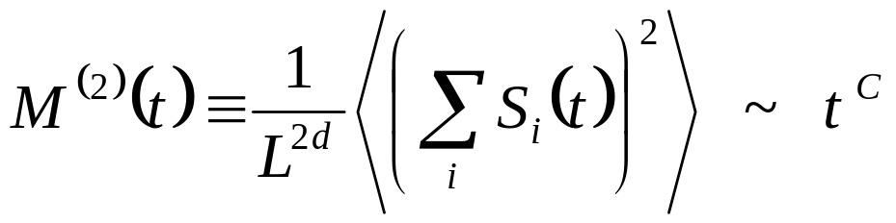

Auto-correlation
Even if contributes to dynamic behavior
Second moment

Slide 14
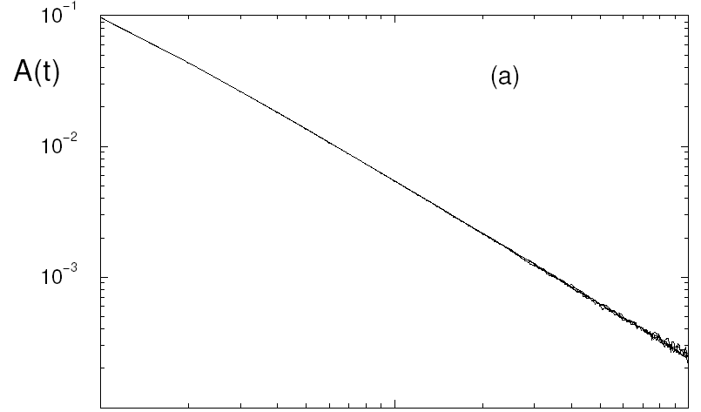
3D Ising Model

Slide 15
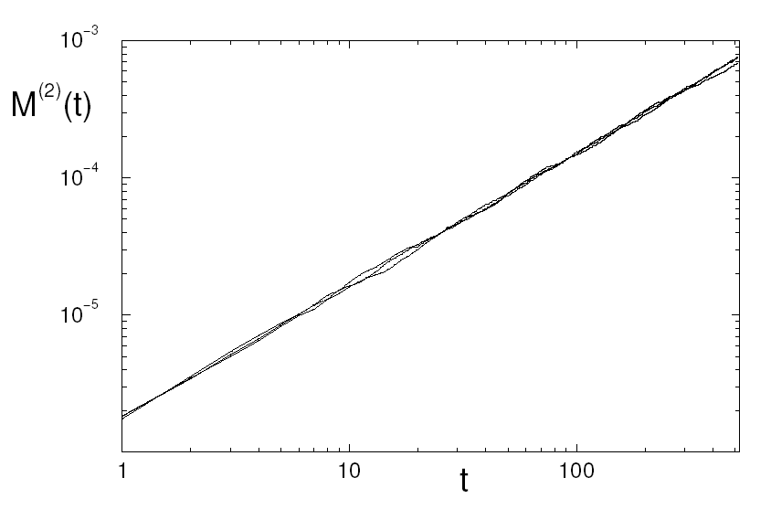
3D Ising Model

Slide 16

Summary
* Short-time dynamic scaling
a new exponent
* Scaling form ==>
==> static exponents
Zheng, IJMPB (98), review
Li,Schuelke,Zheng, Phys.Rev.Lett. (95), Zheng, PRL(96)
Conceptually interesting and important
Dynamic approach does not suffer from
critical slowing down
Compared with cluster algorithms, Wang-Landau …
it applies to local dynamics

Slide 17
III Applications
* second order transitions
e.g. 2D Ising, 3D Ising, 2D Potts, …
non-equilibrium kinetic models
chaotic mappings
2D SU(2) lattice gauge theory, 3D SU(2) …
Chiral degree of freedom of FFXY model
…
Ashkin-Teller model
Parisi-Kardar-Zhang Eq. for growing interface
…

Slide 18
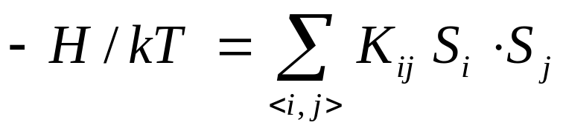
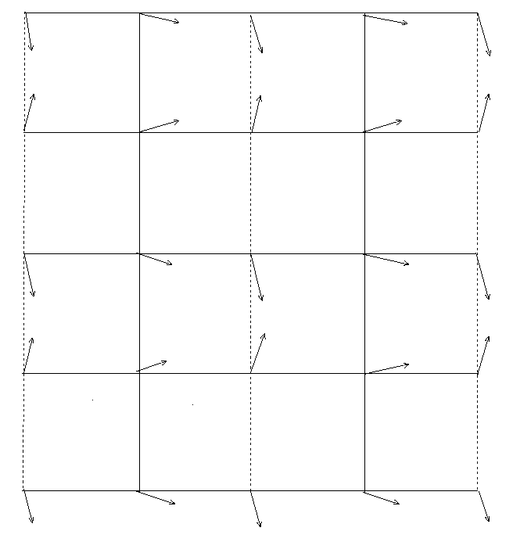
2D FFXY model
Order parameter: Project of the spin configuration
on the ground state
-K K

Slide 19
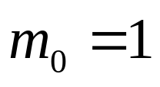
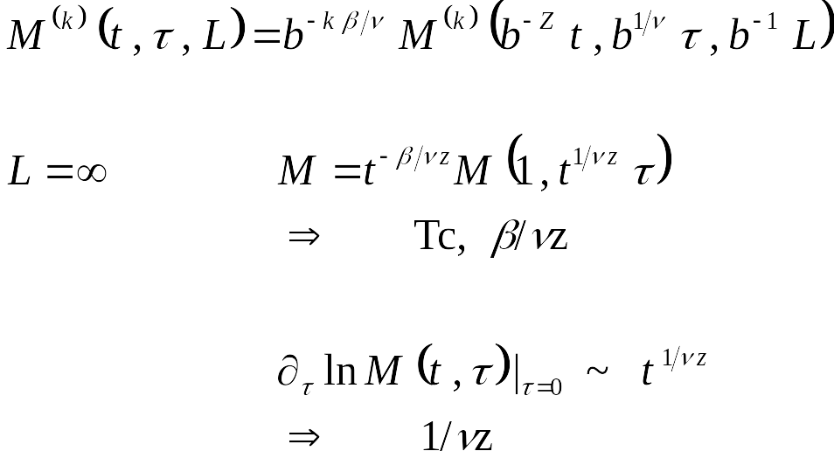
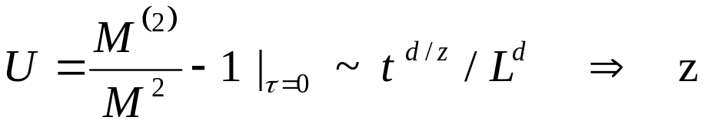
Initial state: ground state,
L finite

Slide 20
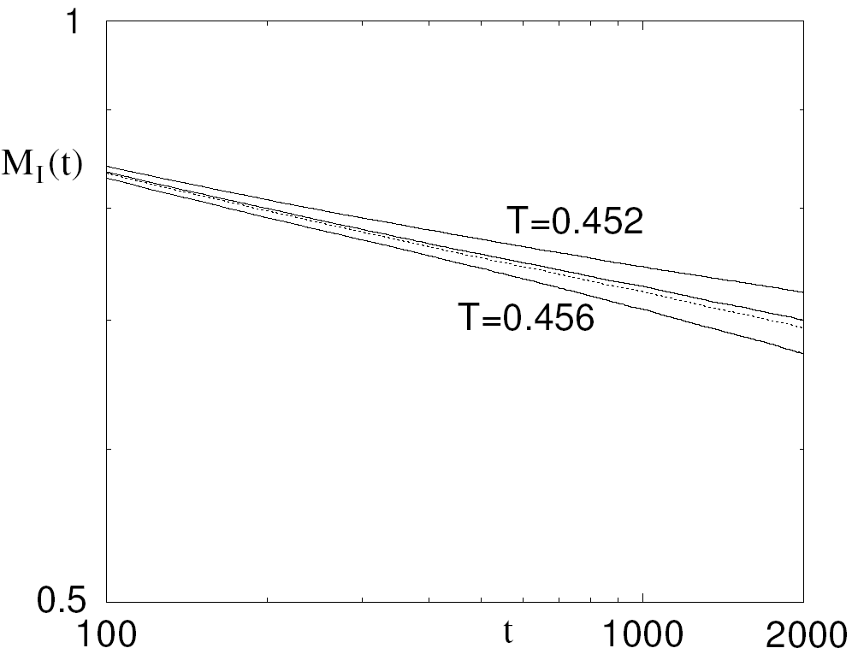
2D FFXY model, Chiral degree of freedom

Slide 21
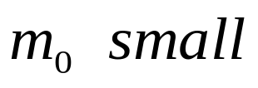
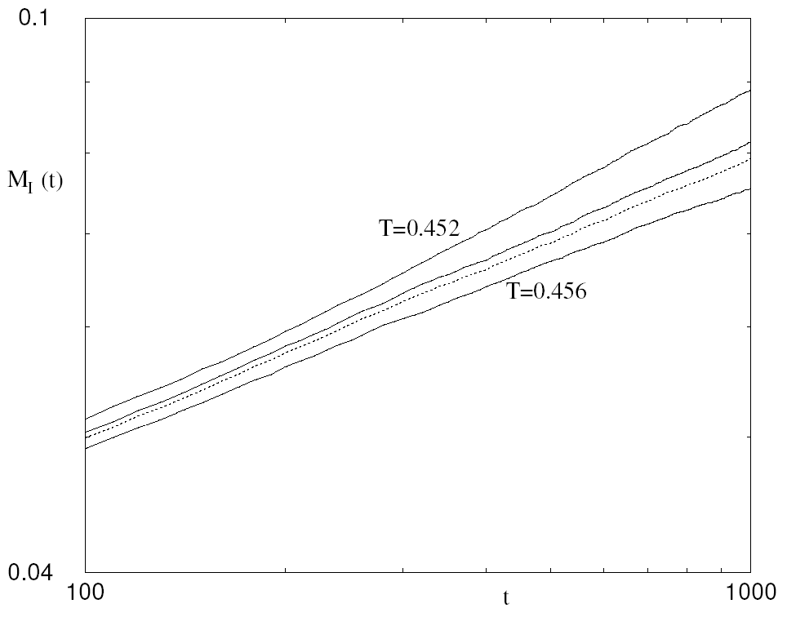
2D FFXY model, Chiral degree of freedom
Initial state: random,

Slide 22
2D FFXY model, Chiral degree of freedom
Luo,Schuelke,Zheng, PRL (98)
 | Tc | θ | Z | 2β/ν | ν
93 | .454(3) |  |  | .38(2) | .80(5)
94 | .454(2) |  |  | .22(2) | .813(5)
95 | .452(1) |  |  |  | 1
96 | .451(1) |  |  |  | .898(3)
OURS (98) | .4545(2) | .202(3) | 2.17(4) | .261(5) | .81(2)
Ising |  | .191(3) | 2.165(10) | .25 | 1

Slide 23
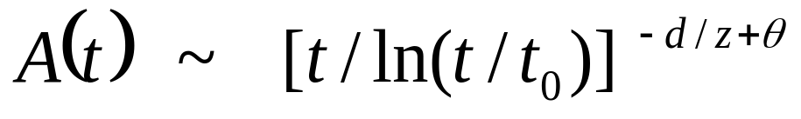
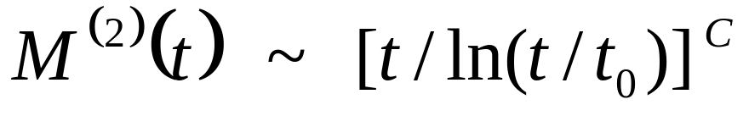
* Kosterlitz-thouless transitions
e.g. 2D Clock model, 2D XY model, 2D FFXY model, …
2D Josephson junction array,…
2D Hard Disk model,…
Logarithmic corrections to the scaling Bray PRL(00)
Auto-correlation
Second moment

Slide 24
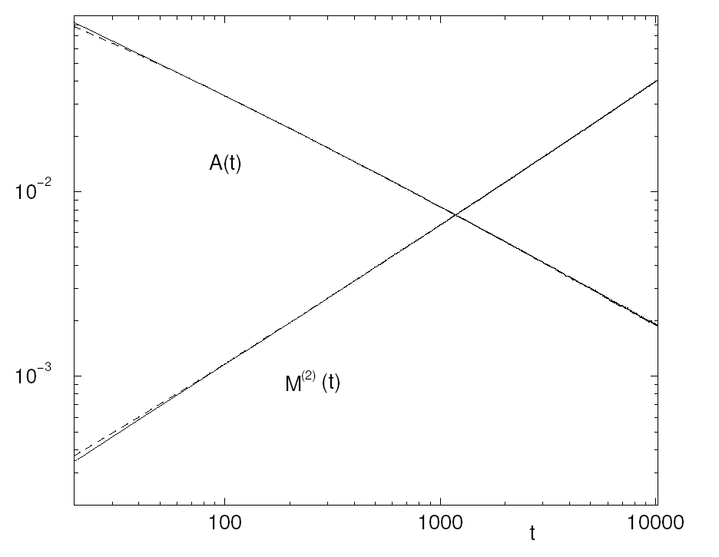
2D XY model, random initial state,
Ying,Zheng et al PRE(01)

Slide 25
* disordered systems
e.g. random-bond, random-field Ising model,…
spin glasses
3D Spin glasses
Challenge: Scaling doesn’t hold
for standard order parameter
Pseudo-magnetization:
Project of the spin configuration on
the ground state

Slide 26
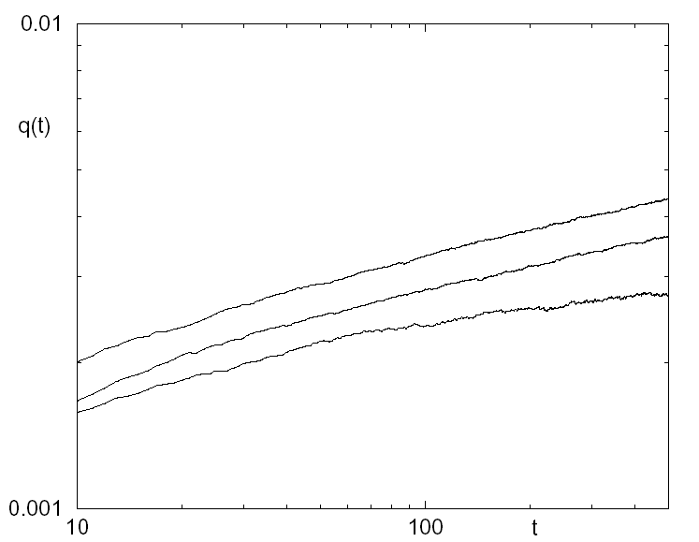
3D spin glasses, Luo,schulke,Zheng (99)
initial increase of the Pseudo-magnetization

Slide 27
* weak first-order phase transitions
How to distinguish weak first order phase transitions from second order or KT phase transtions?
Non-equilibrium dynamic approach:
for a 2nd order transition: at Kc (~ 1/Tc)
there is power law behavior
for a weak 1st order transition: at Kc
there is NO power law behavior
However, there exist pseudo critical points!!

Slide 28
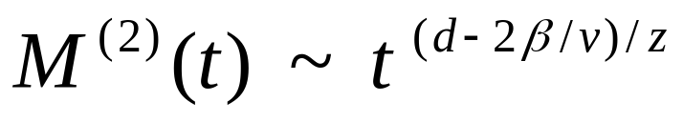
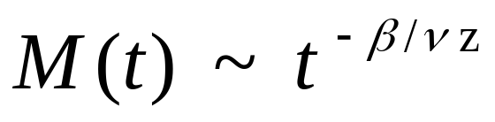
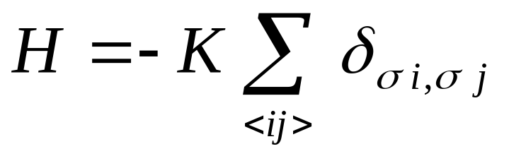
disordered metastable state ➔ K* > Kc
M(0)=0
ordered metastable state ➔ K** < Kc
M(0)=1
For a 2nd order transition, K* = K**
2D q-state Potts model

Slide 29
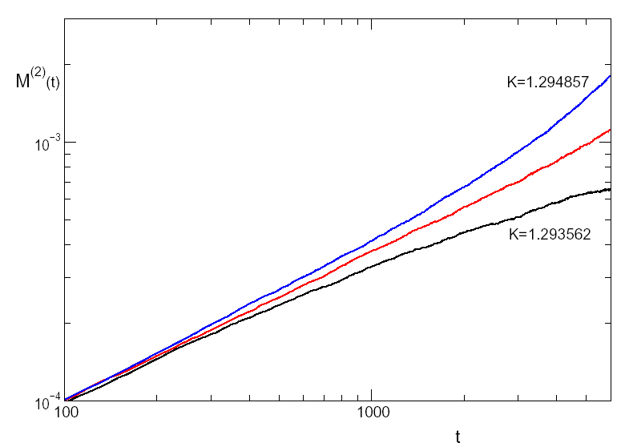
2D 7-state Potts model, heat-bath algorithm
M(0)=0
K*
Kc

Slide 30
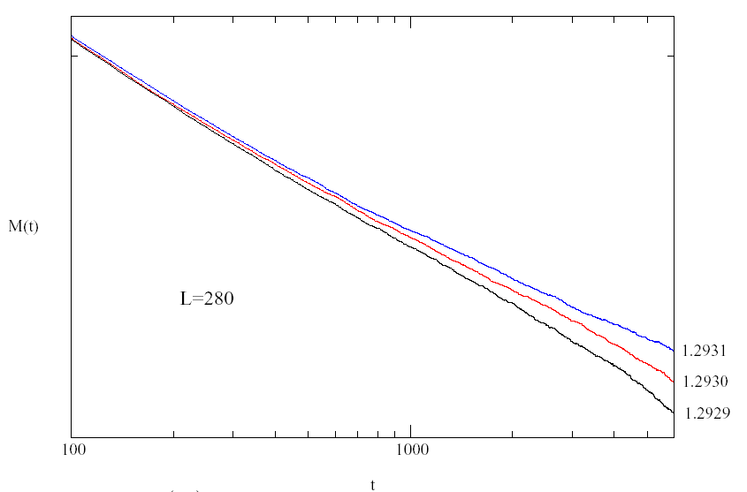
2D 7-state Potts model, heat-bath algorithm
M(0)=1
K**

Slide 31
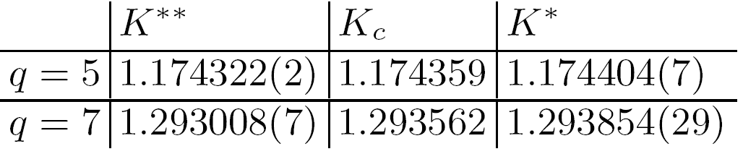
2D Potts models
Schulke, Zheng, PRE(2000)

Slide 32
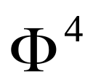
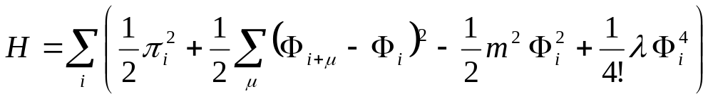
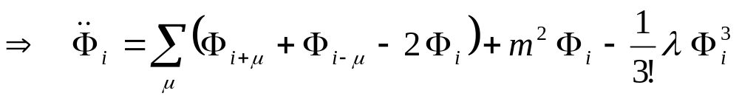
IV Deterministic dynamics
Now it is NOT ‘statistical physics’
theory, isolated

Slide 33
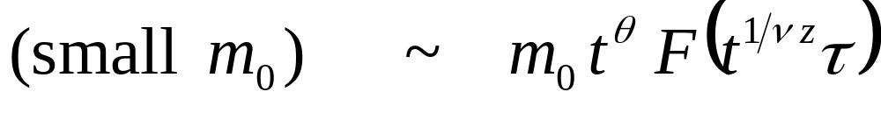
Time discretization
Iteration up to very long time is difficult
Behavior of the ordered initial state is not clear
Random initial state

Slide 34
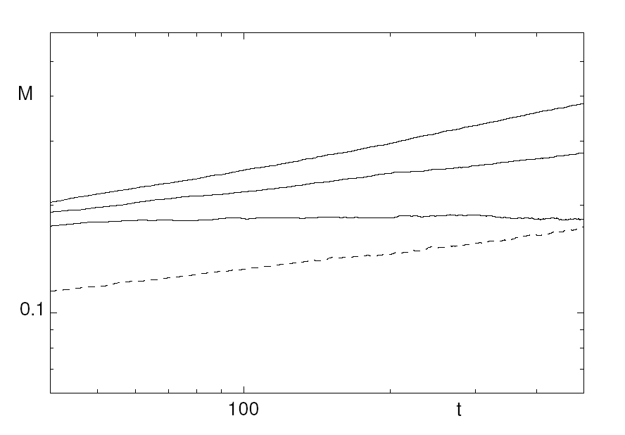

Slide 35
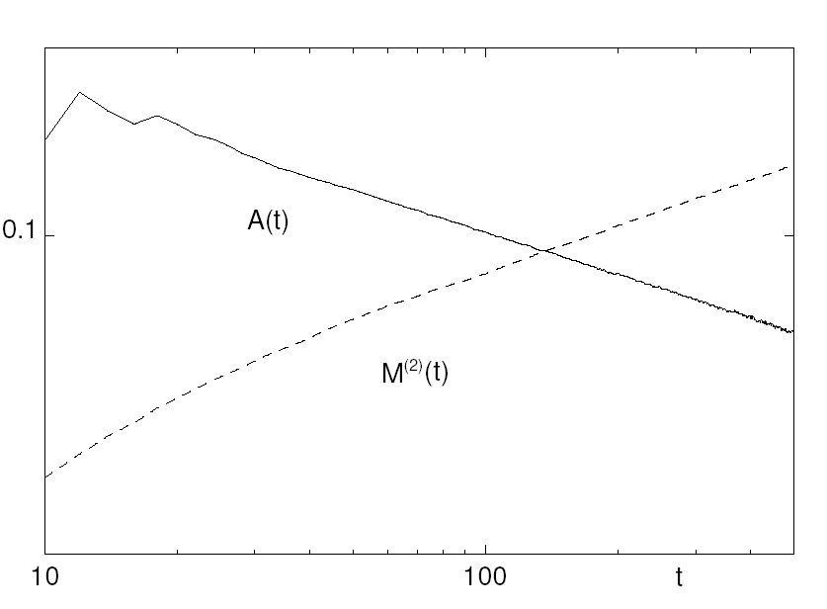

Slide 36


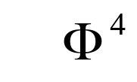
Zheng, Trimper, Schulz, PRL (99)
 | θ | Z
 | .176(7) | 2.148(20) | .24(3) | .95(5)
Ising | .191(1) | 2.165(10) | .25 | 1
Violation of the Lorentz invariance

Slide 37
V Concluding remarks
* There exists universal scaling behavior
in critical dynamics far from equilibrium
-- initial conditions, systematic description
damage spreading
glass dynamics
phase ordering
growing interface …
* Short-time dynamic approach to
the equilibrium state
predicting the future …

