Slide 1
Financial Dynamics,
Minority Game and Herding Model
B. Zheng
Zhejiang University

Slide 2
Contents
I Introduction
II Financial dynamics
III Two-phase phenomenon
IV Minority Game
V Herding model
VI Conclusion

Slide 3
I Introduction
Should physicists remain in traditional physics?
Two ways for penetrating to other subjects:
* fundamental
chemistry,
地球物理
biophysics
* phenomenological
econophysics
social physics

Slide 4
Scaling and universality exist widely in nature
chaos, turbulence
self-organized critical phenomena
earthquake, biology, medicine
financial dynamics, economics
society (traffic, internet, …)
Physical background
strongly correlated
self-similarity
universality

Slide 5
Methods
phenomenology of experimental data
models
Monte Carlo simulations
theoretical study

Slide 6
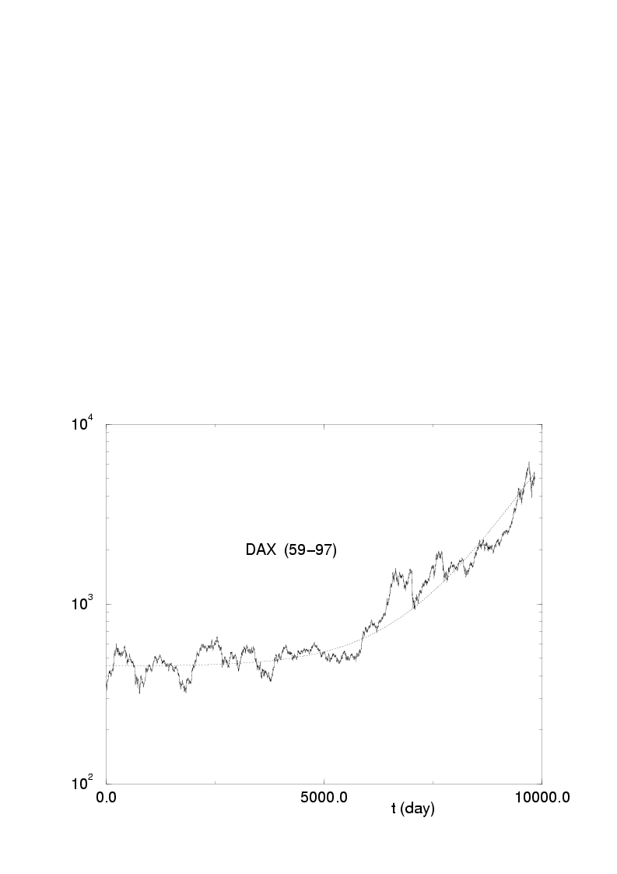
II Financial dynamics

Slide 7
Mantegna and Stanley, Nature 376 (1995)46
Large amount of data
Universal scaling behavior
Financial index Y(t')
Variation Z(t) = Y(t' +t) – Y(t')
Probability distribution P(Z, t)
shorter t truncated Levy distribution
longer t Gaussian

Slide 8
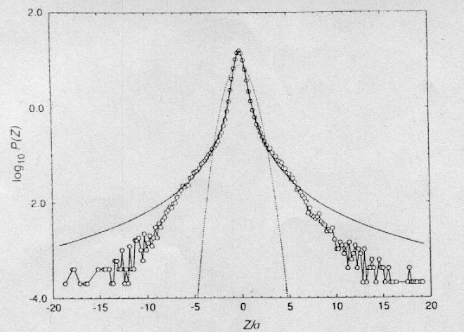

Slide 9
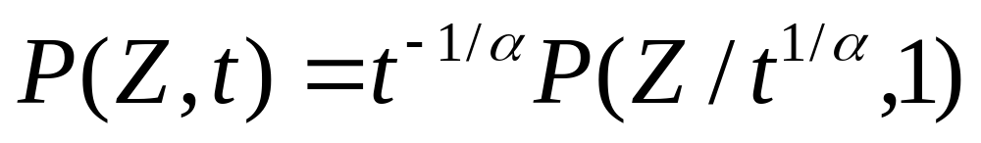
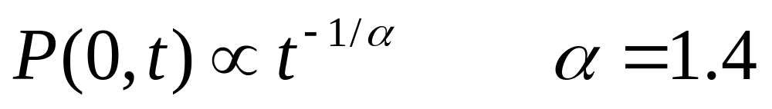
Scaling form
Zero return
--- self-similarity in time direction
usually robust or universal

Slide 10
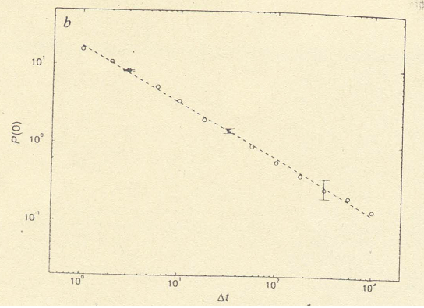
P(0,t)
t

Slide 11
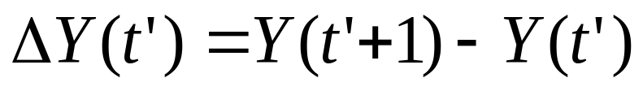
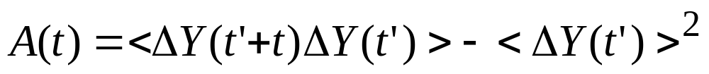
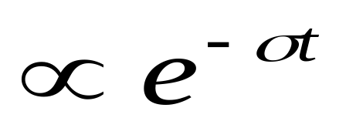
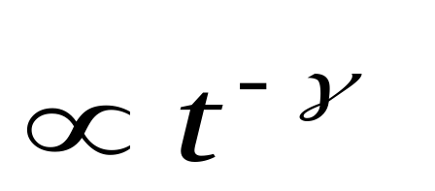
Let
Auto-correlation
exponentially decay
But
power-law decay!!

Slide 12
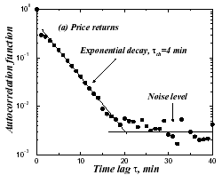
t (min)

Slide 13
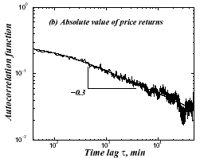
t (min)

Slide 14
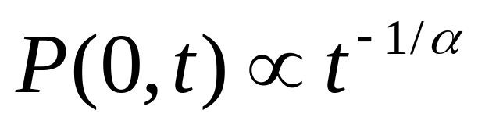
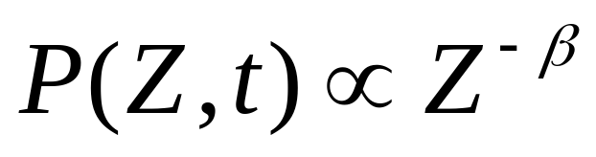
Summary
* △Y(t’) is short-range correlated
* |△Y(t’)| is long-range correlated
*
* for big Z, small t
* High-low asymmetry
* Time reverse asymmetry
……

Slide 15
III Two-phase phenomenon
Index Y(t')
Variation Z(t) = Y(t' +t) – Y(t')
Conditional probability distribution
P(Z, r)
Here
r(t) = < | Y(t''+1)-Y(t'') - < Y(t''+1)-Y(t'')> | >
< … > is the average in [t', t'+t]

Slide 16
Plerou, Gopikrishnan and Stanley,
Nature 421 (2003) 130
Y(t') = Volume imbalance, t < 1 day
r small, P(Z, r) has a single peak
rc critical point
r big, P(Z, r) has double peaks
Our finding
Two-phase phenomenon exists also for
Y(t') = Financial index

Slide 17
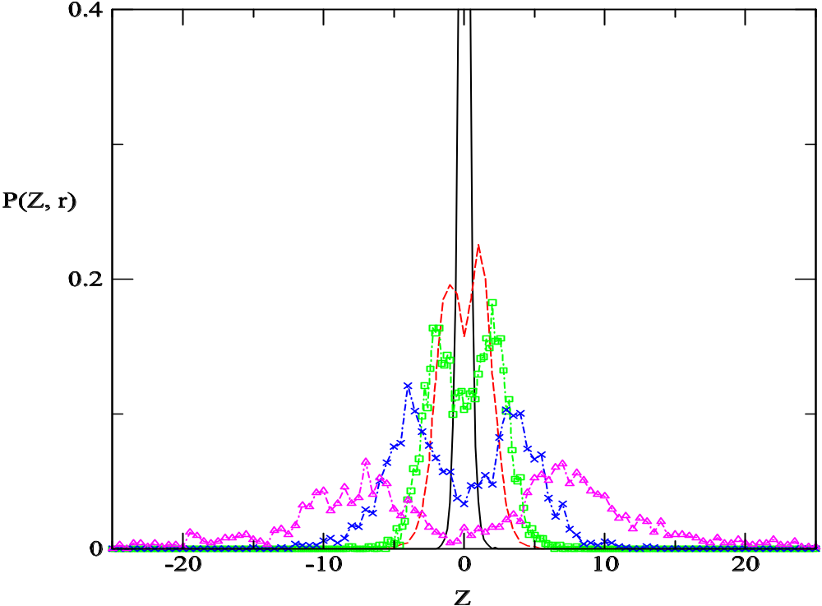
German DAX94-97
t = 10
rc = .15
Solid line: r < .1
Dashed : .2 < r < .3
Squares : .4 < r < .5
Crosses : .6 < r < 1.0
Triangles : 1.0 < r

Slide 18
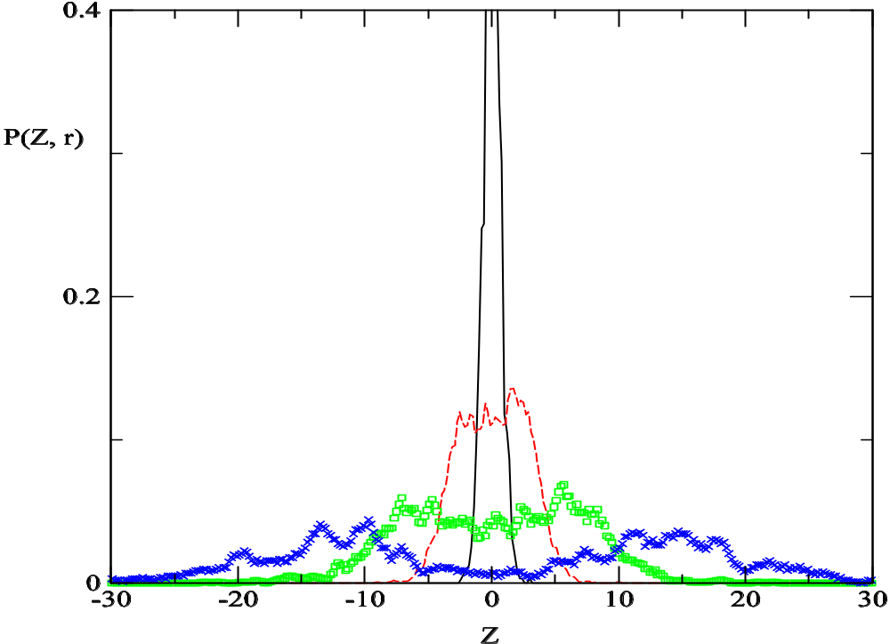
German DAX
t = 20
rc = .30

Slide 19
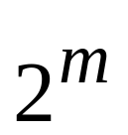

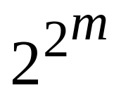
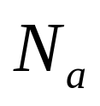
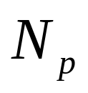
IV Minority Game
History : time steps, states
Strategies:
agents producers
s strategies 1 strategy
and inactive
Scoring : minority wins
Price : Y(t') = buyers - sellers

Slide 20
This Minority game explains most of
stylized fact of financial markets
including long-range correlation, but
NOT the two-phase phenomenon

Slide 21
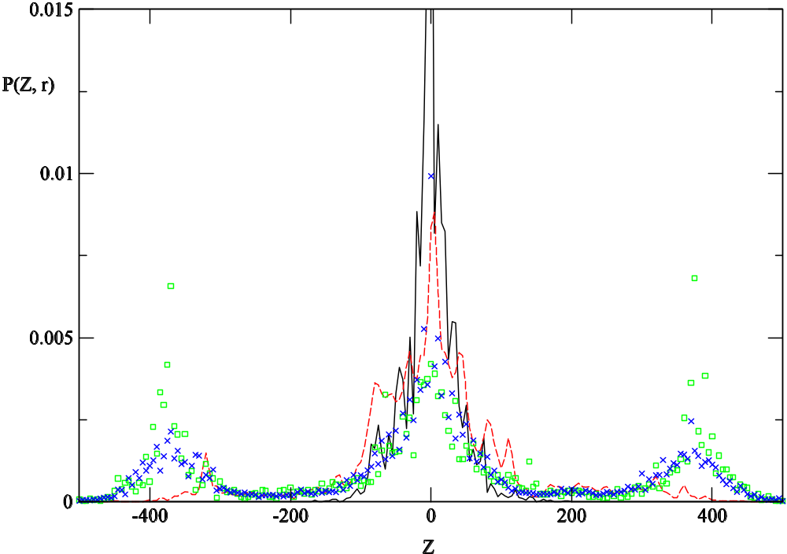
Solid line: r < 30
Dashed : 30 < r < 60
Squares : 60 < r < 120
Crosses : 120 < r
Minority Game
m = 2 s = 2
t = 10

Slide 22
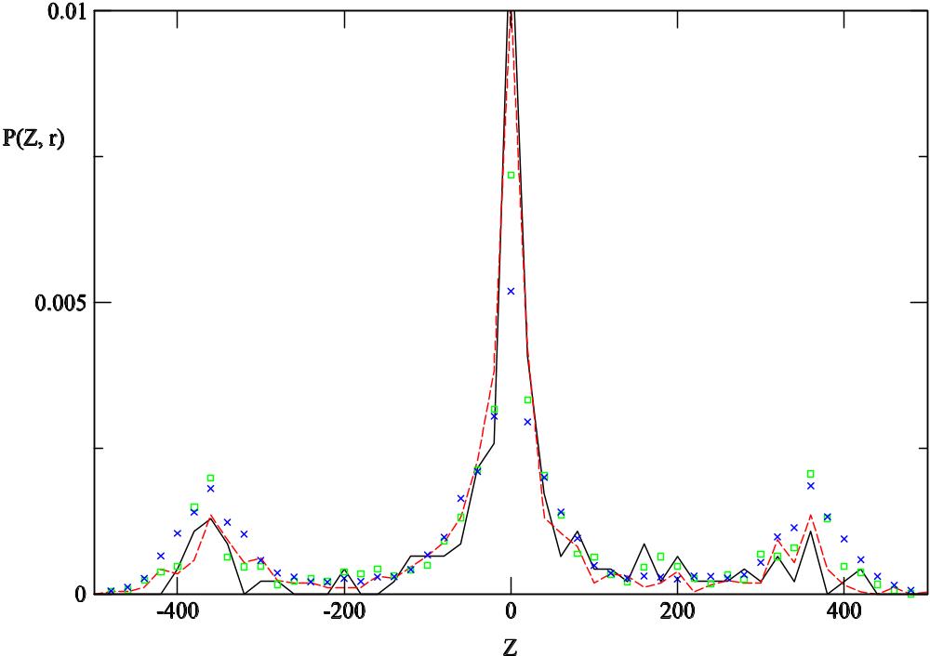
Minority Game
m = 2 s = 2
t = 50

Slide 23
V Herding model
EZ model : Eguiluz and Zimmermann,
Phys. Rev. Lett. 85 (2000)5659
N agents, at time t, pick agent i
with probability 1-a, connect to agent j,
form a cluster;
2) with probability a , cluster i buy (sell),
resolve the cluster i
Price variation :
|△Y(t')| = size of cluster i

Slide 24
This herding model explains
the power-law decay (fat-tail) of P(Z, t), but
NOT the long-range correlation

Slide 25
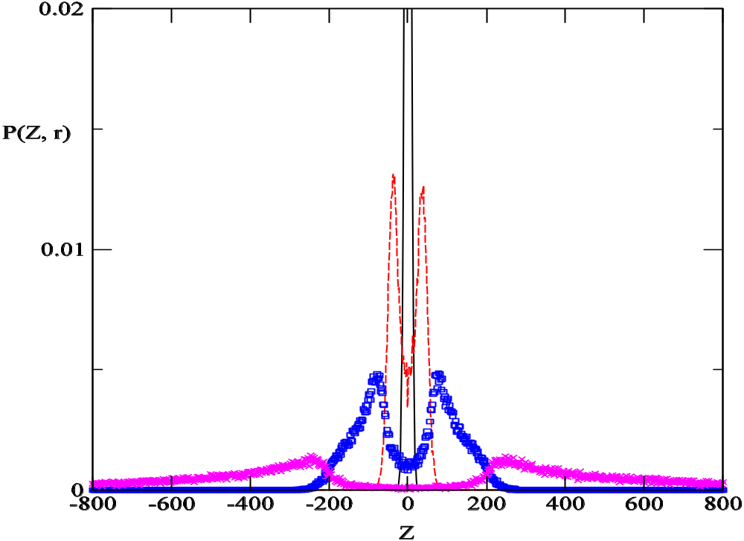
Solid line: r < 20
Dashed : 20 < r < 40
Squares : 60 < r < 80
Crosses : 120 < r
EZ model
t = 10

Slide 26
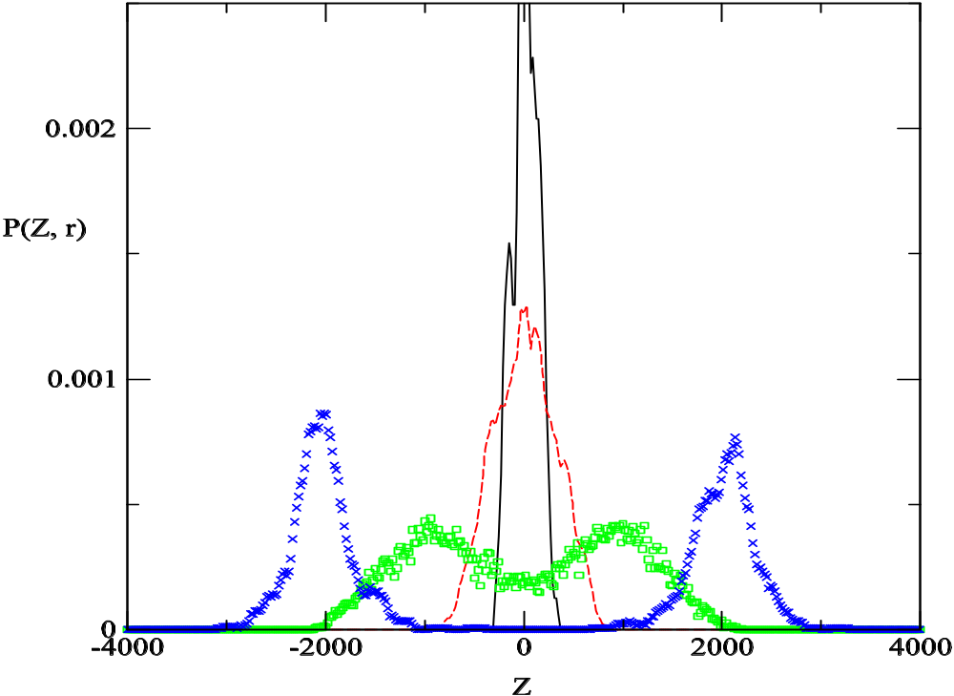
EZ model
t =100

Slide 27
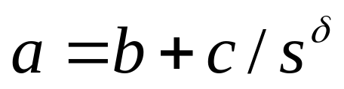
Interacting herding model
B. Zheng, F. Ren, S. Trimper and D.F. Zheng
1/a : rate of information transmission
Dynamic interaction
1/b is the highest rate
* take a small b
* fix c to the ‘critical’ value :
P(Z,t) obeys a power-law

Slide 28
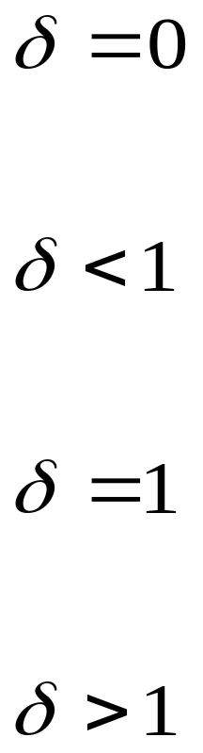
short-range anti-correlated
short-range correlated
long-range correlated
qualitatively explains the markets
unknown

Slide 29
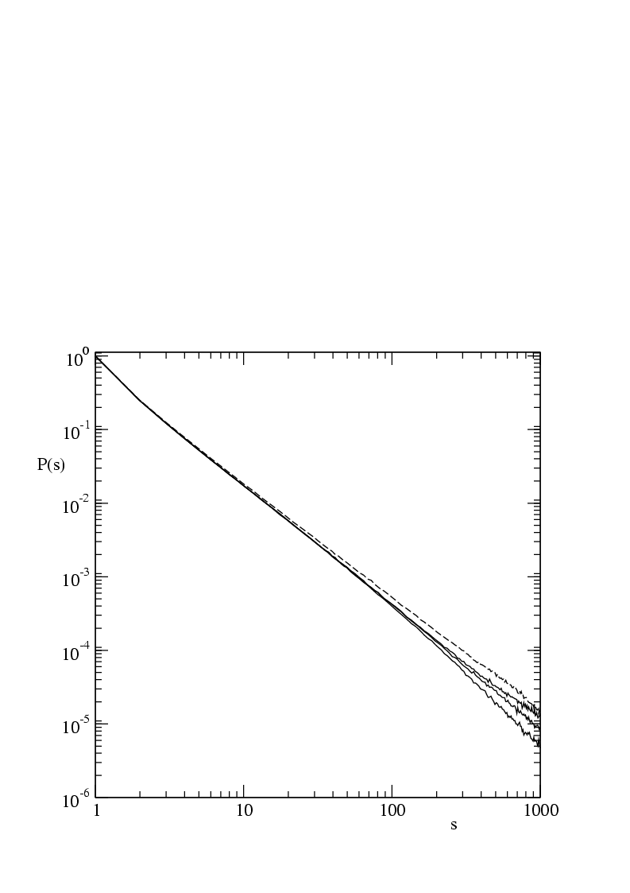

Interacting EZ model
t = 100

Slide 30
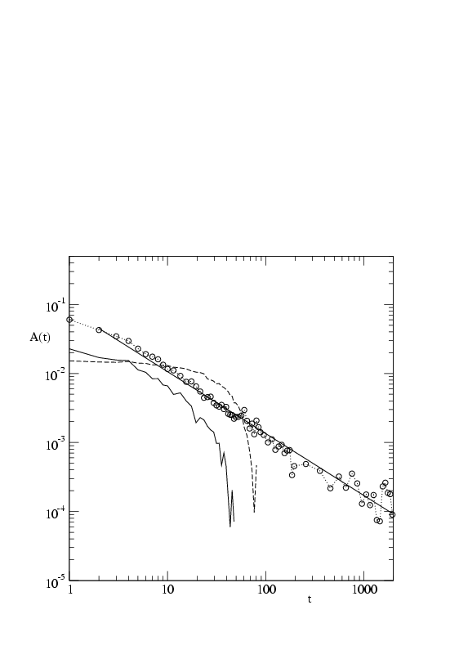
Interacting EZ model
t = 100

Slide 31
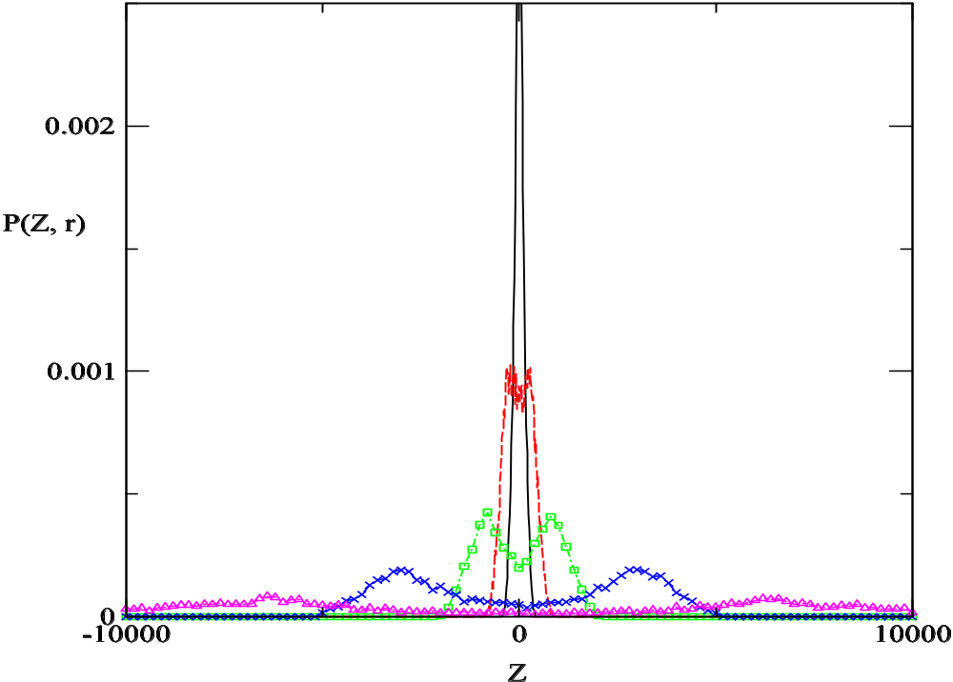
Interacting EZ model
t = 100

Slide 32
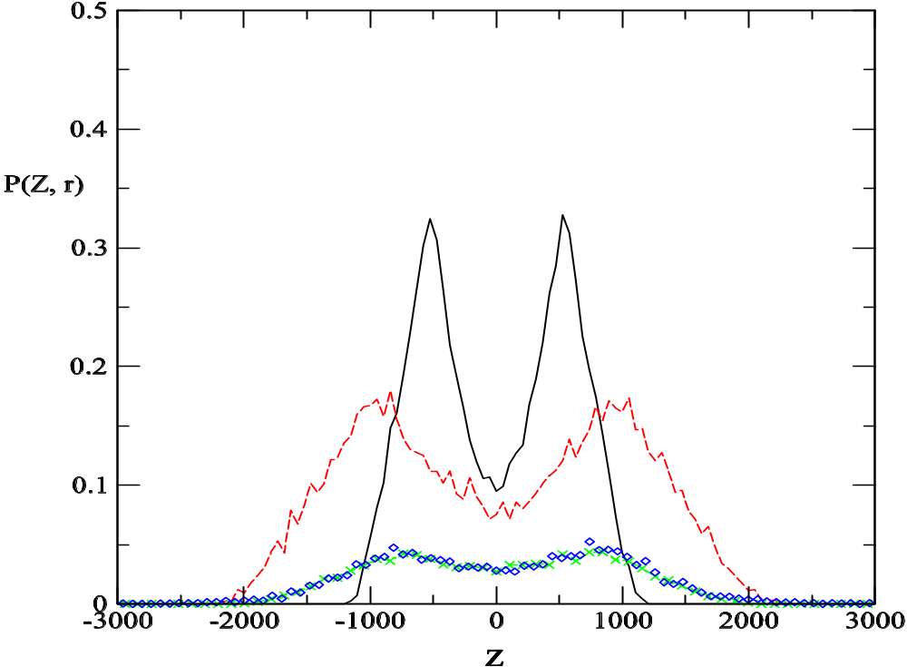
Interacting EZ model
20 < r <40
solid line: t = 50
dashed : t = 100
crosses : t = 200
diam. : DAX

Slide 33
VI Conclusion
* There are two phases in financial markets
* There is no connection between long-range
correlation and two-phase phenomenon
* The interacting dynamic herding model
is rather successful including two-phase
phenomenon, persistence probability ……

Slide 34
谢谢
http://zimp.zju.edu.cn

