Slide 1
CZ1102
Scientific Problem Solving and Computation
Monday/Thursday
2:00pm, LT22
Your lecturer:
Dr. Wang Jian-Sheng

Slide 2
Goal/Objective
Basic ability to write C programs
Formulate scientific problems as computer algorithms
A preparation for almost all other CZ modules

Slide 3




Mode of Study
Attending Lectures
Tutorials
Computer Lab
Home Working

Slide 4
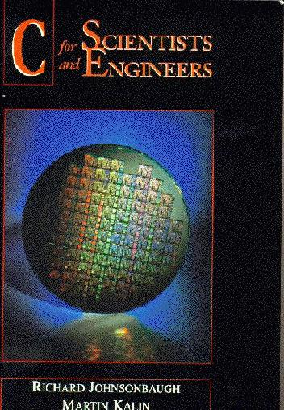
Textbook
C for Scientists and Engineers
© Prentice Hall 1997
Available at NUS CO-OP at S$33.00

Slide 5
Organization of the Course
24 Lectures (2 per week)
5 (Computer) Labs (lab starts from week 4, 10-15 August 98)
6 Tutorials (first tutorial on week 3, 3-8 August 98)
Midterm exam [14 Sep 98] (20%)
Lab/Home Work (20%)
Final exam (60%)
Sign up your lab/tutorial session at 1st Year Lab, S13 Level 5
First two weeks, 20-31 July during lab sessions, introduction to the lab and UNIX.

Slide 6
Course Information on the WEB
URL
  http://www.cz3.nus.edu.sg/
Transparencies/Schedules
Lab/Tutorial/Homeworking Assignments
Relevant Free Software (vi editor, gcc compiler)
Links to Useful Sites

