Slide 1
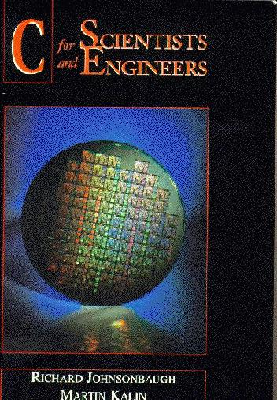
Textbook
C for Scientists and Engineers
© Prentice Hall 1997
Available at NUS CO-OP at S$35.10

Slide 2
Organization of the Course
24 Lectures (2 per week)
6 (Computer) Labs
5 Tutorials
Midterm exam [14 Sep 98] (20%)
Lab/Home Work (20%)
Final exam (60%)
Sign up lab sessions, Unix training, time and venue

Slide 3
Goal/Objective
Basic ability to write C programs
Formulate scientific problems as computer algorithms
A preparation for almost all other CZ modules

Slide 4
Algorithms
An algorithm is a precise, step-by-step method for solving a problem.
Example 1.1.1.
Compute 1 + 2 + 3 + ··· + n
1. sum = 0
2. i = 0
3. i = i + 1
4. sum = sum + i
5. Repeat lines 3 and 4 until i == n.

Slide 5
Computer Code
(i. e., Program)
sum = 0;
i = 0;
do {
i = i + 1;
sum = sum + i;
} while (i < n);
The concepts of “variable”, “assignment’’, “logical expression’’, and “loop’’.

Slide 6
How does the Computer Code
Execute?
1) sum = 0;
2) i = 0;
3) do {
4) i = i + 1;
5) sum = sum + i;
6) } while (i < n);
We assume n = 3.
Line 1) variable sum gets a value 0;
Line 2) variable i gets 0;
Line 3) mark the beginning of a while-loop;
Line 4) replace the value of variable i by its old value (0) plus 1. I.e., i = 1;
Line 5) replace the value of sum by its old value (0) + current value of i,
i.e., sum = 0+1=1.
Line 6) is i < 3? yes, since I=1, so go back to line 4);
Line 4) value i increased by 1 to 2;
Line 5) value sum becomes 1 + 2 = 3;
Line 6) is i < 3? yes, since i = 2, go back to Line 4);
Line 4) i becomes 2 +1 = 3;
Line 5) sum becomes 3 + 3 = 6;
Line 6) is i < 3? no, since i = 3. Program stops.

Slide 7
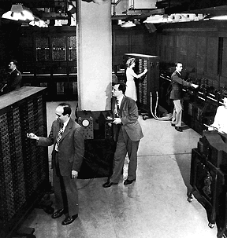
Computer System
ENIAC, built in 1940s, with 18000 vacuum tubes. It is 10² times bigger in size and more than 10⁴ times slower than today’s typical PC.
Input
CPU
Output
Main memory

Slide 8
Internal Representations
All data (integer, real number, character) and programs (machine code) are represented as strings of 0s and 1s.
E.g.,
Units of the data
The meaning of the strings of 0 and 1 depends on interpretation.
00100110
1 byte = 8 bits
1 kilobyte (Kbytes) = 1024 bytes
1 Megabyte = 1024 Kbytes

Slide 9
(Unsigned) Binary Integers
We are familiar with the decimal integers 0, 1, 2, 3, 4, …
In (unsigned/positive) binary representation, the same set of numbers are written as 0, 1, 10, 11, 100,
In general, binary and decimal numbers are related by (e.g.)
100110₂ = 1·2⁵ + 0 ·2⁴ + 0 ·2³ + 1 ·2² + 1·2¹ + 0 · 2⁰
= 32 + 0 + 0 + 4 + 2 + 0 = 38₁₀
Hexadecimal, representation of negative numbers, read the textbook.

Slide 10
Programming Process
High-level programming language
Main()
{ int i;
i = 5;
printf(“I=%”,i);
Compilation
Machine instructions
010100110111101011000100001101000010000111000101111

Slide 11
Language Tree
1950
Fortran
Why C?
Portability, efficiency, modularity, simple syntax and semantics, programming support.
BCPL
Pascal
B
1977
C
Fortran77
C++
1990
ANSI C
Fortran95
Java

Slide 12
Reading/Home Working
Read Chapter 1
  Pages 2 to 30.
  Please DO read for at least a hour of textbook material associated with each lecture.
  Do not procrastinate until exam.
Work on Exercises at
  Section 1.3/page 16-17, exercise 1, 3, 5.
  Answers are on in the back of the book.
  Do not hand in.

