Slide 1
A First C Program
/* Print a Message */
#include <stdio.h>
main()
{
printf("This is a test!\n");
}
The program is compiled and run as
cc pg32.c 
a.out 
This is a test!

Slide 2
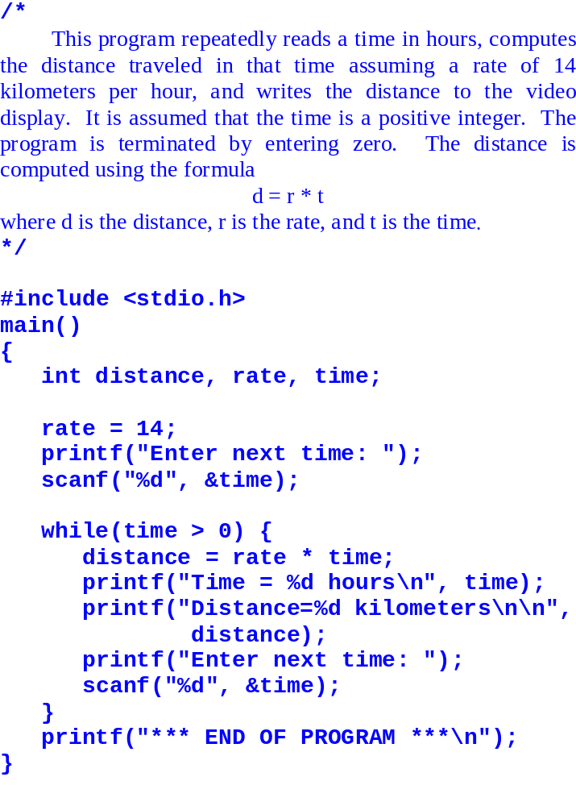
Computing Distance
This is pg34.c

Slide 3
Identifiers
Identifier is the official word for name of a variable in C program.
It must start with a letter (A through Z or a through z).
It must consist of only letters (A to Z, a to z), digits (0 to 9), and the underscore _.
It must not be a keyword, such as int, or while.
Legal identifiers
total
total_cars
_sum
column3
TOTAL
Illegal identifiers
total$
2nd_sum
long
second sum
TOTAL-CARS

Slide 4
The while Statement
while ( expression )
action
START
While(
expression
) {
YES
Expression
true?
NO
statement
·
·
}

Slide 5
Expression/Action
An expression consists of variables and operators of valid combinations. E.g.,
x > 0, y == 0,
or just x.
An action is a statement ending with a semicolon “;”, or several statements enclosed in braces. E.g.,
{
x = 1;
printf("x=%d\n", x);
x = x + 1;
}

Slide 6
Relational Operators
> Greater than
>= Greater than or equal
< Less than
<= Less than or equal
== Equal
!= Not equal

Slide 7
While(), Example
int x;
x = 0;
while ( x != 2)
x = x + 1;
printf("x = %d.\n", x);
The statement
x = 0;
sets x to 0. Since 0 is not equal to 2, x != 2 evaluates to true;
x = x + 1;
is executed, making x equal 1. We return to the top of while condition. x now is 1 not equal to 2. So x is increased to 2. Now x != 2 is false. The loop terminates. The printf prints out
x = 2.

Slide 8
Exercise (DO IT NOW)
What is the output?
int x;
x = 7;
while( x >= 0 ) {
printf("%d\n", x);
x = x - 2;
}

Slide 9
The do while() Statement
do
action
while ( expression );
do {
YES
NO
expression true?
·
·
·
} while (
expression
);

Slide 10
Do-While Example
Do {
printf("Enter a "
"positive integer: ");
scanf("%d", &response);
} while (response <= 0);
Check for the validity of user input (must be positive). If the input is invalid, the user is prompted again to enter a value.

Slide 11
Exercise (DO IT NOW)
What is printed?
int x;
x = 4;
do {
x = x - 2;
printf("x = %d\n", x);
} while ( x >= 1);

Slide 12
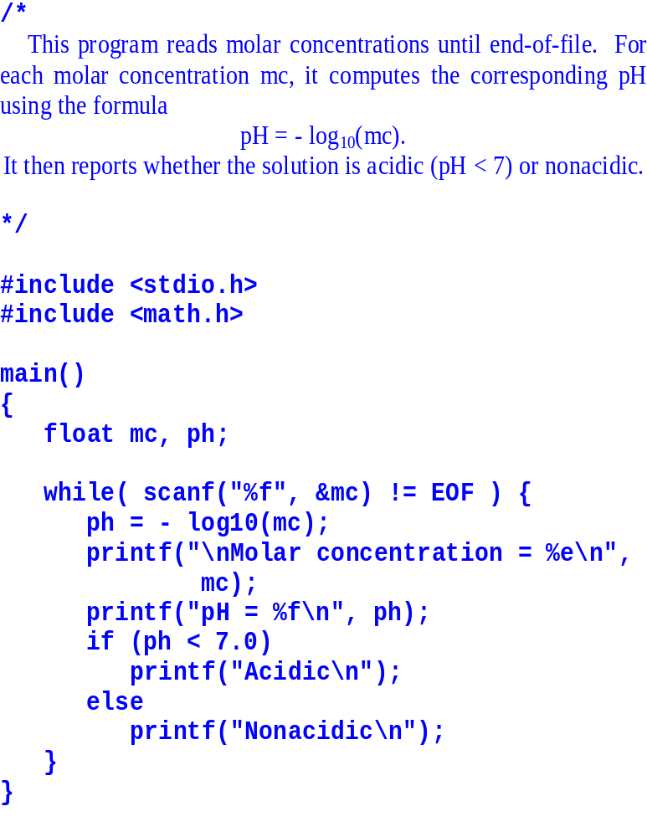
Real World Application
Classifying solutions as acidic or nonacidic
This is pg45.c

Slide 13
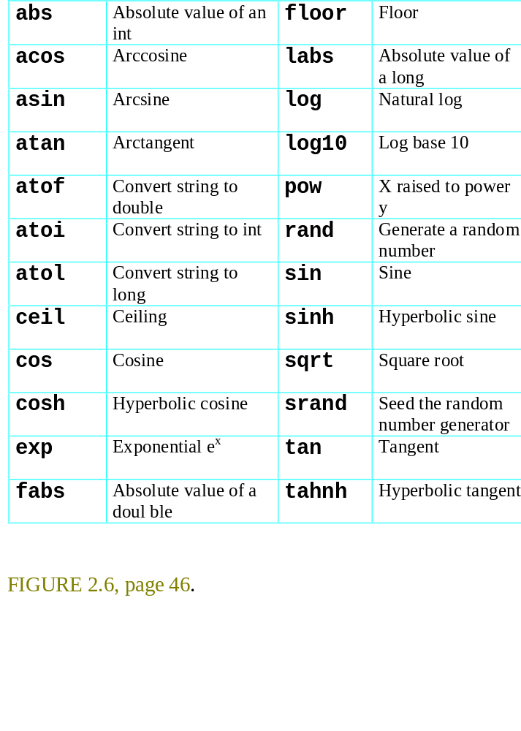
Standard Mathematics Functions

Slide 14
The If Statement
If ( expression )
action
START
If(
expression
){
YES
NO
Expression true?
···
}

Slide 15
If, Example
Int code;
code = 1;
if ( code == 1 )
printf("CZ Courses\n");
printf("*** THE END ***");
the output is
CZ Courses
*** THE END ***
If code is set to 0, the first line will not
be printed.

Slide 16
If, Example 2
Int code;
code = 1;
if ( code == 1 ) {
printf("CZ Courses\n");
printf("Dr Wang\n");
printf("Room 07-21\n");
}
printf("*** THE END ***");
the output is
CZ Courses
Dr Wang
Room 07-21
*** THE END ***
If code is set to 0, the first three lines
will not be printed.

Slide 17
If-else Statement
If ( expression )
action 1
else
action 2

Slide 18
If-else, Example
Int code;
code = 1;
if ( code == 1 )
printf("CZ Courses\n");
else
printf("MA Courses\n");
printf("*** THE END ***");
the output is
CZ Courses
*** THE END ***
If code is set to 0 or any value other
than 1, the output becomes:
MA Courses
*** THE END ***

Slide 19
Exercise (DO IT NOW)
What is the output?
int x, y;
x = 3;
y = 5;
if ( x < 2)
printf("%d\n", x);
else
printf("%d\n", y);

Slide 20
Summary
The structure of a C program
Declare variables with int and float
printf and scanf for displaying and reading data
Looping by while and do-while statements
if and if-else statements for choices
Forming conditions with ==, !=, <, <=, >, >=
Mathematical functions log10( ), sin( ), ...

Slide 21
Reading/Home Working
Read Chapter 2, Pages 32 to 55.
Work on Problems
  Section 2.3, exercise 1, 3, 5, 7, 9.
  Section 2.4, exercise 3, 5.
  Section 2.7, exercise 3, 5.
  Section 2.8, exercise 1.
Check your answers in the back of the textbook. Do not hand in.

