Slide 1
More on if-else
In
  if (expression) {
  action
  }
or
  if (expression) {
  action
  } else {
  action
  }
the action can be any
statement, including if or
if-else.

Slide 2
Nested if/if-else
Use braces {…} to avoid
possible confusion.
if ( course_code == 1) {
if (code < 2)
printf("Mechanics\n");
else
printf("No course\n");
}
vs.
If ( course_code == 1) {
if (code < 2)
printf("Mechanics\n");
} else {
printf("No course\n");
}

Slide 3
If-else if-else...
if (expression1)
action1
else if (expression2)
action2
else if (expression3)
action3
...
else
actionN

Slide 4
If-else if-else, e.g.,
Int code;
code = 2;
if ( code == 1)
printf("Mechanical\n");
else if (code == 2)
printf("Math\n");
else if (code <= 3)
printf("Science\n");
else
printf("Nothing\n");
prints
Math

Slide 5
Files
Define file pointers with
  FILE *fin, *fout;
Open file for read (the file must exist)
  fin = fopen("in.dat","r");
Open file for write
  fout = fopen("outfile.dat","w");
Use file pointers in fprintf and fscanf.
Close files with
  fclose(fin);
  fclose(fout);

Slide 6
File, example
#include <stdio.h>
#include <math.h>
main()
{
float mc, ph;
FILE *fin, *fout;
fin = fopen("ph.in", "r");
fout = fopen("ph.out", "w");
while( fscanf(fin, "%f", &mc) != EOF ) {
ph = - log10(mc);
fprintf(fout, "\nMolar"
"concentration = %e\n", mc);
fprintf(fout, "pH = %f\n", ph);
if (ph < 7.0)
fprintf(fout, "Acidic\n");
else
fprintf(fout, "Nonacidic\n");
}
}

Slide 7
Character data type
The definition
char c;
creates a 1-byte cell that can hold one character.
To store lowercase x in the variable c, we can write
c = 'x';
Note the single quotation marks.
To print a character using printf, we use the format descriptor %c.

Slide 8
Print a Character
#include <stdio.h>
main()
{
char d;
d = 'x';
printf("The character is: %c.",
d);
}
The program prints
The character is: x.

Slide 9
Read and Print Characters
#include <stdio.h>
main()
{
char d1, d2, d3, d4;
int x;
scanf("%d%c%c%c%c", &x,
&d1, &d2, &d3, &d4);
printf("%d%c%c%c%c", x,
d1, d3, d2, d4);
}
With input
97 354
the output is
97 534
Note that
x gets 97
d1 gets ' '
d2 gets '3'
d3 gets '5'
d4 gets '4'

Slide 10
Characters are stored internally as numbers
Each character is stored as a 1-byte number. E.g., 'A' is 65 in ASCII coding.
The char data type can be used as small integers (say from -128 to 127 for signed char).
Both %d and %c descriptor can be used in printf for char and int data - the system converts char type into int type in printf function.

Slide 11
Char/Int Conversion
#include <stdio.h>
main()
{
char d;
d = 76;
printf("%c", d);
d = 'L';
printf(" %c %d", d, d);
}
prints
L L 76
Note that the ASCII code for 'L' is 76, see Appendix A, page 643.

Slide 12
Character v.s. Number
On an ASCII system the code
char c, d;
c = '3';
d = 3;
assigns c the value decimal 51 and d the value decimal 3.

Slide 13
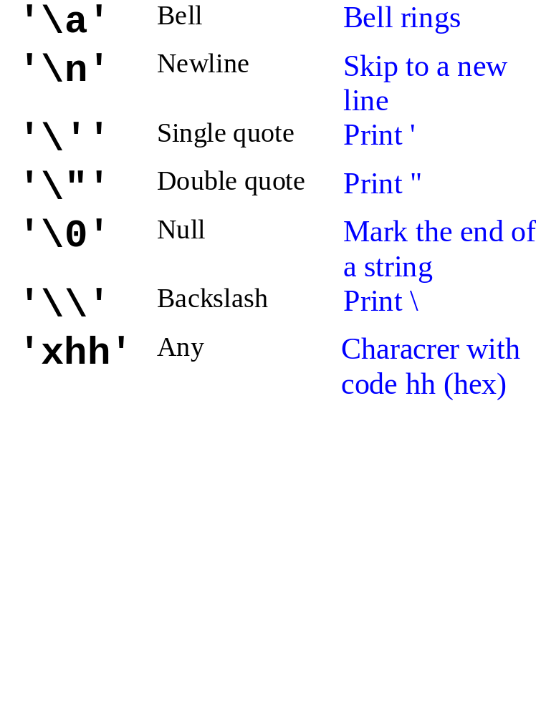
Special Characters
See Appendix B, page 653 for a complete list.

Slide 14
Special Characters, E.g.,
#include <stdio.h>
main()
{
char d1, d2, d3, d4,
d5, d6;
d1 = 'x';
d2 = '\t';
d3 = '\\';
d4 = 'x';
d5 = '\n';
d6 = '\'';
printf("%c%c%c%c%c%c",
d1, d2, d3, d4, d5, d6);
}
prints
x \x
'

Slide 15
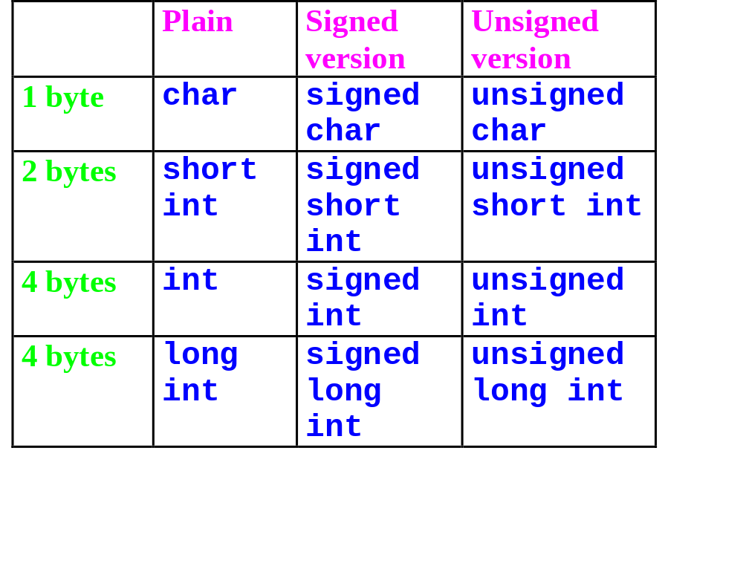
Difference Size of Integers

Slide 16
Difference Type of Floating-Point Numbers
float
  4 bytes log, 6 significant digits.
double
  8 bytes long, 15 significant digits.
long double
  Same as double on many machines.

Slide 17
Write/Print Floating Point
#include <stdio.h>
main()
{
float x, y;
double v, w;
x = 42.4907;
y = 3.8872e-12;
v = -55.23289108;
w = -84.3002669e17;
printf("x=%e, y=%e\n", x, y);
printf("x=%E, y=%E\n", x, y);
printf("x=%f, y=%f\n", x, y);
printf("x=%g, y=%g\n", x, y);
printf("v=%e, w=%e\n", v, w);
printf("v=%E, w=%E\n", v, w);
printf("v=%f, w=%f\n", v, w);
printf("v=%g, w=%g\n", v, w);
}
prints
x=4.249070e+01, y=3.887200e-12
x=4.249070E+01, y=3.887200E-12
x=42.490700, y=0.000000
x=42.4907, y=3.8872e-12
v=-5.523289e+01, w=-8.430027e+18
v=-5.523289E+01, w=-8.430027E+18
v=-55.232891, w=-8430026690000000000.000000
v=-55.2329, w=-8.43003e+18

Slide 18
Read float and double by scan()
Use %e, %f, or %g for float. Use %le, %lf, or %lg for double.
#include <stdio.h>
main()
{
float x;
double y;
scanf("%f%lf", &x, &y);
printf("x=%f\ny=%f\n", x, y);
printf("x=%e\ny=%e\n", x, y);
printf("x=%g\ny=%g\n", x, y);
}
input is
47.403 -38.30026452e5
prints
x=47.304001
y=-3830026.452000
x=4.730400e+01
y=-3.830026e+06
x=47.304
y=-3.83003e+06

Slide 19
Summary
Further examples of conditional statements (if, else if, , nested if)
Files
Character, integers, and floating pointer numbers
Reading and printing characters, integers and floating pointer numbers - descriptor %c, %e, %f, %g, etc

Slide 20
Reading/Home Working
Read Chapter 2, Pages 55 to 65; Chapter 3; pages 70 to82.
Work on Problems
  Section 2.8, exercise 3.
  Section 2.10, exercise 3, 5.
  Section 3.1, exercise 1, 5.
  Section 3.3, exercise 5.
Check your answers in the back of the textbook. Do not hand in.

