Slide 1
Operators
A binary operator combines two values to get one result:
  x OP y
where OP is any binary operators such as +, -, *, /, ==, !=, >, &&, or even =.
A unary operator takes one value and gives one result:
  OP x
where OP can be +, -, &, !, ++, etc.

Slide 2
Arithmetic Operators
+ Add
- Subtract
* Multiply
/ Divide
% Modulus
Examples:
1 + 2 → 3
1 - 3 → -2
3 * 2 → 6
4 / 2 → 2
10 % 3 → 1

Slide 3
Arithmetic Operators, Examples
char c, d;
int i, j;
float w, x;
double y, z;
c = 8; d = 'R'; i = 76;
w = 7.9; y = 23.4891e8;
j = i * i; (j gets 76×76=5776)
j = i * c; (j gets 76×8=608)
j = i / c; (j gets 9, fractional part dropped)
j = i * d; (j gets 76×82=6232)
x = i / w; (x gets 76/7.9=9.6202532)
j = i / w; (j gets 9, fractional part dropped)
z = w * y; (z gets 7.9⋅23.489×10⁸ =
18556389000.0)
This is Example 3.3.1, page 84.

Slide 4
Operator Precedence and Associativity
How is the expression computed if there are multiple binary operators involved? For example:
x OP1 y OP2 z
Is it (x OP1 y ) OP2 z
or x OP1 (y OP2 z)?
Answer:
Operators with high precedence are acted first.
Operators of the same precedence follow the association rule (from left to right or right to left).

Slide 5
Precedence
Operators *, /, and % have higher precedence than +, -.
Thus
  5 + 3 * 4 is
  5 + (3 * 4) = 5 + 12 =17
  8 % 3 + 5 is
  (8 % 3) + 5 = 2 + 5 = 7

Slide 6
Association
Operators *, /, and % have the save precedence; operator + and - have the same precedence. They all associates from left to right.
Thus
  5 - 3 + 4 is
  (5 - 3) + 4 = 2 + 4 = 6
  8 % 3 * 5 is
  (8 % 3) * 5 = 2 * 5 = 10

Slide 7
Assignment Operators
The operators used in the form
    x op= y (no space between op and =)
is equivalent to
  x = x op ( y )
where op is +, -, *, /, %, >>, <<, &, ^ or |.
Examples:
  x += 3 ⇔ x = x + 3
  y *= x+z ⇔ y = y*(x+z)

Slide 8
Relational and Logical Operators
Relational
  == equal
  != not equal
  > greater than
  >= greater than or equal
  < less than
  <= less than or equal
Logical
  && and
  || or
  ! not

Slide 9
Relational Operators
int x, y, z;
x = 1; y = 4; z = 14;
Expression value
x < y + z 1 (true)
y == 2 * x + 3 0 (false)
z <= x + y 0 (false)
z > x 1 (true)
x != y 1 (true)
The values of relational and logical expressions are 0 (for false) and 1 (for true).
This is Example 3.4.2, page 89.

Slide 10
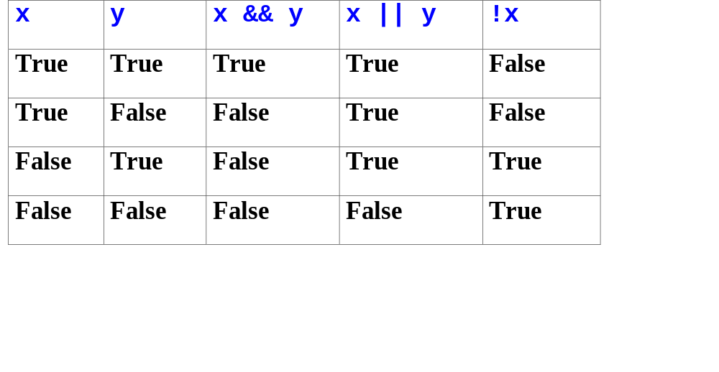
Logical Operators
Zero (0) denotes false; any nonzero values (e.g. 1, 7, or -2) denotes true.

Slide 11
Logical Operators
int x, y, z;
x = 1; y = 4; z = 14;
Expression value
x <= 1 && y == 3 0 (false)
x <= 1 || y == 3 1 (true)
!(x > 1) 1 (true)
!x > 1 0 (false)
!(x<=1 || y==3) 0 (false)
x >= 1 && y == 3 || z < 14
0 (false)
This is Example 3.4.4, page 91

Slide 12
Assignment Operators
The equal sign = is also considered an operator and the construct
  x = y
is also an expression.
Every expression has a value. The value of x = y is the value assigned to the variable x.
A semicolon turns an expression into a statement. E.g.,
  x = y;

Slide 13
Assignment Operators Associate from Right to Left
The expression
  x = y = z
means
  x = (y = z)
If z is 10, the value 10 will be assigned to y and in turn assigned to x.

Slide 14
Reading/Home Working
Read Chapter 3, page 83 to 94.
Work on Problems
  Section 3.3, page 88, exercise 1, 3, 5.
  Section 3.4, page 94, exercise 1.
Check your answers in the back of the textbook. Do not hand in.

